Slide 1
Reactive Power Capabilities PVSystem2
OpenDSS: Version 8.6.2.1 (64-bit build)
Authors: Paulo Radatz and Celso Rocha

Slide 2
New PVSystem2’s properties
pctPminNoVars
pctPminkvarLimit
kvarLimitNeg

Slide 3
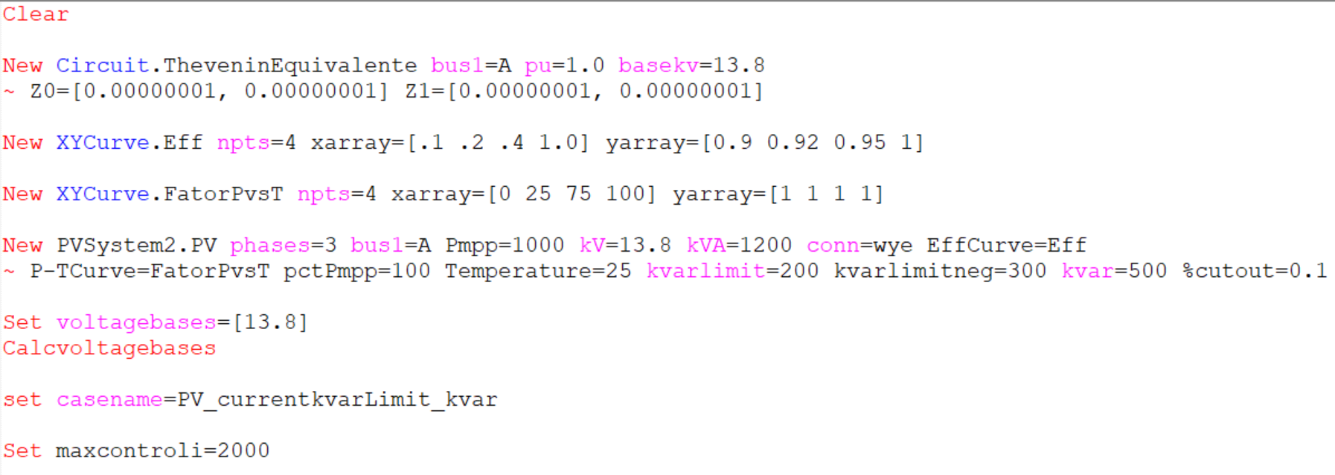
Base case DSS for kvar capacitive – Scenarios 1.
OpenDSS code (PV_currentkvarlimit_kvar.dss)

Slide 4
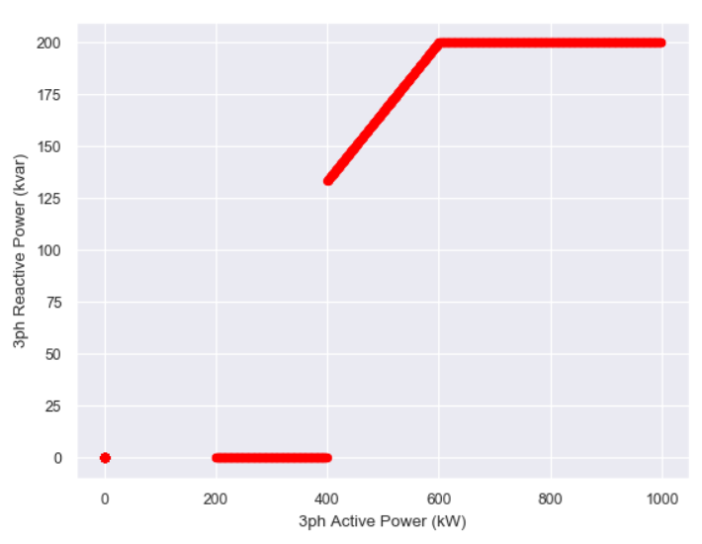
Scenario 1.1
%CutInAC < pctPminNoVars
pctPminkvarLimit = 60% (600kW)
pctPminNoVars = 40% (400kW)
%CutInAC = %CutIn/eff(Pdc) = 16.666% of kVA (200kW)/eff(Pdc)
OpenDSS results
Qac
kvarLimit
Pac
%CutInAC
pctPminNoVars
pctPminkvarlimit
Inv. OFF
Inv. ON

Slide 5
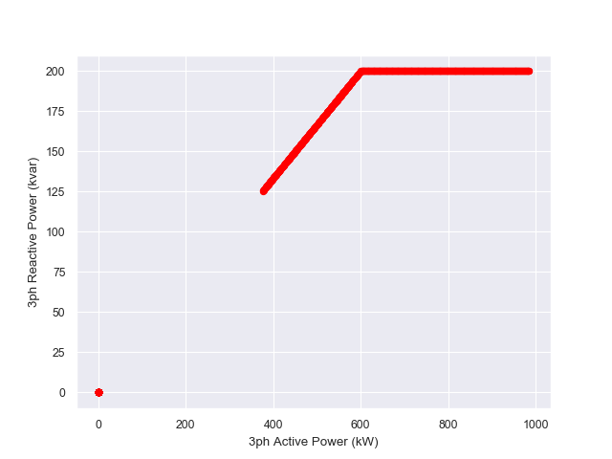
Scenario 1.2
%CutInAC > pctPminNoVars
pctPminkvarLimit = 60% (600kW)
pctPminNoVars = 20% (200kW)
%CutInAC = %CutIn/eff(Pdc) = 33.333% of kVA (400kW)/eff(Pdc)
OpenDSS results
Qac
kvarLimit
Pac
pctPminNoVars
%CutInAC
pctPminkvarlimit
Inv. OFF
Inv. ON
%CutInAC < pctPminNoVars
pctPminkvarLimit = 60% (600kW)
pctPminNoVars = 40% (400kW)
%CutInAC = %CutIn/eff(Pdc) = 16.666% of kVA (200kW)/eff(Pdc)

Slide 6
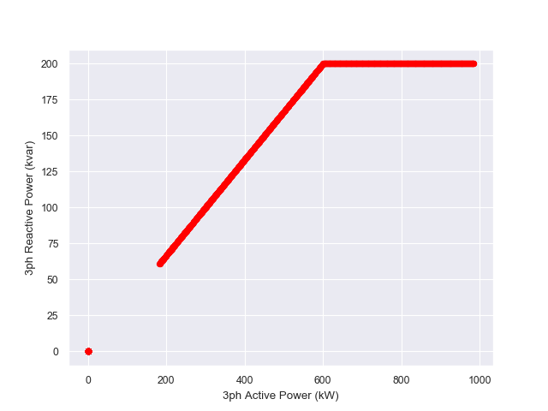
Scenario 1.3
pctPminNoVars = -1
pctPminkvarLimit = 60% (600kW)
%CutInAC = %CutIn/eff(Pdc) = 16.666% of kVA (200kW)/eff(Pdc)
OpenDSS results
Qac
kvarLimit
Pac
%CutInAC
pctPminkvarlimit
Inv. OFF
Inv. ON

Slide 7
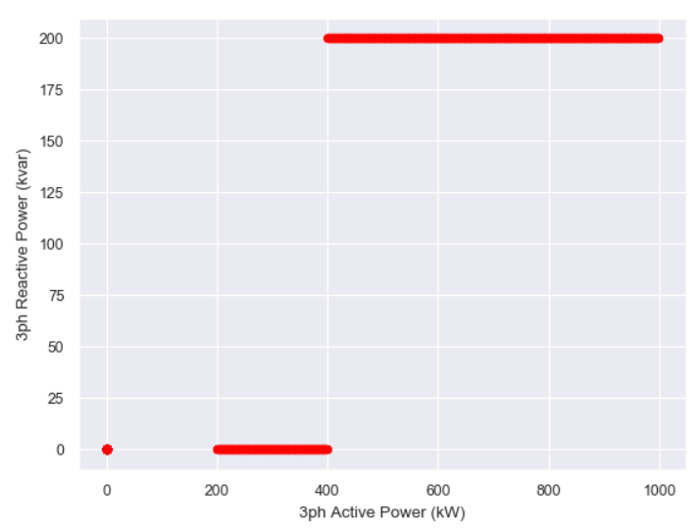
Scenario 1.4
pctPminkvarLimit = -1
pctPminNoVars = 40% (400kW)
%CutInAC = %CutIn/eff(Pdc) = 16.666% of kVA (200kW)/eff(Pdc)
OpenDSS results
Qac
kvarLimit
Pac
%CutInAC
pctPminNoVars
Inv. OFF
Inv. ON

Slide 8
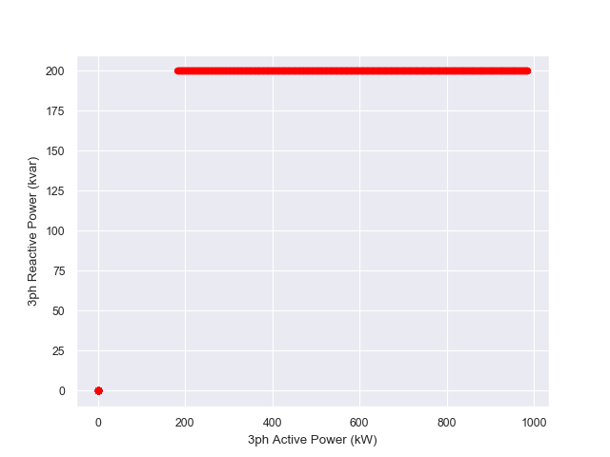
Scenario 1.5
pctPminkvarLimit = -1
pctPminNoVars = -1
%CutInAC = %CutIn/eff(Pdc) = 16.666% of kVA (200kW)/eff(Pdc)
OpenDSS results
Qac
kvarLimit
Pac
%CutInAC
Inv. OFF
Inv. ON

Slide 9
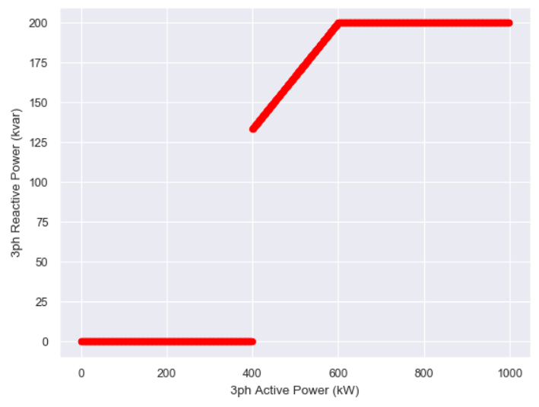
Scenario 1.6
pctPminkvarLimit = 60% (600kW)
pctPminNoVars = 40% (400kW)
%CutIn = 0.01% of kVA (~zero)
OpenDSS results

Slide 10
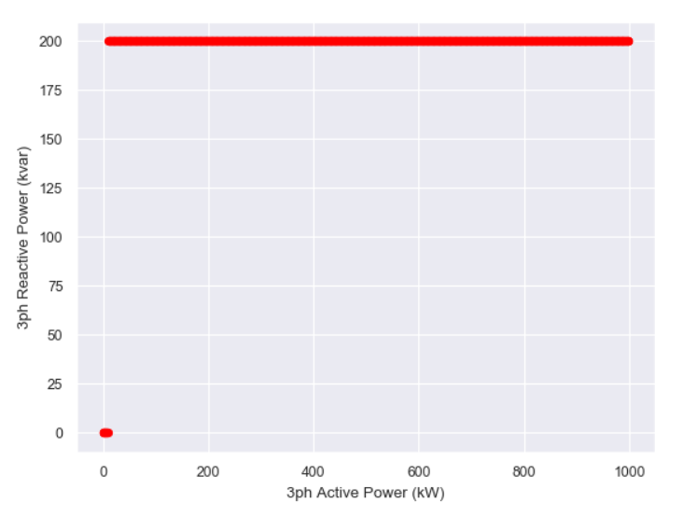
Scenario 1.7
pctPminkvarLimit = -1
pctPminNoVars = -1
%CutIn = 0.01% of kVA (~0)
OpenDSS results

Slide 11
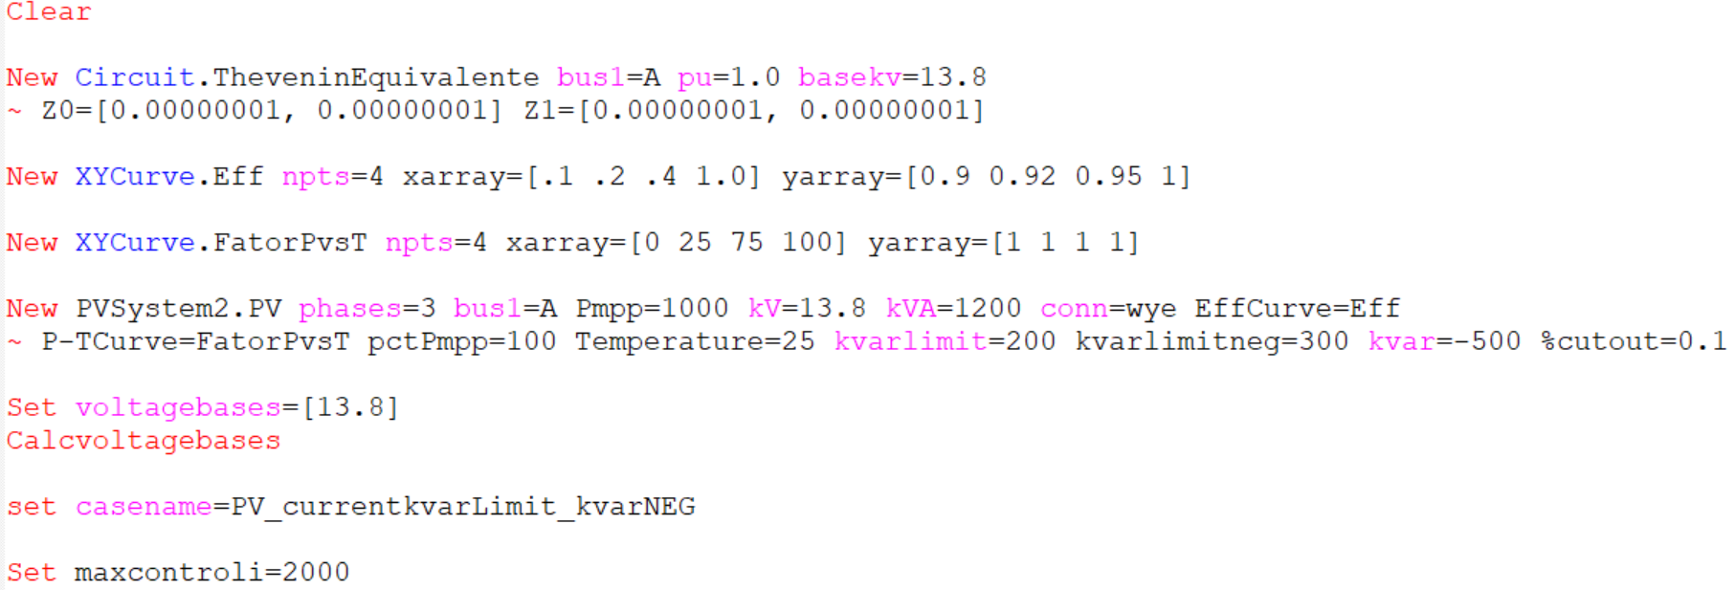
Base case DSS for kvar indutive – PVSystem only – Scenarios 2.
OpenDSS code (PV_currentkvarlimit_kvarNEG.dss)

Slide 12
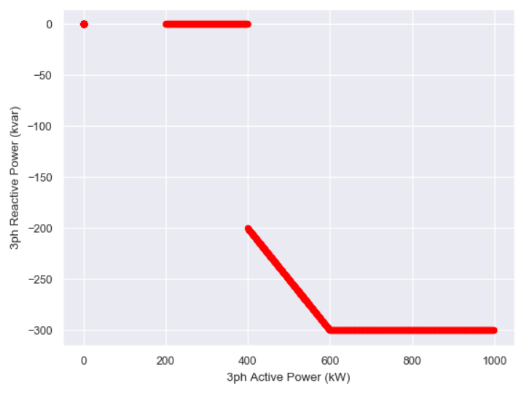
Scenario 2.1
%CutInAC < pctPminNoVars
pctPminkvarLimit = 60% (600kW)
pctPminNoVars = 40% (400kW)
%CutInAC = %CutIn/eff(Pdc) = 16.666% of kVA (200kW)/eff(Pdc)
OpenDSS results

Slide 13
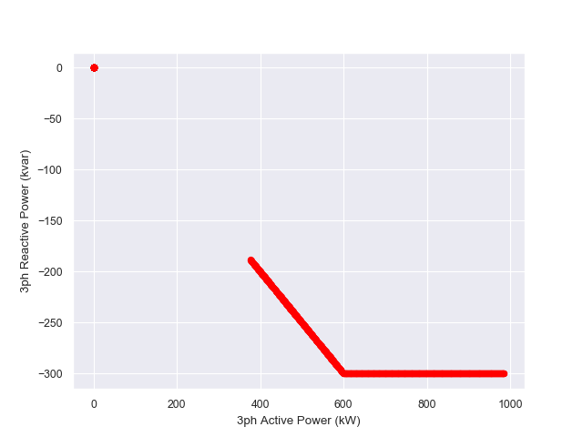
Scenario 2.2
%CutInAC > pctPminNoVars
pctPminkvarLimit = 60% (600kW)
pctPminNoVars = 20% (200kW)
%CutInAC = %CutIn/eff(Pdc) = 33.333% of kVA (400kW)/eff(Pdc)
OpenDSS results

Slide 14
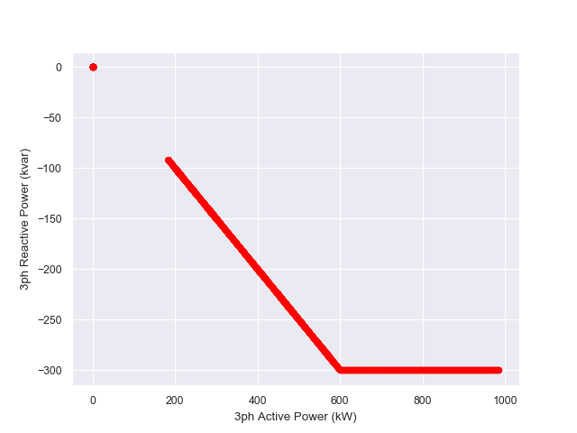
Scenario 2.3
pctPminNoVars = -1
pctPminkvarLimit = 60% (600kW)
%CutInAC = %CutIn/eff(Pdc) = 16.666% of kVA (200kW)/eff(Pdc)
OpenDSS results

Slide 15
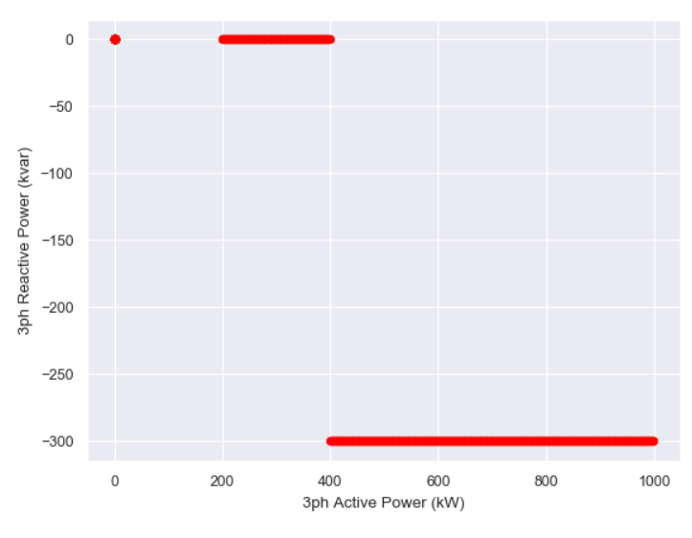
Scenario 2.4
pctPminkvarLimit = -1
pctPminNoVars = 40% (400kW)
%CutInAC = %CutIn/eff(Pdc) = 16.666% of kVA (200kW)/eff(Pdc)
OpenDSS results

Slide 16
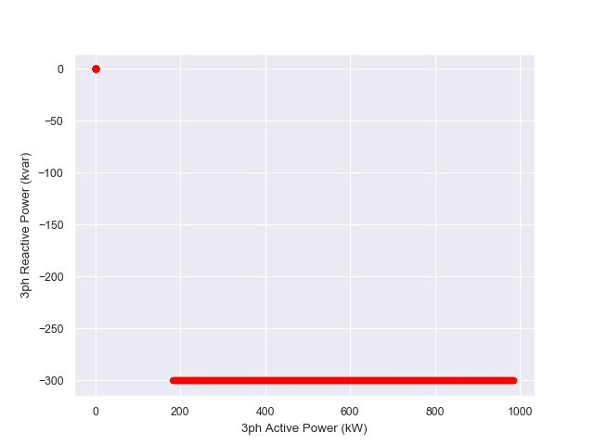
Scenario 2.5
pctPminkvarLimit = -1
pctPminNoVars = -1
%CutInAC = %CutIn/eff(Pdc) = 16.666% of kVA (200kW)/eff(Pdc)
OpenDSS results

Slide 17
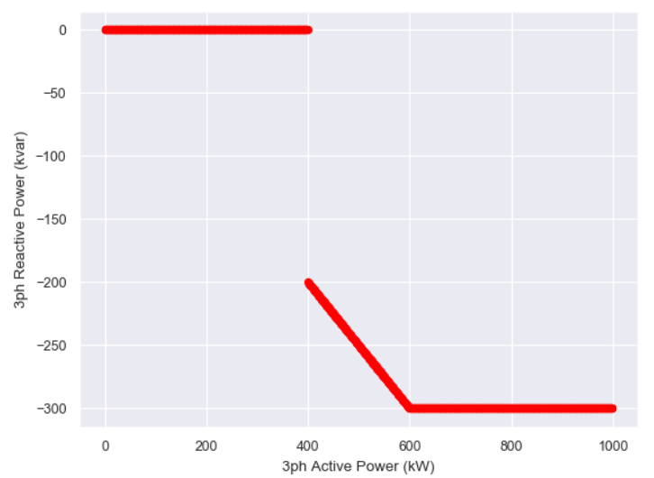
Scenario 2.6
pctPminkvarLimit = 60% (600kW)
pctPminNoVars = 40% (400kW)
%CutIn = 0.01% of kVA
OpenDSS results

Slide 18
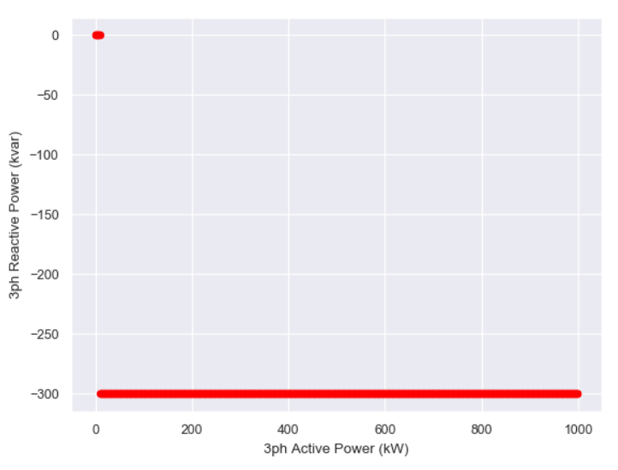
Scenario 2.7
pctPminkvarLimit = -1
pctPminNoVars = -1
%CutIn = 0.01% of kVA
OpenDSS results

