Slide 1
Constant Power Factor mode PVSystem2
OpenDSS: Version 8.6.2.1 (64-bit build)
Authors: Paulo Radatz and Celso Rocha

Slide 2
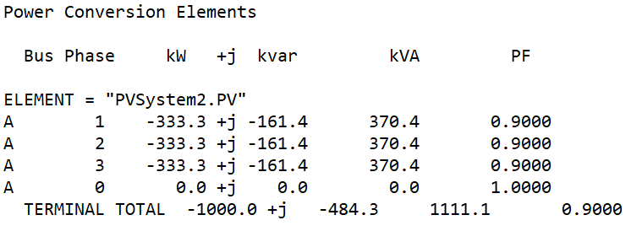
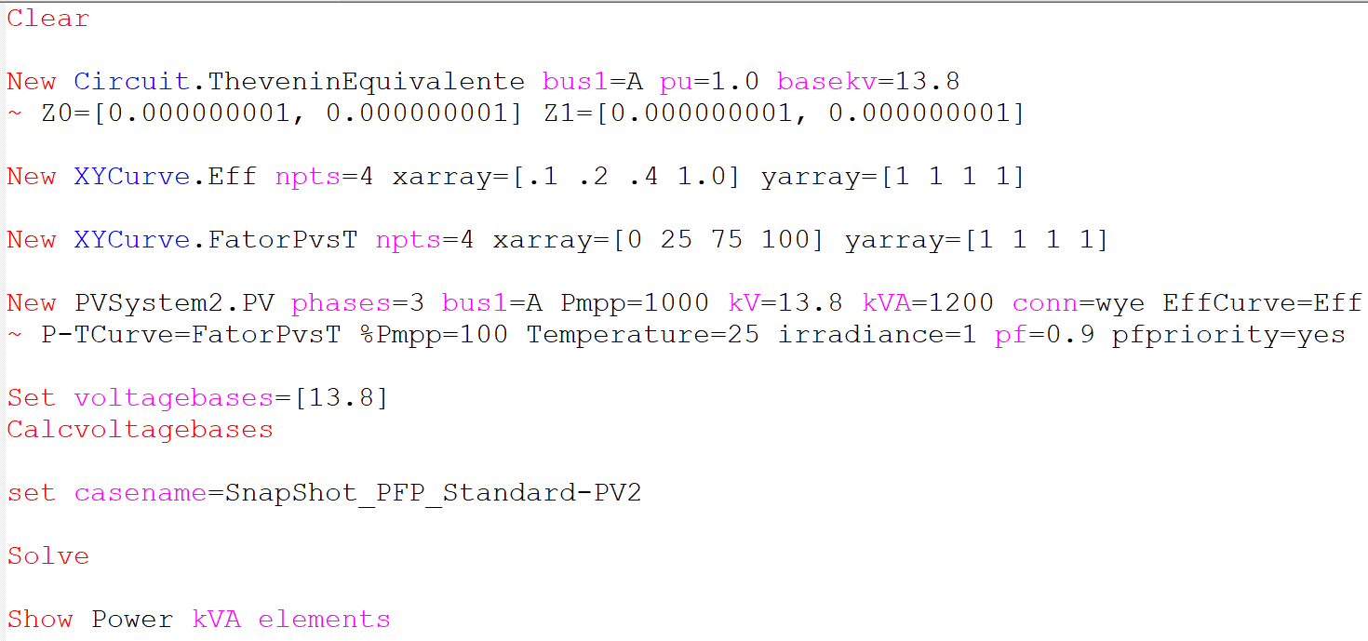
Scenario 1: Snapshot with pf=0.9
Results:
OpenDSS code (SnapShot_PFP_Standard-PV2.dss)
Key points:
It works as expected!
Constant power factor is equal to 0.9

Slide 3
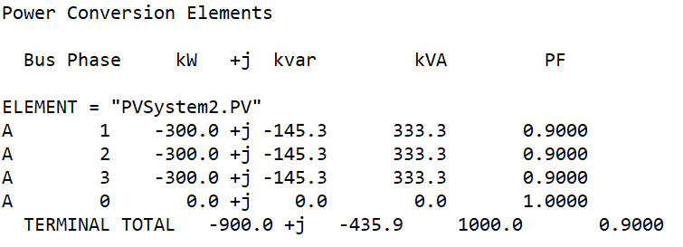
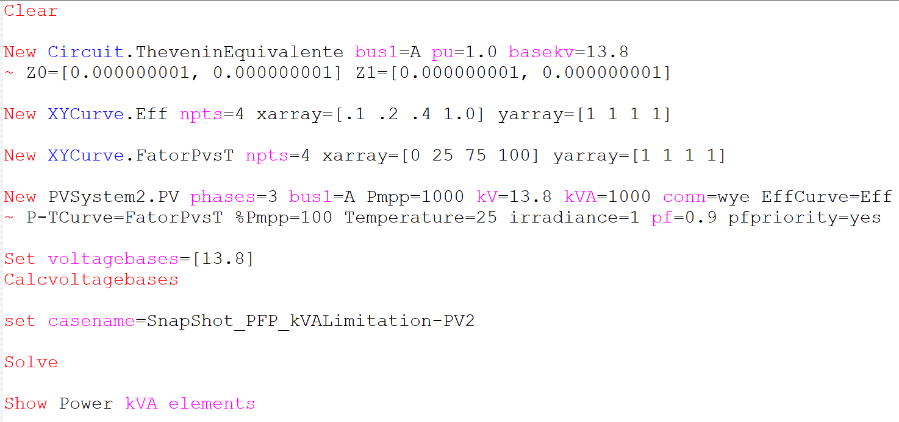
Scenario 2: Snapshot with pf=0.9 and kVA limitation
OpenDSS Modified
kVA = 1000kVA
Results:
OpenDSS code (SnapShot_PFP_kVAlimitation-PV2.dss)
Key points:
It works as expected!
Constant power factor is equal to 0.9
kVA_out is equal to kVA rating

Slide 4
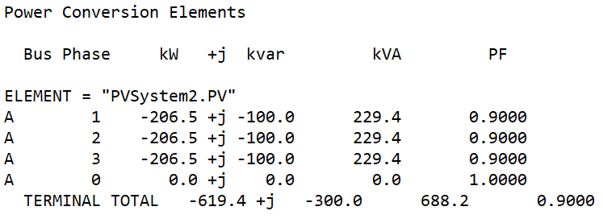
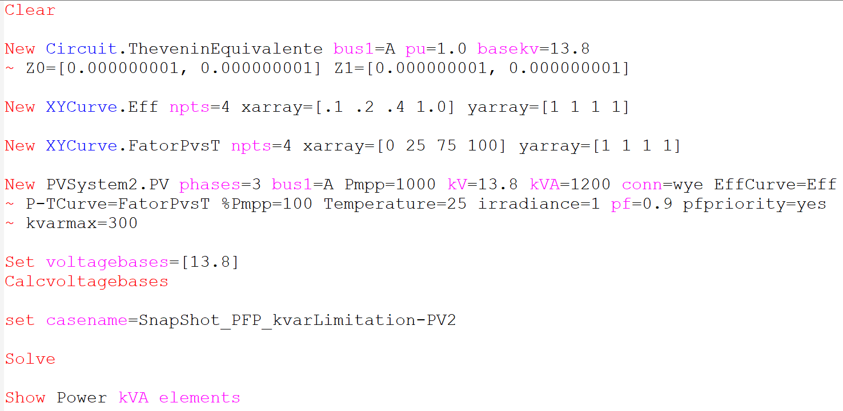
Scenario 3: Snapshot with pf=0.9 and kvar limitation
OpenDSS Modified
kvarmax = 300
Results:
OpenDSS code (SnapShot_PFP_kvarlimitation-PV2.dss)
Key points:
It works as expected!
Constant power factor is equal to 0.9
Kvar_out is equal to kvar limit

Slide 5
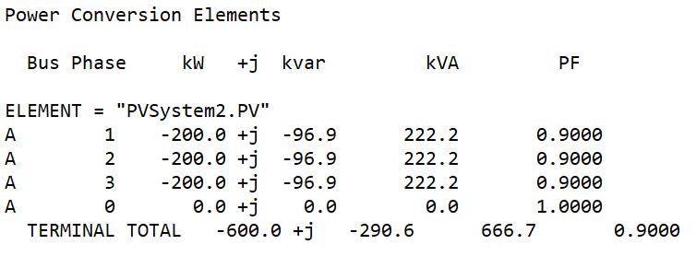
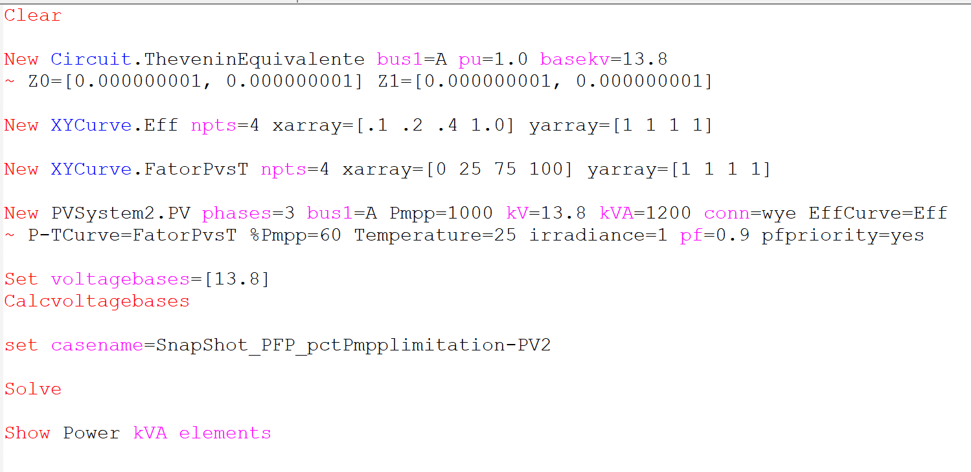
Scenario 4: Snapshot with pf=0.9 and pctPmpp limitation
OpenDSS Modified
pctPmpp = 60
Results:
OpenDSS code (SnapShot_PFP_pctPmpplimitation-PV2.dss)
Key points:
It works as expected!
Constant power factor is equal to 0.9
KW_out is equal to pctPmpp x Pmpp/100

