Slide 1
Using the COM Interface

Slide 2
Three Implementations of OpenDSS
Stand-alone EXE
32-bit
64-bit
Use this to develop text scripts to study problems
In-Process COM Server
32-bit
64-bit
Use this to link OpenDSS to other programs
Automate the program
Execute complex algorithms
DirectDLL API
Use this to link OpenDSS to other programs on platforms/languages that do not support COM

Slide 3
DSS Structure
Text
Scripts
Main Simulation Engine
COM Interface
User-Written DLLs
Scripts, Results

Slide 4
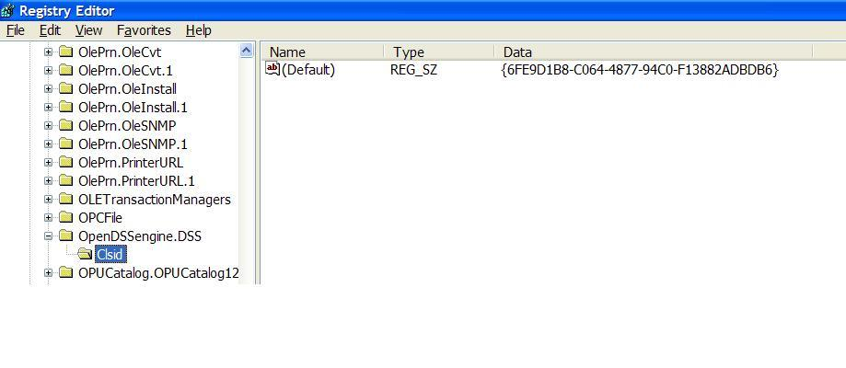
OpenDSSEngine.DSS is Registered
Windows Registry Entry
GUID
The Server shows up as “OpenDSSEngine.DSS” in the Windows Registry
The OpenDSS is now available to any program on the computer

Slide 5
Linking Your Program to the COM Server
Examples of accessing the COM server in various languages
In MATLAB:
DSSobj = actxserver(‘OpenDSSEngine.DSS’);
In VBA: (Early binding)
Public DSSobj As OpenDSSEngine.DSS Set DSSobj = New OpenDSSEngine.DSS
In Dephi
{Import Type Library}
DSSObj := coDSS.Create;
In PYTHON:
self.engine = win32com.client.Dispatch("OpenDSSEngine.DSS")

Slide 6
OpenDSS COM Interfaces
There are many interfaces supplied by the COM server
There is one registered In-Process COM interface:
OpenDSSEngine.DSS
The DSS interface is the one your program instantiates
The DSS interface then creates all the others.
This is for simplicity for users who are not necessarily familiar with COM programming

Slide 7
“Active objects” concept
.The interfaces generally act on the ACTIVE object
Active circuit,
Active circuit element,
Active bus, etc.
The interfaces generally point to the active object
To work with another object, change the active object
There are methods for selecting objects
You may also use script commands

Slide 8
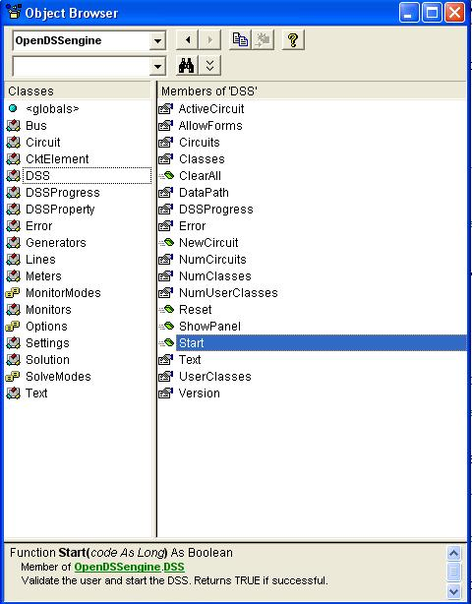
DSS Interface
This is the main interface. It is instantiated upon loading OpenDSSEngine.DSS and then instantiates all other interfaces internally
Call the Start(0) method to initialize the DSS
DSS Class Functions (methods) and Properties

Slide 9
COM with a Simple VBA Macro (Class Exercise)
To run the IEEE 123-bus Test Feeder and plot the voltage profile

Slide 10
Option Explicit
Public MyOpenDSS As OpenDSSengine.DSS
Public MyText As OpenDSSengine.Text
Public MyCircuit As OpenDSSengine.Circuit
Public Sub MyMacro()
Set MyOpenDSS = New OpenDSSengine.DSS
MyOpenDSS.Start (0)
Set MyText = MyOpenDSS.Text
Set MyCircuit = MyOpenDSS.ActiveCircuit
MyText.Command = "Compile (C:\OpenDSS\IEEETestCases\123Bus\IEEE123Master.dss)"
MyText.Command = "New Energymeter.M1 element=Line.L115 terminal=1"
MyText.Command = "Solve"
Dim MyVoltages As Variant
Dim MyNames As Variant
Dim Mydistances As Variant
MyVoltages = MyCircuit.AllBusVmagPu
MyNames = MyCircuit.AllNodeNames
Mydistances = MyCircuit.AllNodeDistances
Dim i As Integer, irow As Integer
irow = 1
For i = LBound(MyVoltages) To UBound(MyVoltages)
ActiveSheet.Cells(irow, 1).Value = MyNames(i)
ActiveSheet.Cells(irow, 2).Value = Mydistances(i)
ActiveSheet.Cells(irow, 3).Value = MyVoltages(i)
irow = irow + 1
Next I
Set MyOpenDSS = Nothing
End Sub

Slide 11
Steps Require to Do This
Register OpenDSSEngine.DLL (32-bit if your Excel is 32-bit)
Start Microsoft Excel
Type alt-F11 to open VBA editor
Or Tools>Macro …
Select OpenDSS Engine under Tools>References
Insert>Module
Enter the VBA code into blank module
Use correct path name for your computer
Execute the macro “MyMacro”

Slide 12
Resulting Chart in Excel

Slide 13
Custom Simulations
(with Python, Matlab, etc.)

Slide 14
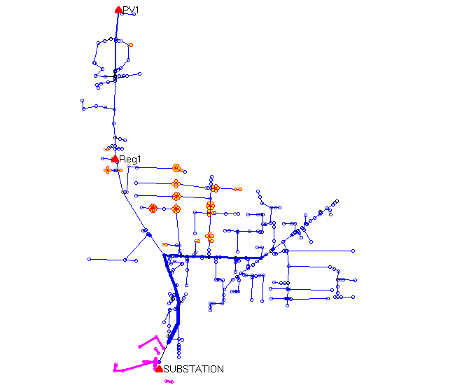
A Co-simulation Example (A Hypothetical Case)
PV Location (2.5 MW)
Voltage regulator
Clusters of
Storage Units
Ref: EPRI/AEP Smart Grid Demo
Community Energy Storage Concept

Slide 15
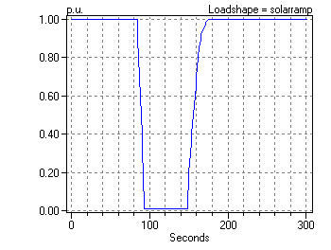
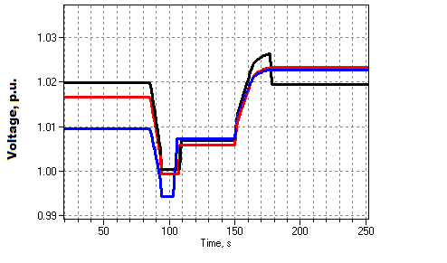
Solar Ramp Rate Issue
Assumed Solar Ramping Function
Result

Slide 16
The Question
Can you dispatch the 84 CES units fast enough to compensate for the sudden loss of PV generation on a “Cloud Transient” ?
Why it might not work:
Communications latency
CES not in right location or insufficient capacity
Calls for a “Hybrid” simulation
Communications network (NS2)
Distribution network (OpenDSS)

Slide 17
How We Did It

Slide 18
OpenDSS Script (Snippet)
Set sec=20
Solve ! Init steady state at t=20
Sample
! Start the ramp down at 1 sec
Set sec=21
Generator.PV1.kW=(2500 250 -) ! Decrement 10%
Solve
Sample
Set sec=22
Generator.PV1.kW=(2500 500 -) ! Decrement another 10%
Solve
Sample
Set sec = 22.020834372 ! Unit 1 message arrives
storage.jo0235001304.state=discharging %discharge=11.9
Solve
Sample
Set sec = 22.022028115 ! Unit 2 message arrives
storage.jo0235000257.state=discharging %discharge=11.9
Solve
Sample
Etc.

Slide 19
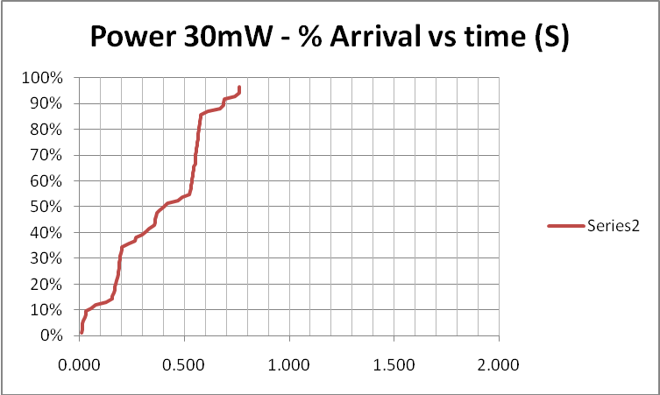
Results (for down ramp only)
Comm Simulation

Slide 20
Comm and Power Co-simulation
New and active research area
Working to more tightly link ns-2 and OpenDSS
Or other comm simulators
Communications latency is an important issue with Smart Grid
Power engineers tend to assume communications will happen
But there are limits

Slide 21
Custom Simulation Scripting in Snapshot Mode
This is the default solution mode
Attempts one solution for each “solve”
Solves the circuit “as is”
If you want something done, you have to specifically tell it
Set Load and Generator kW, etc.
Load.MyLoad.kW=125
Loadshapes are not used in this mode!
Sample Monitors and meters
Solve
Sample

Slide 22
Custom Simulation Scripting in “Time” Mode
Similar to Snapshot mode EXCEPT:
Loads, Generators can follow a selected Loadshape
Duty, Daily, or Yearly
Monitors are automatically sampled
But not Energymeters; do that explicitly if desired
Time is automatically incremented AFTER solve

Slide 23
Snapshot Mode Scripting Example
Set Gen kW explicitly each time step
! Start the ramp down at 1 sec
Set sec=1
Generator.PV1.kW=(2500 250 -)
Solve
Sample
Set sec=2
Generator.PV1.kW=(2500 500 -)
Solve
Sample
Set sec = 2.020834372 ! Unit 1
storage.jo0235001304.state=discharging %discharge=11.9
Solve
Sample
Set sec = 2.022028115 ! Unit 2
storage.jo0235000257.state=discharging %discharge=11.9
Solve
Sample
Set sec = 2.023158858 ! Unit 3
storage.jo0235000265.state=discharging %discharge=11.9
Solve
Sample
Set sec = 2.024604602 ! Unit 4
storage.jo0235000268_1.state=discharging %discharge=11.9
Solve
Sample
Set sec = 2.025738325 ! Unit 5
storage.jo0235000268_2.dispmode=discharging %discharge=11.9
Solve
Sample
Etc.
Solve and Sample explicitly at each step
Set each Storage unit discharge rate explicitly each time step
(time is used for recording purposes only)

Slide 24
Time Mode Scripting Example
All Loads, Generators will follow assigned Duty cycle loadshape
! Start the ramp down at 1 sec
Set mode=time loadshapeclass=duty
set stepsize=1s
Solve ! Base case t=0
Solve ! t=t+1 = 2
Solve ! t=2 second solution; t=t+1 = 3
Set sec = 2.020834372 ! Unit 1 (reset t)
storage.jo0235001304.state=discharging %discharge=11.9
Solve
Set sec = 2.022028115 ! Unit 2
storage.jo0235000257.state=discharging %discharge=11.9
Solve
Set sec = 2.023158858 ! Unit 3
storage.jo0235000265.state=discharging %discharge=11.9
Solve
Set sec = 2.024604602 ! Unit 4
storage.jo0235000268_1.state=discharging %discharge=11.9
Solve
Set sec = 2.025738325 ! Unit 5
storage.jo0235000268_2.dispmode=discharging %discharge=11.9
Solve
Etc.
Set sec=3
Solve ! t=3 solution; t=t+1 = 4
….

Slide 25
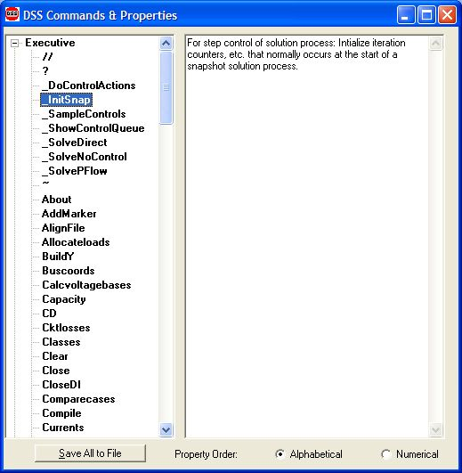
Custom Simulation Scripting: Rolling Your Own Solution Algorithm
These commands allow step-by-step control of the solution process

Slide 26
Custom Simulation Scripting: Rolling Your Own Solution Algorithm
The basic Snapshot solution process:
Initialize Snapshot (_InitSnap)
Repeat until converged:
Solve Circuit (_SolveNoControl)
Sample control devices (_SampleControls)
Do control actions, if any (_DoControlActions)
You may wish, for example, to interject custom control actions after the _SolveNoControl step

Slide 27
Co-simulation and OpenDSS
Simulation of power system and communications networks simultaneously
An important area of smart grid research
Will messages be able to get to targets in time to perform Smart Grid functions?
What will be the effect of communications latency?
Much work needs to be done developing appropriate tools

Slide 28
Custom Simulation Scripting, cont’d
Via COM interface
Whatever you want (if you can write code)
See Examples Folder on Sourceforge site
Excel: SampleDSSDriver.xls
Matlab:
VoltageProfileExample.m
DSSMonteCarlo.m

Slide 29
For More Information …
See OpenDSS Custom Scripting.Doc
(Sourceforge site, “Doc” Folder)

