Slide 1
DRC Scenarios
OpenDSS: Version 8.6.6.1
Authors: Paulo Radatz and Celso Rocha

Slide 2
Results in QSTS mode
Results from mode 3 monitor placed in the PVSystem2
hour | t(sec) | Irradiance | PanelkW | P_TFactor | Efficiency | Vreg | Vavg (DRC) | volt-var | volt-watt | DRC | VV_DRC | kW_out_desired
0 | 1 | 0.7 | 700 | 1 | 1 | 1.03489 | 0 | 9999 | 9999 | 0 | 9999 | 700
0 | 2 | 0.75 | 750 | 1 | 1 | 1.03547 | 1.03489 | 9999 | 9999 | -1 | 9999 | 750
0 | 3 | 0.8 | 800 | 1 | 1 | 1.03627 | 1.03518 | 9999 | 9999 | -1 | 9999 | 800
0 | 4 | 0.85 | 850 | 1 | 1 | 1.03736 | 1.03587 | 9999 | 9999 | -1 | 9999 | 850
0 | 5 | 0.9 | 900 | 1 | 1 | 1.03864 | 1.03681 | 9999 | 9999 | -1 | 9999 | 900
0 | 6 | 0.96 | 960 | 1 | 1 | 1.04022 | 1.038 | 9999 | 9999 | -1 | 9999 | 960
0 | 7 | 0.98 | 980 | 1 | 1 | 1.04152 | 1.03943 | 9999 | 9999 | -1 | 9999 | 980
0 | 8 | 1 | 1000 | 1 | 1 | 1.04284 | 1.04087 | 9999 | 9999 | -1 | 9999 | 1000
0 | 9 | 1 | 1000 | 1 | 1 | 1.04382 | 1.04218 | 9999 | 9999 | -1 | 9999 | 1000
0 | 10 | 1 | 1000 | 1 | 1 | 1.04469 | 1.04333 | 9999 | 9999 | -1 | 9999 | 1000
0 | 11 | 1 | 1000 | 1 | 1 | 1.04538 | 1.04425 | 9999 | 9999 | -1 | 9999 | 1000
0 | 12 | 0.98 | 980 | 1 | 1 | 1.04575 | 1.04504 | 9999 | 9999 | -1 | 9999 | 980
0 | 13 | 0.9 | 900 | 1 | 1 | 1.04523 | 1.04557 | 9999 | 9999 | 1 | 9999 | 900
0 | 14 | 0.9 | 900 | 1 | 1 | 1.04518 | 1.04549 | 9999 | 9999 | 1 | 9999 | 900
0 | 15 | 0.9 | 900 | 1 | 1 | 1.04496 | 1.04521 | 9999 | 9999 | 1 | 9999 | 900
0 | 16 | 0.9 | 900 | 1 | 1 | 1.04486 | 1.04507 | 9999 | 9999 | 1 | 9999 | 900
0 | 17 | 0.8 | 800 | 1 | 1 | 1.04359 | 1.04491 | 9999 | 9999 | 1 | 9999 | 800
0 | 18 | 0.7 | 700 | 1 | 1 | 1.0419 | 1.04423 | 9999 | 9999 | 1 | 9999 | 700
0 | 19 | 0.6 | 600 | 1 | 1 | 1.03961 | 1.04275 | 9999 | 9999 | 1 | 9999 | 600
0 | 20 | 0.5 | 500 | 1 | 1 | 1.03691 | 1.04076 | 9999 | 9999 | 1 | 9999 | 500
Negative value: var absorption
Positive value : var generation
1.0: DRC operating as it supposed to
0.6: DRC limited by inverter’s kVA rating
0.2: DRC limited by varmax/varmaxabs property of the PC element
Voltage used in the DRC equation. V_window

Slide 3
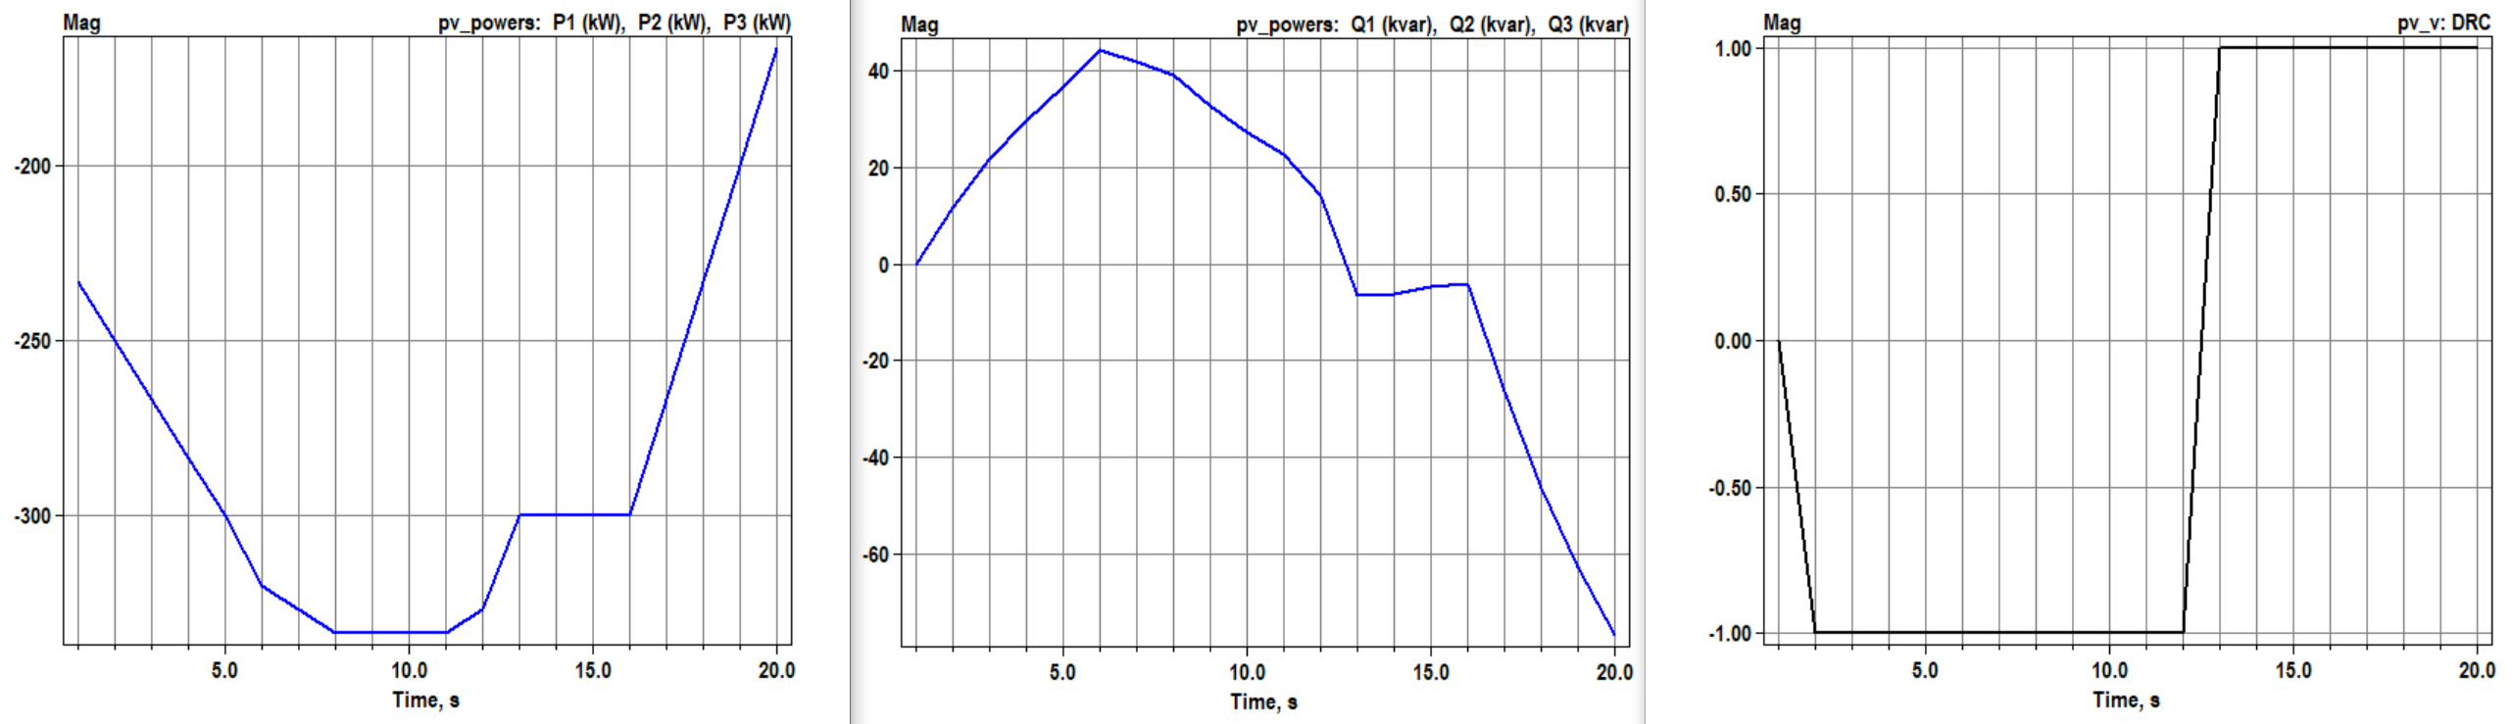



Scenario 1.1: Daily Standard
Results:
DbVMin=DbVMax=1
ArGraLowV=ArGraHiV=50=ArGraV
Kvarmax=kVA
OpenDSS code (Daily_DRC-2.dss)
Standard results.
$V_{Window}(t)=$ (V(t-1) + V(t-2))/2
$Delta(t)=$ V(t) - $V_{Window}(t)$
$Qdesired(t)=$ -Delta(t) x ArGraV x kvarlimit
OpenDSS Results
Key points:
It works as expected!
Qdesired calculated values are equal to Qtotal OpenDSS results

Slide 4
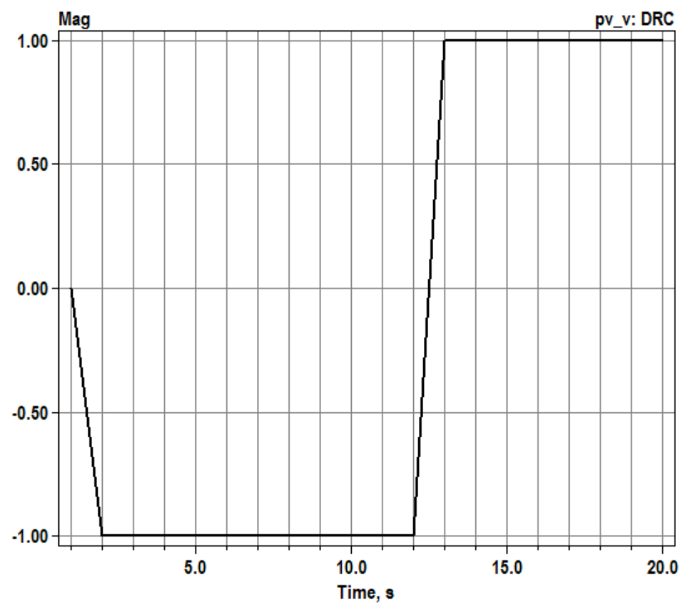
Scenario 1.2: Daily with kVA limitation – Q priority
OpenDSS code (Daily_DRC_kVAlimitation_Q-2.dss)
Results:
P reduced to satisfy kVA rating

Slide 5
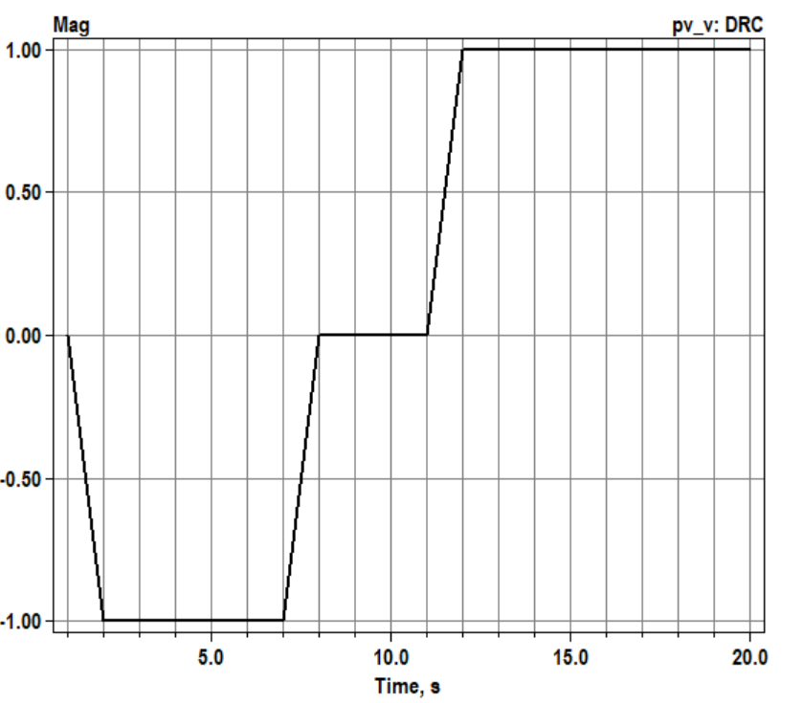
Scenario 1.3: Daily with kVA limitation – P priority
OpenDSS code (Daily_DRC_kVAlimitation_P-2.dss)
Results:
When DRC are limited to 0var by kvarmax or kVA, the DRC flag assumes that DRC does not operate. It happens to all functions
Q reduced to satisfy rating

Slide 6
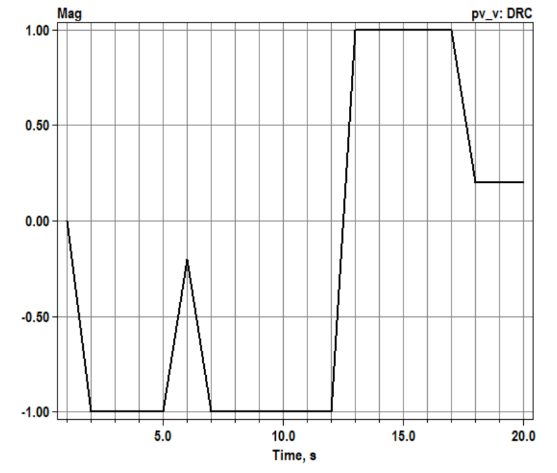

Scenario 1.4: Daily with kvar limitation
OpenDSS code (Daily_DRC_kvarlimitation-2.dss)
kvarmax=100
kVA=1200
$QdesiredAva(t)=$ -Delta(t) x ArGraV x Qava(t)
Q limited to satisfy kvarlimit

Slide 7
Scenario 1.5: Daily Standard with voltage_curvex_ref=avg
OpenDSS code (Daily_DRC_avg-2.dss)
The results are equal to scenario 1.1 as expected
voltage_curvex_ref=avg makes sense only for volt-var and volt-watt functions

