Slide 1
VV-DRC Scenarios
OpenDSS: Version 8.6.6.1 (64-bit build)
Authors: Paulo Radatz and Celso Rocha

Slide 2
Results in QSTS mode
Results from mode 3 monitor placed in the PVSystem2
hour | t(sec) | Irradiance | PanelkW | P_TFactor | Efficiency | Vreg | Vavg (DRC) | volt-var | volt-watt | DRC | VV_DRC | kW_out_desired
0 | 1 | 0.7 | 700 | 1 | 1 | 1.01547 | 0 | 9999 | 9999 | 9999 | -1 | 700
0 | 2 | 0.75 | 750 | 1 | 1 | 1.0159 | 1.01547 | 9999 | 9999 | 9999 | -1 | 750
0 | 3 | 0.8 | 800 | 1 | 1 | 1.01646 | 1.01568 | 9999 | 9999 | 9999 | -1 | 800
0 | 4 | 0.85 | 850 | 1 | 1 | 1.01718 | 1.01618 | 9999 | 9999 | 9999 | -1 | 850
0 | 5 | 0.9 | 900 | 1 | 1 | 1.01798 | 1.01682 | 9999 | 9999 | 9999 | -1 | 900
0 | 6 | 0.96 | 960 | 1 | 1 | 1.01892 | 1.01758 | 9999 | 9999 | 9999 | -1 | 960
0 | 7 | 0.98 | 980 | 1 | 1 | 1.0196 | 1.01845 | 9999 | 9999 | 9999 | -1 | 980
0 | 8 | 1 | 1000 | 1 | 1 | 1.02025 | 1.01926 | 9999 | 9999 | 9999 | -1 | 1000
0 | 9 | 1 | 1000 | 1 | 1 | 1.02064 | 1.01993 | 9999 | 9999 | 9999 | -1 | 1000
0 | 10 | 1 | 1000 | 1 | 1 | 1.02094 | 1.02044 | 9999 | 9999 | 9999 | -1 | 1000
0 | 11 | 1 | 1000 | 1 | 1 | 1.02114 | 1.02079 | 9999 | 9999 | 9999 | -1 | 1000
0 | 12 | 0.98 | 980 | 1 | 1 | 1.02112 | 1.02104 | 9999 | 9999 | 9999 | -1 | 980
0 | 13 | 0.9 | 900 | 1 | 1 | 1.0205 | 1.02113 | 9999 | 9999 | 9999 | -1 | 900
0 | 14 | 0.9 | 900 | 1 | 1 | 1.02032 | 1.02081 | 9999 | 9999 | 9999 | -1 | 900
0 | 15 | 0.9 | 900 | 1 | 1 | 1.02008 | 1.02041 | 9999 | 9999 | 9999 | -1 | 900
0 | 16 | 0.9 | 900 | 1 | 1 | 1.01996 | 1.0202 | 9999 | 9999 | 9999 | -1 | 900
0 | 17 | 0.8 | 800 | 1 | 1 | 1.019 | 1.02002 | 9999 | 9999 | 9999 | -1 | 800
0 | 18 | 0.7 | 700 | 1 | 1 | 1.01781 | 1.01948 | 9999 | 9999 | 9999 | -1 | 700
0 | 19 | 0.6 | 600 | 1 | 1 | 1.0163 | 1.0184 | 9999 | 9999 | 9999 | -1 | 600
0 | 20 | 0.5 | 500 | 1 | 1 | 1.01462 | 1.01706 | 9999 | 9999 | 9999 | -1 | 500
Negative value: var absorption
Positive value : var generation
1.0: operating as it supposed to
0.6: limited by inverter’s kVA rating
0.2: limited by varmax/varmaxabs property of the PC element
Voltage used in the volt-var curve
Voltage used in the DRC function

Slide 3





Scenario 1: Daily Standard
Results:
OpenDSS code (Daily_VVDRC-2.dss)
$V_{Window}(t)=$ (V(t-1) + V(t-2))/2
$Delta(t)=$ V(t) - $V_{Window}(t)$
$QDRC(t)=$ -Delta(t) x ArGraV x kvarlimit
$QVV(t)=$ F(voltage(t))
OpenDSS Results
$Qout(t)=$ QVV(t) + QDRC(t)
Key points:
It works as expected!
Qout calculated values are equal to Qtotal OpenDSS results

Slide 4
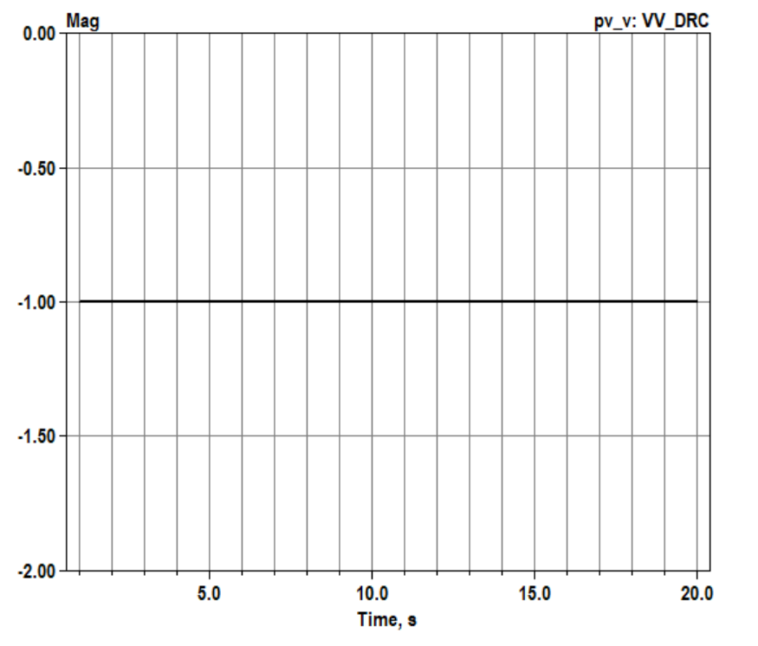
Scenario 2: Daily with kVA limitation – Q priority
OpenDSS code (Daily_VVDRC_kVAlimitation_Q-2.dss)
Results:
Key points:
It works as expected!
Qout calculated values are equal to Qtotal OpenDSS results
P reduced to satisfy kVA rating

Slide 5
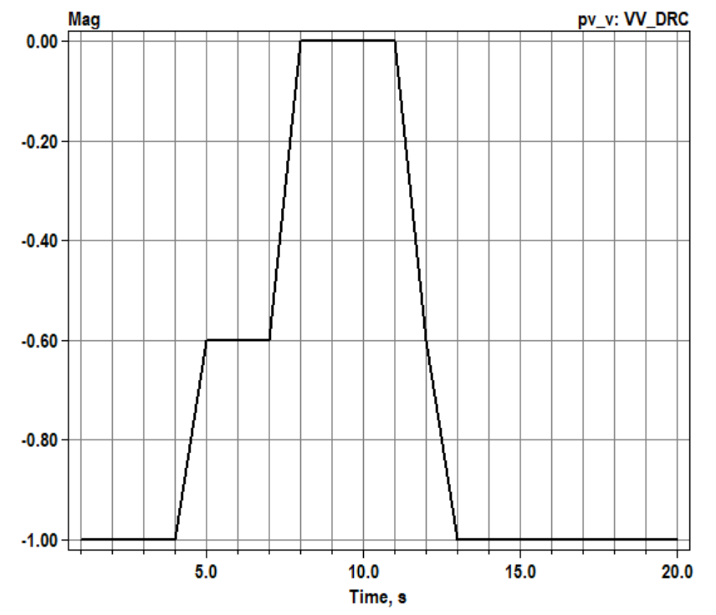
Scenario 3: Daily with kVA limitation – P priority
OpenDSS code (Daily_VVDRC_kVAlimitation_P-2.dss)
Results:
Key points:
It works as expected!
When kVA is exceeded, Qtotal is reduced and then it is not equal to Qout
Q reduced to satisfy rating

Slide 6
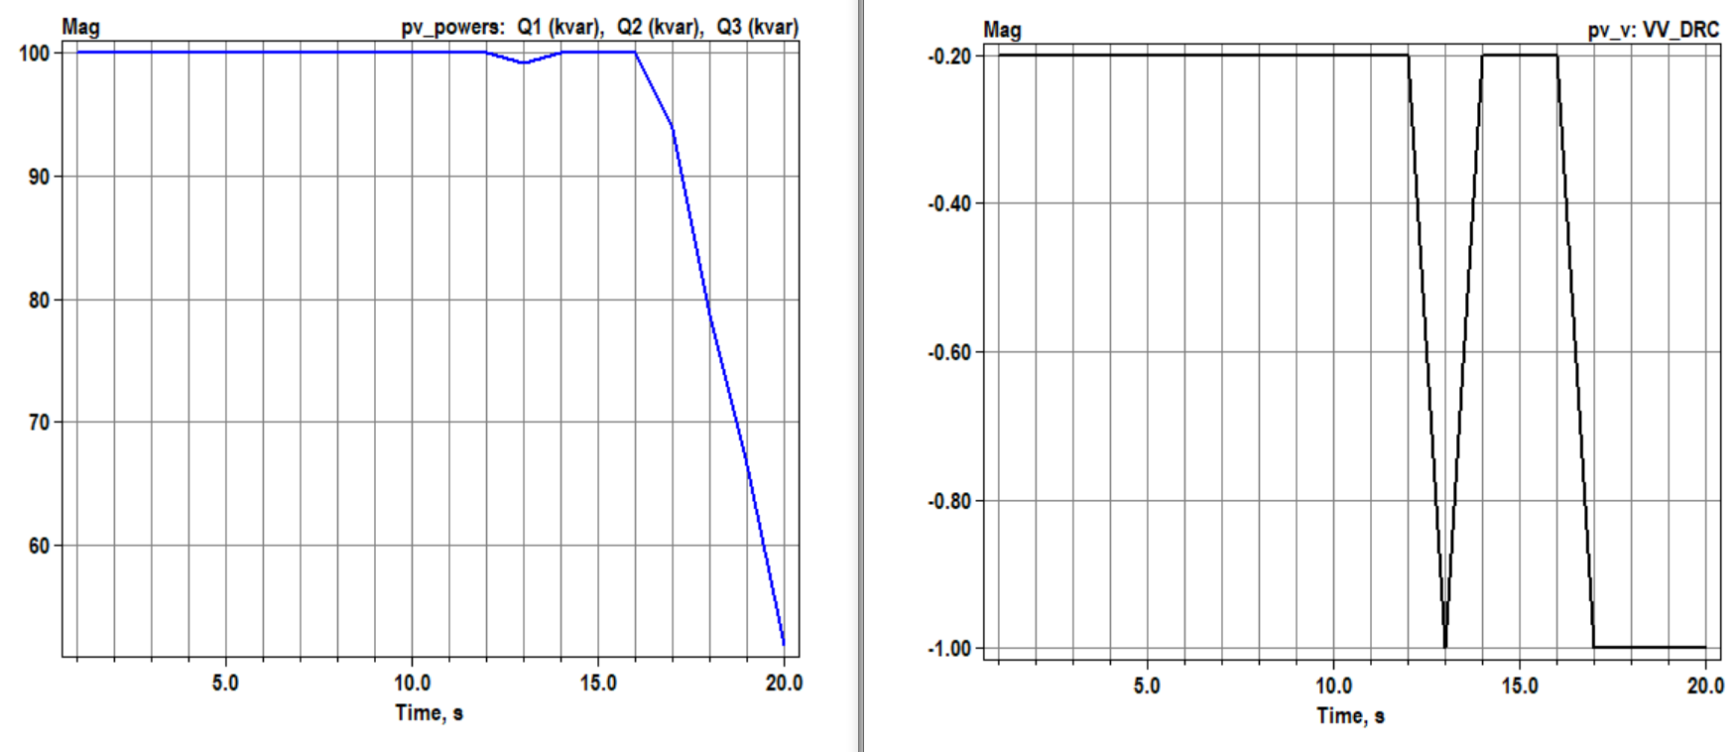


Scenario 4: Daily with kvar limitation
OpenDSS code (Daily_VVDRC_kvarlimitation-2.dss)
$QDRC(t)=$ -Delta(t) x ArGraV x Qava(t)
$QVV(t)=$ F(voltage(t), Qava(t))
Key points:
It works as expected!

Slide 7
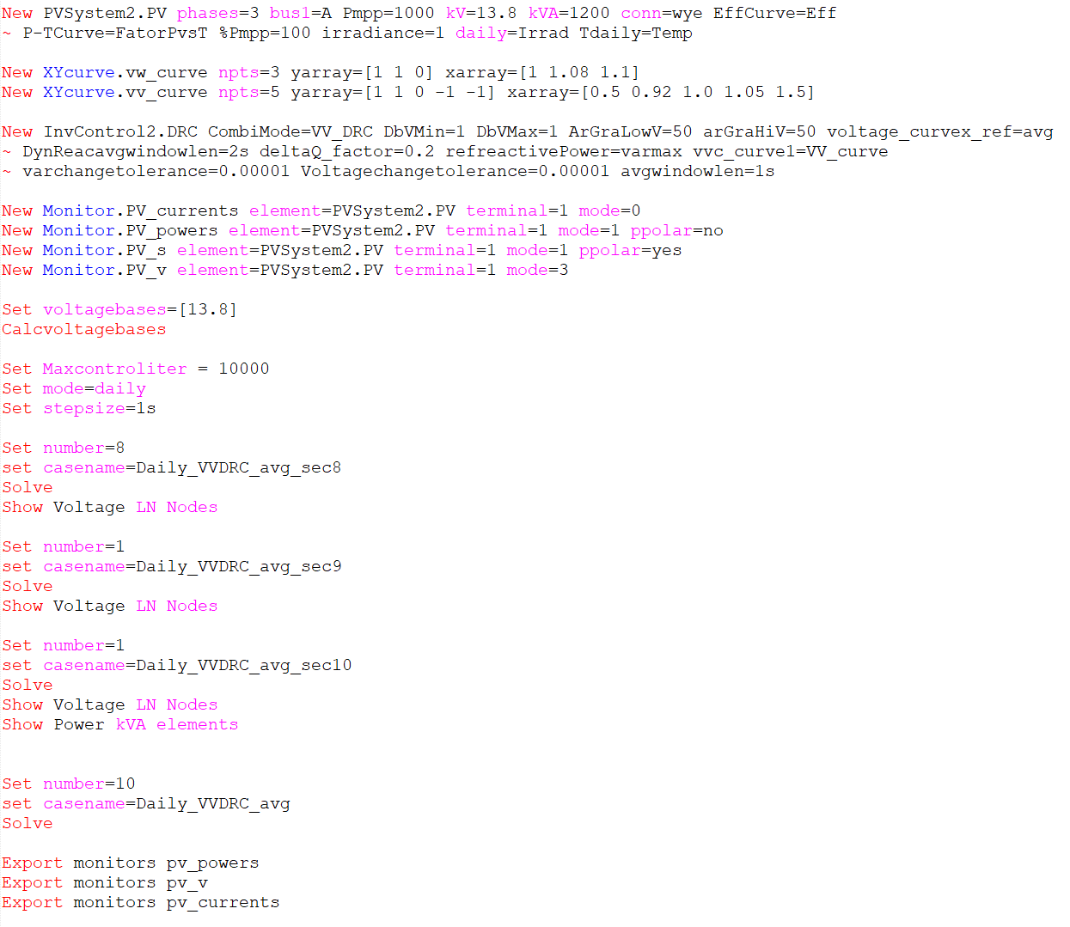
Scenario 1.5: Daily with voltage_curvex_ref=avg
OpenDSS code (Daily_VVDRC_avg-2.dss)

Slide 8
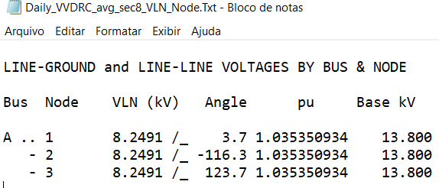
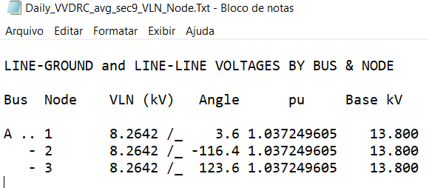
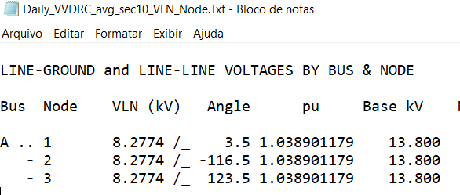
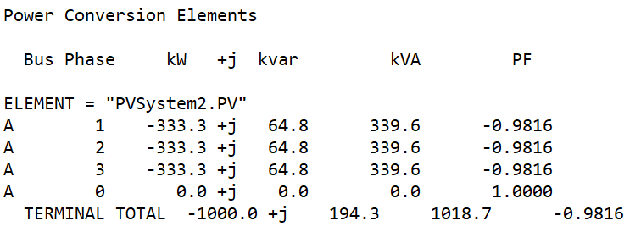
Scenario 1.5: Daily with voltage_curvex_ref=avg
Vpu_8 = Vpu_max_8 = 1.035350934
Vpu_9 = Vpu_max_9 = 1.037249605
Vpu_10 = Vpu_max_10 = 1.038901179
Vpu_DRCavg_8-9 = (Vpu_8 + Vpu_9)/2 = 1.03630027
Vpu_VVavg_9 = Vpu_9 = 1.037249605
VpuVV = Vpu_10/Vpu_VVavg_9 = 1.001592263
DeltaVpuDRC = Vpu_10 - Vpu_DRCavg_8-9 = 0.0026009095
Results for Second 8
Results for Second 9
Volt-var equation
QVV= (-20 x VpuVV +20) x kvarlimit = -38.2143
DRC equation
QDRC = -50 x DeltaVpuDRC x kvarlimit = -156.05457
Kvarlimit=kVA=1200
Qtotal=-194.26887
Results for Second 10
Results for Second 10

