Slide 1
Volt-watt Scenarios
OpenDSS: Version 8.6.6.1 (64-bit build)
Authors: Paulo Radatz and Celso Rocha

Slide 2
Scenarios with PF=1

Slide 3
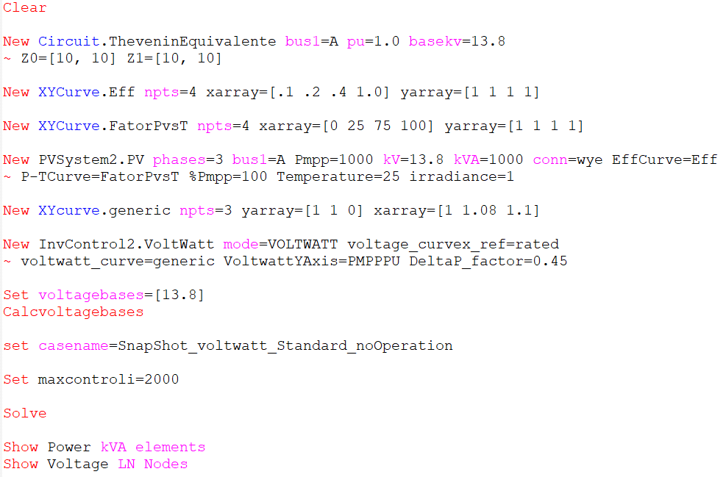
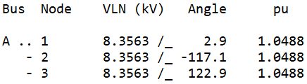
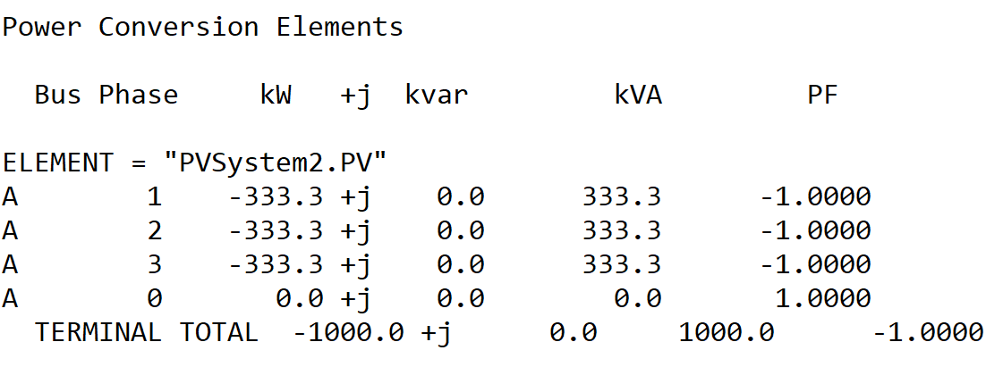
Scenario 1.1: Snapshot without volt-watt operation
OpenDSS code (SnapShot_voltwatt_noOperation-2.dss)

Slide 4
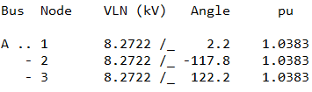
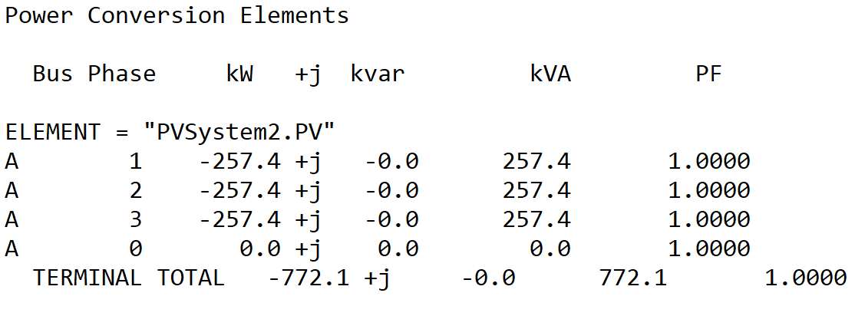
Scenario 1.2: Snapshot volt-wattYAxis PMPPPU
OpenDSS code (SnapShot_voltwatt_PMPPPU-2.dss)

Slide 5
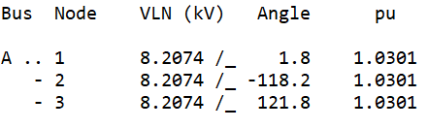
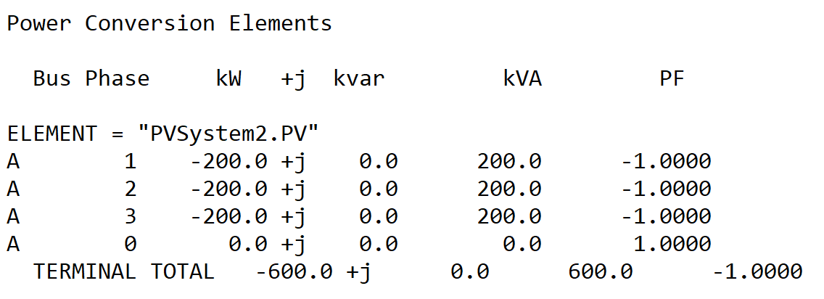
Scenario 1.3: Snapshot volt-wattYAxis PMPPPU with kW limited by pctPmpp*Pmpp
OpenDSS code (SnapShot_voltwatt_PMPPPU_pctPmpp60-2.dss)

Slide 6
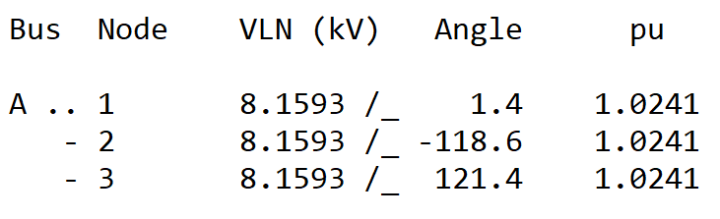
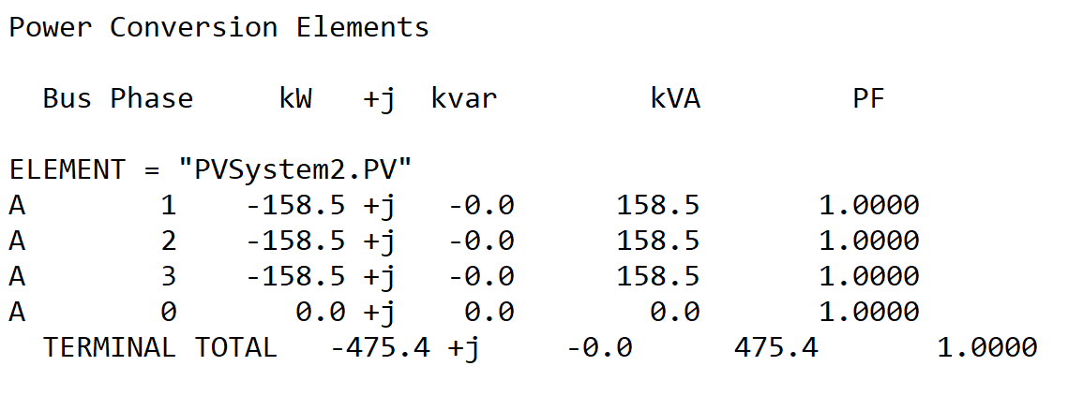
Scenario 1.4: Snapshot volt-wattYAxis PCTPMPPPU
OpenDSS code (SnapShot_voltwatt_PCTPMPPPU-2.dss)

Slide 7
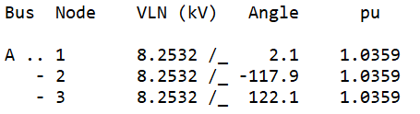
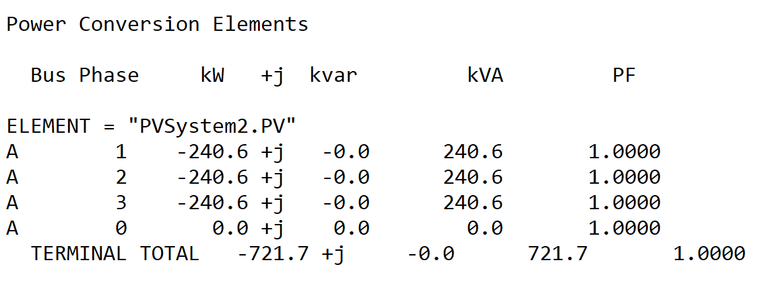
Scenario 1.5: Snapshot volt-wattYAxis PAVAILABLEPU
OpenDSS code (SnapShot_Voltwatt_PAVAILABLEPU-2.dss)

Slide 8
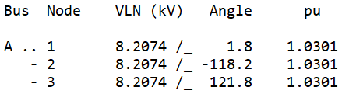

Scenario 1.6: Snapshot volt-wattYAxis PAVAILABLEPU with kW limited by pctPmpp*Pmpp
OpenDSS code (SnapShot_Voltwatt_PAVAILABLEPU_pctPmpp60-2.dss)

Slide 9
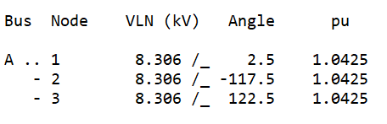
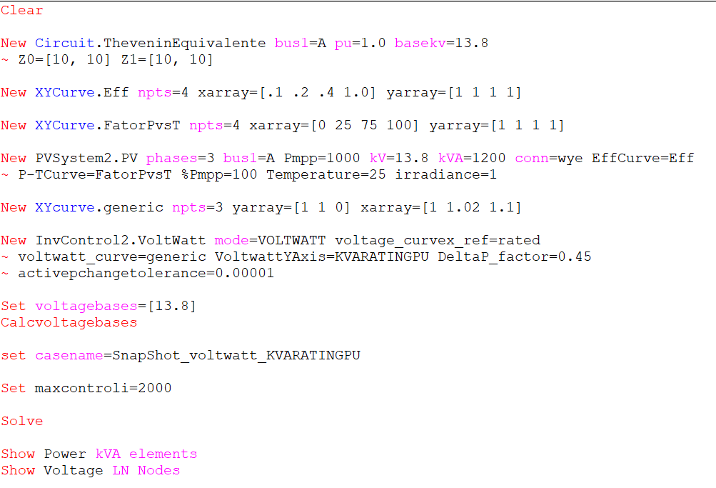
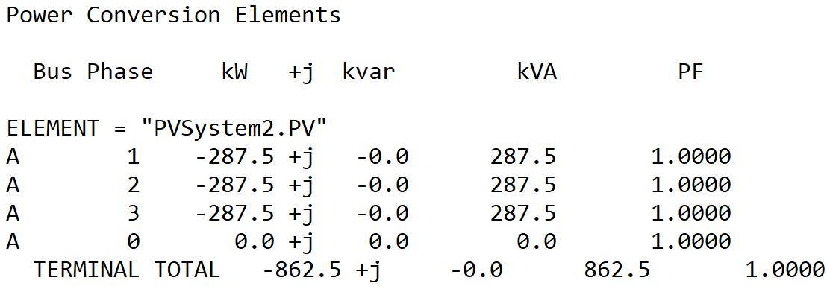
Scenario 1.7: Snapshot volt-wattYAxis KVARATINGPU
OpenDSS code (SnapShot_voltwatt_KVARATINGPU-2dss)

Slide 10
Results in QSTS mode
Output active power when volt-watt does not operate
Results from mode 3 monitor placed in the PVSystem2
hour | t(sec) | Irradiance | PanelkW | P_TFactor | Efficiency | Vreg | Vavg (DRC) | volt-var | volt-watt | DRC | VV_DRC | kW_out_desired
1 | 0 | 0 | 0 | 1 | 1 | 1 | 9999 | 9999 | 0 | 9999 | 9999 | 0
2 | 0 | 0 | 0 | 1 | 1 | 1 | 9999 | 9999 | 0 | 9999 | 9999 | 0
3 | 0 | 0 | 0 | 1 | 1 | 1 | 9999 | 9999 | 0 | 9999 | 9999 | 0
4 | 0 | 0 | 0 | 1 | 1 | 1 | 9999 | 9999 | 0 | 9999 | 9999 | 0
5 | 0 | 0 | 0 | 1 | 1 | 1 | 9999 | 9999 | 0 | 9999 | 9999 | 0
6 | 0 | 0 | 0 | 1 | 1 | 1 | 9999 | 9999 | 0 | 9999 | 9999 | 0
7 | 0 | 0.1 | 100 | 1 | 1 | 1 | 9999 | 9999 | 0 | 9999 | 9999 | 100
8 | 0 | 0.2 | 200 | 1 | 1 | 1.01034 | 9999 | 9999 | 0 | 9999 | 9999 | 200
9 | 0 | 0.3 | 300 | 1 | 1 | 1.01539 | 9999 | 9999 | 0 | 9999 | 9999 | 300
10 | 0 | 0.5 | 500 | 1 | 1 | 1.02528 | 9999 | 9999 | 0 | 9999 | 9999 | 500
11 | 0 | 0.8 | 800 | 1 | 1 | 1.03827 | 9999 | 9999 | 1 | 9999 | 9999 | 800
12 | 0 | 0.9 | 900 | 1 | 1 | 1.03827 | 9999 | 9999 | 1 | 9999 | 9999 | 900
13 | 0 | 1 | 1000 | 1 | 1 | 1.03827 | 9999 | 9999 | 1 | 9999 | 9999 | 1000
14 | 0 | 1 | 1000 | 1 | 1 | 1.03827 | 9999 | 9999 | 1 | 9999 | 9999 | 1000
15 | 0 | 0.99 | 990 | 1 | 1 | 1.03827 | 9999 | 9999 | 1 | 9999 | 9999 | 990
16 | 0 | 0.9 | 900 | 1 | 1 | 1.03827 | 9999 | 9999 | 1 | 9999 | 9999 | 900
17 | 0 | 0.7 | 700 | 1 | 1 | 1.03489 | 9999 | 9999 | 0 | 9999 | 9999 | 700
18 | 0 | 0.4 | 400 | 1 | 1 | 1.02037 | 9999 | 9999 | 0 | 9999 | 9999 | 400
19 | 0 | 0.1 | 100 | 1 | 1 | 1 | 9999 | 9999 | 0 | 9999 | 9999 | 100
20 | 0 | 0 | 0 | 1 | 1 | 1 | 9999 | 9999 | 0 | 9999 | 9999 | 0
21 | 0 | 0 | 0 | 1 | 1 | 1 | 9999 | 9999 | 0 | 9999 | 9999 | 0
22 | 0 | 0 | 0 | 1 | 1 | 1 | 9999 | 9999 | 0 | 9999 | 9999 | 0
23 | 0 | 0 | 0 | 1 | 1 | 1 | 9999 | 9999 | 0 | 9999 | 9999 | 0
24 | 0 | 0 | 0 | 1 | 1 | 1 | 9999 | 9999 | 0 | 9999 | 9999 | 0
Voltage used in the volt-watt curve
1 indicates that volt-watt operated and 0 otherwise

Slide 11
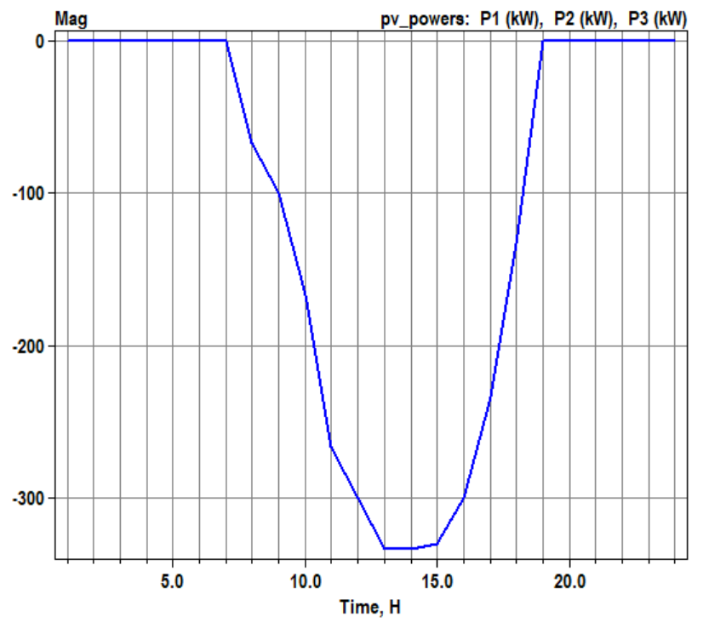
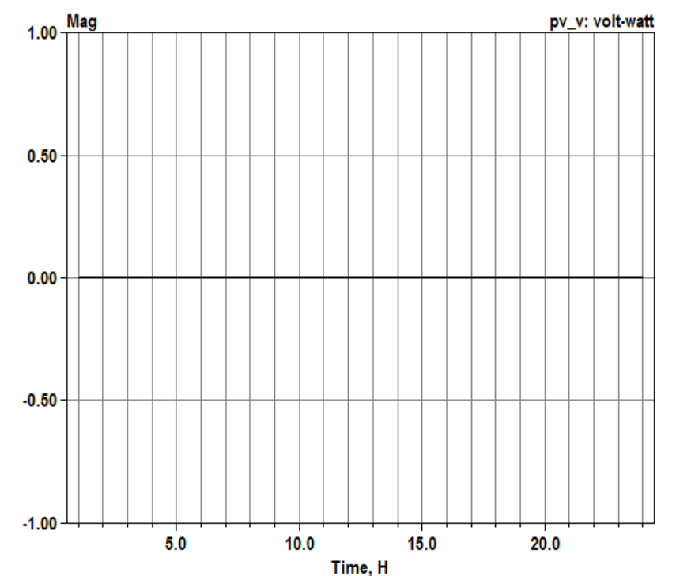
Scenario 1.8: Daily without volt-watt operation
OpenDSS code (Daily_voltwatt_noOperation-2.dss)
Active power generation
volt-watt operation

Slide 12
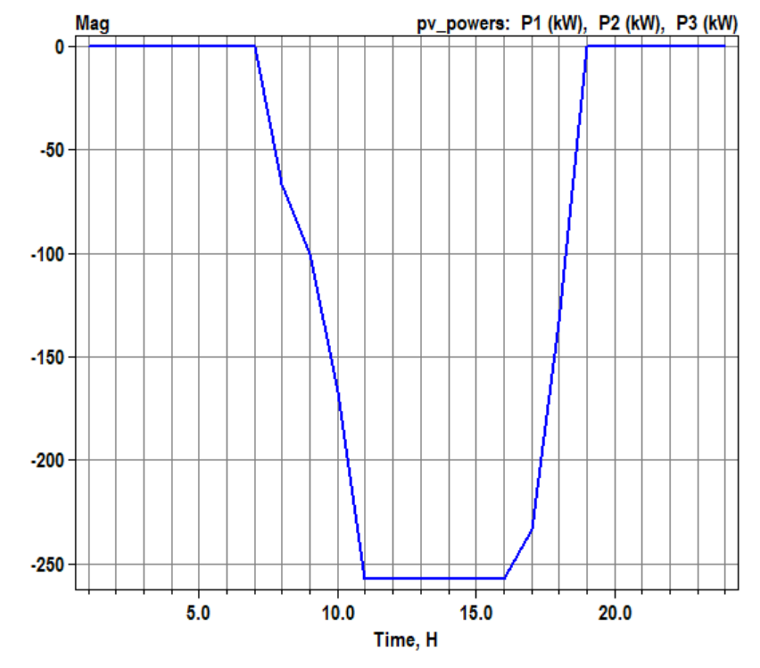
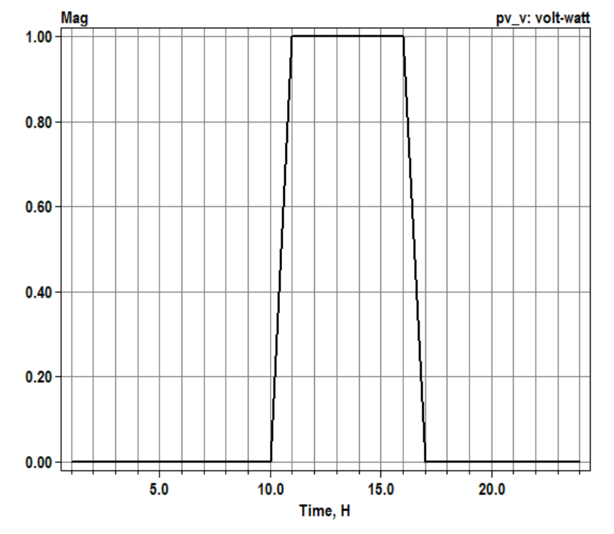
Scenario 1.9: Daily volt-wattYAxis PMPPPU
OpenDSS code (Daily_voltwatt_PMPPPU-2.dss)
Active power generation
volt-watt operation

Slide 13
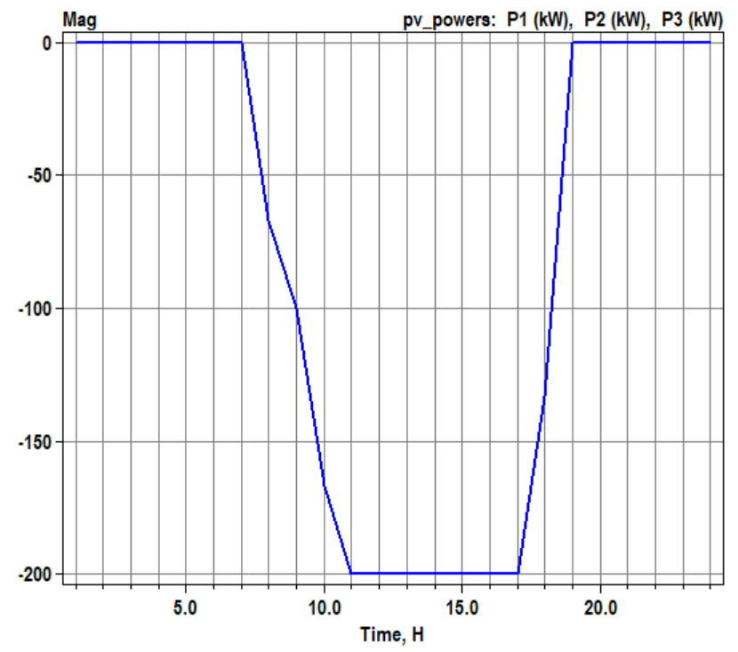
Scenario 1.10: Daily volt-wattYAxis PMPPPU with kW limited by pctPmpp*Pmpp
OpenDSS code (Daily_voltwatt_PMPPPU_pctPmpp60-2.dss)
Active power generation
volt-watt operation

Slide 14
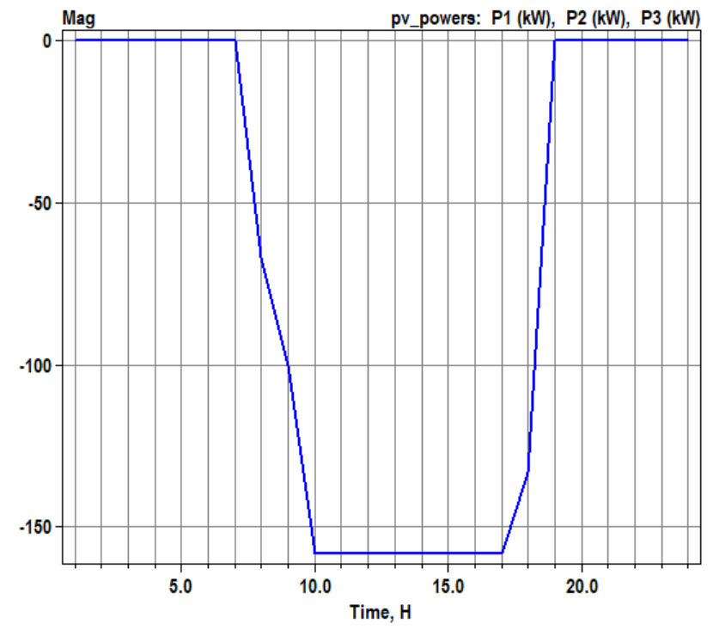
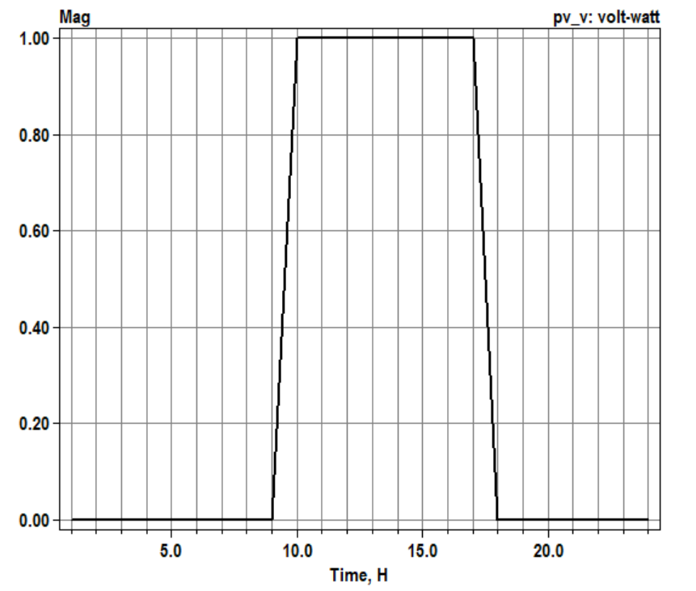
Scenario 1.11: Daily volt-wattYAxis PCTPMPPPU
OpenDSS code (Daily_voltwatt_PCTPMPPPU-2.dss)
Active power generation
volt-watt operation

Slide 15
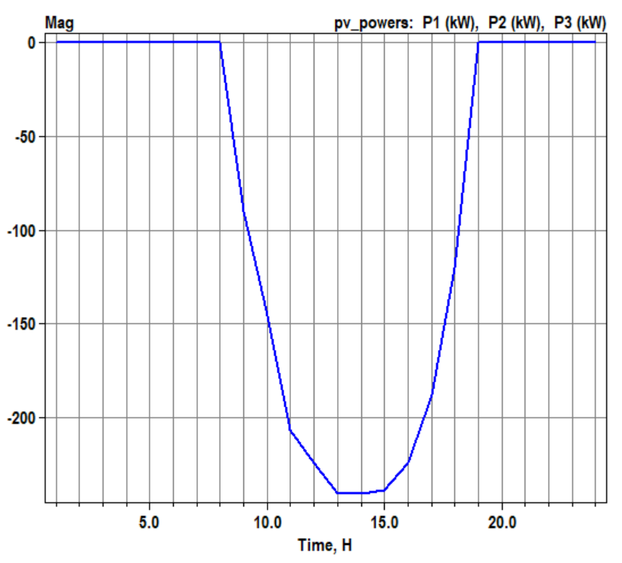
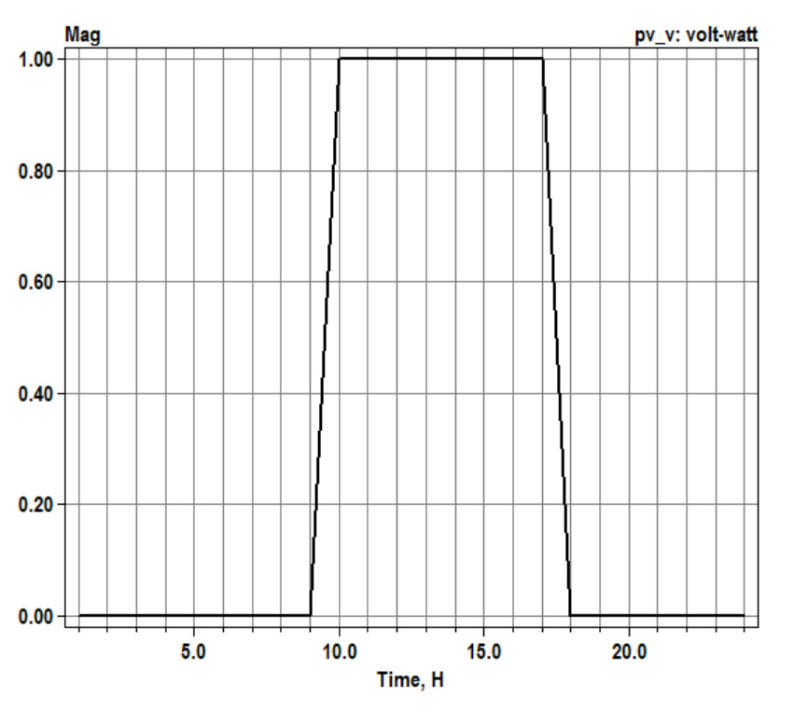
Scenario 1.12: Daily volt-wattYAxis PAVAILABLEPU
OpenDSS code (Daily_Voltwatt_PAVAILABLEPU-2.dss)
Active power generation
volt-watt operation

Slide 16
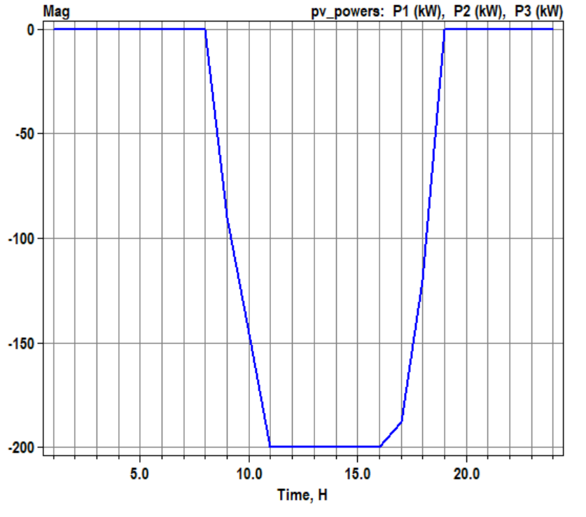
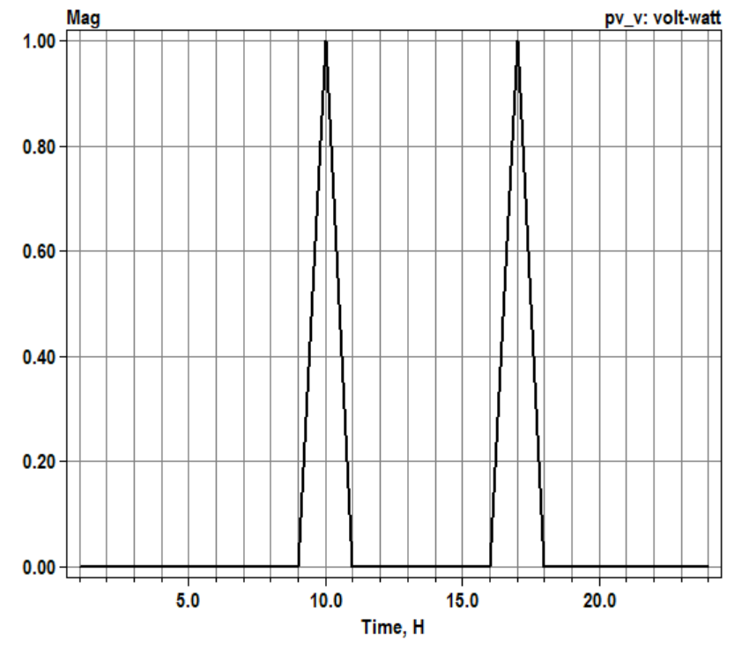
Scenario 1.13: Daily volt-wattYAxis PAVAILABLEPU with kW limited by pctPmpp*Pmpp
OpenDSS code (Daily_Voltwatt_PAVAILABLEPU_pctPmpp60-2.dss)
Active power generation
volt-watt operation

Slide 17
Scenarios with non-unit PF

Slide 18
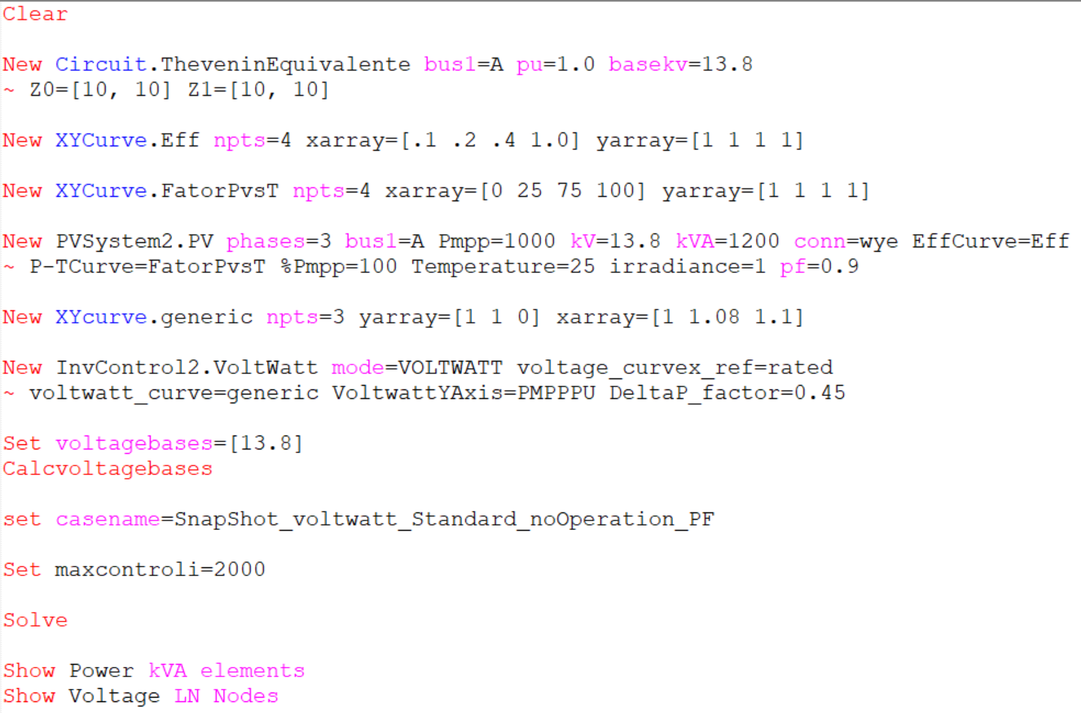
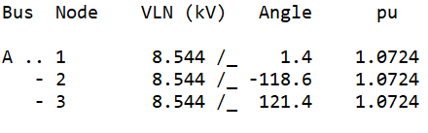
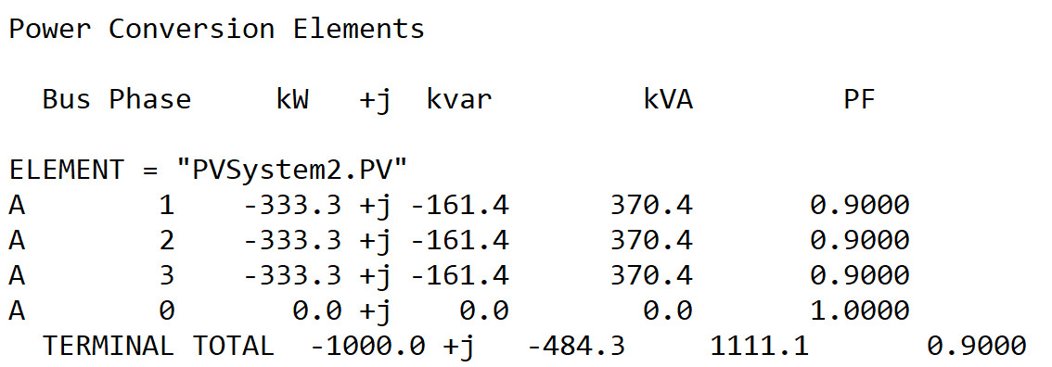
Scenario 2.1: Snapshot without volt-watt operation with pf=0.9
OpenDSS code (SnapShot_voltwatt_noOperation_PF-2.dss)

Slide 19
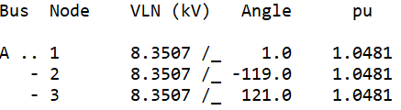
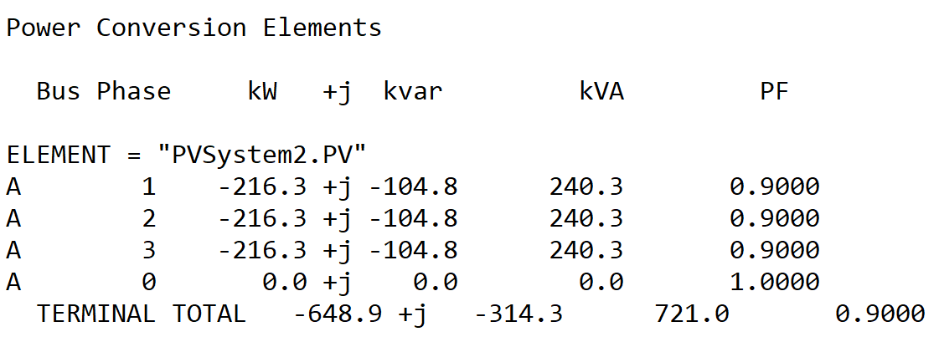
Scenario 2.2: Snapshot volt-wattYAxis PMPPPU with pf=0.9
OpenDSS code (SnapShot_voltwatt_PMPPPU_PF-2.dss)

Slide 20
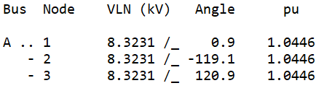
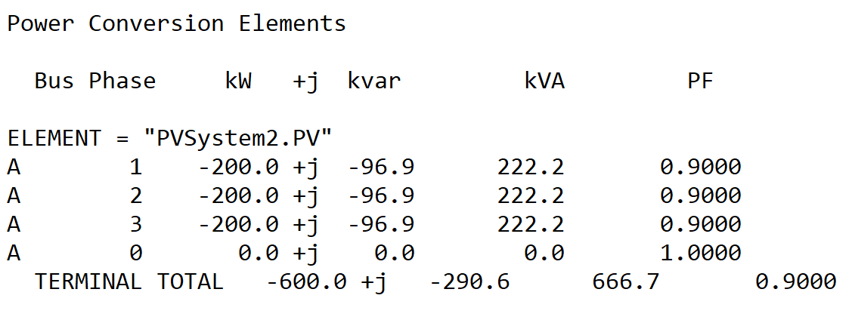
Scenario 2.3: Snapshot volt-wattYAxis PMPPPU with kW limited by pctPmpp*Pmpp and pf=0.9
OpenDSS code (SnapShot_voltwatt_PMPPPU_pctPmpp60_PF-2.dss)

Slide 21
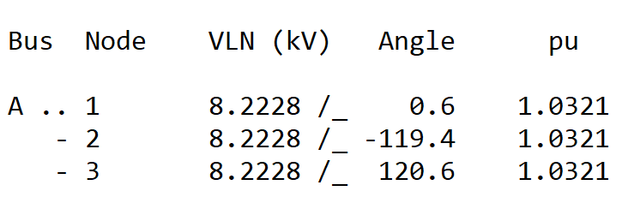
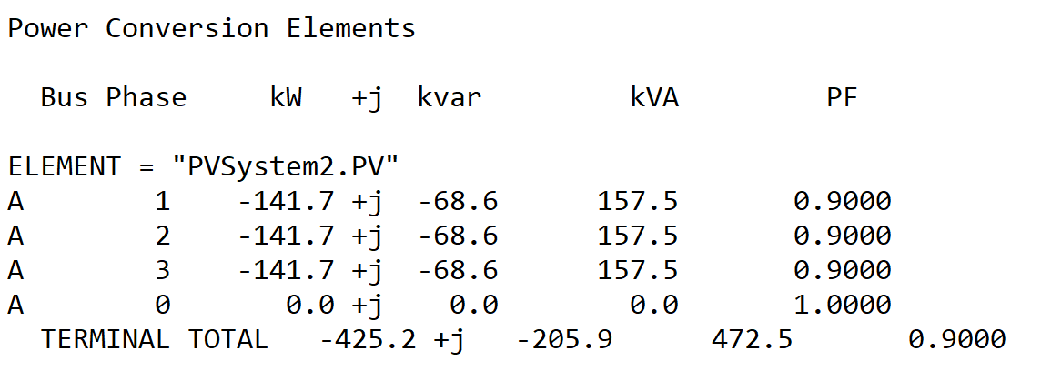
Scenario 2.4: Snapshot volt-wattYAxis PCTPMPPPU with pf=0.9
OpenDSS code (SnapShot_voltwatt_PCTPMPPPU_PF-2.dss)

Slide 22
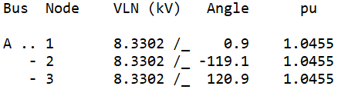
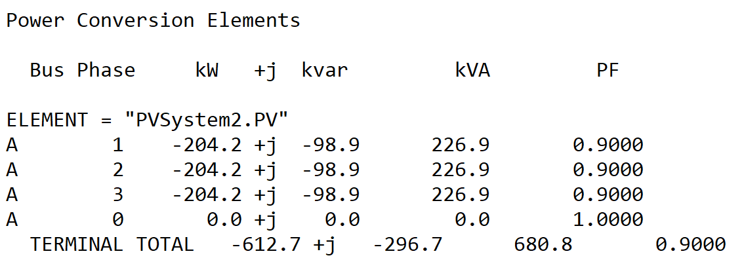
Scenario 2.5: Snapshot volt-wattYAxis PAVAILABLEPU with pf=0.9
OpenDSS code (SnapShot_Voltwatt_PAVAILABLEPU_PF-2.dss)

Slide 23
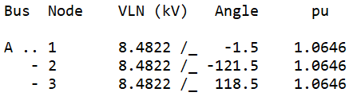
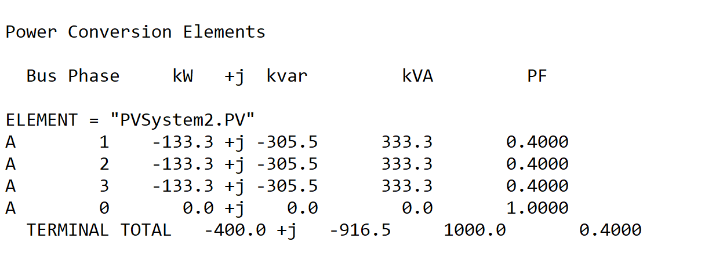
Scenario 2.6: Snapshot volt-wattYAxis PMPPPU with pf=0.4 and kVA limitation
OpenDSS code (SnapShot_voltwatt_PMPPPU_PFP_kVAlimitation-2.dss)
pf priority
Inverter’s kVA rating

Slide 24
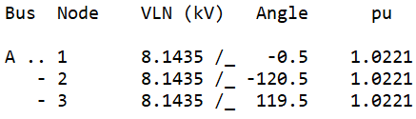
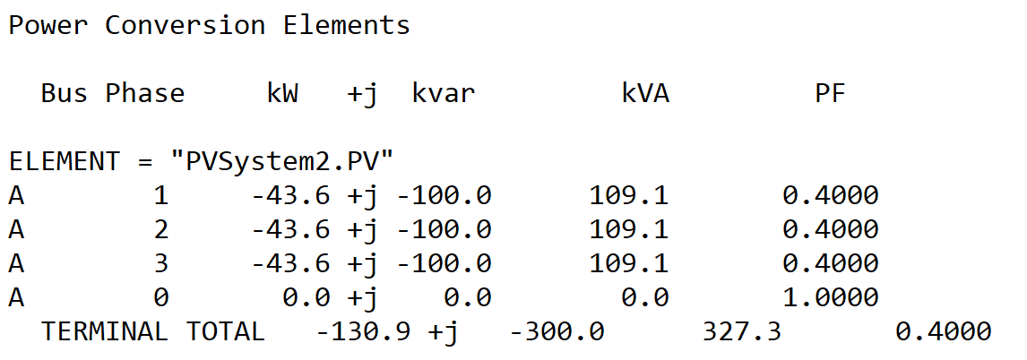
Scenario 2.7: Snapshot volt-wattYAxis PMPPPU with pf=0.4 and kvar limitation
OpenDSS code (SnapShot_voltwatt_PMPPPU_PFP_kvarlimitation-2.dss)
Max kvar

Slide 25

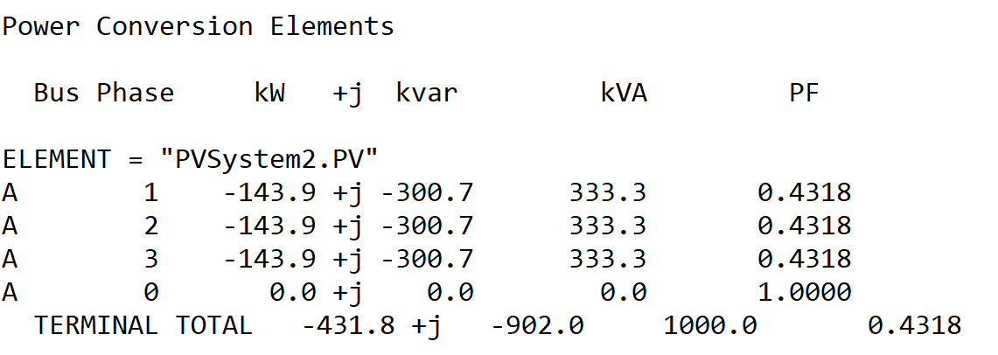
Scenario 2.8: Snapshot volt-wattYAxis PMPPPU with pf=0.4 and kVA limitation – P priority
OpenDSS code (SnapShot_voltwatt_PMPPPU_wattP_kVAlimitation-2.dss)

Slide 26
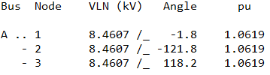
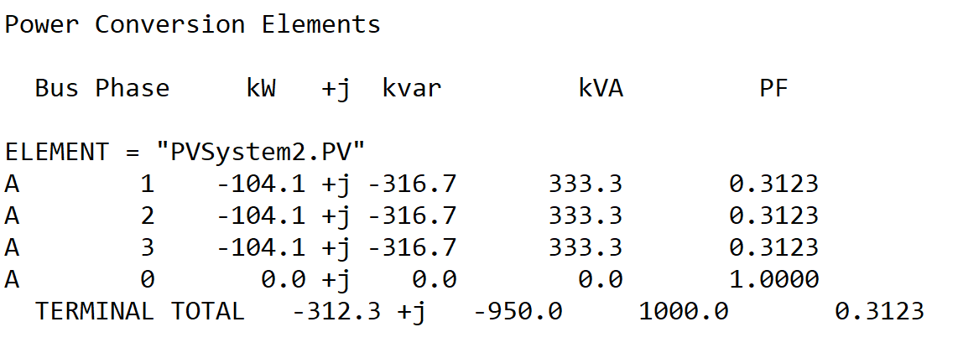
Scenario 2.9: Snapshot volt-wattYAxis PMPPPU with pf=0.4 and kVA limitation – Q priority
OpenDSS code (SnapShot_voltwatt_PMPPPU_varP_kVAlimitation-2.dss)

