Slide 1
InvControl2’s Watt-pf mode validation
PVSyestem2
Paulo Radatz
Engineer/Scientist II
Power System Studies
March 2020

Slide 2
Agenda
New properties of InvControl2
Watt-pf curve
DSS script
Scenarios
Results

Slide 3
New properties of InvControl2
For mode=WATTPF
wattpf_curve: The user gives a watt-pf curve that is define through a XYcurve OpenDSS object

Slide 4
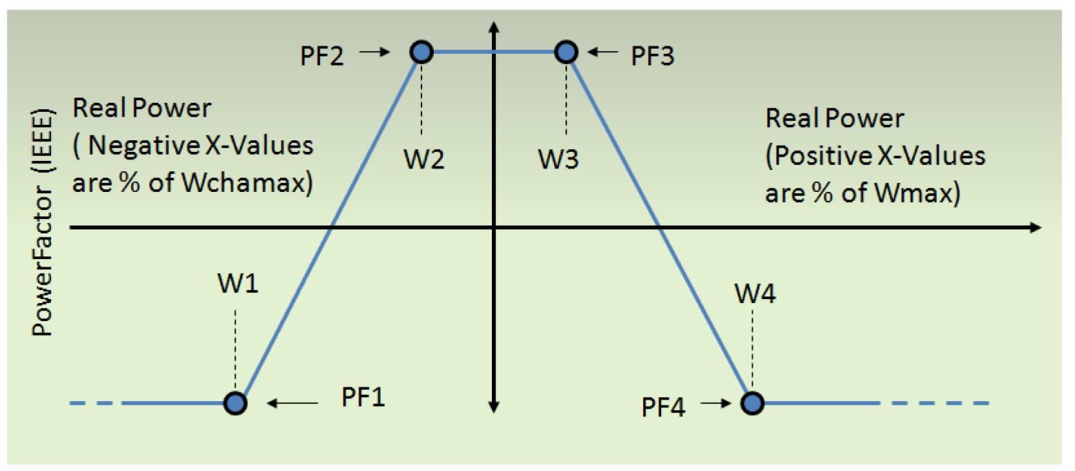
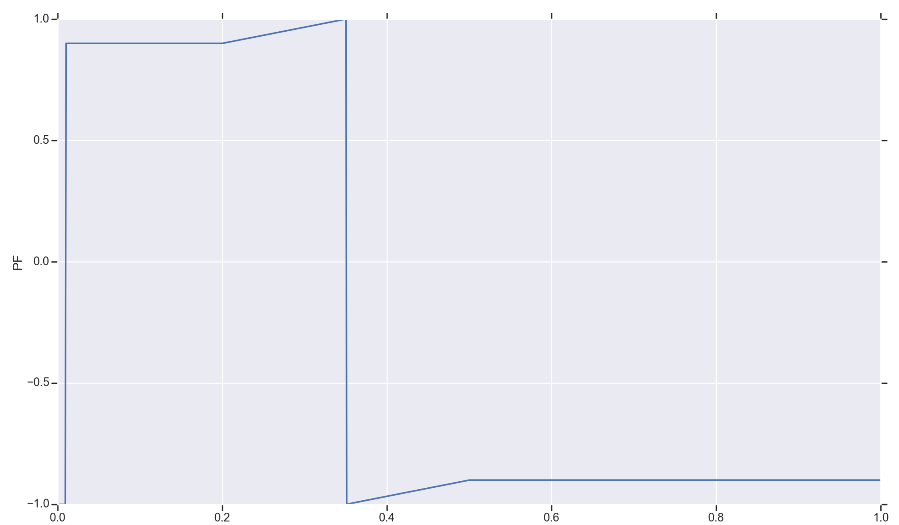
Watt-pf curve
The watt-pf curve used is shown below.
Where:
Only positive real power is considered of PVSystem2
W3=0.2; PF3=0.9
W4=0.5; PF4=-0.9
The OpenDSS user needs to define this curve as shown below:
OpenDSS eventually could read a curve 1 and internally translate it for this curve
Reference is PF=1
Reference is PF=0
PF=-1 and PF=1 are the same
The curves are equivalent

Slide 5
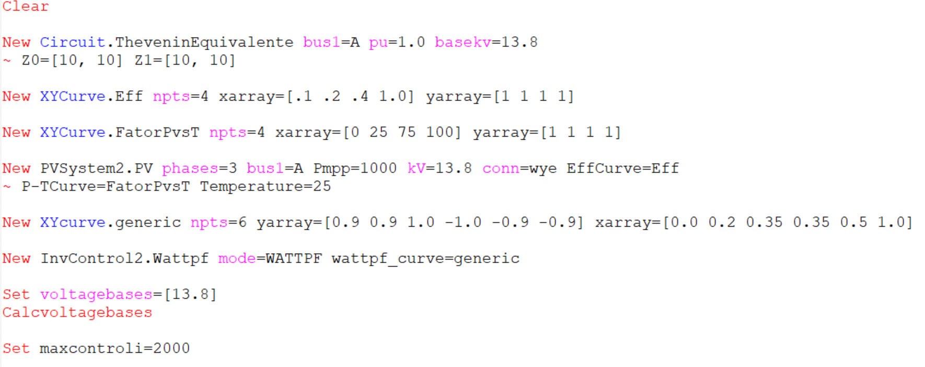
DSS script
New Mode

Slide 6
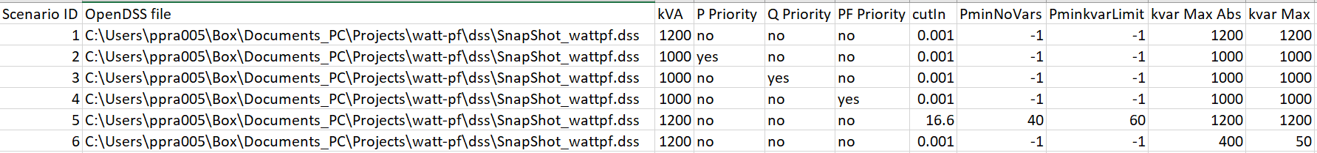
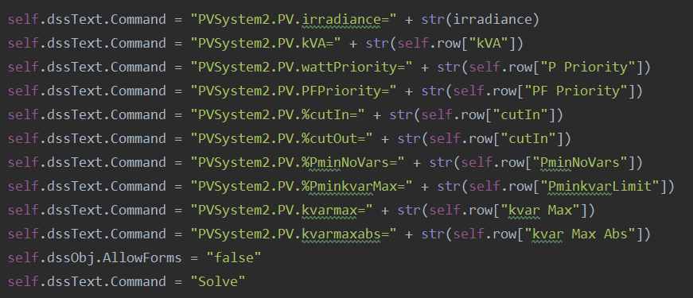
Scenarios
A Python script runs 6 scenarios defined in the table below:
The Python script changes PVSystem2 properties automatically:

Slide 7
Scenarios
Reactive power capabilities. The red regions are allowed to have vars
Scenario 5:
%PminkvarMax = 60% (600kW)
%PminNoVars = 40% (400kW)
%CutIn = 16.666% of kVA (200kW)
Scenarios 1, 2, 3, 4, and 6
%PminkvarMax = -1
%PminNoVars = -1
Q
Q
kvarMax
kvarMax
P
P
%CutIn
%PminNoVars
%PminkvarMax
%CutIn
Inv. OFF
Inv. ON
Inv. ON
Inv. OFF
These curves are also defined for negative Q. Instead of kvarMax, it is kvarMaxAbs

Slide 8
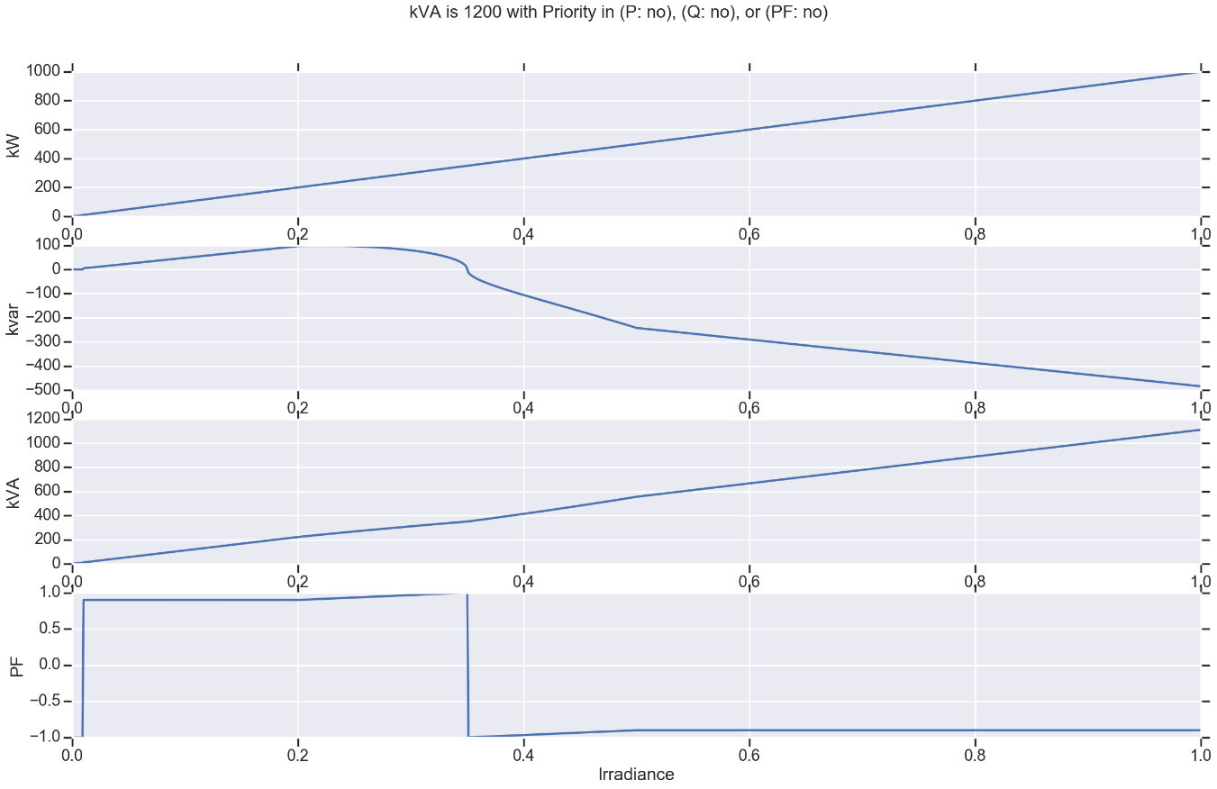
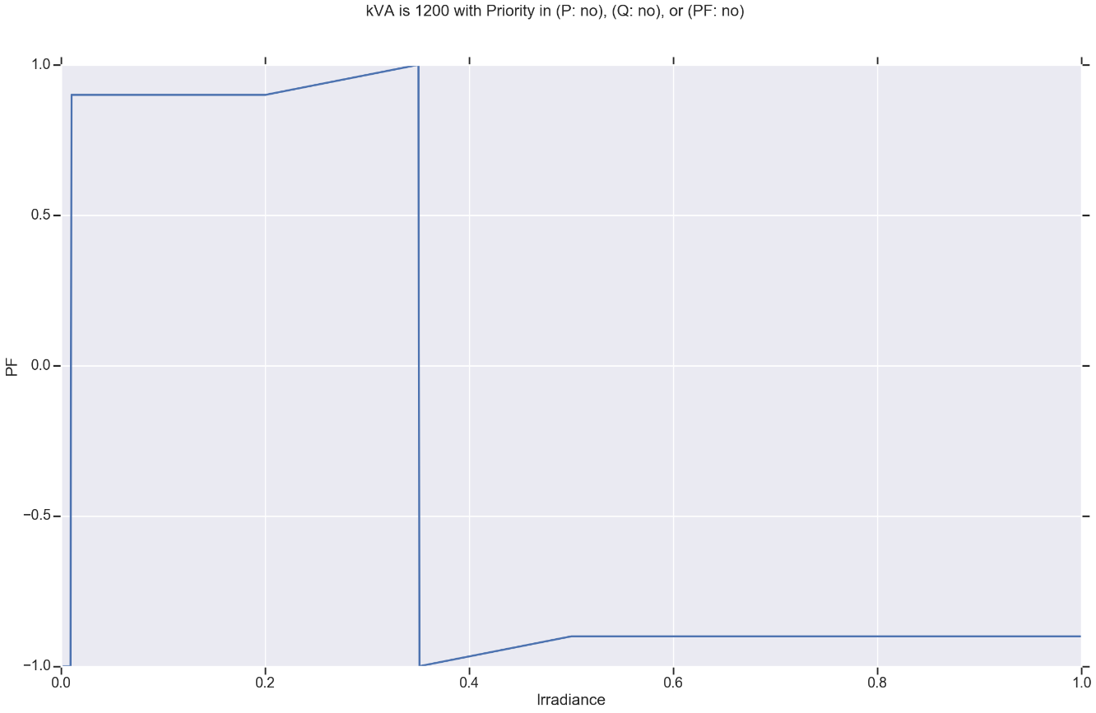
Scenario 1 Results
Scenario ID | kVA | P Priority | Q Priority | PF Priority | cutIn | PminNoVars | PminkvarLimit | kvar Max Abs | kvar Max
1 | 1200 | no | no | no | 0.001 | -1 | -1 | 1200 | 1200
Zoom in
Notes:
kVA is not exceeded
No priority needed
Results are equal to the curve defined

Slide 9
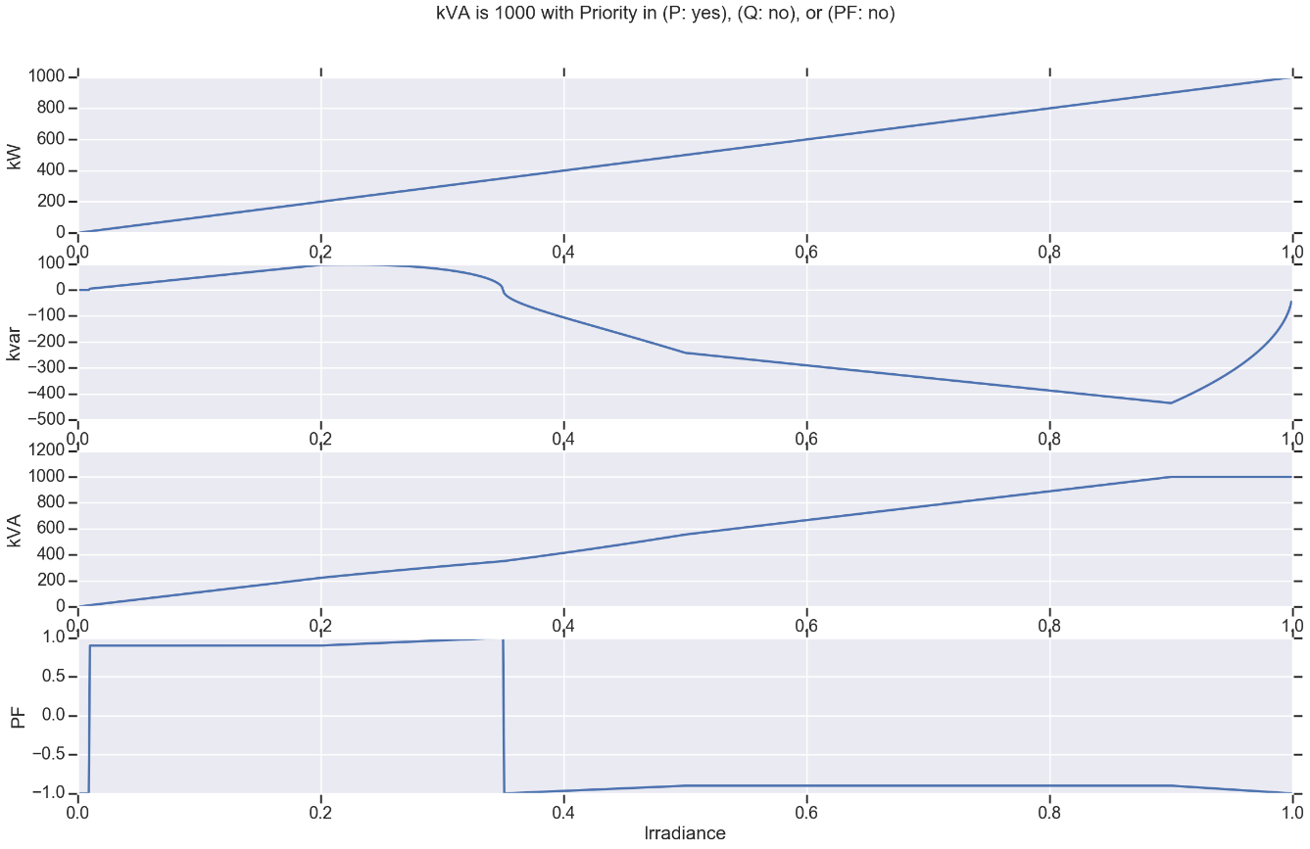
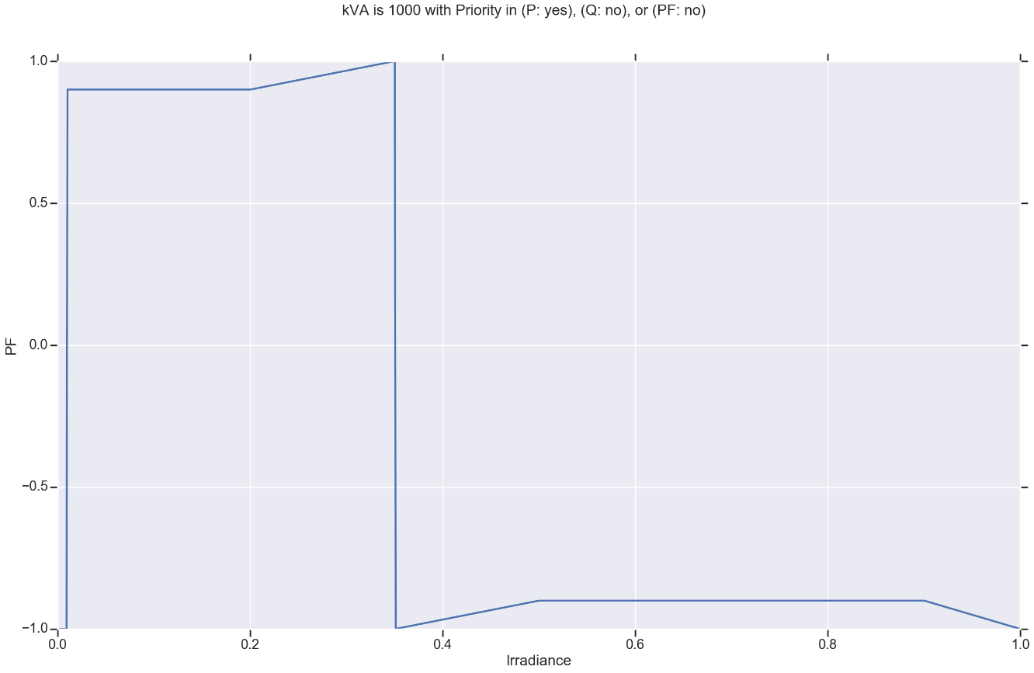
Scenario 2 Results
Scenario ID | kVA | P Priority | Q Priority | PF Priority | cutIn | PminNoVars | PminkvarLimit | kvar Max Abs | kvar Max
2 | 1000 | yes | no | no | 0.001 | -1 | -1 | 1000 | 1000
Notes:
kVA is exceeded
P priority
Q decreases
PF increases
kVA exceeded. Q needs to decrease in magnitude to have KVA and active power desired. Therefore, the PF increases in magnitude

Slide 10
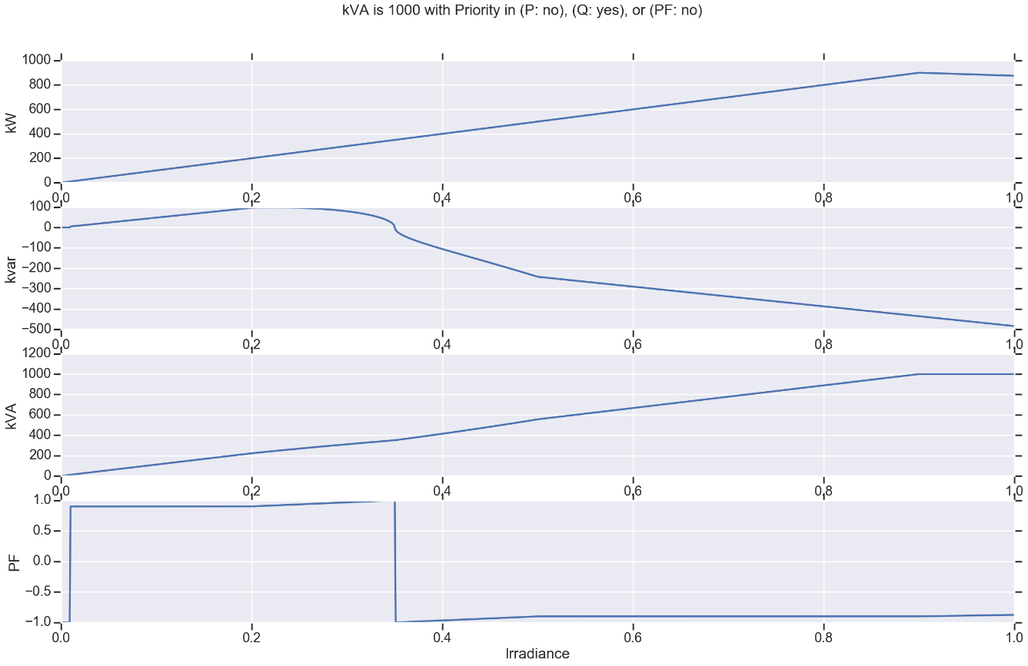

Scenario 3 Results
Scenario ID | kVA | P Priority | Q Priority | PF Priority | cutIn | PminNoVars | PminkvarLimit | kvar Max Abs | kvar Max
3 | 1000 | no | yes | no | 0.001 | -1 | -1 | 1000 | 1000
Notes:
kVA is exceeded
Q priority
P decreases
PF decreases

Slide 11
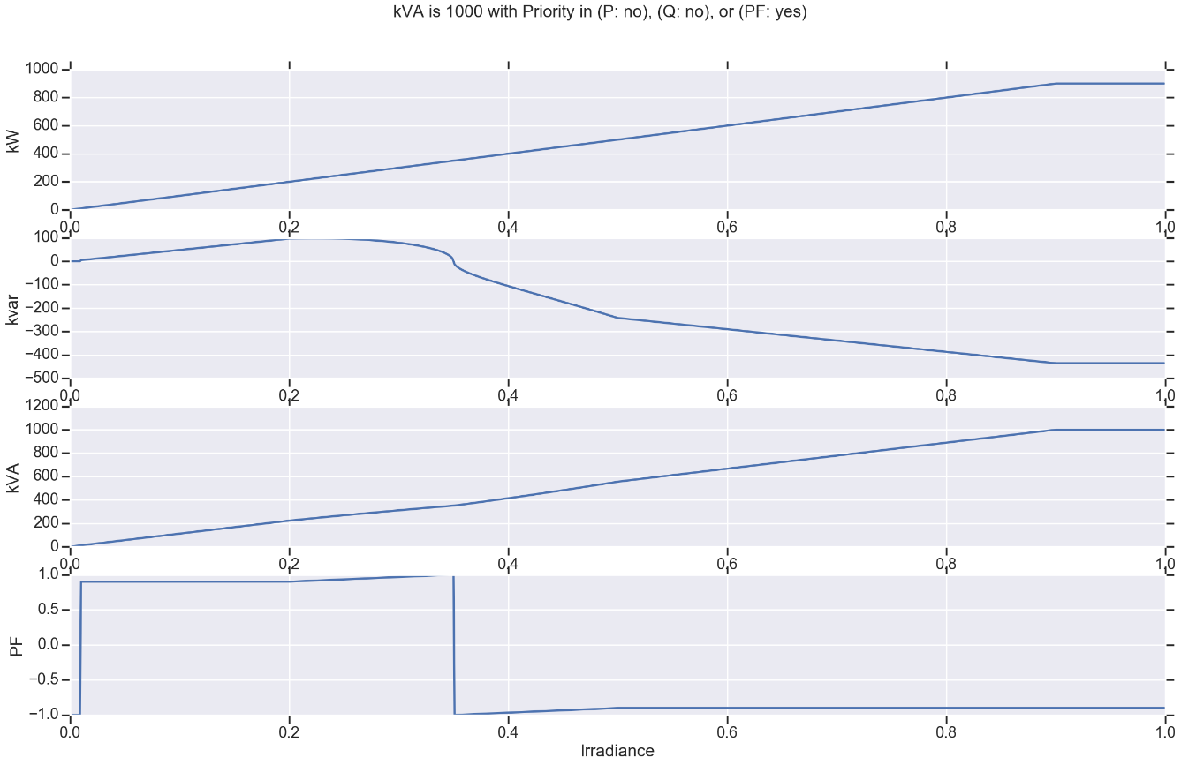

Scenario 4 Results
Scenario ID | kVA | P Priority | Q Priority | PF Priority | cutIn | PminNoVars | PminkvarLimit | kvar Max Abs | kvar Max
4 | 1000 | no | no | yes | 0.001 | -1 | -1 | 1000 | 1000
Notes:
kVA is exceeded
PF priority
P decreases
Q decreases
PF constant

Slide 12
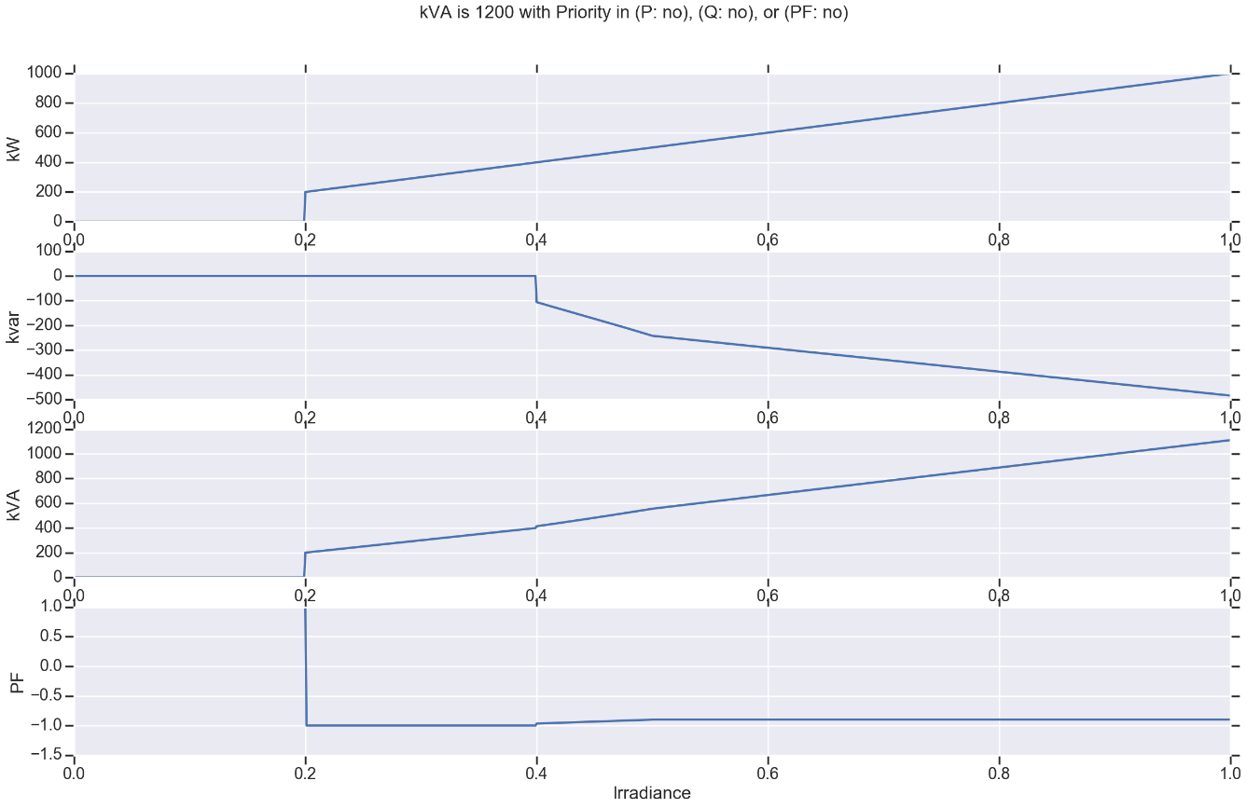
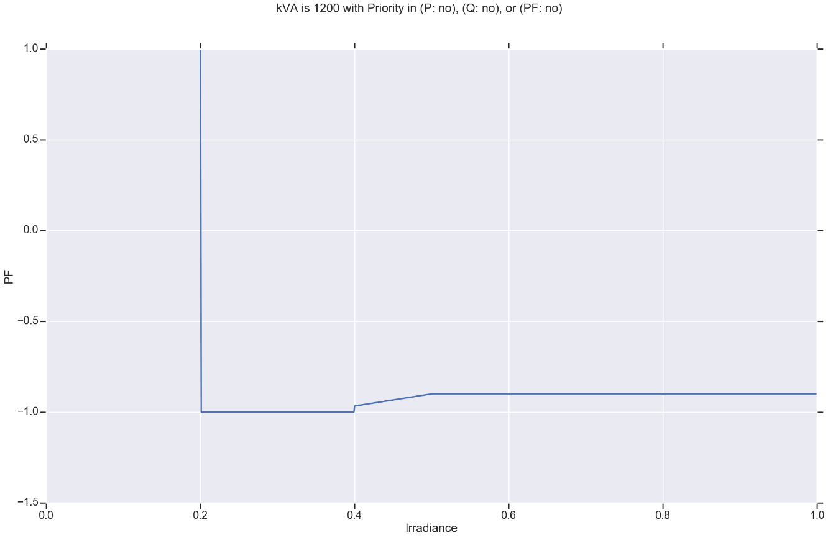
Scenario 5 Results
Scenario ID | kVA | P Priority | Q Priority | PF Priority | cutIn | PminNoVars | PminkvarLimit | kvar Max Abs | kvar Max
5 | 1200 | no | no | no | 16.6 | 40 | 60 | 1200 | 1200
Q
Notes:
Q capabilities are respected. See figure ->
Red regions are places where can exist vars.
kvarMax and kvarMaxAbs are both 1200kvar
kvarMax
P
%CutIn
%PminNoVars
%PminkvarMax
Inv. OFF
Inv. ON

Slide 13
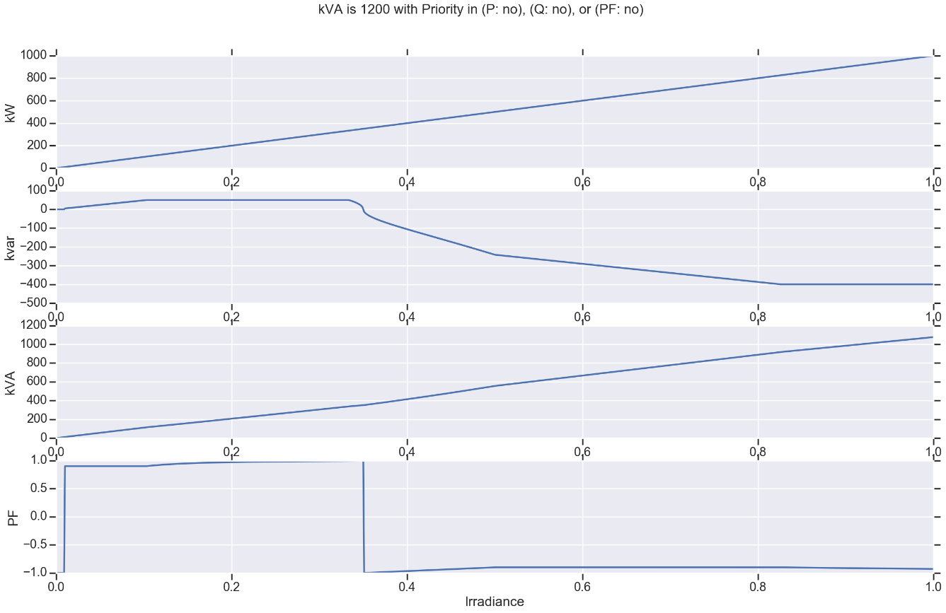
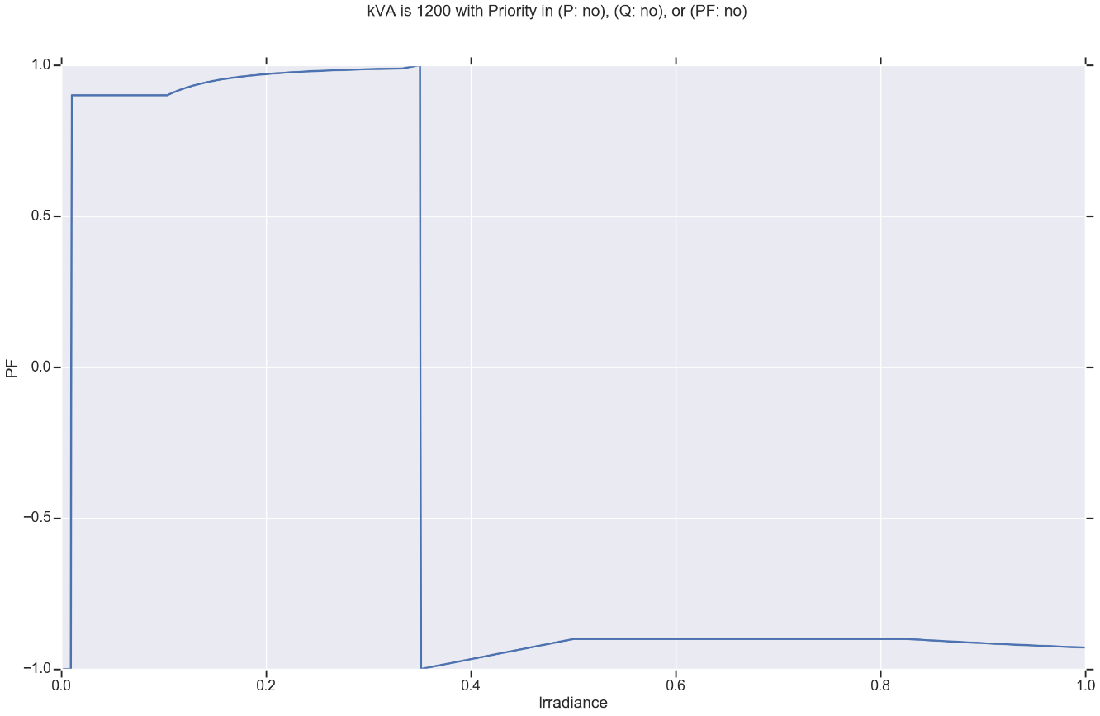
Scenario 6 Results
Scenario ID | kVA | P Priority | Q Priority | PF Priority | cutIn | PminNoVars | PminkvarLimit | kvar Max Abs | kvar Max
6 | 1200 | no | no | no | 0.001 | -1 | -1 | 400 | 50
Notes:
kvarMax and kvarMaxAbs limits are respected.
As a result, PF changes

