Slide 1
InvControl2’s Watt-Var mode validation
PVSyestem2
Paulo Radatz
Engineer/Scientist II
Power System Studies
March 2020

Slide 2
Agenda
New properties of InvControl2
Watt-var curve
DSS script
Scenarios
Results

Slide 3
New properties of InvControl2
For mode=WATTVAR
wattvar_curve: The user gives a watt-var curve that is define through a XYcurve OpenDSS object

Slide 4
Watt-Var curve
The watt-var curve used is shown below.
Where:
Only positive real power is considered of PVSystem2
The OpenDSS user needs to define this curve as shown below:

Slide 5
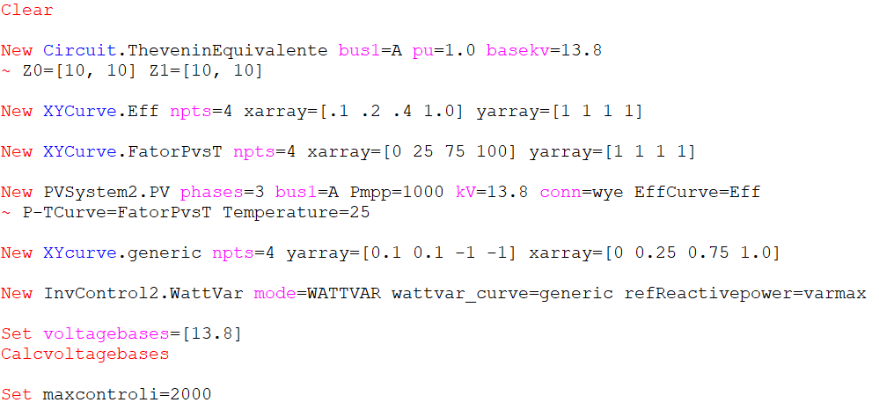
DSS script
New Mode

Slide 6
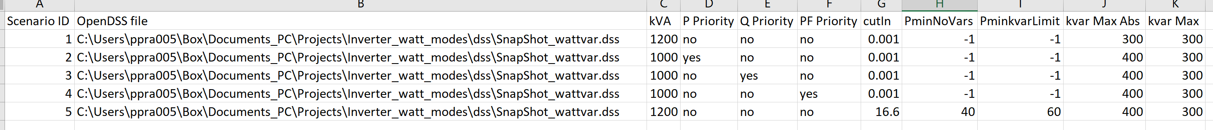
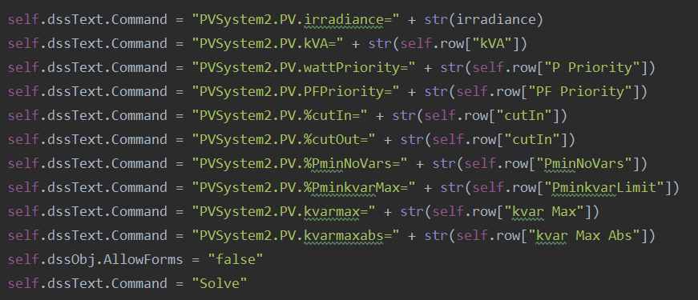
Scenarios
A Python script runs 4 scenarios defined in the table below:
The Python script changes PVSystem2 properties automatically:

Slide 7
Scenarios
Reactive power capabilities. The red regions are allowed to have vars
Scenario 5:
%PminkvarMax = 60% (600kW)
%PminNoVars = 40% (400kW)
%CutIn = 16.666% of kVA (200kW)
Scenarios 1, 2, 3, 4, and 6
%PminkvarMax = -1
%PminNoVars = -1
Q
Q
kvarMax
kvarMax
P
P
%CutIn
%PminNoVars
%PminkvarMax
%CutIn
Inv. OFF
Inv. ON
Inv. ON
Inv. OFF
These curves are also defined for negative Q. Instead of kvarMax, it is kvarMaxAbs

Slide 8
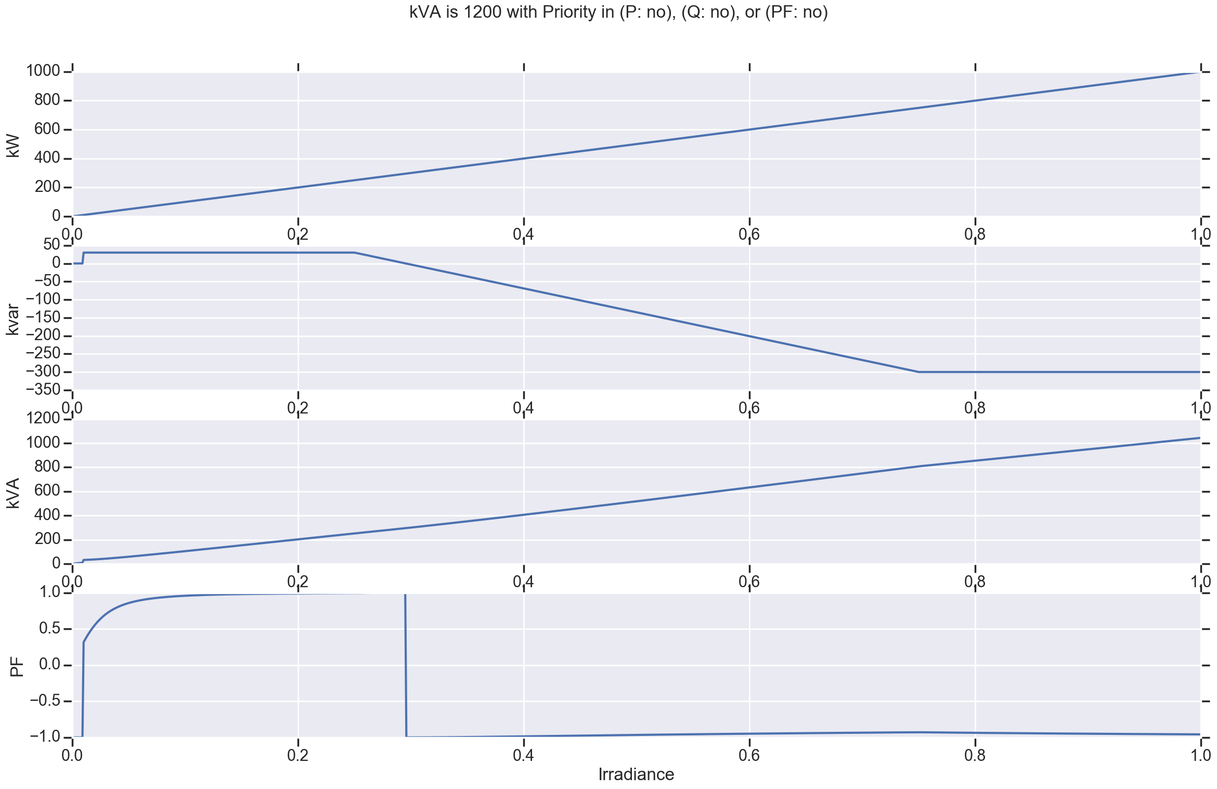
Scenario 1 Results
Results are equal to the curve defined
Notes:
kVA is not exceeded
No priority needed

Slide 9
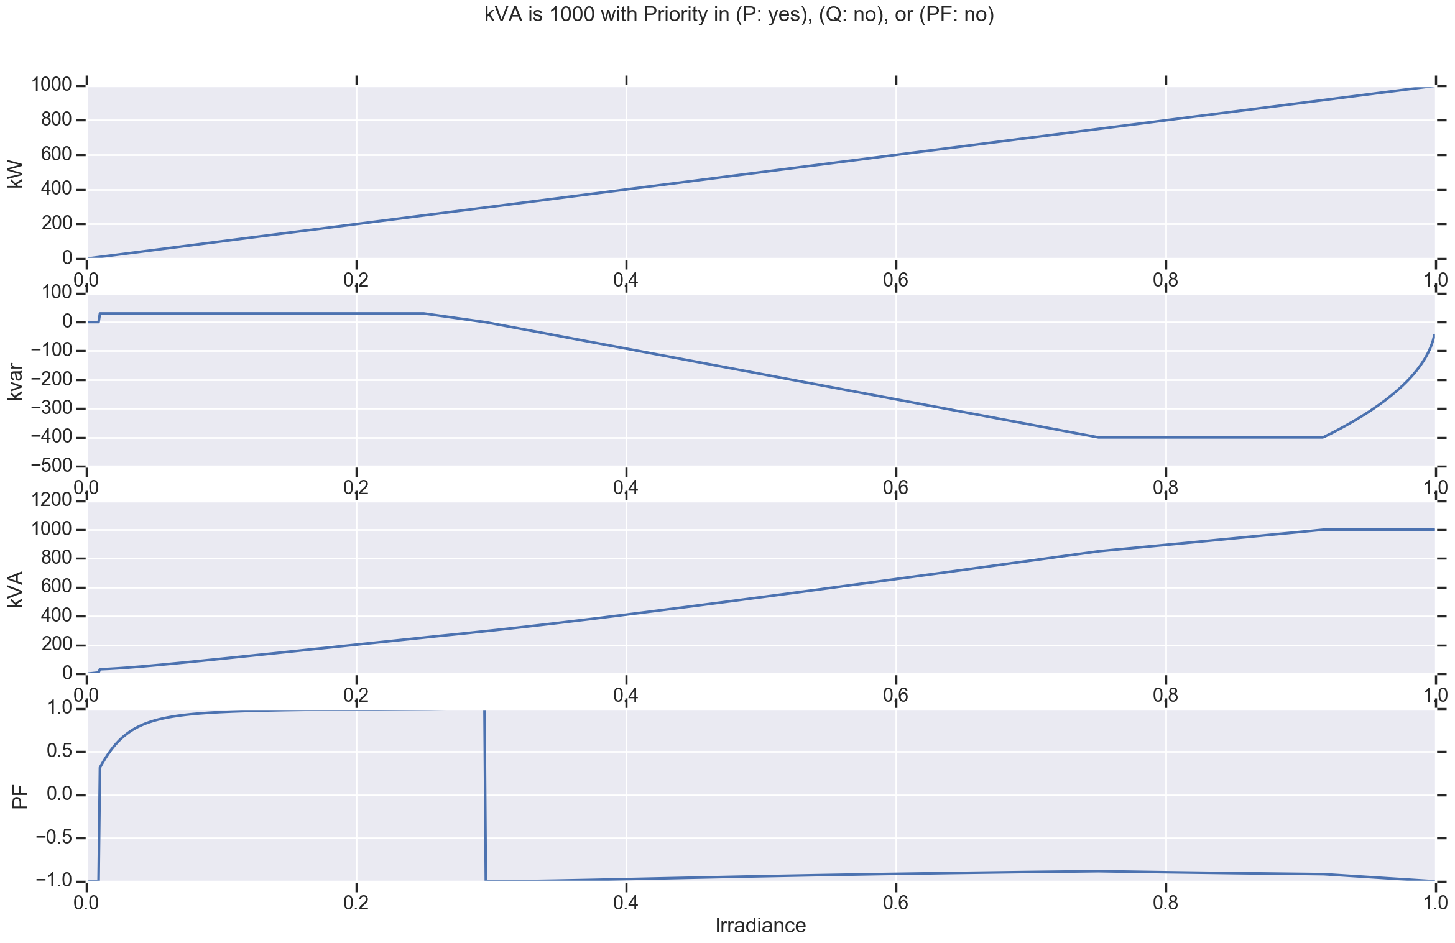
Scenario 2 Results
kVA exceeded. Q needs to decrease in magnitude to have KVA and active power desired. Therefore, the PF increases in magnitude
Notes:
kVA is exceeded
P priority
Q decreases
PF increases

Slide 10
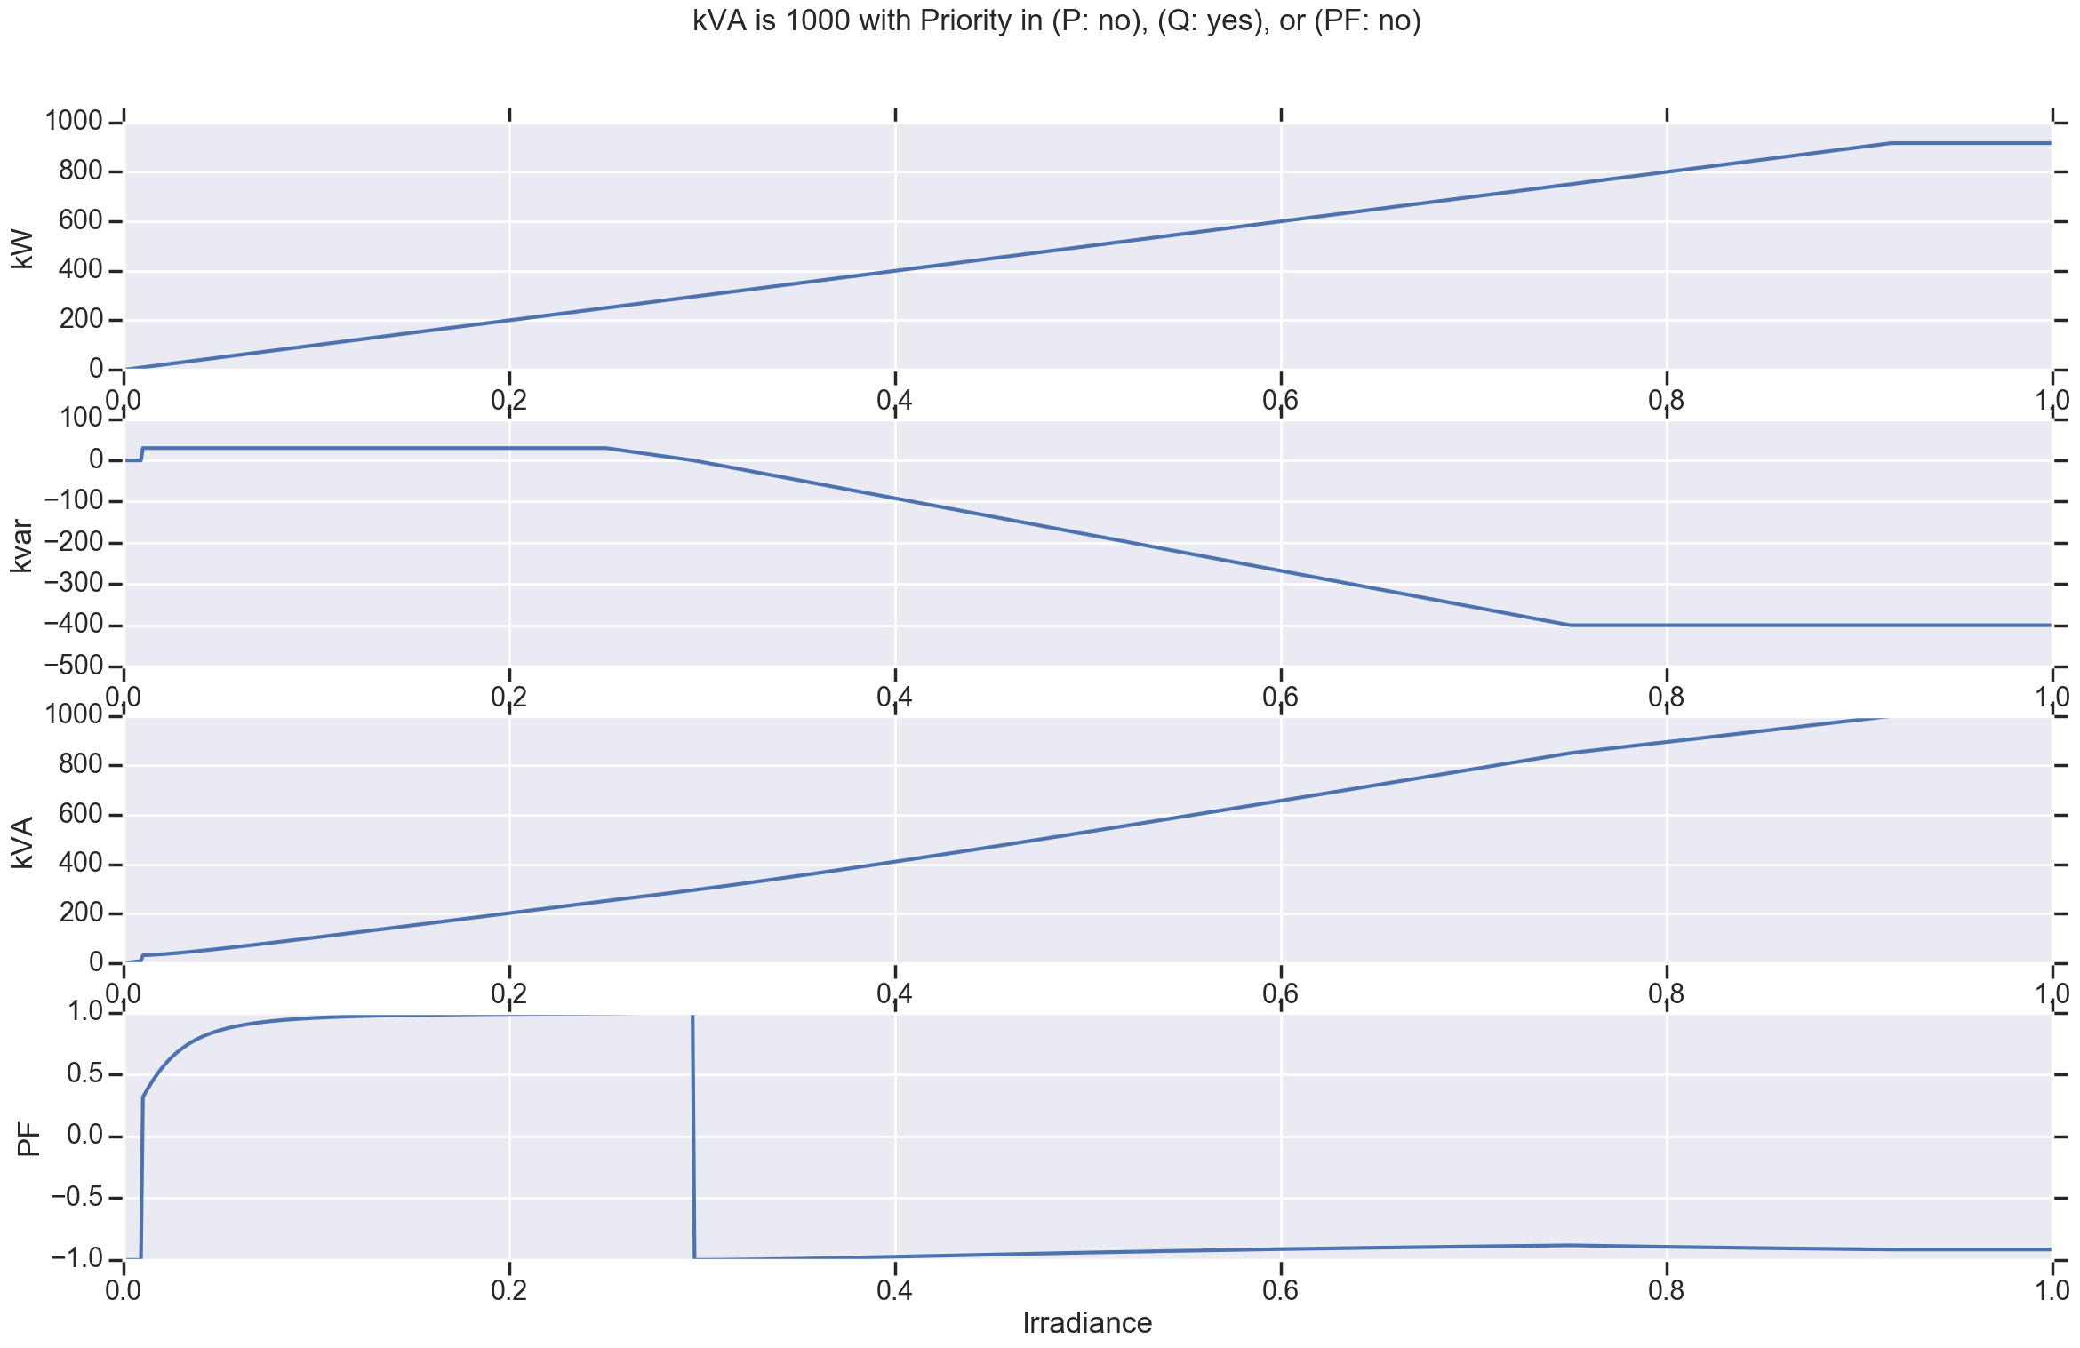
Scenario 3 Results
Notes:
kVA is exceeded
Q priority
P decreases
PF decreases

Slide 11
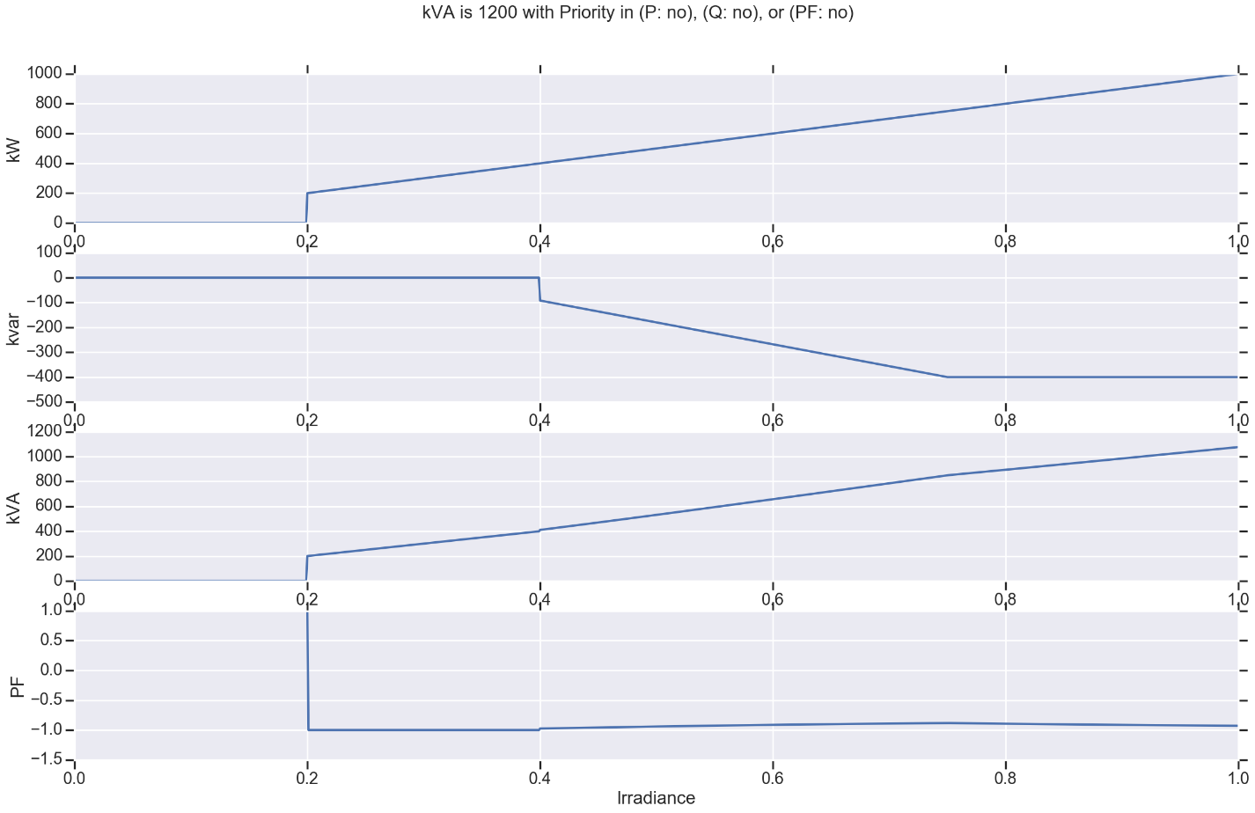
Scenario 4 Results
Q
Notes:
Q capabilities are respected. See figure ->
Red regions are places where can exist vars.
kvarMax
P
%CutIn
%PminNoVars
%PminkvarMax
Inv. OFF
Inv. ON

