Slide 1
VV_VW Scenarios
OpenDSS: Version 8.6.6.1 (64-bit build)
Authors: Paulo Radatz and Celso Rocha

Slide 2
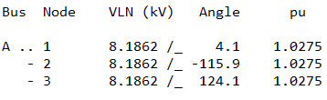
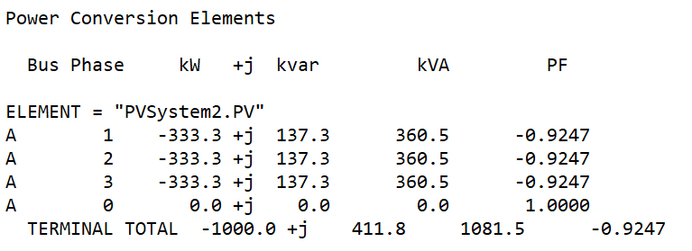
Scenario 1.1: Snapshot without volt-watt operation
OpenDSS code (SnapShot_VVVW_VWnoOperation-2.dss)

Slide 3

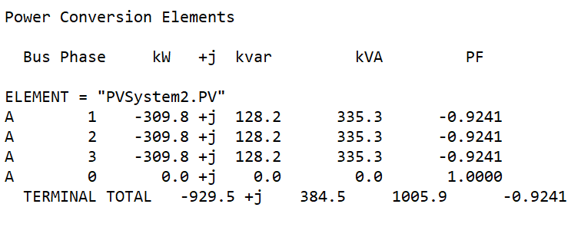
Scenario 1.3: Snapshot volt-varYAxis varMax volt-wattYAxis PMPPPU
OpenDSS code (SnapShot_VVVW_varMax_PMPPPU-2.dss)

Slide 4
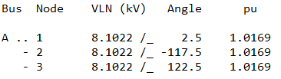
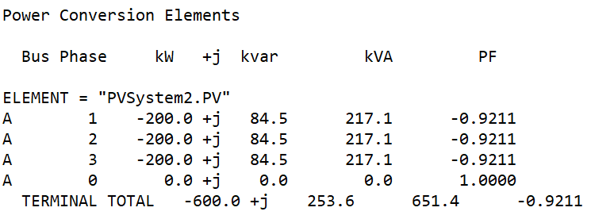
Scenario 1.4: Snapshot volt-varYAxis varMax volt-wattYAxis PMPPPU with kW limited by pctPmpp*Pmpp
OpenDSS code
(SnapShot_VVVW_varMax_PMPPPU_pctPmpp60-2.dss)

Slide 5
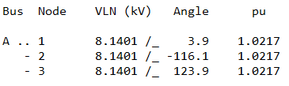
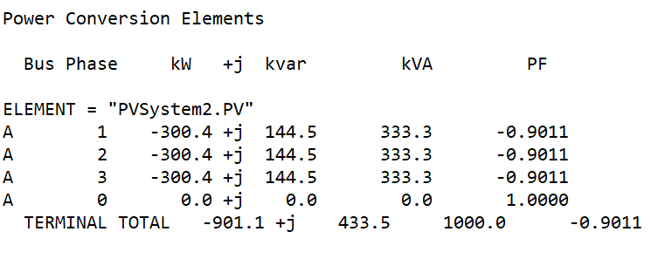
Scenario 1.6: Snapshot volt-varYAxis varMax volt-wattYAxis PMPPPU with kVA limitation – Q priority
OpenDSS code (SnapShot_VVVW_varMax_PMPPPU_kVAlimitation_Qpriority-2.dss)

Slide 6
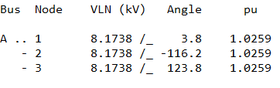
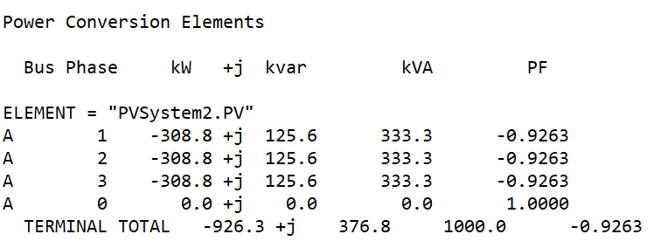
Scenario 1.7: Snapshot volt-varYAxis varMax volt-wattYAxis PMPPPU with kVA limitation – P priority
OpenDSS code (SnapShot_VVVW_varMax_PMPPPU_kVAlimitation_Ppriority-2.dss)

Slide 7

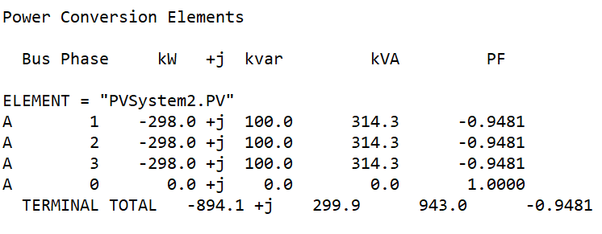
Scenario 1.8: Snapshot volt-varYAxis varAval volt-wattYAxis PMPPPU with kvar limitation
OpenDSS code (SnapShot_VVVW_varAval_PMPPPU_kvarlimit-2.dss)

Slide 8
Results in QSTS mode
Output active power when volt-watt does not operate
Results from mode 3 monitor placed in the PVSystem2
hour | t(sec) | Irradiance | PanelkW | P_TFactor | Efficiency | Vreg | Vavg (DRC) | volt-var | volt-watt | DRC | VV_DRC | kW_out_desired
1 | 0 | 0 | 0 | 1 | 1 | 0.999973 | 9999 | 0 | 0 | 9999 | 9999 | 0
2 | 0 | 0 | 0 | 1 | 1 | 0.999983 | 9999 | 0 | 0 | 9999 | 9999 | 0
3 | 0 | 0 | 0 | 1 | 1 | 0.999989 | 9999 | 0 | 0 | 9999 | 9999 | 0
4 | 0 | 0 | 0 | 1 | 1 | 0.999993 | 9999 | 0 | 0 | 9999 | 9999 | 0
5 | 0 | 0 | 0 | 1 | 1 | 0.999994 | 9999 | 0 | 0 | 9999 | 9999 | 0
6 | 0 | 0 | 0 | 1 | 1 | 0.999995 | 9999 | 0 | 0 | 9999 | 9999 | 0
7 | 0 | 0.1 | 100 | 1 | 1 | 0.999996 | 9999 | 0 | 0 | 9999 | 9999 | 100
8 | 0 | 0.2 | 200 | 1 | 1 | 0.999997 | 9999 | 0 | 0 | 9999 | 9999 | 200
9 | 0 | 0.3 | 300 | 1 | 1 | 1.00682 | 9999 | -1 | 0 | 9999 | 9999 | 300
10 | 0 | 0.5 | 500 | 1 | 1 | 1.0112 | 9999 | -1 | 0 | 9999 | 9999 | 500
11 | 0 | 0.8 | 800 | 1 | 1 | 1.01756 | 9999 | -1 | 0 | 9999 | 9999 | 800
12 | 0 | 0.9 | 900 | 1 | 1 | 1.01961 | 9999 | -1 | 0 | 9999 | 9999 | 900
13 | 0 | 1 | 1000 | 1 | 1 | 1.02131 | 9999 | -1 | 1 | 9999 | 9999 | 1000
14 | 0 | 1 | 1000 | 1 | 1 | 1.02131 | 9999 | -1 | 1 | 9999 | 9999 | 1000
15 | 0 | 0.99 | 990 | 1 | 1 | 1.02131 | 9999 | -1 | 1 | 9999 | 9999 | 990
16 | 0 | 0.9 | 900 | 1 | 1 | 1.01961 | 9999 | -1 | 0 | 9999 | 9999 | 900
17 | 0 | 0.7 | 700 | 1 | 1 | 1.01547 | 9999 | -1 | 0 | 9999 | 9999 | 700
18 | 0 | 0.4 | 400 | 1 | 1 | 1.00903 | 9999 | -1 | 0 | 9999 | 9999 | 400
19 | 0 | 0.1 | 100 | 1 | 1 | 0.999977 | 9999 | 0 | 0 | 9999 | 9999 | 100
20 | 0 | 0 | 0 | 1 | 1 | 0.999985 | 9999 | 0 | 0 | 9999 | 9999 | 0
21 | 0 | 0 | 0 | 1 | 1 | 0.999991 | 9999 | 0 | 0 | 9999 | 9999 | 0
22 | 0 | 0 | 0 | 1 | 1 | 0.999994 | 9999 | 0 | 0 | 9999 | 9999 | 0
23 | 0 | 0 | 0 | 1 | 1 | 0.999995 | 9999 | 0 | 0 | 9999 | 9999 | 0
24 | 0 | 0 | 0 | 1 | 1 | 0.999996 | 9999 | 0 | 0 | 9999 | 9999 | 0
Negative value: var absorption
Positive value : var generation
1.0: volt-var operating as it supposed to
0.6: volt-var limited by inverter’s kVA rating
0.2: volt-var limited by varmax/varmaxabs property of the PC element
Voltage used in the volt-var and volt-watt curves
1 indicates that volt-watt operated and 0 otherwise

Slide 9
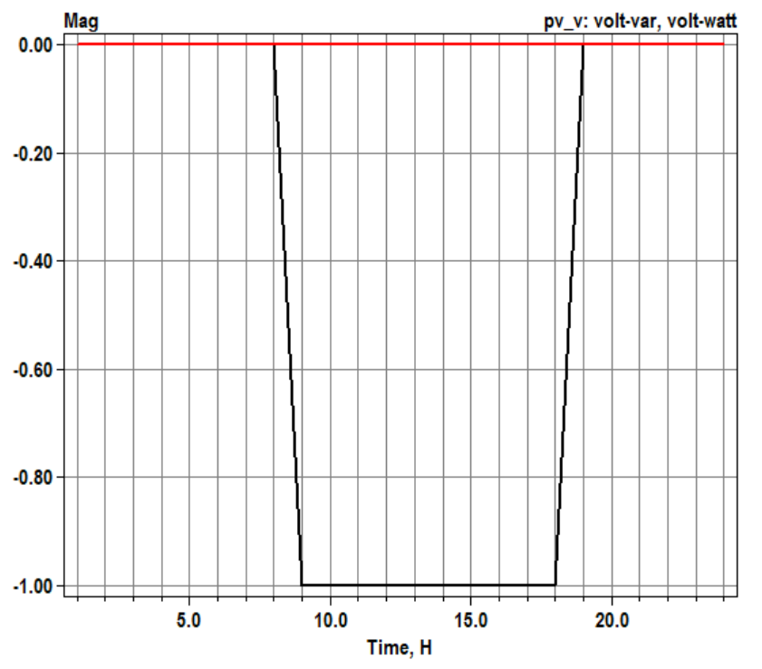
Scenario 1.9: Daily without volt-watt operation
OpenDSS code (Daily_VVVW_VWnoOperation-2.dss)
Results:
From curve
Key points:
Qtotal is equal -Qcalculated!

Slide 10
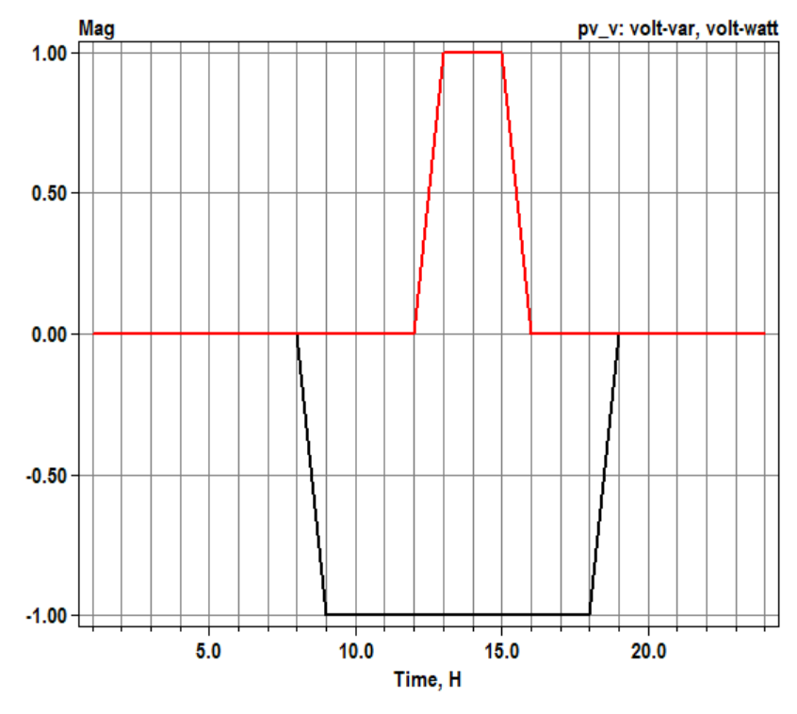
Scenario 1.11: Daily volt-varYAxis varMax volt-wattYAxis PMPPPU
OpenDSS code (Daily_VVVW_varMax_PMPPPU-2.dss)
Results:

Slide 11
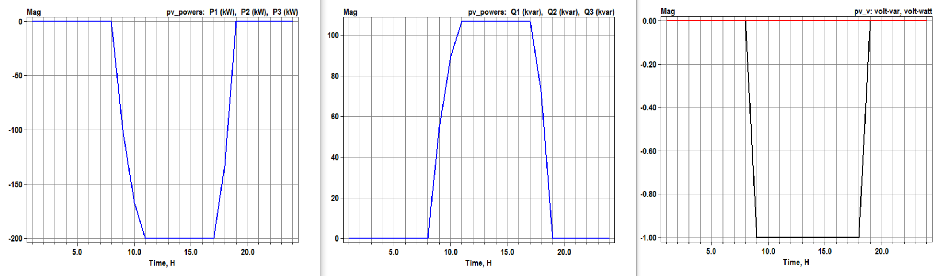
Scenario 1.12: Daily volt-varYAxis varMax volt-wattYAxis PMPPPU with kW limited by pctPmpp*Pmpp
OpenDSS code
(Daily_VVVW_varMax_PMPPPU_pctPmpp60-2.dss)

Slide 12
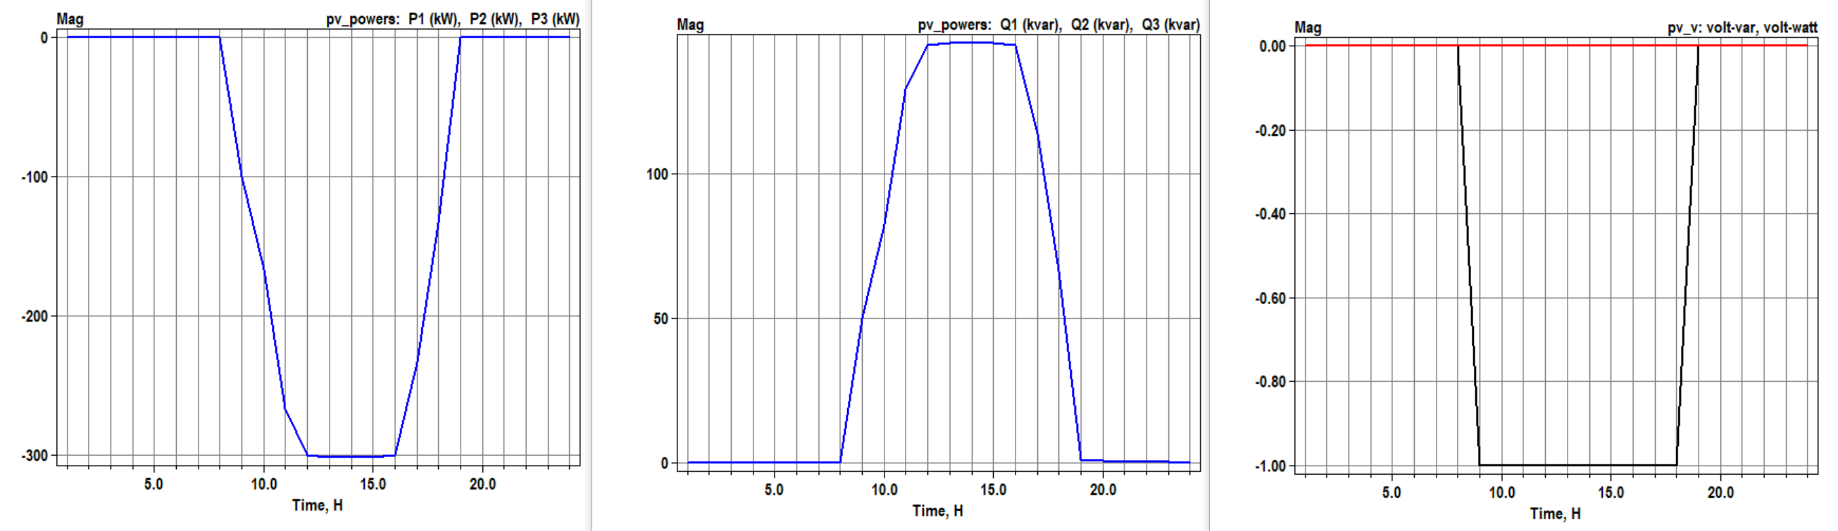
Scenario 1.14: Daily volt-varYAxis varMax volt-wattYAxis PMPPPU with kVA limitation – Q priority
OpenDSS code (Daily_VVVW_varMax_PMPPPU_kVAlimitation_Qpriority-2.dss)

Slide 13
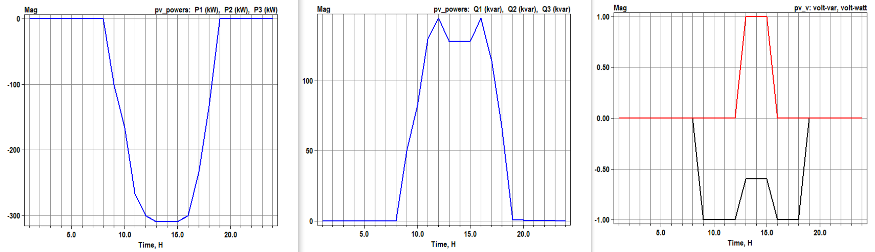
Scenario 1.15: Daily volt-varYAxis varMax volt-wattYAxis PMPPPU with kVA limitation – P priority
OpenDSS code (Daily_VVVW_varMax_PMPPPU_kVAlimitation_Ppriority-2.dss)

Slide 14
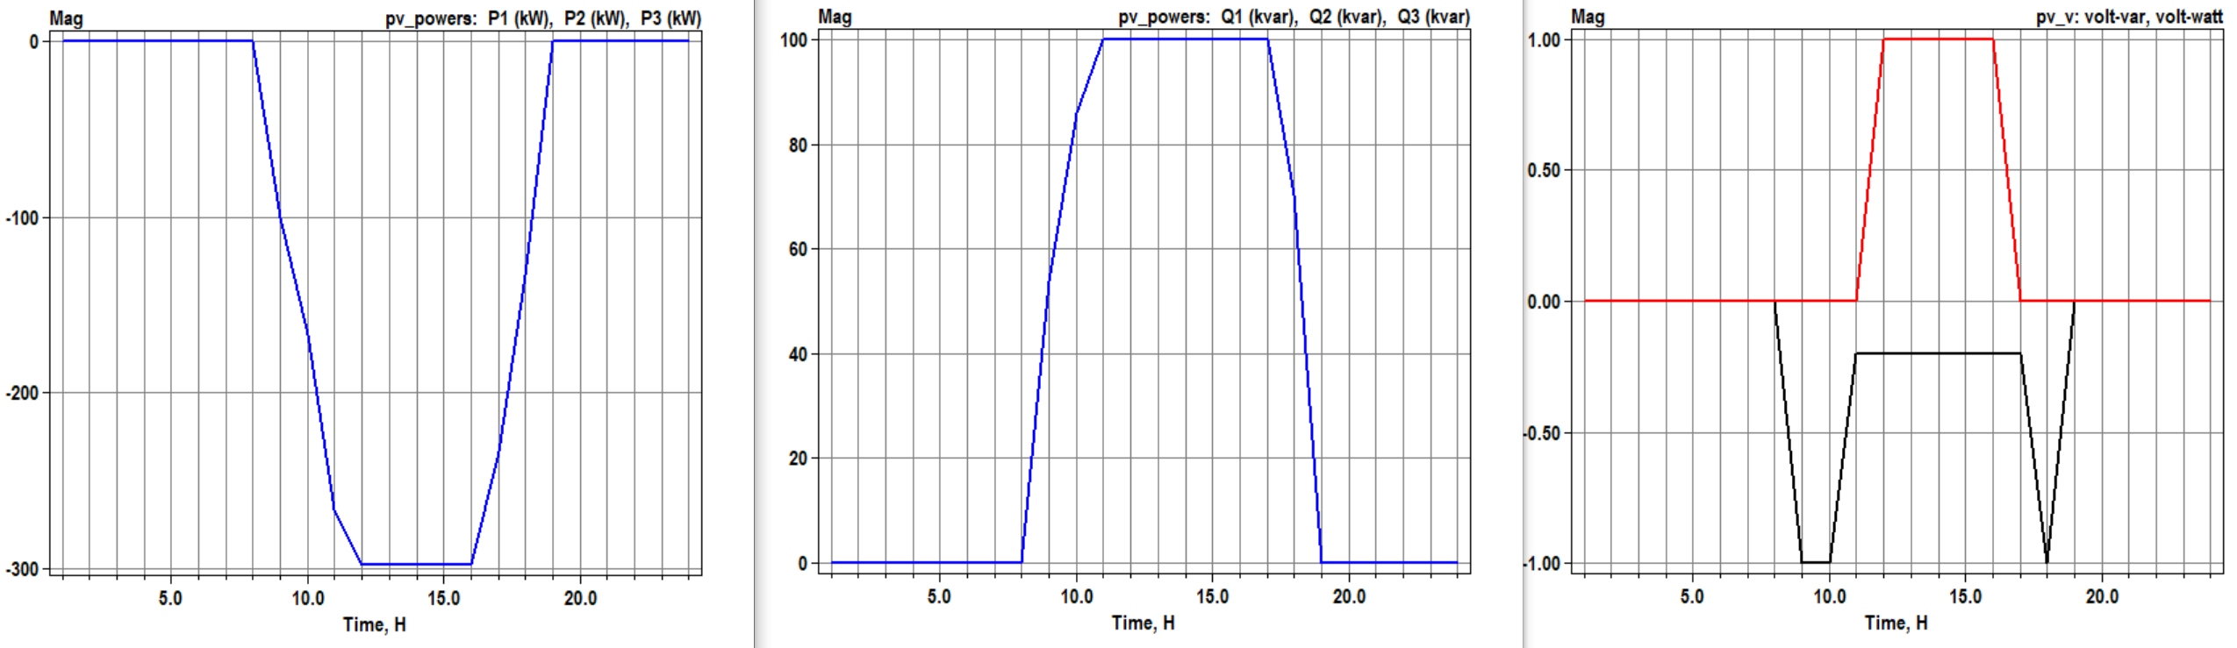
Scenario 1.16: Daily volt-varYAxis varAval volt-wattYAxis PMPPPU with kvar limitation
OpenDSS code (Daily_VVVW_varAval_PMPPPU_kvarlimit-2.dss)

