Slide 1
VV_VW Scenarios
OpenDSS: Version 8.6.6.1 (64-bit build)
Authors: Paulo Radatz and Celso Rocha

Slide 2
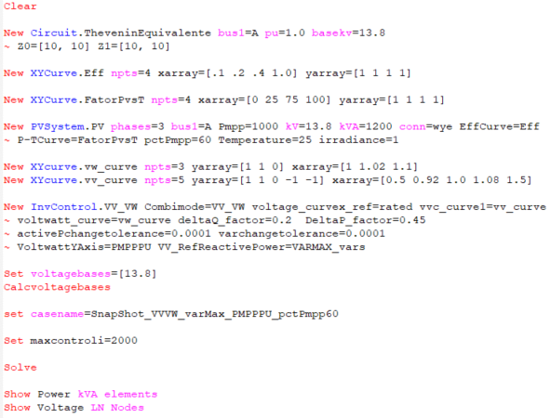
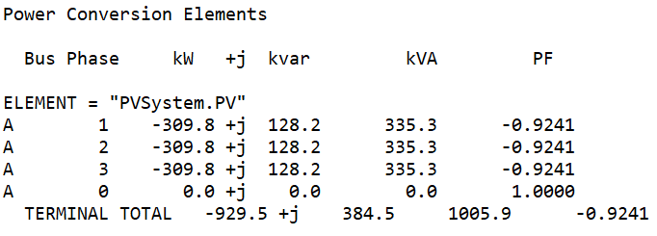
Scenario 1: Snapshot volt-varYAxis varMax volt-wattYAxis PMPPPU with kW limited by pctPmpp*Pmpp
Results:
pctPmpp = 60%
OpenDSS code
(SnapShot_ VVVW_varMax_PMPPPU_pctPmpp60.dss)
Key points:
It does not work as expected!

Slide 3
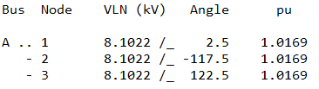
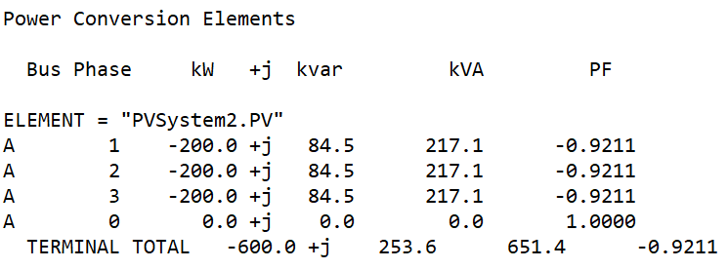
Scenario 1: Snapshot volt-varYAxis varMax volt-wattYAxis PMPPPU with kW limited by pctPmpp*Pmpp
Results:
pctPmpp = 60%
OpenDSS code
(SnapShot_ VVVW_varMax_PMPPPU_pctPmpp60-2.dss)
Key points:
It works as expected!
kW is limited to 600.

Slide 4
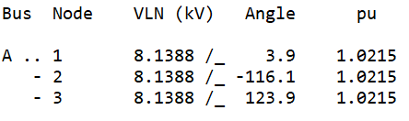
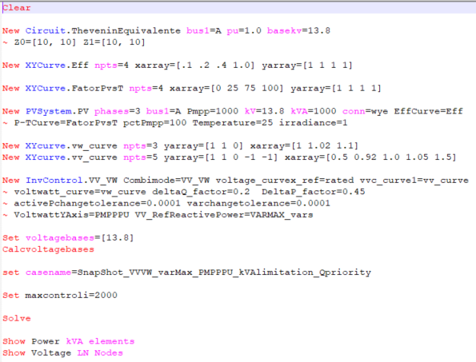
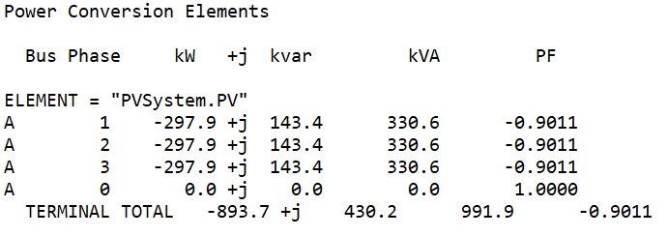
Scenario 2: Snapshot volt-varYAxis varMax volt-wattYAxis PMPPPU with kVA limitation – Q priority
Results:
OpenDSS code (SnapShot_VVVW_varMax_PMPPPU_kVAlimitation_Qpriority.dss)
Key points:
It does not work as expected

Slide 5
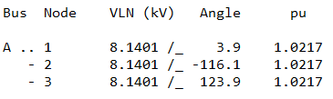
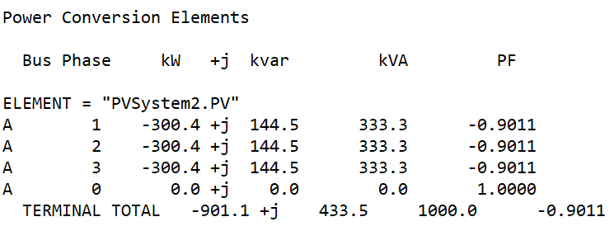
Scenario 2: Snapshot volt-varYAxis varMax volt-wattYAxis PMPPPU with kVA limitation – Q priority
Results:
OpenDSS code (SnapShot_VVVW_varMax_PMPPPU_kVAlimitation_Qpriority-2.dss)
Key points:
It works as expected
kVA is limited with var priority

Slide 6
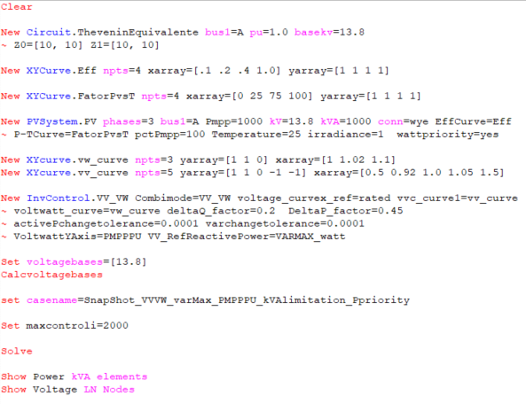
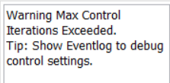
Scenario 3: Snapshot volt-varYAxis varMax volt-wattYAxis PMPPPU with kVA limitation – P priority
Results:
OpenDSS code (SnapShot_VVVW_varMax_PMPPPU_kVAlimitation_Ppriority.dss)
Key points:
It does not work as expected!

Slide 7
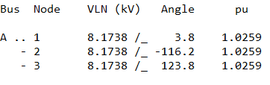
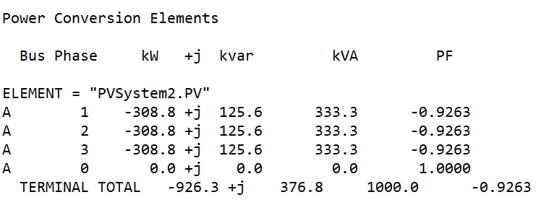
Scenario 3: Snapshot volt-varYAxis varMax volt-wattYAxis PMPPPU with kVA limitation – P priority
Results:
OpenDSS code (SnapShot_VVVW_varMax_PMPPPU_kVAlimitation_Ppriority-2.dss)

Slide 8
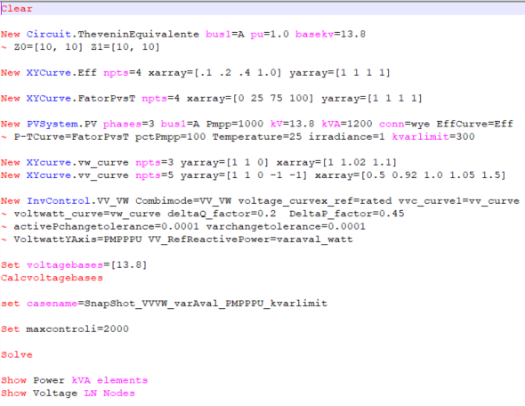
Scenario 4: Snapshot volt-varYAxis varAval volt-wattYAxis PMPPPU with kvar limitation
Results:
OpenDSS code (SnapShot_VVVW_varAval_PMPPPU_kvarlimit.dss)
Key points:
It does not work as expected

Slide 9

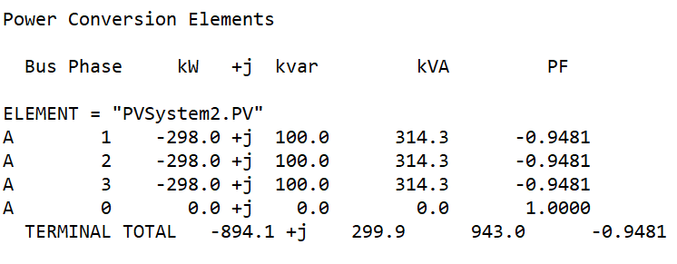
Scenario 4: Snapshot volt-varYAxis varAval volt-wattYAxis PMPPPU with kvar limitation
Results:
OpenDSS code (SnapShot_VVVW_varAval_PMPPPU_kvarlimit-2.dss)
Key points:
It works as expected
Kvar is limited to 300.

