Slide 1
OpenDSS Training Workshop
University of Puerto Rico - Mayaguez
Roger C. Dugan
Sr. Technical Executive
EPRI Knoxville, TN
January 21-22, 2019

Slide 2
Circuit Models and Basic Scripting

Slide 3
Circuit Modeling Basics

Slide 4
DSS Bus Model (Bus ≠ Node)
Nodes
Bus
Referring to Buses and Nodes (A Bus has 1 or more Nodes)
Bus1=BusName.1.2.3.0
(This is the default for a 3-phase circuit element)
Shorthand notation for taking the default:
Bus1=BusName
Note: Sometimes this can bite you (e.g. – Transformers, or capacitors with ungrounded neutrals)

Slide 5
Node Numbers
Bus
The voltage at Node 0 = 0 (always)
The other Node numbers are arbitrary
By convention, Nodes 1, 2, 3 correspond to phase ABC
But they don’t have to
You can have a very large number of nodes at a Bus
They do not have to be pre-declared

Slide 6
DSS Terminal Definition
Conductors
Circuit Elements have one or more Terminals with 1..N conductors.
Conductors connect to Nodes at a Bus
Each Terminal connects to one and only one Bus

Slide 7
Power Delivery Elements
PD Elements are Generally Completely Described by [Yprim]

Slide 8
Power Conversion Elements
I_{Term}(t) = F(V_{Term}, [State], t)
Power Conversion (PC) elements are typically connected in “shunt” with the Power Delivery (PD) elements
PC Elements may be nonlinear
Described some function of V
May be linear
e.g., Vsource, Isource
May have more than one terminal, but typically one
Load, generator, storage, etc.

Slide 9
Specifying Bus Connections
Shorthand (implicit)
New Load.LOAD1 Bus1=LOADBUS
Assumes standard 3-phase connection by default
LOADBUS
6
5
4
3
3-ph
grounded-
Wye
LOAD
2
1
0

Slide 10
Specifying Bus Connections
Explicit
New Load.LOAD1 Bus1=LOADBUS.1.2.3.0
Explicitly defines which node
New Load.1-PHASELOAD Phases=1 Bus1=LOADBUS.2.0
Connects 1-phase load between Node 2 and ground
Note: 1-phase Load has 2 conductors
1-Phase Load Example

Slide 11
Specifying Bus Connections
Default Bus templates
Node connections assumed if not explicitly declared
Element declared Phases=1
… LOADBUS.1.0.0.0.0.0.0.0.0.0. …
Element declared Phases=2
… LOADBUS.1.2.0.0.0.0.0.0.0.0. …
Element declared Phases=3
… LOADBUS.1.2.3.0.0.0.0.0.0.0. …

Slide 12
Specifying Bus Connections
Ungrounded-Wye Specification
Bus1=LOADBUS.1.2.3.4 (or some other unused Node number)
Voltage at this Node explicitly computed (just like any other Node)

Slide 13
Possible Gotcha: Specifying Two Ungrounded-Wye Capacitors on Same Bus
MyBus
… Bus1=MyBus.1.2.3 Bus2=MyBus.5.5.5
Neutrals are not connected to each other in this specification!
… Bus1=MyBus Bus2=MyBus.4.4.4

Slide 14
Capacitor Object
The Capacitor object is a basic 2-terminal branch that may be connected in different ways.
If defined with only one Bus, it is assumed to be a shunt capacitor
Same rules apply to Reactor and Fault objects

Slide 15
Circuit Element Conductors are Connected to the Nodes of Buses
MyBus
3
2
1
0
. . . Bus2 = MyBus.2.1.3.0 . . .
. . . Bus1 = MyBus . . .
(take the default)
(Explicitly define connections)
DSS Convention: A Terminal can be connected to only one Bus. You can have any number of Nodes at a bus.

Slide 16
Example: Connections for 1-Phase Residential Transformer Used in North America
! Line-to-Neutral Connected 1-phase Center-tapped transformer
New Transformer.Example_1-ph phases=1 Windings=3
! Typical impedances for small transformer with interlaced secondaries
~ Xhl=2.04 Xht=2.04 Xlt=1.36 %noloadloss=.2
! Winding Definitions
~ wdg=1 Bus=Bus1.1.0 kV=7.2 kVA=25 %R=0.6 Conn=wye
~ wdg=2 Bus=Bus2.1.0 kV=0.12 kVA=25 %R=1.2 Conn=wye
~ Wdg=3 Bus=Bus2.0.2 kV=0.12 kVA=25 %R=1.2 Conn=wye
Note: You may use the XfmrCode object to define a library of transformer definitions that are used repeatedly (like LineCode for Line elements)

Slide 17
All Terminals of a Circuit Element Have Same Number of Conductors
3-Phase Transformer

Slide 18
The Versatile REACTOR Model
A Model to represent many impedance characteristics

Slide 19
Specify R and X or Z1, Z2, Z0
Basic series R-X model
With option parallel Rp that can represent no-load losses or produce lower X/R at higher frequencies
1.. N phases
If Z2 <> Z1 then Yprim is asymmetric
Good for modeling induction machine

Slide 20
Specify Rmatrix and Xmatrix
Can specify series (default) or parallel
Significantly different frequency response will result for parallel model
Can represent some very creative, somewhat arbitrary R-L networks.
Restricted to symmetrical at 7.6.3

Slide 21
Scripting Basics – Simple Circuit

Slide 22
Scripting
OpenDSS is a scriptable solution engine
Scripts
Series of commands
From text files
From edit forms in OpenDSS.EXE
From another program through COM interface
e. g., This is how you would do looping
Scripts define circuits
Scripts control solution of circuits
Scripts specify output, etc.

Slide 23
Command Syntax
Command parm1, parm2 parm3 parm 4 ….
Parameters may be positional or named (tagged).
If named, an "=" sign is expected.
Name=value (this is the named form)
Value (value alone in positional form)
For example, the following two commands are equivalent:
New Object="Line.First Line" Bus1=b1240 Bus2=32 LineCode=336ACSR, …
New “Line.First Line”, b1240 32 336ACSR, …
Comma or white space

Slide 24
Delimiters
Array or string delimiter pairs: [ ] , { },( ),“ “,‘ ‘
Matrix row delimiter: |
Value delimiters: , (comma) any white space (tab or space)
Class, Object, Bus, or Node delimiter: . (period)
Keyword / value separator: =
Continuation of previous line: ~ (More)
Comment line: //
In-line comment: !
Query a property: ?

Slide 25
Array and Matrix Parameters
Array
kvs = [115, 6.6, 22]
kvas=[20000 16000 16000]
Matrix
(3x3 matrix)
Xmatrix=[1.2 .3 .3 | .3 1.2 3 | .3 .3 1.2]
(3x3 matrix – lower triangle)
Xmatrix=[ 1.2 | .3 1.2 | .3 .3 1.2 ]

Slide 26
A Simple Example

Slide 27
A Basic Script (Class Exercise)
Clear
New Circuit.Simple ! Creates voltage source (Vsource.Source)
Edit Vsource.Source BasekV=115 pu=1.05 ISC3=3000 ISC1=2500 !Define source V and Z
New Transformer.TR1 Buses=[SourceBus, Sub_Bus] Conns=[Delta Wye] kVs= [115 12.47]
~ kVAs=[20000 20000] XHL=10
New Linecode.336ACSR R1=0.058 X1=.1206 R0=.1784 X0=.4047 C1=3.4 C0=1.6 Units=kft
New Line.LINE1 Bus1=Sub_Bus Bus2=LoadBus Linecode=336ACSR Length=1 Units=Mi
New Load.LOAD1 Bus1=LoadBus kV=12.47 kW=1000 PF=.95
Solve
Show Voltages LN Nodes
Show Currents Element
Show Powers kVA Elements

Slide 28
Circuit
New Circuit.Simple ! (Vsource.Source is active circuit element)
Edit Vsource.Source BasekV=115 pu=1.05 ISC3=3000 ISC1=2500
Vsource.Source
SourceBus
Source
115
kV
Short Circuit Impedance (a matrix) that yields 3000A 3-ph fault current and 2500A 1-ph fault current.
115 kV, 1.05 pu
One-Line Diagram (default is 3-phase wye-grd source)

Slide 29
Vsource Element Note
Vsource is actually a Two-terminal Device
2nd terminal defaults to connected to ground (0V)
But you can connect it between any two buses
Comes in handy sometimes
Conceptually a Thevinen equivalent
Short circuit equivalent
Actually converted to a Norton equivalent internally

Slide 30
20 MVA Substation Transformer
SourceBus
TR
1
Sub_Bus
Defining Using Arrays
Defining Winding by Winding
New Transformer.TR1 Phases=3 Windings=2
~ Buses=[SourceBus, Sub_Bus]
~ Conns=[Delta Wye]
~ kVs= [115 12.47]
~ kVAs=[20000 20000]
~ XHL=10
New Transformer.TR1 Phases=3 Windings=2 XHL=10
~ wdg=1 bus=SourceBus Conn=Delta kV=115 kVA=20000
~ wdg=2 bus= Sub_Bus Conn=wye kV=12.47 kVA=20000

Slide 31
The Line
Sub_Bus
LoadBus
LINE
1
1
Mile
,
336
New Linecode.336ACSR R1=0.058 X1=.1206 R0=.1784 X0=.4047 C1=3.4 C0=1.6 Units=kft
New Line.LINE1 Bus1=Sub_Bus Bus2=LoadBus Linecode=336ACSR Length=1 Units=Mi
Line objects may also be defined by Geometry or matrix properties.
(Rmatrix=… Xmatrix=… Cmatrix=…)

Slide 32
The Load
Loadbus
LOAD
1
1000
kW
0
.
95
PF
New Load.LOAD1 Bus1=LoadBus kV=12.47 kW=1000 PF=.95
For 3-phase loads, use L-L kV and total kW
For 1-phase loads, typically use L-N kV and total kW unless L-L-connected; Then use L-L kV.

Slide 33
Solving and Showing Results Reports
Solve
Show summary (power flow summary)
Show Voltages LN Nodes
Show Currents Element
Show Powers kVA Elements
Also
Export … (creates CSV files)
Plot …

Slide 34
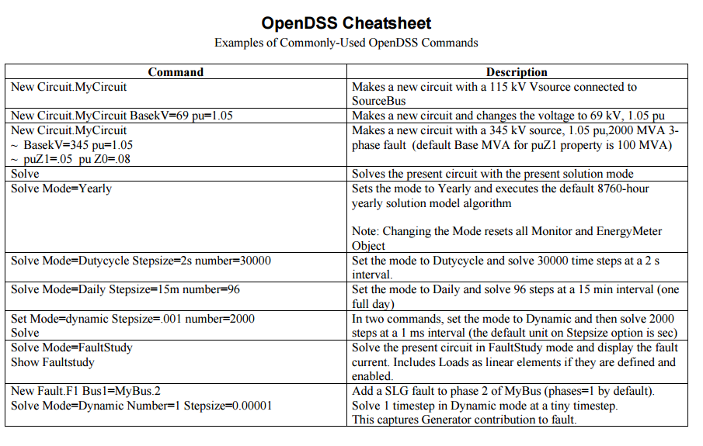
Refer to “OpenDSS Cheatsheet.PDF” in Doc Folder

Slide 35
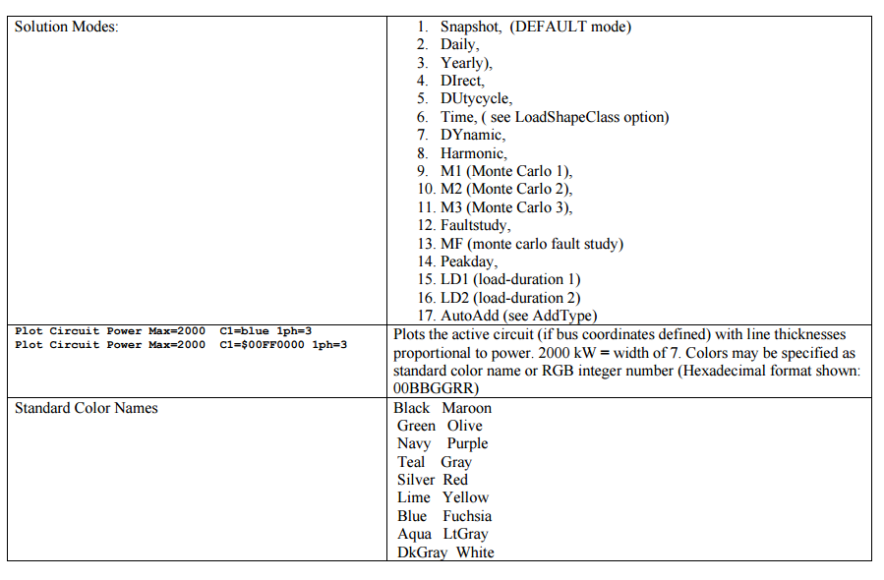
“OpenDSS Cheatsheet.PDF” continued

Slide 36
Add a 500-kW Generator Object to LoadBus
DG
… (continue from existing Script)
New Generator.DG1 Bus1=LoadBus kV=12.47 kW=500 PF=1.0
// solve again and observe results
Solve ! Starts with previous solution
Show Voltages LN Nodes
Show Currents Element
Show Powers kVA Elements

