Slide 1
OpenDSS Training Workshop
University of Puerto Rico - Mayaguez
Roger C. Dugan
Sr. Technical Executive
EPRI Knoxville, TN
January 21-22, 2019

Slide 2
7. PVSystem and Storage

Slide 3
PVSystem Model

Slide 4
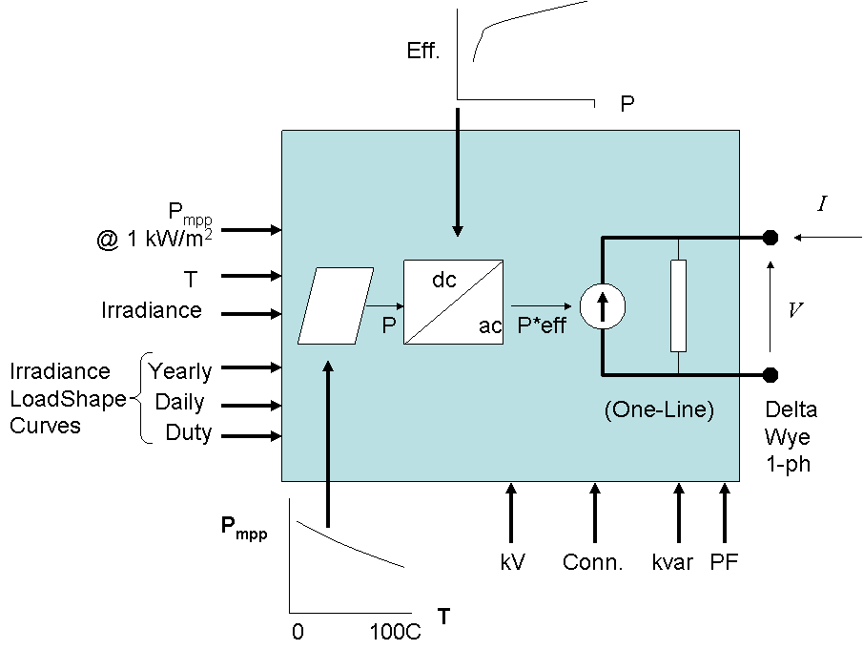
PVSystem in the OpenDSS
The PVSystem model combines a model of the PV array and the PV inverter into one convenient model to use for distribution system impacts studies

Slide 5
Example Script
This example defines a PV system with a panel Pmpp of 500 kW at 1 kW/m² irradiance and a panel temperature of 25°C. The inverter is rated at 500 kVA. A PF of 1.0 is assumed for this example.
Can also be used with the InvControl control object that implements advanced (‘smart’) inverter functions such as volt-var, volt-watt, and dynamic reactive current.

Slide 6
Example Script
clear
New Circuit.PVSystem basekv=12.47 Isc3=1000 Isc1=900
// P-T curve is per unit of rated Pmpp vs temperature
// This one is for a Pmpp stated at 25 deg
New XYCurve.MyPvsT npts=4 xarray=[0 25 75 100] yarray=[1.2 1.0 0.8 0.6]
// efficiency curve is per unit eff vs per unit power
New XYCurve.MyEff npts=4 xarray=[.1 .2 .4 1.0] yarray=[.86 .9 .93 .97]
// per unit irradiance curve (per unit if "irradiance" property)
New Loadshape.MyIrrad npts=24 interval=1 mult=[0 0 0 0 0 0 .1 .2 .3 .5 .8 .9 1.0 1.0 .99 .9 .7 .4 .1 0 0 0 0 0]
// 24-hr temp shape curve
New Tshape.MyTemp npts=24 interval=1 temp=[25, 25, 25, 25, 25, 25, 25, 25, 35, 40, 45, 50 60 60 55 40 35 30 25 25 25 25 25 25]
// **** plot tshape object=mytemp
// take the default line
New Line.line1 Bus1=sourcebus bus2=PVbus Length=2

Slide 7
Example Script (cont’d)
! PV definition
New PVSystem.PV phases=3 bus1=PVbus kV=12.47 kVA=500 irrad=0.8 Pmpp=500
~ temperature=25 PF=1 effcurve=Myeff P-TCurve=MyPvsT
~ Daily=MyIrrad TDaily=MyTemp
set voltagebases=[12.47]
calcv
solve ! solves at the specified irradiance and temperature
new monitor.m1 PVSystem.PV 1 mode=1 ppolar=no
new monitor.m2 PVSystem.PV 1
solve
solve mode=daily
show mon m1
show mon m2

Slide 8
Example Script (cont’d)
Export monitors m1
Plot monitor object= m1 channels=(1 )
Export monitors m2
Plot monitor object= m2 channels=(1 ) base=[7200]
Export monitors m2
Plot monitor object= m2 channels=(9 )

Slide 9
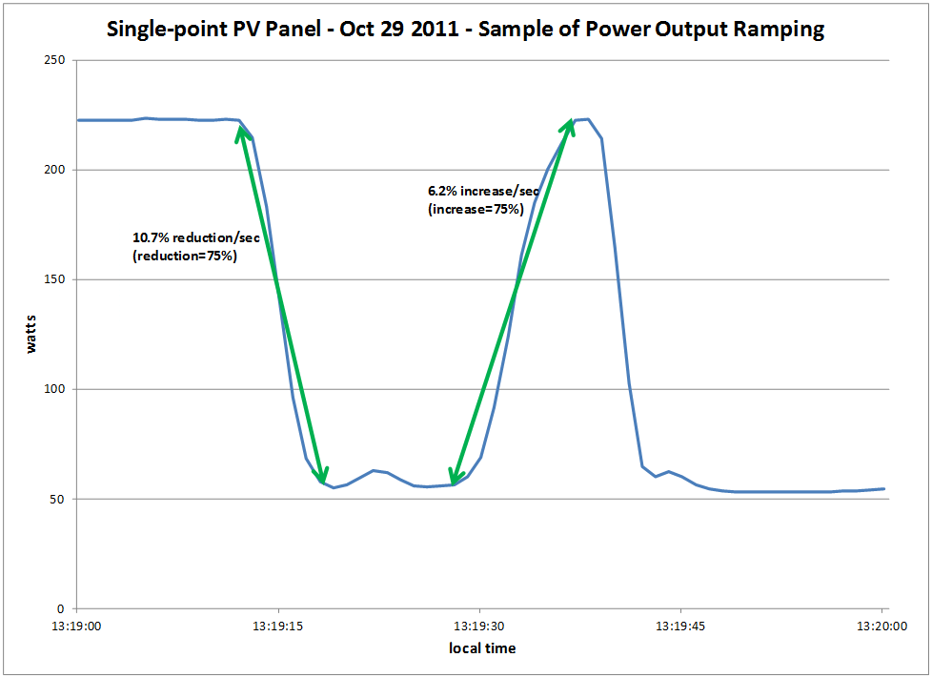
Modeling PV Systems – Variability/Ramping – Single-Panel

Slide 10
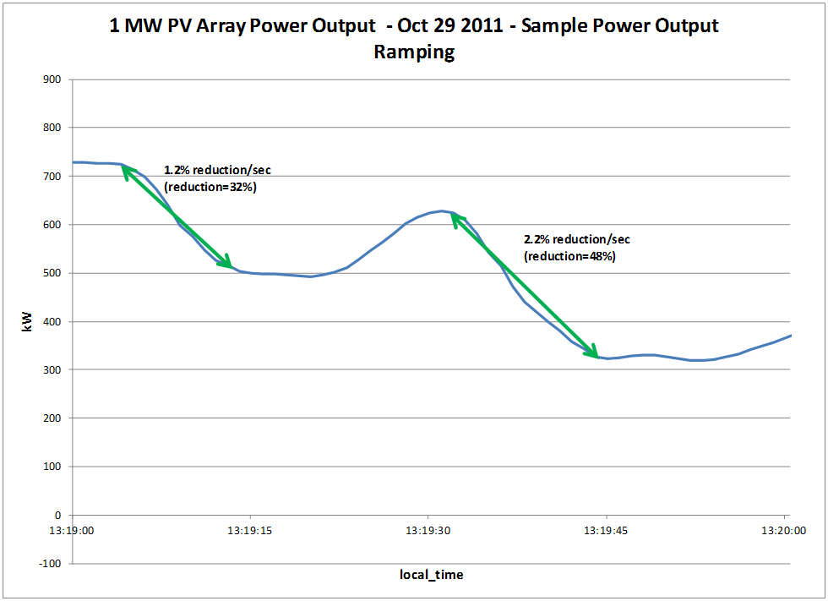
Modeling PV Systems – Variability/Ramping – 1 MW PV Array (same location as Single-Panel)

Slide 11
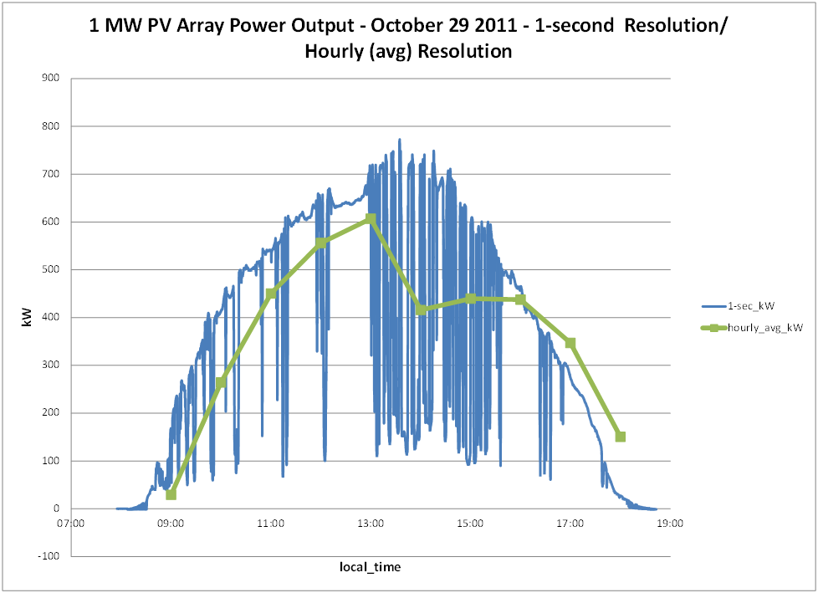
Modeling PV Systems – Variability/Ramping – Significance of Solar Irradiance Resolution

Slide 12
Modeling PV Systems for Distribution System Impact Assessment – Fault Response
Fault current contribution
Conservative Rule-of-thumb: 2 x Full Output Rating of Inverter for 1 cycle (three-phase fault)
Other testing has been performed by EPRI, Southern California Edison, NREL, PV inverter manufacturers, etc
Inverters generally shut down at 1.2 pu of rated current
May be 3-4 times pre-fault load current
Irregular behavior on voltage sags
Tries to hold constant power (current increases)
May become discontinuous

Slide 13
‘Smart’ Inverter Control in the OpenDSS
InvControl

Slide 14
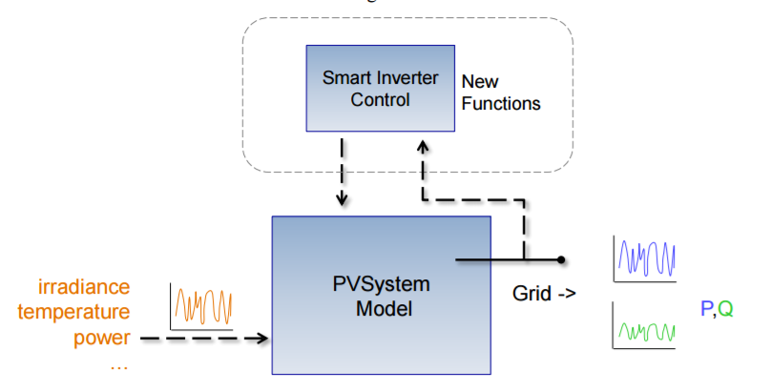
Inverter Control Manages One or More PVSystems

Slide 15
InvControl Control Object
Works in conjunction with PVSystem object(s) to control the PVSystem(s) output according to ‘smart’ inverter functions
Three modes currently available:
Volt-var
Follows a voltage versus reactive power curve and changes the reactive power generation (capacitive) or reactive power absorption (inductive) according to the terminal voltage at each PVSystem
Volt-watt
Follows a voltage versus active power curve and changes the active power output according to the terminal voltage at each PVSystem (within the limits of the present irradiance)
Dynamic Reactive Current (DRC)
Has several settings that change the reactive power generation or absorption in response to fast changes in terminal voltage (e.g., during a sag or swell)

Slide 16
Volt-var Control Mode – Example Volt-var Curve

Slide 17
InvControl in Volt-var Mode – Script
New PVSystem.3P_ExistingSite4 phases=3 bus1=B51854_sec kV=0.4157 kVA=523 ~ irradiance=1 Pmpp=475 pf=1 %cutin=0.1 %cutout=0.1 yearly=PV_ls
New PVSystem.3P_ExistingSite1 phases=3 bus1=X_5865228330A kV=0.4157 kVA=314 ~ irradiance=1 Pmpp=285 pf=1 %cutin=0.1 %cutout=0.1 yearly=PV_ls
New PVSystem.3P_ExistingSite3 phases=3 bus1=X_5891328219_Cust1 kV=0.4157 ~ kVA=836 irradiance=1 Pmpp=760 pf=1 %cutin=0.1 %cutout=0.1 yearly=PV_ls
New PVSystem.3P_ExistingSite2 phases=3 bus1=B4832_sec kV=0.4157 kVA=209 ~ irradiance=1 Pmpp=190 pf=1 %cutin=0.1 %cutout=0.1 yearly=PV_ls
New XYCurve.vv_curve npts=4 Yarray=(1.0,1.0,-1.0,-1.0) ~ XArray=(0.5,0.95,1.05,1.5)
New InvControl.InvPVCtrl mode=VOLTVAR voltage_curvex_ref=rated ~ vvc_curve1=vv_curve EventLog=yes

Slide 18
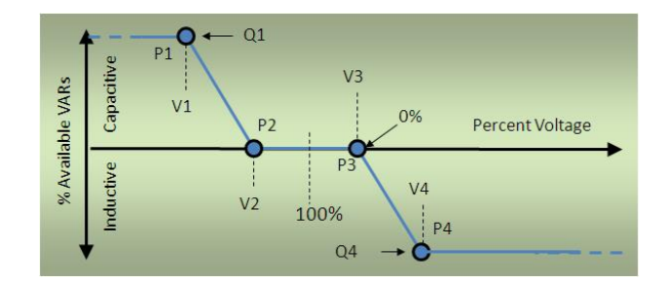
Volt-Var Control Mode – with a Dead Band

Slide 19
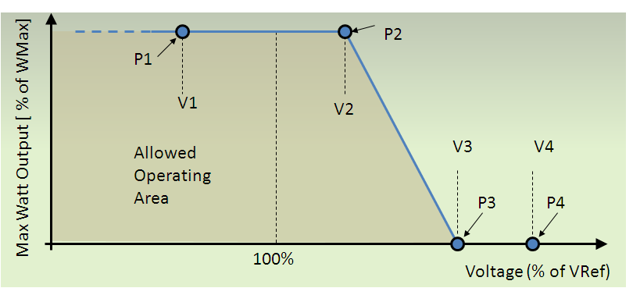
Volt-watt Control Mode – Example Volt-watt Curve

Slide 20
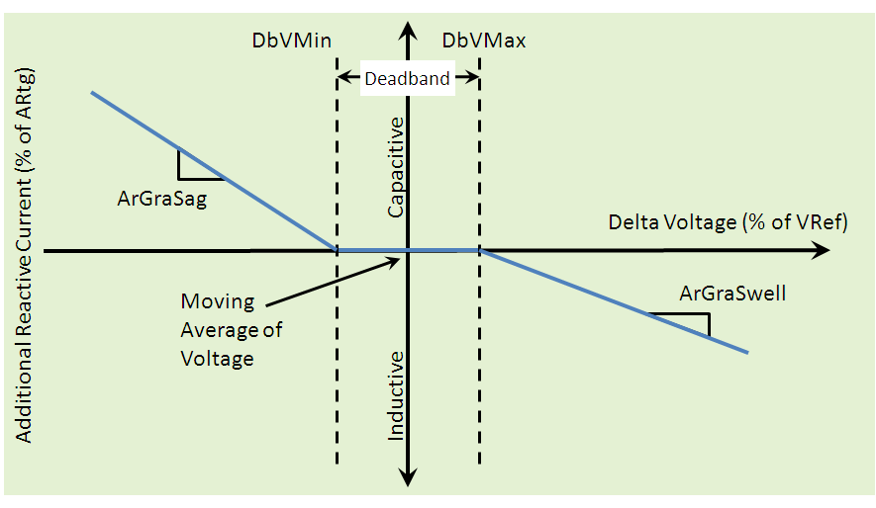
DRC Control Mode – Settings Curve

Slide 21
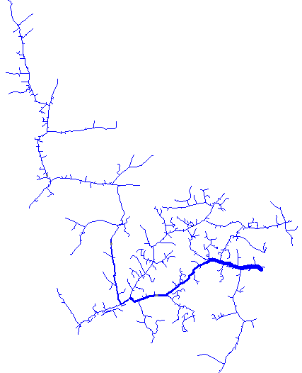
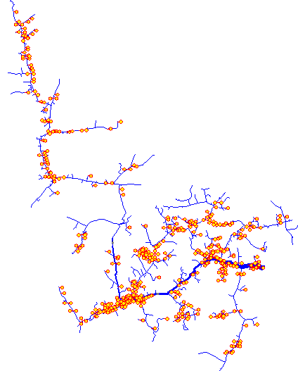
Use of Smart Inverters for Accommodating High-Penetration PV
Solar Rooftop PV
Solar Rooftop PV
With volt/var control
Volt-Var Control
Customer Load
Q1
Customer PV
Capacitive
System Voltage
Initial analysis indicated 25%-100% more PV can be accommodated using Volt/var control
VARs Generated
Q2
Q3
Inductive
V4
V1
V2
V3
Q4
20% PV
20% PV with volt/var control
Baseline – No PV
Source: J. Smith, T. Key “High-Penetration PV Impact Analysis on Distribution Systems,” Solar Power International, Oct 2011
24 Hour Simulation

Slide 22
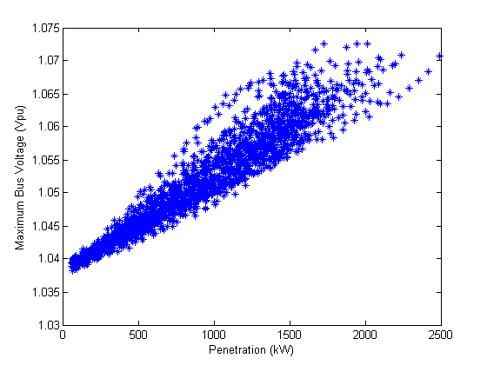
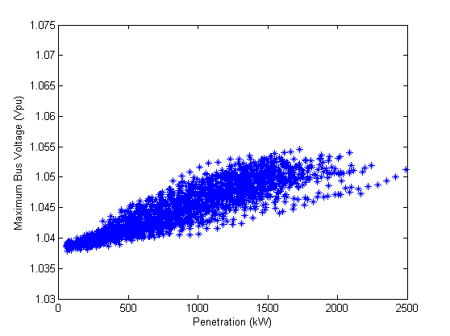
Increasing Hosting Capacity with Smart Inverters
Without Volt/var Control
Volt/var Control
ANSI voltage limit
Maximum Feeder Voltages (pu)
Maximum Feeder Voltage (pu)
ANSI voltage limit
5000 cases shown Each point = highest primary voltage
Increasing penetration (kW)
Increasing penetration (kW)
 |  | PV Hosting Capacity (kW)
 |  | Without Volt/var | With Volt/var
Primary Voltage Deviation | 1st violation | 938 | >2500
 | 50% scenarios with violation | 1323 | >2500
 | All scenarios with violation | 1673 | >2500
Primary Over Voltage | 1st violation | 540 | 880
 | 50% scenarios with violation | 871 | 1464
 | All scenarios with violation | 1173 | 2418
No observable violations regardless of size/location
160% increase in hosting capacity
60% increase in hosting capacity
Possible violations based upon size/location
Observable violations occur regardless of size/location

Slide 23
Storage Model

Slide 24
Introduction
Storage is a frequently-proposed solution to renewable generation issues
US states and Canadian provinces are requiring large amounts of storage
(Cal: 1.3 GW by 2020; 425 MW on distribution)
Significant amounts are expected on Distribution systems
controlled for benefit of Transmission

Slide 25
Introduction, cont’d
Distribution planners accustomed to static power flow calculations
Accurate analysis of storage requires sequential-time simulation (“QSTS”)
This presentation:
summary of EPRI research into modeling energy storage for planning

Slide 26
Applications of Storage on Distribution
Smoothing solar PV power output
Extending solar PV output into the evening
Support of the Transmission grid
Extending capacity of existing assets
Supporting alternate feeds during reconfiguration
Controlling frequency of a microgrid
Increasing short circuit strength of a microgrid

Slide 27
Planning Issues Introduced by Storage
Overvoltages while discharging
Low voltages while charging
Voltage regulation while compensating for transmission grid support
Interference with overcurrent protection scheme
Insufficient short-circuit capacity in microgrid

Slide 28
The Planning Problem with Storage is More than Capacity to meet Demand
Storage is a variable resource but it is also Limited
Planning tools must account for energy stored
Has a limited ramp rate
Has to be recharged at some other time
Has losses
Charge-discharge cycle (~15-20%)
Idling losses (temperature dependent)

Slide 29
6 Simulation Modes Have Been Identified and Implemented in OpenDSS Program
Static (charge or discharge at specific rate)
Time (charge or discharge at specific time)
Peak Shave
Load Following
Loadshape Following (define a loadshape)
Dynamics (i.e., electromechanical transients)

Slide 30
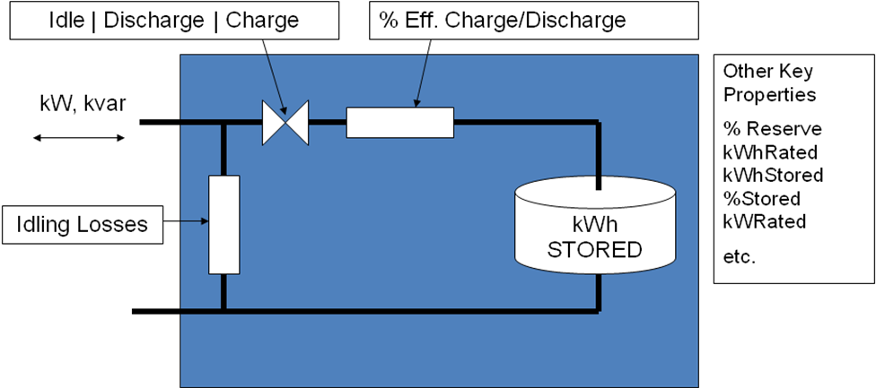
EPRI’s OpenDSS Employs a Generic Energy Storage Element

Slide 31
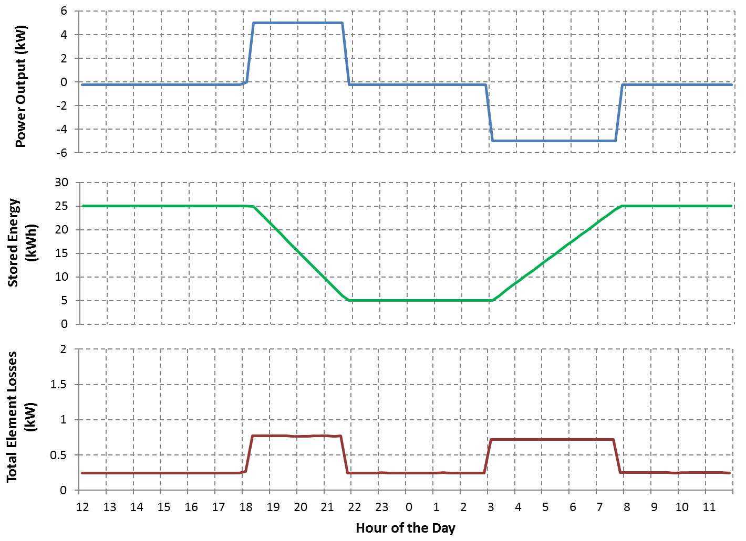
Storage Element Operation

Slide 32
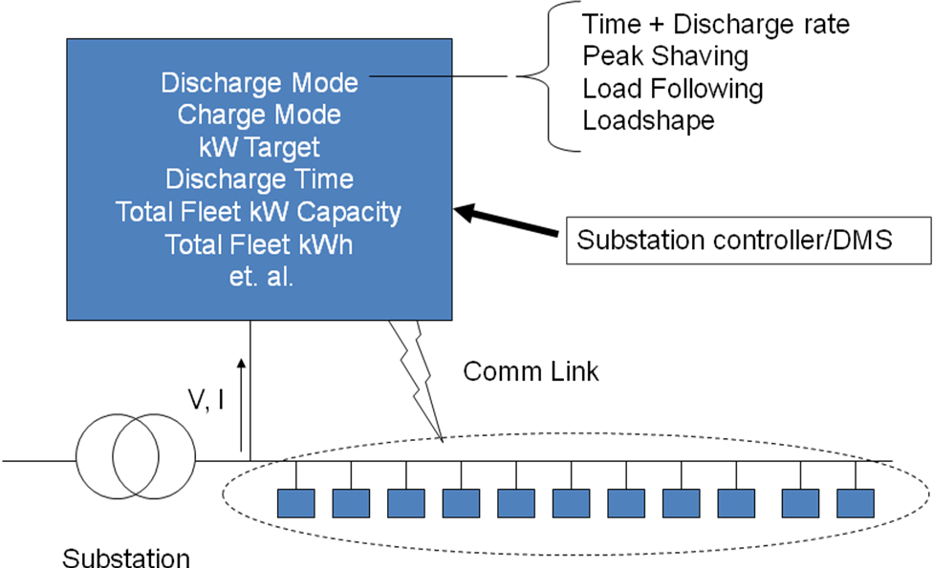
Storage Controller Model
Fleet of Distributed Energy Storage Elements

Slide 33
Peak Shaving Applications
Time step size: 15-60 min

Slide 34
Compensating for Renewable Generation
Extend solar PV output into evening peak.

Slide 35
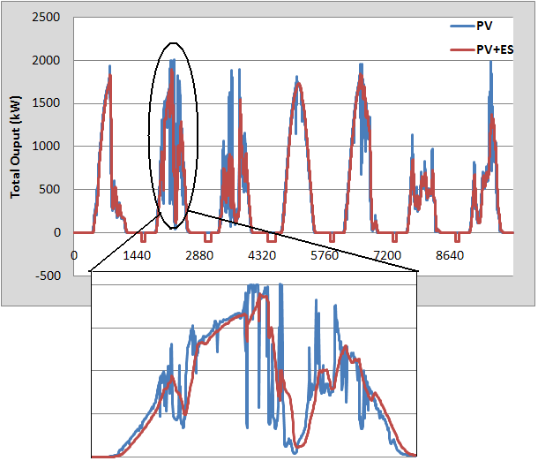
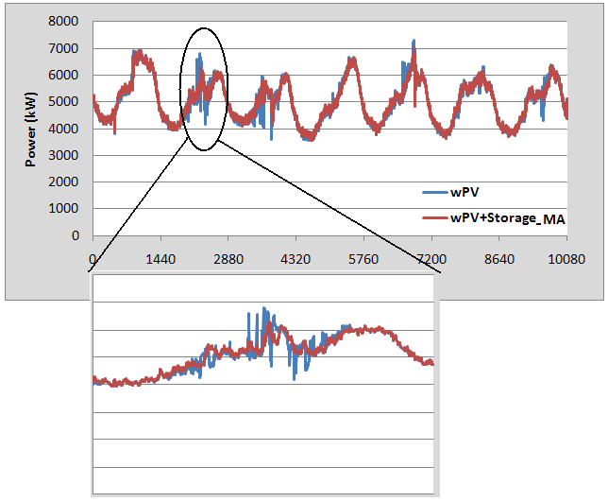
Intermittent Generation Smoothing
Network Response
PV Output

Slide 36
Storage Power Output for Smoothing

Slide 37
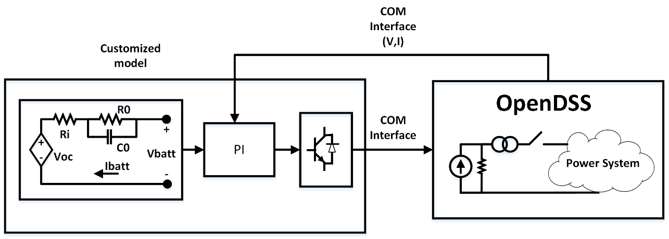
A Dynamics Example (Black start of a Microgrid)
Model may require more than 30 parameters.

Slide 38
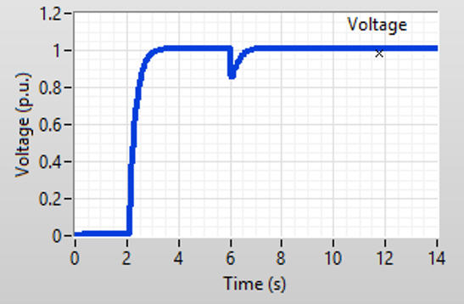
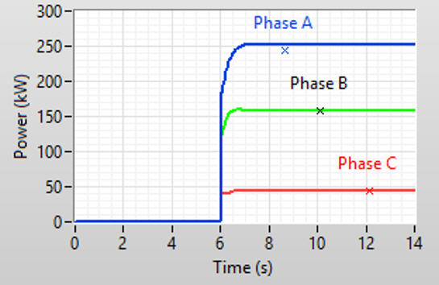
Results from the Model

Slide 39
How to Support Vendor-Supplied Models for Complex Storage System Models
Establish common software interface (DLL?)
Variants for QSTS, Dynamics, and EMT
Windows dominant platform in US for distribution
DSA vendors will have to support
Storage system vendors will want protection

Slide 40
Simplified Distribution Planning
System Performance Considerations
Overvoltages while discharging
Low voltages when charging
Voltage regulation interaction (bulk system dispatch)
Interference with overcurrent protection
Short circuit capacity when islanded
At least two accommodation screens:
Max output / min load
Max charge / max load

Slide 41
Default OpenDSS Storage Model Dispatch

Slide 42
OpenDSS Storage Model Dispatch (Follow Mode)

Slide 43
Script for Follow-mode Simulation
Clear
New Circuit.TestStorage BasekV=12.47
New Line.Line1 Bus1=Sourcebus LoadBus ! default line
New Loadshape.DailyShape npts=96 minterval=15
~ mult=[file=storagetestshape.csv]
New Storage.Battery phases=3 Bus1=loadbus kV=12.47
~ kW=250 kWrated=250 kWhrated=1000
~ dispmode=follow daily=dailyshape
set voltagebases=[12.47]
calcv
new monitor.PQ storage.battery 1 ppolar=no mode=1
new monitor.vars storage.battery 1 mode=3
solve
solve mode=daily step=15m number=(2 96 *)

Slide 44
Example Results in Follow Mode

Slide 45
Example Storage Definition Scripts
! simple Standalone Storage model
New storage.JO0235000540_1 phases=1
~ bus1=X_50_4921721_JO0235000513.1 yearly=Phasealoadshape
~ kV=0.24 kwrated=25 pf=1.0 kwhrated=25 state=IDLING
~ DischargeTrigger=0.8 ChargeTrigger=0.6
! A StorageController Definition
New StorageController.CESmain element=line.568_4921721 terminal=1
~ kWTarget=7000 PFTarget=0.98
~ %ratecharge=30
~ eventlog=y
~ modedischarge=follow TimeDischargeTrigger = 13 ! ---- 12

Slide 46
Example Storage Definition Scripts - DynaDLL
! Example with experimental user-written DynaDLL
New Storage.Store1 phases=3 Bus1=LVBus kV=0.400 conn=Delta kVA=60
~ kWrated=60 kWHrated= 0.20833 %reserve=50 // 750 kW-s (kJ)
~ state=discharge
~ kW=50 PF=1
~ DynaDLL="C:\Users\prdu001\OpenDSS\Source\DESS1\Dess1.DLL"
~ DynaData=(file=DESSModel_Test.TxT)

Slide 47
A Creative Yearly Simulation Script With Variable Dispatch Targets
set mode=yearly stepsize=0.25h
Set overloadreport=true voltexceptionreport = true
set demand=true DIVerbose=true
solve number=760
StorageController.CESmain.kWtarget=8000
solve number=120
StorageController.CESmain.kWtarget=7500
solve number=96
StorageController.CESmain.kWtarget=7000
solve number=472
StorageController.CESmain.kWtarget=7500
solve number=200
StorageController.CESmain.kWtarget=7000
solve number=(2784 200 - 472 - 96 - 120 - 760 -) ! Balance of 2784
closeDI

