Slide 1
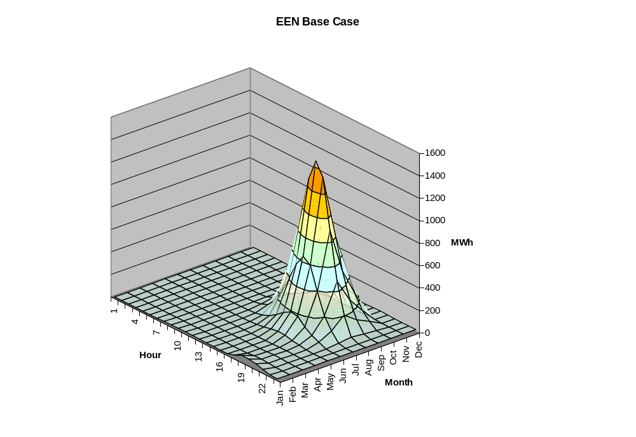
OpenDSS
Introductory Training
Level 1
28 APR 2009
Roger Dugan
rdugan@epri.com

Slide 2
Introduction

Slide 3
Why DSS?
DSS was developed to provide a very flexible research platform and a foundation for special distribution analysis applications such as DG analysis
Fills gaps left by other distribution system analysis tools.
  These do very well in traditional distribution system analysis meeting the needs of their respective user bases
  Integration of user interface, GIS and other databases quite important, but results in slower implementation of innovative modeling to meet new challenges

Slide 4
Current Related EPRI Activities
Intelligrid
  Distribution Fast Simulation & Modeling
  DSE – Distribution State Estimator
CIM/DCIM
OpenDSS – Distribution System Simulator
  Multipurpose distribution system analysis tool
  Open source version has been released – 5 Sept 2008
  Official release – November 2008
  (Focus of this Presentation)

Slide 5
DSS Background
Under development for more than 10 Years
  Started at Electrotek Concepts in 1997
  Purchased by EPRI in 2004
Objectives in 1997
  Tool to support all distribution planning aspects of distributed generation
  Implement a flexible research platform
  Incorporate object-oriented data ideas
Key Future work
  Platform for DSE for North American Systems
  Research platform for reliability tools

Slide 6
Distribution System Simulator (DSS)
The DSS is designed to simulate utility distribution systems in arbitrary detail for most types of analyses related to distribution planning.
  It performs its analysis types in the frequency domain,
    Power flow,
    Harmonics, and
    Dynamics.
  It does NOT perform electromagnetic transients (time domain) studies.

Slide 7
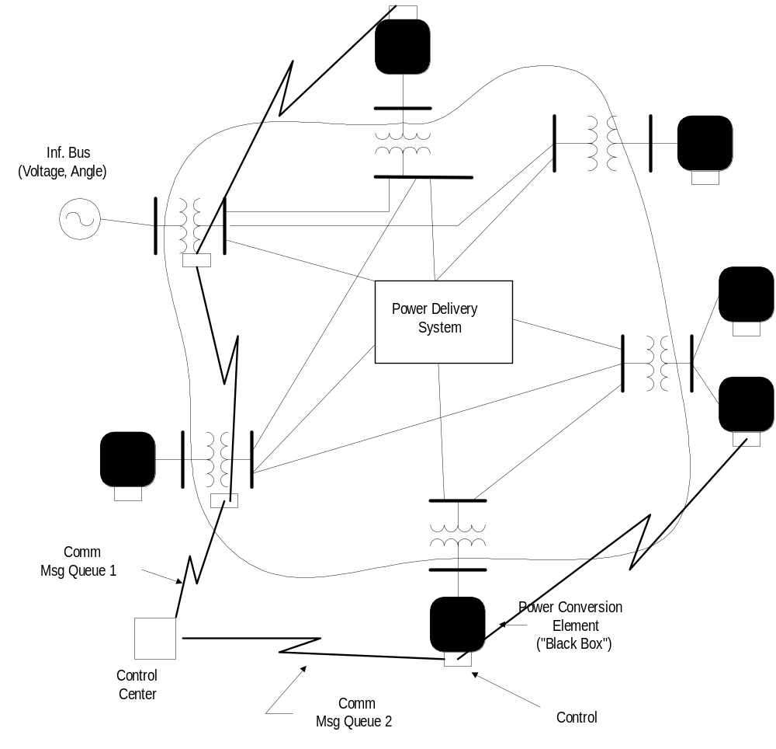
Overall Model Concept

Slide 8
Example DSS Applications
Neutral-to-earth (stray) voltage simulations.
Loss evaluations due to unbalanced loading.
Development of DG models for the IEEE Radial Test Feeders.
High-frequency harmonic and interharmonic interference.
Losses, impedance, and circulating currents in unusual transformer bank configurations.
Transformer frequency response analysis.
Distribution automation control algorithm assessment.
Impact of tankless water heaters on flicker and distribution transformers.
Wind farm collector simulation.
Wind farm impact on local transmission.
Wind generation and other DG impact on switched capacitors and voltage regulators.
Open-conductor fault conditions with a variety of single-phase and three-phase transformer connections.

Slide 9
Examples of Analysis Performed by DSS

Slide 10
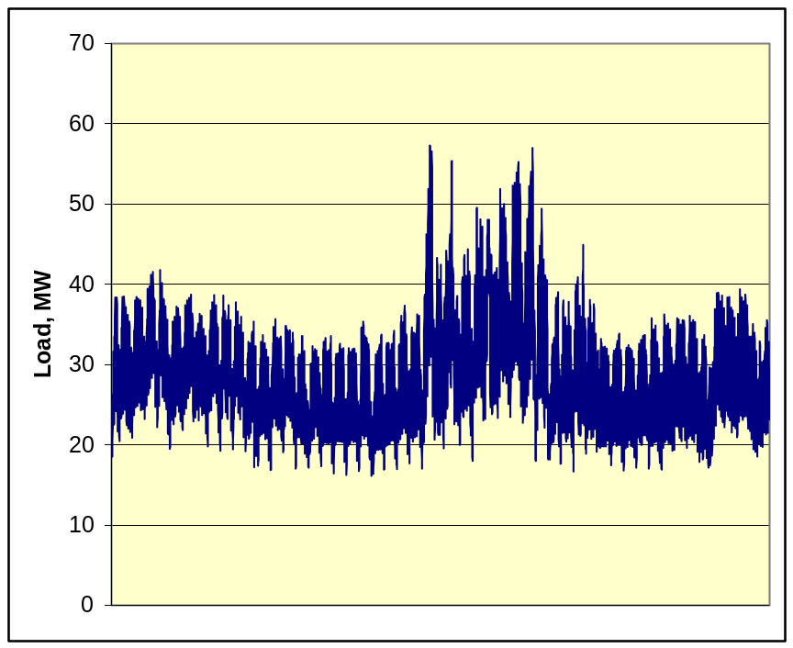
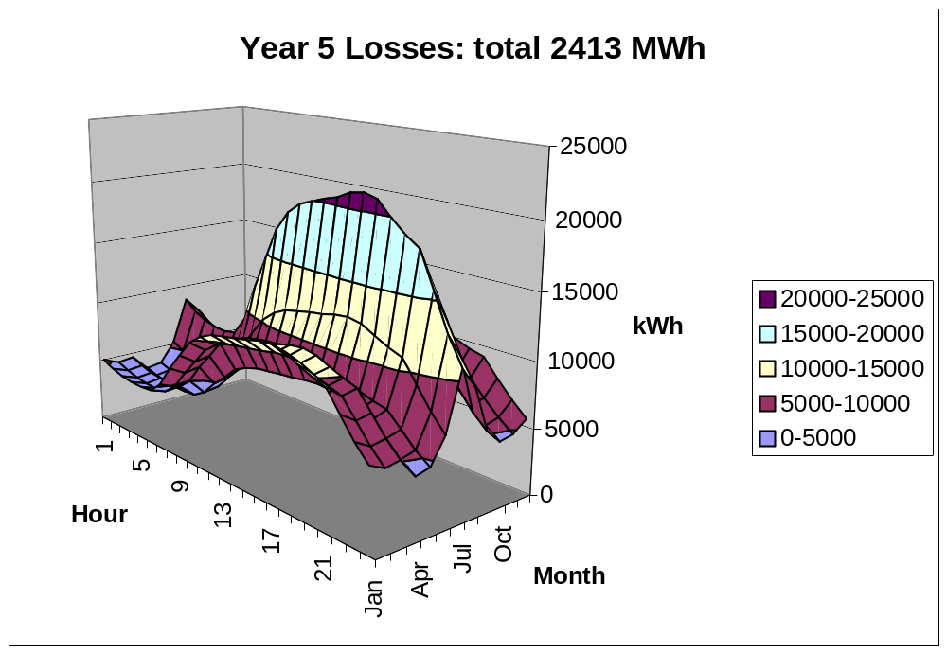
Annual Losses
Peak load losses are not necessarily indicative of annual losses

Slide 11
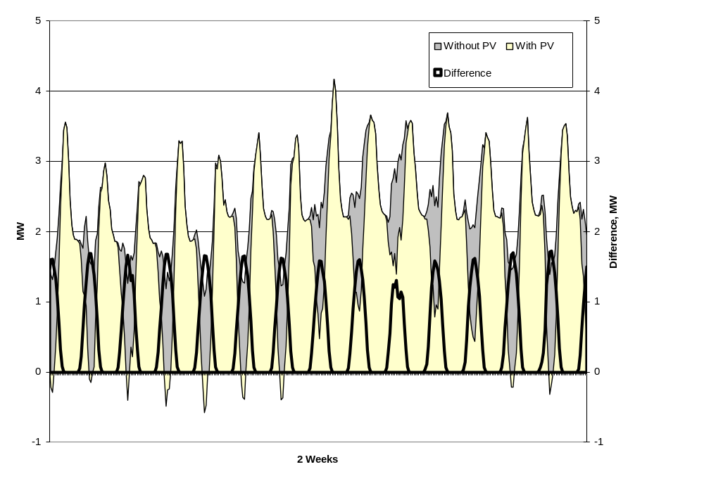
Solar PV Simulation

Slide 12
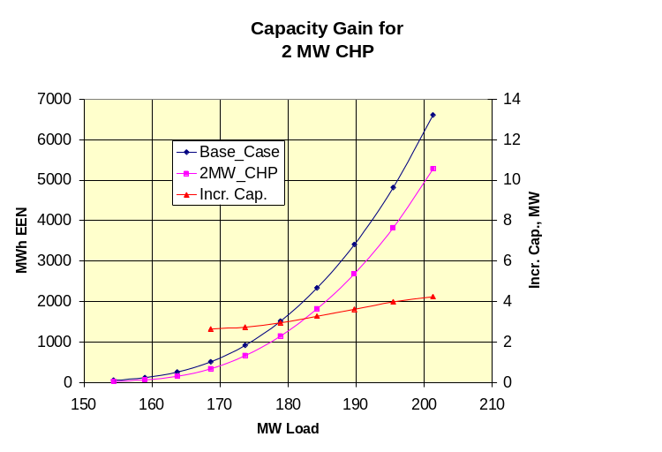
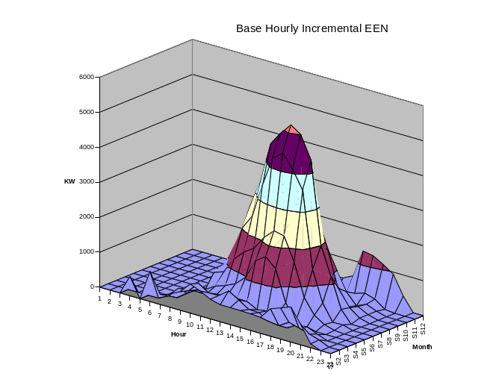
Using DSS to Determine Incremental Capacity of DG
“Needle” Peaking System
“How much more power can be served at the same risk of unserved energy?”
Broad Summer Peaking System

Slide 13
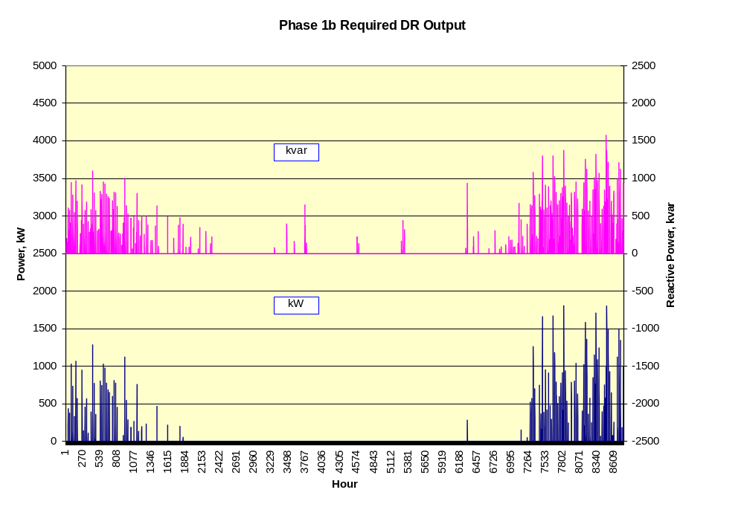
DG Dispatch

Slide 14
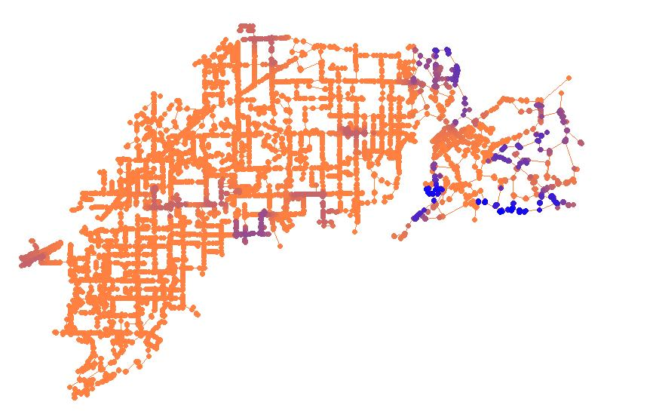
DG Impact Visualization
Areas with greatest change in fault current due to DG

Slide 15
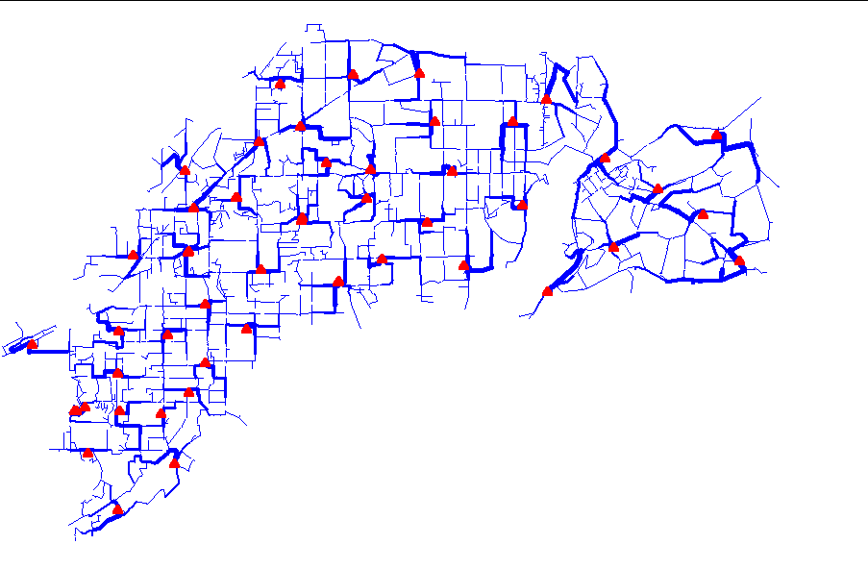
Power Flow Visualization

Slide 16
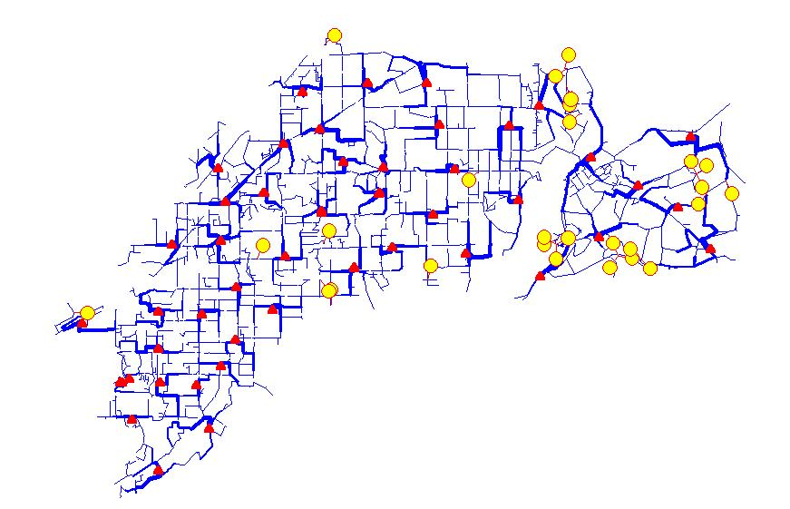
Optimal DG Siting

Slide 17
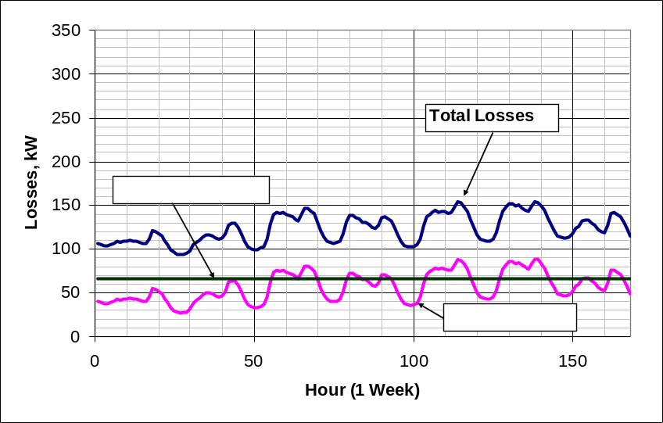
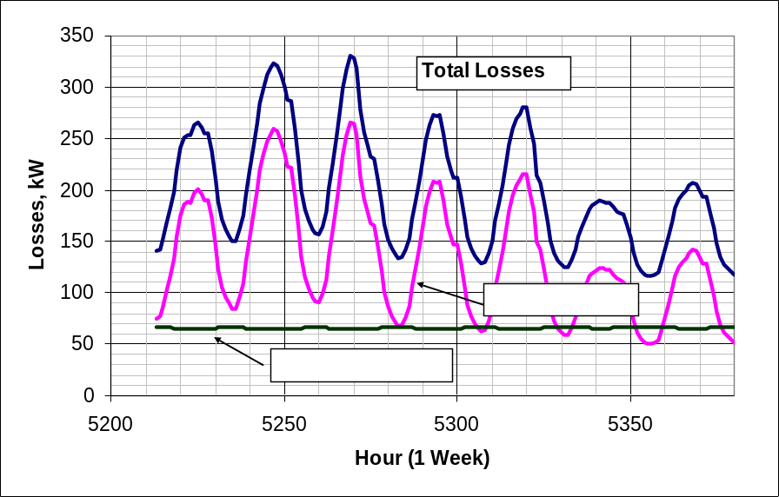
Power Distribution Efficiency
Peak Load Week
Light Load Week

Slide 18
Broadband Driving Point Admittance
0.035
0.03
0.025
0.02
Siemens
|Y|
0.015
0.01
0.005
0
0
100000
200000
300000
400000
500000
Frequency, Hz

Slide 19
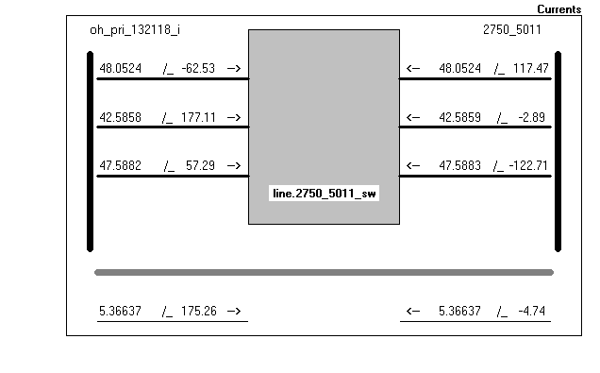
Current

Slide 20
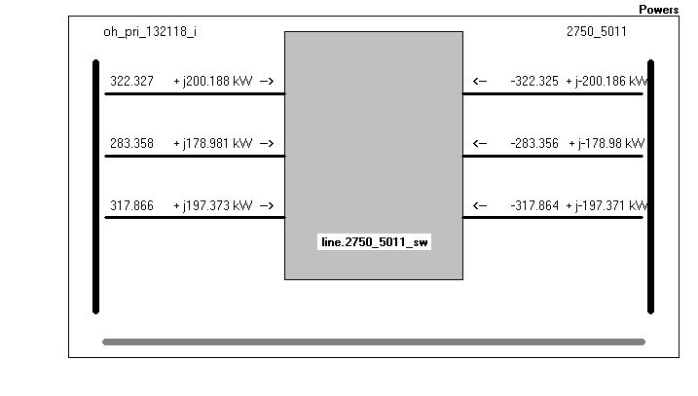
Power

Slide 21
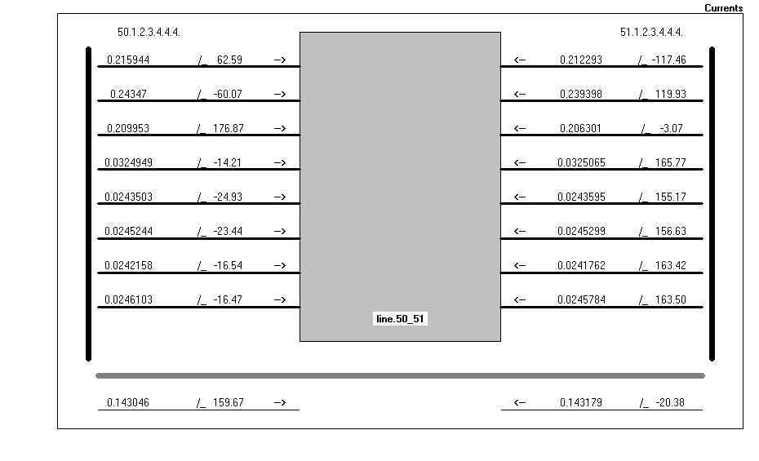
A Bit More Complicated …

Slide 22
Installation

Slide 23
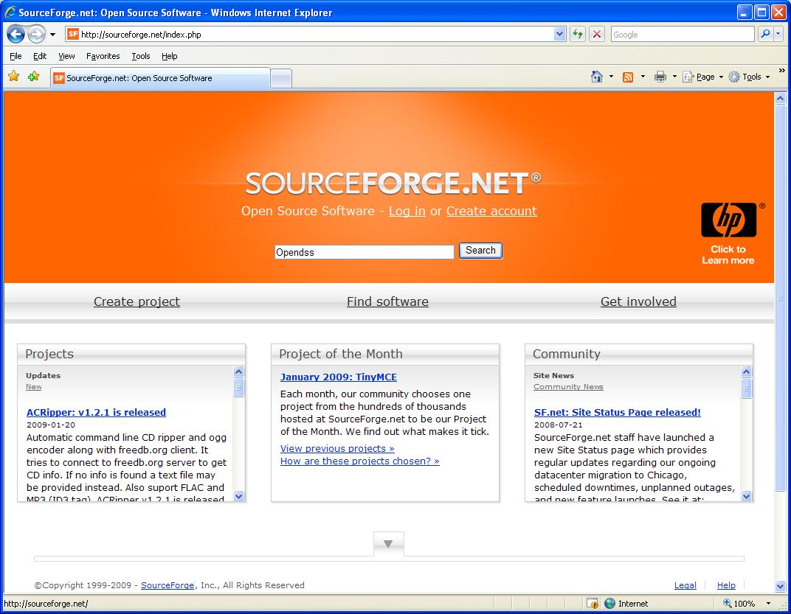

Slide 24
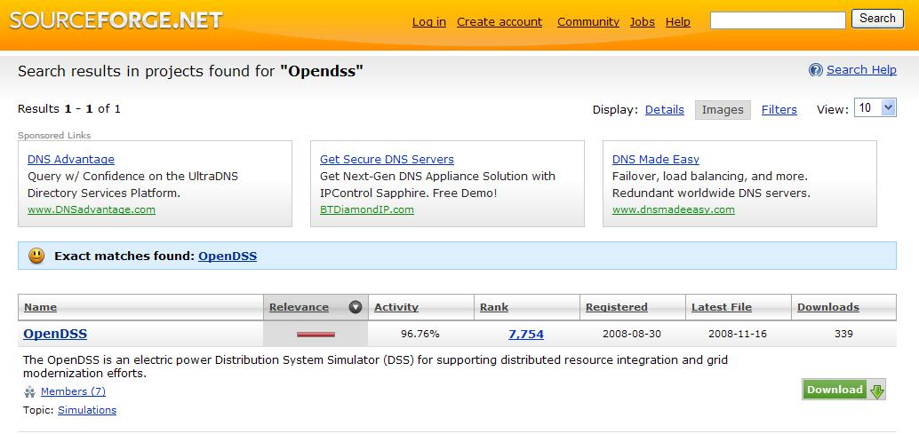
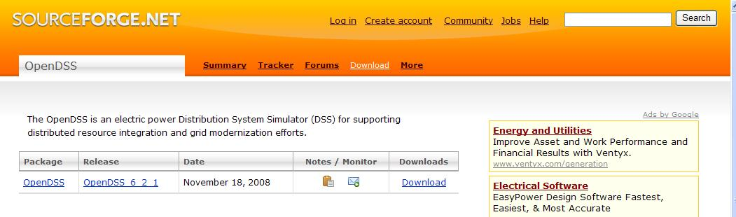

Slide 25
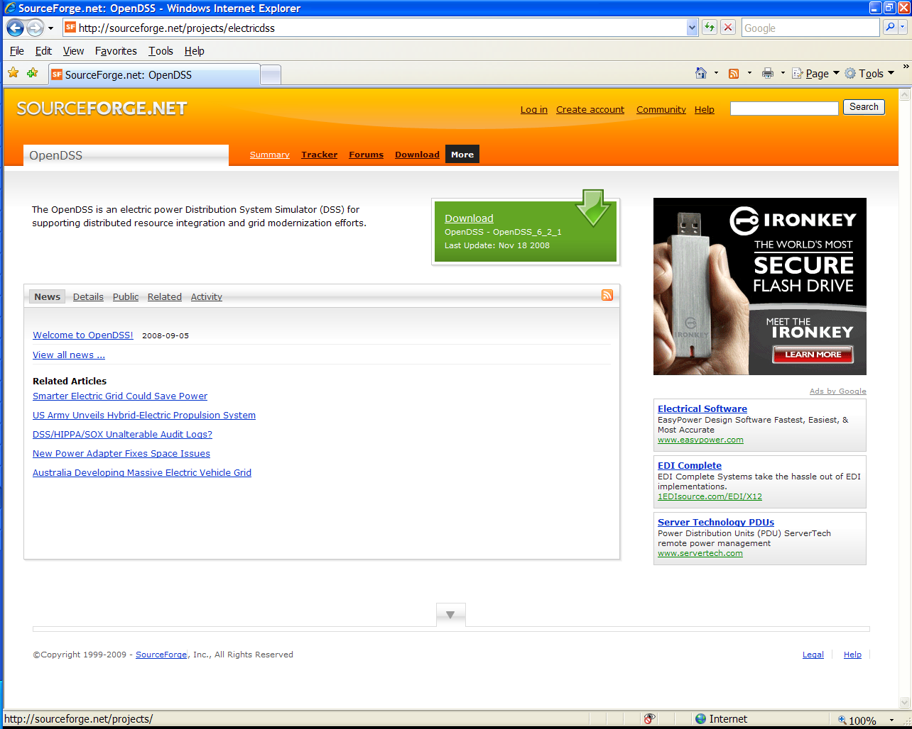
Finding the Wiki …
Click on “More”

Slide 26
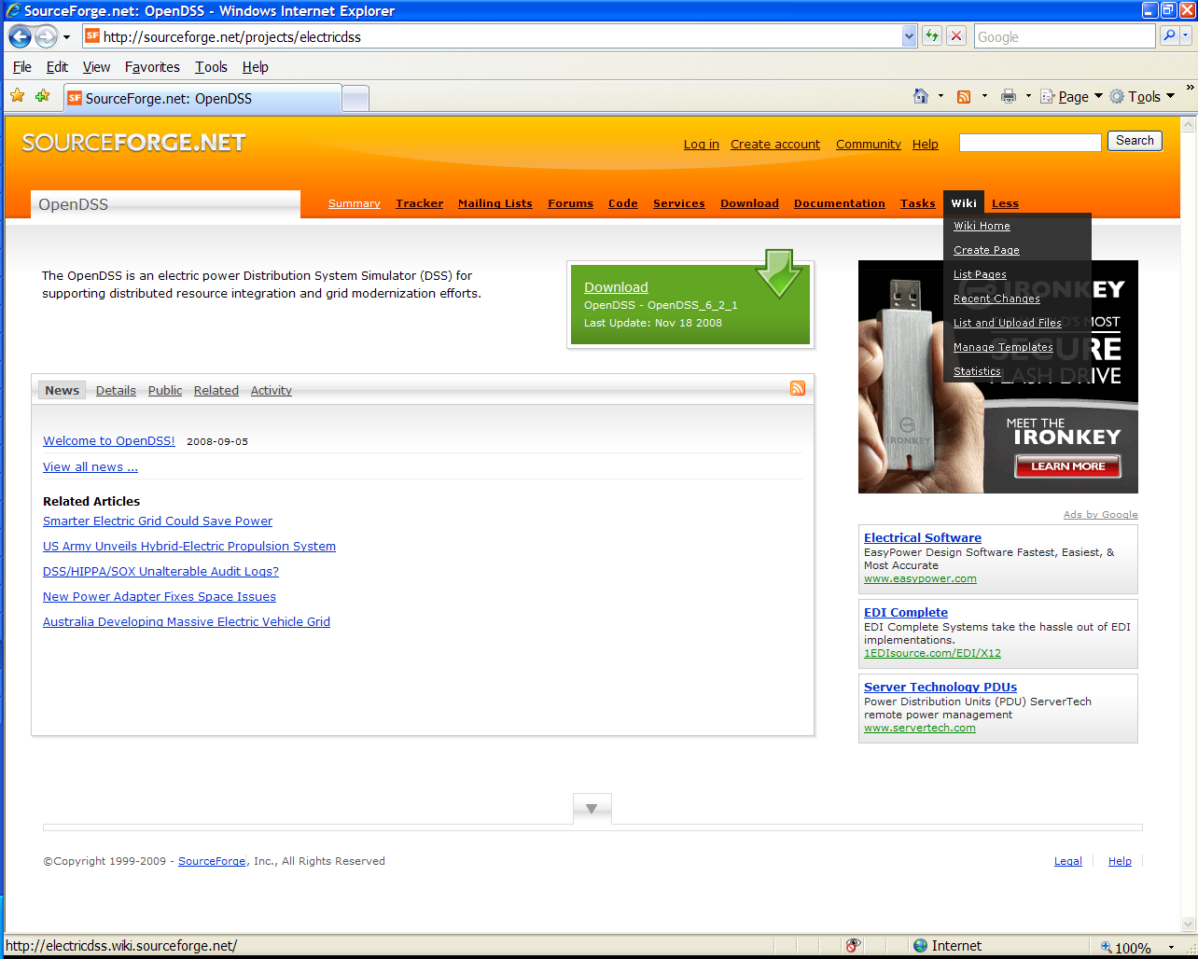
Finding the Wiki, cont’d
Menu Expands; Select Wiki

Slide 27
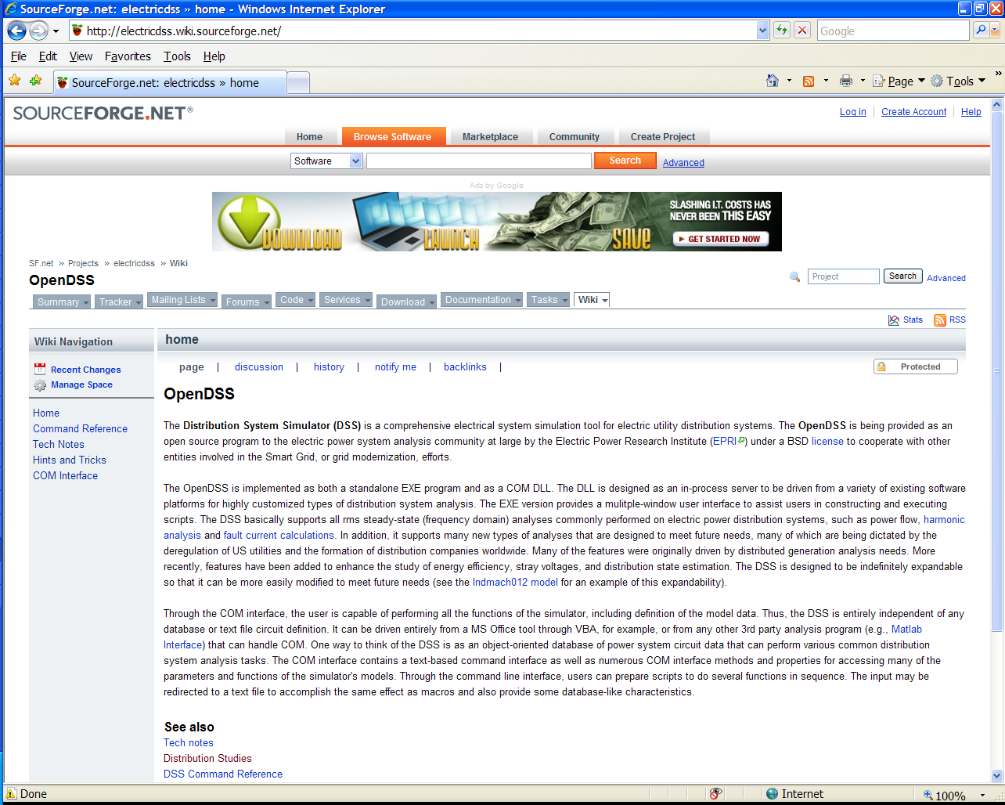
Wiki Home Page (Latest documentation)

Slide 28
Program Files
OpenDSS.EXE Standalone EXE
OpenDSSEngine.DLL In-process COM server
KLUSolve.DLL Sparse matrix solver
DSSgraph.DLL DSS graphics output
Copy these files to the directory (folder) of your choice
  Typically c:\OpenDSS or c:\Program Files\OpenDSS
If you intend to drive OpenDSS from another program, you will need to register the COM server

Slide 29
Registering the COM Server
In DOS window, change to folder where you installed it and type:
  Regsvr32 OpenDSSEngine.DLL
The Server shows up as “OpenDSSEngine.DSS” in the Windows Registry
For Example, to include in Matlab:
  DSSobj = actxserver(‘OpenDSSEngine.DSS’);
In VBA:
  Public DSSobj As OpenDSSEngine.DSS
  Set DSSobj = New OpenDSSEngine.DSS

Slide 30
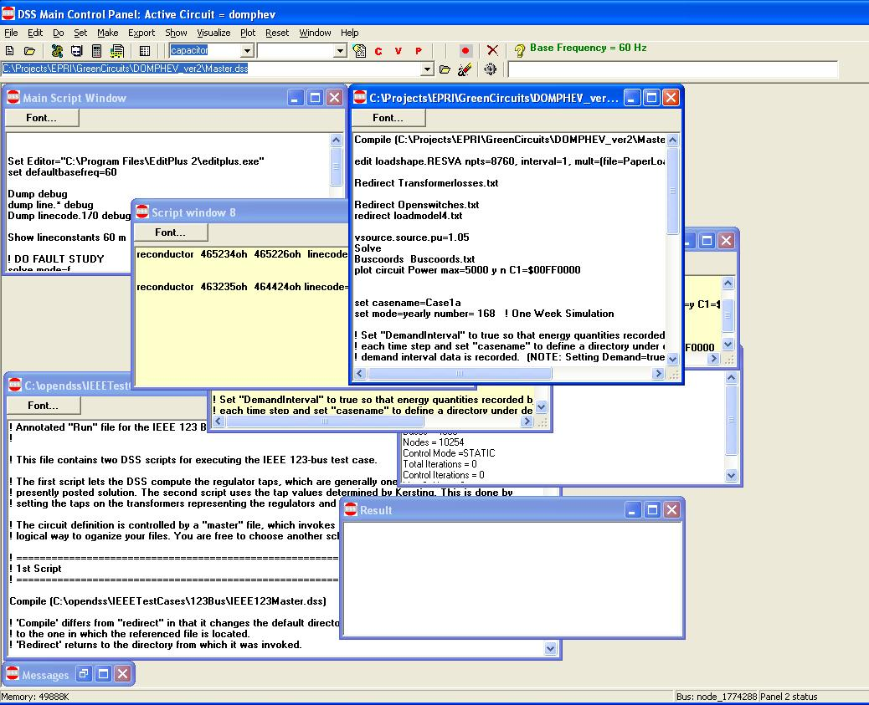
OpenDSS Standalone EXE User Interface

Slide 31
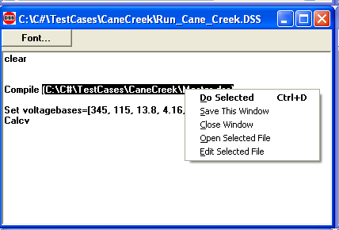
Executing Scripts in the EXE
Select all or part of a line
Right-Click to get this pop-up menu
DSS executes selected line or opens selected file name
Any script window may be used at any time.

Slide 32
DSS Structure
Scripts
Main Simulation Engine
COM Interface
User-Written DLLs
Scripts, Results

Slide 33
DSS Object Structure
DSS Executive
Commands
Options
Circuit
Solution
V
[Y]
I
PDElement
PCElement
Controls
Meters
General
Line
Transformer
Capacitor
Reactor
Load
Generator
Vsource
Isource
RegControl
CapControl
Relay
Reclose
Fuse
Monitor
EnergyMeter
Sensor
LineCode
LineGeometry
WireData
LoadShape
GrowthShape
Spectrum
TCCcurve

Slide 34
DSS Class Structure
Instances of Objects of this class
Class
Object 1
Property Definitions
Property Values
Methods
Class Property Editor
Yprim
Collection Manager
States
Object n
Property Values
Methods
Yprim
States

Slide 35
DSS Classes
Power Delivery (PD) Elements
  Line
  Transformer
  Reactor
  Capacitor
Power Conversion (PC) Elements
  Load
  Generator
  Vsource
  Isource
Control Elements
  RegControl
  CapControl
  Recloser
  Relay
  Fuse
Metering Elements
  Monitor
  EnergyMeter
  Sensor
General
  LineCode
  LineGeometry
  Loadshape
  Growthshape
  Wiredata
  Spectrum
  TCC Curves

Slide 36
Circuit Principles

Slide 37
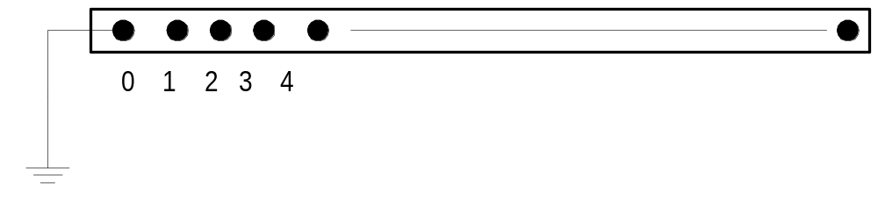
DSS Bus Model

Slide 38
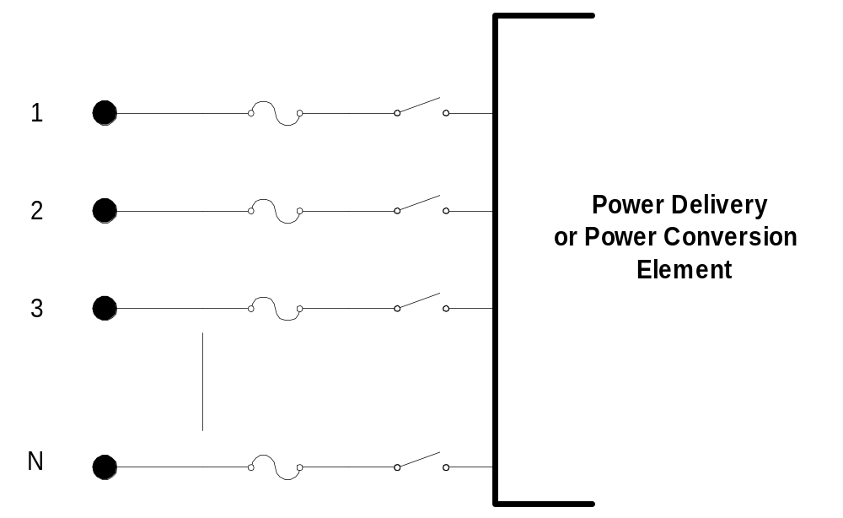
DSS Terminal Definition

Slide 39
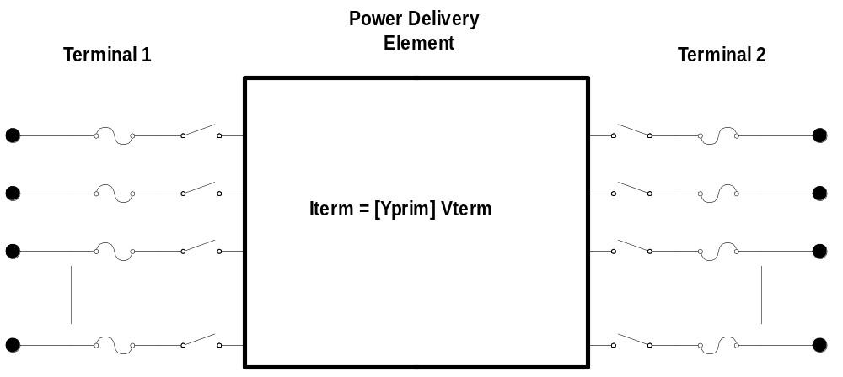
Power Delivery Elements

Slide 40
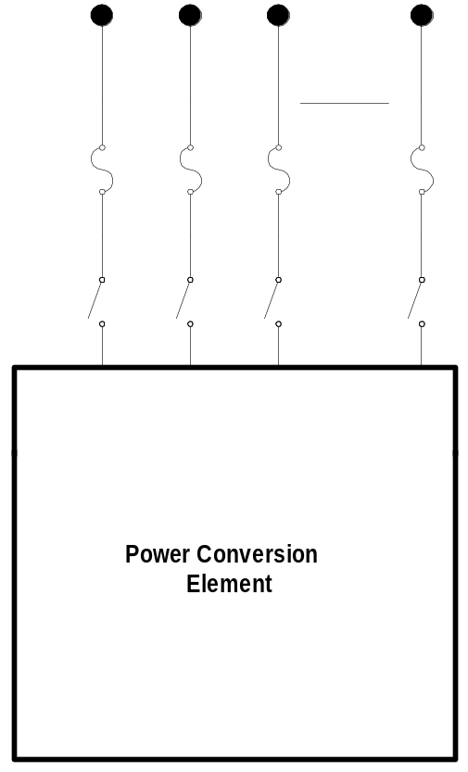

Power Conversion Elements
I_{Term}(t) = F(V_{Term}, [State], t)

Slide 41
Circuit Elements are Connected together at the Nodes of Buses
BusX
3
2
1
0
. . . Bus2 = BusX.2.1.3.0 . . .
. . . Bus1 = BusX . . .
(take the default)
(Explicitly define connections)
DSS Convention: A Terminal can be connected to only one Bus. You can have any number of Nodes at a bus.

Slide 42
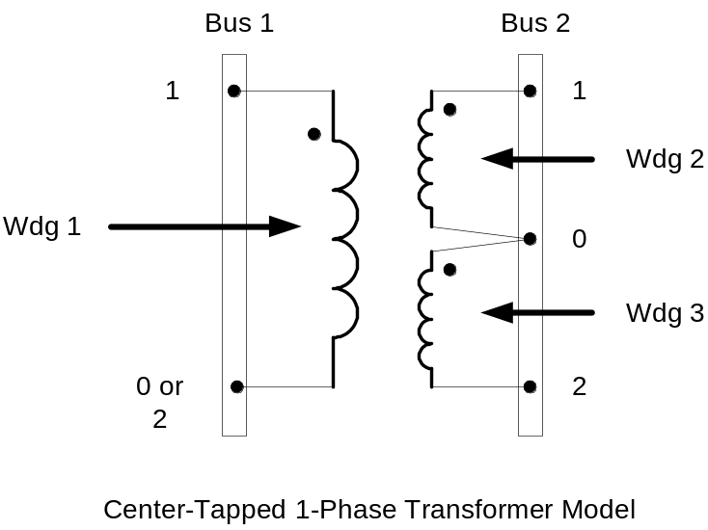
Connections for 1-Phase Residential Transformer
! Line-to-Neutral Connected 1-phase Center-tapped transformer
New Transformer.Example1-ph phases=1 Windings=3
~ Xhl=2.04 Xht=2.04 Xlt=1.36 %noloadloss=.2
~ Buses=[bus1.1 bus2.1.0 bus2.0.2] !!! Note polarity
~ kVs=[7.2 .12 .12] ! ratings of windings
~ kVAs=[25 25 25]
~ %Rs = [0.6 1.2 1.2]
~ conns=[wye wye wye] ! default

Slide 43
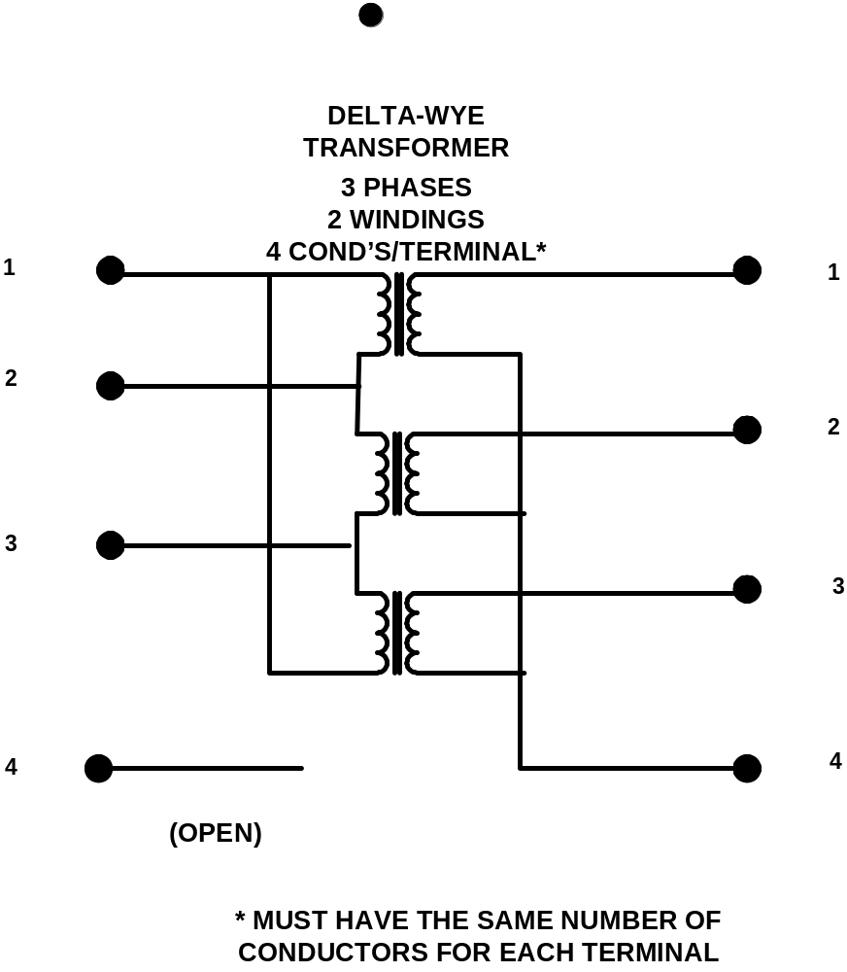
All Terminals of a Circuit Element Have Same Number of Conductors
3-Phase Transformer

Slide 44
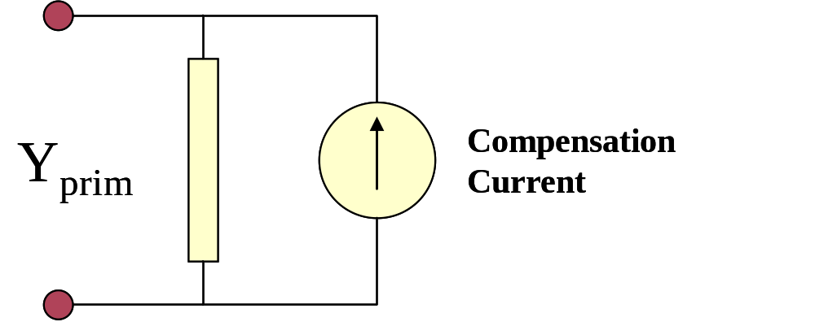
Load (a PC Element)
(One-Line Diagram)

Slide 45
Load - 3-phase Y connected
Phase 1
1
2
Phase 2
3
4 Conductors/Terminal
Phase 3
4

Slide 46
Load - 3-phase Delta connected
Phase 1
2
1
Phase 2
3
3 Conductors/Terminal
Phase 3

Slide 47
Putting it All Together
ALL Elements
Yprim 1
Yprim 2
Yprim 3
Yprim n
PC Elements
I1
I2
Y
Node
Voltages
I_{inj}
=
V
Im
Iteration Loop

Slide 48
Solution Speed
Distribution systems generally converge quite rapidly with this method.
The OpenDSS program seems to be on par with the faster commercial programs – or faster
It is set up to run annual simulations easily
  Our recommendation:
    Err on the side of running more power flow simulations
    That is, don’t worry about the solution time until it proves to be a problem
    That reveals more information about the problem.

Slide 49
Scripting Basics

Slide 50
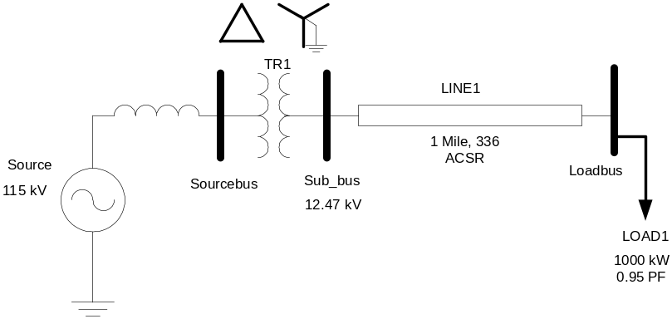
A Basic Script
New Circuit.Simple ! Creates voltage source (Vsource.Source)
Edit Vsource.Source BasekV=115 pu=1.05 ISC3=3000 ISC1=2500 !Define source V and Z
New Transformer.TR1 Buses=[SourceBus, Sub_Bus] Conns=[Delta Wye] kVs= [115 12.47]
~ kVAs=[20000 20000] XHL=10
New Linecode.336ACSR R1=0.058 X1=.1206 R0=.1784 X0=.4047 C1=3.4 C0=1.6 Units=kft
New Line.LINE1 Bus1=Sub_Bus Bus2=LoadBus Linecode=336ACSR Length=1 Units=Mi
New Load.LOAD1 Bus1=LoadBus kV=12.47 kW=1000 PF=.95
Solve
Show Voltages
Show Currents
Show Powers kVA elements

Slide 51
Command Syntax
Command parm1, parm2 parm3 parm 4 ….
Parameters may be positional or named (tagged).
If named, an "=" sign is expected.
  Name=value (this is the named form)
  Value (value alone in positional form)
For example, the following two commands are equivalent:
  New Object="Line.First Line" Bus1=b1240 Bus2=32 LineCode=336ACSR, …
  New “Line.First Line”, b1240 32 336ACSR, …
Comma or white space

Slide 52
Delimiters
Array or string delimiter pairs: [ ] , { },( ),“ “,‘ ‘
Matrix row delimiter: |
Value delimiters: , (comma)
any white space (tab or space)
Class, Object, Bus, or Node delimiter: . (period)
Keyword / value separator: =
Continuation of previous line: ~ (More)
Comment line: //
In-line comment: !
Query a property: ?

Slide 53
Array and Matrix Parameters
Array
  kvs = [115, 6.6, 22]
  kvas=[20000 16000 16000]
Matrix
  (3x3 matrix)
    Xmatrix=[1.2 .3 .3 | .3 1.2 3 | .3 .3 1.2]
  (3x3 matrix – lower triangle)
    Xmatrix=[ 1.2 | .3 1.2 | .3 .3 1.2 ]

Slide 54
Specifying Bus Connections
Shorthand (implicit)
  New Load.LOAD1 Bus1=LOADBUS
  Assumes standard 3-phase connection by default
Explicit
  New Load.LOAD1 Bus1=LOADBUS.1.2.3
    Explicitly defines which node
  New Load.1-PHASELOAD Phases=1 Bus1=LOADBUS.2
    Connects 1-phase load to phase 2
Default Bus template (defaults to grounded Wye)
  … LOADBUS.1.2.3.0.0.0.0.0.0.0. (ad infinitum)
Ungrounded-Wye Specification
  Bus1=LOADBUS.1.2.3.4 (or some other unused Node number)

Slide 55
Common Sense Structuring of Script Files
Run_The_Master.DSS
“Compile” the Master file from here
Master.DSS
LineCodes.DSS
WireData.DSS
LineGeometry.DSS
Libraries
Put a “Clear” in here
Spectrum.DSS
LoadShape.DSS
Transformers.DSS
Lines.DSS
Circuit
Definition
Make a separate folder for each circuit
Loads.DSS
Etc.

Slide 56
The Distribution System Simulator™ (DSS)
Solution Modes

Slide 57
Distribution System Analysis Tools
DSS has the basic tools for Planning built in:
  Power Flow
  Short Circuit Calculations
In Addition, it has Several Advanced Capabilities
  “Dynamic” Power Flow
  Other power flow modes
  Dynamics
  Harmonics
If it is not built in, you can drive it from another program such as Matlab
  For example: Reliability Analysis

Slide 58
Classes of Solution Modes
Power Flow
  Snapshot
  Direct
Dynamic Power Flow
  Daily
  Yearly
  DutyCycle
  Peakday
Dynamics
Harmonics
Other Power Flow
  LD1
  LD2
  Monte Carlo
    M1
    M2
    M3
Short Circuit
  Faultstudy
  MF - Monte Carlo Fault

Slide 59
Power Flow Modes

Slide 60
Snapshot Mode
This is the DEFAULT MODE
Does one power flow solution at the present load level
  Controlmode is set to “static”
  All Control devices execute in sequence of their time delays – shortest first
    Next control action may then be cancelled
  You can change the default control mode if driving the DSS externally
  You have to explicitly tell monitoring devices to “sample”
Watch the SUMMARY window for lack of convergence

Slide 61
Bus List in DSS
The Bus List in the DSS is NOT FORMED until you do something requiring a solution or explicitly request that it be formed:
  Solve
  CalcVoltagebases (zero-load power flow)
  MakeBusList (explicitly forms the bus list)
If you do something that adds a bus after you do a Solve-related command the bus list is NOT automatically updated!

Slide 62
CalcVoltageBases
This command was implemented to avoid having to specify base voltages for each bus
  You can do that by “Setkvbase bus=… kvln|kvll =…“
Solves a ZERO LOAD SNAPSHOT power flow
Set voltage bases = closest value in the set defined by
  Set Voltagebases=[115 12.47 0.48 …]
Note: this will not always work if you have two voltage bases really close together such as 12.0 and 12.47
Remember: The DSS works in Volts, Amps, and Ohms
  Voltage bases are provided for convenience

Slide 63
Direct Solution Mode
Solve System Y matrix directly
  I = [Y]V (assume nominal I value)
  No iterations
  No compensation currents from load and generator models
    Primitive admittance should reflect load
Load updating forced
Rebuilds System Y if necessary
All Voltage and Current sources accounted for
  Including generators if in dynamics or harmonics mode

Slide 64
“Dynamic” Power Flow Modes

Slide 65
Daily
Does 24 hour solution following load shape defined as “Daily”
  See Load definition
  There is a default loadshape defined called “default”
  Note: the LOAD model default is NONE
You may change the default values
  To use a 15-min load shape,
  Set NUMBER=96 and stepsize=(3600 4 /) … 900 s
Meters and Monitors are reset when entering mode
  Are not reset until mode is changed
  Automatically sampled at end of each power flow solution
Static control mode
  Be careful specifying time delays! If all the same, they will all try to operate at once!

Slide 66
Daily Solution Algorithm
For Number of solutions specified (set number =…)
t = t + stepsize
Solve snapshot
Sample meters and monitors
Finally,
Save meters and monitors (does not reset them)
(Energymeter demand intervals may be used)

Slide 67
Yearly
Similar to Daily
Defaults to
  1 hr stepsize (3600 s)
  Number = 8760
Adjusts load for growth (Set Year = …)
Load uses loadshape defined for Yearly=…
  Defaults to Daily … repeats over and over
  If Daily is NONE, then load is constant
Note: Energymeters stay open; (Monitors are saved)
  Have to be explicitly closed by Reset or Set Year=

Slide 68
Using DSS to Determine Incremental Capacity of DG
“Needle” Peaking System
“How much more power can be served at the same risk of unserved energy?”
Broad Summer Peaking System

Slide 69
Energy Meter Registers (As of Jan 2009)
Reg 1 = kWh
Reg 2 = kvarh
Reg 3 = Max kW
Reg 4 = Max kVA
Reg 5 = Zone kWh
Reg 6 = Zone kvarh
Reg 7 = Zone Max kW
Reg 8 = Zone Max kVA
Reg 9 = Overload kWh Normal
Reg 10 = Overload kWh Emerg
Reg 11 = Load EEN
Reg 12 = Load UE
Reg 13 = Zone Losses kWh
Reg 14 = Zone Losses kvarh
Reg 15 = Zone Max kW Losses
Reg 16 = Zone Max kvar Losses
Reg 17 = Load Losses kWh
Reg 18 = Load Losses kvarh
Reg 19 = No Load Losses kWh
Reg 20 = No Load Losses kvarh
Reg 21 = Max kW Load Losses
Reg 22 = Max kW No Load Losses
Reg 23 = Line Losses
Reg 24 = Transformer Losses
Reg 25 = Line Mode Line Losses
Reg 26 = Zero Mode Line Losses
Reg 27 = 3-phase Line losses
Reg 28 = 1-and 2-phase Line Losses
Reg 29 = Gen kWh
Reg 30 = Gen kvarh
Reg 31 = Gen Max kW
Reg 32 = Gen Max kVA
Reg 33 = 34.5 kV Losses
Reg 34 = 0.208 kV Losses
Reg 35 = 4.16 kV Losses
Reg 36 = 230 kV Losses
Reg 37 = Aux5
Reg 38 = Aux6
Reg 39 = Aux7

Slide 70
Dutycycle
Meant to study
  Rock crushers
  Wind turbines
  Rolling mills and other cyclic large motor loads
Loads follow shape defined by Duty property
Monitors are sampled & saved
Energymeters are NOT sampled during the loop

Slide 71
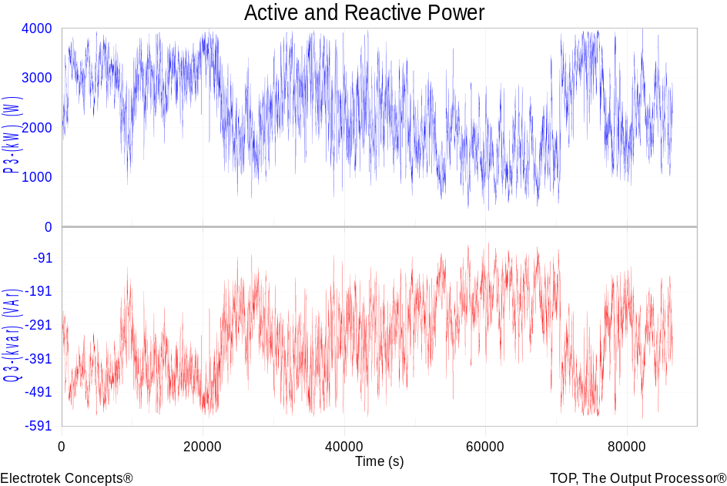
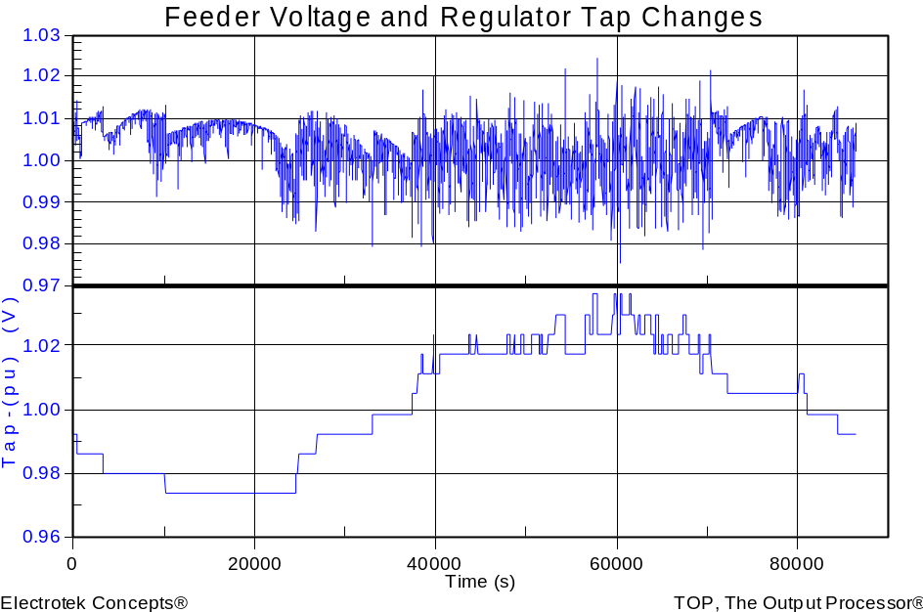
Wind Plant 1-s Simulation
Notes:
The plot you see to the right is a sample case study we did where a developer wanted to install 3 750kW turbines at the end of a 10-mile distribution feeder. Along the feeder was a voltage regulator and large intermittent load. The concern we had was the impact the turbine output fluctuations would have on the flicker, regulator action, as well as the voltage profile along the feeder. Utilizing software that Electrotek had developed, specifically the Distribution System Simulator, or DSS,, minor modifications were made that allowed us to simulate the wind plant fluctuation impact over time, thus giving us the ability to address the concerns at hand.
The plot you see to the right is simulation output from the DSS, over a time horizon of ~ 4 minutes. The three turbines were modeled explicitly, along with the 5-step switched capacitor banks connected to each turbine as well as the voltage regulator upline from the wind plant. This software allows us to make recommendations to the utility and/or wind plant developer regarding modifications necessary, if any, to allow for the wind plant to have minimal impact on the distribution feeder and surrounding customers, or perhaps even improve feeder performance.
We also utilize this software for estimating flicker according the IEC standard 1400-21. The software, along with data specific to the turbine being considered allows one to estimate the flicker impact BEFORE the turbine is installed.

Slide 72
Short Circuit Modes

Slide 73
In a Power Flow Mode
The DSS will allow you to put a FAULT object on the circuit at almost any time, even for a SNAPSHOT solution
  Be sure to check for convergence
  Answer may differ slightly from Faultstudy mode
Safer (for accuracy) procedure:
  Solve snapshot
  Set mode=dynamics number=1 stepsize=.00001 (small)
  Add/Enable Fault object
  Solve (does a direct solution with generators converted to Thevenin equivalent)

Slide 74
FaultStudy Mode
Algorithm
  Disable all FAULT objects defined in the circuit
  Sets Loadmodel=Admittance
  Does DIRECT solution
    Generators included (Thevenin equivalent)
    Save Open-circuit voltages, Voc
  Computes Ysc matrix at each bus
  Computes Isc by applying
    Isc = Ysc*Voc
  Answer could differ slightly from specific fault solution
Show Fault to see answers

Slide 75
MF – Monte Carlo Fault Mode
First, define FAULT objects at all buses of interest
  All fault types of interest
Changes loadmodel to ADMITTANCE
Algorithm
  For the number of times specified
  Picks one fault at random; disables the others
  Randomizes the fault resistance
    Uniform
    Gaussian
    Log-Normal

Slide 76
Introduction to Driving the COM Server from another Application

Slide 77
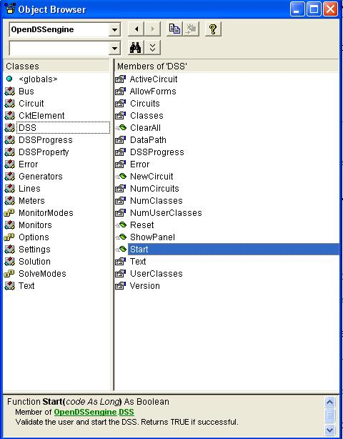
DSS Interface
This interface is instantiated upon loading OpenDSSEngine.DSS and then instantiates all other interfaces
Call the Start(0) method to initialize the DSS
DSS Class Functions (methods) and Properties

Slide 78
Instantiate the DSS Interface and Attempt Start
Public Sub StartDSS()
' Create a new instance of the DSS
Set DSSobj = New OpenDSSengine.DSS
' Start the DSS
If Not DSSobj.Start(0) Then
MsgBox "DSS Failed to Start"
Else
MsgBox "DSS Started successfully“
' Assign a variable to the Text interface for easier access
Set DSSText = DSSobj.Text
End If
End Sub

Slide 79
Assign a Variable to the Text Interface
Public Sub StartDSS()
' Create a new instance of the DSS
Set DSSobj = New OpenDSSengine.DSS
' Start the DSS
If Not DSSobj.Start(0) Then
MsgBox "DSS Failed to Start"
Else
MsgBox "DSS Started successfully“
' Assign a variable to the Text interface for easier access
Set DSSText = DSSobj.Text
End If
End Sub

Slide 80
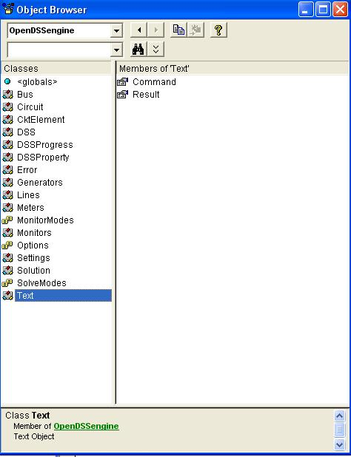
COM Interface
Interfaces as Exposed by VBA Object Browser in MS Excel
Text interface is simplest
Text has two Properties

Slide 81
Result Property
The Result property is a Read Only property that contains any result messages the most recent command may have issued.
  Error messages
  Requested values
‘ Example: Query line length
DSSText.Command = “? Line.L1.Length”
S = DSSText.Result ‘ Get the answer
MsgBox S ‘ Display the answer

Slide 82
Running OpenDSS From Matlab
Starting the DSS
%Start up the DSS
[DSSStartOK, DSSObj, DSSText] = DSSStartup(myDir);
function [Start,Obj,Text] = DSSStartup(mydir)
% Function for starting up the DSS
% make sure we are in the proper directory
cd(mydir);
%
%instantiate the DSS Object
Obj = actxserver('OpenDSSEngine.DSS');
%
%Start the DSS. Only needs to be executed the first time w/in a
%Matlab session
Start = Obj.Start(0);
% Define the text interface
Text = Obj.Text;

Slide 83
Using the DSS through the DSSText Interface from Matlab (harmonics example)
%Compile the DSS circuit script
DSSText.Command = 'compile master.dss';
% get an interface to the active circuit called "DSSCircuit"
DSSCircuit = DSSObj.ActiveCircuit;
%Determine which connection type for the source and call
%appropriate DSS file
switch XFMRType
case 1
DSSText.Command = 'redirect directconnectsource.DSS';
case 2
DSSText.Command = 'redirect deltadelta.DSS';
case 3
DSSText.Command = 'redirect deltawye.DSS';
otherwise
disp('Unknown source Connection Type')
end
%Set the system frequency and vsource frequency for harmonic requested
DSSText.Command = ['set frequency=(' num2str(Freq) ' 60 *)'];
DSSText.Command = ['vsource.source.frequency=(' num2str(Freq) ' 60 *)'];

Slide 84
Using the DSS through the DSSText Interface from Matlab (harmonics example) (cont’d)
% Vary the parameters according to a random distribution
% If more parameters need to be varied, just add them to the below
% list. Set ParamNum to total number of parameters varied
ParamNum = 6; %ParamNum used for sorting/plotting
for Case_Count = 1:Max_Cases
%Create index in the OutputData matrix to keep the cases in order
OutputData(Case_Count,1) = Case_Count;
% Generate random new coordinates for each conductor
[x1 y1 x2 y2 x3 y3 geomean] = RandomGeometry(8,0.75,30);
(... etc. etc. )
%define a new line geometry with random spacing
DSSText.Command = ['New LineGeometry.OHMOD nconds=3 nphases=3 cond=1 wire=acsr336 x=' num2str(x1) ' ' num2str(y1) ' units=ft cond=2 wire=acsr336 x=' num2str(x2) ' ' num2str(y2) ' units=ft cond=3 wire=acsr336 x=' num2str(x3) ' ' num2str(y3) ' units=ft'];
%Solve the circuit
DSSText.Command = 'solve';
(etc. etc.)

Slide 85
Questions?

