Slide 1
OpenDSS Training Workshop
Consolidated Edison Co.
New York, NY
Roger C. Dugan
Davis Montenegro
EPRI Knoxville, TN
October 17-18, 2019

Slide 2

Instructor
Roger C. Dugan, Life Fellow, IEEE
Roger is a Sr. Technical Executive with EPRI in Knoxville, Tennessee USA. He has over 45 years of combined experience in distribution engineering with EPRI, Electrotek Concepts, and Cooper Power Systems. He holds the BSEE degree from Ohio University and the Master of Engineering in Electric Power Engineering degree from Rensselaer Polytechnic Institute, Troy, NY. Roger has worked on many diverse aspects of power engineering over his career because of his interests in applying computer methods to power system simulation. Beginning with a student internship with Columbus and Southern Ohio Electric Co, his work has been focused on Distribution Engineering. He was elected a Fellow of the IEEE for his contributions in harmonics and transients analysis. Recently, he has been very active in distributed generation, particularly as it applies to utility distribution systems and distribution system analysis. He was the 2005 recipient of the IEEE Excellence in Distribution Engineering Award. He is coauthor of Electrical Power Systems Quality published by McGraw-Hill, now in its 3rd edition. He serves on the IEEE PES Distribution System Analysis Subcommittee and is active in the Distribution Test Feeders WG.

Slide 3
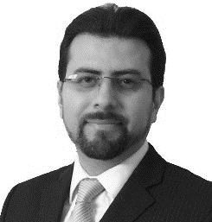
Instructor
Davis Montenegro, Senior Member, IEEE
Davis Montenegro-Martinez serves as Engineer/Scientist III at the Electric Power Research Institute (EPRI) in the areas of power system modeling, analysis and high performance computing. He received his B.Sc. degree in electronics engineering from Universidad Santo Tomás, Bogotá, Colombia (2004); he is M.Sc. in electrical engineering from Universidad de los Andes, Bogotá , Colombia (2012). He received his Ph.D. in electrical engineering from Universidad de los Andes (2015), and a Ph.D. in electrical engineering from the University Grenoble-Alpes, France (2015).
Before joining EPRI, Davis served for 10 years as a lecturer for Universidad Santo Tomas in Colombia, during this time he was also technology consultant in the areas of industrial automation, software and electronic hardware design focused in the electric power industry, specifically in monitoring and control for meter calibration laboratories. His expertise in parallel computing techniques is being used at EPRI for incorporating multi-core processing to power system analysis methods such as QSTS, reducing the computational time required to perform these analysis using standard computing architectures.
Dr. Montenegro is also a member of the International Council on Large Electric Systems CIGRE, he was awarded with the IEEE 2016 I&CPS Ralph H. Lee Department Prize Paper Award at the 2017 I&CPS Technical Conference Awards luncheon in Niagara Falls, ON, Canada, for the paper titled “Energy Storage Modeling for Distribution Planning.” He was also awarded an IEEE recognition in 2017 for notable services and contributions towards the advancement of IEEE and the engineering professions chairing of IM09 (Instrumentation and Measurements) Society Chapter, Colombian Section 2015–2017.

Slide 4
1. Introduction to the OpenDSS Program

Slide 5
What is the OpenDSS?
The examples in this Workshop will be taught using the EPRI OpenDSS computer program
The program is freely available and is updated regularly
You may find it on www.Sourceforge.net
Also, bookmark the EPRI link site:
https://www.epri.com/#/pages/sa/opendss?lang=en-US
This is the “jump page” for OpenDSS internet locations

Slide 6

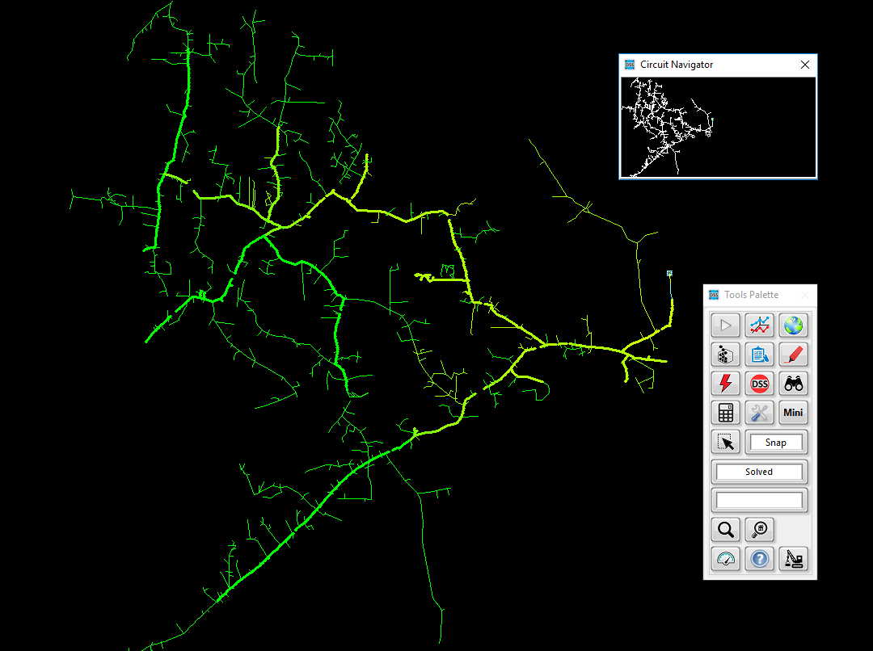
Overview of OpenDSS OpenDSS – Open-Source Distribution System Simulator
Download OpenDSS Here
Advanced distribution analysis platform that enables engineers to perform complex distribution analysis
Flexible and customizable solution designed specifically to meet the challenges facing distribution engineers
Enables engineers to easily model both traditional and advanced distribution technologies, resources, assets, and controls
Leveraged throughout the industry for modeling and simulating advanced distribution applications
Designed from the beginning to capture the time and spatial affects of distributed energy resources
Brief history and current usage
Developed/designed in 1997 to capture the time and spatial affects of distributed energy resources
Open-sourced in 2008 to coordinate and advanced smart grid assessments
Primary modeling and simulation platform used to enable execution of cutting-edge research
Notes:
OpenDSS – EPRI’s best kept secret. ☺

Slide 7
Highlighting a Few Capabilities
Grid Devices
Quasi-static time-series (QSTS)
Full library of traditional assets (lines, conductors, transformers, cap banks, switches, etc.)
Line Reg/LTC, cap banks
DER smart inverter
Solution Capabilities
Unbalanced multi-phase power flow
Fault analysis
Harmonic analysis
Controls
Energy storage dispatch
DMS/DERMS
VVO
Load models
Linear and non-linear analysis
Stray voltage/current analysis
Price modeling/dispatch
Flicker analysis
Automation
Distribution automation
Load transfers
FLISR (Fault Location, Isolation, and Service Restoration)
Solution Interfaces
Parallel processing using actors
Fast power flow
Smart inverters
Energy storage
PV systems
Wind systems
Demand response
Microgrids
DER short-ckt
Misc
Radial and networked systems
Transmission and distribution modeling
Arbitrary sized systems (single feeder to planning area)
Multithreading circuit processing
Multi-core management
DER Models
Distribution System Scripting language
Full graphical user-interface
Co-simulation capabilities
Integrated SDK for customized development
High-Performance Solutions
Notes:
Three main points
1. Wide range of capabiliites
Highlight main points
These have been added through many years of research-driven needs
2. A few we are going to be able to show
3. Some we are not:
- Distribution system scripting language
<Extra not to be discussed>
EPRI R&D and other industry partners (National Labs, universities) continue to advance the tool
Advanced capabilities fully vetted through years of user application
User-minded approach to modeling
All modeling capabilities have and continue to be developed through the years with two things in mind:
Application: How can system models/solutions be created to answer the question/issue at hand
User: how can this be modeled to enable ease of use, but flexible enough for customized analysis

Slide 8
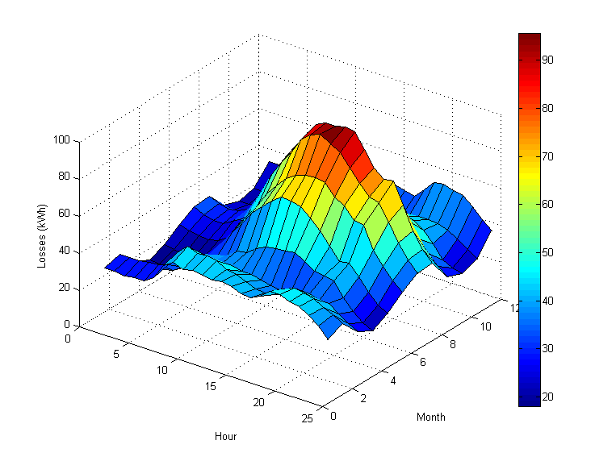
Flexible Tool Enabling a Wide Range of Analysis Types
DER Interconnection studies
Locational value studies
Hosting capacity studies
DA/FLISR scheme evaluation
Volt/var optimization
Energy impact analysis
DER protection impacts
Power quality (harmonics/flicker)
Long-range planning studies
Smart inverter control optimization
Planning for electrification
Notes:
Why do some of these things matter to you and ADP?
- Strength of DSS is it’s w

Slide 9
What is the OpenDSS?
Script-driven, frequency-domain electrical circuit simulation tool
Specific models for:
Supporting utility distribution system analysis
Designed for the unbalanced, multi-phase North American power distribution systems
As well as European-style systems
These typically have a simpler structure

Slide 10
What is the OpenDSS? (cont’d)
Heritage
Harmonics solvers rather than power flow
Gives OpenDSS extraordinary distribution system modeling capability
Simpler to solve power flow problem with a harmonics solver than vice-versa
Supports all rms steady-state (i.e., frequency domain) analyses commonly performed for utility distribution system planning
And many new types of analyses
Original purpose: DG interconnection analysis

Slide 11
What is the OpenDSS? (cont’d)
What it Isn’t
An Electromagnetic transients solver (Time Domain)
It can solve Electromechanical transients
Frequency Domain => “Dynamics”
All solutions are in phasors (complex math)
Not a “Power Flow” program
Not a radial circuit solver
Does meshed networks just as easily
Not a distribution data management tool
It is a simulation engine designed to work with data extracted from one or more utility databases

Slide 12
Time- and Location-Dependent Benefits
The OpenDSS was designed to capture both
Time-specific benefits and
Location-specific benefits
Needed for
DG analysis
Renewable generation
Energy efficiency analysis
PHEV and EV impacts
Other proposed capacity enhancements that don’t follow typical loadshapes

Slide 13
Time- and Location-Dependent Benefits
Traditional distribution system analysis programs
Designed to study peak loading conditions
Capture mostly location-specific benefits
Ignores time; Assumes resource is available
This gets the wrong answer for many DG, energy efficiency, and Smart Grid analyses
Must do time sequence analysis to get the right answer
“Quasi-Static Time-Series” (QSTS) simulations
Over distribution planning area

Slide 14
What are the Key Features?
Can model virtually any circuit configuration
Fast and efficient QSTS simulations
Designed to allow expansion indefinitely
Impossible to anticipate everything users will want to do
Scripting language and COM interface allows easier customization
OOP design of software makes it easy to add new circuit element models
See Documentation for more details
http://svn.code.sf.net/p/electricdss/code/trunk/Distrib/Doc/
Help menu on OpenDSS.exe

Slide 15
Controls
A key feature is that controls are modeled separately from the devices being controlled
Capacitors
Regulators/tapchangers
Control Modes
Static
Power flows with large time steps
Time
Control queue employed to delay actions
Control acts when time is reached
Event

Slide 16
Overall Model Concept

Slide 17
User Interfaces Currently Implemented
A stand-alone executable program (OpenDSS.exe) that provides a text-based interface (multiple windows)
Some graphical output is also provided.
No graphical input is provided.
An in-process COM server (for Windows) that supports driving the simulator from user-written programs.
OpenDSSEngine.DLL
A direct DLL interface (OpenDSSDirect.dll) that mimics the COM interface with a standard call library
For non-Windows platforms, such as HPCs
For programming languages that do not support COM or are not efficient at supporting COM

Slide 18
Plan for Future Work/Enhancements
We are exploiting high performance desktop computing to make it feasible to study distribution systems of at least 100,000 nodes and perhaps as many as 1,000,000 nodes.
OpenDSS-PM (for Parallel Machine) developed in 2016 to perform parallel processing for faster QSTS simulations
Can solve different time periods in parallel
Employs Diakoptics to solve very large networks
Still under development with US DOE (Sandia & NREL) contract (since 2016)
Improved Distribution Management Systems (DMS) functions
Existing EPRI research project
Improved distribution state estimation functions
Improved microgrid simulations (Dynamics mode)

Slide 19
What’s Next?
Other Advanced Distribution System Analysis problems
Microgrids
Advanced inverters
Probabilistic planning
DMS and DA
Communications and control latency co-simulation
Masking of load growth by PV and other DG
Recloser siting
Training next generation distribution engineer for the “Integrated Grid”

Slide 20
Introduction to Distribution Systems

Slide 21
Typical North American Distribution System
Typical 4-wire multi-grounded neutral system
Unigrounded/Delta 3-wire also common on West Coast

Slide 22
The Unbalanced Distribution System
This takes more than a positive-sequence model !!

Slide 23
Typical European Style System
3-wire unigrounded primary
Three-phase throughout,
including secondary (LV)

Slide 24
Comparisons of Systems
European-Style System
MV
LV
North American System
MV (ALL)

Slide 25
Comparison of Distribution Systems
North American System
Primary (MV) system is extensive, complex
Secondary (LV) is short
4-5 houses per distribution transformer
120/240 V single-phase (“split phase”) service
1 Industrial customer per distribution transformer
Or multiple transformers per customer
Extended by adding transformer + wire
European Style System
MV System has simpler structure
LV System (400 V) is extensive
Perhaps 100 residences on MV/LV transformer
230/400 V 3-phase
Extended by adding wire
Fewer transformers

Slide 26
Urban Low-Voltage Network Systems

Slide 27
Urban LV Network Systems – Another View
SUBSTATION
PRIMARY FEEDERS
TRANSMISSION
SYSTEM
FEEDER BREAKER
OR RECLOSER
LOW-VOLTAGE NETWORK
NETWORK
PROTECTOR

Slide 28
Urban LV Network Systems
Used in downtown areas (e.g., Manhattan) requiring extraordinary reliability
In a number of major cities
New York
Seattle
Chicago
Reliability is on the order of 100 times better than radial
Much more costly to build
Use devices not found on other distribution systems
Network transformer and network protectors
Most distribution systems in the world are radial

Slide 29
Why are most distribution systems radial?

Slide 30
Utility Fault-Clearing Practices
This explains why most systems are radial
Important to understand this for DER application on the “Integrated Grid”
Lower-cost protection for the inevitable short circuit
This is where many of the operating conflicts arise !!
DER response during faults can
Affect utility practices, fault clearing
Be damaged by fault clearing practices

Slide 31
Radial Distribution Fault Protection
Series Overcurrent Devices
(current is expected from only one source)
Only one device operates to clear fault

Slide 32
Transmission Fault Protection
Multiple Sources
Two Devices Must Operate to Clear Fault

Slide 33
Radial Circuit Economics
Most distribution systems are radially configured because the protection system is
Simpler to operate
Less expensive to build
Smart, or “Integrated”, Grid with multiple sources is changing that
Current flows in more than one direction
Overcurrent relaying/fuses inadequate on microgrids

Slide 34
Radial System Protection Principles
Radial Distribution Systems are employed because protection is economical
DER provides multiple sources for faults
System must revert to radial configuration for the fault clearing to proceed when using conventional radial system overcurrent protection.

Slide 35
LV Network Systems

Slide 36
LV Network Protection Principles
Designed for higher reliability than a radial system
Can withstand more failures (2 or more)
Network protectors open very quickly on reverse power
Assumption: The only time the power will reverse is for a fault
Have to shut off all sources of fault current
This makes it very difficult to accommodate much DER on urban LV networks

Slide 37
Reclosing on Radial Circuits
Most faults on primary distribution are temporary
Lightning
Trees blow into lines
Reclosing allows for prompt restoration of service
Interrupt the current and allow arc to disperse
Automatically reclose to restore service
Very common on North American distribution systems

Slide 38
Typical Reclosing Sequences
DG may prevent faults from clearing
DG may be damaged by reclose
DG must disconnect here

Slide 39
Summary: Distribution Systems
Structure and operations are dictated by the economics of the protection system and desired Reliability
It will be too costly to modify the protection system just to accommodate DER devices
DER must disconnect for fault clearing on same feeder or LV network
The greater value for DER is generally on the end-user side or to subtransmission feed to distribution
DER can economically defer investments in distribution infrastructure under some circumstances

Slide 40
Installation and Startup
Installation and basic usage

Slide 41
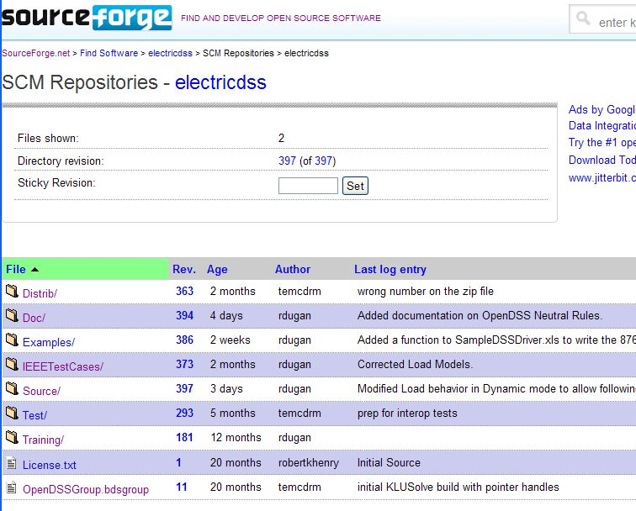
Repository on SourceForge.Net

Slide 42
Accessing the SourceForge.Net Source Code Repository with TortoiseSVN
Install a TortoiseSVN client from Tortoisesvn.net/downloads.
Recommendation:
Then, to grab the files from SourceForge by: 1 - create a clean directory such as "c:\opendss" 2 - right-click on it and choose "SVN Checkout..." from the menu 3 - the repository URL is
http://electricdss.svn.sourceforge.net/svnroot/electricdss
(Change the checkout directory if it points somewhere other than what you want.)
Thereafter, to update a folder or file, right-click on the folder or file and select SVN Update

Slide 43
Program Installation

Slide 44
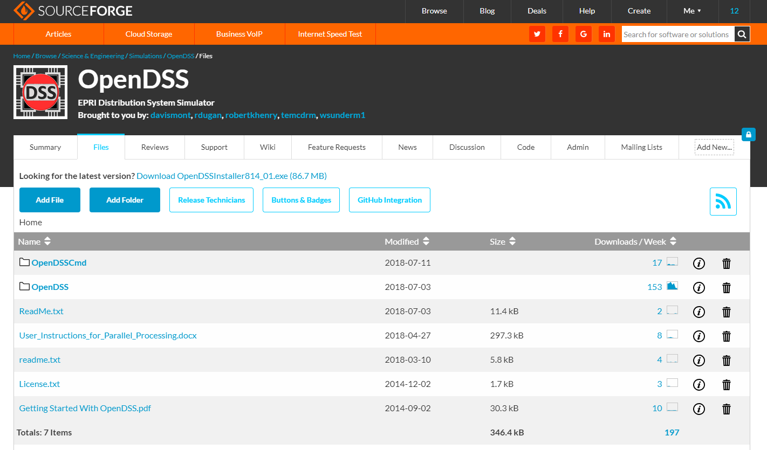
Download the Installer Files

Slide 45
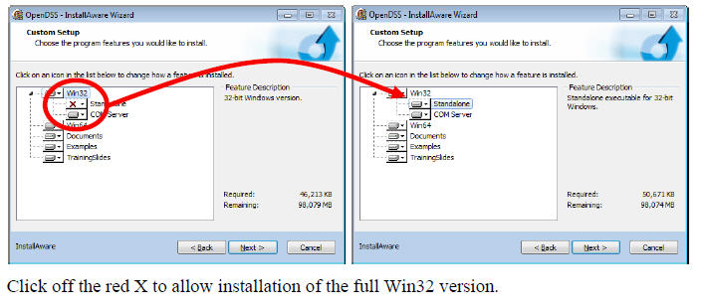
Install Both 32-bit and 64-bit Versions of OpenDSS
DG Screener and Excel typically use 32-bit OpenDSS, but both versions must be installed to get 32-bit server fully installed. Windows will figure out which one needs to be executed. Magic!!

Slide 46
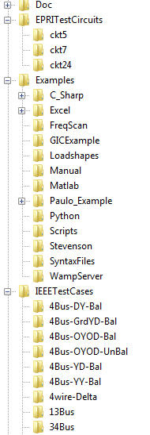
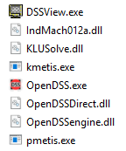
OpenDSS Files Installed
Main Program Files

Slide 47
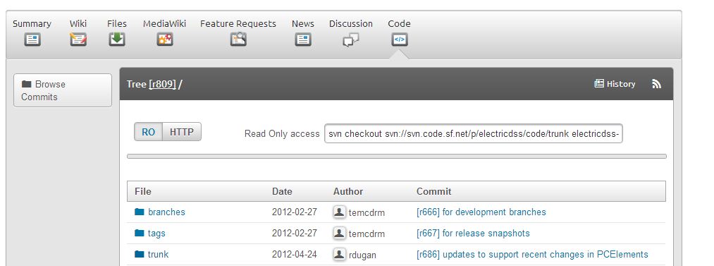
SourceForge.Net Links for OpenDSS
EPRI Links Page
https://www.epri.com/#/pages/sa/opendss?lang=en-US
OpenDSS Download Files:
http://sourceforge.net/projects/electricdss/files/
Top level of Main Repository

Slide 48
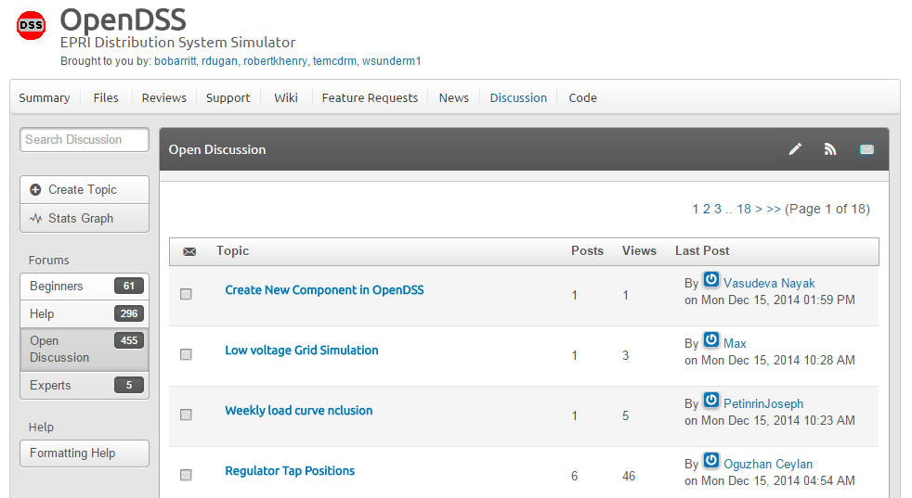
Discussion Forum & News for OpenDSS

Slide 49
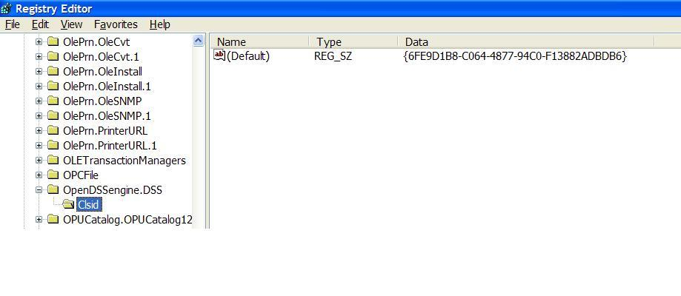
COM Server Registration
Windows Registry Entry
GUID
The Server shows up as “OpenDSSEngine.DSS” in the Windows Registry
The OpenDSS is now available to any program on the computer

Slide 50
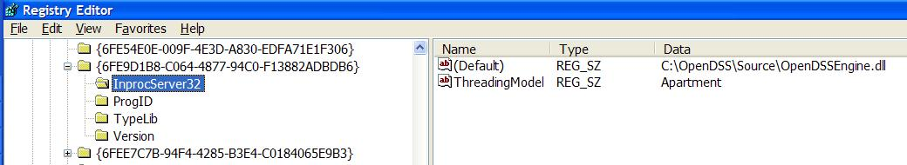
The GUID References the DLL File ….
If you look up the GUID in RegEdit
Points to OpenDSSEngine.DLL (In-process server, Apartment Threading model)

Slide 51
Accessing the SourceForge.Net Source Code Repository with TortoiseSVN
Install a TortoiseSVN client from Tortoisesvn.net/downloads.
Recommendation:
Then, to grab the files from SourceForge by: 1 - create a clean directory such as "c:\opendss" 2 - right-click on it and choose "SVN Checkout..." from the menu 3 - the repository URL is
http://electricdss.svn.sourceforge.net/svnroot/electricdss
(Change the checkout directory if it points somewhere other than what you want.)
Thereafter, to update a folder or file, right-click on the folder or file and select SVN Update

Slide 52
Starting the Program
.

Slide 53
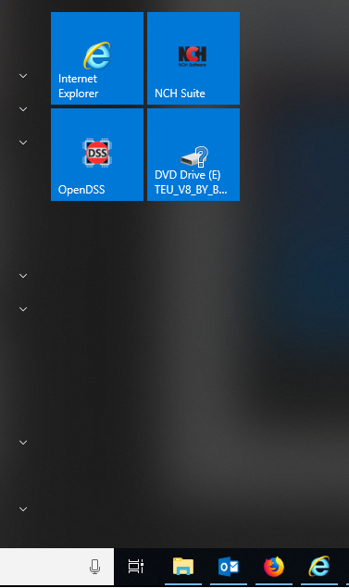

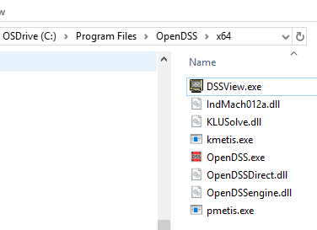
Starting OpenDSS.exe – Standalone executable
Start Menu
Desktop Icon
File Manager/Explorer

Slide 54
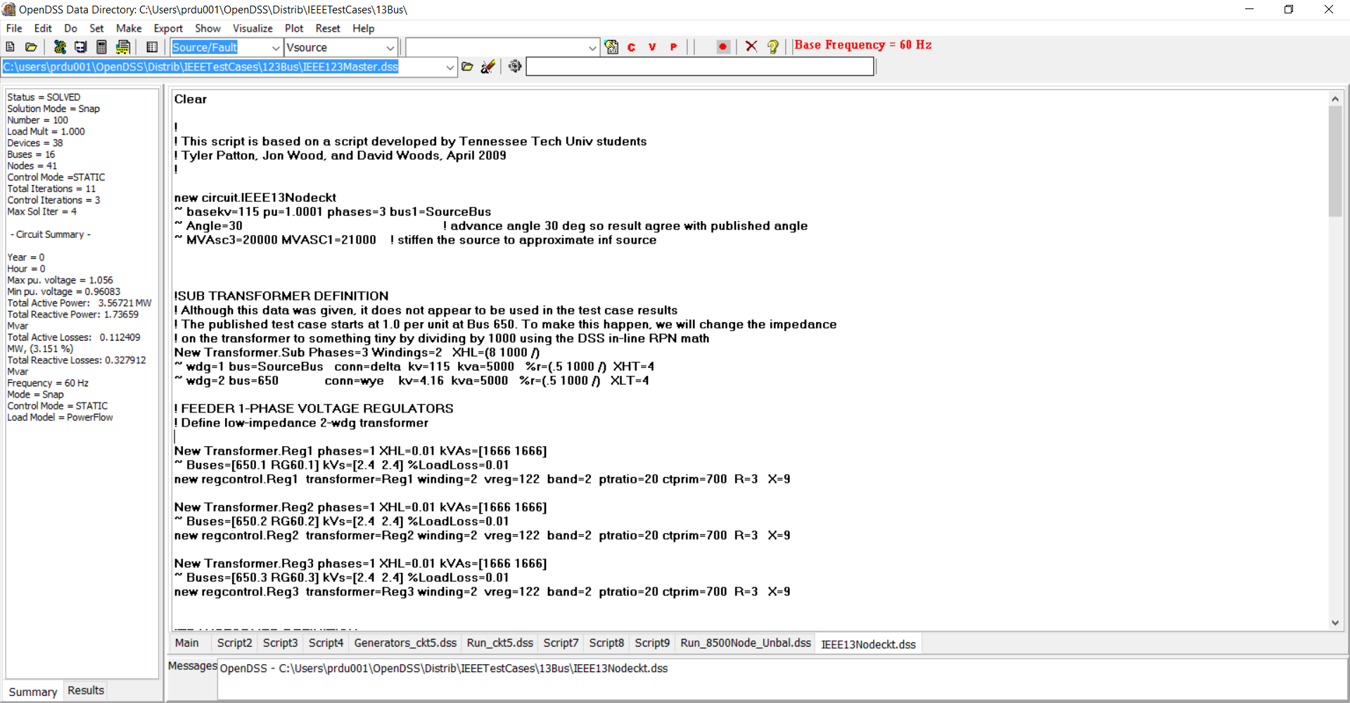
Basic User Screen
Home Folder
Circuit Script
Solution Summary
File Displayed

Slide 55
(Live Demo)
.

Slide 56
How Does OpenDSS Work?

Slide 57
OpenDSS Architecture
.

Slide 58
DSS Structure
Scripts
Main Simulation Engine
COM Interface
User-Written DLLs
Scripts, Results

Slide 59
DSS Object Structure
DSS Executive
Commands
Options
Circuit
Solution
V
[Y]
I
PDElement
PCElement
Controls
Meters
General
Line Transformer Capacitor Reactor
Load Generator Vsource Isource Storage
RegControl CapControl Relay Reclose Fuse
Monitor EnergyMeter Sensor
LineCode LineGeometry WireData LoadShape GrowthShape Spectrum TCCcurve XfmrCode

Slide 60
DSS Class Structure
Instances of Objects of this class
Class
Object 1
Property Definitions
Property Values
Methods
Class Property Editor
Yprim
Collection Manager
States
Object n
Property Values
Methods
Yprim
States

Slide 61
Models Currently Implemented (April 2017)
POWER DELIVERY ELEMENTS
CAPACITOR (Series and shunt capacitors; filter banks)
LINE (All types of lines, cables)
REACTOR (Series and shunt reactors)
TRANSFORMER (multi-phase, multi-winding transformer models)
POWER CONVERSION ELEMENTS
GENERATOR (General generator models)
LOAD (General load models)
PVSYSTEM (Solar PV system with panel and inverter)
STORAGE (Generic storage element models)
INDMACH012 (Induction Machine Model in Symmetrical Components)
CONTROL ELEMENTS
CAPCONTROL (Capacitor bank control; various types)
FUSE (Controls a switch, modeling fuse TCC behavior)
GENDISPATCHER (A specialized controller for dispatching DG)
RECLOSER (Controls a switch, modeling recloser behavior)
REGCONTROL (Standard 32-step regulator/LTC control)
RELAY (Controls a switch, modeling various relay behaviors)
STORAGECONTROLLER (Implementation of AEP’s hub controller)
SWTCONTROL (one way to control switches during simulations)
INVCONTROL (Inverter control for VVO, etc)

Slide 62
Models Currently Implemented (April 2017)
GENERAL DATA
CNDATA (Concentric neutral cable data)
GROWTHSHAPE (Growth vs year)
LINECODE (Line and cable impedances, matrices or symmetrical components)
LINEGEOMETRY (Line geometry data)
LINESPACING (spacing data for LINEGEOMETRY)
LOADSHAPE (Load shape data)
PRICESHAPE (Price shape data)
SPECTRUM (Harmonic spectra)
TCC_CURVE (TCC curves)
TSDATA (Tape shield cable data)
TSHAPE (Temperature shape data)
WIREDATA (Wire parameters, GMR, etc.)
XFMRCODE (Transformer type definitions)
XYCURVE (Generic x-y curves)
METERS
ENERGYMETER (Captures energy quantities and losses)
MONITOR (Captures selected quantities at a point in the circuit)
SENSOR (Simple monitor used for state estimation)
OTHER
FAULT (1 or more faults can be placed anywhere in the circuit)
ISOURCE (Multi-phase current source)
VSOURCE (2-terminal multiphase voltage source, thevinen equivalent)

Slide 63
Built-in Solution Modes
Snapshot (static) Power Flow
Direct (non-iterative solution of I=YV )
Daily mode (default: 24 1-hr increments)
Yearly mode (default 8760 1-hr increments)
Duty cycle (1 to 5s increments)
Dynamics (electromechanical transients)
Fault study
Monte carlo fault study
Harmonic
Custom user-defined solutions

Slide 64
Input Data Requirements
OpenDSS is a Script-driven circuit solution engine
The OpenDSS was designed in a research or consulting environment where input data might come from a variety of sources.
The program can accept many common forms of data for describing impedances, loading, and topology of distribution systems for planning analysis.
The OpenDSS scripting language is designed to require minimal translation from other formats of distribution data.
The program can accept more detailed data for lines, transformers, etc. than the typical data for distribution system analysis when they are available.

Slide 65
Input Data Requirements
OpenDSS Circuit elements have many properties
Nearly all have reasonable default values
Users only need to specify the property values that are
Different than the default values
Used in the circuit simulation
Throughout OpenDSS, property values remain at the value most recently set until they are subsequently changed
They generally do NOT reset to original values unless you explicitly change them

Slide 66
Advanced Types of Data in OpenDSS
Harmonic spectra for harmonic analysis,
Various curves as a function of time for sequential time simulations:
Load shapes (e.g., AMI P, Q data),
Price shapes,
Temperature shapes,
Storage dispatch curves,
Growth curves.
Efficiency curves for PV inverters,
Voltage dependency exponents for loads,
Capacitor control settings,
Regulator control settings,
TCC Curves and other data for Fuse, Relay, and Recloser objects
Machine data.

Slide 67
Equations

Slide 68
The Math …
Nearly everything results in a matrix or array
Nodal Admittance formulation
Circuit elements modeled by primitive admittance matrices
Y_{prim}
Primitive Y matrices used to build System Y matrix
OpenDSS Works In
Phase domain
Actual volts and amps
Symmetrical components and per units not used inside the program !! -- Input and output only!

Slide 69
Primitive Y Matrix
Simple Resistor

Slide 70
Primitive Y Matrix, cont’d
LINE model

Slide 71
What about 3-phase elements?
Simply let R, X, B, G, C, etc. represent 3x3 matrix
Notation stays the same
And it works!
I1, I2, V1, V2 etc become 3x1 vectors
This is basically how all the Circuit Element (CktElement) models in OpenDSS work.

Slide 72
The Network Model

Slide 73
Nodal Admittance Equations
V₁
V₂
…
V_{S}
…
V_{L1}
…
V_{L2}
…
V_{N}
I₁
I₂
…
I_{S}
…
I_{L1}
…
I_{L2}
…
I_{N}
Y_{SYSTEM}
=
N x N
(Sparse)
N = Number of NODES (not BUSES)

Slide 74
Solving the Power Flow
Once the circuit model is connected properly the next step is to Solve the base power flow
PC elements (i.e., Loads) are usually nonlinear
Loads are linearized to a Norton equivalent based on nominal 100% rated voltage.
Current source is “compensation current”
Compensates for the nonlinear characteristic
A fixed point iterative solution algorithm is employed for most solutions
This method allows for flexible load models and is robust for most distribution systems

Slide 75
Load (a PC Element)
General Concept
Added into Injection Current Vector
Goes into System Y Matrix
(One-Line Diagram)
Most Power Conversion (PC) Elements are Modeled Like This

Slide 76
Load - 3-phase Y connected
Phase 1
1
2
Phase 2
3
4 Conductors/Terminal
Phase 3
4

Slide 77
Load - 3-phase Delta connected
Phase 1
2
1
Phase 2
3
3 Conductors/Terminal
Phase 3

Slide 78
Load Models (Present version)
1:Standard constant P+jQ load. (Default)
2:Constant impedance load.
3:Const P, Quadratic Q (like a motor).
4:Nominal Linear P, Quadratic Q (feeder mix). Use this with CVRfactor.
5:Constant Current Magnitude
6:Const P, Fixed Q
7:Const P, Fixed Impedance Q
8: Special ZIP load model

Slide 79
Standard P + jQ (constant power) Load Model
When the voltage goes out of the normal range for a load the model reverts to a linear load model
This generally guarantees convergence
Even when a fault is applied
This script changes break points to +/- 10%:
Load.Load1.Vmaxpu=1.10
Load.Load1.Vminpu=0.90
Note: to solve some of the IEEE Radial Test feeders and match the published results, you have to set Vminpu to less than the lowest voltage published (usually about 0.80 per unit)

Slide 80
Standard P + jQ Load Model (Model=1)
Const Z
105%
(Defaults*)
95%
|I| = |S/V|
Const Z
New Method (2014)
* Change by setting Vminpu and Vmaxpu Properties

Slide 81
Power Flow Solution Algorithm
Initial Guess at Node Voltages, V
Compute all Injection (Compensation) Currents, I
For PC Elements
Solve for new guess at V
Repeat 2 and 3 until Converged
Convergence is based on change in per unit voltage magnitude
Default tolerance = 0.0001
Good enough for distribution systems

Slide 82
Putting it All Together
ALL Elements
Yprim 1
Yprim 2
Yprim 3
Yprim n
PC Elements Comp. Currents
I1
I2
Y
Node
Voltages
I_{inj}
=
V
Im
Iteration Loop

Slide 83
Putting it All Together
Th-Th-That's All Folks !
ALL Elements
Yprim 1
Yprim 2
Yprim 3
Yprim n
PC Elements Comp. Currents
I1
I2
Y
Node
Voltages
I_{inj}
=
V
Im
Iteration Loop

Slide 84
A More Concise Form …
Fixed-point solution form for normal solution
V_{n+1} = [Y_{system}]⁻¹ I_{PC}(V_{n}) n = 0, 1, 2, …
…until converged
I_{PC}(V) = compensation currents from Power Conversion (PC) elements in the circuit as a function of voltage

Slide 85
OpenDSS Solution Loop with Controls
Controls are sampled and executed after a converged power flow solution
Power Flow Solution

Slide 86
Solving the Power Flow …
This solution method requires that the first guess at the voltages be close to the final solution
Not a problem for daily or yearly simulations
Present solution is a good initial guess at next time step
First solution is often most difficult
The solution initialization routine in OpenDSS accomplishes this with ease in most cases
Method works well for arbitrary unbalances
For conditions that are sensitive, a Newton method is provided that is more robust, but slower.
Not to be confused with “Newton-Raphson Power Flow”

Slide 87
Losses are computed quite simply for any device model
Sum the powers into each conductor and losses are the power left over (not summing to zero)
I
V
S_{i}=V_{i}I_{i}*=P_{i}+jQ_{i}

