Slide 1
OpenDSS Training Workshop
Consolidated Edison Co.
New York, NY
Roger C. Dugan
Davis Montenegro
EPRI Knoxville, TN
October 17-18, 2019

Slide 2
4. Application Programming Interfaces

Slide 3
COM and DirectDLL Interfaces

Slide 4
Why You Might Want to Write Some Code …
There is no looping in the DSS scripting language
To implement an algorithm not in OpenDSS
For optimizing device siting …
Generators
Capacitors
Reclosers
To automate some repetitive analysis task
To develop a new device model or control
Using the COM interface
Writing a Dynamic-Linked Library (DLL)

Slide 5
Ways to Write Code to Do Innovative Things with OpenDSS
COM Interface
Microsoft standard: Windows only
Well supported in MS Office as well as Python and other languages
DirectDLL Interface
Standard function call library
Same functions as COM interface, but for languages that do not support COM
Write a separate program to auto-generate DSS scripting code and run as text script

Slide 6
DSS Structure
Scripts
Main Simulation Engine
COM Interface
User-Written DLLs
Scripts, Results

Slide 7
What Languages Can You use for Your Code?
Excel VBA
VB.net
C#
C/C++
Delphi, Free Pascal
MATLAB
Python
Java
LabView
R
Fortran (for DLLs, with DirectDLL)
Julia (with DirectDLL)

Slide 8
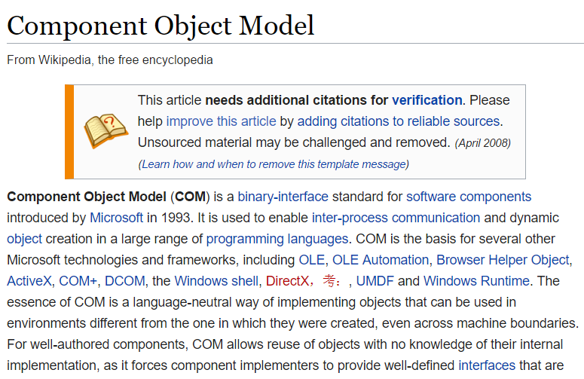
COM Interface

Slide 9
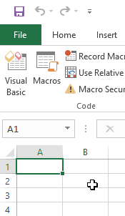
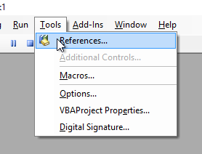
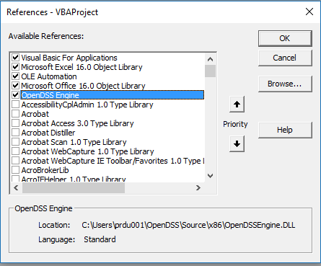
Finding COM Servers on Your Computer
Excel VBA

Slide 10
OpenDSS COM Interfaces
There are many interfaces supplied by the COM server
There is one registered In-Process COM interface:
OpenDSSEngine.DSS
The DSS interface is the one your program instantiates
The DSS interface then creates all the others.
This is for simplicity for users who are not necessarily familiar with COM programming

Slide 11
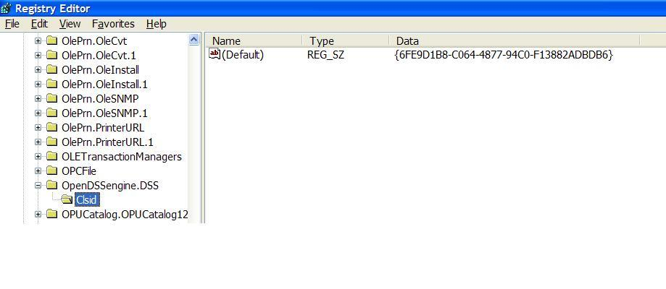
The in-process COM server in the Windows Registry
Windows Registry Entry
GUID
The Server shows up as “OpenDSSEngine.DSS” in the Windows Registry
The OpenDSS is now available to any program on the computer

Slide 12
“Active objects” concept
.The interfaces generally act on the ACTIVE object
Active circuit,
Active circuit element,
Active bus, etc.
The interfaces generally point to the active object
To work with another object, change the active object
There are methods for selecting objects
You may also use script commands

Slide 13
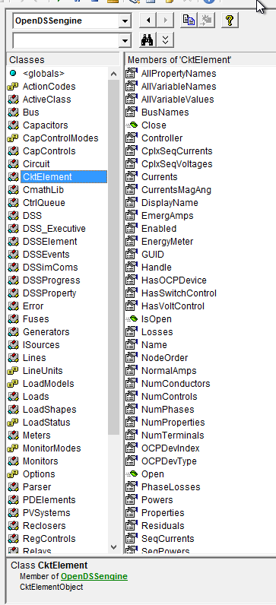
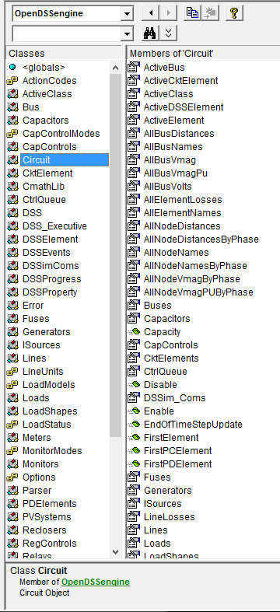
Object Browser in VBA for OpenDSSEngine
The Object Browser in MS Office VBA is a good way to learn what is available through the OpenDSS COM Interface

Slide 14
A Simple Excel VBA Macro
To run the IEEE 123-bus Test Feeder and plot the voltage profile

Slide 15
Option Explicit
Public MyOpenDSS As OpenDSSengine.DSS
Public MyText As OpenDSSengine.Text
Public MyCircuit As OpenDSSengine.Circuit
Public Sub MyMacro()
Set MyOpenDSS = New OpenDSSengine.DSS
MyOpenDSS.Start (0)
Set MyText = MyOpenDSS.Text
Set MyCircuit = MyOpenDSS.ActiveCircuit
MyText.Command = "Compile (C:\OpenDSS\IEEETestCases\123Bus\IEEE123Master.dss)"
MyText.Command = "New Energymeter.M1 element=Line.L115 terminal=1"
MyText.Command = "Solve"
Dim MyVoltages As Variant
Dim MyNames As Variant
Dim Mydistances As Variant
MyVoltages = MyCircuit.AllBusVmagPu
MyNames = MyCircuit.AllNodeNames
Mydistances = MyCircuit.AllNodeDistances
Dim i As Integer, irow As Integer
irow = 1
For i = LBound(MyVoltages) To UBound(MyVoltages)
ActiveSheet.Cells(irow, 1).Value = MyNames(i)
ActiveSheet.Cells(irow, 2).Value = Mydistances(i)
ActiveSheet.Cells(irow, 3).Value = MyVoltages(i)
irow = irow + 1
Next I
Set MyOpenDSS = Nothing
End Sub

Slide 16
Steps Required to Do This
Register OpenDSSEngine.DLL (32-bit)
Start Microsoft Excel
Type alt-F11 to open VBA editor
Or Tools>Macro …
Select OpenDSS Engine under Tools>References
Insert>Module
Enter the VBA code into blank module
Use correct path name for your computer
Execute the macro “MyMacro”

Slide 17
Resulting Chart in Excel

Slide 18
VBA Example
Option Explicit
Public DSSobj As OpenDSSengine.DSS
Public DSSText As OpenDSSengine.Text
Public DSSCircuit As OpenDSSengine.Circuit
Public Sub StartDSS()
' Create a new instance of the DSS
Set DSSobj = New OpenDSSengine.DSS
' Assign a variable to the Text interface for easier access
Set DSSText = DSSobj.Text
' Start the DSS
If Not DSSobj.Start(0) Then MsgBox "DSS Failed to Start"
End Sub
Define some public variables that are used throughout the project
This routine instantiates the DSS and starts it. It is also a good idea at this time to assign the text interface variable.

Slide 19
VBA Example
Public Sub LoadCircuit(fname As String)
' Always a good idea to clear the DSS when loading a new circuit
DSSText.Command = "clear"
' Compile the script in the file listed under "fname" cell on the main form
DSSText.Command = "compile " + fname
' The Compile command sets the current directory the that of the file
' Thats where all the result files will end up.
' Assign a variable to the Circuit interface for easier access
Set DSSCircuit = DSSobj.ActiveCircuit
End Sub
This subroutine loads the circuit from the base script files using the Compile command through the Text interface. “fname” is a string contains the name of the master file.
There is an active circuit now, so assign the DSSCircuit variable.

Slide 20
VBA Example
Public Sub LoadSeqVoltages()
' This Sub loads the sequence voltages onto Sheet1 starting in Row 2
Dim DSSBus As OpenDSSengine.Bus
Dim iRow As Long, iCol As Long, i As Long, j As Long
Dim V As Variant
Dim WorkingSheet As Worksheet
Set WorkingSheet = Sheet1 'set to Sheet1 (target sheet)
iRow = 2
For i = 1 To DSSCircuit.NumBuses ' Cycle through all buses
Set DSSBus = DSSCircuit.Buses(i) ' Set ith bus active
' Bus name goes into Column 1
WorkingSheet.Cells(iRow, 1).Value = DSSCircuit.ActiveBus.Name
' Load sequence voltage magnitudes of active bus into variant array
V = DSSBus.SeqVoltages
' Put the variant array values into Cells
' Use Lbound and UBound because you don't know the actual range
iCol = 2
For j = LBound(V) To UBound(V)
WorkingSheet.Cells(iRow, iCol).Value = V(j)
iCol = iCol + 1
Next j
iRow = iRow + 1
Next i
End Sub
This Sub puts the sequence voltage onto a spreadsheet
Define a variable for the Bus interface
Define a variant to pick up the arrays
Cycle through all the buses
Get the bus name
Get the voltages into the variant array
Put them on the spreadsheet

Slide 21
DirectDLL

Slide 22
Direct connection Shared Library (DLL) for OpenDSS
The direct connection shared library is a DLL that implements the same classes, properties and methods of the OpenDSS COM interface. This alternative was generated to accelerate the In-process co-simulation between OpenDSS and external software when the client software does not support early bindings connection to COM servers/controls.
Normally, high level programming languages do not support early bindings, which make them use late bindings for data exchanging with COM servers. Late bindings procedures add an important overhead to the co-simulation process specially when executing loops.
So, if your programming language does not support early bindings connection with COM servers, this is the library you should use to accelerate your simulations. This library is called OpenDSSDDirect.dll, and can be accessed directly without needing to register it into the OS registry.
However, if your programming language supports early bindings, keep using the COM interface, the simulation speed will be accelerated naturally when using this connection procedure instead of late bindings.
The properties implemented in this library are the same implemented in the COM interface, so, this manual can be used as a reference manual for the classes, properties and methods included in the COM interface.

Slide 23
Why Use DirectDLL?
Your programming language does not support COM
In a non-Windows environment such as Apache server
Your programming language does not support early bindings in COM and you want to speed things up
MATLAB
See “COM Speed Comparison.pdf” in the Doc folder
If your programming language supports early binding in COM, continue to use the COM interface
The properties implemented in this library are the same implemented in the COM interface; Just accessed differently

Slide 24
DirectDLL Exports
exports
DSSPut_Command,
DSSLoads, DSSLoadsF,DSSLoadsS, DSSLoadsV,
DSSProperties,
CktElementI, CktElementF, CktElementS, CktElementV,
ErrorCode, ErrorDesc,
CircuitI, CircuitF, CircuitS, CircuitV,
BusI, BusF, BusS, BusV,
SolutionI, SolutionF, SolutionS, SolutionV,
MonitorsI, MonitorsS,MonitorsV,
MetersI,MetersF,MetersS,MetersV,
GeneratorsI,GeneratorsF,GeneratorsS,GeneratorsV,
DSSProgressI,DSSProgressS,
SettingsI,SettingsF,SettingsS,SettingsV,
LinesI, LinesF, LinesS, LinesV,
CtrlQueueI,CtrlQueueV,
DSSElementI, DSSElementS, DSSElementV,
ActiveClassI, ActiveClassS, ActiveClassV,
CapacitorsI,CapacitorsF,CapacitorsS,CapacitorsV,
TransformersI,TransformersF,TransformersS,TransformersV,
SwtControlsI,SwtControlsF,SwtControlsS,SwtControlsV,
CapControlsI,CapControlsF,CapControlsS,CapControlsV,
RegControlsI,RegControlsF,RegControlsS,RegControlsV,
TopologyI,TopologyS,TopologyV,
DSSExecutiveI,DSSExecutiveS,
SensorsI,SensorsF,SensorsS,SensorsV,
XYCurvesI,XYCurvesF,XYCurvesS,XYCurvesV,
PDElementsI,PDElementsF,PDElementsS,
ReclosersI, ReclosersF, ReclosersS, ReclosersV,
RelaysI,RelaysS,RelaysV,
CmathLibF,CmathLibV,
ParserI,ParserF,ParserS,ParserV,
LoadShapeI,LoadShapeF,LoadShapeS,LoadShapeV,
FusesI,FusesF,FusesS,FusesV,
IsourceI,IsourceF,IsourceS,IsourceV,
PVsystemsI,PVsystemsF,PVsystemsS,PVsystemsV,
VsourcesI,VsourcesF,VsourcesS,VsourcesV,
DSSI,DSSS,DSSV,
InitAndGetYparams,GetCompressedYMatrix,ZeroInjCurr,GetSourceInjCurrents,GetPCInjCurr,
SystemYChanged,BuildYMatrixD,UseAuxCurrents,AddInAuxCurrents,getIpointer,
getVpointer,SolveSystem;

Slide 25
Example: Circuit Interface in Direct DLL
For each COM Interface there is a series of functions:
function CircuitI(mode:longint; arg: longint):longint;cdecl;
function CircuitF(mode:longint; arg1, arg2: double):double;cdecl;
function CircuitS(mode:longint; arg: pAnsiChar):pAnsiChar;cdecl;
procedure CircuitV(mode:longint; out arg:variant; arg2: longint);cdecl;
…I – Returns Integer values
…F – Returns Floating-Point Values (64 bit)
…S – Returns long pointer to ANSI string
…V – Returns Variant values (arrays, complex numbers, etc.)
Mode – Specifies which quantity you want from the Circuit interface (see doc)
The OpenDSS DirectDLL is documented in
…\doc\OpenDSS_Direct_DLL.pdf

Slide 26
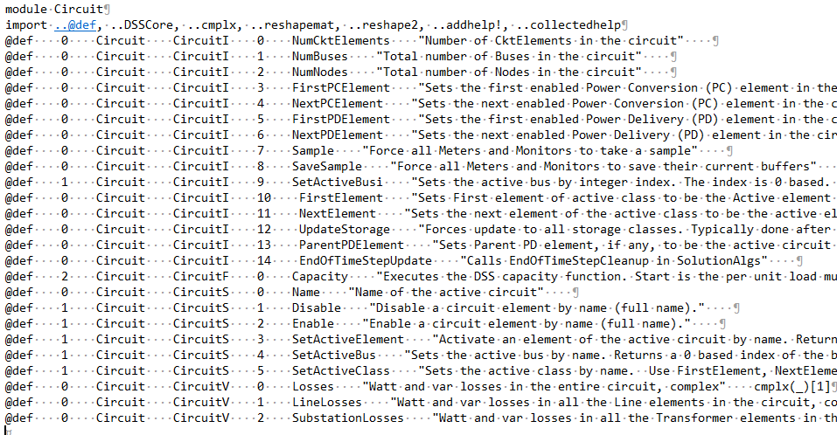
Example: Redefining the DirectDLL Functions for Julia
From Tom Short, EPRI (search GitHub)

Slide 27
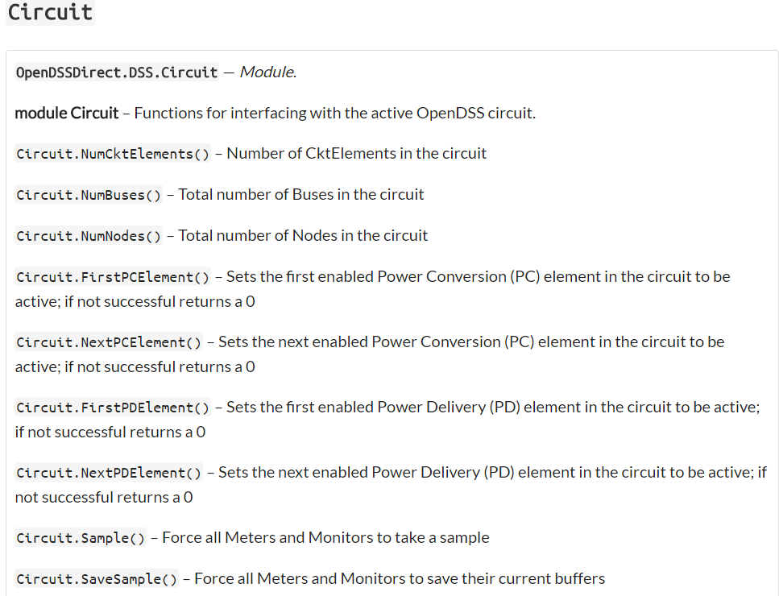
Resulting Circuit Interface in Julia

Slide 28
References to DirectDLL Usage via Julia
https://tshort.github.io/OpenDSSDirect.jl/stable/api.html
https://github.com/tshort/OpenDSSDirect.jl/tree/master/examples
https://github.com/tshort/OpenDSSDirect.jl/tree/75ec31703fc44035d9f617775f21def2489a3a07
https://github.com/tshort/OpenDSSDirect.jl/blob/75ec31703fc44035d9f617775f21def2489a3a07/src/api.jl#L1278
(From Tom Short’s github site)

Slide 29
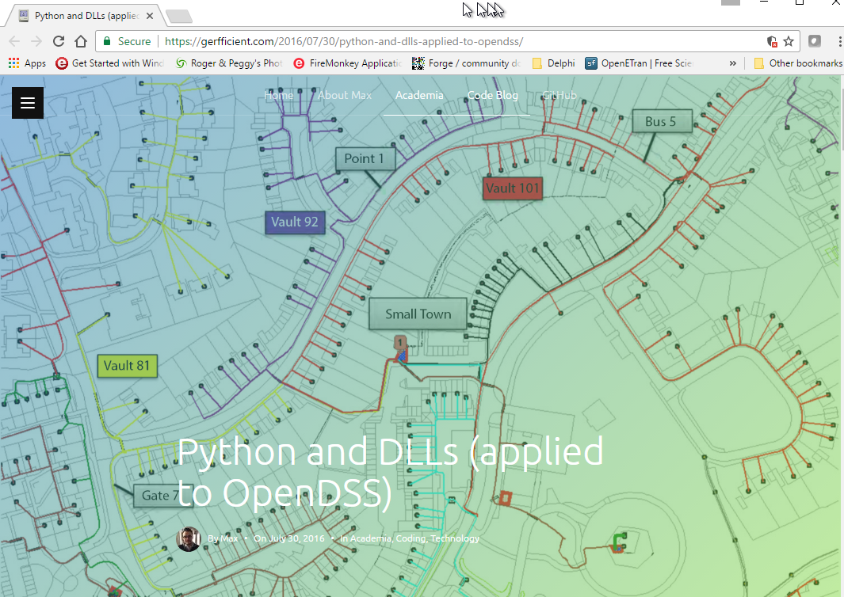
An Interesting 3rd Party Link Using the Direct DLL interface

