Slide 1
DRC Scenarios
OpenDSS: Version 8.6.6.1
Authors: Paulo Radatz and Celso Rocha

Slide 2
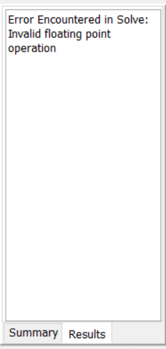
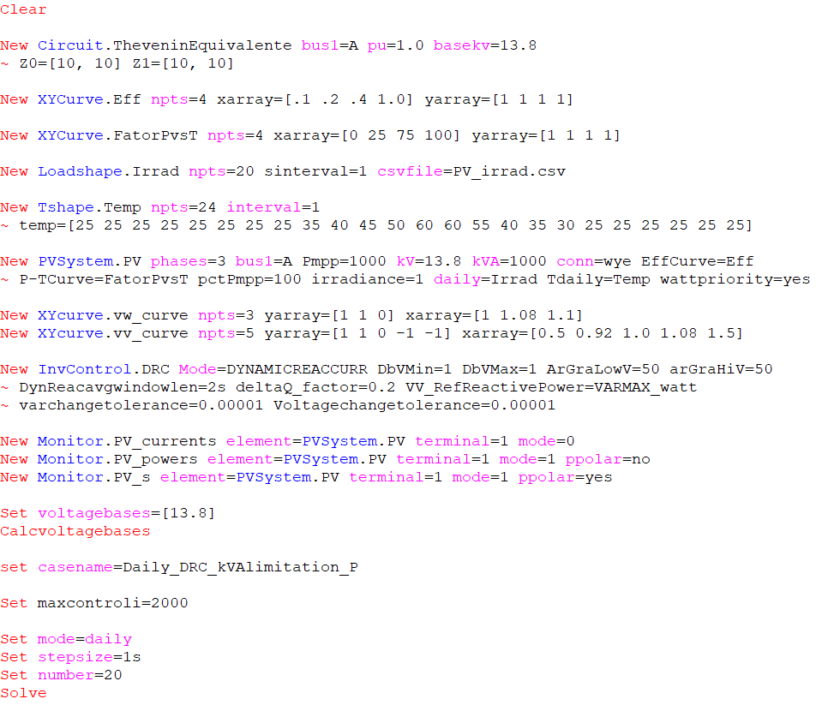
Scenario 3: Daily with kVA limitation – P priority
DbVMin=DbVMax=1
ArGraLowV=ArGraHiV=50=ArGraV
Kvarlimit=kVA
Results:
OpenDSS code (Daily_DRC_kVAlimitation_P.dss)
Key points:
It does not work as expected!

Slide 3
Scenario 3: Daily with kVA limitation – P priority
DbVMin=DbVMax=1
ArGraLowV=ArGraHiV=50=ArGraV
Kvarmax=kVA
Results:
OpenDSS code (Daily_DRC_kVAlimitation_P-2.dss)
Q reduced to satisfy rating
Key points:
It works as expected!
When kVA is exceeded, Qtotal is reduced and then it is not equal to Qdesired

Slide 4
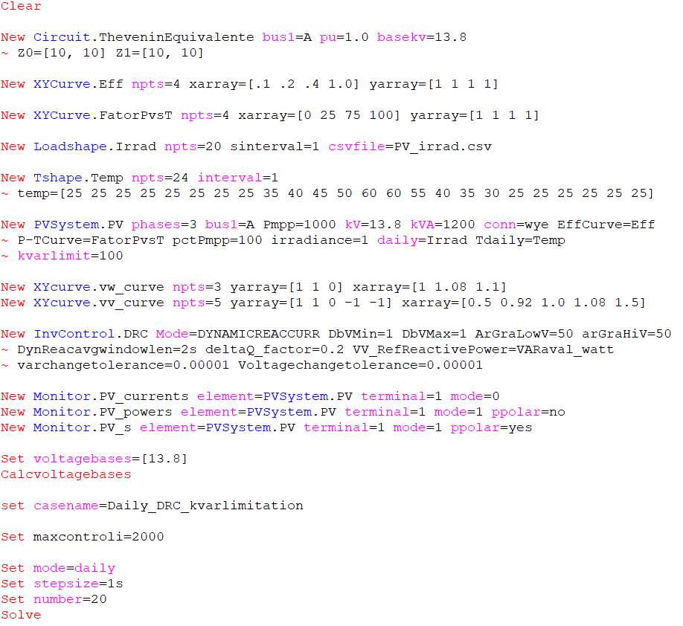

Scenario 4: Daily with kvar limitation
DbVMin=DbVMax=1
ArGraLowV=ArGraHiV=50=ArGraV kvarlimit=100
Kvarlimit=kVA VV_RefReactivePower = Varaval_watts
Results:
OpenDSS code (Daily_DRC_kvarlimitation.dss)
$QdesiredAva(t)=$ -Delta(t) x ArGraV x Qava(t)
Key points:
It does not work as expected!
Qtotal is not equal to QdesiredAva

Slide 5
Scenario 4: Daily with kvar limitation
DbVMin=DbVMax=1
ArGraLowV=ArGraHiV=50=ArGraV kvarlimit=100
Kvarmax=kVA VV_RefReactivePower = Varaval_watts
Results:
OpenDSS code (Daily_DRC_kvarlimitation-2.dss)
$QdesiredAva(t)=$ -Delta(t) x ArGraV x Qava(t)
Key points:
It works as expected!
Q limited to satisfy kvarlimit

