Slide 1
OpenDSS Training Workshop
Idaho Power Co.
Boise, Idaho
Roger C. Dugan
Davis Montenegro
EPRI Knoxville, TN
September 24-25, 2019

Slide 2
5. Smart Grid Simulation

Slide 3
COM Interfaces, Loadshapes, Dynamics Modeling, and Custom Simulations

Slide 4
MATLAB COM Interface Example

Slide 5
MATLAB Startup Function
%--------------------------------------------------------------------------
function [Start,DSSObj,Text] = DSSStartup
% Function for starting up the DSS
%instantiate the DSS Object
DSSObj = actxserver('OpenDSSEngine.DSS');
%
%Start OpenDSS. Only needs to be executed the first time w/in a
%Matlab session
Start = DSSObj.Start(0);
% Define a variable that points to the text interface
Text = DSSObj.Text;

Slide 6
MATLAB Startup Function
% Examples of using Matlab to plot the voltage profile and other data
% NOTE: if this doesn't work, you might try updating your openDSS version
% Also, don't forget to register OpenDSSEngine.DLL (see instructions)
% execute DSSStartup.m
[DSSStartOK, DSSObj, DSSText] = DSSStartup;
if DSSStartOK
DSSText.command='Compile (C:\opendss\IEEETestCases\123Bus\IEEE123Master.dss)';
% Set up the interface variables
DSSCircuit=DSSObj.ActiveCircuit;
DSSSolution=DSSCircuit.Solution;
% Add an EnergyMeter object so the distances down the feeder are
% computed
DSSText.Command='New EnergyMeter.Main Line.SW1 1';
% Add a Monitor, too
DSSText.Command='New Monitor.FeederEnd Line.L99 1';
% Limit regulator tap changes to 1 tap per change to better
% approximate the published results
% This example does this using the RegControls collection in the COM
% interface instead of the Command interface
% Assign a Variable to the RegControls interface
Regulators = DSSCircuit.RegControls;
% cycle through all the regulators using First .. Next
iReg = Regulators.First;
while iReg>0
Regulators.MaxTapChange = 1;
Regulators.Delay = 30; % set all delays to 30s
iReg = Regulators.Next;
end
% now set creg1a delay to 15s so it goes first
<SNIP>

Slide 7
Example Solution Loop in MATLAB
% Solve executes the solution for the present solution mode, which is "snapshot" and
% establishes the bus list.
% We're going to do the solution in pieces to demonstrate how it is
% done
MyControlIterations = 0;
while MyControlIterations < DSSSolution.MaxControlIterations
DSSSolution.SolveNoControl;
% display the result
disp(['Result=' DSSText.Result])
if DSSSolution.Converged
a = ['Solution Converged in ' num2str(DSSSolution.Iterations) ' iterations.'];
else
a = 'Solution did not Converge';
end
disp(a)
DSSSolution.SampleControlDevices;
DSSSolution.DoControlActions;
if DSSSolution.ControlActionsDone, break, end
MyControlIterations = MyControlIterations + 1;
end

Slide 8
Another Example in MATLAB
% ---------------------------------------------------------------------
% Run a Daily analysis and plot the voltages at the end of the feeder
% --------------------------------------------------------------------
% First set all the Load daily properties to Default
DSSLoads = DSSCircuit.Loads;
iLoad = DSSLoads.First;
while iLoad>0
DSSLoads.daily = 'default';
iLoad = DSSLoads.Next;
end
DSSText.Command = 'set mode=daily';
DSSSolution.Solve;
% Export monitor
DSSText.Command = 'export mon FeederEnd';
MonFileName = DSSText.Result;
MyCSV = csvread(MonFileName, 1, 0);
Hour = MyCSV(:,1);
Volts1 = MyCSV(:,3);
Volts2 = MyCSV(:,5);
Volts3 = MyCSV(:,7);
figure(2);
plot(Hour, Volts1,'-k+'); % black *
hold on
plot(Hour, Volts2,'-r+');
plot(Hour, Volts3,'-b+');
title('Daily Simulation');
ylabel('Volts');
xlabel('Hour');
hold off
See “MiscExamples.m” in …\Examples\Matlab

Slide 9
Loadshapes and Quasi-Static Time-Series (QSTS) Simulation

Slide 10
Loadshapes
A key feature of OpenDSS
Sequential time simulation is required for many Smart Grid analyses
Basic time-varying modes that use Loadshape objects
Daily (nominally 24 h, 1 h steps)
Yearly (nominally 8760 h, 1 h steps)
Dutycycle (nominal step size 1 s .. 5 m)
(used for wind and solar)
Learning to work with Loadshapes is essential skill for OpenDSS users

Slide 11
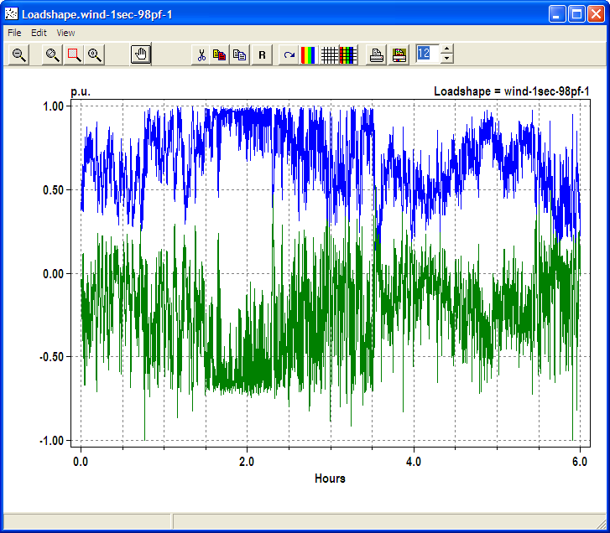
Example Loadshape for Wind Turbine Output
Watts
Vars

Slide 12
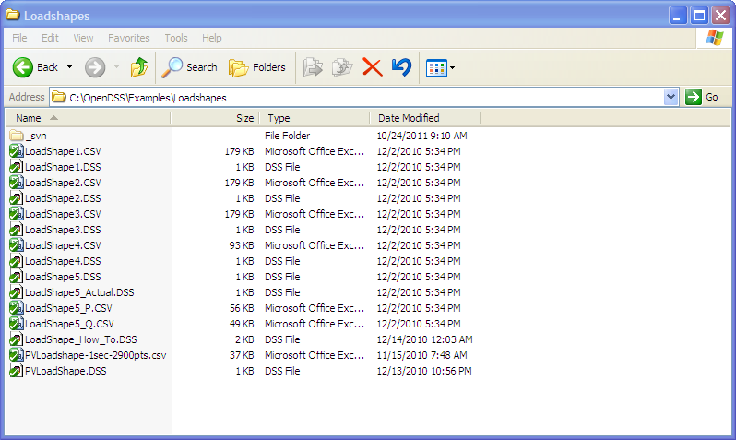
Example Loadshapes Provided in Examples Folder

Slide 13
How to Define
Clear
! Example scripts for loading and plotting loadshapes out of the loadshape library
! You have to have a circuit defined to load in loadshapes.
New Circuit.LoadshapeExamples
! directly ...
New "LoadShape.LoadShape1a" npts=8760 interval=1.0 mult=(File=LoadShape1.csv)
Plot Loadshape Object=Loadshape1a ! execute this to prove you got it
! or using Redirect
Redirect Loadshape1.DSS ! Load in Loadshape 1
Plot Loadshape Object=Loadshape1

Slide 14
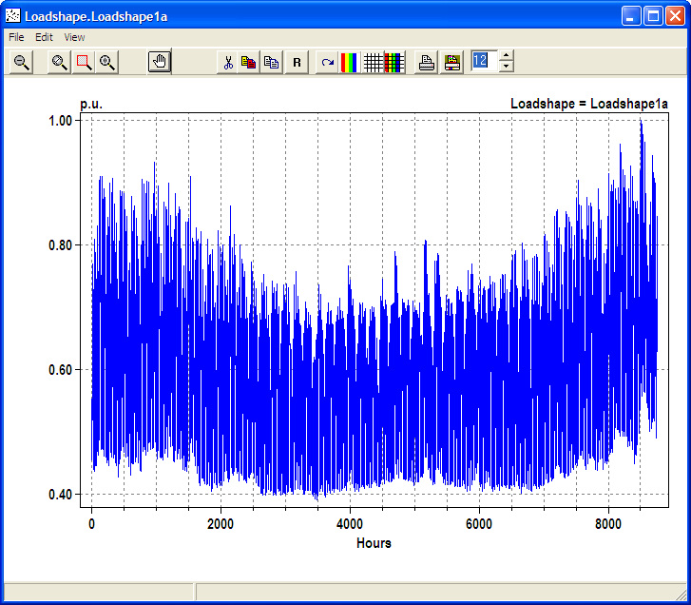
Example Yearly LoadShape, Winter Peaking

Slide 15
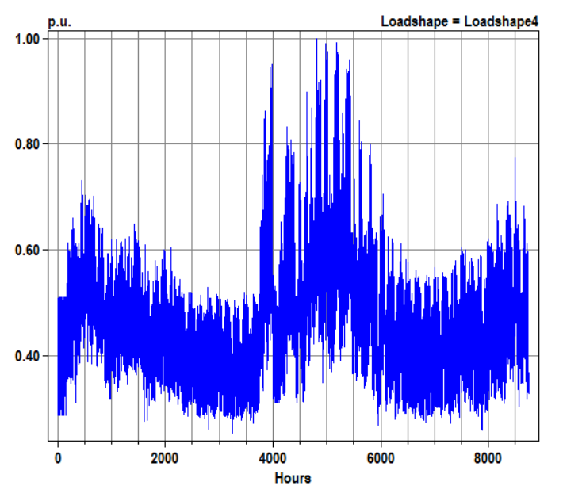
Example Loadshape – Summer Peaking

Slide 16
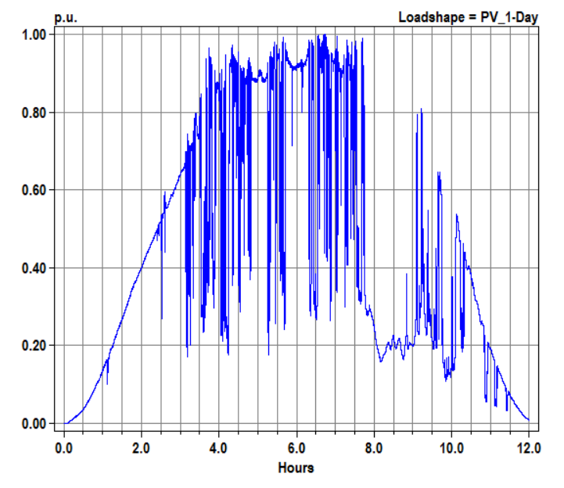
Example Loadshape – One Day Solar (1-s interval)

Slide 17
Loadshape Interpolation
The OpenDSS LOADSHAPE class uses two different types of interpolation depending on it is defined
Fixed interval data
Variable interval data
Fixed interval data.
This is the Default. INTERVAL property defaults to 1 hour.
You can set it to another value or to 0.
The SINTERVAL and MINTERVAL properties facilitate defining intervals in second or minutes.
INTERVAL > 0 implies fixed interval data
CSV files --one numeric value per line.
Interpolation algorithm assumes the value REMAINS CONSTANT over the entire interval
The HOUR array property is ignored

Slide 18
Loadshape Interpolation, Cont’d
For LINEAR INTERPOLATION between the points, define INTERVAL=0.
Then both the time and multiplier values for the loadshape using the HOUR, MULT, and QMULT array properties.
Alternatively, you may use the CSVFILE, DBLFILE, or SNGFILE properties.
Enter both the time in hours and the multiplier values.
A CSV file would have two values per line separated by a comma or whitespace.
The variable interval interpolation could be a little bit slower than the fixed interval data because there is more work to do to compute the factor.

Slide 19
Importing Packed Binary Files
For simulations, such as AMI load data, requiring large volumes of Loadshapes to be imported, using packed binary files can save time
Standard CSV or TXT file
Mult=[file=myfile.txt]
File of doubles
Mult=[dblfile=myfile.dbl]
File of singles
Mult=[sngfile=myfile.sng]

Slide 20
Defining Array Properties Using CSV files
Syntax:
mult=[File=myMultiColumnFile.CSV, Column=n, Header=Yes/No]
Allows use of multicolumn CSV files with a single header row.
Example:
New Loadshape.Ramp2 npts=4000 sInterval=1 mult=(file=MultiChannelTest.csv, column=3, header=yes)
Imports the 3rd column from the file, skipping the header row

Slide 21
Dynamics Mode Solution

Slide 22
Dynamics Mode
Dynamics mode is used for
Fault current calculations including Generator contributions
Single time-step solution
Machine transients
Inverter transients
Typical time step: 0.2 – 1 ms
Depends on time constants in model
A converged power flow is required to initialize the model.

Slide 23
Basic Algorithm (From SolutionAlgs.Pas)
Increment_time;
{Predictor}
IterationFlag := 0;
IntegratePCStates;
SolveSnap;
{Corrector}
IterationFlag := 1;
IntegratePCStates;
SolveSnap;

Slide 24
Entering Dynamics Mode
Initialize state variables in all PC Elements
For example, in a Generator object currently:
Compute voltage, E₁, behind Xd‘ and Initialize the phase angle, θ, to match power flow (approximately)
Set derivatives of the state variables to zero
For the Generator: Speed (relative to synch frequency), Angle
Set controlmode=time
When running in time steps of a few seconds or less, controls that depend on the control queue for instructions on delayed actions will be automatically sequenced when the solution time reaches the designated time for an action to occur.

Slide 25
3-Phase Generator Model in Dynamics Mode
E∠θ

Slide 26
Differential Equations for Default Generator (1-Mass)
Derivative Calculation:
Integration
Trapezoidal integration formula for θ, for example:

Slide 27
User-Written DLLs
More complex behaviors can be modeled using Dynamic-Linked Libraries
Requires more sophisticated programming skills
Certain PCElements provide interfaces
Generator, Storage
Some Control elements, too (CapControl)
IndMach012a.DLL is an example supplied with the program
A symmetrical component based induction machine model for the Generator class element
(2017: now built in as a base model)

Slide 28
Custom Simulations

Slide 29
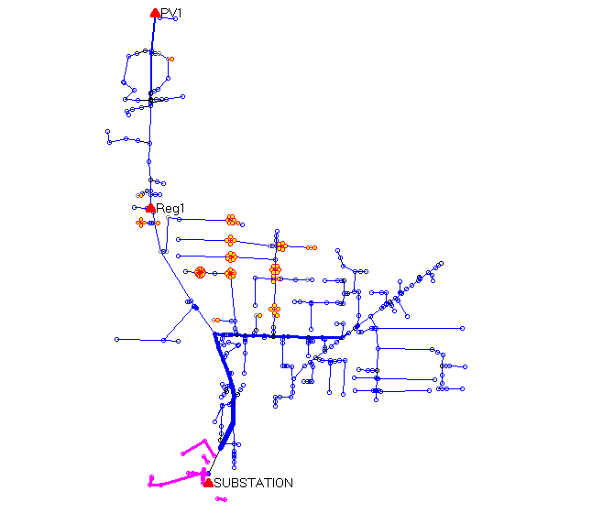
A Co-simulation Example (A Hypothetical Case)
PV Location (2.5 MW)
Voltage regulator
Clusters of
Storage Units
Ref: EPRI/AEP Smart Grid Demo
Community Energy Storage Concept

Slide 30
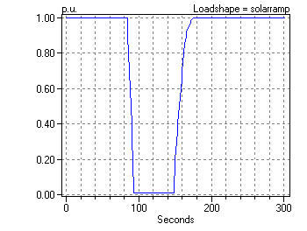
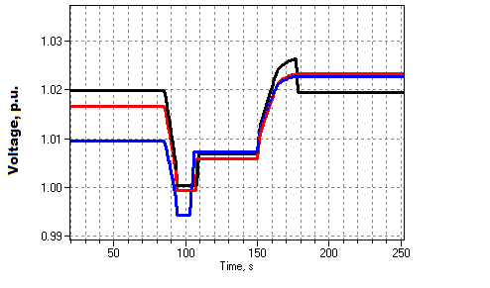
Solar Ramp Rate Issue
Assumed Solar Ramping Function
Result

Slide 31
The Question
Can you dispatch the 84 CES units fast enough to compensate for the sudden loss of PV generation on a “Cloud Transient” ?
Why it might not work:
Communications latency
CES not in right location or insufficient capacity
Calls for a “Hybrid” simulation
Communications network (NS2)
Distribution network (OpenDSS)

Slide 32
How We Did It

Slide 33
OpenDSS Script (Snippet)
Set sec=20
Solve ! Init steady state at t=20
Sample
! Start the ramp down at 1 sec
Set sec=21
Generator.PV1.kW=(2500 250 -) ! Decrement 10%
Solve
Sample
Set sec=22
Generator.PV1.kW=(2500 500 -) ! Decrement another 10%
Solve
Sample
Set sec = 22.020834372 ! Unit 1 message arrives
storage.jo0235001304.state=discharging %discharge=11.9
Solve
Sample
Set sec = 22.022028115 ! Unit 2 message arrives
storage.jo0235000257.state=discharging %discharge=11.9
Solve
Sample
Etc.

Slide 34
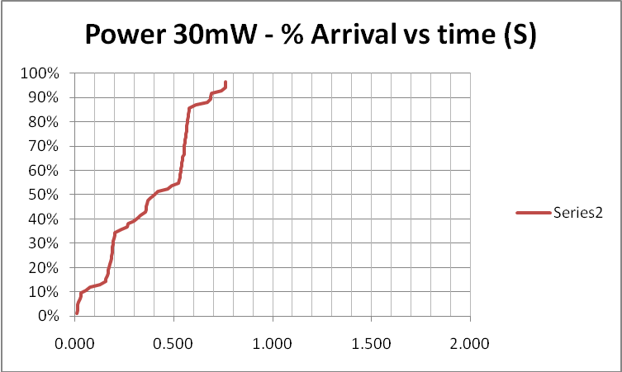
Results (for down ramp only)
Comm Simulation

Slide 35
Comm and Power Co-simulation
New and active research area
Working to more tightly link ns-2 and OpenDSS
Or other comm simulators
Communications latency is an important issue with Smart Grid
Power engineers tend to assume communications will happen
But there are limits

Slide 36
Custom Simulation Scripting in Snapshot Mode
This is the default solution mode
Attempts one solution for each “solve”
Solves the circuit “as is”
If you want something done, you have to specifically tell it
Set Load and Generator kW, etc.
Load.MyLoad.kW=125
Loadshapes are not used in this mode!
Sample Monitors and meters
Solve
Sample

Slide 37
Custom Simulation Scripting in “Time” Mode
Similar to Snapshot mode EXCEPT:
Loads, Generators can follow a selected Loadshape
Duty, Daily, or Yearly
Monitors are automatically sampled
But not Energymeters; do that explicitly if desired
Time is automatically incremented AFTER solve

Slide 38
Snapshot Mode Scripting Example
Set Gen kW explicitly each time step
! Start the ramp down at 1 sec
Set sec=1
Generator.PV1.kW=(2500 250 -)
Solve
Sample
Set sec=2
Generator.PV1.kW=(2500 500 -)
Solve
Sample
Set sec = 2.020834372 ! Unit 1
storage.jo0235001304.state=discharging %discharge=11.9
Solve
Sample
Set sec = 2.022028115 ! Unit 2
storage.jo0235000257.state=discharging %discharge=11.9
Solve
Sample
Set sec = 2.023158858 ! Unit 3
storage.jo0235000265.state=discharging %discharge=11.9
Solve
Sample
Set sec = 2.024604602 ! Unit 4
storage.jo0235000268_1.state=discharging %discharge=11.9
Solve
Sample
Set sec = 2.025738325 ! Unit 5
storage.jo0235000268_2.dispmode=discharging %discharge=11.9
Solve
Sample
Etc.
Solve and Sample explicitly at each step
Set each Storage unit discharge rate explicitly each time step
(time is used for recording purposes only)

Slide 39
Time Mode Scripting Example
All Loads, Generators will follow assigned Duty cycle loadshape
! Start the ramp down at 1 sec
Set mode=time loadshapeclass=duty
set stepsize=1s
Solve ! Base case t=0
Solve ! t=t+1 = 2
Solve ! t=2 second solution; t=t+1 = 3
Set sec = 2.020834372 ! Unit 1 (reset t)
storage.jo0235001304.state=discharging %discharge=11.9
Solve
Set sec = 2.022028115 ! Unit 2
storage.jo0235000257.state=discharging %discharge=11.9
Solve
Set sec = 2.023158858 ! Unit 3
storage.jo0235000265.state=discharging %discharge=11.9
Solve
Set sec = 2.024604602 ! Unit 4
storage.jo0235000268_1.state=discharging %discharge=11.9
Solve
Set sec = 2.025738325 ! Unit 5
storage.jo0235000268_2.dispmode=discharging %discharge=11.9
Solve
Etc.
Set sec=3
Solve ! t=3 solution; t=t+1 = 4
….

Slide 40
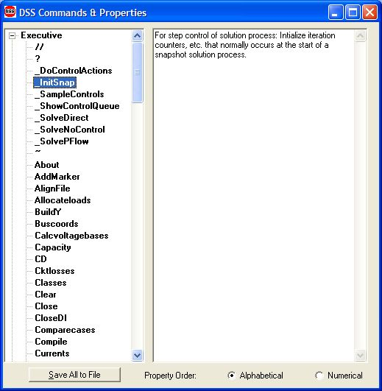
Custom Simulation Scripting: Rolling Your Own Solution Algorithm
These commands allow step-by-step control of the solution process

Slide 41
Custom Simulation Scripting: Rolling Your Own Solution Algorithm
The basic Snapshot solution process:
Initialize Snapshot (_InitSnap)
Repeat until converged:
Solve Circuit (_SolveNoControl)
Sample control devices (_SampleControls)
Do control actions, if any (_DoControlActions)
You may wish, for example, to interject custom control actions after the _SolveNoControl step

Slide 42
OpenDSS Solution Loop with Controls
Controls are sampled and executed after a converged power flow solution
_SolveNoControl
_SampleControls
_DoControlActions

Slide 43
Co-simulation and OpenDSS
Simulation of power system and communications networks simultaneously
An important area of smart grid research
Will messages be able to get to targets in time to perform Smart Grid functions?
What will be the effect of communications latency?
Much work needs to be done developing appropriate tools

Slide 44
Custom Simulation Scripting, cont’d
Via COM interface
Whatever you want (if you can write code)
See Examples Folder on Sourceforge site
Excel: SampleDSSDriver.xls
Matlab:
VoltageProfileExample.m
DSSMonteCarlo.m

Slide 45
For More Information …
See OpenDSS Custom Scripting.Doc
(Sourceforge site, “Doc” Folder)

