Slide 1
Volt-var Scenarios
OpenDSS: Version 8.6.6.1 (64-bit build)
Authors: Paulo Radatz and Celso Rocha

Slide 2
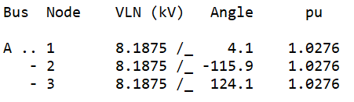
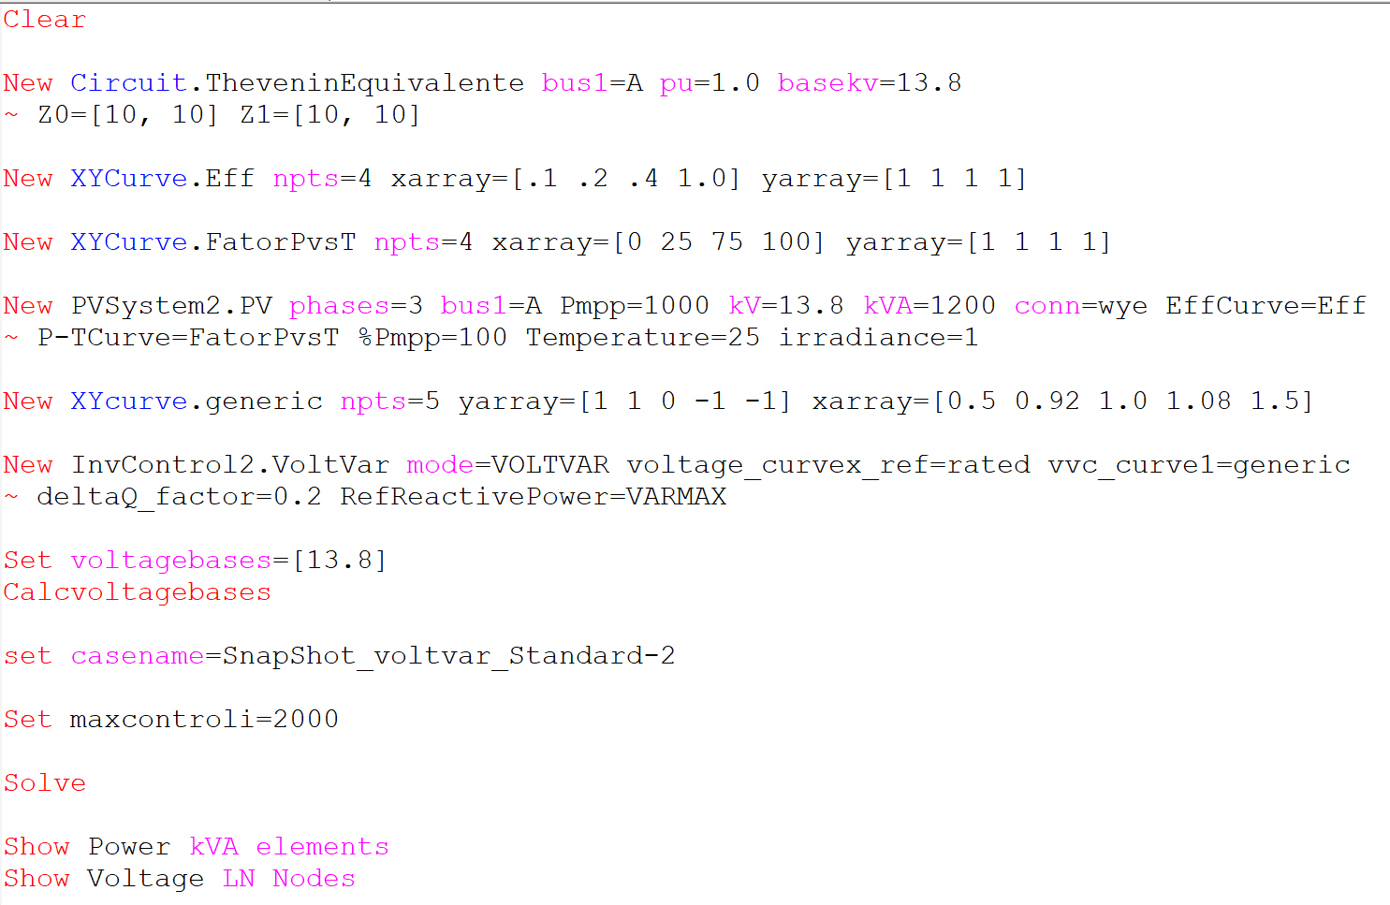
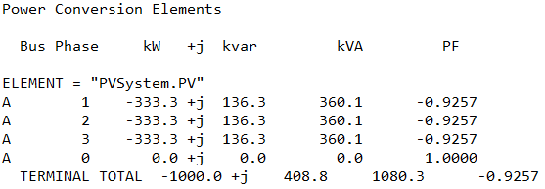
Scenario 1.1: Snapshot with no power limitation
OpenDSS code (SnapShot_voltvar_Standard-2.dss)

Slide 3
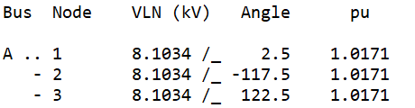
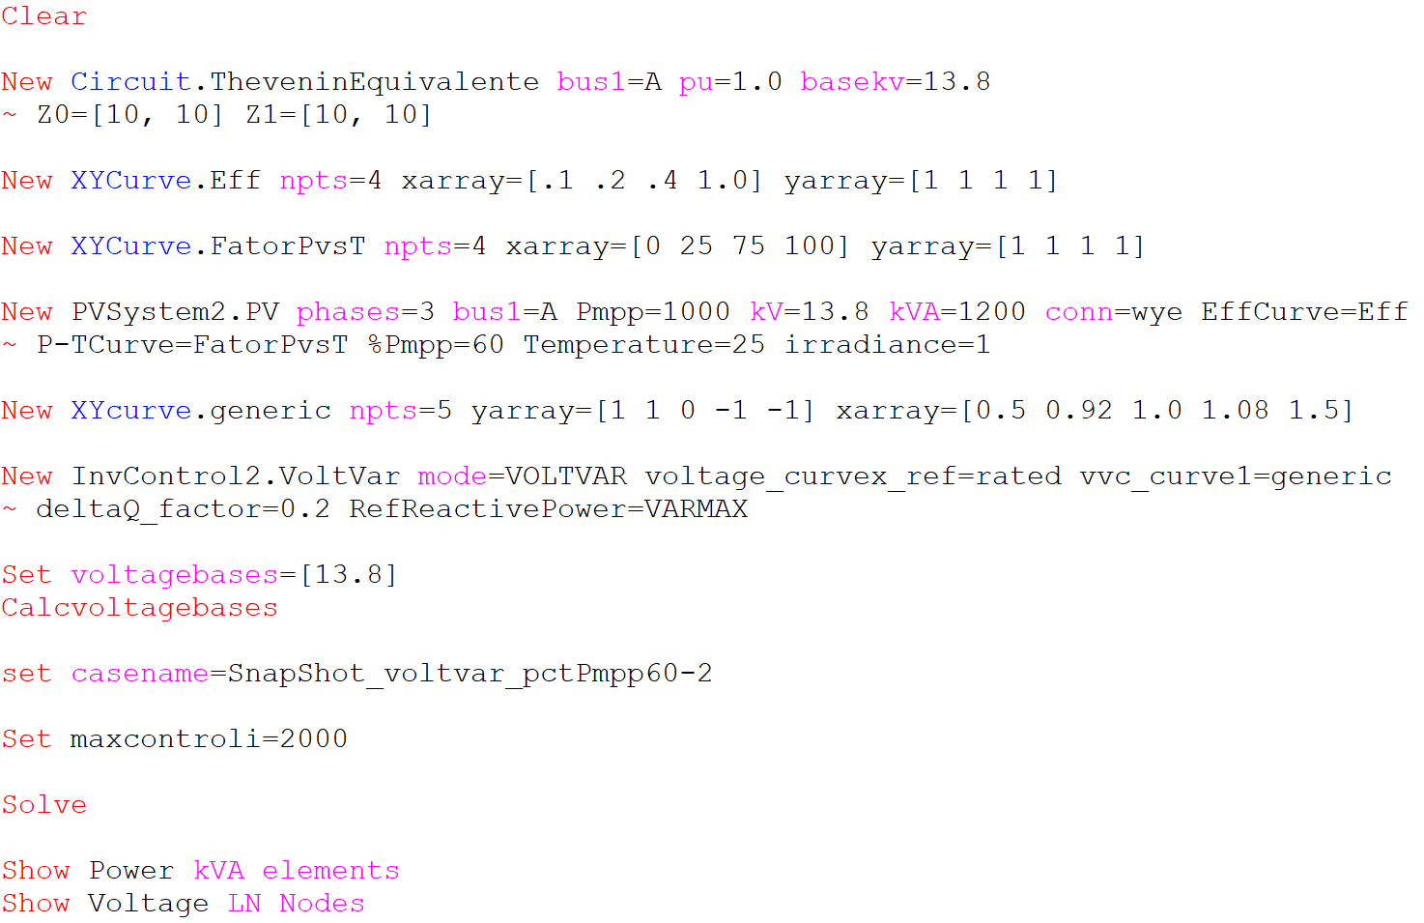
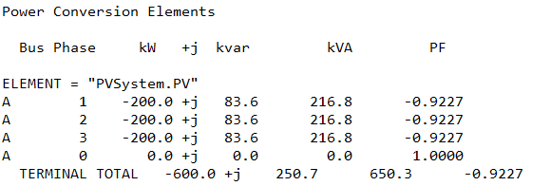
Scenario 1.2: Snapshot with kW limited by pctPmpp*Pmpp only (no limit by inverter`s kVA rating)
OpenDSS code (SnapShot_voltvar_pctPmpp60-2.dss)

Slide 4
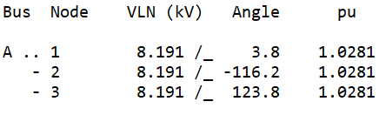
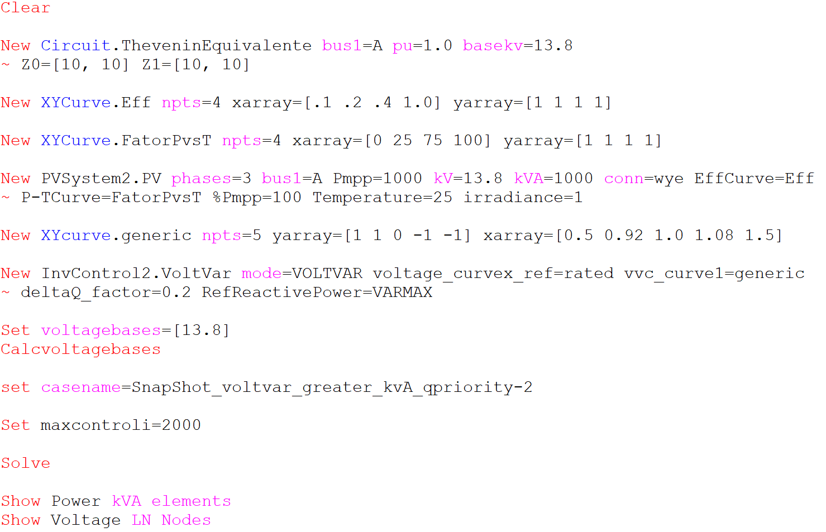
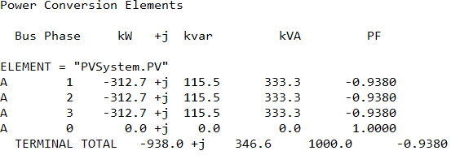
Scenario 1.3: Snapshot with kVA limitation only (no limit on kW by Pmpp*pctPmpp) – Q priority
OpenDSS code (SnapShot_voltvar_greater_kvA_qpriority-2.dss)

Slide 5
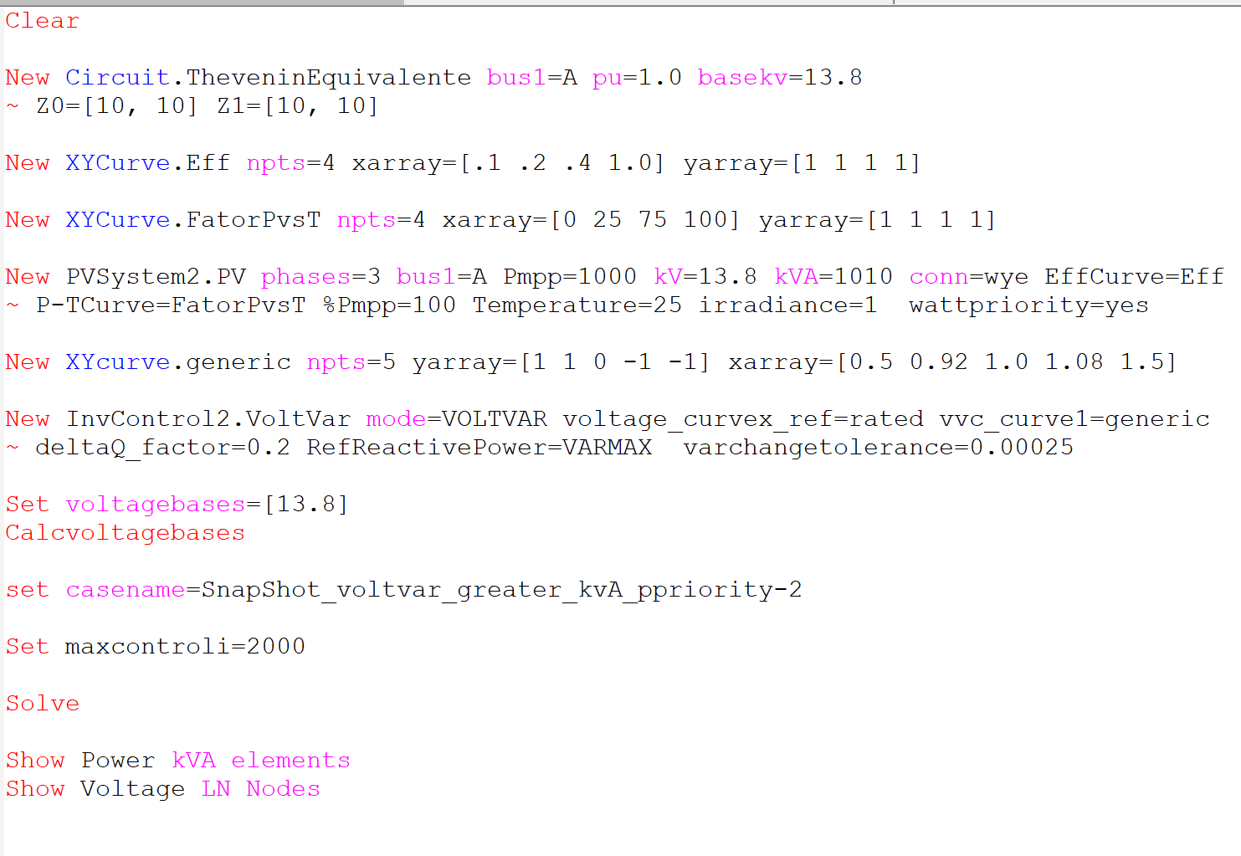
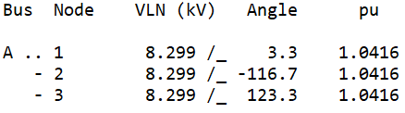
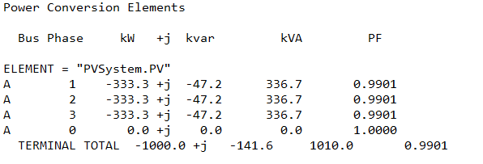
Scenario 1.4: Snapshot with kVA limitation only (no limit on kW by Pmpp*pctPmpp) – P priority
OpenDSS code (SnapShot_voltvar_greater_kvA_ppriority-2.dss)

Slide 6
Results in QSTS mode
Results from mode 3 monitor placed in the PVSystem2
hour | t(sec) | Irradiance | PanelkW | P_TFactor | Efficiency | Vreg | Vavg (DRC) | volt-var | volt-watt | DRC | VV_DRC | kW_out_desired
1 | 0 | 0 | 0 | 1 | 1 | 0.999973 | 9999 | 0 | 9999 | 9999 | 9999 | 0
2 | 0 | 0 | 0 | 1 | 1 | 0.999983 | 9999 | 0 | 9999 | 9999 | 9999 | 0
3 | 0 | 0 | 0 | 1 | 1 | 0.999989 | 9999 | 0 | 9999 | 9999 | 9999 | 0
4 | 0 | 0 | 0 | 1 | 1 | 0.999993 | 9999 | 0 | 9999 | 9999 | 9999 | 0
5 | 0 | 0 | 0 | 1 | 1 | 0.999994 | 9999 | 0 | 9999 | 9999 | 9999 | 0
6 | 0 | 0 | 0 | 1 | 1 | 0.999995 | 9999 | 0 | 9999 | 9999 | 9999 | 0
7 | 0 | 0.1 | 100 | 1 | 1 | 0.999996 | 9999 | 0 | 9999 | 9999 | 9999 | 100
8 | 0 | 0.2 | 200 | 1 | 1 | 0.999997 | 9999 | 0 | 9999 | 9999 | 9999 | 200
9 | 0 | 0.3 | 300 | 1 | 1 | 1.00863 | 9999 | -1 | 9999 | 9999 | 9999 | 300
10 | 0 | 0.5 | 500 | 1 | 1 | 1.01419 | 9999 | -1 | 9999 | 9999 | 9999 | 500
11 | 0 | 0.8 | 800 | 1 | 1 | 1.02225 | 9999 | -1 | 9999 | 9999 | 9999 | 800
12 | 0 | 0.9 | 900 | 1 | 1 | 1.02487 | 9999 | -1 | 9999 | 9999 | 9999 | 900
13 | 0 | 1 | 1000 | 1 | 1 | 1.02746 | 9999 | -1 | 9999 | 9999 | 9999 | 1000
14 | 0 | 1 | 1000 | 1 | 1 | 1.02746 | 9999 | -1 | 9999 | 9999 | 9999 | 1000
15 | 0 | 0.99 | 990 | 1 | 1 | 1.02719 | 9999 | -1 | 9999 | 9999 | 9999 | 990
16 | 0 | 0.9 | 900 | 1 | 1 | 1.02487 | 9999 | -1 | 9999 | 9999 | 9999 | 900
17 | 0 | 0.7 | 700 | 1 | 1 | 1.0196 | 9999 | -1 | 9999 | 9999 | 9999 | 700
18 | 0 | 0.4 | 400 | 1 | 1 | 1.01143 | 9999 | -1 | 9999 | 9999 | 9999 | 400
19 | 0 | 0.1 | 100 | 1 | 1 | 0.999982 | 9999 | 0 | 9999 | 9999 | 9999 | 100
20 | 0 | 0 | 0 | 1 | 1 | 0.999988 | 9999 | 0 | 9999 | 9999 | 9999 | 0
21 | 0 | 0 | 0 | 1 | 1 | 0.999992 | 9999 | 0 | 9999 | 9999 | 9999 | 0
22 | 0 | 0 | 0 | 1 | 1 | 0.999994 | 9999 | 0 | 9999 | 9999 | 9999 | 0
23 | 0 | 0 | 0 | 1 | 1 | 0.999995 | 9999 | 0 | 9999 | 9999 | 9999 | 0
24 | 0 | 0 | 0 | 1 | 1 | 0.999996 | 9999 | 0 | 9999 | 9999 | 9999 | 0
Negative value: var absorption
Positive value : var generation
1.0: volt-var operating as it supposed to
0.6: volt-var limited by inverter’s kVA rating
0.2: volt-var limited by varmax/varmaxabs property of the PC element
Voltage used in the volt-var curve

Slide 7
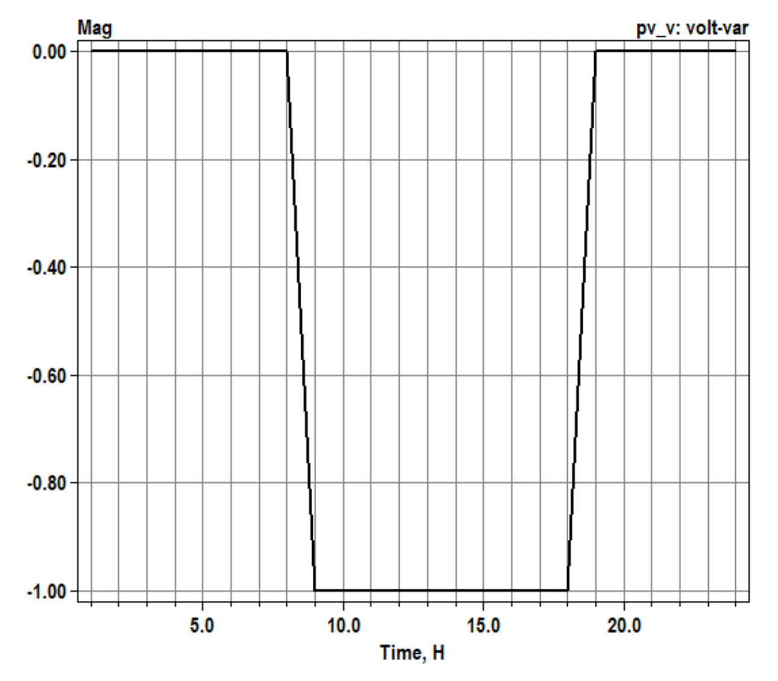
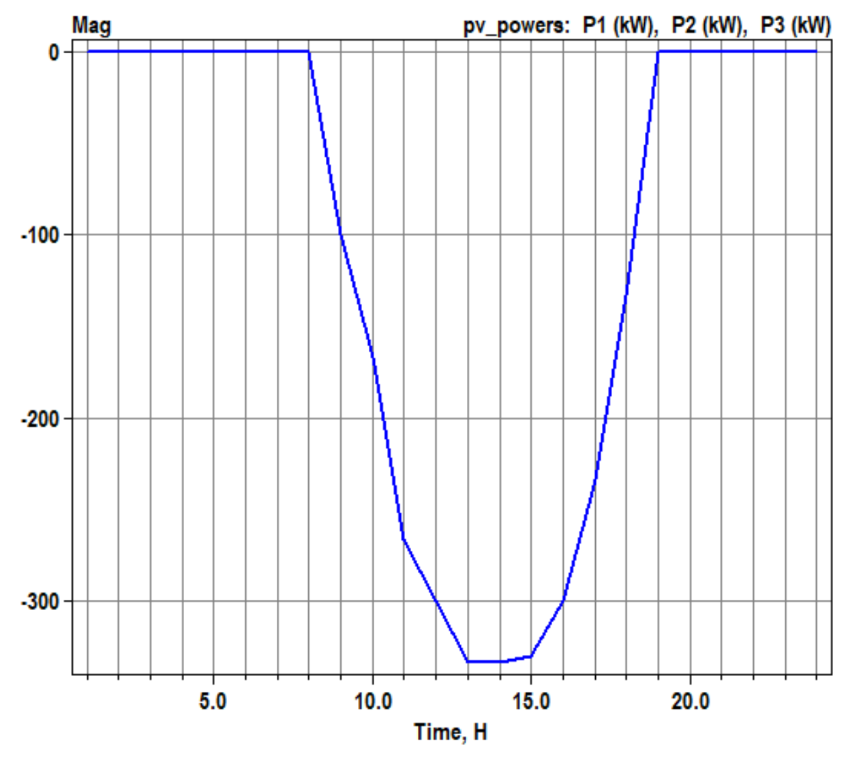
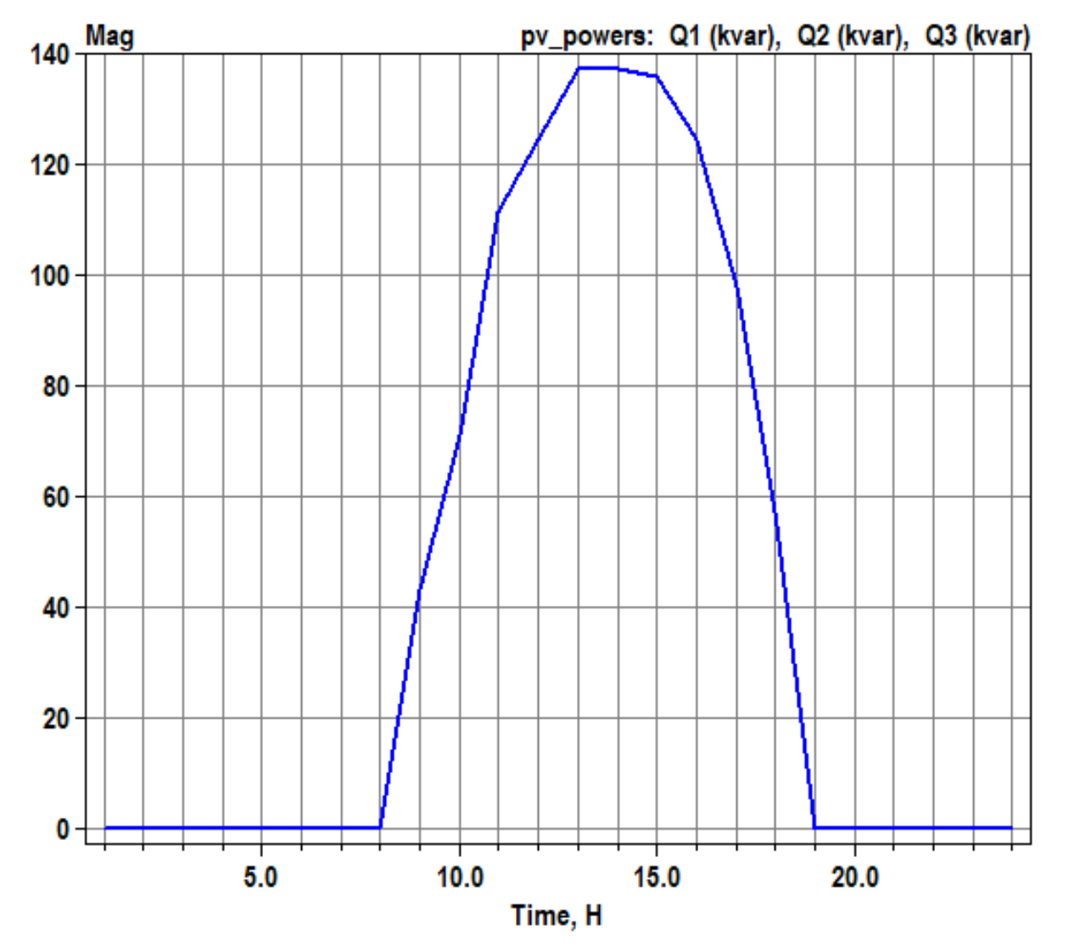
Scenario 1.5: Daily with no power limitation
volt-var operation
OpenDSS code (Daily_voltvar_Standard-2.dss)
Active power generation
Reactive power absorption
Negative value: var absorption
Positive value : var generation
1.0: volt-var operating as it supposed to
0.6: volt-var limited by inverter’s kVA rating
0.2: volt-var limited by varmax/varmaxabs property of the PC element

Slide 8
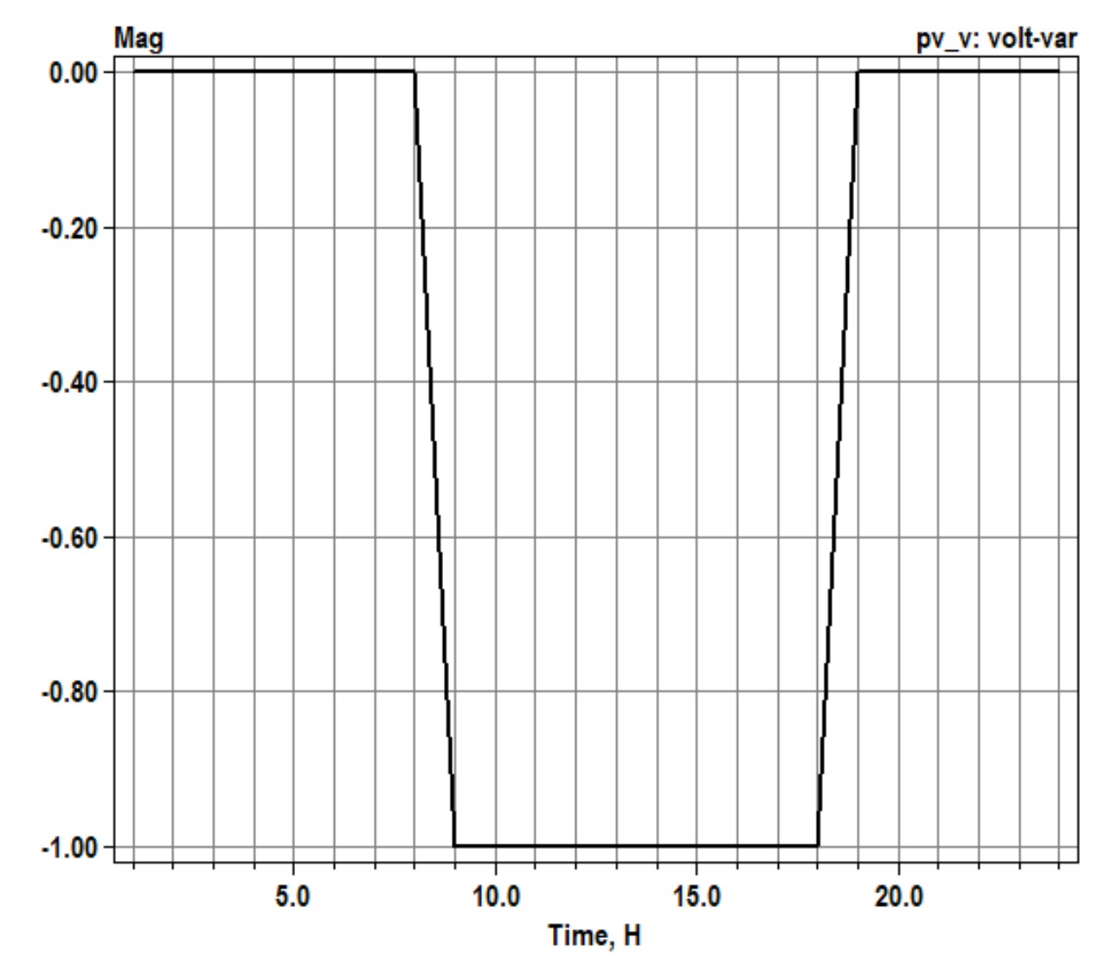
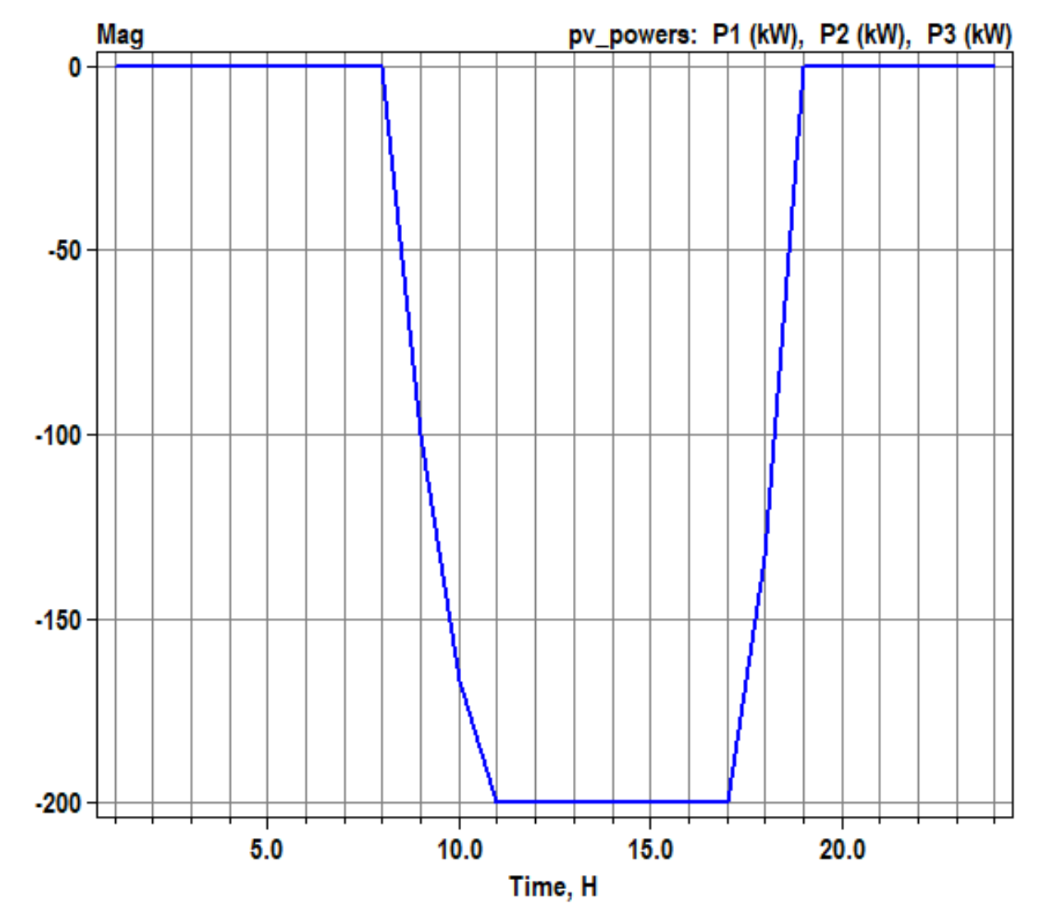
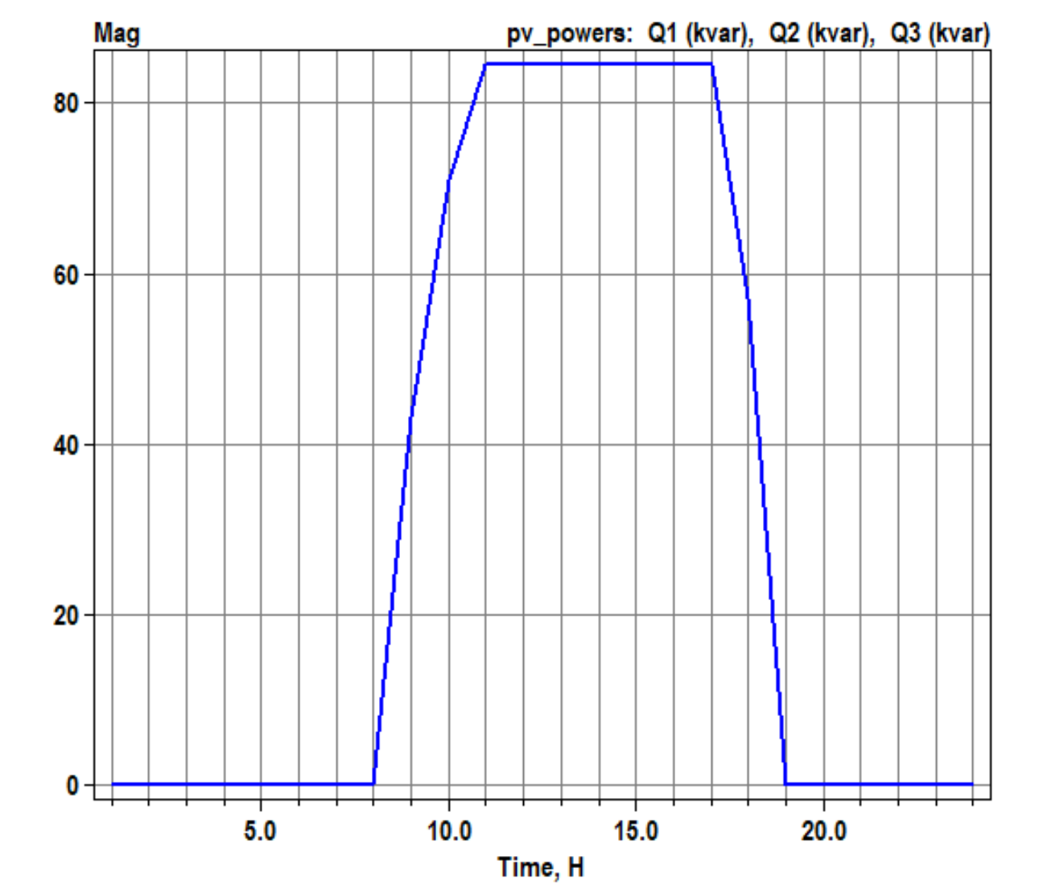
Scenario 1.6: Daily with kW limited by pctPmpp*Pmpp only (no limit by inverter`s kVA rating)
volt-var operation
OpenDSS code (Daily_voltvar_pctPmpp60-2.dss)
Active power generation
Reactive power absorption
Negative value: var absorption
Positive value : var generation
1.0: volt-var operating as it supposed to
0.6: volt-var limited by inverter’s kVA rating
0.2: volt-var limited by varmax/varmaxabs property of the PC element

Slide 9
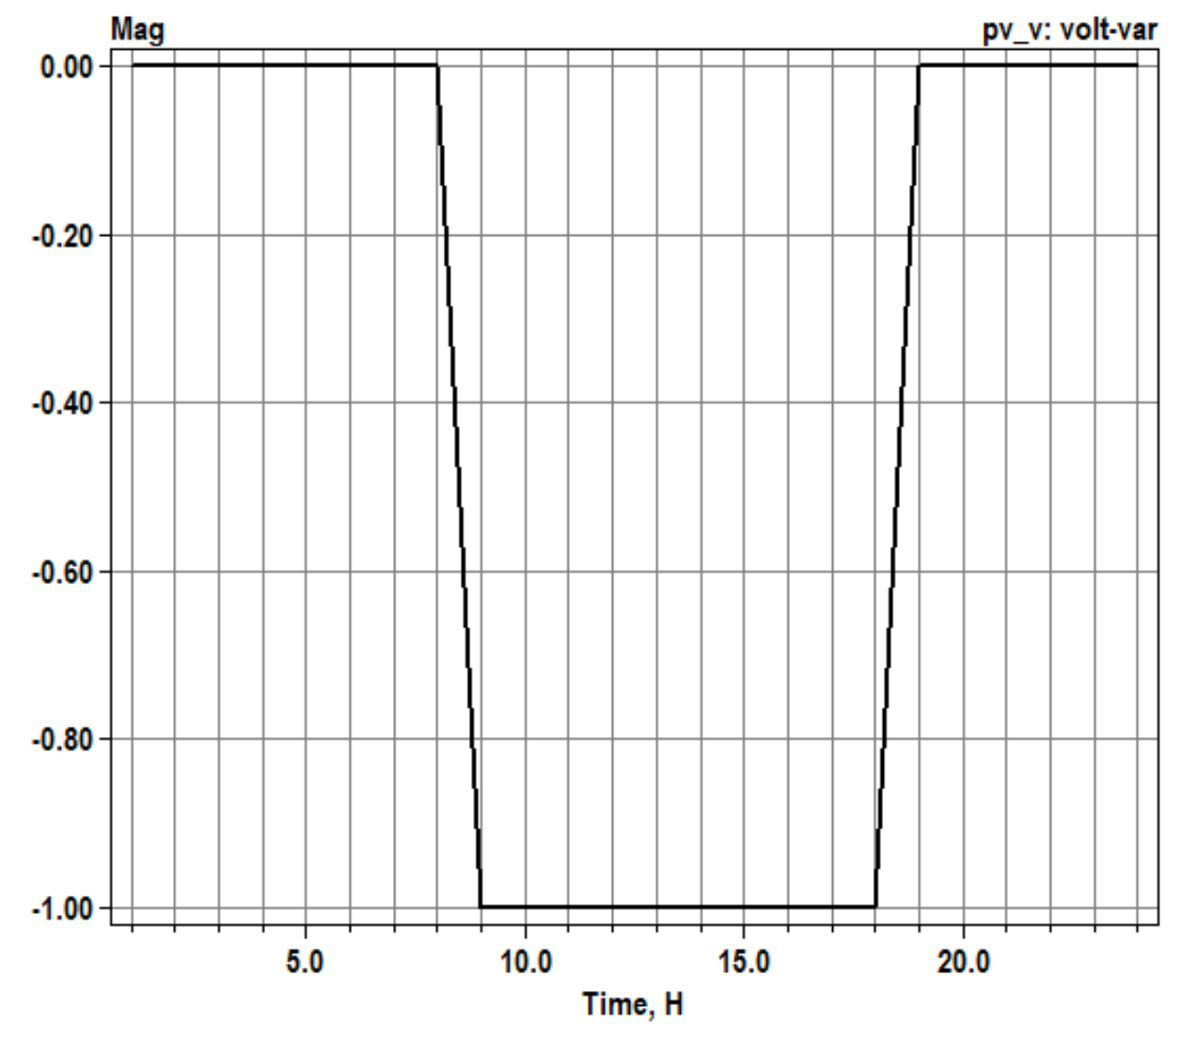
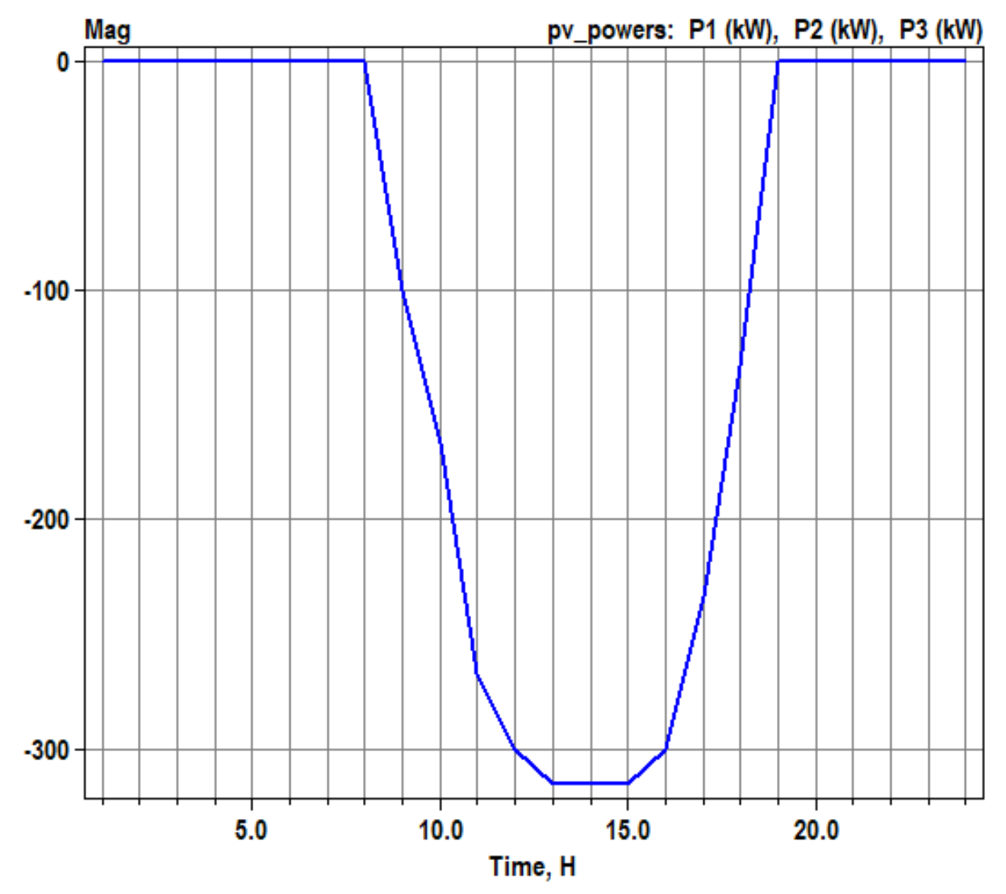
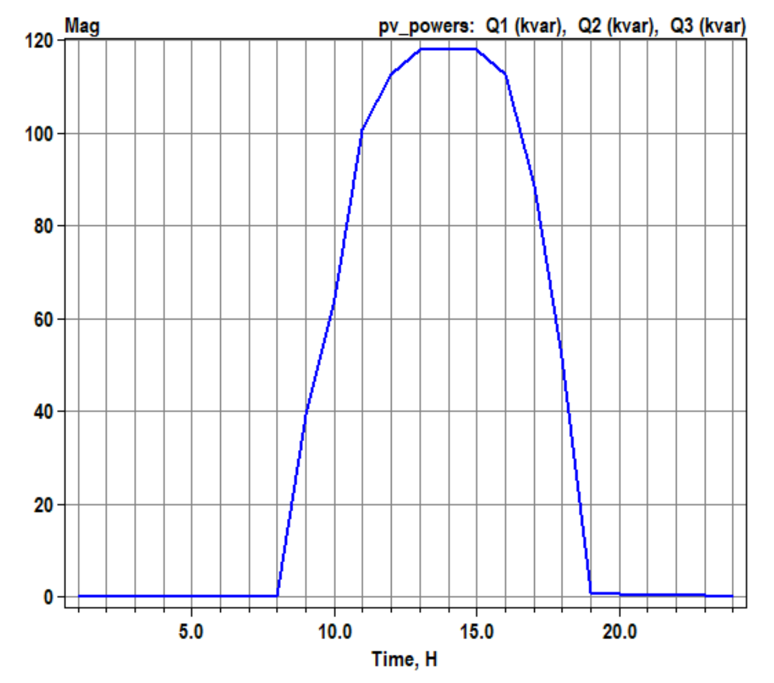
Scenario 1.7: Daily with kVA limitation only (no limit on kW by Pmpp*pctPmpp) – Q priority
volt-var operation
OpenDSS code (Daily_voltvar_greater_kVA_qpriority-2.dss)
Active power generation
Reactive power absorption
Negative value: var absorption
Positive value : var generation
1.0: volt-var operating as it supposed to
0.6: volt-var limited by inverter’s kVA rating
0.2: volt-var limited by varmax/varmaxabs property of the PC element

Slide 10
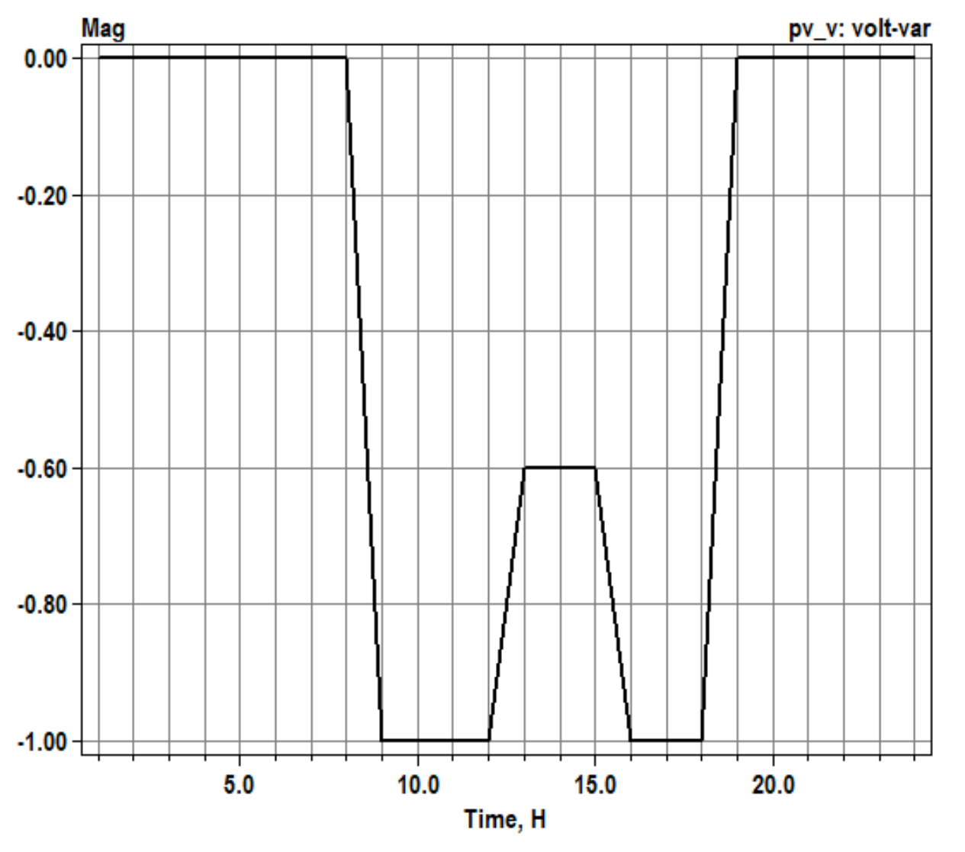
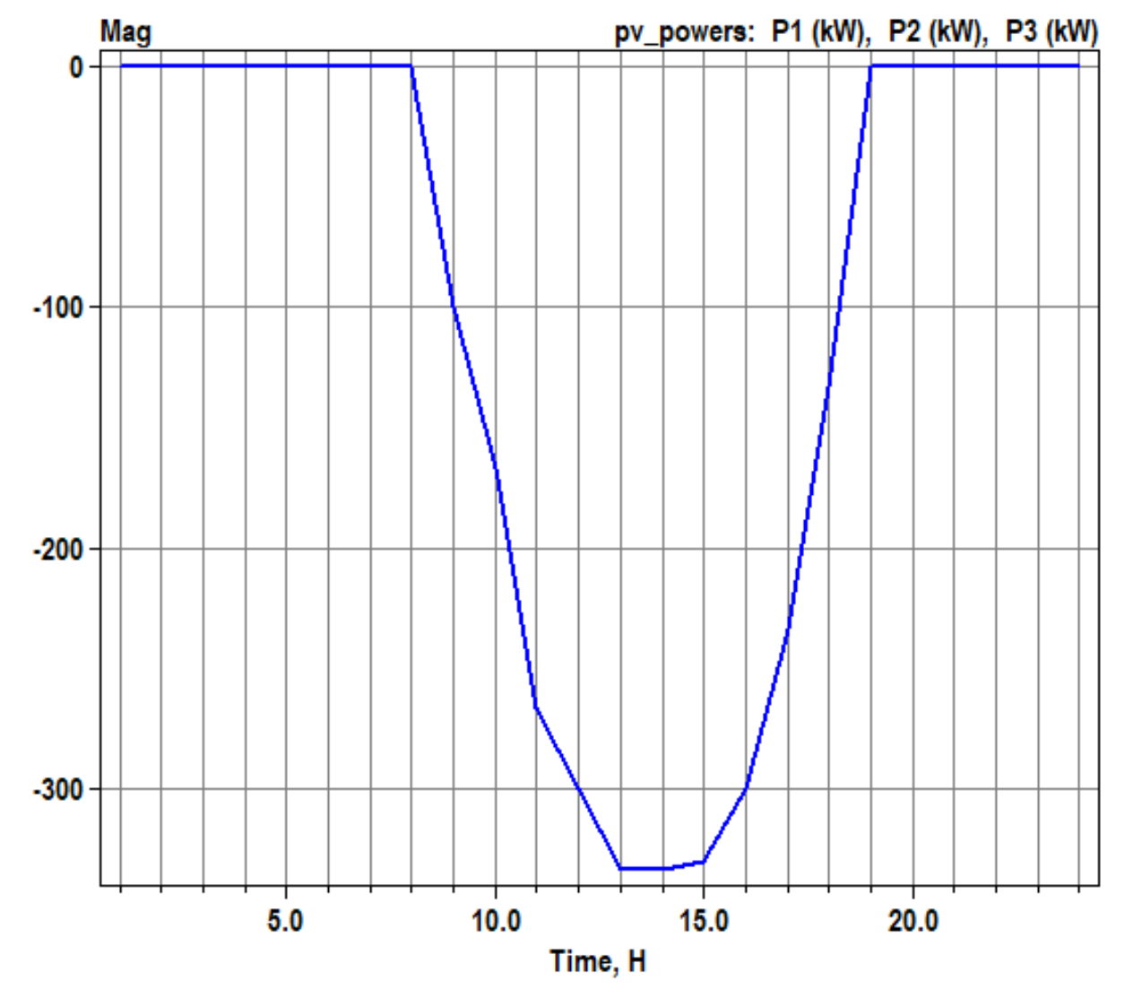
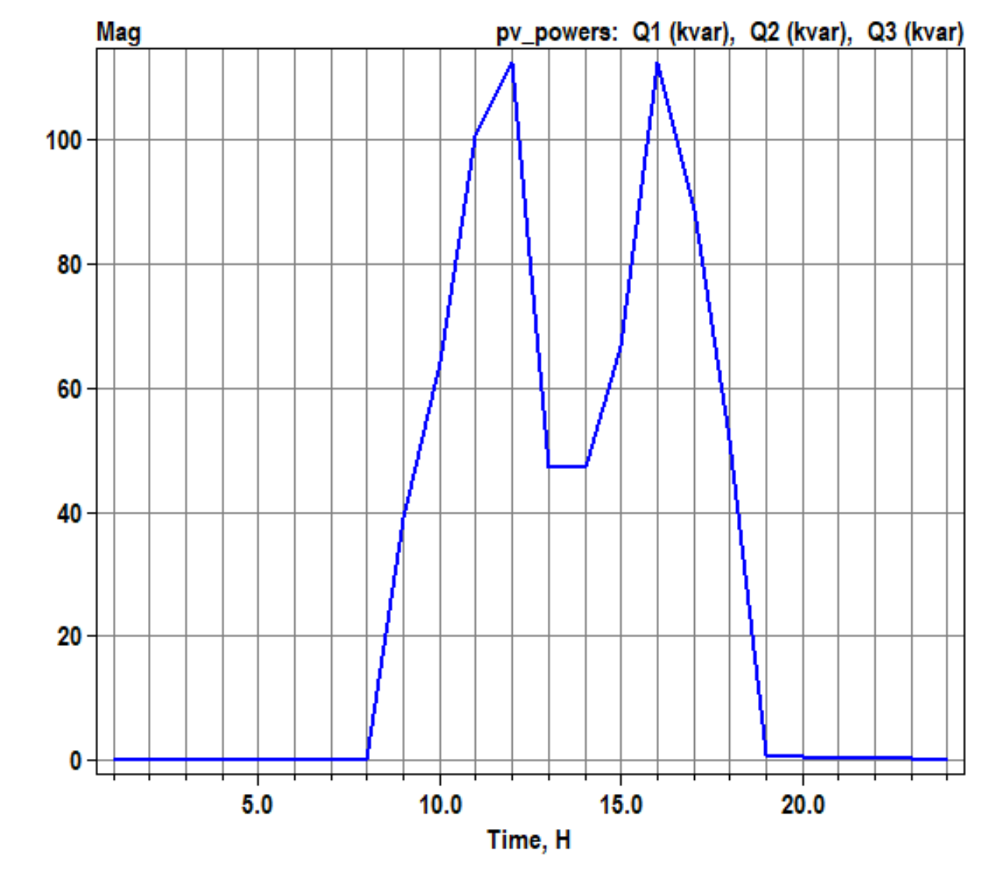
Scenario 1.8: Daily with kVA limitation only (no limit on kW by Pmpp*pctPmpp) – P priority
volt-var operation
OpenDSS code (Daily_voltvar_greater_kVA_ppriority-2.dss)
Active power generation
Reactive power absorption
Negative value: var absorption
Positive value : var generation
1.0: volt-var operating as it supposed to
0.6: volt-var limited by inverter’s kVA rating
0.2: volt-var limited by varmax/varmaxabs property of the PC element

Slide 11
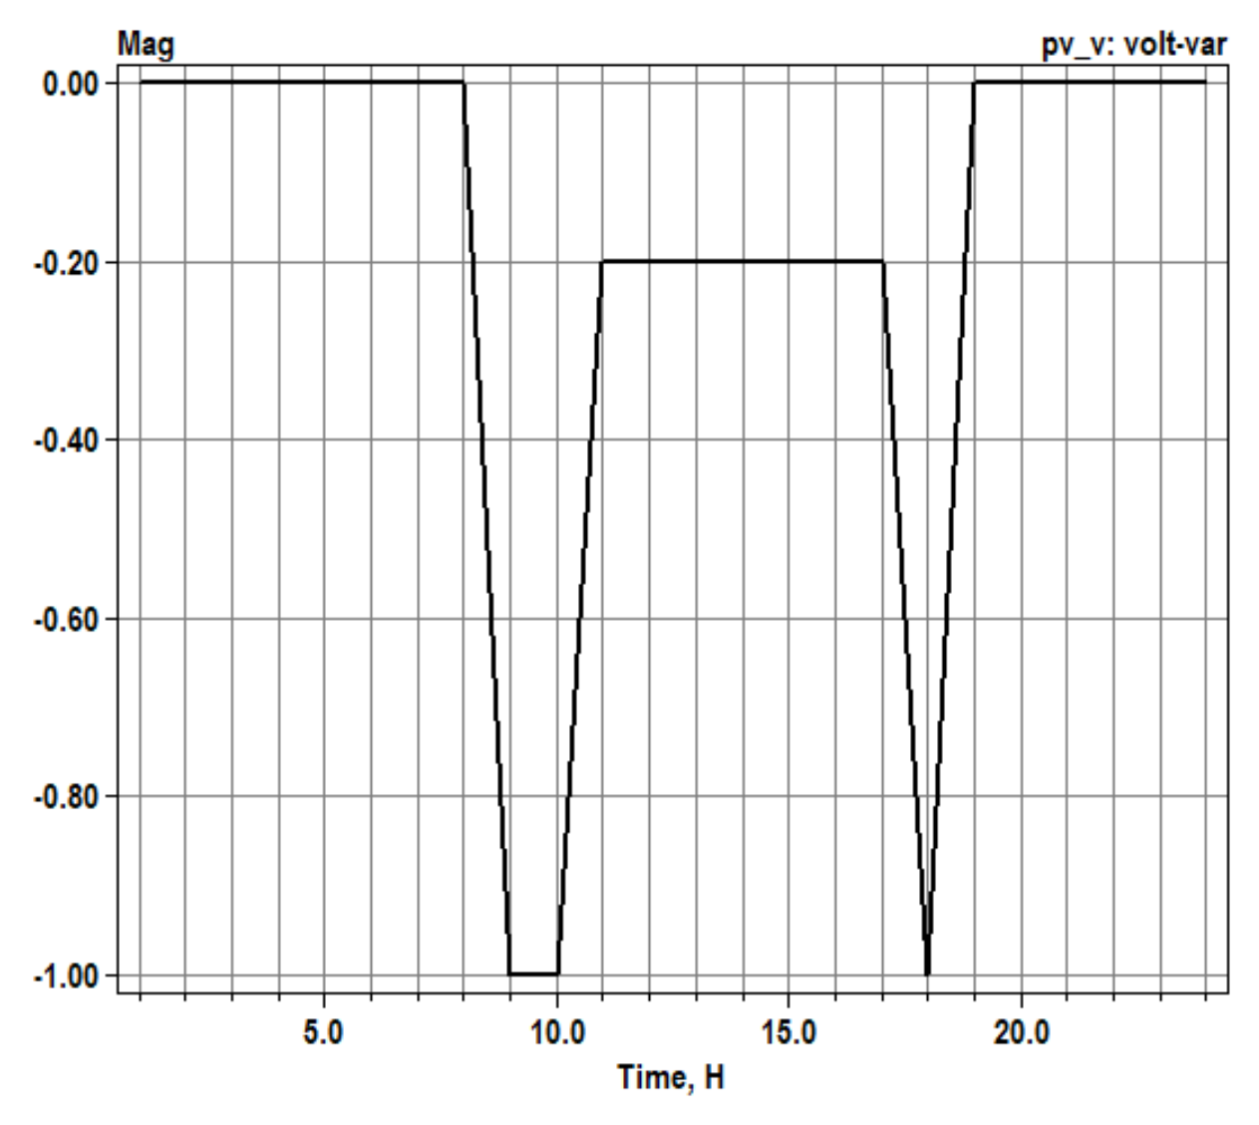
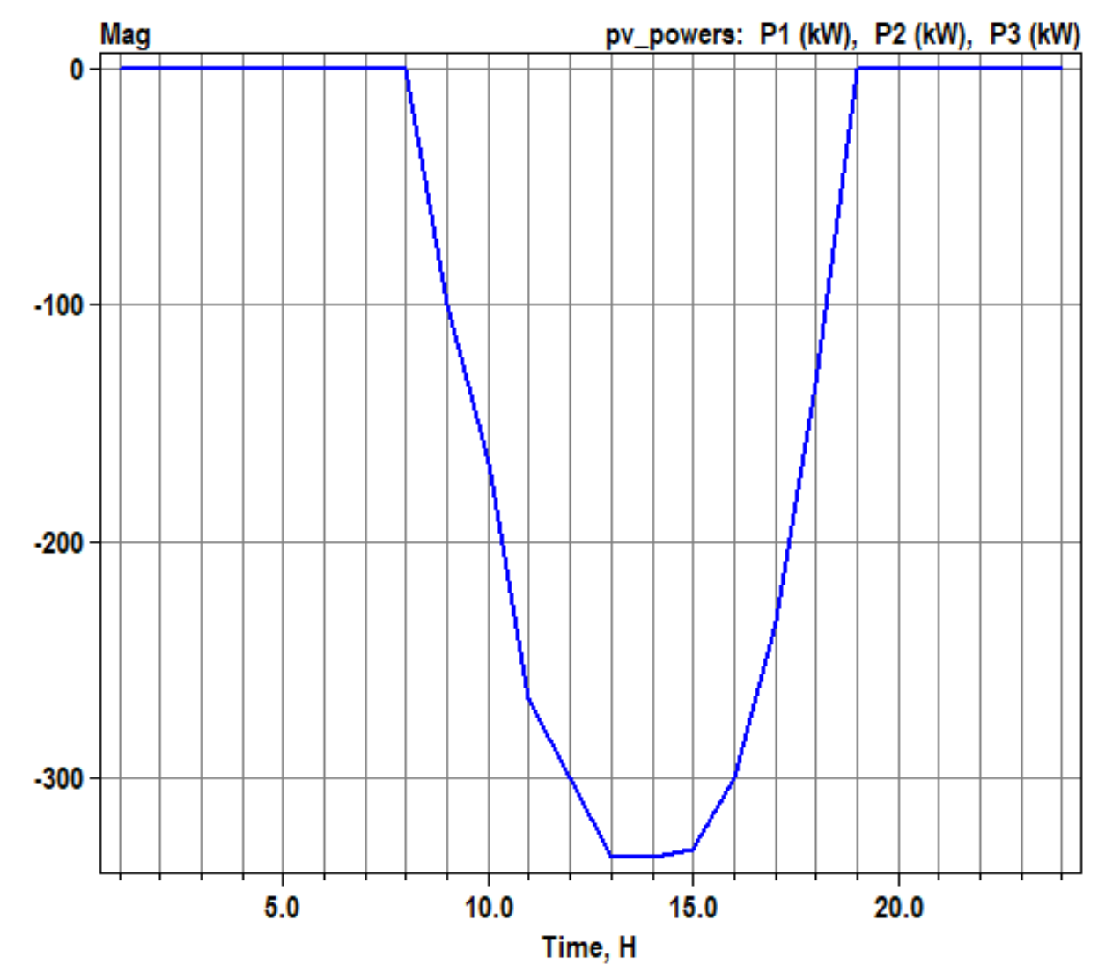
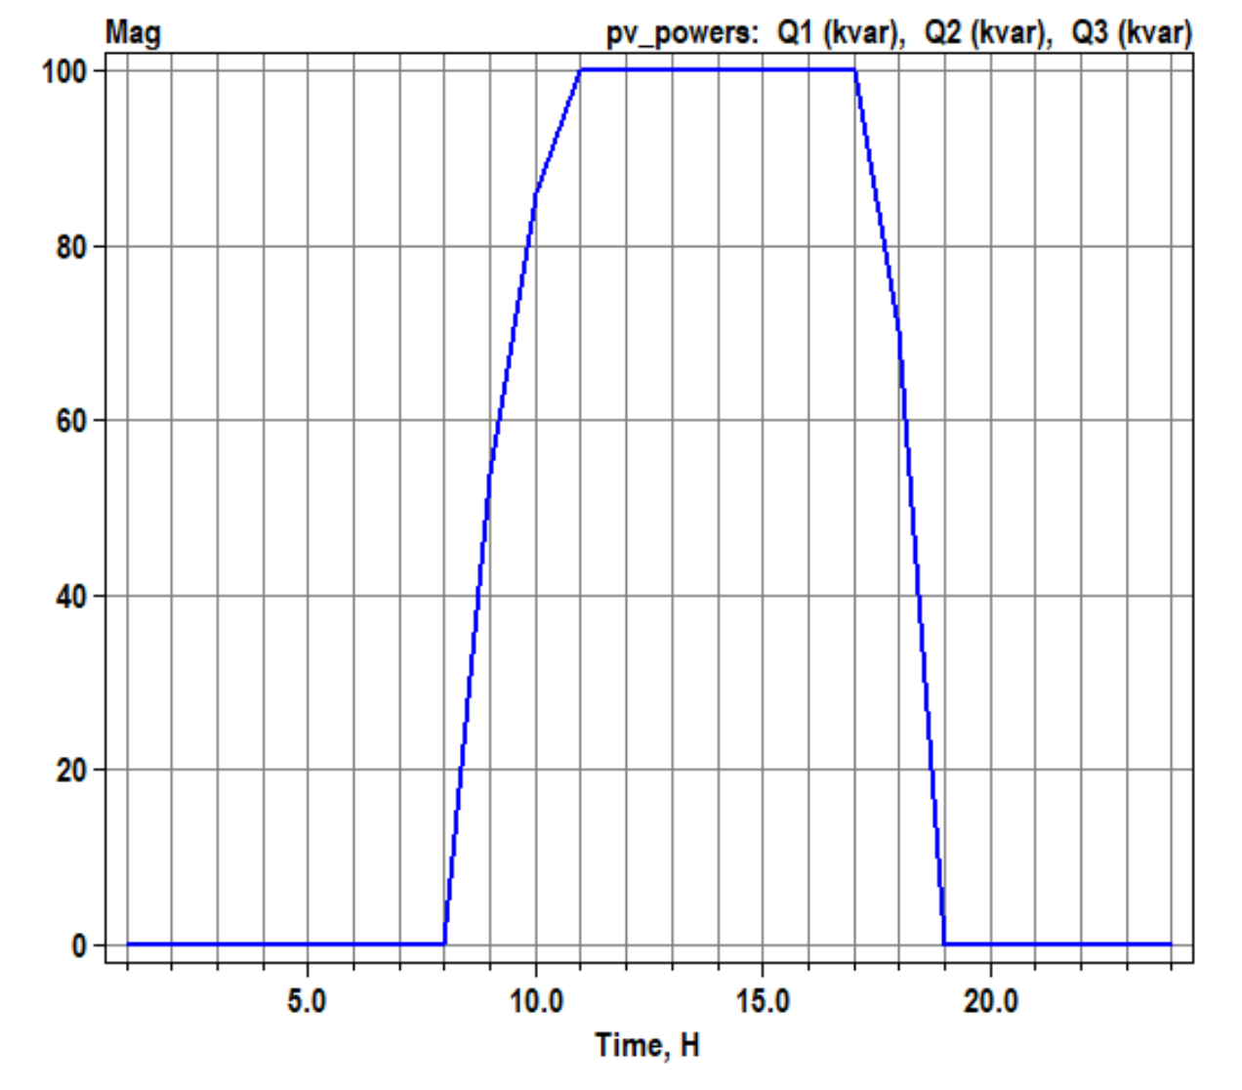
Scenario 1.8: Daily with kvar limitation
volt-var operation
OpenDSS code (Daily_voltvar_kvarlimit-2.dss)
Active power generation
Reactive power absorption
Negative value: var absorption
Positive value : var generation
1.0: volt-var operating as it supposed to
0.6: volt-var limited by inverter’s kVA rating
0.2: volt-var limited by varmax/varmaxabs property of the PC element

