Slide 1
Volt-watt Scenarios
OpenDSS: Version 8.6.6.1
Authors: Paulo Radatz and Celso Rocha

Slide 2
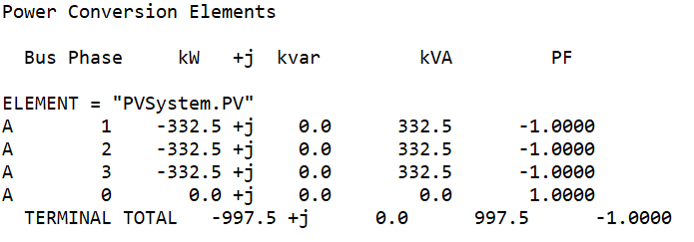
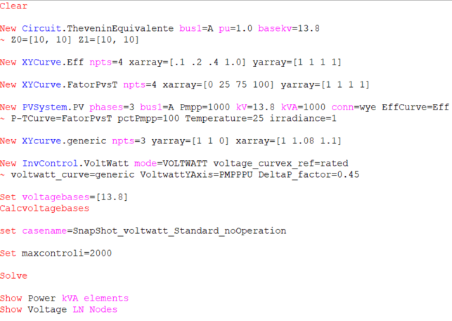
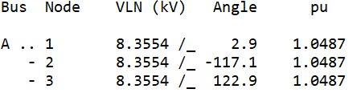
Scenario 1.1: Snapshot without volt-watt operation
OpenDSS code (SnapShot_voltwatt_noOperation.dss)
Results:
Key points:
It does not work as expected
kW should be 1000, because 1.0487 Vpu is less than 1.08 Vpu of the generic curve
We changed ActivePchangeTolerance from its default value (0.01) to 0.0001 and the results remains the same

Slide 3
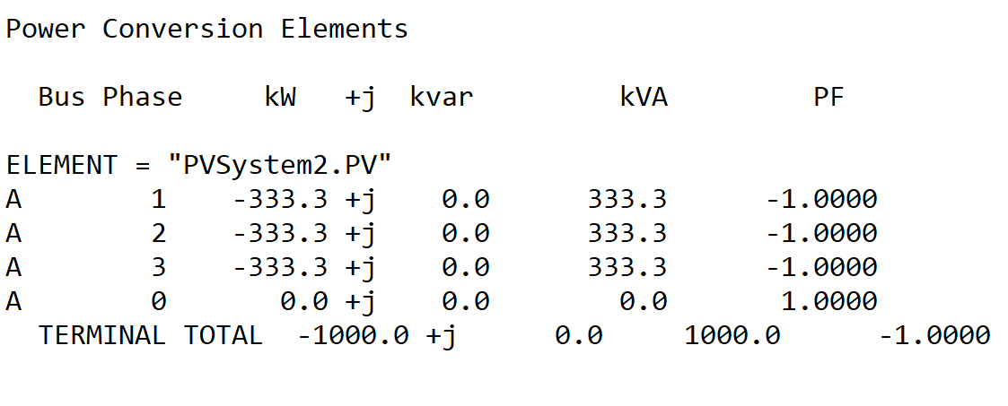
Scenario 1.1: Snapshot without volt-watt operation
OpenDSS code (SnapShot_voltwatt_noOperation-2.dss)
Results:
Key points:
It works as expected!

Slide 4
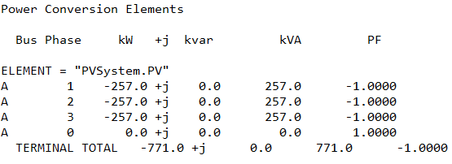
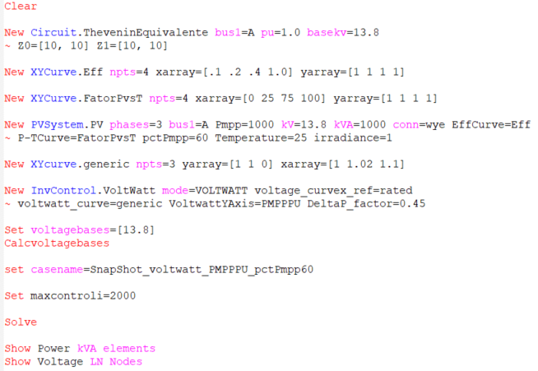
Scenario 1.3: Snapshot volt-wattYAxis PMPPPU with kW limited by pctPmpp*Pmpp
Results:
pctPmpp = 60%
OpenDSS code (SnapShot_voltwatt_PMPPPU_pctPmpp60.dss)
Key points:
It does not work as expected!
kW should be limited to pctPmpp*Pmpp (0.6*1000=600)

Slide 5
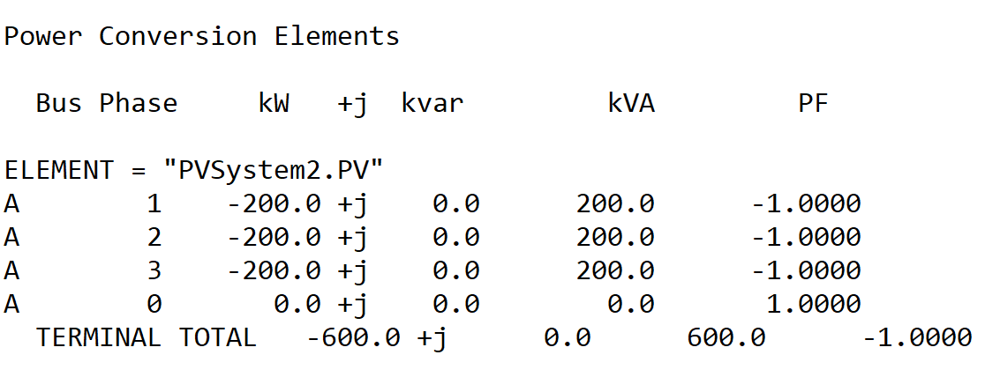
Scenario 1.3: Snapshot volt-wattYAxis PMPPPU with kW limited by pctPmpp*Pmpp
OpenDSS code (SnapShot_voltwatt_PMPPPU_pctPmpp60-2.dss)
Results:
Key points:
It works as expected!
kW is limited to minimum between pctPmpp*Pmpp (600) and Pdesired from the volt-watt curve (~771)

Slide 6
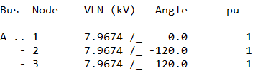
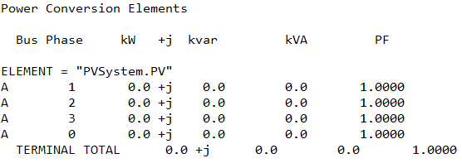
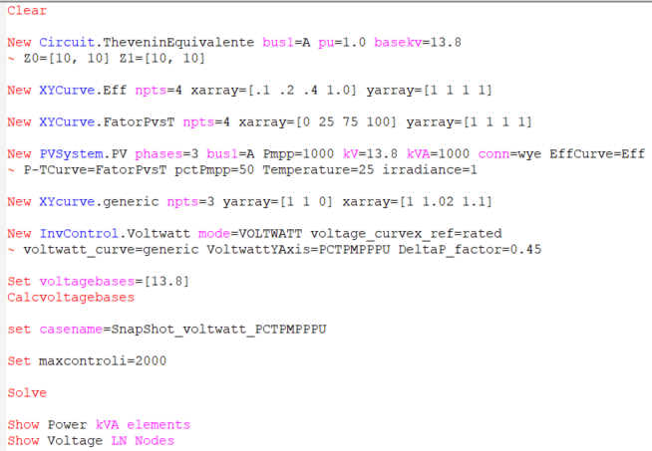
Scenario 1.4: Snapshot volt-wattYAxis PCTPMPPPU
Results:
pctPmpp = 50%
OpenDSS code (SnapShot_voltwatt_PCTPMPPPU.dss)
Key points:
It does not work as expected!

