Slide 2
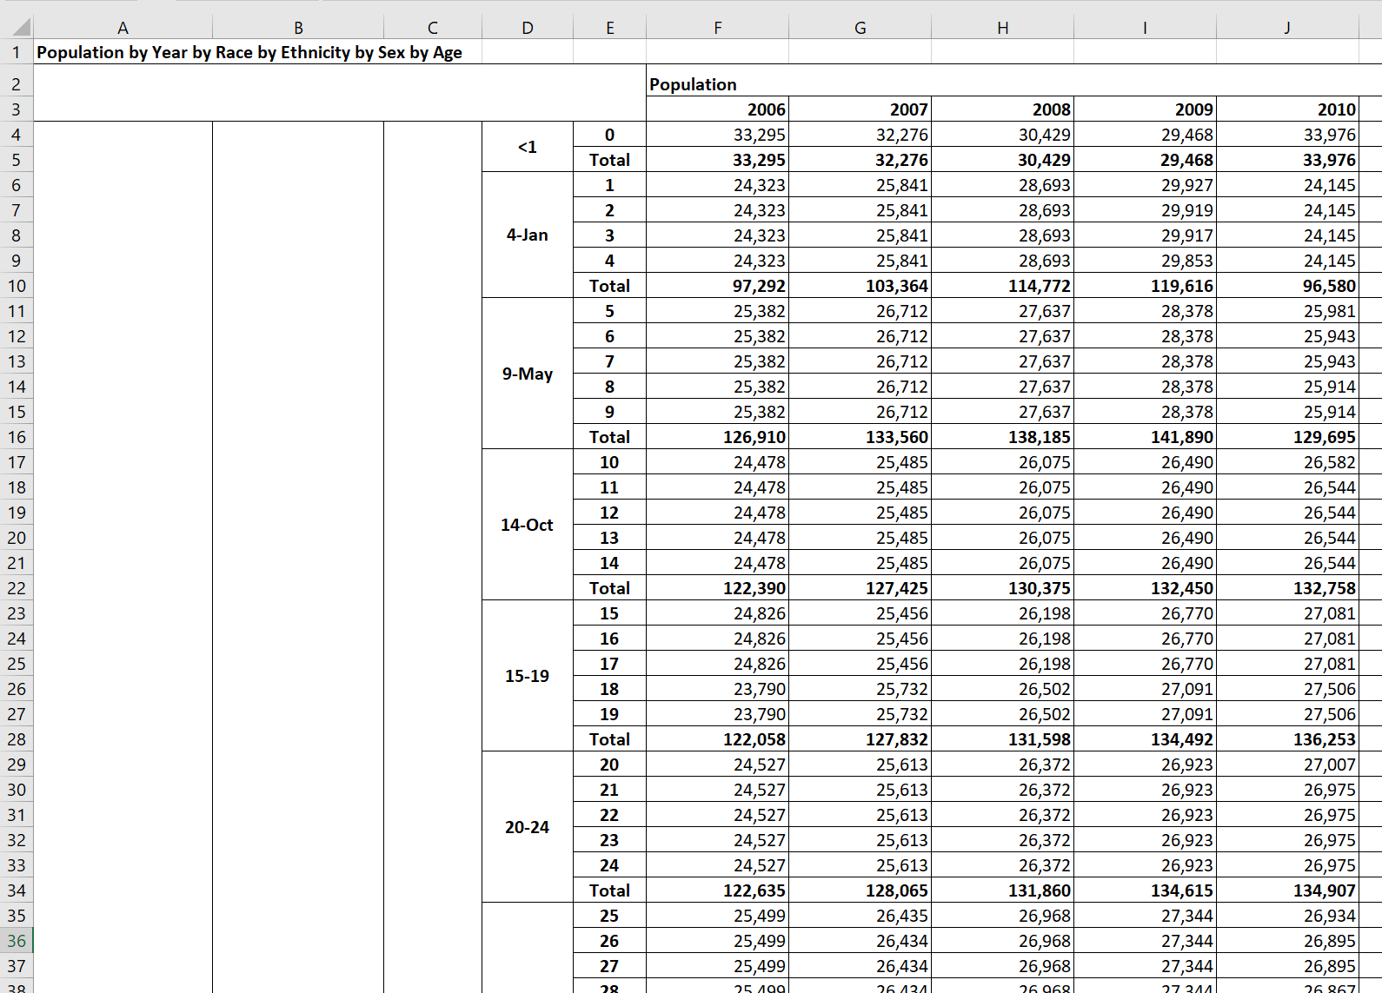
Age
Race
Ethnicity
Age
Group

Slide 3
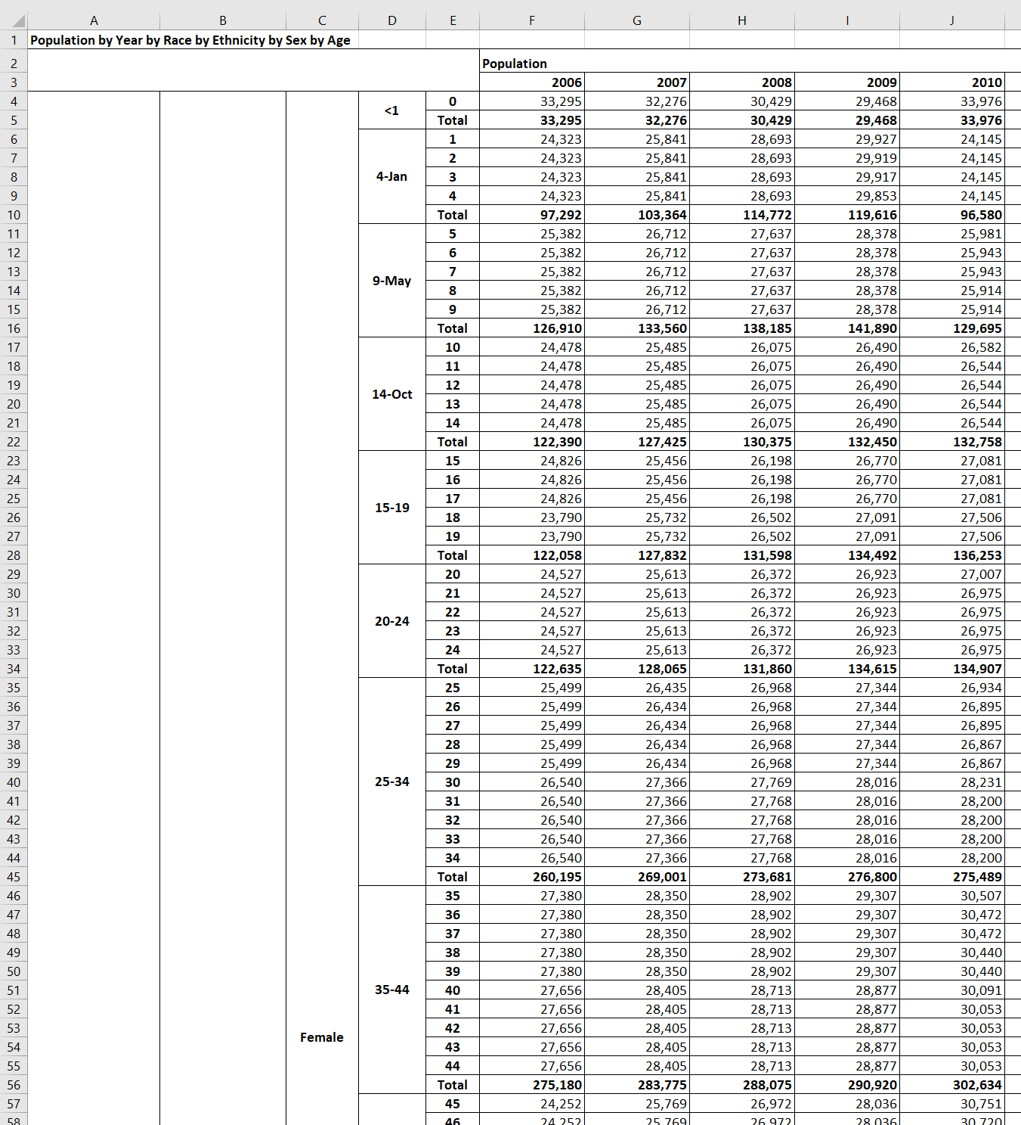
Age
Age
Group
Sex
Race
Ethnicity

