Slide 1


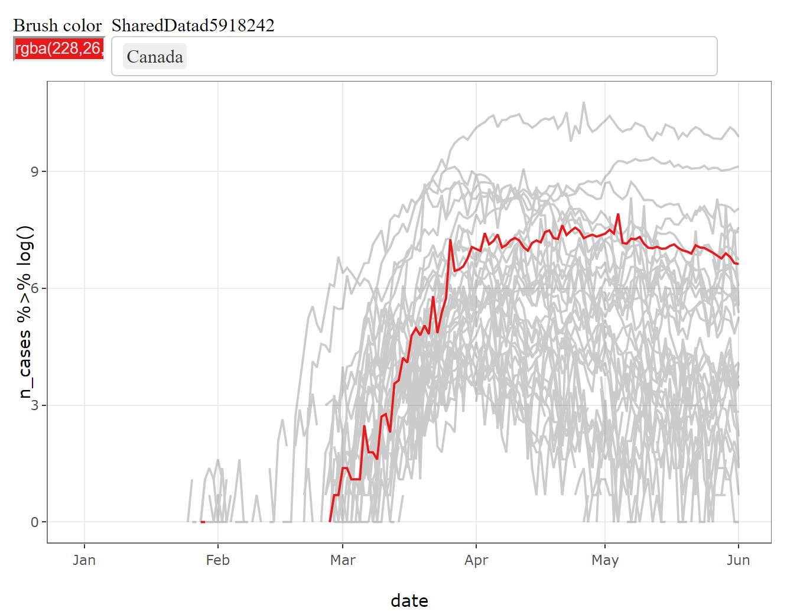
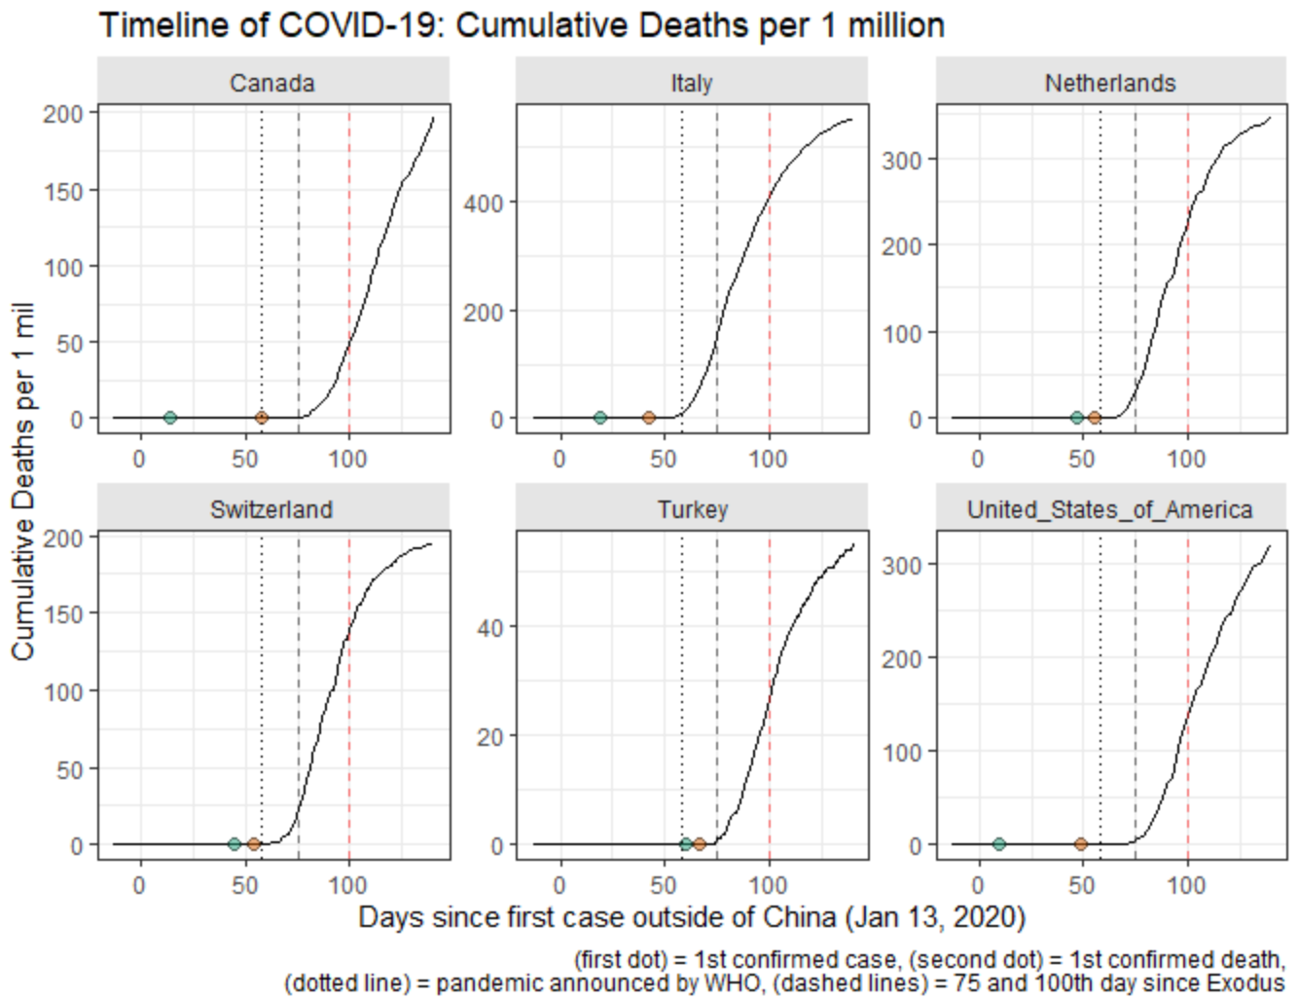
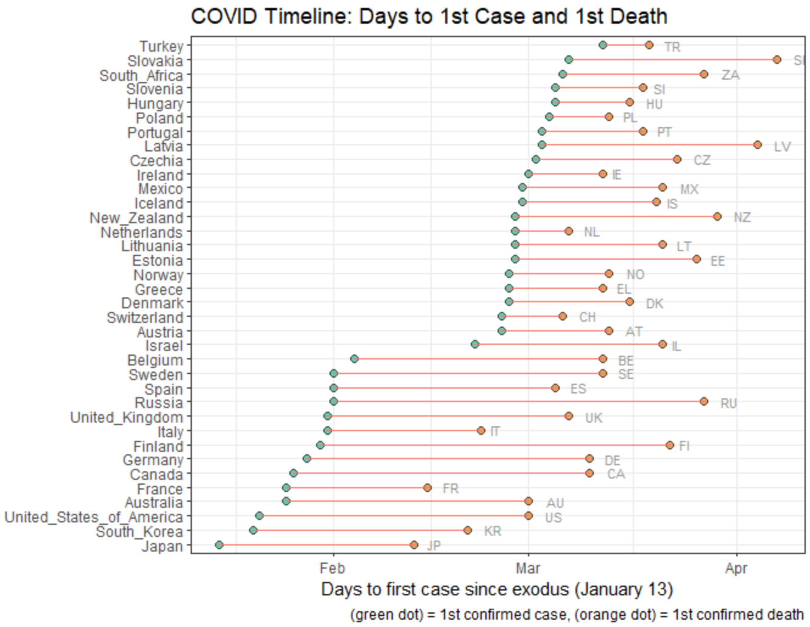
Visualizing the Pandemic: Comparing Trajectories of COVID-19 across Countries
Andriy Koval, Ph.D.
2020 VADA Summer School
June 2, 2020

