Slide 1
Inside the post
8 x 5.88 inches
Main page
8 x 4.51 inches
Widest during scaling of the page
8 x 2.8 inches

Slide 2



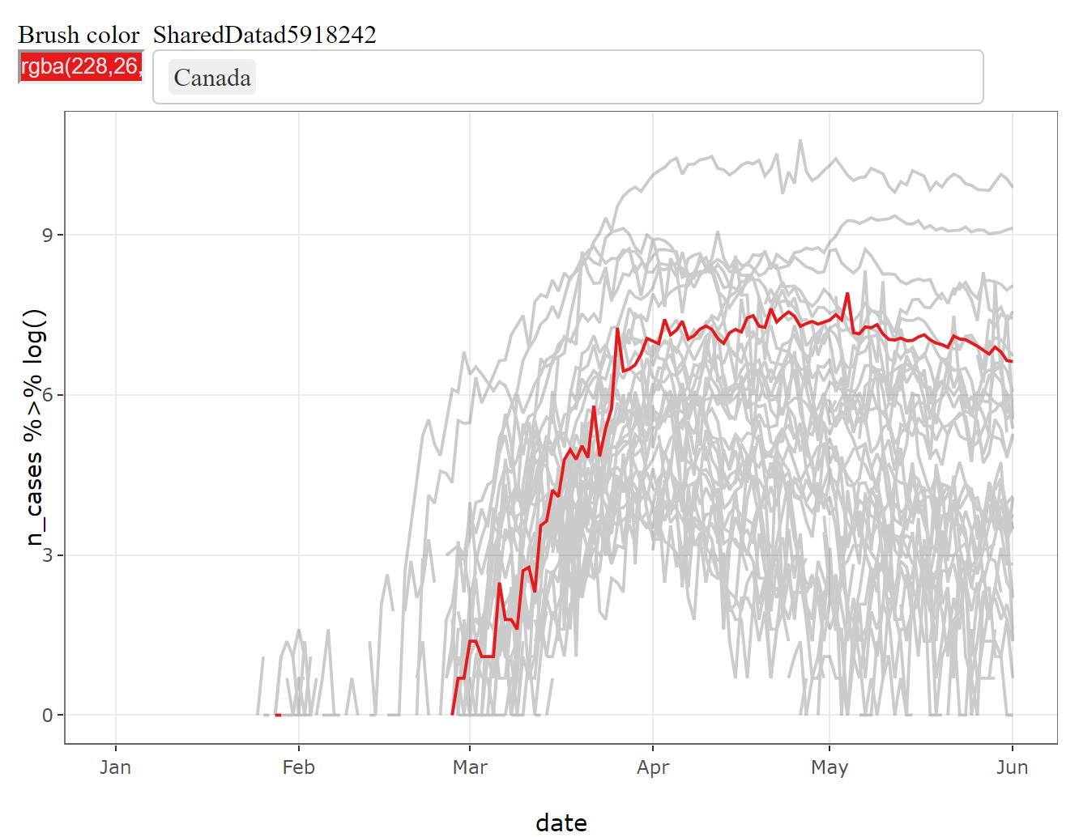
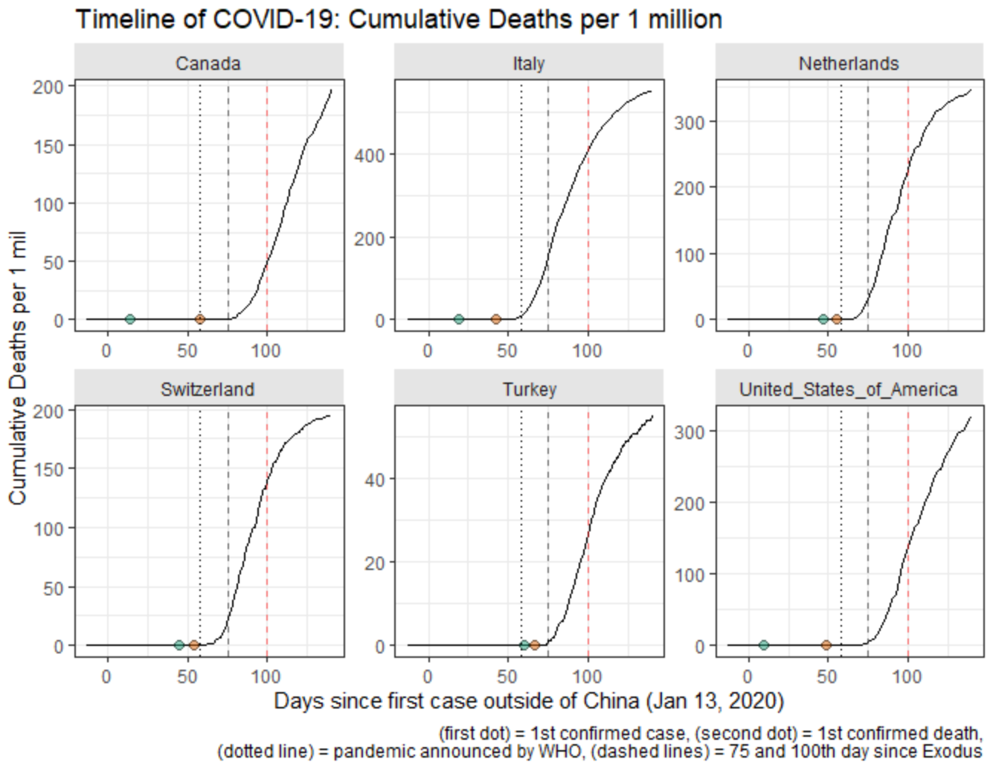
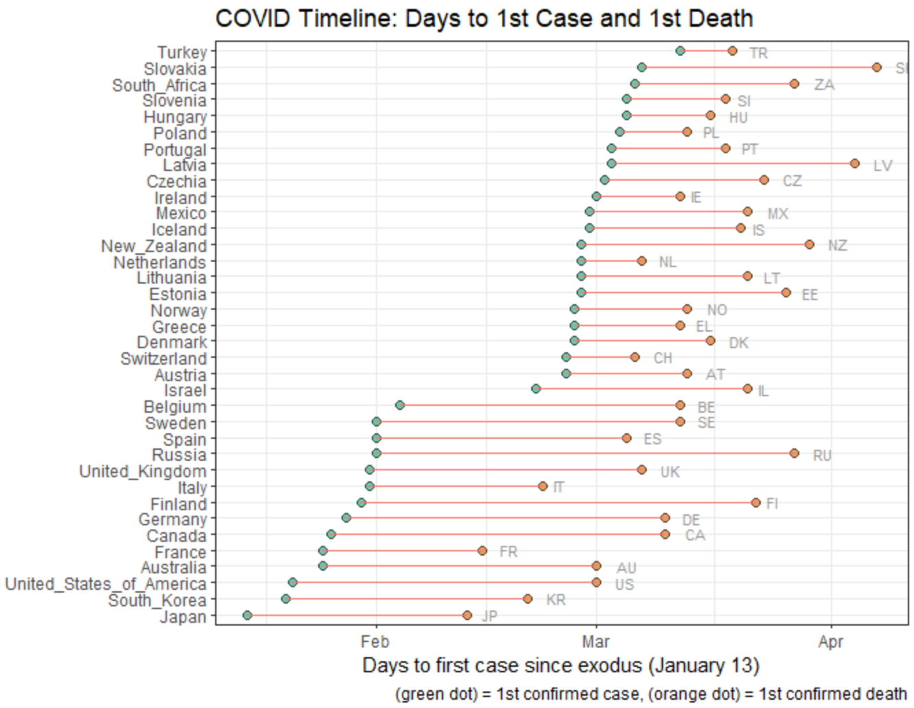
Andriy Koval, Ph.D.
2020 VADA Summer School
June 2, 2020
Visualizing the Pandemic: Comparing Trajectories of COVID-19 across Countries

Slide 3
