Slide 1

Displaying Health Data
Cases, Techniques, Solutions
Colloquium + Live-Webcast + Recording
Medical Sciences Building (MBS) 160
University of Victoria
November 28 – 30 , 1 – 3 pm PST
Notes:
The colloquium series discusses information visualization and statistical graphing in health research. The series invites you to share ideas, lesson and insights from real-world projects rather than listing the promises and challenges of “data science.” What worked? What didn’t? Why?
Information visualization and statistical graphing is the engine of knowledge mobilization, a vehicle that delivers ideas and insights across the boundaries of professional expertise. We must do it well! But what does “well” mean? The series invites the speakers to share examples of “good” and “bad” information displays from their work. What inspired their solutions? What compromises did they have to make?
A well-designed information display or statistical graphic should require minimal explanation. However, learning how to make such displays is aided by explaining the design and development process. The speakers will take us behind the scenes of display production and share practical wisdom for displaying data in health research.

Slide 2
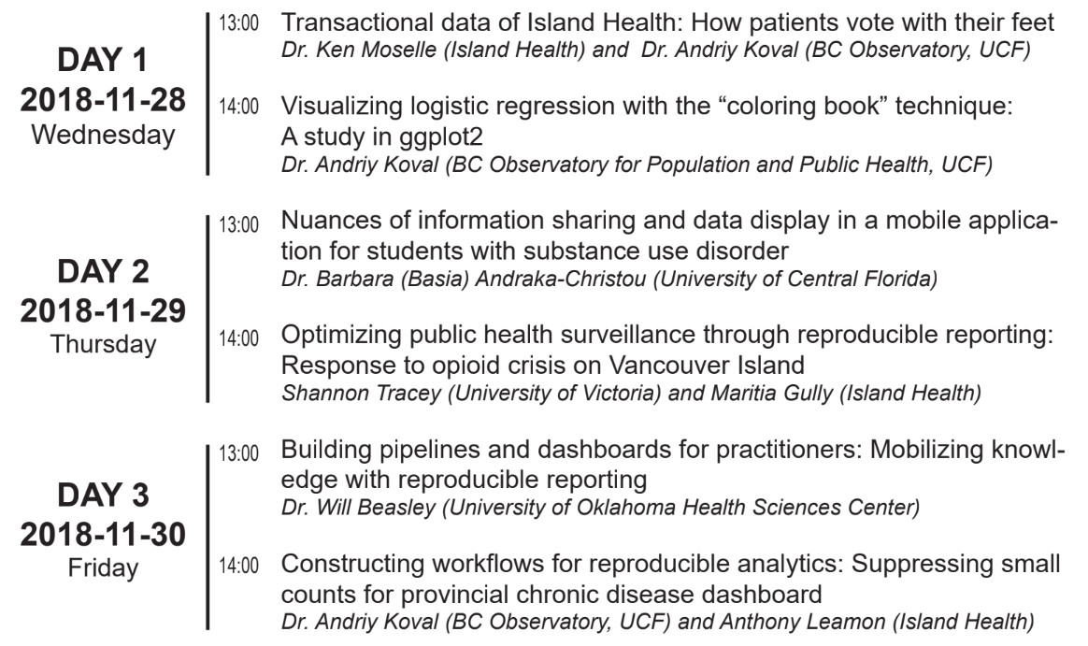

Displaying Health Data
Cases, Techniques, Solutions
Health Data
Substance Use
Pipelines & Dashboards
Notes:
Day 1 - Wednesday - Health Data
Day 2 - Thursday - Substance Use
Day 3 - Friday - Dashboards

Slide 3


Building pipelines and dashboards for practitioners
Knowledge mobilization with reproducible reporting
Please email questions to aging@uvic.ca
Access lecture slides from
Will Beasley
github.com/dss-ialh/displaying-health-data
Clone the repo to reproduce examples
Notes:
The colloquium series discusses information visualization and statistical graphing in health research. The series invites you to share ideas, lesson and insights from real-world projects rather than listing the promises and challenges of “data science.” What worked? What didn’t? Why?
Information visualization and statistical graphing is the engine of knowledge mobilization, a vehicle that delivers ideas and insights across the boundaries of professional expertise. We must do it well! But what does “well” mean? The series invites the speakers to share examples of “good” and “bad” information displays from their work. What inspired their solutions? What compromises did they have to make?
A well-designed information display or statistical graphic should require minimal explanation. However, learning how to make such displays is aided by explaining the design and development process. The speakers will take us behind the scenes of display production and share practical wisdom for displaying data in health research.

Slide 4
Today
A.0. What is BBMC and what I do there
A.1. Examples of the dashboards I have built
Takeaway: Dashboards are fun only if the pipeline is solid
B.0 Fictional dashboard to demonstrate the pipeline
Very simple, reproducible example.
Reproduce the example by forking github.com/dss-ialh/displaying-health-data
What the dashboard does
How it was build - pipeline
Diagram
C.0. Takeaways and recommendations

Slide 5
Who I am and what I do

Slide 6
Dashboard example 1

Slide 7
Dashboard example 2

Slide 8
Dashboard example 3

Slide 9
Fictional, Reproducible example

Slide 10
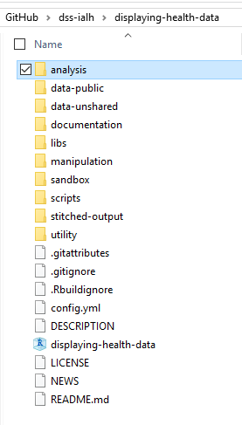
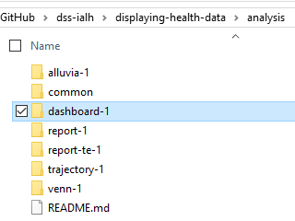
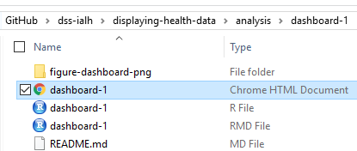
github.com/dss-ialh/displaying-health-data

Slide 11
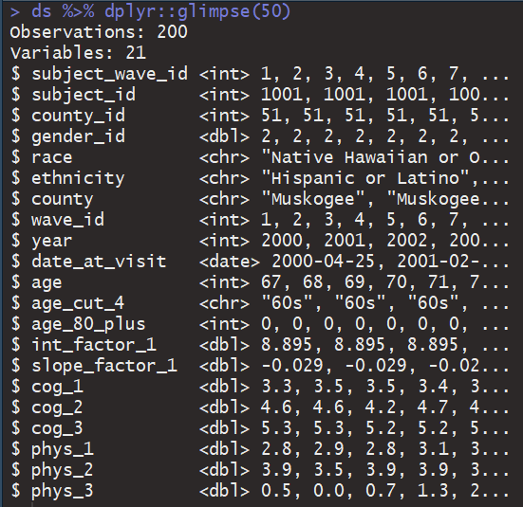
Data background
Studying cognitive decline among OK seniors
Collecting measures on COG and PHYS performace
Total of 200 respondents from three counties in Oklahoma

Slide 12
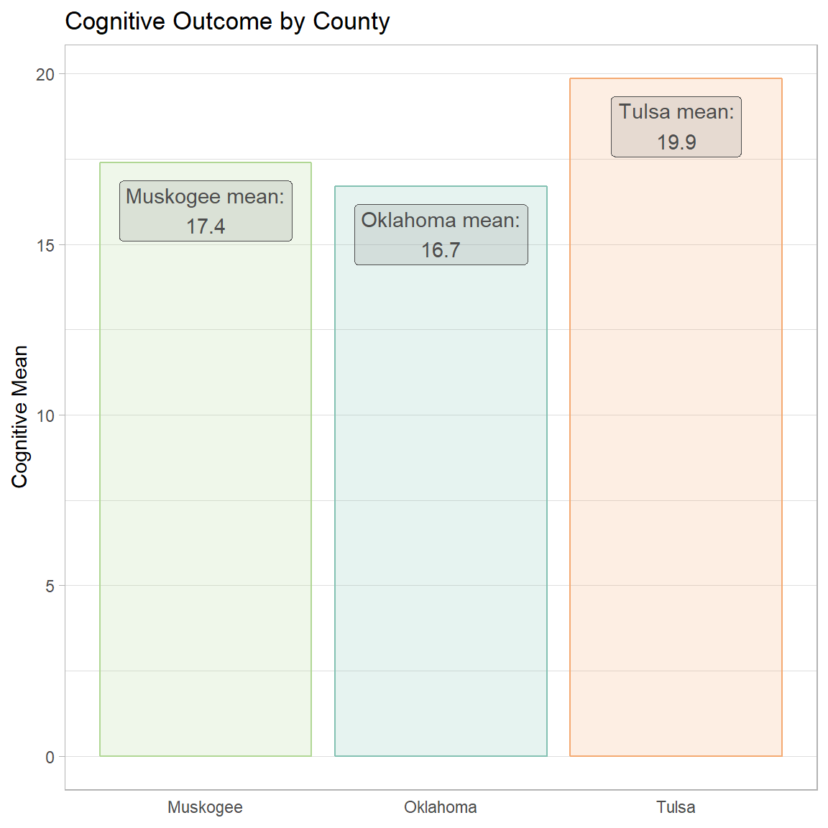
Scenario:
We want to study cognitive decline among seniors in Oklahoma
Objective: monitoring cognitive trajectories over time
Recruited 200 seniors from three counties
Dashboard is tailor to providers in Tulsa

Slide 13
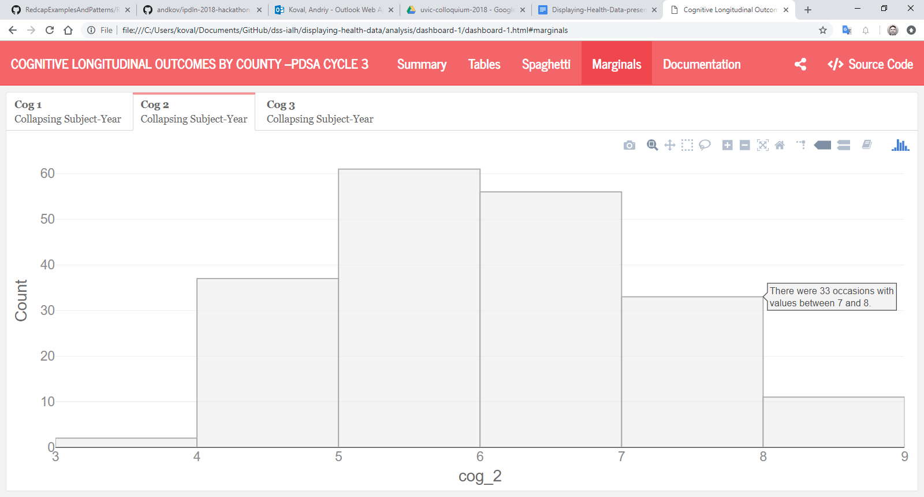

Slide 14
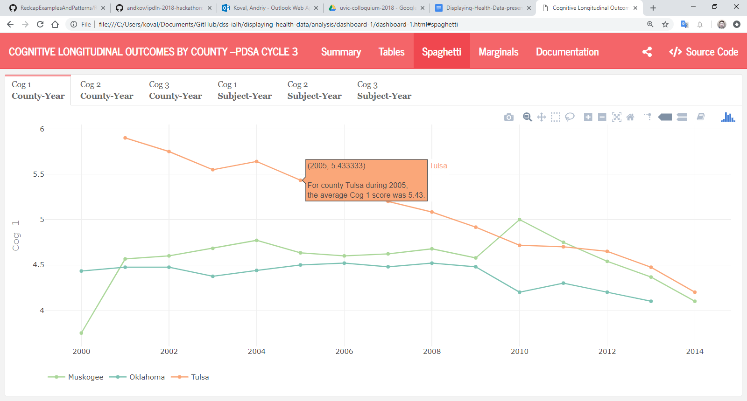
We need to monitor focal group over time
Other counties provide meaningful reference points

Slide 15
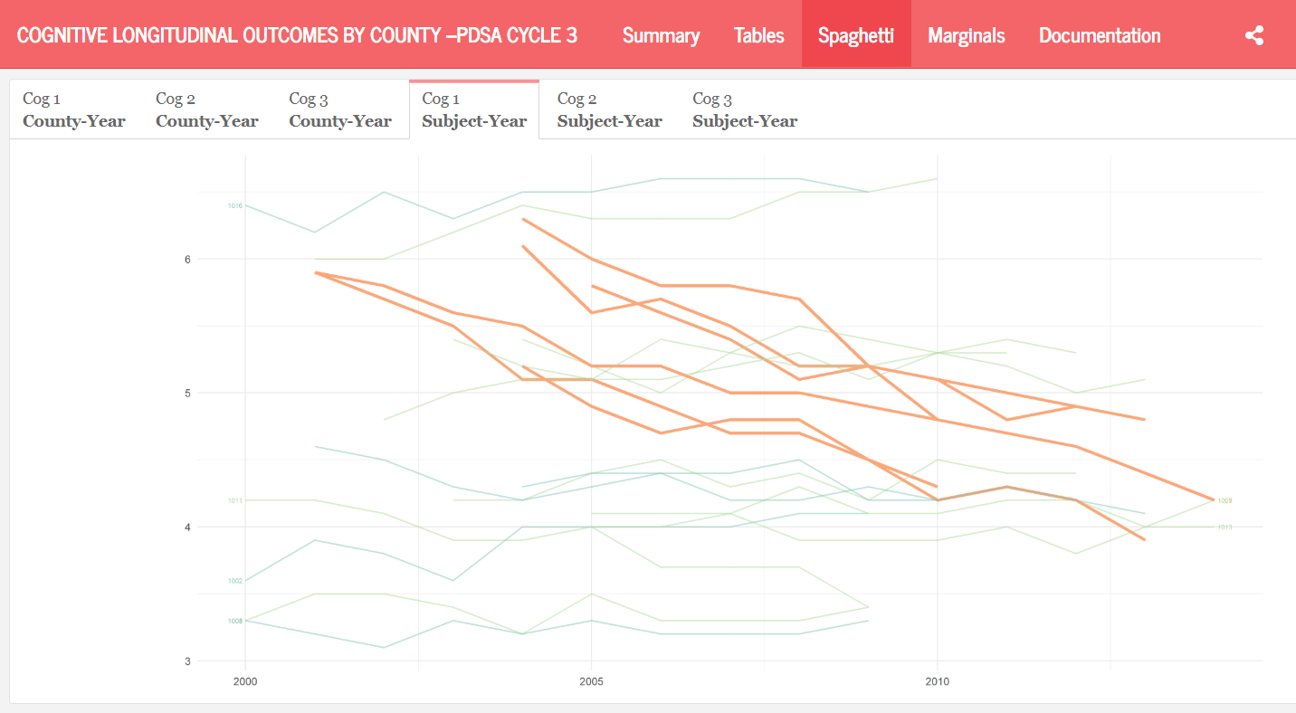
We also need to see the progress of individuals
(Tulsa county trajectories are in orange)

Slide 16
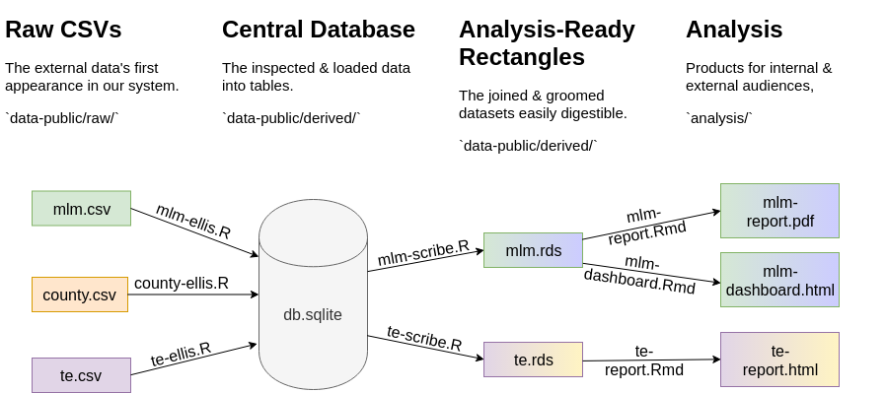
Pipeline diagram

Slide 17
Takeaways

Slide 18
Displaying Health Data
Cases, Techniques, Solutions
Colloquium + Live-Webcast + Recording
Medical Sciences Building (MBS) 160
University of Victoria
November 28 – 30 , 1 – 3 pm PST
Please email questions to aging@uvic.ca
Notes:
The colloquium series discusses information visualization and statistical graphing in health research. The series invites you to share ideas, lesson and insights from real-world projects rather than listing the promises and challenges of “data science.” What worked? What didn’t? Why?
Information visualization and statistical graphing is the engine of knowledge mobilization, a vehicle that delivers ideas and insights across the boundaries of professional expertise. We must do it well! But what does “well” mean? The series invites the speakers to share examples of “good” and “bad” information displays from their work. What inspired their solutions? What compromises did they have to make?
A well-designed information display or statistical graphic should require minimal explanation. However, learning how to make such displays is aided by explaining the design and development process. The speakers will take us behind the scenes of display production and share practical wisdom for displaying data in health research.

Slide 19








