Slide 1

Displaying Health Data
Cases, Techniques, Solutions
Colloquium + Live-Webcast + Recording
Medical Sciences Building (MBS) 160
University of Victoria
November 28 – 30 , 1 – 3 pm PST
Notes:
The colloquium series discusses information visualization and statistical graphing in health research. The series invites you to share ideas, lesson and insights from real-world projects rather than listing the promises and challenges of “data science.” What worked? What didn’t? Why?
Information visualization and statistical graphing is the engine of knowledge mobilization, a vehicle that delivers ideas and insights across the boundaries of professional expertise. We must do it well! But what does “well” mean? The series invites the speakers to share examples of “good” and “bad” information displays from their work. What inspired their solutions? What compromises did they have to make?
A well-designed information display or statistical graphic should require minimal explanation. However, learning how to make such displays is aided by explaining the design and development process. The speakers will take us behind the scenes of display production and share practical wisdom for displaying data in health research.

Slide 2
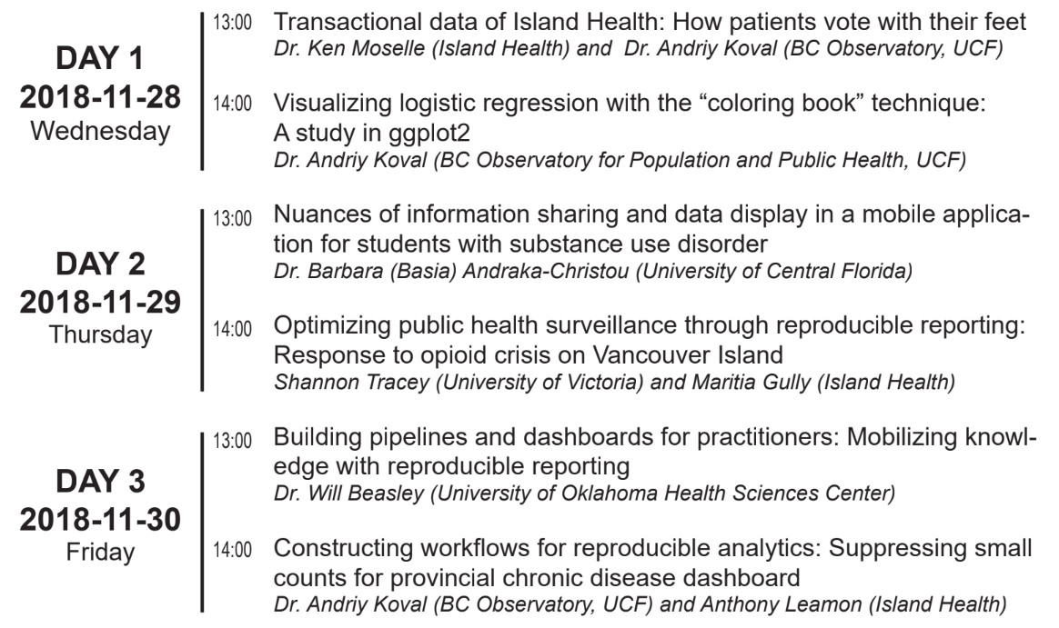

Displaying Health Data
Cases, Techniques, Solutions
Health Data
Substance Use
Pipelines & Dashboards
Notes:
Day 1 - Wednesday - Health Data
Day 2 - Thursday - Substance Use
Day 3 - Friday - Dashboards

Slide 3


Building pipelines and dashboards for practitioners
Knowledge mobilization with reproducible reporting
Please email questions to aging@uvic.ca
Access lecture slides from
Will Beasley
github.com/dss-ialh/displaying-health-data
Clone the repo to reproduce examples
Notes:
The colloquium series discusses information visualization and statistical graphing in health research. The series invites you to share ideas, lesson and insights from real-world projects rather than listing the promises and challenges of “data science.” What worked? What didn’t? Why?
Information visualization and statistical graphing is the engine of knowledge mobilization, a vehicle that delivers ideas and insights across the boundaries of professional expertise. We must do it well! But what does “well” mean? The series invites the speakers to share examples of “good” and “bad” information displays from their work. What inspired their solutions? What compromises did they have to make?
A well-designed information display or statistical graphic should require minimal explanation. However, learning how to make such displays is aided by explaining the design and development process. The speakers will take us behind the scenes of display production and share practical wisdom for displaying data in health research.

Slide 4
Building Pipelines and Dashboards for Practitioners: Mobilizing knowledge with reproducible reporting
Will Beasley, Geneva Marshall, & David Bard
University of Oklahoma Health Science Center
Biomedical and Behavioral Health Core

Slide 5
Common Roles for the BBMC
domain expertise in a few areas
incorporation of data sources from multiple agencies
statistical analysis for academic publications
construct information displays for nontechnical audiences

Slide 6
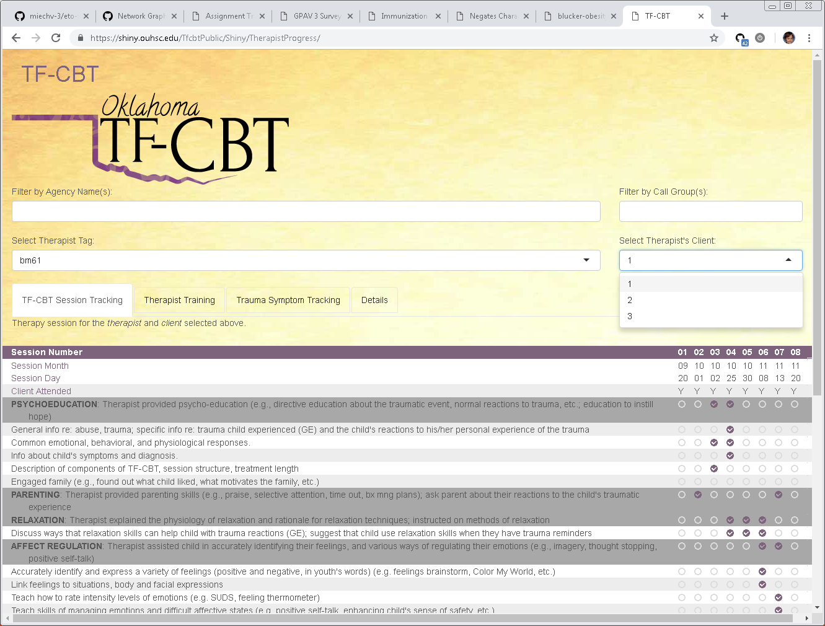
Example 1: history of therapist training

Slide 7
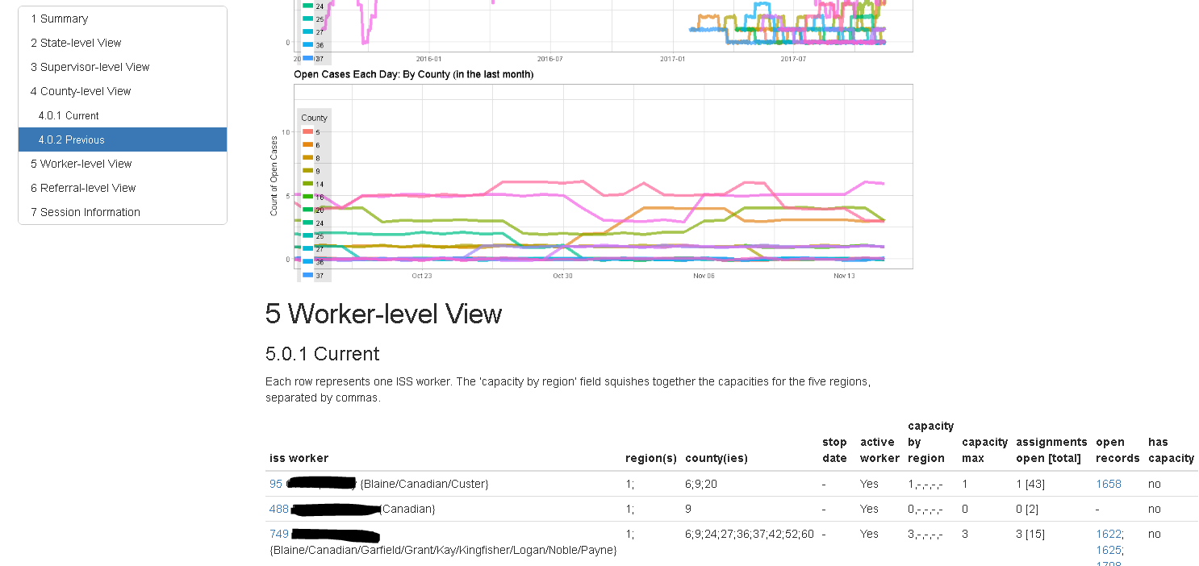
Example 2: availability of specialized CPS workers

Slide 8
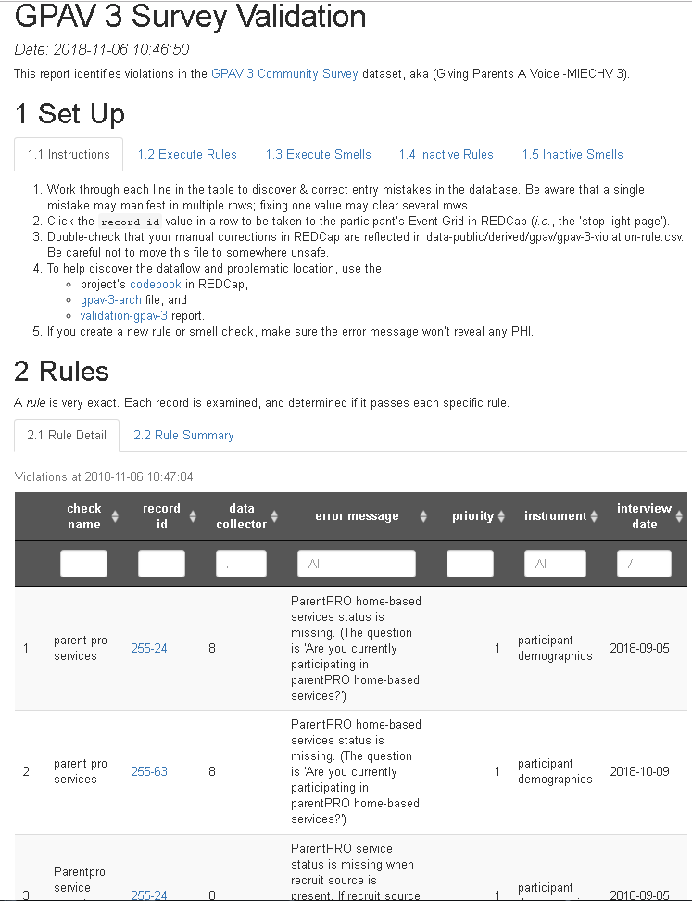
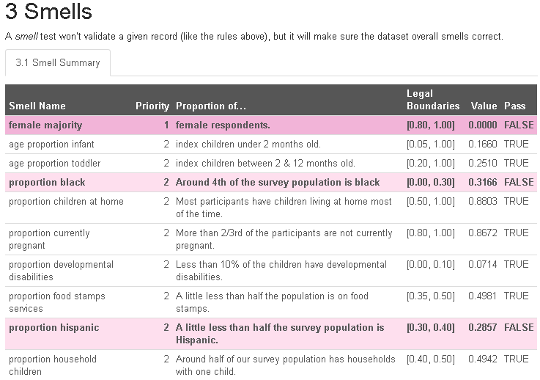
Example 3: data collection quality

Slide 9
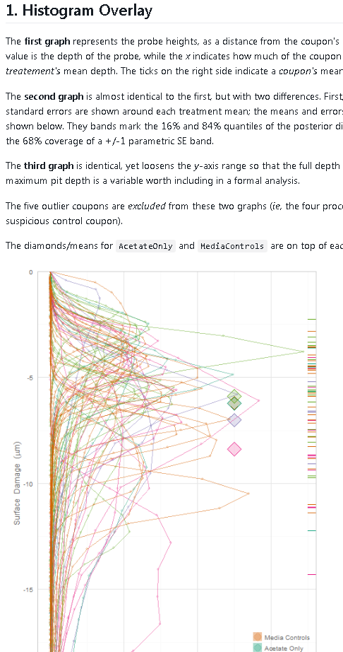
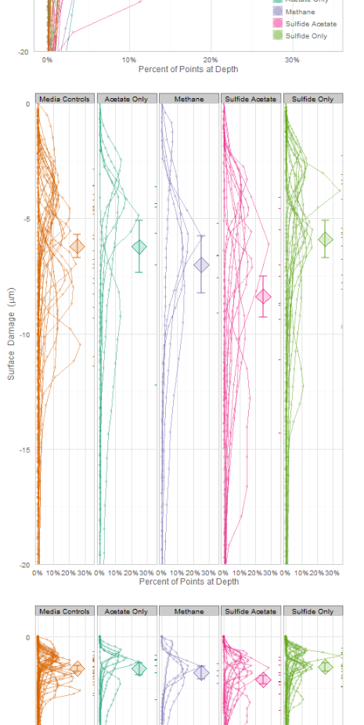
Example 4: MCMC HPDs are updated as collection progresses

Slide 10
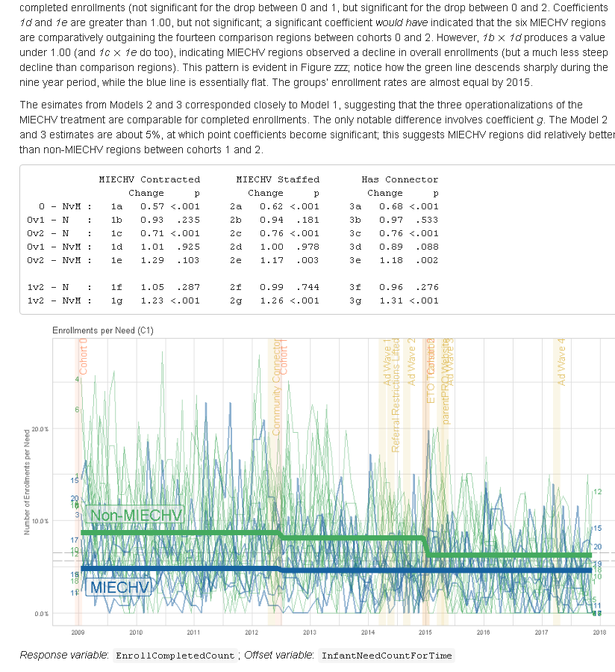
Example 5: semi-annual reports with multilevel longitudinal models

Slide 11
dashboards vs reports
Blur the distinction
Try to make your reports more like dashboards, so they
Are automated,
Are frequently updated & consumed (especially early in the project),
Actively flag errors, and
Are easy and fun to jump into
Try to make your dashboards more like reports, so they
Provide context and are self-explanatory,
Are portable and archivable, and
Contain statistical analyses that encourage sophisticated reasoning.

Slide 12
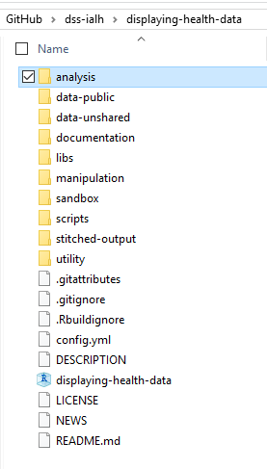
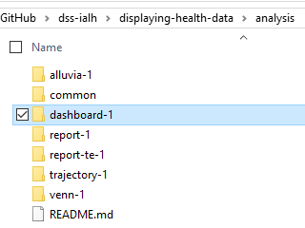
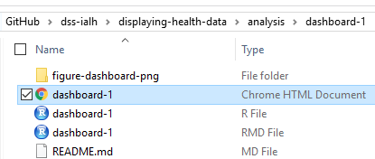
Fictional, Reproducible example
github.com/dss-ialh/displaying-health-data

Slide 13
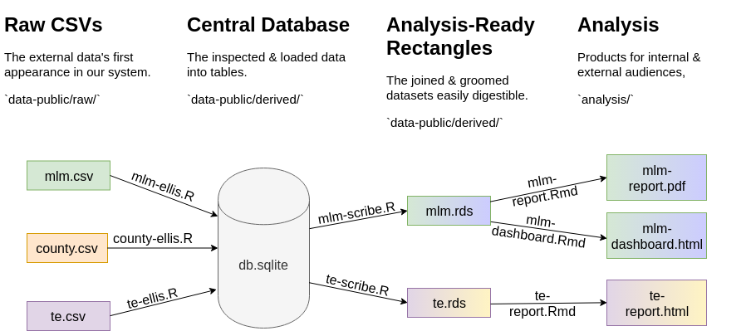
Pipeline (available at github.com/dss-ialh/displaying-health-data)

Slide 14
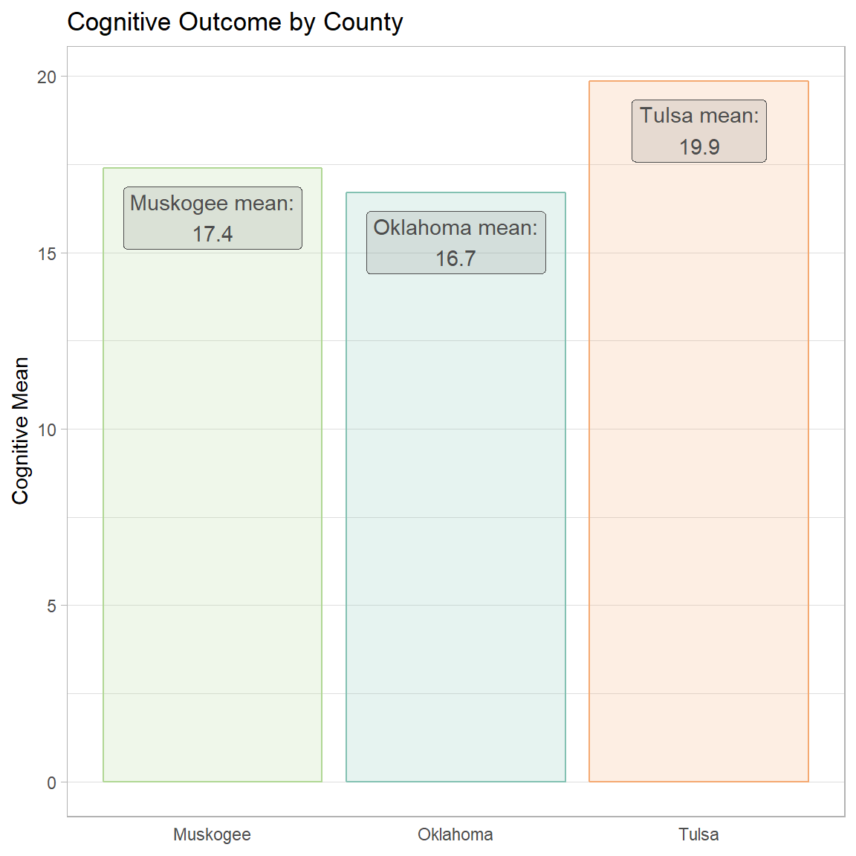
Fictional scenario
We partner with the government to monitor the cognitive trajectories of patients over time.
Recruited 200 seniors from three county programs.
Dashboard is tailored to providers in Tulsa

Slide 15
In the real study…
The nurses create three 6-month mini-research studies.
They develop a manageable change to the services the provide, and see if their mini-intervention improves an outcome they’ve chosen.
One real intervention developed a thorough script of welcoming new clients. A second intervention was sending text messages to clients to reduce no-shows. A third intervention developed guidelines for discussing traumatic ACEs in their past.
Starts with 2-day workshop to develop the ideas.

Slide 16
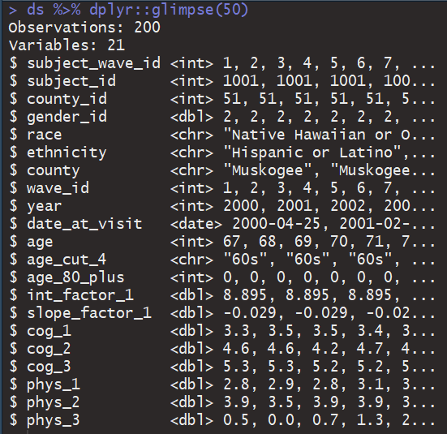
Data Glimpse
(start demo)

Slide 17
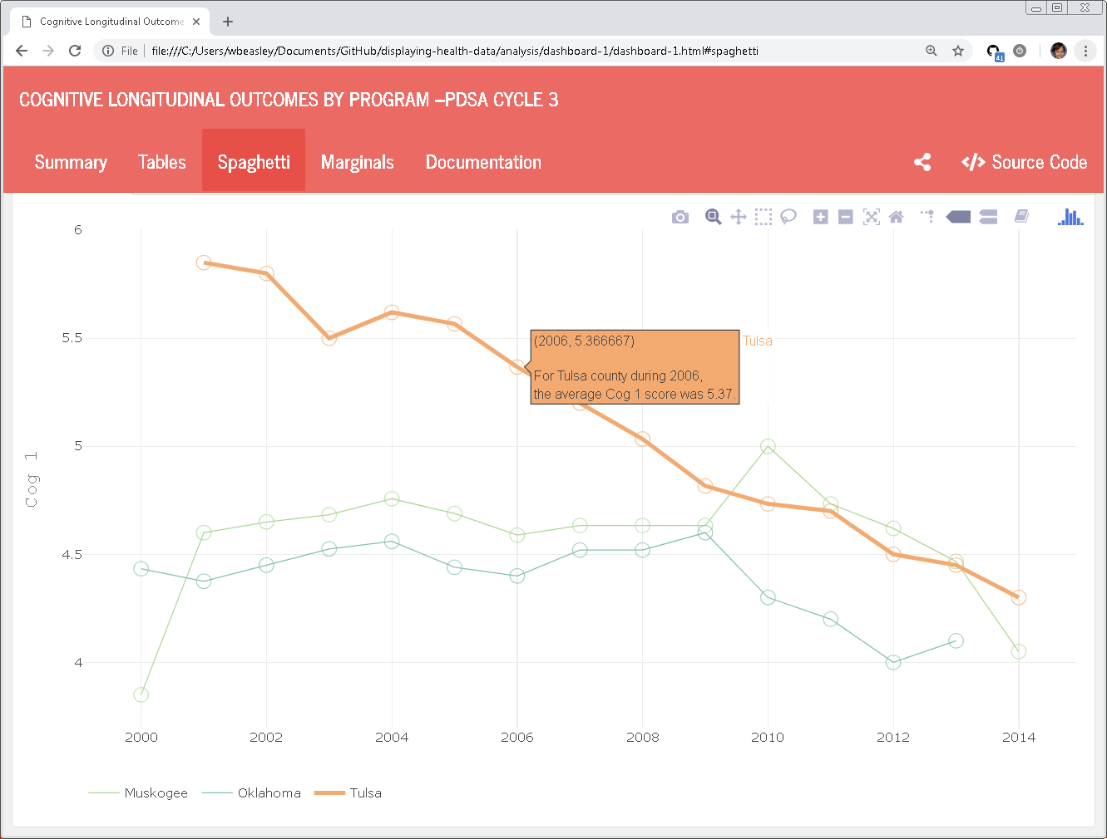
Program directors need to monitor the focal group over time.
De-emphasized programs provide meaningful reference points.

Slide 18
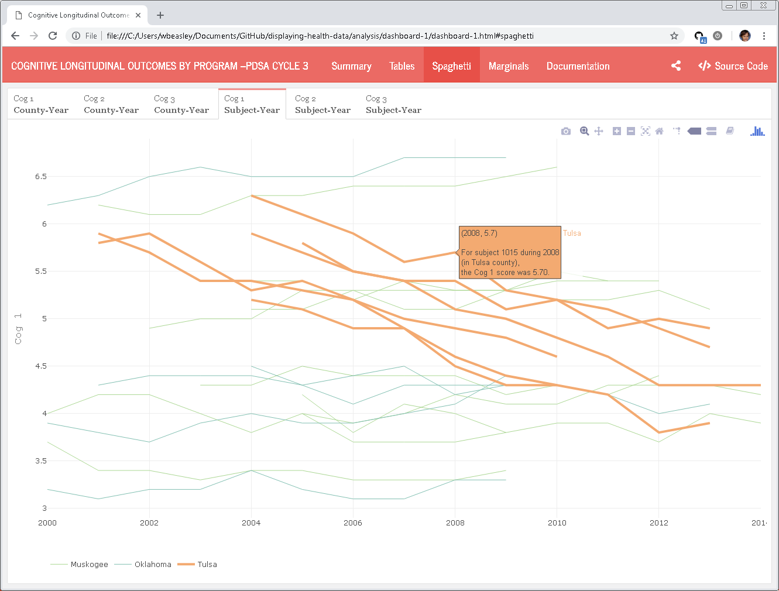
We also need to see the progress of individuals
Tulsa county trajectories are in orange. The others are primarily for context.

Slide 19
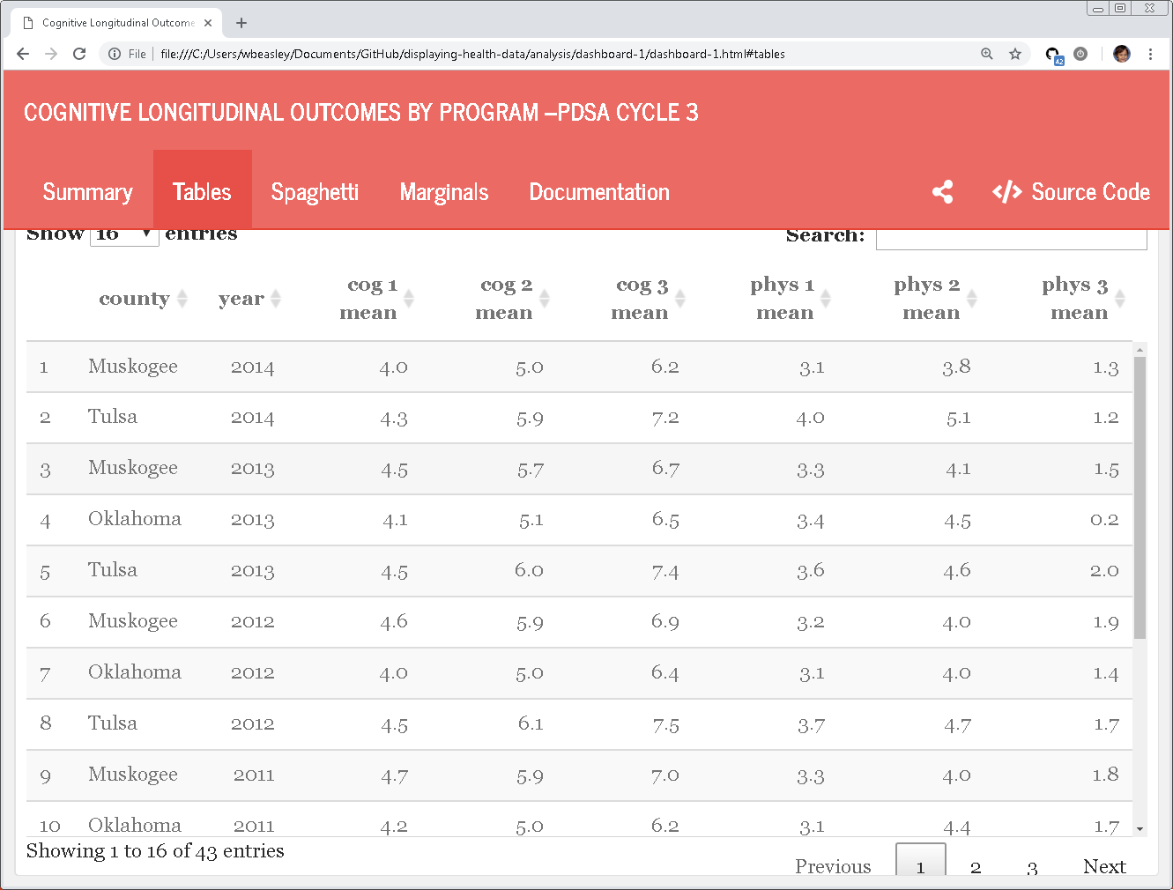
Some nurses were more comfortable starting with tables than graphs.

Slide 20
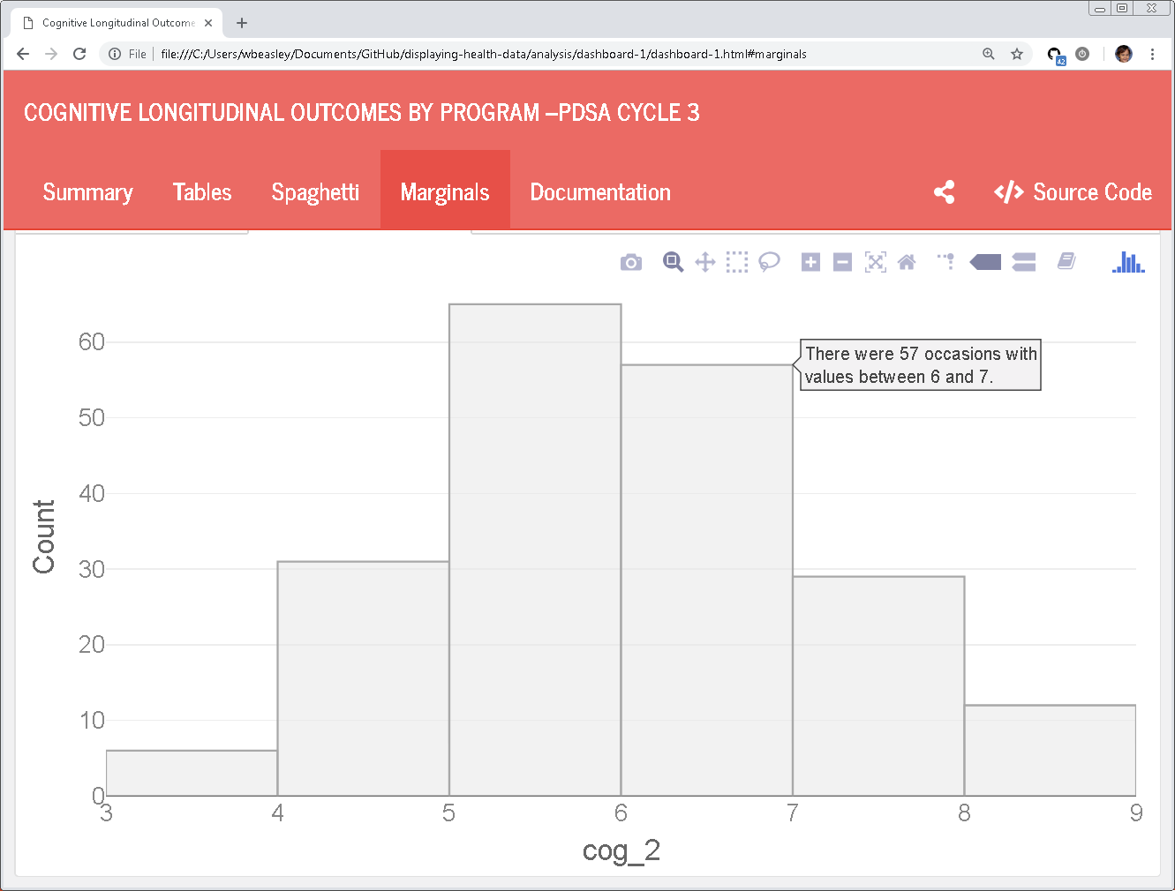
Histograms are particularly benefited from full-sentence hover text.

Slide 21
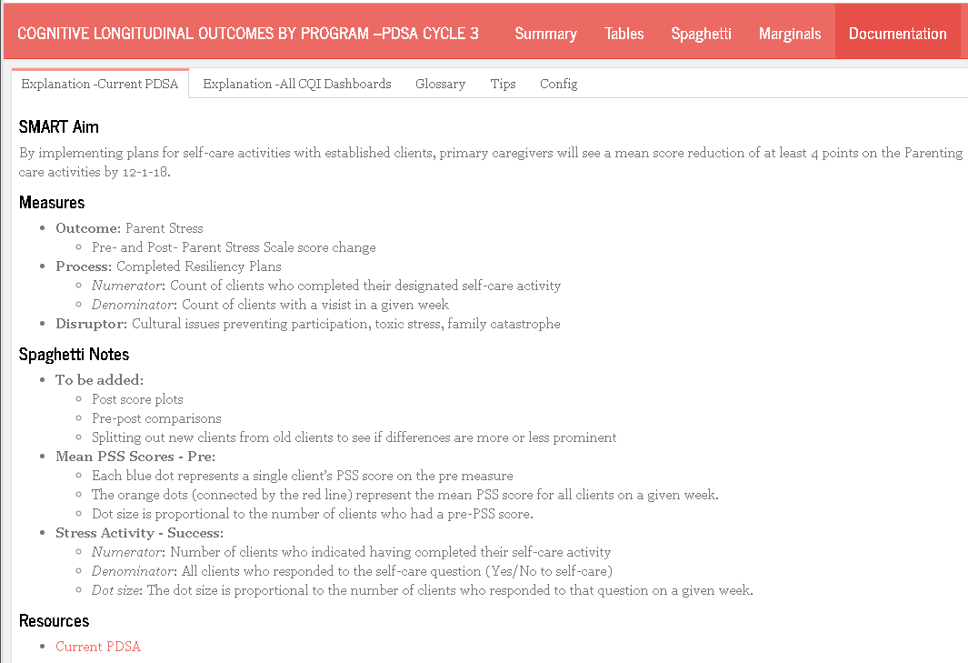
Each dashboard had several tabs of documentation.
Our quality varied across dashboards, and this is a representative example.

Slide 22
Lessons Reinforced
The providers have incredible ideas for improving services delivered. It's worth our time to facilitate and translate these ideas.
Implementing their tx & measurements ideas increases their engagement.
Incorporate the providers in the dashboard design
Math phobia is real, and it might be hard for your developers to related to.
Writing the scribes is difficult (ie, grooms and reshapes multiple analysis-agnostic data tables into a single analysis-specific rectangle).
Notes:
1. The nurses have incredible ideas for improving services delivered. It's worth our time to facilitate and translate these ideas into interventions that can be evaluated with quantitative evidence.
2. Even if you "knew" everything you do is superior, implementing the nurses treatment ideas and measurement ideas increases their engagement in the process. This should improve the services the provide, and the quality of the research.
3. The effectiveness of the dashboards will improve if the nurses are involved in their development. They are the audience, after all.
4. Math phobia is a real thing. It was a powerful obstacle to the nurses' acceptance of the information display. Even after you warn your dashboard developers (and the nurses), there will probably be a gap still.
5. Writing the scribes is difficult (ie, the piece that grooms and reshapes multiple analysis-agnostic data tables into a single analysis-specific rectangle).

Slide 23
Lessons Learned
This particular group of nurses preferred a top-down entry into their data. Most scientists prefer bottom-up. Here are some examples of how we changed our presentation.
Hovering text provides an alternative entry into understanding the graph.
Incorporate the providers in the dashboard design
Monthly meetings are not frequent enough at the beginning
Notes:
*. Writing the scribes is really difficult, particularly for these monitoring scenarios. That's another 20 minute talk.
2. This particular group of nurses preferred a top-down entry into their data. Most scientists prefer bottom-up. Here are some examples of how we changed our presentation.
3. Hovering text provides an alternative entry into understanding the graph. Showing a textual representation of the coordinates wasn't helpful for some. The hover text were complete sentences, like "For Tulsa county in 2004, the average cognitive score was 5.5" in spaghetti plots and "" in histograms.
4. Monthly meetings are not frequent enough at the beginning.

Slide 24
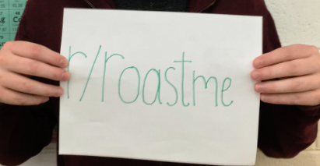
Suggestions for dashboard improvements?
Specific graphs
Presentation order
Verbal documentation
My approach/attitude towards the information
My approach/attitude towards the consumers
Feature to emphasis or de-emphasize

Slide 25
Pipeline (available at github.com/dss-ialh/displaying-health-data)

Slide 26
Pipeline

Slide 27
Benefits
Scaling
more data sources
multiple analysts
multiple reports
Hide PHI for as long as possible
Leverage database performance

Slide 28
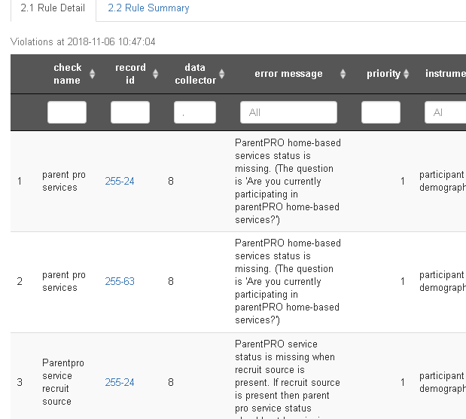
Deployment Options
Server-rendered vs Client-rendered
Interactive vs static
Stage to redact PHI
Reconnect to PHI record using authentication
human vs cronjob

Slide 29
Providers in Oklahoma
Oklahoma State Department of Health– Persephone Starks, John Delara, Beth Martin
Children First Tulsa – LouAnn Beuke
LCDA – Patty Demoraes-Huffhine
Oklahoma City County Health Department – Denise Howard, Diane Sammons, Sally Dixon
OKC Public Schools – Yolanda Lucero, Kethzia Njikam
PAT Bethany Public Schools – Mindy Turner, Jem Balderas
PAT Parent Promise – Shawna Norman
Community Action Program Tulsa – Dana James
Cherokee PARENTS – Ben King, Jennifer Kirby, Amy Thilges
PCCT PAT Tulsa - Sarah Neyman
SafeCare PCCT – Sheri Davis
SafeCare NorthCare – Dwan McDonald

Slide 30
University of Oklahoma HSC Analysts for the MIECHV-3 CQI
David Bard,
Will Beasley
Geneva Marshall
Thomas Wilson
Andrew Peters
Chris Aston
Donna Wells
Som Bohora
Maleeha Shahid
Yutian Thompson

Slide 31
Displaying Health Data
Cases, Techniques, Solutions
Colloquium + Live-Webcast + Recording
Medical Sciences Building (MBS) 160
University of Victoria
November 28 – 30 , 1 – 3 pm PST
Please email questions to aging@uvic.ca
Notes:
The colloquium series discusses information visualization and statistical graphing in health research. The series invites you to share ideas, lesson and insights from real-world projects rather than listing the promises and challenges of “data science.” What worked? What didn’t? Why?
Information visualization and statistical graphing is the engine of knowledge mobilization, a vehicle that delivers ideas and insights across the boundaries of professional expertise. We must do it well! But what does “well” mean? The series invites the speakers to share examples of “good” and “bad” information displays from their work. What inspired their solutions? What compromises did they have to make?
A well-designed information display or statistical graphic should require minimal explanation. However, learning how to make such displays is aided by explaining the design and development process. The speakers will take us behind the scenes of display production and share practical wisdom for displaying data in health research.

Slide 32








