Slide 1

Displaying Health Data
Cases, Techniques, Solutions
Colloquium + Live-Webcast + Recording
Medical Sciences Building (MBS) 160
University of Victoria
November 28 – 30 , 1 – 3 pm PST
Notes:
The colloquium series discusses information visualization and statistical graphing in health research. The series invites you to share ideas, lesson and insights from real-world projects rather than listing the promises and challenges of “data science.” What worked? What didn’t? Why?
Information visualization and statistical graphing is the engine of knowledge mobilization, a vehicle that delivers ideas and insights across the boundaries of professional expertise. We must do it well! But what does “well” mean? The series invites the speakers to share examples of “good” and “bad” information displays from their work. What inspired their solutions? What compromises did they have to make?
A well-designed information display or statistical graphic should require minimal explanation. However, learning how to make such displays is aided by explaining the design and development process. The speakers will take us behind the scenes of display production and share practical wisdom for displaying data in health research.

Slide 2
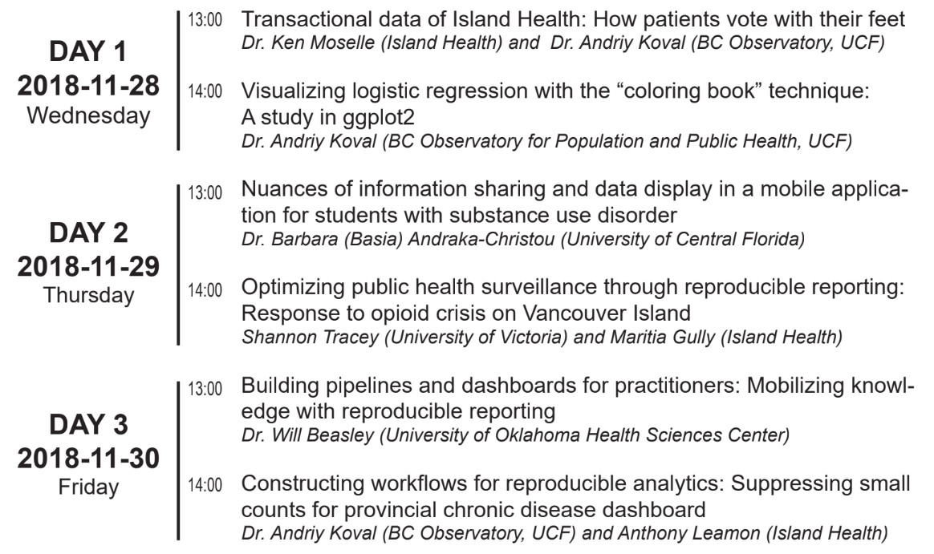

Displaying Health Data
Cases, Techniques, Solutions
Health Data
Substance Use
Pipelines & Dashboards
Notes:
Day 1 - Wednesday - Health Data
Day 2 - Thursday - Substance Use
Day 3 - Friday - Dashboards

Slide 3


Building pipelines and dashboards for practitioners
Knowledge mobilization with reproducible reporting
Please email questions to aging@uvic.ca
Access lecture slides from
Will Beasley
github.com/dss-ialh/displaying-health-data
Clone the repo to reproduce examples
Notes:
The colloquium series discusses information visualization and statistical graphing in health research. The series invites you to share ideas, lesson and insights from real-world projects rather than listing the promises and challenges of “data science.” What worked? What didn’t? Why?
Information visualization and statistical graphing is the engine of knowledge mobilization, a vehicle that delivers ideas and insights across the boundaries of professional expertise. We must do it well! But what does “well” mean? The series invites the speakers to share examples of “good” and “bad” information displays from their work. What inspired their solutions? What compromises did they have to make?
A well-designed information display or statistical graphic should require minimal explanation. However, learning how to make such displays is aided by explaining the design and development process. The speakers will take us behind the scenes of display production and share practical wisdom for displaying data in health research.

Slide 4
Building Pipelines and Dashboards for Practitioners: Mobilizing knowledge with reproducible reporting
Will Beasley, Geneva Marshall, & David Bard
University of Oklahoma Health Science Center
Biomedical and Behavioral Health Core

Slide 5
A.0. What is BBMC and what I do there
A.1. Examples of the dashboards I have built
Takeaway: Dashboards are fun only if the pipeline is solid
B.0 Fictional dashboard to demonstrate the pipeline
Simplified reproducible example.
Reproduce the example by forking github.com/dss-ialh/displaying-health-data
Dashboard content
Upstream pipeline
C.0. Takeaways and recommendations

Slide 6
Who I am and what I do

Slide 7
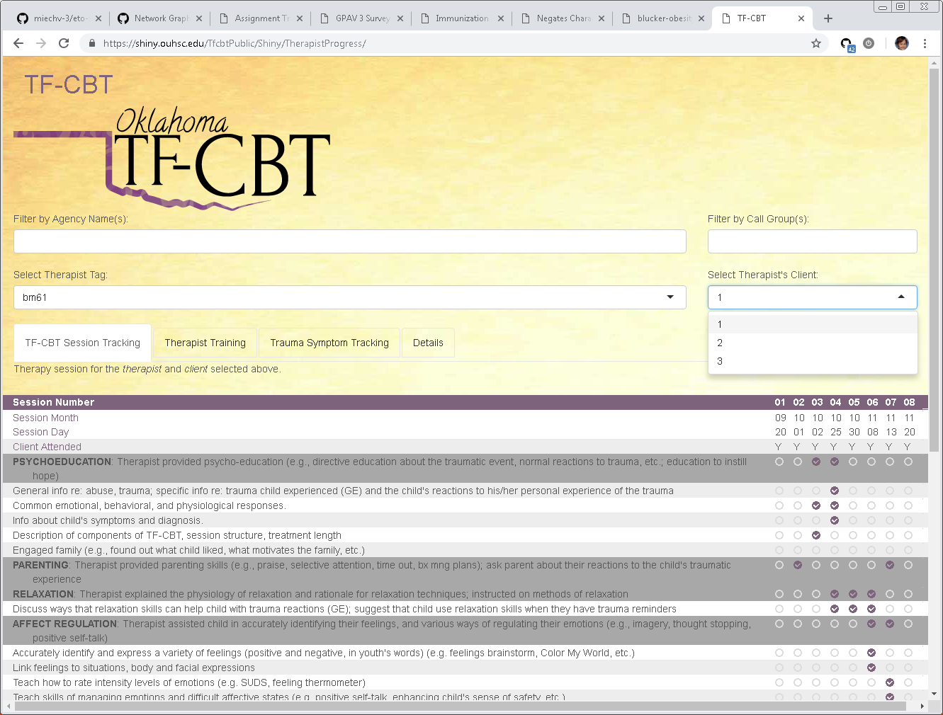
Example 1: history of therapist training

Slide 8
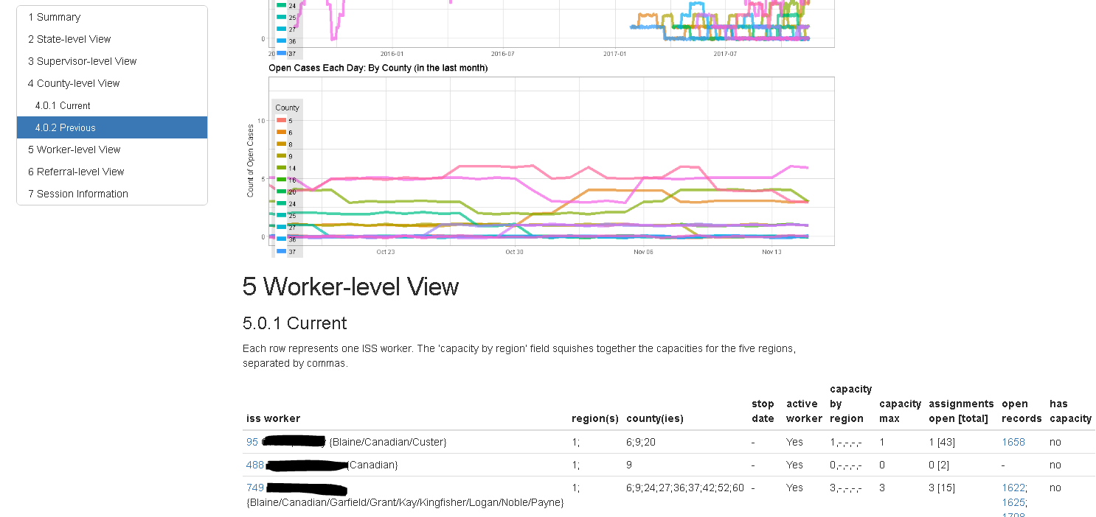
Example 2: availability of specialized CPS workers

Slide 9
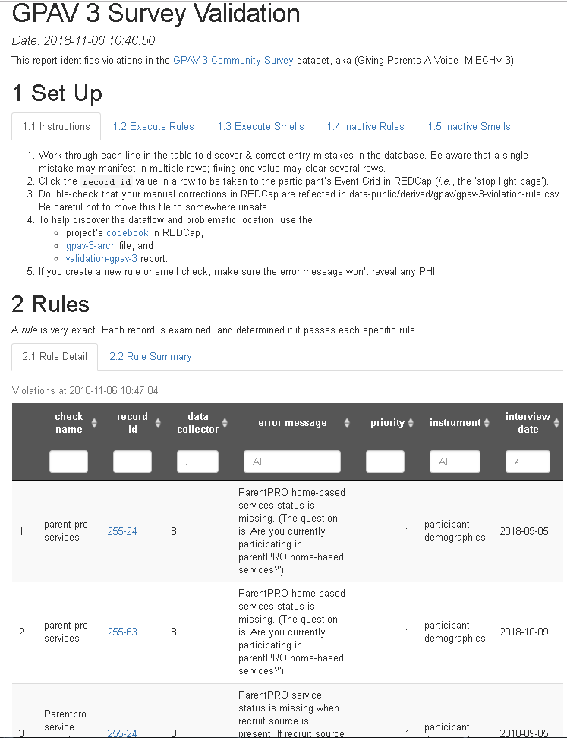
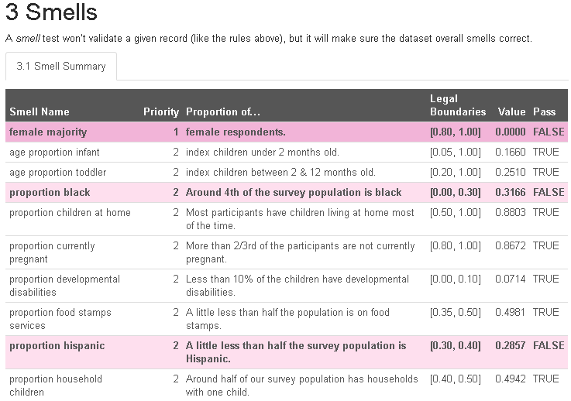
Example 3: data collection quality

Slide 10
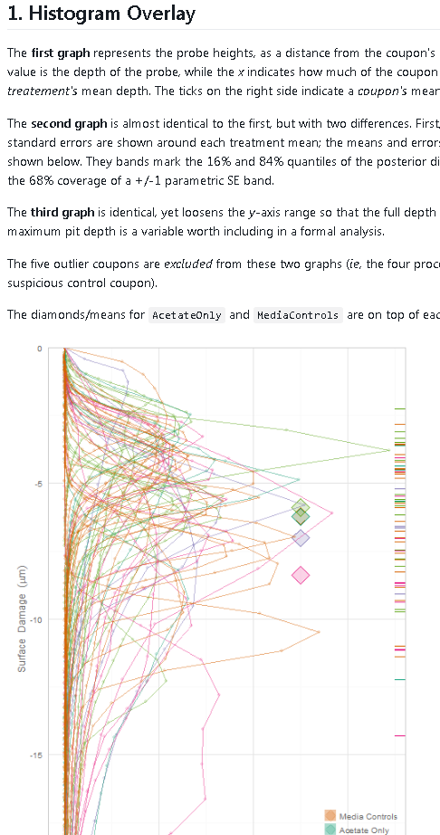
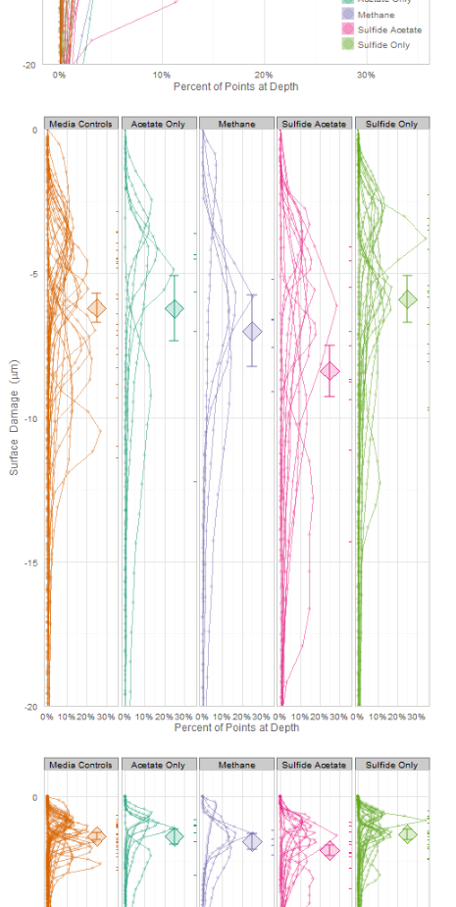
Example 4: MCMC HPDs are updated as collection progresses

Slide 11
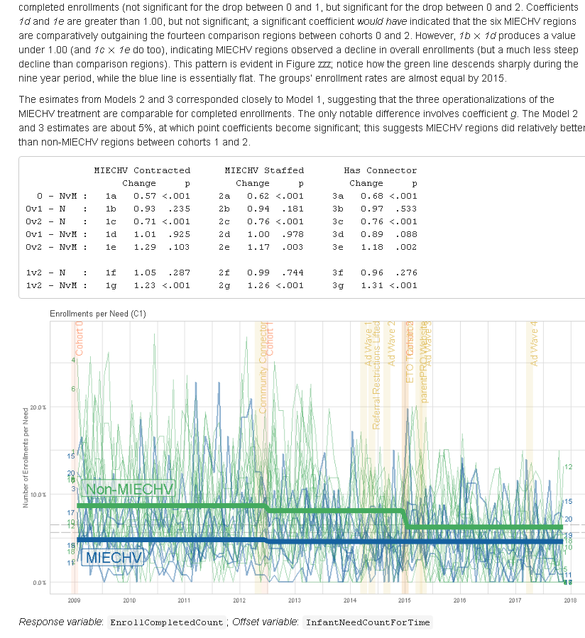
Example 5: semi-annual reports with multilevel longitudinal models

Slide 12
dashboards vs reports
Blur the distinction
Try to make your reports more like dashboards, so they
Are automated,
Are frequently updated & consumed (especially early in the project),
Actively flag errors, and
Are easy and fun to jump into
Try to make your dashboards more like reports, so they
Provide context and are self-explanatory,
Are portable and archivable, and
Contain statistical analyses that encourage sophisticated reasoning.

Slide 13
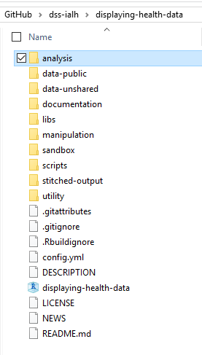
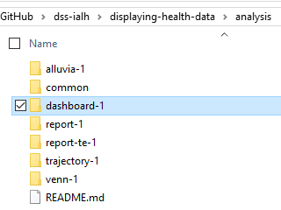
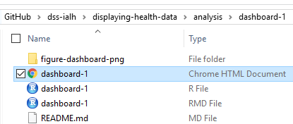
Fictional, Reproducible example
github.com/dss-ialh/displaying-health-data

Slide 14
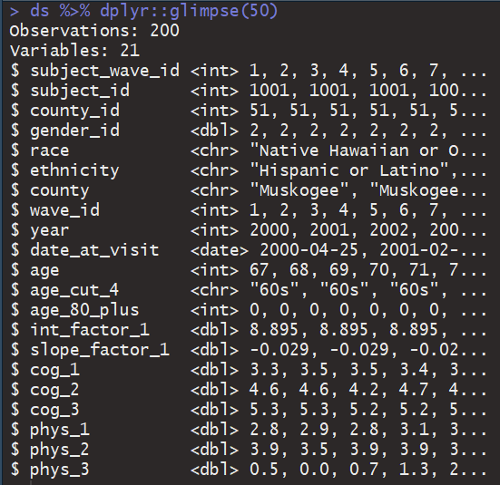
Data background
Studying cognitive decline among OK seniors
Collecting measures on COG and PHYS performance
Total of 200 respondents from three programs/counties in Oklahoma

Slide 15
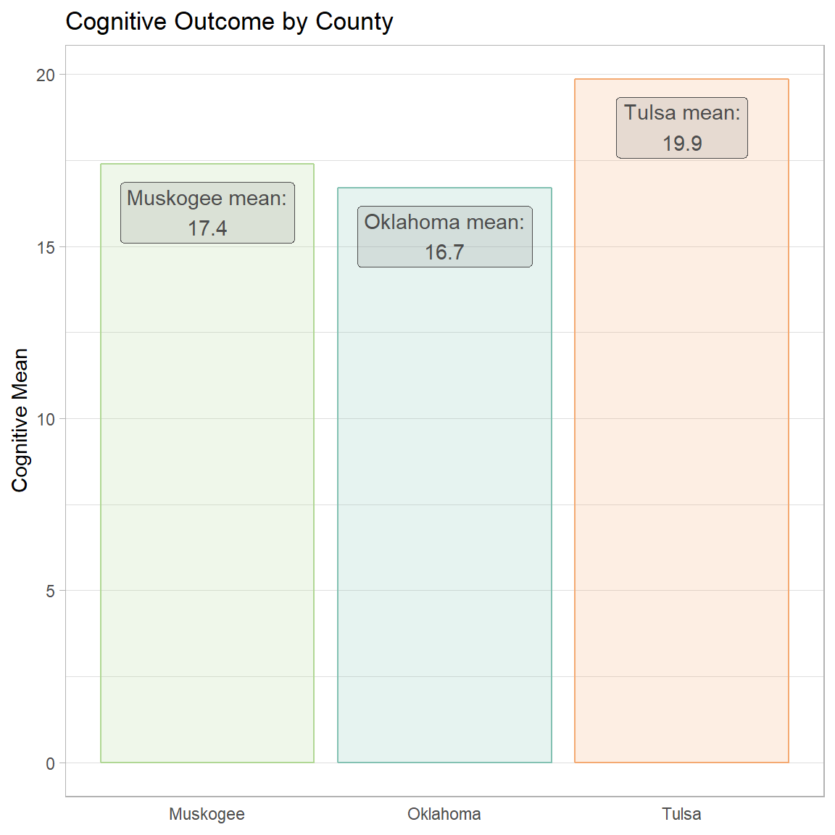
Fictional scenario:
We want to study cognitive decline among seniors in Oklahoma
Objective: monitoring cognitive trajectories over time
Recruited 200 seniors from three programs/counties
Dashboard is tailored to providers in Tulsa

Slide 16
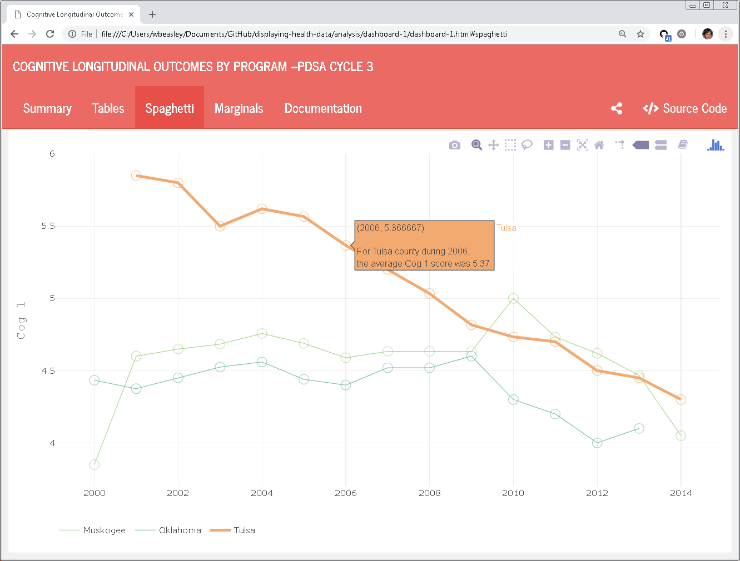
Program directors need to monitor the focal group over time.
De-emphasized programs provide meaningful reference points.

Slide 17
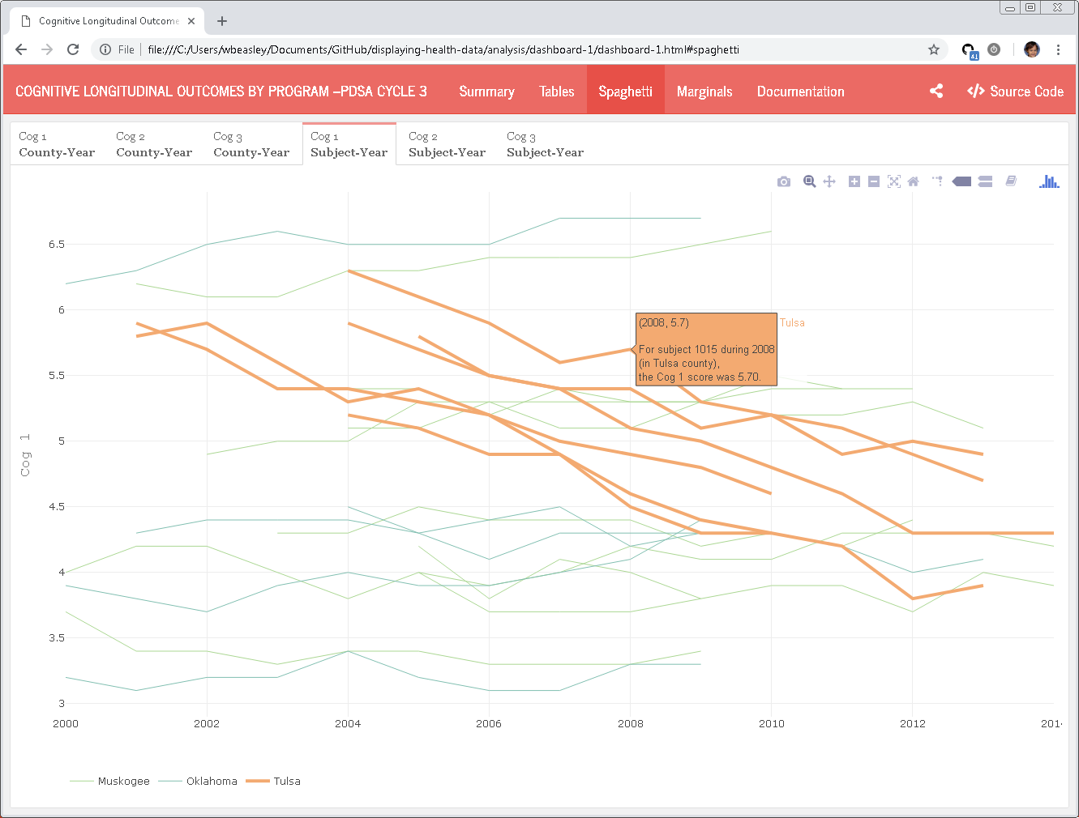
We also need to see the progress of individuals
Tulsa county trajectories are in orange. The others are primarily for context.

Slide 18
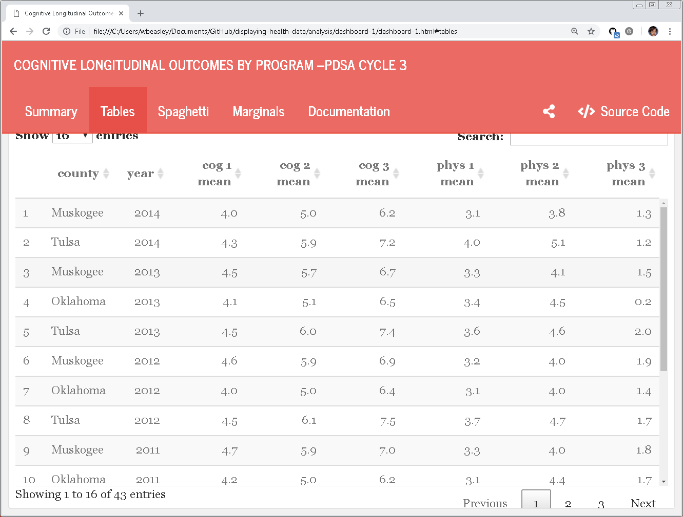
Some nurses were more comfortable starting with tables than graphs.

Slide 19
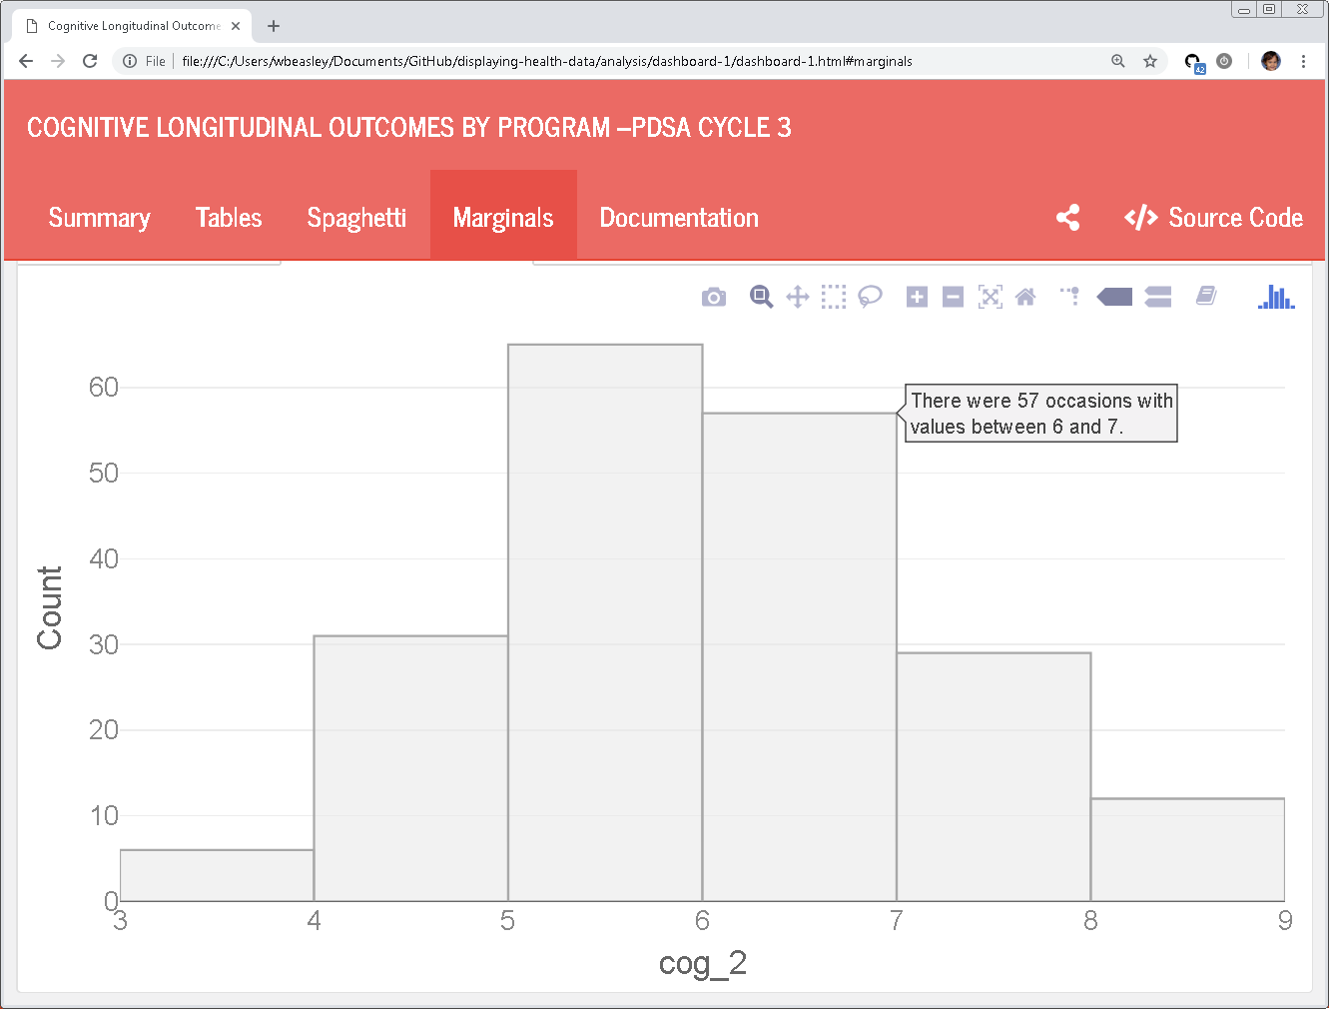
Histograms are particularly benefited from full-sentence hover text.

Slide 20
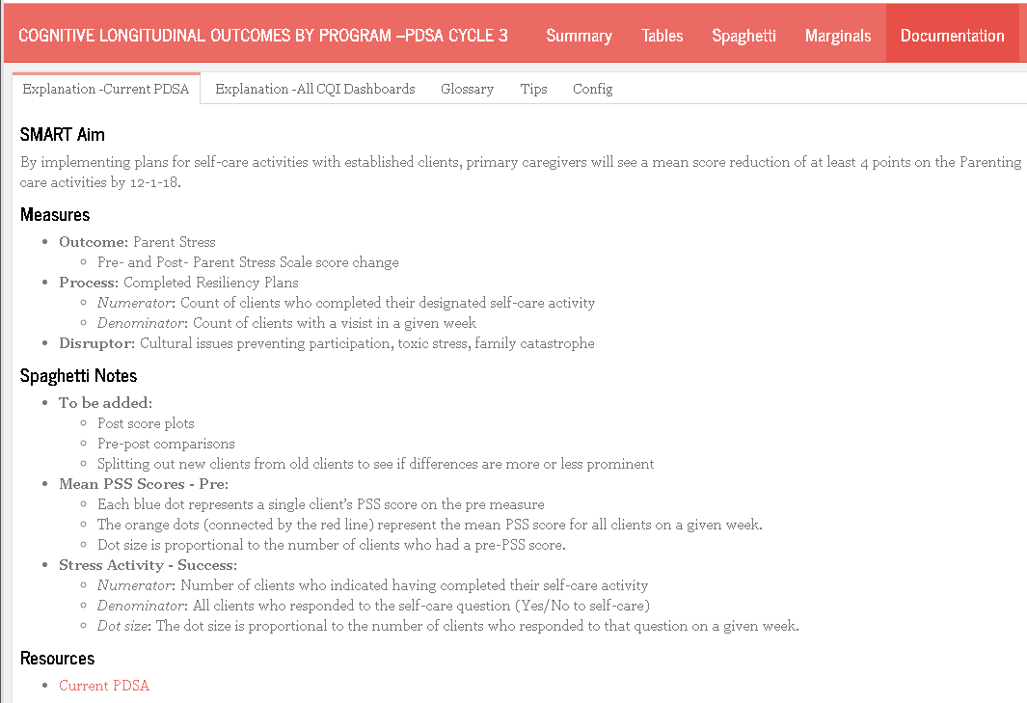
Each dashboard had several tabs of documentation.
Our quality varied across dashboards, and this is a representative example.

Slide 21
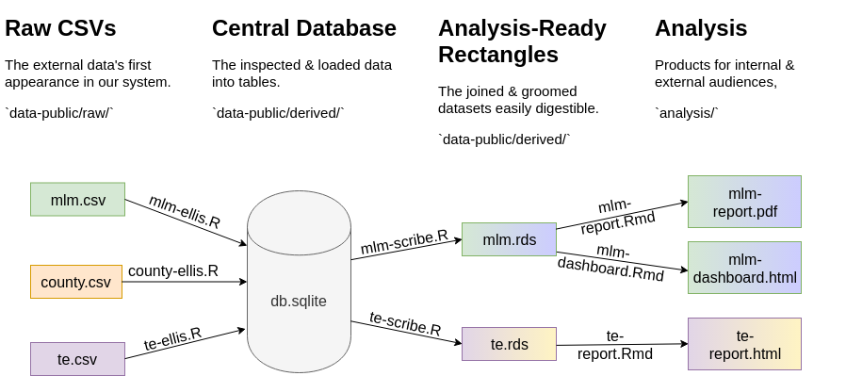
Pipeline (available at github.com/dss-ialh/displaying-health-data)

Slide 22
Pipeline

Slide 23
Takeaways

Slide 24
Providers
Oklahoma State Department of Health– Persephone Starks, John Delara, Beth Martin
Children First Tulsa – LouAnn Beuke
LCDA – Patty Demoraes-Huffhine
Oklahoma City County Health Department – Denise Howard, Diane Sammons, Sally Dixon
OKC Public Schools – Yolanda Lucero, Kethzia Njikam
PAT Bethany Public Schools – Mindy Turner, Jem Balderas
PAT Parent Promise – Shawna Norman
Community Action Program Tulsa – Dana James
Cherokee PARENTS – Ben King, Jennifer Kirby, Amy Thilges
PCCT PAT Tulsa - Sarah Neyman
SafeCare PCCT – Sheri Davis
SafeCare NorthCare – Dwan McDonald

Slide 25
University of Oklahoma HSC Analysts for the MIECHV-3 CQI
David Bard,
Will Beasley
Geneva Marshall
Thomas Wilson
Andrew Peters
Chris Aston
Donna Wells
Som Bohora
Maleeha Shahid
Yutian Thompson

Slide 26
Displaying Health Data
Cases, Techniques, Solutions
Colloquium + Live-Webcast + Recording
Medical Sciences Building (MBS) 160
University of Victoria
November 28 – 30 , 1 – 3 pm PST
Please email questions to aging@uvic.ca
Notes:
The colloquium series discusses information visualization and statistical graphing in health research. The series invites you to share ideas, lesson and insights from real-world projects rather than listing the promises and challenges of “data science.” What worked? What didn’t? Why?
Information visualization and statistical graphing is the engine of knowledge mobilization, a vehicle that delivers ideas and insights across the boundaries of professional expertise. We must do it well! But what does “well” mean? The series invites the speakers to share examples of “good” and “bad” information displays from their work. What inspired their solutions? What compromises did they have to make?
A well-designed information display or statistical graphic should require minimal explanation. However, learning how to make such displays is aided by explaining the design and development process. The speakers will take us behind the scenes of display production and share practical wisdom for displaying data in health research.

Slide 27








