Slide 1
Decision Support Arsenal Usage For Strategic Planning
Sergii Kadenko

Slide 2
Strategy Definition
Strategy (from Greek στρατηγία stratēgia, "art of troop leader; office of general, command, generalship") is a high level plan to achieve one or more goals under conditions of uncertainty.
Strategy is important because the resources available to achieve these goals are usually limited. Strategy generally involves setting goals, determining actions to achieve the goals, and mobilizing resources to execute the actions. A strategy describes how the ends (goals) will be achieved by the means (resources).

Slide 3
Research Context
Academic Research Works
Development of a methodology to evaluate the effectiveness of implementation of the Plan of action on space activity development and space equipment manufacturing for 2013, National academy of sciences of Ukraine, State Space Agency of Ukraine (2013)
Theoretical and technological principles of expert decision-making support for strategic plans construction National academy of sciences of Ukraine (2015-2017)
Publication: V.Tsyganok, S.Kadenko, O.Andriichuk. Using different pair-wise comparison scales for developing industrial strategies . Int. J. of Management and Decision Making, 2015 Vol.14, No.3, pp.224 - 250

Slide 4
Legislative/official Documents, Related to Project Evaluation
1. Проект Закону про затвердження Загальнодержавної цільової науково-технічної космічної програми на 2013-2017 роки [Електрон. ресурс]. Режим доступу: http://w1.c1.rada.gov.ua/pls/zweb2/webproc4_1?pf3511=45766
2. Розпорядження Кабінету Міністрів України №790-р від 17 жовтня 2012 р. Про затвердження плану заходів з розвитку космічної діяльності та виробництва космічної техніки на 2013 рік [Електрон. ресурс]. Режим доступу: http://zakon1.rada.gov.ua/laws/show/790-2012-%D1%80
3. Постанова Кабінету Міністрів України №684 від 18 липня 2012 р. Про затвердження Порядку та критеріїв оцінки економічної ефективності проектних (інвестиційних) пропозицій та інвестиційних проектів [Електрон. ресурс]. Режим доступу: http://zakon4.rada.gov.ua/laws/show/684-2012-%D0%BF
4. Наказ Міністерства економіки України №1279 від 13 листопада 2012 р. Про затвердження Методичних рекомендацій з розроблення інвестиційного проекту, для реалізації якого може надаватися державна підтримка [Електрон. ресурс]. Режим доступу: http://www.me.gov.ua/control/uk/publish/category/main ?cat_id=32854&stind=1
5. Наказ Міністерства економічного розвитку і торгівлі України №243 від 13 березня 2013 р. Про затвердження Методики проведення державної експертизи інвестиційних проектів та форми висновку за її результатами [Електрон. ресурс]. Режим доступу: http://zakon2.rada.gov.ua/laws/show/z0437-13
6. Наказ Міністерства економіки та з питань Європейської інтеграції України та Міністерства фінансів України №218/446 від 25.09.2001 Про затвердження Методики визначення економічної ефективності витрат на наукові дослідження і розробки та їх впровадження у виробництво [Електрон. ресурс]. Режим доступу: http://www.licasoft.com.ua/index.php/component/lica/?href=0&view =text&base=1&id=138228&menu=113975
7. United States Air Force Scientific Advisory Board. Report on A Space Roadmap for the 21st Century Aerospace Force. Volume 1: Summary. November 1998 [Електрон. ресурс]. Режим доступу: http://www.wslfweb.org/docs/usg /afsabsprm.pdf
8. Joint Vision 2010 [Електрон. ресурс]. Режим доступу: http://www.wslfweb.org /docs/dstp2000/jwstppdf/04-VS.pdf
9. 2011 NASA Strategic Plan [Електрон. ресурс]. Режим доступу:
http://www.nasa.gov/pdf/516579main_NASA2011StrategicPlan.pdf
10. 2010 Science Plan [Електрон. ресурс]. Режим доступу:
http://science.nasa.gov/media/medialibrary/2010/08/10/2010SciencePlan.pdf
11. NASA – National Aeronautics and Space Administration \\ Small Business Innovation Research & Technology Transfer 2012 Program Solicitations \\ Method of Selection and Evaluation Criteria [Електрон. ресурс]. Режим доступу: http://sbir.gsfc.nasa.gov/SBIR/sbirsttr2012/solicitation/contents.html
12. Постанова Кабінету Міністрів України №701 від від 9 червня 2011 р. Про затвердження Порядку проведення державної експертизи інвестиційних проектів [Електрон. ресурс]. Режим доступу: http://zakon1.rada.gov.ua/laws /show/701-2011-%D0%BF

Slide 5
Drawbacks of Legally Established Approaches to Project Evaluation
Lack of systematic approach
Lack of opportunity to build intermediary estimates
No clear methodology for decomposition of large-scale projects
No opportunity to provide grounds for discontinuing of a project (in order to avoid further expenditures)
No thematic (particular industry-oriented) methodologies
(Frequently) Orientation on quantitative (particularly, financial) indicators only

Slide 6
A Methodology for Expert Data Based Decision Support Tools for Industrial Strategic Planning: Phases
Selection of experts who will conduct the examination
Building (in the process of a dialogue with experts) of a hierarchy of criteria (a system of interconnected indicators), which describe the subject domain
Estimation of (weights) priorities of criteria from the hierarchy by the experts
Calculation of relative efficiency of the projects, i.e. the contribution of each project to the achievement of the main goal
Definition of the optimal industry development strategy. An optimal strategy is an optimal variant of resource allocation to (distribution among) the projects, i.e. the variant, which ensures the most efficient achievement of the main goal in the hierarchy, under calculated relative project efficiency values.

Slide 7
1. Expert selection
For evaluation of the plan of action for implementation of the national space programme of Ukraine, the experts were represented by the employees of the Institute of Space Research and the National Space Agency of Ukraine.
In the general case it is appropriate to envision an opportunity to use not only expert data, but also deterministic information (from search and meta-search engines, measurements, existing databases, etc)
Don’t forget the expert competency (Tsyganok et al. (2012))

Slide 8
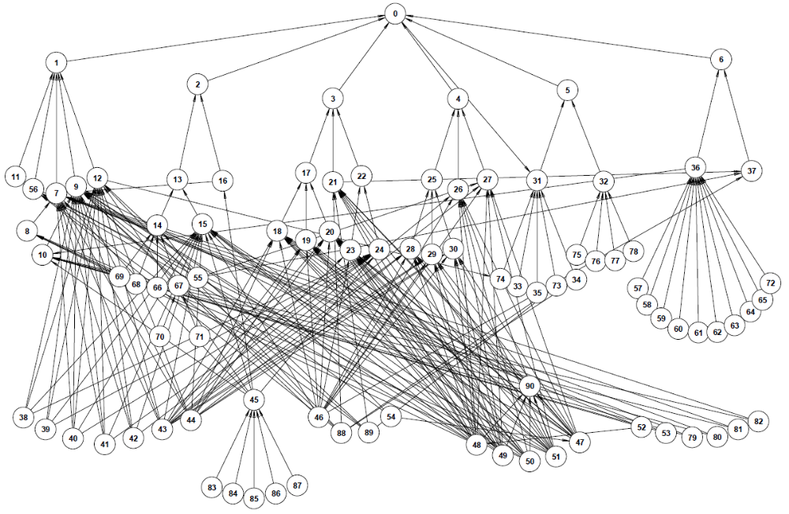
2. Building of Criteria Hierarchy

Slide 9
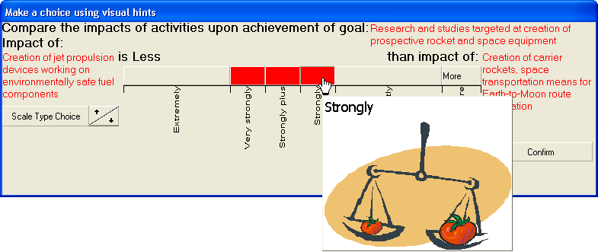
3. Expert Estimation of Priorities of Criteria (activities, projects): a tool for providing pair comparisons in different scales
а)
2
3
4
5
6
7
8
9
1.5
2.5
3.5
4.5
5.5
6.5
7.5
8.5
9.5
б)
2
3
4
5
6
7
8
9
1.5
2.5
3.5
4.5
5.5
6.5
7.5
8.5
9.5
2.8(3)
5.5
8.1(6)
в)
1.5
2.5
3.5
4.5
5.5
6.5
7.5
8.5
9.5

Slide 10
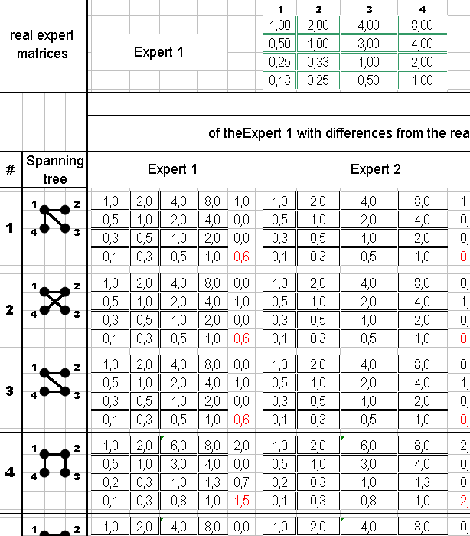
3. Estimation of priorities: combinatory (spanning tree enumeration) aggregation method
An expert provides a “triangular” PCM.
Based on the PCM, all possible basic sets of comparisons are formed. The general number of these sets for m alternatives is m^(m – 2)
An ideally consistent PCM is built according to the transitivity principle
Priorities (relative weights) are calculated based on the average (aggregate) PCM
*If there are several experts involved, the averaging is performed across the PCMs of all experts

Slide 11
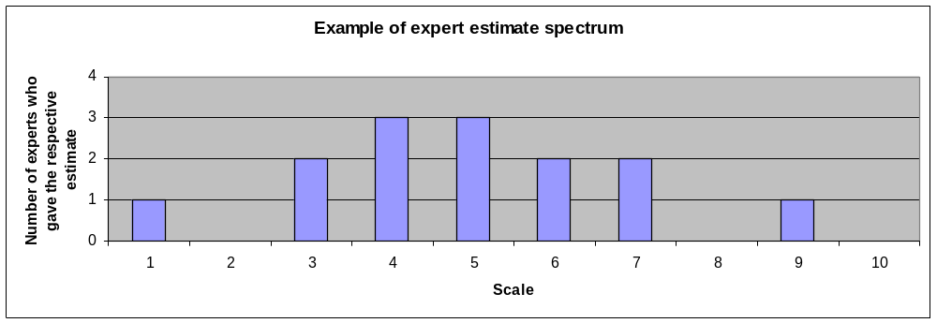
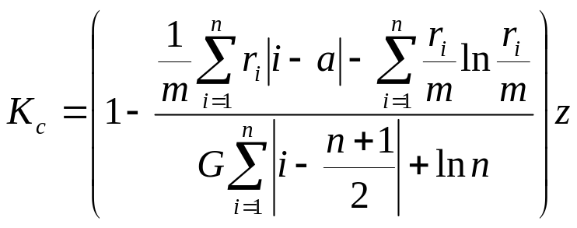
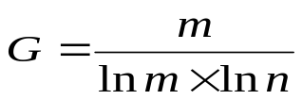
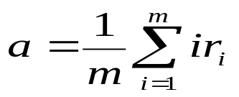
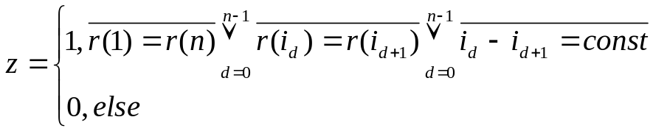
3. Estimation of priorities: spectral consistency coefficient Kc
Spectral consistency coefficient
calculation formula
V.G. Totsenko, The Agreement Degree of Estimations Set with Regard for Experts’ Competence, Proceedings of the IV International Symposium on the AHP, ISAHP ‘96 , Simon Fraser University, Burnaby, B.C.,CANADA, July 12-15,1996, 229-241
m – number of experts (in case of group rankings), or basic pair comparisons used to build spectrums (in case of individual rankings);
n – number of scale points;
– scaling coefficient;
– average of all estimates
in the spectrum;
- boolean indicator.

Slide 12
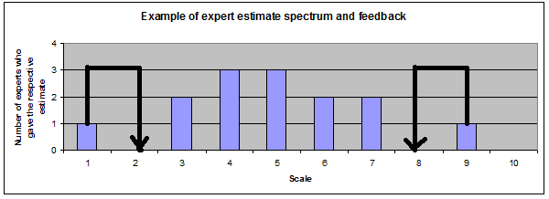

3. Evaluation of priorities: consistency improvement principle based on Kc
Drawbacks of spectral consistency coefficient Kc:
heavy dependence on the size of scale point (for instance, )
attempt to minimize dispersion and entropy of estimates (independent measures!) at the same time

Slide 13
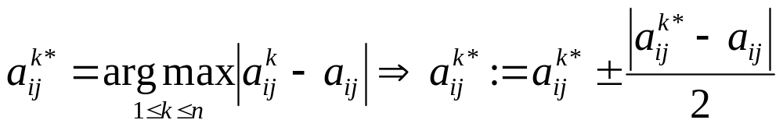
3. Evaluation of priorities: alternative consistency improvement principles
Kadenko (2014)
Olenko Andriy & Tsyganok Vitaliy (2016) Double Entropy Inter-Rater Agreement Indices Applied Psychological Measurement, 40(1), 37–55

Slide 14
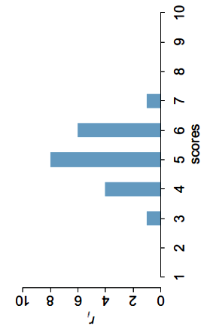



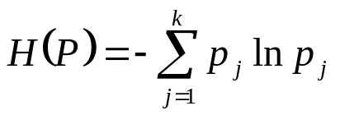
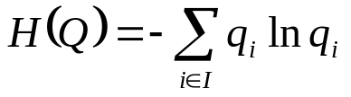
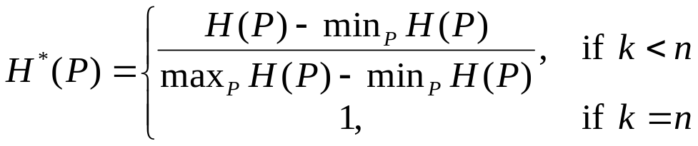
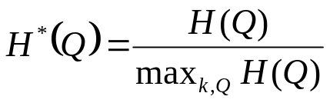
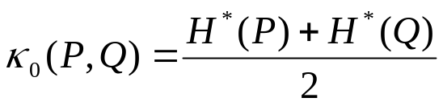


3.Calculating consistency index by spectrum
using Double Entropy Consistency Index
Let n ≥ 2 – the number of grades in the scale; – set of expert estimates; m ≥ 2 – the number of experts in the group; – the number of estimates equal i. – spectrum. Entropy – disagreement:
1^{-st}: – among k estimates; 2^{-nd}: – frequencies of

Slide 15
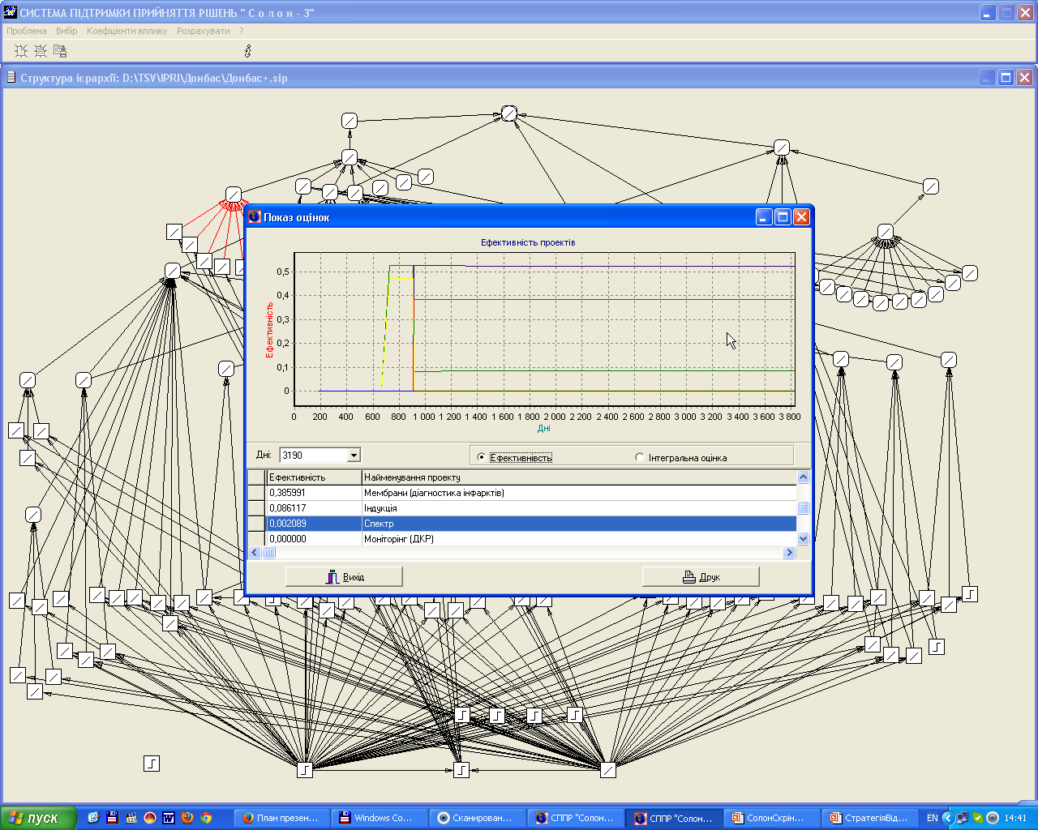
4. Calculation of relative efficiency of the projects, i.e., the contribution of each project into the achievement of the main goal

Slide 16
5. Selection of the optimal industry development strategy
An optimal strategy is an optimal variant of resource allocation to (distribution among) the projects, i.e. the variant, which ensures the most efficient achievement of the main goal in the hierarchy, under calculated relative project efficiency values.

Slide 17
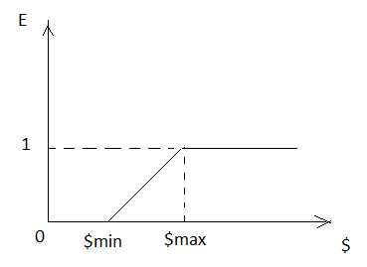
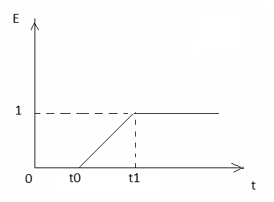
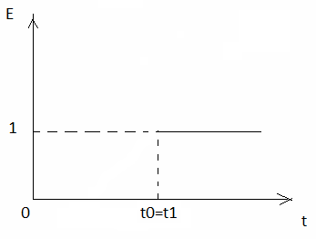
5. Definition of the optimal industry development strategy: dependence of the level of project efficiency (fulfillment) from funding volumes and time

Slide 18
5. Definition of the optimal industry development strategy: resource allocation problem
What is given: {Pi;i=1..k} – a set of projects (activities, envisioned by the strategy); {ti;i=1..k } – the terms of project implementation; {$mini, $maxi; i=1..k } –necessary funding (resource allocation) ranges; {Ei(t); i=1..k} – relative efficiency value (priority, weight) of each project (in the general case – a time-dependant value).
What is to be found: {$i(t); i=1..k} – an optimal vector of resource distribution among projects in the context of the strategy’s main goal at a given time (although time is not necessarily present in the problem).
Solution idea: enumeration of possible resource allocations (with given precision, say, up to 1000 USD), potentially, using the genetic algorithm.

Slide 19
Future research
Development of mechanisms for aggregation of data, coming from different sources, in a DSS
Further development of consistency and compatibility improvement procedures
Development of an algorithm to distribute resources among projects (activities)

Slide 20
Key publications
V. Tsyganok “Investigation of the aggregation effectiveness of expert estimates obtained by the pairwise comparison method” - Mathematical and Computer Modelling, Vol. 52, Issue 3, 2010
V.V.Tsyganok, S.V.Kadenko, O.V.Andriichuk “Significance of expert competence consideration in group decision making using AHP” Volume 50, Issue 17, 2012
S.V.Kadenko “Consistency Improvement in Combinatory Spanning Tree Enumeration Method” – Proceedings of the Thirteenth International Symposium for the AHP/ANP (ISAHP 2014)
V.V.Tsyganok, S.V.Kadenko, O.V.Andriichuk “Using Different Pair-wise Comparison Scales for Developing Industrial Strategies” – Int. J. of Management and Decision Making Vol.14, No.3, 2015
A.Olenko, V.Tsyganok “Double Entropy Inter-Rater Agreement Indices” Applied Psychological Measurement, Vol. 40 Issue 1, 2016

Slide 21
Thank you for attention!

