Slide 1
The Eleventh International Symposium on the Analytic Hierarchy Process
Significance of Expert Competence Consideration while Group Decision-Making using AHP
Vitaliy V.Tsyganok, Sergey V.Kadenko, Oleg V.Andriichuk
The Institute for Information Recording of National Academy of Sciences of Ukraine
vitaliy.tsyganok@gmail.com
June 15-18, 2011, SORRENTO, Naples, ITALY
Notes:
<number><number>

Slide 2
Significance of Expert Competence Consideration while Group Decision-Making using AHP
ISAHP 2011
Outline of experiment
Modelling experts’ estimates:
Setting “true” alternative weights
Forming PCMs
Fluctuating PCMs using some distribution laws
Calculating percentage of differences in expert estimation results
Aggregating PCMs with and without competence consideration
Calculating weights using eigenvector method
Imitating expert competence
The Institute for Information Recording of National Academy of Sciences of Ukraine: Vitaliy Tsyganok, Sergey Kadenko, Oleg Andriichuk 2

Slide 3
Significance of Expert Competence Consideration while Group Decision-Making using AHP
ISAHP 2011
Expert estimation process simulation
Requirements to resulting distribution of modelled experts’ estimates:
probability density function (PDF) must be defined on all Fundamental scale range
the function must be continuous on all its definitional domain
the function should have a maximum in some given „true” value
distance from a given true value to points with equal values of function should satisfy the ratio scale requirements
The Institute for Information Recording of National Academy of Sciences of Ukraine: Vitaliy Tsyganok, Sergey Kadenko, Oleg Andriichuk 3

Slide 4
Significance of Expert Competence Consideration while Group Decision-Making using AHP
ISAHP 2011
Modelling deviation
Requirements to deviation value distribution law:
PDF must be defined in the range [1; ∞), but the interval, where significant part of the function lies and where random value belongs with confidence probability of 0.95, should be the interval [1; 2] (it means the experts’ probable error does not exceed 100%)
the function must be continuous in all its definitional domain
the only maximum of the function lies in point x=1 (the function is a monotonically decreasing one)
The Institute for Information Recording of National Academy of Sciences of Ukraine: Vitaliy Tsyganok, Sergey Kadenko, Oleg Andriichuk 4

Slide 5
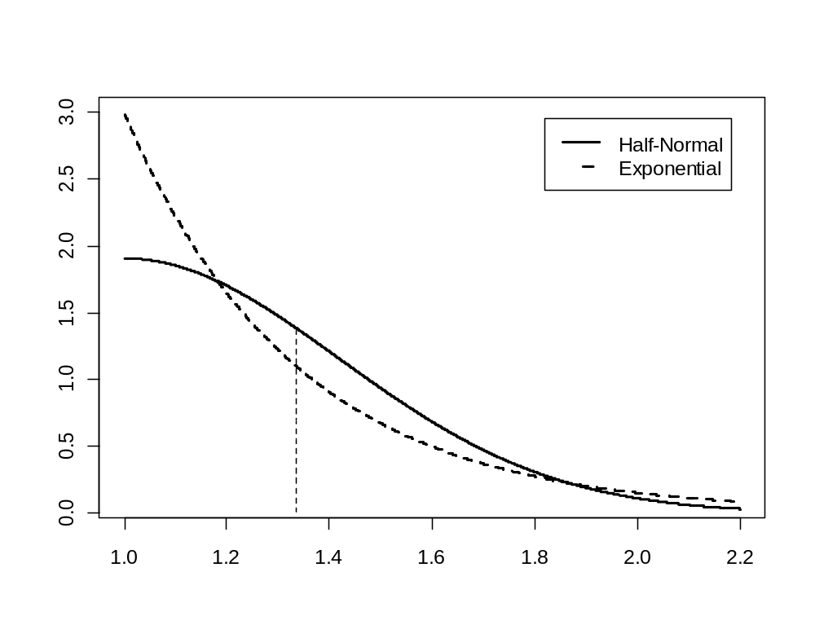
Significance of Expert Competence Consideration while Group Decision-Making using AHP
ISAHP 2011
Suggested expert estimate distribution laws
Distribution laws of individual expert estimates’ deviation from the given “true” value
The Institute for Information Recording of National Academy of Sciences of Ukraine: Vitaliy Tsyganok, Sergey Kadenko, Oleg Andriichuk 5

Slide 6


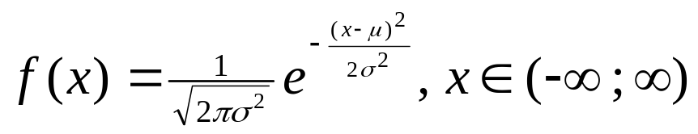
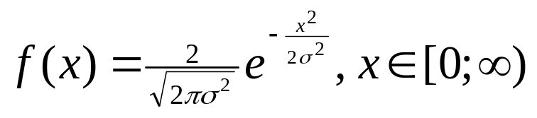
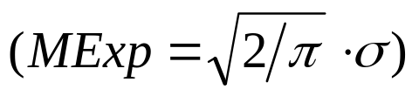
Significance of Expert Competence Consideration while Group Decision-Making using AHP
ISAHP 2011
Suggested expert estimate distribution laws
The PDF of exponential distribution:
where λ > 0 - parameter of the distribution (the rate parameter)
The PDF of normal (Gaussian) distribution:
where parameter μ is the mean / expected value (location of the peak) and σ² is the variance (the measure of the width of the distribution)
The PDF for half-normal distribution (at μ = 0) :
The Institute for Information Recording of National Academy of Sciences of Ukraine: Vitaliy Tsyganok, Sergey Kadenko, Oleg Andriichuk 6

Slide 7
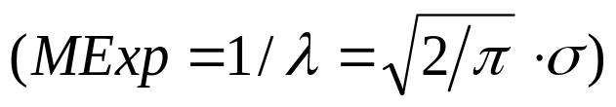


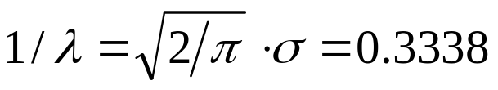
Significance of Expert Competence Consideration while Group Decision-Making using AHP
ISAHP 2011
Suggested expert estimate distribution laws
Calculating parameters for both distributions:
when fit appropriate math.expect.:
from cumulative distribution function for exponential distribution 1/λ =
(in our case x=1) and it equals approximately 0.3338 (33.38%).
So we can calculate parameters for both distributions based on following relation: .
The Institute for Information Recording of National Academy of Sciences of Ukraine: Vitaliy Tsyganok, Sergey Kadenko, Oleg Andriichuk 7

Slide 8
Significance of Expert Competence Consideration while Group Decision-Making using AHP
ISAHP 2011
Setting “true” alternative weight values and pair comparison matrices (PCM)
The Institute for Information Recording of National Academy of Sciences of Ukraine: Vitaliy Tsyganok, Sergey Kadenko, Oleg Andriichuk 8

Slide 9
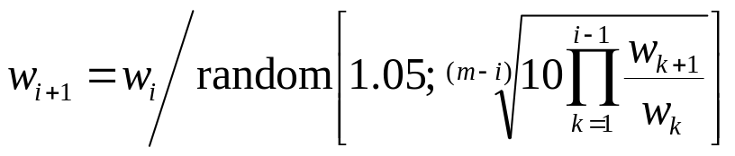
Significance of Expert Competence Consideration while Group Decision-Making using AHP
ISAHP 2011
Setting “true” alternative weight values and pair comparison matrices (PCM)
random – is a function, generating a random value from a given range
The Institute for Information Recording of National Academy of Sciences of Ukraine: Vitaliy Tsyganok, Sergey Kadenko, Oleg Andriichuk 8

Slide 10
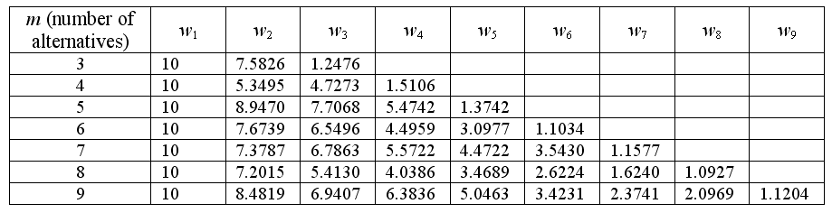
Significance of Expert Competence Consideration while Group Decision-Making using AHP
ISAHP 2011
Setting “true” alternative weight values and pair comparison matrices (PCM)
random – is a function, generating a random value from a given range
True alternative weights, generated for various numbers of alternatives
The Institute for Information Recording of National Academy of Sciences of Ukraine: Vitaliy Tsyganok, Sergey Kadenko, Oleg Andriichuk 8

Slide 11






Significance of Expert Competence Consideration while Group Decision-Making using AHP
ISAHP 2011
Forming an ideally consistent PCM
using the equation:
Properties of PCM:
(PCM reciprocally symmetrical) ⇒ (using only the elements above principal diagonal)
are sorted in the order of decrement ⇒
Fundamental scale – continuous ⇒
The Institute for Information Recording of National Academy of Sciences of Ukraine: Vitaliy Tsyganok, Sergey Kadenko, Oleg Andriichuk 9

Slide 12
Significance of Expert Competence Consideration while Group Decision-Making using AHP
ISAHP 2011
Fluctuating the PCM
The Institute for Information Recording of National Academy of Sciences of Ukraine: Vitaliy Tsyganok, Sergey Kadenko, Oleg Andriichuk 10

Slide 13
Significance of Expert Competence Consideration while Group Decision-Making using AHP
ISAHP 2011
Fluctuating the PCM
Deviation Δ – the random value, distributed by exponential or half-normal law:
Ratio scale ⇒ Δ=( a_{Δ+}/ a_{e})=(a_{e}/ a_{Δ‑}),
a_{e} is the value of ideally consistent PCM element, subject to fluctuation
a_{Δ+} is the value of this same element in case of its increment
a_{Δ‑} is the value in case of its decrement
The deviation direction is chosen randomly:
positive (a_{Δ+}=a_{e} Δ) or negative (a_{Δ‑}=a_{e}/ Δ)
Approximating
(possible PCM elements values are:{1/9, 1/8, …, 1/2, 1, 2, …, 8, 9})
The Institute for Information Recording of National Academy of Sciences of Ukraine: Vitaliy Tsyganok, Sergey Kadenko, Oleg Andriichuk 10

Slide 14
Significance of Expert Competence Consideration while Group Decision-Making using AHP
ISAHP 2011
Estimate aggregation rules
The Institute for Information Recording of National Academy of Sciences of Ukraine: Vitaliy Tsyganok, Sergey Kadenko, Oleg Andriichuk 11

Slide 15
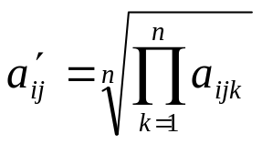
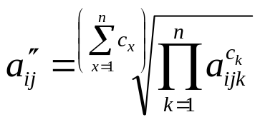
Significance of Expert Competence Consideration while Group Decision-Making using AHP
ISAHP 2011
Estimate aggregation rules
– without competence consideration
– with competence consideration
The Institute for Information Recording of National Academy of Sciences of Ukraine: Vitaliy Tsyganok, Sergey Kadenko, Oleg Andriichuk 11

Slide 16


Significance of Expert Competence Consideration while Group Decision-Making using AHP
ISAHP 2011
Estimate aggregation rules
– without competence consideration
– with competence consideration
eigenvector method
The Institute for Information Recording of National Academy of Sciences of Ukraine: Vitaliy Tsyganok, Sergey Kadenko, Oleg Andriichuk 11

Slide 17
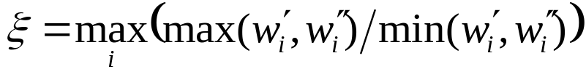
Significance of Expert Competence Consideration while Group Decision-Making using AHP
ISAHP 2011
Estimate aggregation rules
– without competence consideration
– with competence consideration
Difference of results:
eigenvector method
The Institute for Information Recording of National Academy of Sciences of Ukraine: Vitaliy Tsyganok, Sergey Kadenko, Oleg Andriichuk 11

Slide 18



Significance of Expert Competence Consideration while Group Decision-Making using AHP
ISAHP 2011
Input data for the experiment
the number of expert n, n ∈ [3; 200]
the number of estimated alternatives m, m ≤7±2 ⇒ m ∈ [3; 9]
N repetitions of experiment:
is the dispersion of the random value under consideration
is the expectancy of getting the random value lying within the specified interval β.
when β=±5% , =95% and ≈10% ⇒ N=200
The Institute for Information Recording of National Academy of Sciences of Ukraine: Vitaliy Tsyganok, Sergey Kadenko, Oleg Andriichuk 12

Slide 19
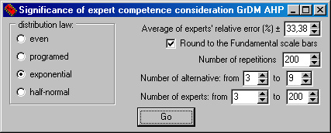
Significance of Expert Competence Consideration while Group Decision-Making using AHP
ISAHP 2011
Screenshot of modelling software’s input interface
The Institute for Information Recording of National Academy of Sciences of Ukraine: Vitaliy Tsyganok, Sergey Kadenko, Oleg Andriichuk 13

Slide 20
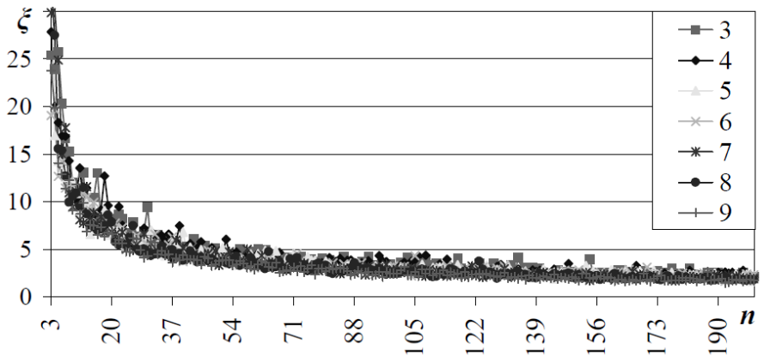
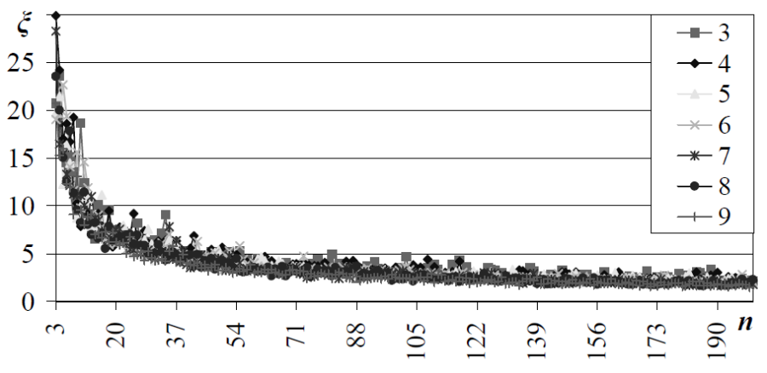
Significance of Expert Competence Consideration while Group Decision-Making using AHP
ISAHP 2011
Results of experiment
exponential deviation distribution law
half-normal deviation distribution law
The Institute for Information Recording of National Academy of Sciences of Ukraine: Vitaliy Tsyganok, Sergey Kadenko, Oleg Andriichuk 14

Slide 21
Significance of Expert Competence Consideration while Group Decision-Making using AHP
ISAHP 2011
Thank You for attention
The Institute for Information Recording of National Academy of Sciences of Ukraine: Vitaliy Tsyganok, Sergey Kadenko, Oleg Andriichuk 15

