Slide 1
A method for providing sufficient strict individual rankings’ consistency level while group decision-making with feedback
OR-52
Vitaliy V. Tsyganok
The Institute for Information Recording
of the National Academy of Sciences of Ukraine

Slide 2
Criterion for determining sufficient consistency level
2
OR-52
Individual rankings’ set is considered consistent enough for their aggregation, if aggregate preference relation, built on their basis using Condorcet method, is transitive (i.e. represents a rank order relation).

Slide 3
Problem formulation:
3
OR-52
We have a set of n alternatives evaluated by m experts; strict alternative rankings provided by the experts; an aggregate relation (in general case, intransitive) given as a matrix built through aggregation of individual rankings using Condorcet’s method
We should find a way to organize feedback with the experts in order to transform the aggregate relation into a transitive one, minimizing the number of times the experts are addressed in the dialogue process (it is necessary to define successively, which experts should be addressed and which alternatives they are to swap in individual rankings)

Slide 4
Presumptions, concerning expert’s logic:
4
OR-52
1. An expert prefers to change the previous estimates, which, to his mind, are less important.
2. The possibility of getting a negative answer from the expert grows proportionally to the number of suggestions made. So, the more changes an expert is offered to make, the less chances (s)he will agree with all of them.

Slide 5
Essence of the method
5
OR-52
Feedback organization strategy is aimed at minimizing the number of times the experts are addressed. The algorithm is based on the idea of transforming the set of individual rankings, which do not allow to build strict ranking after the aggregation using Condorcet method, in such a way that the consistency condition is fulfilled. The search is organized among all possible strict expert ranking variants. The goal of this search is to find the set of rankings, closest to the given one in terms of changes’ quantity and quality, which will form a strict rank order relation after their aggregation using Condorcet method. The search will be performed using Genetic Algorithm (GA), allowing to find acceptable solutions of multi-variable function extreme values’ search problems.
The suggested algorithm searches for a solution variant, corresponding to the minimum of GA utility function. It is possible to transform the initial expert rankings’ set into this solution variant, using the minimal number of change suggestions to the experts.

Slide 6
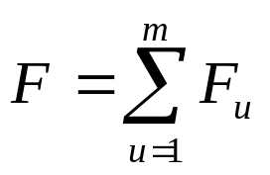
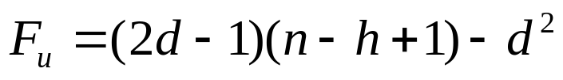
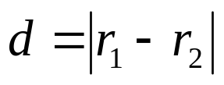
Utility function F used in Genetic Algorithm
6
OR-52
is built based on the presumptions about expert’s logic and equivalence of permutations in the rankings:
(1)
each of components F_{u} corresponds to an expert ranking, and looks as follows:
, (2)
where n is a quantity of alternatives in the ranking,
h is the smaller of two alternative ranks, involved in the permutations,
d is the distance between swapped alternatives (absolute value of difference between swapped alternative ranks):
, (3)
r₁, r₂ are the ranks of swapped alternatives in the initial expert ranking.

Slide 7
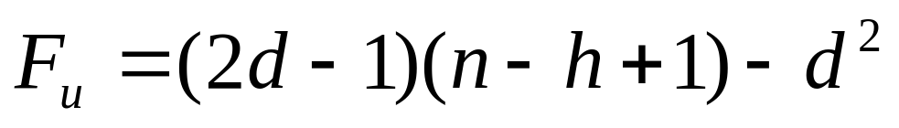
Component
7
OR-52
This equation considers the number of so called elementary permutations of alternatives, - swaps of neighbouring alternatives (d = 1), necessary for introducing given changes into expert ranking. The equation also includes the weight of every elementary permutation, depending on alternatives’ remoteness from the ranking’s end. Besides, the weight of swapping non-neighbouring alternatives equals the sum of respective consequent elementary permutation weights.
For instance, let alternatives be denoted by their initial rank numbers (1, 2, 3, 4, 5), then, in order to swap alternatives “2” and “5”, and to get ranking (1, 5, 3, 4, 2), a series of 5 following permutations can be performed: (“2”; “3”), (“2”; “4”), (“2”; “5”), (“5”; “4”), (“5”; “3”), so: F₂₅ = F₂₃ + F₂₄ + F₂₅ + F₅₄ + F₅₃.

Slide 8
Feedback organization principle:
8
OR-52
search among all possible ranking variants according to the conditions:
1) initial rankings from the set must be strict ones;
2) aggregation of these rankings using Condorcet method must result in a strict ranking as well;
3) transforming the initial expert ranking set into the required set must require minimal trade-offs from the experts;

Slide 9
Step-by-step example
9
OR-52
Say, a group of 4 experts ranked 4 alternatives.
The individual rankings are:
R₁=(3, 4, 2, 1),
R₂=(1, 3, 2, 4),
R₃=(1, 2, 3, 4),
R₄=(3, 4, 1, 2).
In order to check whether the consistency level of these expert rankings is sufficient or not, let us perform the following 3 steps of the algorithm.

Slide 10
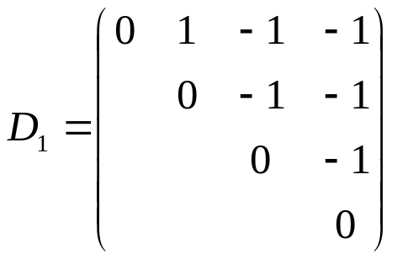
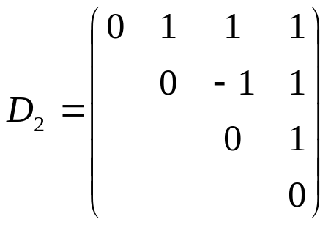
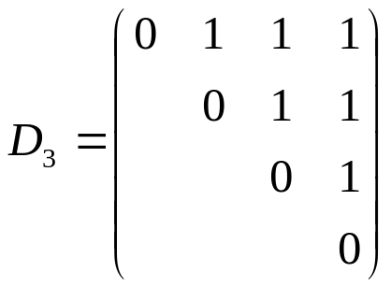
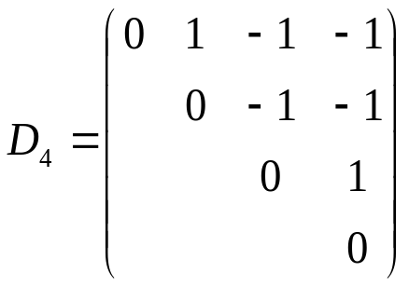
Step 1.
10
OR-52
Define the domination matrices based on expert rankings:
These matrices are built as follows:
if alternative A₁ dominates over A₂ (its rank is smaller (r₁<r₂)),
then the respective matrix element d₁₂=1, otherwise d₁₂=–1.

Slide 11


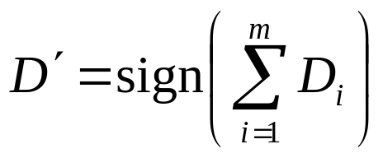
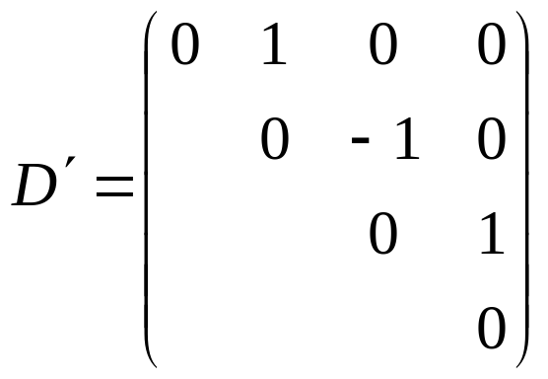
Step 2.
11
OR-52
Build the aggregate matrix based on matrices, obtained on the previous step, using Condorcet’s method. The method executes the summing of initial matrices followed by finding the sign of respective matrix elements:
.
We should note that the aggregate matrix can include zero elements above the principal diagonal; these may appear if the number of experts in the group is even. Thus,
.

Slide 12


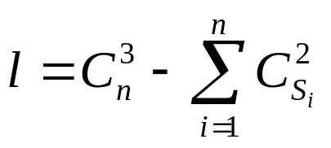
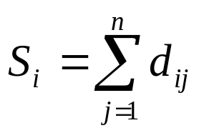
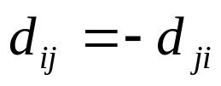
Step 3.
12
OR-52
Check, if the matrix includes zero elements above the principal diagonal, and if there are none, check, if it is transitive.
the relationship is not a strict ordering one.
the aggregate relation is transitive.
, where – are row sums of matrix ,
where .
Thus, as a result of step 3, we conclude that does not satisfy the posed requirements (it includes non-diagonal zero elements), so we proceed with the next step to organize feedback with the experts.

Slide 13
Step 4. (search)
13
OR-52
GA performs a targeted enumeration of expert ranking variants, which are respectively coded as individuals in the population.
An individual - a set of m numbers from 1 to n!, each number - code of a strict ranking variant for n alternatives.
GA search is over when after a given number of iterations (generations) the fittest individual stabilizes, then it is selected as the search result.
So, as a result of step 4, we find an individual (12, 3, 1, 9), which corresponds to the set of rankings
{R*₁=(2, 4, 3, 1), R*₂=(1, 3, 2, 4), R*₃=(1, 2, 3, 4), R*₄=(2, 3, 1, 4)},
where the utility function F=5 reaches its minimum.

Slide 14
Step 5. (feedback)
14
OR-52
Successively offer the experts to change previously built ranking R into R* by introducing one or more alternative swaps.
R₁=(3, 4, 2, 1) → R*₁=(2, 4, 3, 1) : (3↔2)
R₂=(1, 3, 2, 4) → R*₂=(1, 3, 2, 4)
R₃=(1, 2, 3, 4) → R*₃=(1, 2, 3, 4)
R₄=(3, 4, 1, 2) → R*₄=(2, 3, 1, 4) : (3↔2, 3↔4)
Suggestion for the expert #1: “do you agree to swap alternatives #1 and #3 (ranks “3” and “2”) in your ranking?”
expert #1 agrees → R₁=R*₁
R₂=R*₂, R₃=R*₃.
Suggestion for the 4th expert: “do you agree to swap alternatives #1 and #4 (ranks “3” and “2”) in your ranking?”
Say, expert #4 refused, so we proceed to step 4.

Slide 15
Step 5. (2-nd iteration)
15
OR-52
The result of step 4 is an individual (12, 3, 1, 15),
{R*₁=(2, 4, 3, 1), R*₂=(1, 3, 2, 4), R*₃=(1, 2, 3, 4), R*₄=(3, 2, 1, 4)}, where F=5.
R₁=(3, 4, 2, 1) → R*₁=(2, 4, 3, 1) : (3↔2)
R₂=(1, 3, 2, 4) → R*₂=(1, 3, 2, 4)
R₃=(1, 2, 3, 4) → R*₃=(1, 2, 3, 4)
R₄=(3, 4, 1, 2) → R*₄=(3, 2, 1, 4) : (4↔2)
The question to expert #1 of swapping alternatives #1 and #3 is not posed - have a positive answer.
Suggestion for expert #4: “do you agree to swap alternatives #2 and #4 (ranks “4” and “2”) in your ranking?”
expert #4 agrees → R₄=R*₄ → the feedback algorithm ends its work.
As a result, the set of expert rankings R is transformed into set R*, which is sufficiently consistent for aggregating.

Slide 16
Conclusions:
16
OR-52
An algorithm for organizing feedback with experts while building group ranking is suggested. The considered problem is extremely topical in the areas of expert examinations and decision-making support systems development, that’s why the suggested algorithm can become an important element of their mathematical software. The experimental research of the algorithm proves its high efficiency.
The final result of the algorithm’s work is the strict group alternative ranking, which can be built through aggregation of individual rankings.
The key direction of future research lies in the approach extrapolation to the cases of different expert competence and non-strict alternative rankings.

Slide 17
Thank You for attention !
OR-52

