Slide 1
AHP/ANP stability measurement and its applications
Vitaliy Tsyganok
National Academy of Sciences of Ukraine
The Institute for Information Recording
Kyiv, Ukraine

Slide 2
Considered two main classes of problems solved by AHP/ANP :
alternatives’ ranking
alternatives’ estimation

Slide 3
Problem statement:
What is given:
A ready-built criteria hierarchy;
Expert priorities, given in the form of pair-wise comparison matrices (PCM) in Fundamental scale.
What is to be obtained:
stability metric value under given conditions.

Slide 4
Stability metrics
  Modeling expert’s errors, made in pair-wise comparisons k_{i}, i∈{1..n} :
  k_{i}* = k_{i} + R_{i} ⋅ k_{i} ⋅Δ / 100, where R_{i}∈[-1;1]
  stability metric - maximal deviation Δ, under which AHP/ANP result remains stable
  max(Δ) is obtained through division-in-half (dichotomy) method

Slide 5
To reduce the search range
Under the assumption, that dependence of stability violation’s probability from deviation value is a monotonously increasing function, only the outermost values of the deflection range during enumeration are considered:
k_{i}* = k_{i} ± k_{i} ⋅ Δ / 100.

Slide 6
The problem solved by applying genetic algorithm
What is given:
A ready-built criteria hierarchy, based on n pair comparisons, conducted by the expert;
Deviation of the pair comparisons δ.
We should find:
a set of pair comparisons’ values obtained under influence of deviation δ, on which maximal stability violation of AHP/ANP results is observed.

Slide 7
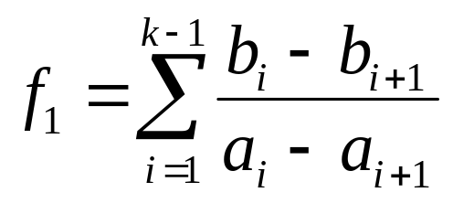
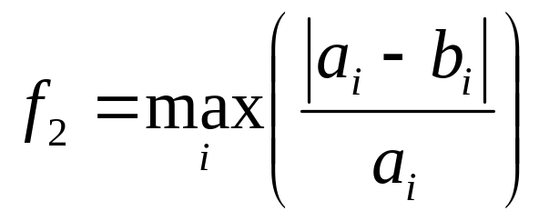
Formulating genetic algorithm’s utility function
for alternative ranking-related problems :
for alternatives’ estimations problems :
where a and b are cardinal estimates, obtained without and under deviation of pair comparison results, respectively

Slide 8
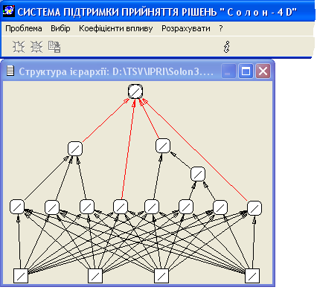
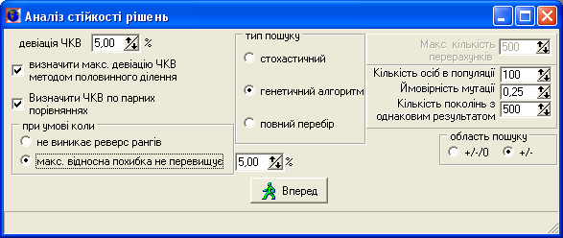
Software used in the experiment
Figure 1. DSS interface with a given hierarchy structure.
Figure 2. Search parameters input window

Slide 9
Conclusions
A technique for calculating decisions’ stability measure, is suggested. We consider AHP-based decisions, which are made using expert data, input into an existing DSS
The developed decision stability estimation methodology can also be applied to obtaining stability measure in ANP method, and integrated into other systems, where expert information is used
The described stability metric calculation technique can be used for stability breach detections, resulting from deviations of criterion weights and alternative estimates
In cases when stability metric values do not satisfy posed requirements, it is possible to develop methods for improving decision stability using the suggested technique.

Slide 10
Thank You for attention

