Slide 1
A Method with Feedback for Aggregation of Group Incomplete Pair-Wise Comparisons using Scales with Different Numbers of Grades
Vitaliy V. Tsyganok, Dr.Eng.,
Institute for Information Recording of National Academy of Sciences of Ukraine

Slide 2
Plan
Problem statement
Essentials of the method
Evaluation consistency
Aggregation using Combinatorial method
Using different expert scales
Main phases of the method

Slide 3
Problem statement
What is given:
A_{l}, l∈[1..m] – expert PCMs, A={a_{ij}}, i,j∈[1..n]
PCMs properties:
reciprocally-symmetrical;
multiplicative;
in the general case - incomplete;
every single element a_{ij} is obtained in some scale, which is assigned a weight coefficient s_{h}, h∈[0..8]);
c_{l}, l∈ [1..m] – relative competence of experts in the group (Σc_{l}=1).
We should find:
The resulting object weight (priority) vector w_{k}, k∈[1..n] (Σw_{k}=1).

Slide 4
Essentials of the method
We can aggregate expert estimates (PWC) only when they are consistent/compatible enough
Existing AIJ & AIP approaches are not convenient for consistency improvement process because they involve 2 potentially contradictive stages
Single-phase consistency improving procedure of feedback with experts is proposed

Slide 5
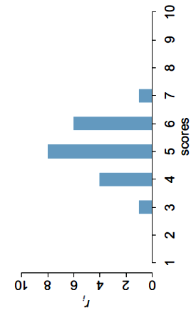
Evaluation consistency in PCMs
Using spectral approach:
for every spanning tree we calculate weights of alternatives (using any of available ways);
for every alternative we obtain spectrum of weights rounded to discreet scale;

Slide 6



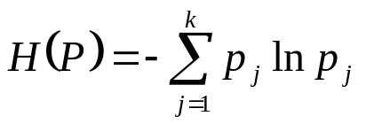
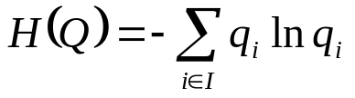
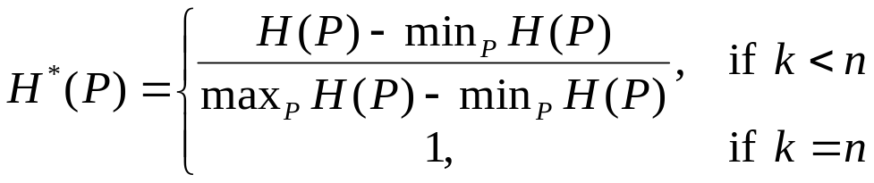
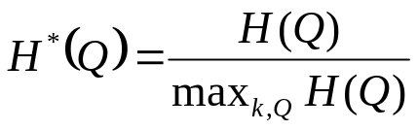
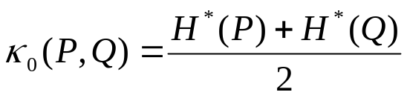


Calculating consistency index by spectrum
using Double Entropy Consistency Index
(Olenko Andriy & Tsyganok Vitaliy (2016) Double Entropy Inter-Rater Agreement Indices Applied Psychological Measurement, 40(1), 37–55)
Let n ≥ 2 – the number of grades in the scale; – set of expert estimates; m ≥ 2 – the number of experts in the group; – the number of estimates equal i. – spectrum. Entropy – disagreement:
1^{-st}: – among k estimates; 2^{-nd}: – frequencies of

Slide 7
Aggregation using Combinatorial method
high level of aggregation effectiveness (Tsyganok, 2010)
can be used for:
  Group Decision Making with account of relative expert competency in the group as well as for individual DM;
  Multiplicative PWC as well as for additive ones;
  Triangular PCMs as well as for square PCMs;
  Incomplete PCMs as well as for complete ones;
  Expert evaluation in scales with different numbers of grades;
  Composition of spanning tree components by geometric mean as well as arithmetic mean or other methods (e.g. median …)
Single-phase priority vector calculation enables feedback with experts for consistency/compatibility improvement

Slide 8
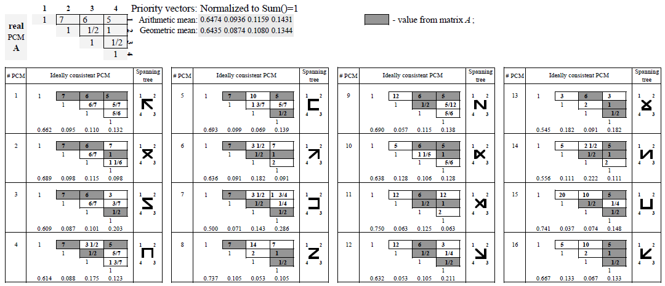
Combinatorial method – individual case
( Tsyganok Vitaliy (2010) Investigation of the aggregation effectiveness of expert estimates obtained by the pairwise comparison method. Mathematical and Computer Modelling, 52(3-4), 538-544 )

Slide 9
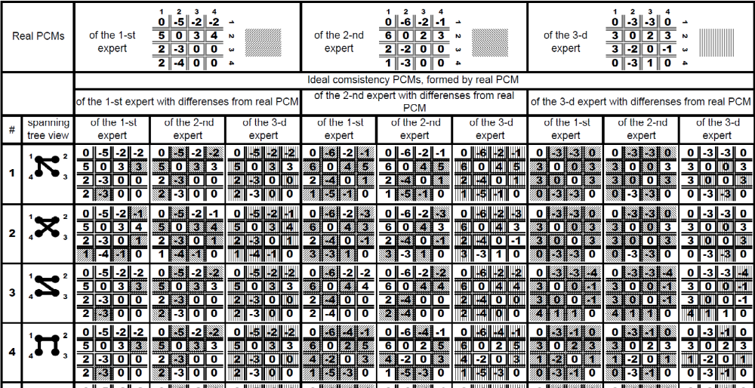
Combinatorial method – Group DM case
…

Slide 10
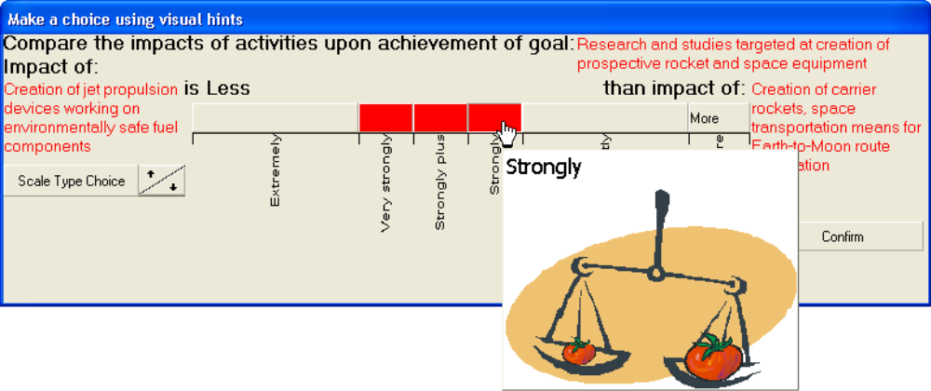
Using different pair-wise comparison scales
By means of created PWC software tools an expert can:
Use the scale (s)he finds most suitable, with appropriate number of grades
Use visual tips for estimation
Be more confident in his/her choice of the scale grade
Be unbiased, because (s)he is not forced to choose the more detailed scale because it is the only option (even abstain from any choice if (s)he is not sure)
V.V.Tsyganok, S.V.Kadenko, O.V.Andriichuk “Using Different Pair-wise Comparison Scales for Developing Industrial Strategies” – Int. J. of Management and Decision Making Vol.14, No.3, 2015

Slide 11
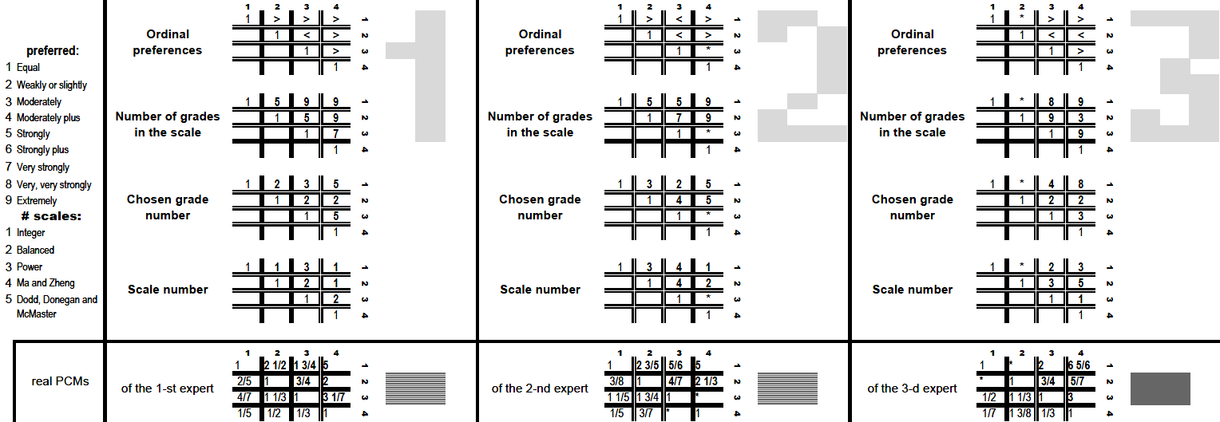
Obtaining unified PCMs using different expert scales

Slide 12
Main phases of the method
Input of PWCs by each expert using software tools
Checking and providing set of PCMs for completeness
Calculation of averaged priorities across all ideally consistent PCMs, constructed using the combinatory approach
Calculation of consistency level (CL) of PCM set
If CL is not sufficient – improvement of CL by “moving individual expert PCM” towards ideally consistent PCM, obtained from averaged priorities on phase 3
Otherwise, acceptance of obtained aggregate priorities as the final result

Slide 13
Thank You for your attention !

