Slide 1
DSS5105 CAPSTONE · TRACK 2 · SPRINT 1
THE CHAT MESSAGE
“Send it to QuickStitch, need it back by the 19th.”
Subcontracting Desk
From informal chat decisions
to verified, accountable outsourcing dispatch
THE DESK'S ANSWER
GiantWeave
back Fri 10 Apr, on time · Sat 11 Apr if reworked
QuickStitch not considered: excluded by Boss
Every number traced to a tool output
Group NN
屈妍玥 Qu Yanyue · 张锦若 Zhang Jinruo · 吴杰 Wu Jie
李岩 Li Yan · 吴若晗 Wu Ruohan · 许佩瑶 Xu Peiyao
github.com/dss5105-track2/track2-desk · 16 October 2026
Notes:
[10 s] Good evening, we are Group NN. Our project is the Subcontracting Desk: it turns the chat message that sends a batch to an outside workshop into a verified, recorded decision.

Slide 2
A batch goes outside on one chat message, unchecked and unrecorded
TODAY
WHAT THE DESK MUST DO
“@Chen — order 042, 1,500 crewnecks. Send it to QuickStitch, need it back by the 19th.”
Read the chat. Extract the request; ask when it is ambiguous or incomplete; refuse, with a reason and an alternative, when the named workshop cannot take it; honour constraints and record who set them.
Can they make it? Not every workshop makes every product.
Decide on numbers. Keep the workshop register; estimate a delivery date per candidate before committing; allocate with the reasoning attached; when nobody can make the date, say so and lay out the options.
1
2
Can they take it now? A fast shop with a 3-day queue is not fast today.
Leave a record. An auditable record of every decision — what the group chat never produced.
3
Are they allowed to? One shop is suspended after an audit; one is on trial, small batches only.
Optional, assessed after Sprint 2: the stage extension (--stages). Not pursued: multi-agent negotiation — the mechanism is not graded.
Get one wrong and the batch bounces back a day later. In a ten-day cycle that is the margin gone.
BUSINESS VALUE
The decision: which eligible workshop, with capacity, returns the batch by its due date — and why.
Dispatcher: faster decisions with verified recommendations
Factory: fewer late deliveries, shown in simulation
Customer: more reliable delivery-date commitments
DSS5105 Capstone · Track 2 · Subcontracting Desk · Sprint 1
1
Notes:
[35 s] Today that decision is a chat message. Behind it are three questions: can the workshop make this product, can it take the batch now, is it allowed to? Get one wrong and the batch bounces back a day later; in a ten-day cycle that is the margin gone. So the desk reads the chat, decides on numbers, and leaves a record. The value: a verified recommendation for the dispatcher, fewer late batches for the factory, a date the customer can rely on.

Slide 3
The model reads, code decides, the dispatcher confirms
INPUT
Chat message
Free text from five people, as they type it.
LANGUAGE MODEL + CHECK
Language layer
The model extracts order, pieces, date, constraint. Code checks each value against the text.
CODE · NO LLM
Kernel
Register: make it, take it, allowed? Estimator: two dates per shop. Allocator: the objective is a setting.
CODE
Explain and check
Writes the reason from tool outputs. Flags any number that is not in one.
HUMAN
Dispatcher
Confirms, changes or escalates. Only then is capacity booked and the audit record written.
1
2
3
1 Text decides. Every value the model extracts is checked against the message; anything the message does not contain is dropped.
2 Eligibility before ranking. Three hard checks first; then every eligible shop gets two dates — expected, and if the batch is reworked — and the ranking follows the chosen objective.
3 Traced, then booked. Every number in the explanation must come from a tool output; capacity is booked and the audit record written only after the dispatcher confirms.
ONE REAL MESSAGE, R12, THROUGH THE FIVE STAGES
“ORD-053 — 800 polo shirts for UrbanThread, due Apr 10. Boss says nothing new to QuickStitch this week.”
ORD-053 · 800 pcs · due 10 Apr · constraint: QuickStitch excluded — standing, set by Boss
4 shops eligible. GiantWeave back Fri 10 Apr; Sat 11 Apr if reworked, still on time
“GiantWeave: on time; it only makes tops, so the two shops that also make accessories stay free for tighter batches.”
Confirmed → ledger updated, audit record A0004
DSS5105 Capstone · Track 2 · Subcontracting Desk · Sprint 1
2
Notes:
[50 s] The language model only reads: order, pieces, date, constraint. Then code takes over, with three mechanisms. One, the text decides: every extracted value is checked against the message, and anything the message does not contain is dropped. Two, eligibility before ranking: three hard checks, then two dates per eligible shop, expected and if reworked, and only then a ranking by the objective. Three, traced, then booked: every number in the explanation comes from a tool output, and nothing is booked until the dispatcher confirms. The bottom row is one real message going through: the standing constraint recorded, four shops eligible, GiantWeave on time even if reworked.

Slide 4
Primary objective: minimise late deliveries
Late-delivery rate = batches returned after their due date ÷ all batches. Also reported: mean days late (0 when on time). Both are the simulator's own metrics.
WHY THIS ONE
THE OTHER THREE
1
Relevant. The due date is the one constraint every order carries; quick response exists to protect it — “the factory that farms out a batch today beats the one that decides on Thursday.”
Defects, fairness. Switchable settings of the same allocator; results reported on the same 120 orders.
2
Measurable. The simulator records when every batch returns, so lateness is computed, not estimated.
Hybrid. One weighted setting (late 1.0, finish 0.3, defect 0.25, load 0.5). Metrics scaled 0–1 first; weights at the knee of the lateness–defect curve, checked on held-out seeds.
3
Controllable. Lateness depends on queue, capacity and transport — exactly what the choice of workshop changes.
Robust to failure. Tested with the shock scenario; guardrail: lateness no worse than random.
The three baselines are 34–92% late in simulation: the largest gap, but supporting evidence, not the reason.
Declared tie-break: when two settings are equally late, we take the shorter turnaround — the track names turnaround days as the business impact.
DSS5105 Capstone · Track 2 · Subcontracting Desk · Sprint 1
3
Notes:
[40 s] Our primary objective is to minimise late deliveries: the share of batches returned after their due date. Three reasons. Relevant: the due date is the one constraint every order carries, and quick response exists to protect it. Measurable: the simulator records when every batch returns. Controllable: lateness depends on queue, capacity and transport, exactly what the choice of workshop changes. The other objectives stay: defects and fairness as switchable settings, one hybrid, and robustness under the shock scenario. And we declare our tie-break up front: equal lateness, shorter turnaround.

Slide 5
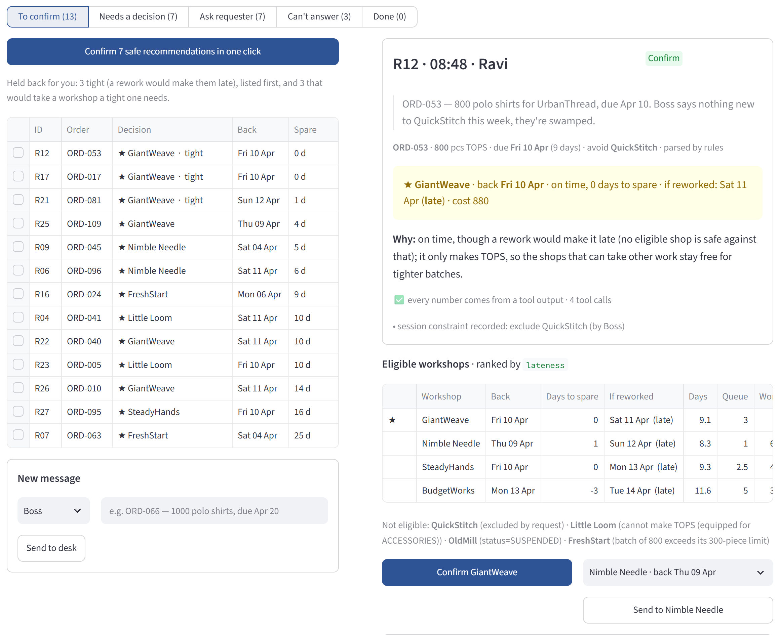
The loop runs end to end, and the first results are in
IN SIMULATION · OFFICIAL 120 ORDERS · MEAN OF 10 SEEDS
Policy | Late batches | Mean days late
random (baseline) | 34.2% | 6.13
cheapest (baseline) | 91.8% | 81.9
earliest-finish (simple rule, no LLM) | 1.7% | 0.18
ours (lateness setting) | 1.7% | 0.09
On 200 fresh order books the simple rule never saw, ours is ahead: 0.9% vs 1.7% late on 100 jittered sets (better on 72, worse on 3). Under shock the simple rule still edges us, 1.9% vs 2.0%: one batch in ten runs. Source: simulate.py v3, commit 1c6cb61.
56 automated tests pass; every number in every reply on the 30-message inbox traces to a tool output.
All six of us labelled the 30 messages independently (κ 0.70); labels frozen on 7 Oct; counts per kind match the instructor's mix.
The language model was measured, then corrected: GPT-5 mini now reads all 30 official and 38 new messages right; the cheapest model started at 86%.
One message in, one recommendation with two dates and a reason, one click to confirm, one audit record.
DSS5105 Capstone · Track 2 · Subcontracting Desk · Sprint 1
4
Notes:
[60 s] The loop runs end to end, and the first results are in. In simulation, on the official 120 orders, random allocation is 34 percent late. Our lateness setting is 1.7 percent, the same as a simple earliest-finish rule with no language model; we do not hide that tie. On 200 fresh order books the simple rule never saw, we are ahead: 0.9 against 1.7 percent, better on 72 of 100 sets. Where the simple rule still wins: it is a day faster, and it edges us in the shock run by one batch in ten. Beyond the allocator: 56 tests pass, every number in every reply traces to a tool output, all six of us labelled the 30 messages and froze the labels, and we measured the language model before trusting it: GPT-5 mini now reads all 30 official and 38 new messages right; the cheapest model started at 86.

Slide 6
What could go wrong, and what we are assuming
RISK
IMPACT
MITIGATION
No clean language test yet. The 30 official messages were used in development; the 38 new ones are AI-written.
We may overstate how well the model reads.
Held-out inbox: 44 messages written by four teammates who do not touch the prompt; answers frozen before the first run (frozen 14 Oct, first run 15 Oct).
The simulator is kinder than reality. Seven-day week; the estimator does not know when a workshop closes.
Lateness looks better than it would be.
Sunday variant reported separately (simple rule 1.7 → 3.7%, ours → 2.1%); closed-workshop detection in Sprint 2.
Our online policy is not globally optimal. A hindsight search that knows every order in advance reaches 0% late in the tested setting.
Room we have not captured.
A dispatcher cannot see future orders; we report the gap and keep the rule simple enough to explain.
Assumptions: requests arrive in time order and a confirmed dispatch occupies capacity · a standing constraint (“nothing new to QuickStitch this week”) applies to every later request · a reworked batch takes half as long again (simulator rule) · the data holds no customer prices and no history, so those questions are declined.
DSS5105 Capstone · Track 2 · Subcontracting Desk · Sprint 1
5
Notes:
[45 s] Three risks. No clean language test yet: the 30 messages were used in development, the 38 new ones are AI-written; so four teammates who never touch the prompt are writing a held-out inbox, answers frozen before the first run. The simulator is kinder than reality: a seven-day week, and the estimator does not know when a workshop closes; we report a Sunday variant and will add closed-workshop detection. And our policy is not optimal: a hindsight search reaches zero late, but a dispatcher cannot see future orders. Our assumptions are on the bottom line.

Slide 7
Sprint 2 (30 Oct) and Sprint 3 (13 Nov): from a working loop to evidence we can defend
WORK
ACCEPTANCE
OWNER
WHEN
Held-out inbox
44 hand-written messages, answers frozen first, ≥ 90% right behaviour
张锦若 freezes; 李岩, 吴若晗 run
written 9–11 Oct; frozen 14 Oct; first run 15 Oct
Closed-workshop detection
In the shock run the closed shop is detected and gets no new batches; shock lateness no worse than normal
吴若晗
design 14 Oct; done 27 Oct
User test
2–3 students from other groups complete the 9 tasks
李岩, 屈妍玥
by 28 Oct
Public demo
Reachable from an outside browser; one dispatch completed
李岩 (吴杰 logs in)
by 28 Oct
Evaluation draft
10 failure cases with root causes
李岩, 吴若晗 (causes); 吴杰, 许佩瑶 (text)
24–29 Oct
Optional: stage extension (--stages)
Assessed after Sprint 2, if time allows
—
—
SUCCESS CRITERIA · MEASURED ON v3 DATA
≤ 2%
late on the official orders, normal and shock (now 1.7% / 2.0%)
Beat it
fewer late batches than the simple rule on fresh order books (now 0.9% vs 1.7%)
≥ 90%
right behaviour on the held-out inbox, labels frozen first
100%
numbers traced; every “if reworked” date kept (now 100%; 99% in shock)
DSS5105 Capstone · Track 2 · Subcontracting Desk · Sprint 1
6
Notes:
[40 s] Next: the held-out inbox, frozen before the first run. Closed-workshop detection, so the system notices a stuck queue. A user test with students from other groups, a public demo, and an evaluation draft with ten failure cases. Our criteria: under 2 percent late on the official orders, normal and shock; fewer late batches than the simple rule on fresh data; 90 percent right behaviour on the held-out inbox; and every promised rework date kept. Thank you.

Slide 8
BACKUP SLIDE
Appendix A · Results on v3 data, mean of 10 seeds
Policy | Late % | Late days | Mean days | Defective pcs % | Max share % | Cost | Late % in shock
random (official) | 34.2 | 6.13 | 21.9 | 5.6 | 23 | 111,780 | 38.2
greedy_biggest (official) | 84.2 | 26.53 | 50.3 | 5.3 | 70 | 108,430 | 84.9
cheapest (official) | 91.8 | 81.92 | 106.2 | 8.2 | 70 | 85,960 | 91.8
earliest_finish (simple rule) | 1.7 | 0.18 | 8.3 | 7.2 | 26 | 115,566 | 1.9
lateness: specialist-first rule (ours) | 1.7 | 0.09 | 9.3 | 7.7 | 28 | 115,438 | 2.0
use_slack: latest safe finish (ours) | 1.0 | 0.07 | 14.0 | 6.8 | 32 | 105,502 | 1.7
lateness, round 1 (ours) | 1.7 | 0.18 | 8.2 | 7.5 | 26 | 115,592 | 1.9
hybrid (ours) | 4.3 | 0.29 | 10.1 | 6.1 | 29 | 111,238 | 5.5
defects (ours) | 28.7 | 2.23 | 21.1 | 5.1 | 43 | 110,396 | 31.0
fairness (ours) | 6.8 | 0.64 | 12.6 | 7.1 | 20 | 113,088 | 10.1
cost (ours) | 4.4 | 0.24 | 17.2 | 5.7 | 38 | 100,931 | 5.2
simulate.py v3, commit 1c6cb61. use_slack is late less often and costs less, but takes 14 days on average. Single-seed defect draws move defective pcs by about ±2 points.
DSS5105 Capstone · Track 2 · Subcontracting Desk · Sprint 1
7
Notes:
Backup: full results table, seeds 5105 to 5114.

Slide 9
BACKUP SLIDE
Appendix B · How the desk sorted the 30 messages
R01
ask: missing info
R02
can't answer
R03
ask: which order
R04 ★
allocate
R05
ask: missing info
R06 ★
allocate
R07 ★
allocate
R08
refuse
R09
allocate
R10
ask: missing info
R11
refuse
R12
allocate
R13
can't answer
R14
refuse
R15
ask: which order
R16 ★
allocate
R17 ★
allocate
R18
can't answer
R19
ask: which order
R20
no on-time option
R21
allocate
R22 ★
allocate
R23 ★
allocate
R24
refuse
R25
allocate
R26 ★
allocate
R27 ★
allocate
R28
no on-time option
R29
ask: which order
R30
no on-time option
allocate
no on-time option
ask: which order
ask: missing info
refuse
can't answer
★ changed by the instructor in v3. Shown with the morning queues; the counts by kind match the instructor's published mix. Processed in order, 11 of the 13 on-time requests stay on time (R21 is 1 day late; R25 is 1 day late); at most 12 can.
DSS5105 Capstone · Track 2 · Subcontracting Desk · Sprint 1
8
Notes:
Backup: every request, coloured by the desk's decision.

Slide 10
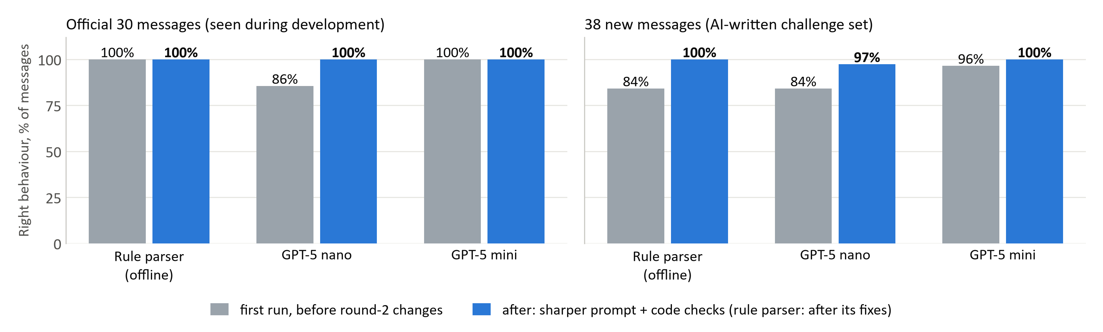
BACKUP SLIDE
Appendix C · The language layer, measured on two inboxes
The rule parser was built around the 30: 100% there, 84% on new wording at first try.
Model choice matters: with the round-1 prompt GPT-5 nano gets 86% of the 30 right, GPT-5 mini 100%. After our checks nano still misreads one new phrasing (a date “sooner than planned, not said when”) in 3 runs of 3.
Not a clean test yet: the 38 new messages are AI-written and two of our fixes came from errors seen on them. The held-out inbox will be written by teammates.
DSS5105 Capstone · Track 2 · Subcontracting Desk · Sprint 1
9
Notes:
Backup: behaviour accuracy by parser, before and after.

Slide 11
BACKUP SLIDE
Appendix D · Promised dates, and a six-day week
QUOTING TWO DATES · 1,200 BATCHES, LATENESS RULE
SUNDAYS OFF, AS THE PRIMER SAYS · LATE BATCHES %
94%
Policy | Seven-day week | Sundays off
random | 34.2 | 50.2
earliest_finish (simple rule) | 1.7 | 3.7
lateness rule (ours) | 1.7 | 2.1
lateness rule, estimate knows Sundays | 1.7 | 1.8
of expected dates hold. Every miss in normal runs is a defect rework.
100%
of “if reworked” dates hold (99.2% with a workshop closed). They are 1.8 days later on average.
Same orders, same defect draws; only change: no work on Sundays. The allocators are not told. With the Sunday rule switched off the variant reproduces simulate.py exactly.
DSS5105 Capstone · Track 2 · Subcontracting Desk · Sprint 1
10
Notes:
Backup: two dates per promise; Sundays off.

Slide 12
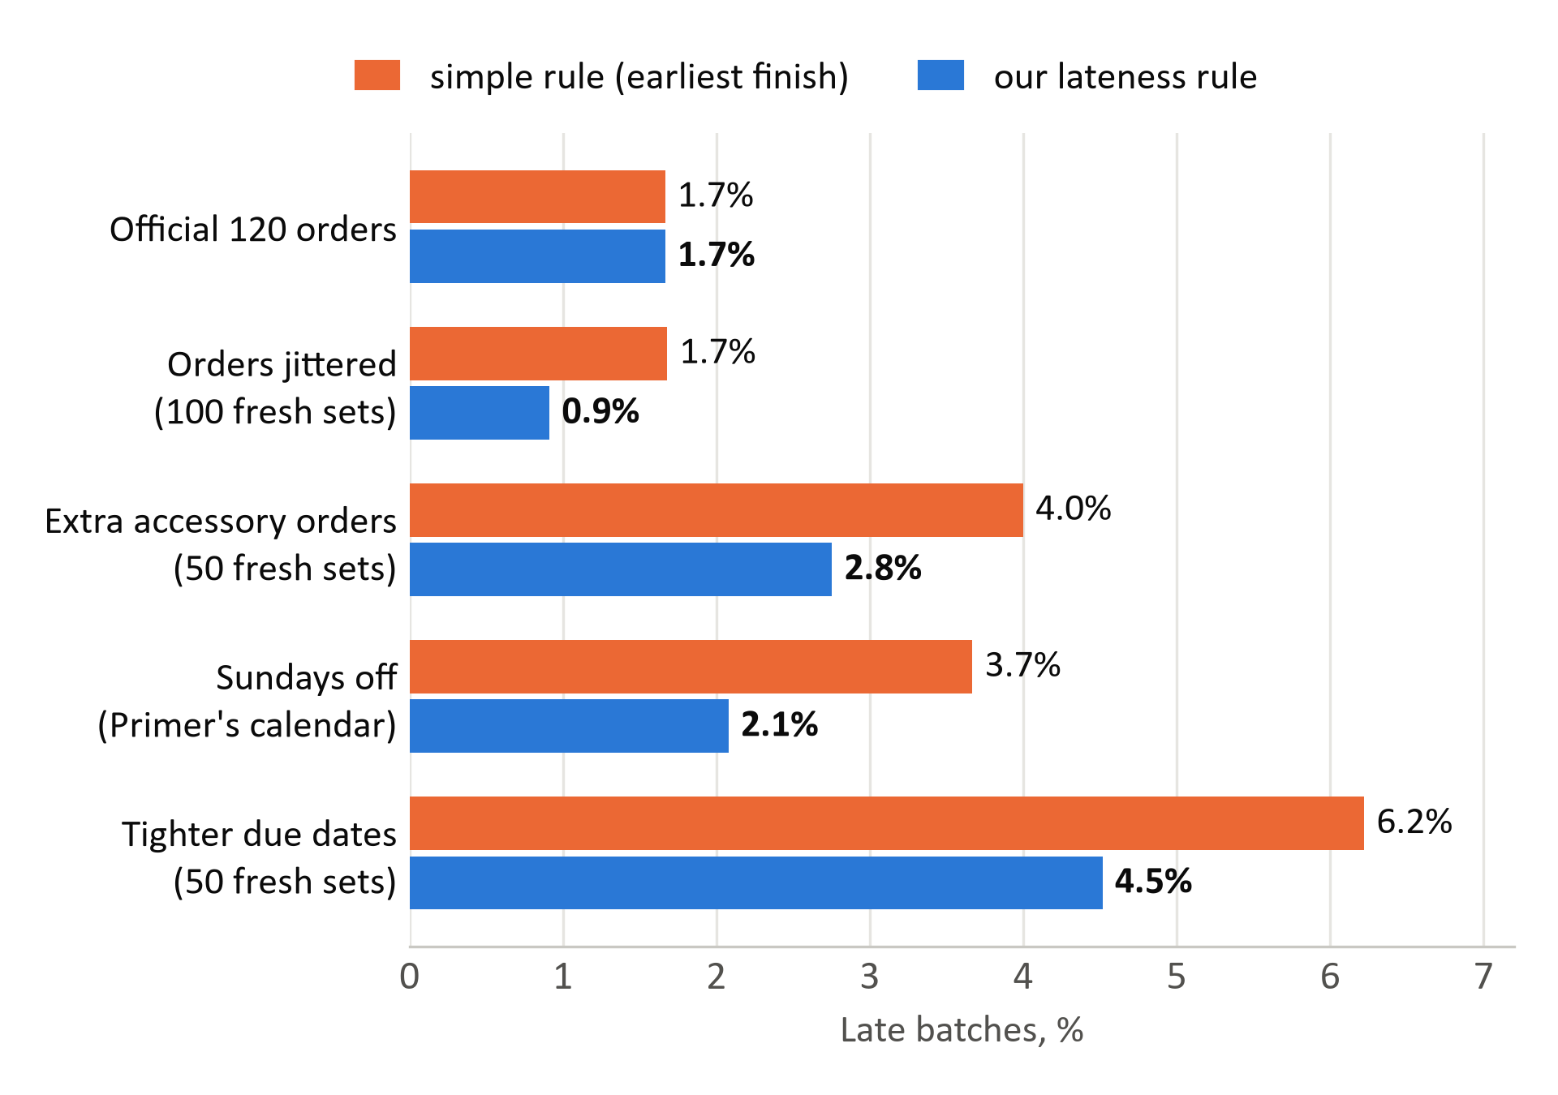
BACKUP SLIDE
Appendix E · Our rule ties the simple rule on the official data, and wins when the data moves
The rule, in order: on time even if the batch is reworked; then the least flexible shop (a specialist before one that makes both categories); then earliest finish.
Why it helps: earliest-finish spends the fast, flexible shops on batches that had slack; the next tight batch then has nowhere to go.
Official data: a tie on late batches (1.7%), half the late days (0.09 against 0.18).
Fresh data: better on 72 of 100 jittered order books, worse on 3.
Where the simple rule still wins: mean turnaround, 8.3 against 9.3 days; the shock run, by one batch in ten.
Official: seeds 5105 to 5114. Fresh sets were generated after the rule was fixed (seeds 20000+), 3 seeds each. The allocators are not told about Sundays.
DSS5105 Capstone · Track 2 · Subcontracting Desk · Sprint 1
11
Notes:
Backup: late batches, simple rule against ours, on the official orders and four kinds of data the rule was never shaped on.

Slide 13
BACKUP SLIDE
Appendix F · Why not the setting with 1.0% late? Its edge does not hold on fresh data
Both settings share steps 1 and 2 (rework-safe shops, specialist first) and differ only in the tie-break: earliest finish, or the latest finish that is still safe (use_slack). Paired runs on the same data and seeds; a sign test on how often use_slack is later or earlier.
Data | Runs | use_slack better / equal / worse on late % | Sign test p | Mean late % (ours / use_slack) | Mean turnaround, days
Official 120 orders, 10 seeds | 10 | 8 / 2 / 0 | 0.008 | 1.67 / 1.00 | 9.3 / 14.0
Official, shock, 10 seeds | 10 | 5 / 4 / 1 | 0.219 | 2.00 / 1.67 | 9.4 / 14.0
100 jittered order books | 100 | 38 / 40 / 22 | 0.052 | 0.91 / 0.79 | 8.8 / 13.6
50 sets, tighter due dates | 50 | 26 / 4 / 20 | 0.461 | 4.52 / 4.37 | 8.0 / 10.0
50 sets, extra accessory orders | 50 | 23 / 11 / 16 | 0.337 | 2.75 / 2.69 | 9.8 / 14.5
Reading. use_slack is reliably better only on the official orders, which both settings were shaped on (8 of 10 seeds, p = 0.008). On 200 fresh order books the two are indistinguishable on lateness (p ≥ 0.05). The robust differences are elsewhere: use_slack returns batches about 5 days later and costs about 9% less. The track names turnaround days as the business impact, so we declared the faster tie-break and keep use_slack as the cost-saving setting.
DSS5105 Capstone · Track 2 · Subcontracting Desk · Sprint 1
12
Notes:
Backup: use_slack against the earliest-finish tie-break, paired on the same data and seeds.

