Slide 1
DSS5105 CAPSTONE · TRACK 2 · SPRINT 1
THE CHAT MESSAGE
“Send it to QuickStitch, need it back by the 19th.”
Subcontracting Desk
From a group-chat decision
to a checked, recorded allocation
THE DESK'S ANSWER
GiantWeave
back Fri 10 Apr, on time · Sat 11 Apr if reworked
QuickStitch not considered: excluded by Boss
Every number traced to a tool output
Group NN
屈妍玥 Qu Yanyue · 张锦若 Zhang Jinruo · 吴杰 Wu Jie
李岩 Li Yan · 吴若晗 Wu Ruohan · 许佩瑶 Xu Peiyao
github.com/dss5105-track2/track2-desk · 16 October 2026
Notes:
[10 s] Good evening, we are Group NN. Our project is the Subcontracting Desk: it turns the chat message that sends a batch to an outside workshop into a checked, recorded allocation.

Slide 2
A batch goes outside on one chat message: unchecked and unrecorded
TODAY
WITH THE DESK
“@Chen — order 042, 1,500 crewnecks. Send it to QuickStitch, need it back by the 19th.”
R12 · ORD-053 · 800 polo shirts, due Fri 10 Apr
Standing constraint recorded: Boss, nothing new to QuickStitch this week
1
Can they make it? Not every workshop makes every product.
 | Workshop | Back | If reworked | Status
★ | GiantWeave | Fri 10 Apr | Sat 11 Apr | on time
 | Nimble Needle | Thu 9 Apr | Sun 12 Apr | on time
 | SteadyHands | Fri 10 Apr | Mon 13 Apr | on time
 | BudgetWorks | Mon 13 Apr | Tue 14 Apr | 3 d late
2
Can they take it now? A fast shop with a 3-day queue is not fast today.
3
Are they allowed to? One shop is suspended after an audit, one is on trial with small batches only.
Why GiantWeave: it only makes tops, so the two shops that also make accessories stay free for tighter batches.
Not eligible: QuickStitch (excluded), OldMill (suspended), FreshStart (300-piece cap), Little Loom (accessories only).
Get one wrong and the batch bounces back a day later. In a ten-day cycle that is the margin gone.
DSS5105 Capstone · Track 2 · Subcontracting Desk · Sprint 1
2
Notes:
[40 s] Today the decision is a chat message. Behind it are three questions: can the workshop make the product, can it take the batch now, is it allowed to? Get one wrong and the batch bounces back a day later. Our desk checks all three and recommends one workshop, with the reason.
This is a real message, R12: nothing new to QuickStitch this week. The desk records that, gives two dates per shop, expected and if reworked, and books nothing until the dispatcher confirms.

Slide 3
The language model reads and explains; the arithmetic stays in code
INPUT
Chat message
Free text from five people: “Send it to QuickStitch, need it back by the 19th.”
LANGUAGE MODEL + CHECK
Language layer
The model extracts order, pieces, date, constraint. Code checks each value against the message text.
CODE · NO LLM
Kernel
Register: can they make it, take it, are they allowed? Estimator: two dates per shop. Allocator: the objective is a setting.
CODE
Explain and check
Writes the reason from tool outputs. Flags any number that is not in one.
HUMAN
Dispatcher
Sees candidates, dates and one recommendation. Confirms, changes or escalates. Then the audit record is written.
The model proposes; the text and the code decide. Queues, estimates, rankings and costs come from code, so every number can be audited.
Shared simulator (harness/simulate.py, v3)
Replays 120 orders through the allocator, against three baselines. Its shock option closes one workshop for two weeks.
Language model
Code
Human
DSS5105 Capstone · Track 2 · Subcontracting Desk · Sprint 1
3
Notes:
[35 s] The language layer extracts the order, pieces, due date and constraint, asks when something is unclear, and declines what the data cannot answer. The model only proposes: code checks every extracted value against the message text.
Everything numeric happens in the kernel, which has no LLM: eligibility, two delivery dates per shop, and a ranking by an objective that is a setting. The dispatcher confirms before anything is booked.

Slide 4
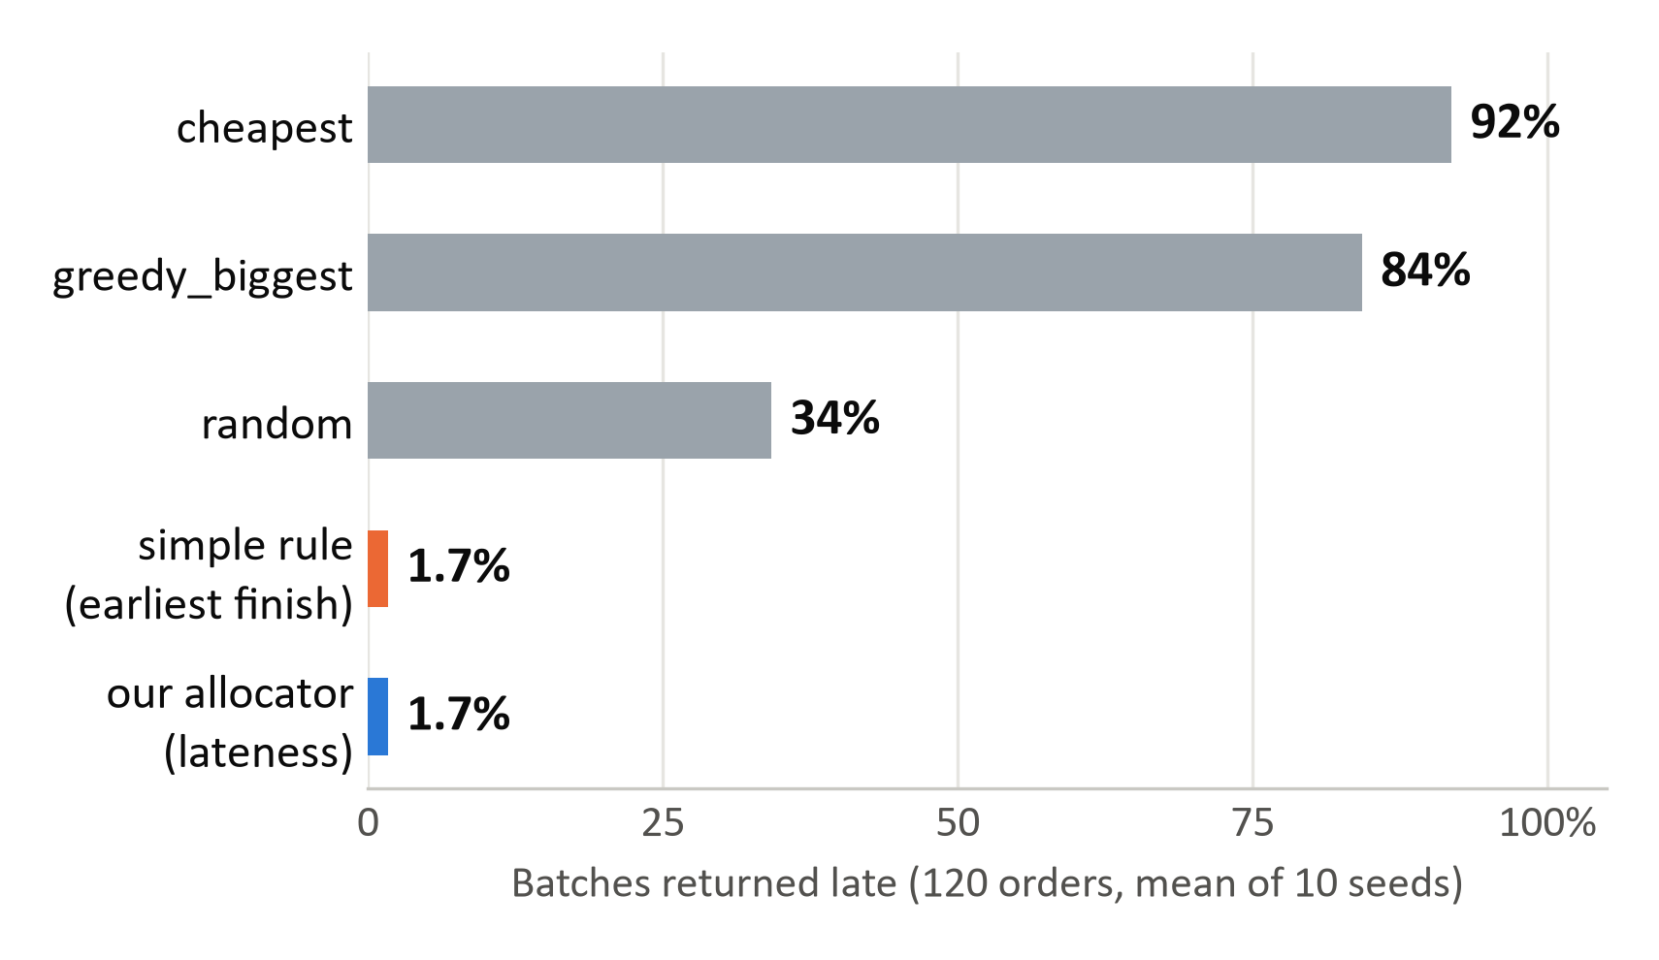
In replay, late batches fall from 34% to 1.7%
WHAT THE DISPATCHER GETS
9.3 days
mean turnaround, down from 21.9 days when workshops are picked at random
+3.3% cost
against random (115.4k against 111.8k): speed is not free
17 of 30
Source: harness/simulate.py v3, seeds 5105 to 5114, repo commit 1c6cb61. Every order is replayed as if it had gone outside on its order date.
morning messages cannot simply be dispatched: 7 need a question, 4 name a workshop that cannot take the job, 3 cannot meet the date, 3 have no answer in the data
DSS5105 Capstone · Track 2 · Subcontracting Desk · Sprint 1
4
Notes:
[30 s] We replayed 120 orders through the shared simulator. Picking workshops at random returns 34 percent of batches late; our lateness setting returns 1.7 percent, and mean turnaround falls from 22 to 9 days, for about 3 percent more cost. On the morning inbox, 17 of 30 messages cannot simply be dispatched. A chat thread lets those through; the desk stops them.

Slide 5
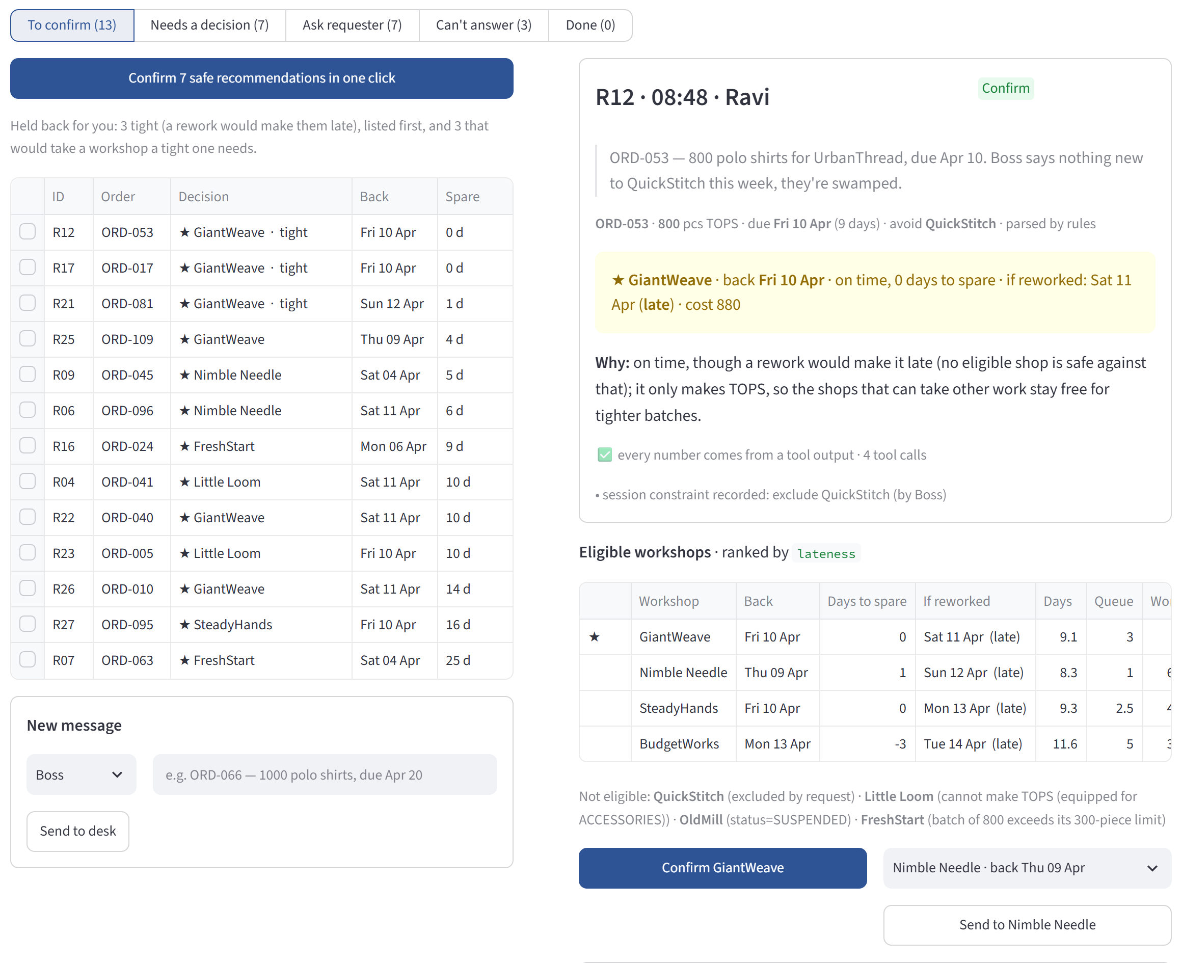
Sprint 1 so far: the loop runs end to end, and each part is now measured
56 / 56
Tests pass. Kernel, dispatcher workflow, the new rule, and the checks on what the model extracts.
30 / 30
Replies fully traced. Every number in every reply on the 30-message inbox comes from a tool output.
κ 0.70
Six members labelled the inbox on their own. The 9 changed requests: unanimous. Weakest where the named workshop cannot take the job.
86% → 100%
Right behaviour with GPT-5 nano on the 30 we developed on. A sharper prompt, plus code that checks each extracted value against the message. 97% on 38 new messages.
Dispatcher interface: grouped by next step, tightest first; one click confirms the rework-safe recommendations
DSS5105 Capstone · Track 2 · Subcontracting Desk · Sprint 1
5
Notes:
[35 s] The whole loop runs. 56 tests pass, and every number in every reply traces to a tool output. The interface puts the tightest requests first and confirms the safe ones in one click. All six of us labelled the requests independently: kappa 0.70. And we measured the language model: the cheapest one got 86 percent of behaviours right; with a sharper prompt and code checks, 100 percent on these thirty, which we developed on.

Slide 6
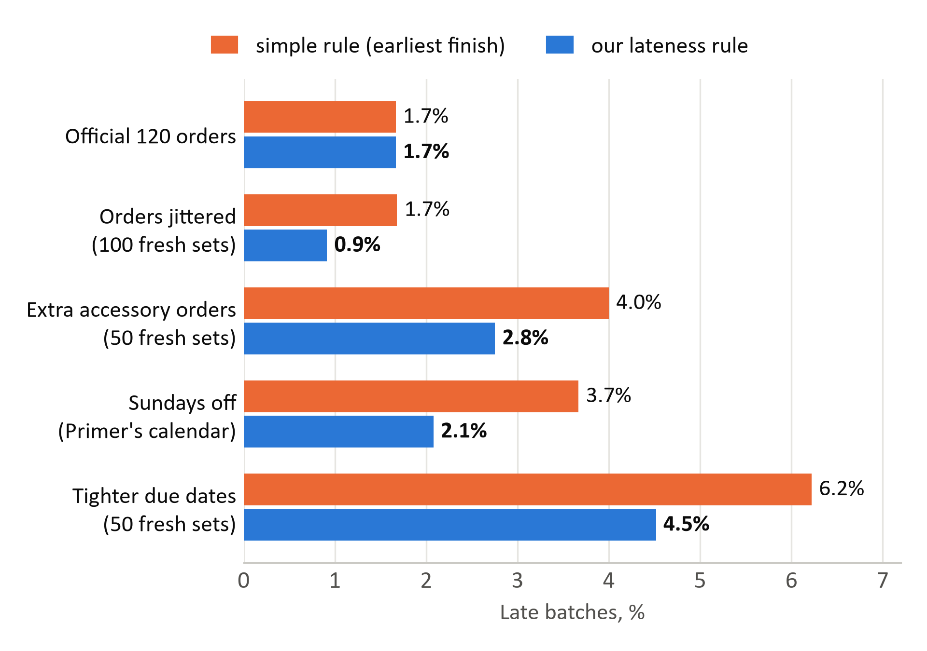
Our lateness rule ties the simple rule on the official data, and wins when the data moves
PRIMARY OBJECTIVE
Minimise lateness
The rule, in order: on time even if the batch is reworked; then the least flexible shop (a specialist before one that makes both categories); then earliest finish.
Official data: a tie on late batches (1.7%), half the late days (0.09 against 0.18).
Fresh data: better on 72 of 100 jittered order books, worse on 3.
Where the simple rule still wins: mean turnaround, 8.3 against 9.3 days.
Official: seeds 5105 to 5114. Fresh sets were generated after the rule was fixed (seeds 20000+), 3 seeds each. The allocators are not told about Sundays.
DSS5105 Capstone · Track 2 · Subcontracting Desk · Sprint 1
6
Notes:
[45 s] Our primary objective is minimise lateness. On the official 120 orders a simple earliest-finish rule ties us at 1.7 percent late. But earliest-finish is greedy: it spends the fast, flexible shops on batches that had slack, and the next tight batch has nowhere to go. Our rule keeps the shops that make the date even if the batch is reworked, takes the least flexible of them, and only then looks at speed. That halves the late days on the official data. On order books the rule was never shaped on, it wins: 0.9 percent late against 1.7 on a hundred jittered copies, and likewise with extra accessory orders, tighter due dates, and Sundays off. The simple rule is still a day faster on average.

Slide 7
What could go wrong, and what we are assuming
RISKS
ASSUMPTIONS
Our labels are ours, not the instructor's. Frozen on 7 Oct: 5 of 30 fell short of 5/6 agreement and were settled by a team vote on one stated rule. The counts per kind match the instructor's.
Today is 1 April 2026; requests arrive in time order. A confirmed dispatch occupies capacity for later requests (team decision).
On the official data we only tie the simple rule. Our edge shows on jittered and stressed data. We report both, and where the baseline wins.
Standing constraints persist. “Nothing new to QuickStitch this week” applies to every later request, with who set it.
The cheap model misreads messages. GPT-5 nano: 86% right behaviour before our checks. A teammate-written held-out inbox is still to come.
Two dates per estimate. Expected: queue + work + expected rework + transport. If reworked: work takes half as long again (simulator rule).
The simulator is a what-if replay. With Sundays off, the simple rule goes from 1.7% to 3.7% late. We report that separately.
The data has no customer prices and no history. Questions about either are declined, never invented.
DSS5105 Capstone · Track 2 · Subcontracting Desk · Sprint 1
7
Notes:
[30 s] Four risks. Our labels are frozen, but five needed a team vote, so we state the rule we used. On the official data we only tie the simple rule, so we show both the tie and the stressed results. The cheap language model misreads messages; code now checks what it extracts, and the real test is an inbox our teammates still have to write. And the simulator is a what-if replay. On the right, our assumptions: above all, a confirmed dispatch occupies capacity for later requests.

Slide 8
Sprint 2, 30 October: from a working loop to evidence we can defend
5 – 9 Oct
Align and freeze
Gold labels frozen on 7 Oct; round-2 code to merge.
10 – 16 Oct
Sprint 1
Rehearse twice; present live on 16 Oct.
17 – 23 Oct
Evidence
Held-out inbox written and frozen; user test with 3 people; closed-workshop detection.
24 – 29 Oct
Ship
Public demo; Evaluation draft with 10 failure cases; 5-minute video.
SUCCESS CRITERIA · MEASURED ON v3 DATA
≤ 2%
late batches on the official orders, normal and shock (10 seeds). Now 1.7% and 2.0%.
Beat it
fewer late batches than the simple rule on fresh order books. Now 0.9% against 1.7%.
≥ 90%
right behaviour on a held-out inbox written by teammates, labels frozen first. Now 97% (nano) and 100% (mini) on 38 AI-written messages.
100%
of numbers traced; promised rework dates kept (now 100%, 99% under shock).
DSS5105 Capstone · Track 2 · Subcontracting Desk · Sprint 1
8
Notes:
[30 s] The plan has four steps; the two ahead of us matter most. First the evidence: a held-out inbox written by teammates who do not touch the prompt, a user test of the interface, and detecting a closed workshop from a stuck queue. Then a public demo and the evaluation. Our criteria are on the bottom row: under 2 percent late, beating the simple rule on fresh data, 90 percent right behaviour on the held-out inbox, and every promised rework date kept.

Slide 9
BACKUP SLIDE
Appendix A · Results on v3 data, mean of 10 seeds
Policy | Late % | Late days | Mean days | Defective pcs % | Max share % | Cost | Late % in shock
random (official) | 34.2 | 6.13 | 21.9 | 5.6 | 23 | 111,780 | 38.2
greedy_biggest (official) | 84.2 | 26.53 | 50.3 | 5.3 | 70 | 108,430 | 84.9
cheapest (official) | 91.8 | 81.92 | 106.2 | 8.2 | 70 | 85,960 | 91.8
earliest_finish (simple rule) | 1.7 | 0.18 | 8.3 | 7.2 | 26 | 115,566 | 1.9
lateness: specialist-first rule (ours) | 1.7 | 0.09 | 9.3 | 7.7 | 28 | 115,438 | 2.0
use_slack: latest safe finish (ours) | 1.0 | 0.07 | 14.0 | 6.8 | 32 | 105,502 | 1.7
lateness, round 1 (ours) | 1.7 | 0.18 | 8.2 | 7.5 | 26 | 115,592 | 1.9
hybrid (ours) | 4.3 | 0.29 | 10.1 | 6.1 | 29 | 111,238 | 5.5
defects (ours) | 28.7 | 2.23 | 21.1 | 5.1 | 43 | 110,396 | 31.0
fairness (ours) | 6.8 | 0.64 | 12.6 | 7.1 | 20 | 113,088 | 10.1
cost (ours) | 4.4 | 0.24 | 17.2 | 5.7 | 38 | 100,931 | 5.2
simulate.py v3, commit 1c6cb61. use_slack is late less often and costs less, but takes 14 days on average. Single-seed defect draws move defective pcs by about ±2 points.
DSS5105 Capstone · Track 2 · Subcontracting Desk · Sprint 1
9
Notes:
Backup: full results table, seeds 5105 to 5114.

Slide 10
BACKUP SLIDE
Appendix B · How the desk sorted the 30 messages
R01
ask: missing info
R02
can't answer
R03
ask: which order
R04 ★
allocate
R05
ask: missing info
R06 ★
allocate
R07 ★
allocate
R08
refuse
R09
allocate
R10
ask: missing info
R11
refuse
R12
allocate
R13
can't answer
R14
refuse
R15
ask: which order
R16 ★
allocate
R17 ★
allocate
R18
can't answer
R19
ask: which order
R20
no on-time option
R21
allocate
R22 ★
allocate
R23 ★
allocate
R24
refuse
R25
allocate
R26 ★
allocate
R27 ★
allocate
R28
no on-time option
R29
ask: which order
R30
no on-time option
allocate
no on-time option
ask: which order
ask: missing info
refuse
can't answer
★ changed by the instructor in v3. Shown with the morning queues; the counts by kind match the instructor's published mix. Processed in order, 11 of the 13 on-time requests stay on time (R21 is 1 day late; R25 is 1 day late); at most 12 can.
DSS5105 Capstone · Track 2 · Subcontracting Desk · Sprint 1
10
Notes:
Backup: every request, coloured by the desk's decision.

Slide 11
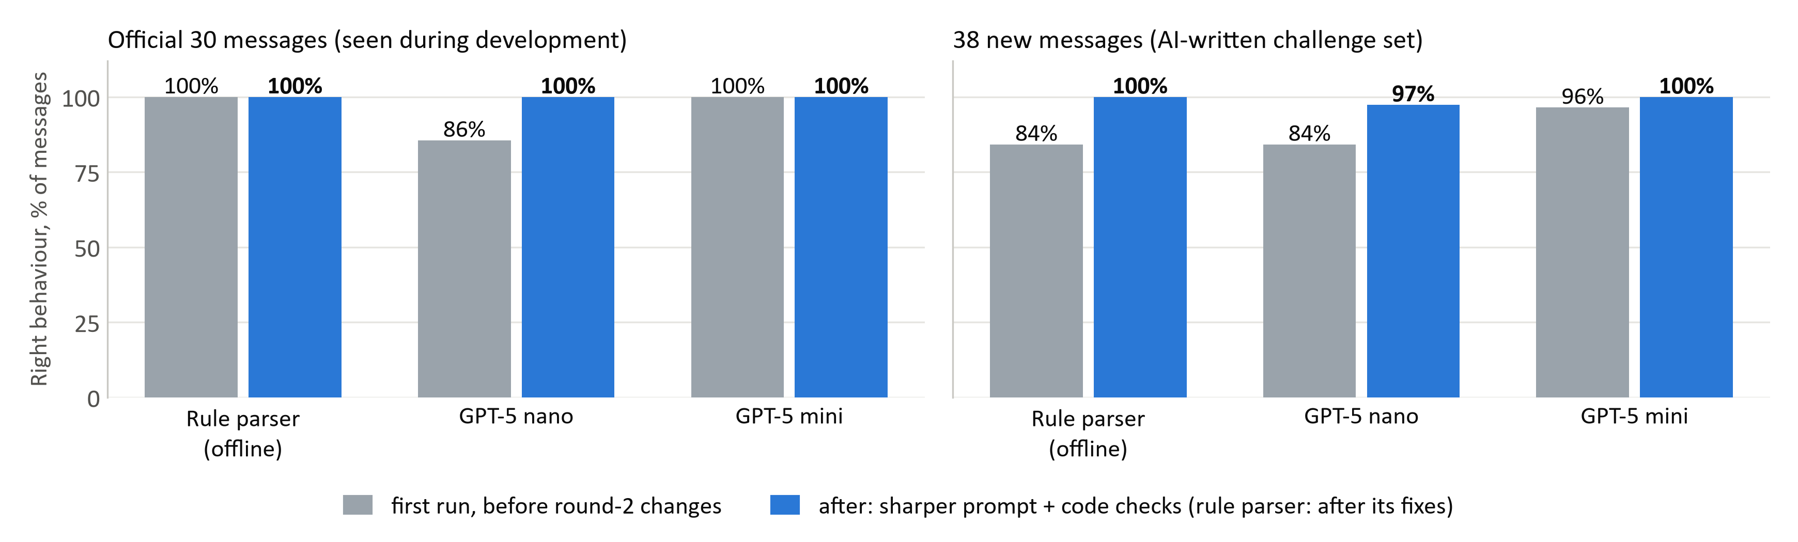
BACKUP SLIDE
Appendix C · The language layer, measured on two inboxes
The rule parser was built around the 30: 100% there, 84% on new wording at first try.
Model choice matters: with the round-1 prompt GPT-5 nano gets 86% of the 30 right, GPT-5 mini 100%. After our checks nano still misreads one new phrasing (a date “sooner than planned, not said when”) in 3 runs of 3.
Not a clean test yet: the 38 new messages are AI-written and two of our fixes came from errors seen on them. The held-out inbox will be written by teammates.
DSS5105 Capstone · Track 2 · Subcontracting Desk · Sprint 1
11
Notes:
Backup: behaviour accuracy by parser, before and after.

Slide 12
BACKUP SLIDE
Appendix D · Promised dates, and a six-day week
QUOTING TWO DATES · 1,200 BATCHES, LATENESS RULE
SUNDAYS OFF, AS THE PRIMER SAYS · LATE BATCHES %
94%
Policy | Seven-day week | Sundays off
random | 34.2 | 50.2
earliest_finish (simple rule) | 1.7 | 3.7
lateness rule (ours) | 1.7 | 2.1
lateness rule, estimate knows Sundays | 1.7 | 1.8
of expected dates hold. Every miss in normal runs is a defect rework.
100%
of “if reworked” dates hold (99.2% with a workshop closed). They are 1.8 days later on average.
Same orders, same defect draws; only change: no work on Sundays. The allocators are not told. With the Sunday rule switched off the variant reproduces simulate.py exactly.
DSS5105 Capstone · Track 2 · Subcontracting Desk · Sprint 1
12
Notes:
Backup: two dates per promise; Sundays off.

