Slide 1

RapidMiner Workshop - A Crash Course
Presented by : Aditya Tyagi
Teaching Assistants : Jerry Chen, Kensen Tan, Jerry Lin

Slide 2
Who are we and more importantly who are you?
Aditya : “I’m an IEOR Sophomore, hailing from Abu Dhabi. I love reading history in my spare time and I just bought a squash racket for myself. Hope to play this Thanksgiving Week!”
Jerry Chen: “I’m a 4th year East Bay native studying Statistics with an emphasis on machine learning and practical data analysis. In my spare time, I also enjoy design, animation, and video editing.”
Kensen Tan : “I’m majoring in Statistics and minoring in IEOR (graduating in Dec. 2017). I came to LA from China when I was 11. This Thanksgiving I will be going to Arizona (I think).”
Jerry Lin : “I’m a 3rd year Math major, currently doing renewable energy research at RAEL and election research with FairVote. I love politics and am contemplating starting a vegetarian fast food restaurant.”

Slide 3




So that you can map names to faces:
Aditya : “I grew a magnificent moustache this summer. People mistook me for a 1940s-era Indian revolutionary!”
Kensen : “Don’t be surprised if you see me on a Ray-Ban commercial. In the meantime, NEVER HIDE!”
Jerry Chen: “The woods are lovely, dark, and deep. Well, they better be- coz I’m gonna take my profile pic in them.”
Jerry Lin : “The face you make when you realize the mean was 50% and you scored 51% on your midterm.”

Slide 4
What We’ll Be Covering…
The Typical Structure of a Data Science Project. We’ll be following this today:
Data Prep – {Imputation, Normalization,Feature Selection, Dimensionality Red.}
Model the Data – {Apply/train the predictive mode. E.g. k-NN, SVM, Regression.}
Validate Model – { Split Validation, k-Fold Cross Val., Leave-out one cross val.}
Operationalize Model into Business Processes – {Unleash your creation out into the real world to make predictions.}
Deep Dive into RapidMiner!
Exploring the dataset (Labor Negotiations, Sonar).
Data vs. Process Distinction
The fundamental building block in RapidMiner: Operators

Slide 5

Our Challenge:
To show you the immense power of RapidMiner, we’re going to build two full-scale data science projects using real world data in as little as two hours! Can it be done?

Slide 6
Some basic ML terminology (if you’re new to the game)
Label : Attribute whose value we’re trying to predict.
Training Data : Data that is used by the model to come up with a decision-making rule for classifying instances.
Test Data : Data that hasn’t been ‘seen’ by the model (i.e. not training data), but whose label we know from before.
A simple analogy : Imagine a parent taking his little child out for a walk. He wants to teach him/her to distinguish between cats & dogs. He first shows him 20 animals (either cats or dogs) and tells him which is which [Training data]. He then shows the child a new set of 10 animals and asks him/her to classify. [Testing data] The parent of course knows which is which.

Slide 7
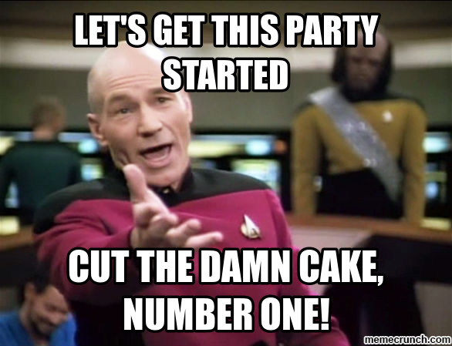
Armed with that, let’s get the party started…
Download & install RapidMiner Studio 7.3.0 from their website.
When prompted, create an account (it should take no more than 4 minutes.)

Slide 8
Introducing the Dataset: Labor Negotiations
Data is from all collective agreements reached in the business and personal services sector local companies in Canada in ’87.
--->Will be useful when applying for Canadian citizenship<----
Has 16 Predictive Attributes {Length of service, 1st Wage Inc., etc.}
Label is “Whether there was a positive outcome (suitable for management or not).” We’re playing from the capitalist side here!
57 ‘instances’ (records) in total. Each record represents a particular labor negotiation result (i.e. ‘Good’ or ‘bad’).

Slide 9

RapidMiner Operators: What makes RapidMiner so effective!

Slide 10
RapidMiner Operators: The fundamental building block
RapidMiner employs a drag-and-drop approach.
Operators are what you’ll be dragging & dropping.
An operator takes one or more inputs, carries out an operation, and returns one or more outputs. They also usually have parameters that you can adjust.

Slide 11
I : Data Preparation- Visualization & Imputation
Our first step will be to get a feel for the data by exploring some basic visualizations.
Observe class distribution and other basic histograms
Now the tough part (from the real-world): Imputation (not amputation!)
Sometimes data is simply not filled in. People forget to enter data (/ or sometimes deliberately do so with malicious intent in order to derail our project.)
Our answer: replace a missing value in a given record with its corresponding value in another record that is complete and similar to our current record on other attributes.
Known as a Nearest Neighbor Imputation.

Slide 12

II : Modelling the Data
We will be using a Decision Tree to model our data.
Operators used in this stage
Apply Model, Decision Tree, Retrieve Data
Search for them in the Operators Panel.

Slide 13
III : Validating the Model
Answer to the Question : Is the model I generated the best model to answer my questions about the real-world?
We can do this in a few ways:
Split Validation (we’ll be using this today!)
Train the model on 70% of your source data
Test the model on the remaining 30% of your source data[whose label you know].
Cross Validation – a More advanced technique that accounts for variations in training data

Slide 14

IV : Operationalizing the Model
This means embedding the predictive model into a business process.
(Or unleashing it into the real world to go out and make decisions by itself- for the more imaginatively-inclined people in the audience!)
Viktor Frankenstein on his creation :

Slide 15
Project II : Sonar Predictions Stuck between a ‘rock’ & ‘an explosive device’
To illustrate the diversity of applications possible, we’ll explore a dataset from a totally different field: oceanography/mine detection.
This dataset was sourced from a mine-detection ship that basically emitted sound waves into the ocean, received a reflection back and then analyzed it to determine whether it’s a metallic mine or a rock.
The dataset contains 70 predictor attributes which are sonar readings taken from a variety of aspect angles on the ship.
The label is whether a set of particular readings is to be associated with a mine or a rock.

Slide 16
I : Data Preparation- Normalization & PCA.
Let’s begin with visualizing the data using the same steps as before.
This time however, we need to carry out two things first:
Due to the high number of dimensions/predictor variables involved (some of which we suspect to be highly correlated because they are basically readings of the same Sonar signal taken from different angles.), we will employ a dimensionality reduction procedure known as Principal Component Analysis.
Think of it in terms of black box : you enter say, a 50 variable dataset, and get out a derived dataset consisting only of say, 10 variables.
These 10 variables are known as Principal Components and they are simply linear combinations of the old columns/variables.
They are artificial in that they do not correspond to anything in the real-world.
Lastly, we normalize the data before we begin model creation using a z-score normalization.

Slide 17
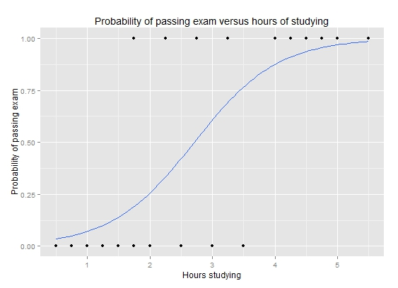
II: Modelling the data
Let’s use a logistic regression to model the data.
Logistic Regression fits a logistic function through the data points and then uses them to generate probabilities of an instance being in a given class. The probabilities are then used to make a classification decision. (e.g. if the p(instance being a Rock) >= 0.5, then I shall classify this instance as being a Rock.
Operators used in this stage : Apply model, Logistic Regression , Retrieve.

Slide 18
III : Validating the Model
Let’s use the same split validation methodology as before using a 70:30 split.

Slide 19
IV : Operationalizing the Model
Now that we’re done validating, we need to operationalize our model.
Train your model using all your source data and let it out in the real-world.
A natural application : Navy Minehunting,

Slide 20
Let’s take stock of all we’ve accomplished…
We carried out an array of data preprocessing steps: dimensionality reduction (PCA), normalization, imputation.
We applied, tested & validated two complete Machine Learning models: Decision Trees & Logistic Regression using techniques such as Split Validation.
And what’s even more remarkable is that we did this all in a span of two hours, without writing even a line of code!

Slide 21
And that brings us to the end of our workshop- but that doesn’t mean our work needs to end!
I’m sure you all are amazed at the power of RapidMiner. It not only enables to you to start making meaningful data science projects with minimal coding background, but also speeds up the entire process (as we saw here today).
It’s particularly relevant to those from a non-technical/CS background (Business Administration, Humanities, Social Sciences, etc.) who still want a share of the fast-expanding data-science pie.
What we did today would normally require 1000s of lines of code and countless hours of debugging, etc.
A real-world caveat : while it keeps the coding under the hood, you still need to have a grasp of the underlying statistical theory/concepts in order to make the right decisions.

Slide 22
Here’s where we say goodbye…
It was our pleasure having everyone over; I hope this sparks a curiosity for data science in all of you and that it empowers you to create your own project(s).
We’re happy to have let you in on the secret!
Stay tuned with DSSB’s events and hit ‘like’ on the Facebook page to keep abreast of latest news and activities within the Data Science Community at Cal.

