Slide 1
SQL WORKSHOP
Fall 16
1. Download SQLite Studio from here:
http://sqlitestuido.pl
2. Download Chinook.zip from http://www.sqlitetutorial.net/sqlite-sample-database/
Tony Yin
Soyoung Lee
Dhruv Relwani

Slide 2
GOALS AND OBJECTIVES
Give you hands-on experience with the SQL language
Understand practical uses of SQL
Enough knowledge to practice on your own

Slide 3
WHAT IS SQL
SQL (Structured Query Language) is used to access and manipulate data in databases
Allows users to communicate with a database
Database - ?

Slide 4
WHAT IS SQL
SQL (Structured Query Language) is used to access and manipulate data in databases
Allows users to communicate with a database
Database - A collection of datas are stored as tables

Slide 5
Purpose
Modify data
Insert data
Request and retrieve data
Remove Data

Slide 6
Tables
A table stores and displays data in a structured format
Rows and columns, similar to excel spreadsheet
Each table have a specific purpose, and databases often contain multiple tables (Relational Database)

Slide 7
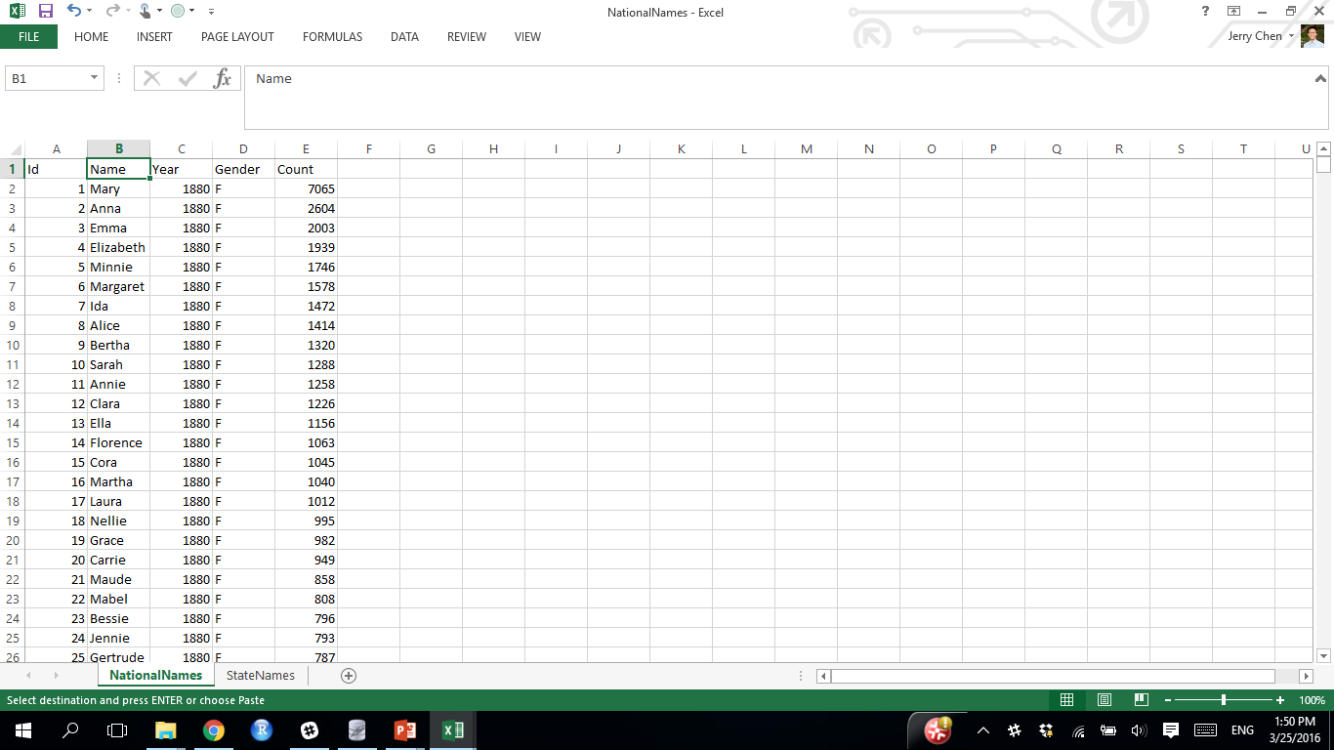
TABLES
These are an “array” of data
Think Excel spreadsheets
. . .

Slide 8
Relational Database
Primary Key – Consists of one or more columns used to uniquely identifies the table
Foreign Key – One or more columns in a table that refers to the primary key in another table

Slide 9
Queries and Operators
Queries are the most common operation in SQL
Use declarative statements to carry out desired actions
SELECT column(s)
FROM table
WHERE condition > 100
ORDER BY criteria

Slide 10



Platforms
SQLite
PostgreSQL
MySQL

Slide 11
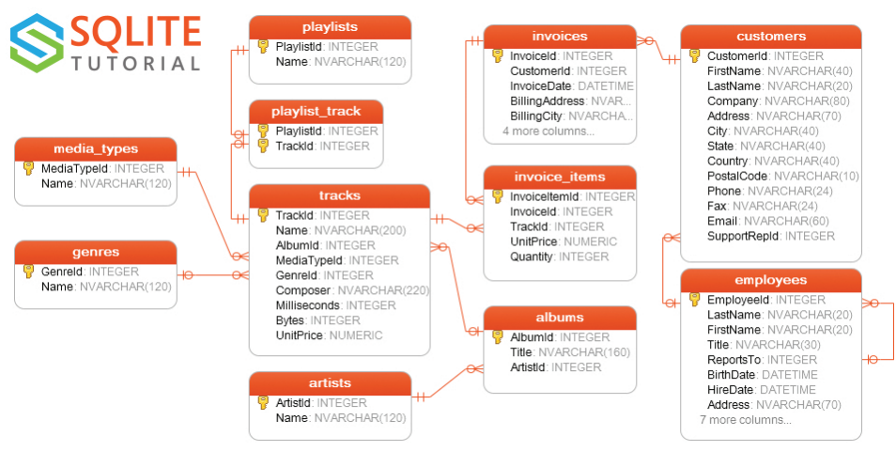
Make sure to download Chinook.zip from http://www.sqlitetutorial.net/sqlite-sample-database/

Slide 12
BASIC SYNTAX
SELECT [DISTINCT] column expression list
FROM table_ name AS alias_name (for shorthand naming purposes)
WHERE condition AND/OR
LIMIT the limited number of rows to return ;
DISTINCT removes duplicates before output.

Slide 13
Examples
Q1) List the first name and last name of customers in the United States.
select c.FirstName, c.LastName
from customers as c
where c.Country = "USA";
Q2) List 10 different first names of customers who are in the United States.
sqlite> select distinct c.FirstName
...> from customers c
...> where c.Country = "USA"

Slide 14
AGGREGATE FUNCTIONS
SUM()
eg) What is the total revenue (using UnitPrice and Quantity in the invoice_items table)?
sqlite> select sum(UnitPrice*Quantity)
...> from invoice_items;
AVG()
COUNT() returns the total number of values in a given column
COUNT(*) returns the number of rows in the table
eg 1) How many rows in the invoice_items table?
2) How many distinct values in UnitPrice?

Slide 15
AGGREGATES and GROUP BY
Are used to apply aggregate functions by a specified column, group
SELECT column_name, aggregate_function(column_name)
FROM table_name
GROUP BY column_name;
eg) List the number of customers by country and the corresponding country.
sqlite> select count(CustomerId), Country
...> from customers
...> group by Country;

Slide 16
GROUP BY and HAVING
Are used to filter groups based on some conditions
Having aggregate_function (column_name) operator value
ex) Having count (customerId) >= 2
WHERE = Subset data before running the query
Eliminate rows in a table
GROUP BY
HAVING = Subset data after running query, aggregate functions are allowed
Eliminate groups after group by
eg) List the number of customers by country where there are at least 2 customers
...> order by BirthDate;

Slide 17
ORDER BY
Is used to sort the result-set by one or more columns
ORDER BY column_name, [column_name] [DESC]
Default is “ascending”; put DESC for “descending” order
eg) Order the previous problem by the number of customers in descending order.
eg) Order the same problem by country names alphabetically.
select Country, Count(CustomerId) as numCust
from customers
group by Country
Having numCust >=2
order by Country;

Slide 18
Multi-Relation Queries
Reference: CS 186 Fall 2016

Slide 19
Querying Multiple Relations
‹#›
SELECT S.sname FROM Sailors S, Reserves R WHERE S.sid = R.sid AND R.bid = 102
Sailors
Reserves
sid | sname | rating | age
1 | Popeye | 10 | 22
2 | OliveOyl | 11 | 39
3 | Garfield | 1 | 27
4 | Bob | 5 | 19
sid | bid | day
1 | 102 | 9/12
2 | 102 | 9/13
1 | 101 | 10/01
Notes:
CREATE TABLE Sailors2 (sid INTEGER, sname CHAR(20), rating INTEGER, age REAL, PRIMARY KEY (sid));
CREATE TABLE Boats2 (bid INTEGER, bname CHAR (20), color CHAR(10), PRIMARY KEY (bid));
CREATE TABLE Reserves2 (sid INTEGER, bid INTEGER, day DATE, PRIMARY KEY (sid, bid, day), FOREIGN KEY (sid) REFERENCES Sailors, FOREIGN KEY (bid) REFERENCES Boats);
INSERT INTO Sailors2 VALUES
(1, 'Popeye', 10, 22),
(2, 'OliveOyl', 11, 39),
(3, 'Garfield', 1, 27),
(4, 'Bob', 5, 19);
INSERT INTO Reserves2 VALUES
(1, 102, '2016-08-30'),
(2, 102, '2016-08-31'),
(1, 101, '2016-09-01');

Slide 20
Join Queries
‹#›
SELECT [DISTINCT] <column expression list> FROM <table1 [AS t1], ... , tableN [AS tn]> [WHERE <predicate>] [GROUP BY <column list>] [HAVING <predicate>] [ORDER BY <column list>] ;

Slide 21
Query Semantics Recap
‹#›
SELECT [DISTINCT] target-list
FROM relation-list
WHERE qualification
FROM: compute cross product of tables.
WHERE: Check conditions, discard tuples that fail.
SELECT: Specify desired fields in output.
DISTINCT (optional): eliminate duplicate rows.

Slide 22
Conceptual SQL Evaluation
‹#›
SELECT [DISTINCT] target-list
FROM relation-list
WHERE qualification
GROUP BY grouping-list
HAVING group-qualification
Project away columns
(just keep those used in SELECT, GBY, HAVING)
SELECT
[DISTINCT]
Eliminate duplicates
Apply selections
(eliminate rows)
WHERE
HAVING
Eliminate groups
Relation cross-product
FROM
GROUP BY

Slide 23
Find sailors who have reserved at least one boat
‹#›
Will DISTINCT make a difference here, if sid is a foreign key from Sailors to Reserves? (Hint : sid will be a primary key in Reserves table).
SELECT S.sid
FROM Sailors AS S, Reserves AS R
WHERE S.sid = R.sid
Notes:
SELECT S.sid
FROM Sailors2 AS S, Reserves2 AS R
WHERE S.sid = R.sid

Slide 24
Find sids of sailors who’ve reserved a red or green boat
‹#›
SELECT R.sid
FROM Boats B, Reserves R
WHERE R.bid=B.bid AND
(B.color='red' OR
B.color='green')
... or:
SELECT R.sid
FROM Boats B, Reserves R
WHERE R.bid=B.bid AND
B.color='red'
UNION ALL
SELECT R.sid
FROM Boats B, Reserves R
WHERE R.bid=B.bid AND B.color='green'
Notes:
Do these two queries have the same execution plan?
SELECT R.sid, s.sname
FROM Boats B, Reserves2 R, Sailors s
WHERE R.bid=B.bid AND s.sid = R.sid AND
(B.color='red' OR B.color='green');
SELECT R.sid
FROM Boats B, Reserves2 R
WHERE R.bid=B.bid AND
B.color='red'
UNION ALL
SELECT R.sid
FROM Boats B, Reserves2 R
WHERE R.bid=B.bid AND B.color='green';

Slide 25
Find sids of sailors who’ve reserved a red AND a green boat
‹#›
SELECT R.sid
FROM Boats B,Reserves R
WHERE R.bid=B.bid AND
(B.color='red' AND B.color='green')
Notes:
SELECT R.sid
FROM Boats B,Reserves2 R
WHERE R.bid=B.bid AND
(B.color='red' AND B.color='green')
;

Slide 26
Find sids of sailors who’ve reserved a red AND a green boat
‹#›
SELECT S.sid
FROM Sailors S, Boats B, Reserves R
WHERE S.sid=R.sid
AND R.bid=B.bid
AND B.color='red'
INTERSECT
SELECT S.sid
FROM Sailors S, Boats B, Reserves R
WHERE S.sid=R.sid
AND R.bid=B.bid
AND B.color='green'
Notes:
SELECT S.sid
FROM Sailors2 S, Boats B, Reserves2 R
WHERE S.sid=R.sid
AND R.bid=B.bid
AND B.color='red'
INTERSECT
SELECT S.sid
FROM Sailors2 S, Boats B, Reserves2 R
WHERE S.sid=R.sid
AND R.bid=B.bid
AND B.color='green'
;

Slide 27
Find sids of sailors who have not reserved a boat
‹#›
SELECT S.sid
FROM Sailors S
EXCEPT
SELECT S.sid
FROM Sailors S, Reserves R
WHERE S.sid=R.sid
Notes:
Set Difference
SELECT S.sid
FROM Sailors2 S
EXCEPT
SELECT S.sid
FROM Sailors2 S, Reserves2 R
WHERE S.sid=R.sid
;

Slide 28
Nested Queries: IN
‹#›
Names of sailors who’ve reserved boat #102
SELECT S.sname
FROM Sailors S
WHERE S.sid IN
(SELECT R.sid
FROM Reserves R
WHERE R.bid=102)
Notes:
SELECT S.sname
FROM Sailors2 S
WHERE S.sid IN
(SELECT R.sid
FROM Reserves2 R
WHERE R.bid=102)
;

Slide 29
NULL Values
‹#›
Field values are sometimes unknown or inapplicable
SQL provides a special value null for such situations.
The presence of null complicates many issues. E.g.:
Special syntax “IS NULL” and “IS NOT NULL”
Assume rating IS NULL. Consider predicate “rating>8”.
True? False?
What about AND, OR and NOT connectives?
SUM?
We need a 3-valued logic (true, false and unknown).

Slide 30
Joins

Slide 31
Joins
‹#›
SELECT (column_list)
FROM table_name
[INNER | {LEFT | RIGHT | FULL} {OUTER}] JOIN table_name
ON qualification_list
WHERE …
INNER is default

Slide 32
Inner Joins
‹#›
SELECT s.sid, s.sname, r.bid
FROM Sailors s, Reserves r
WHERE s.sid = r.sid
SELECT s.sid, s.sname, r.bid
FROM Sailors s INNER JOIN Reserves r
ON s.sid = r.sid
Both are equivalent!

Slide 33
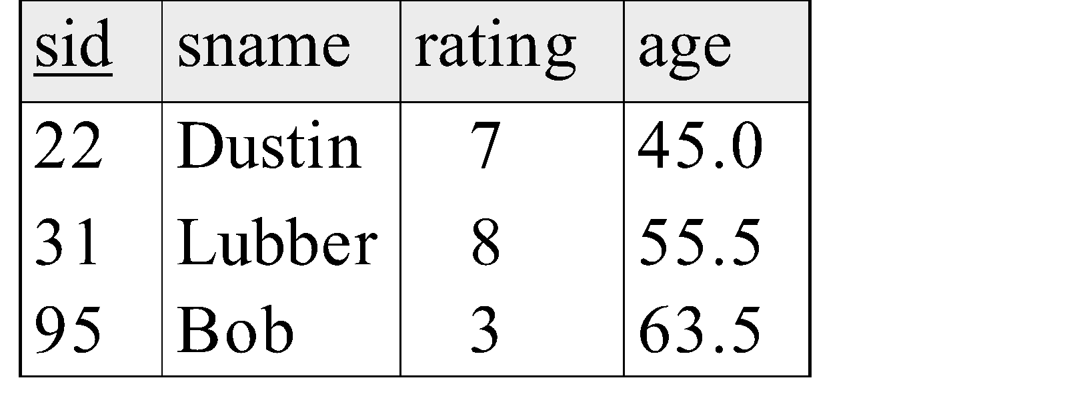
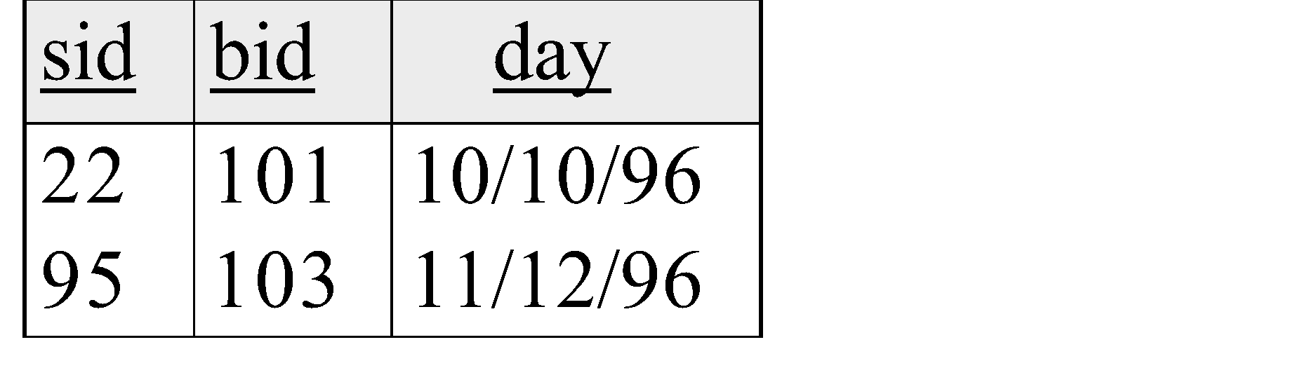
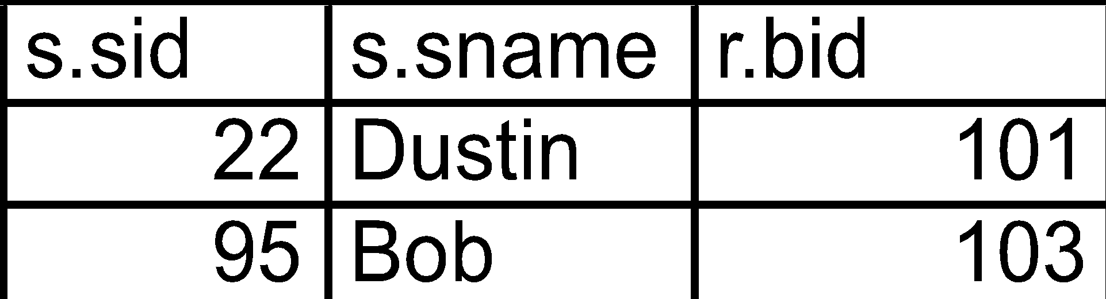
‹#›
SELECT s.sid, s.sname, r.bid FROM Sailors2 s INNER JOIN Reserves2 r ON s.sid = r.sid;

Slide 34
Left Outer Join
‹#›
Returns all matched rows, plus all unmatched rows from the table on the left of the join clause
(use nulls in fields of non-matching tuples)
SELECT s.sid, s.sname, r.bid
FROM Sailors2 s LEFT OUTER JOIN
Reserves2 r
ON s.sid = r.sid;
Returns all sailors & bid for boat in any of their reservations
Note: no match for s.sid? r.sid IS NULL!

Slide 35
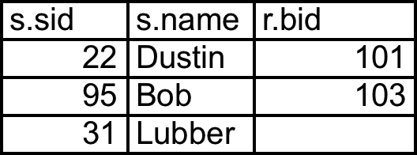
SELECT s.sid, s.sname, r.bid FROM Sailors2 s LEFT OUTER JOIN Reserves2 r ON s.sid = r.sid;
‹#›
NULL

Slide 36
Right Outer Join
‹#›
Returns all matched rows, plus all unmatched rows from the table on the right of the join clause
(use nulls in fields of non-matching tuples)
SELECT s.sid, b.bid, b.bname
FROM Reserves2 r RIGHT OUTER JOIN
Boats2 b
ON r.bid = b.bid;
Returns all boats & information on which ones are reserved
Note: no match for b.bid? r.bid IS NULL!

Slide 37
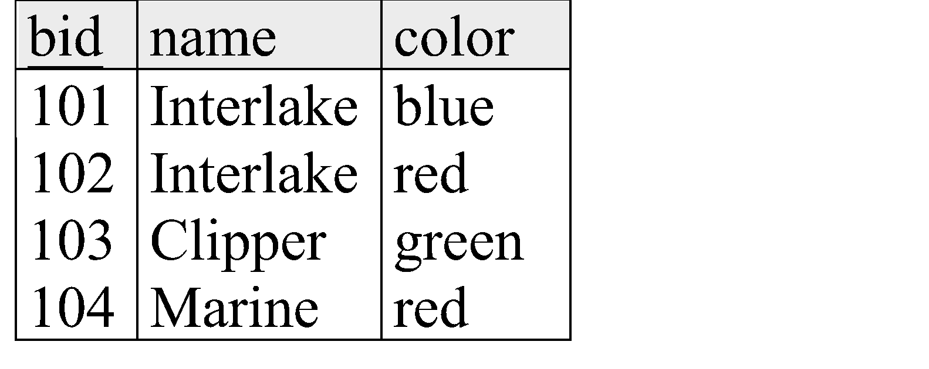

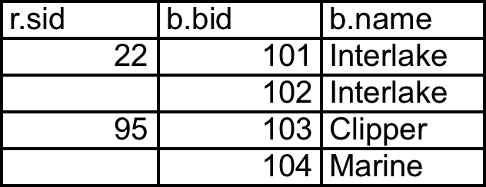
SELECT r.sid, b.bid, b.bname FROM Reserves2 r RIGHT OUTER JOIN Boats2 b ON r.bid = b.bid;
‹#›

Slide 38
Full Outer Join
‹#›
Full Outer Join returns all (matched or unmatched) rows from the tables on both sides of the join clause
SELECT r.sid, b.bid, b.bname
FROM Reserves2 r FULL OUTER JOIN
Boats2 b
ON r.bid = b.bid;
Returns all boats & all information on reservations
No match for r.bid?
b.bid IS NULL AND b.bname is NULL
No match for b.bid?
r.sid is NULL

Slide 39
SELECT r.sid, b.bid, b.bname FROM Reserves2 r FULL OUTER JOIN Boats2 b ON r.bid = b.bid;
‹#›
Note: in this case it is the same as the Right Outer Join! bid is a foreign key in reserves, so all reservations must
have a corresponding tuple in boats.

Slide 40
QUESTIONS

Slide 41
THANK YOU!

