Slide 1


Tableau
Data Visualization
Workshop Series #7
https://github.com/chenwnicole/dss-sql-workshop

Slide 2


Instructors
Ricky Pan
Junior
Applied Math & Stats
Nicole Chen
Junior
EECS

Slide 3
Teaching Assistants
Alex Nakagawa
Sophomore
CS²
Katharine Chua
Sophomore
Econ

Slide 4
Ice Breaker
name | major | year | pet peeve | favorite mickey-d item
Notes:
nicole

Slide 5
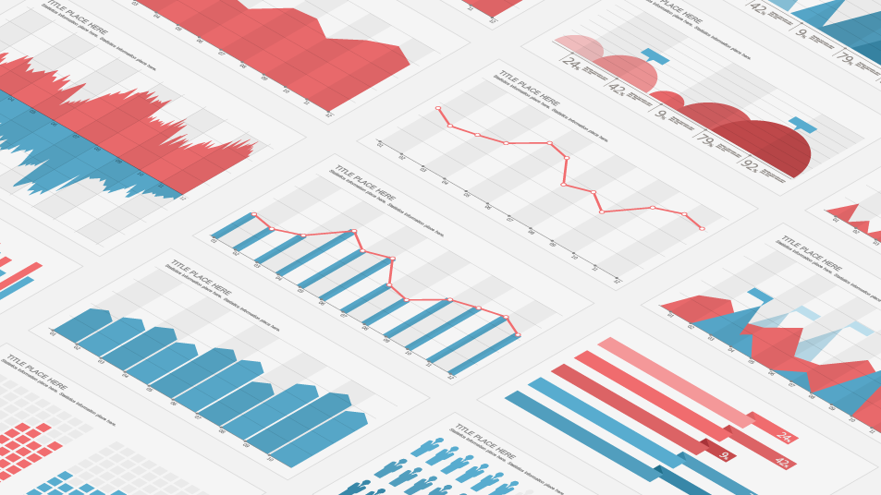
Data Visualization: Why?
Notes:
ricky

Slide 6

Tableau: Why?
Notes:
ricky

Slide 7
Environment Setup
HTTPS://WWW.TABLEAU.COM/ACADEMIC/STUDENTS
Notes:
nicole

Slide 8

Environment Setup
Superstore Sales.xls
Notes:
nicole
after this, live demo importing cereal.db into sqlite studio

Slide 9
Alcohol Consumption For Portuguese Students
info
name | mfr | type | shelf | rating
100% Bran | N | C | 3 | 68.402973
Notes:
nicole
available on github, also show how to see this in sqlite studio

Slide 10
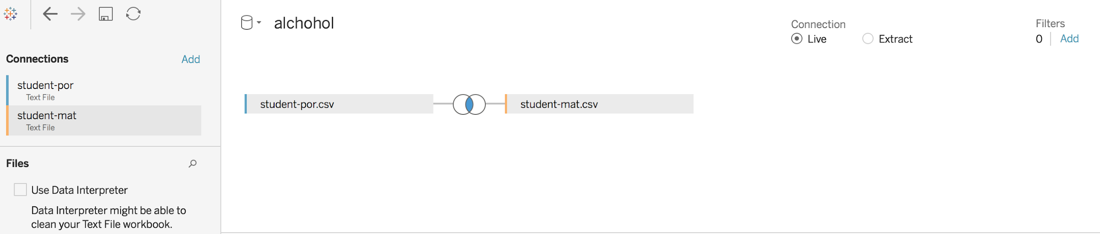
Data Joining
Notes:
ricky

Slide 11
Inner & Outer Joins on Data
Picture of venn diagram
Notes:
ricky

Slide 12
Basics: Rows/Columns,
Rows - Partitions x-axis
Columns - Partitions y-axis
Short demo of what this looks like
Notes:
ricky

Slide 13
Measures & Dimensions
Measures - quantitative data
Dimensions - Categorical data (split things into groups)
Can use measures or dimensions for either rows or columns, make sure what you are trying to display makes sense logically first
Notes:
ricky

Slide 14
Brief Demo of Rows/Columns & Measures/Dimensions
Notes:
columns: category, sub-category, avg(sales)
rows: state
Mention: how to sort data by clicking button on top

Slide 15
Alias
Changes names, just right click the variable
Do brief demo, alias on some random variable.
Notes:
columns: category, sub-category, avg(sales)
rows: state
Mention: how to sort data by clicking button on top

Slide 16
Filters
Places a condition on values
Possible booleans
>
<
>=
<=
etc
Certain categorical variables
Notes:
ricky

Slide 17
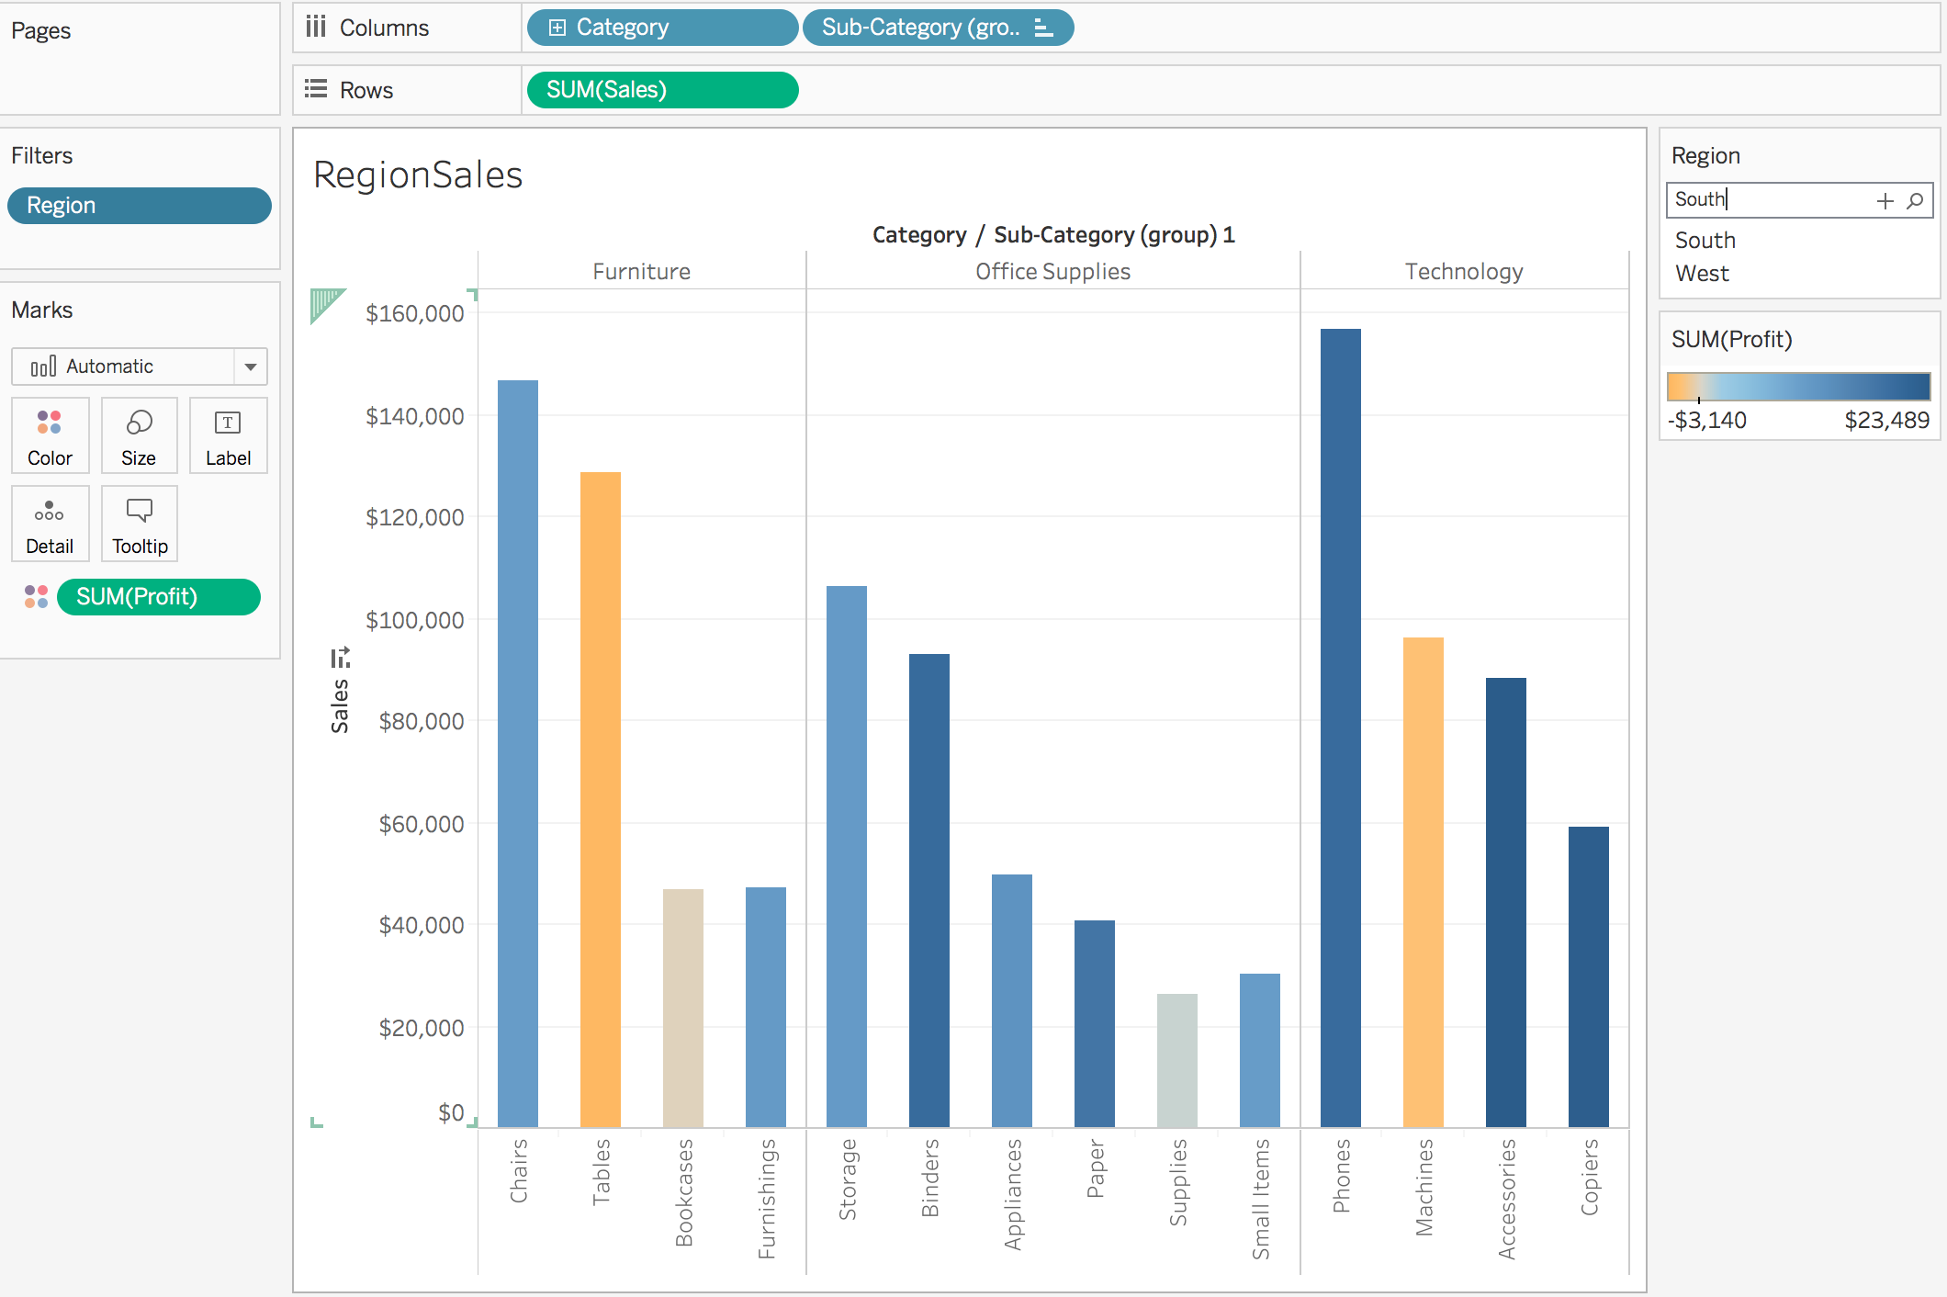
Filters Demo
Notes:
filter by right clicking region and writing Region:East/South/West/North or other conditions

Slide 18
Sets
Corrals data into subsets, based on conditions
Advantage: Stores subsets for easy access
Notes:
right click a dimension

Slide 19
Sets
Practice: Find all states with profit at least 7500. Plot as a treemap. What other type of graph could be useful for visualizing the spread of profit per state with at least $7500 profit? What can we do to improve/gain greater insight into this plot?
Practice: Find the top 50 cities with the greatest average sales, and plot as a barplot. What are some problems with this graph? How can we improve this visualization?
Notes:
ricky

Slide 20
Groups
Simplifies data into higher level categories
Notes:
right click a dimension

Slide 21
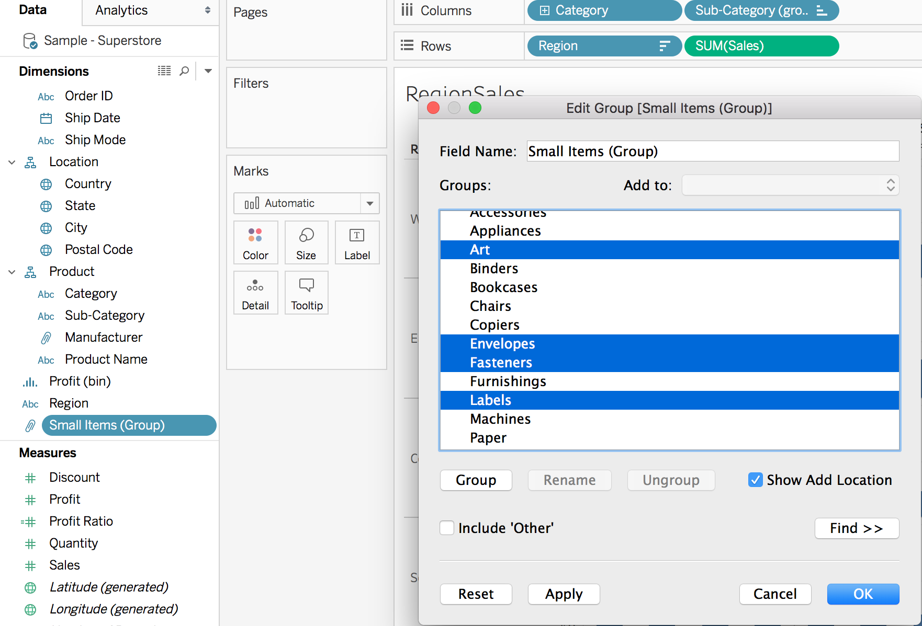
Groups
Right click on labels in worksheet and highlight subsets you’d like to make a group from.
Right click a dimension and create group from certain values.

Slide 22
Groups
You can also filter by groups!
Try going to previous worksheet with the top 50 cities by sale. Make a set from this group.
First practice: Make a new treeplot of the categories and subcategories of the products as the classifications we want to examine, and their profit as the value we want to examine.
Notes:
ricky

Slide 23
Bar Plots
Useful for: measuring differences between variables
Notes:
select sodium from nutrition;
select mfr, rating from info;

Slide 24
Barplot practice
Find the sales of each product type for each region, and measure them as barplots.
Notes:
Column: Category, Sub-category
Rows: Region, SUM(Sales)

Slide 25
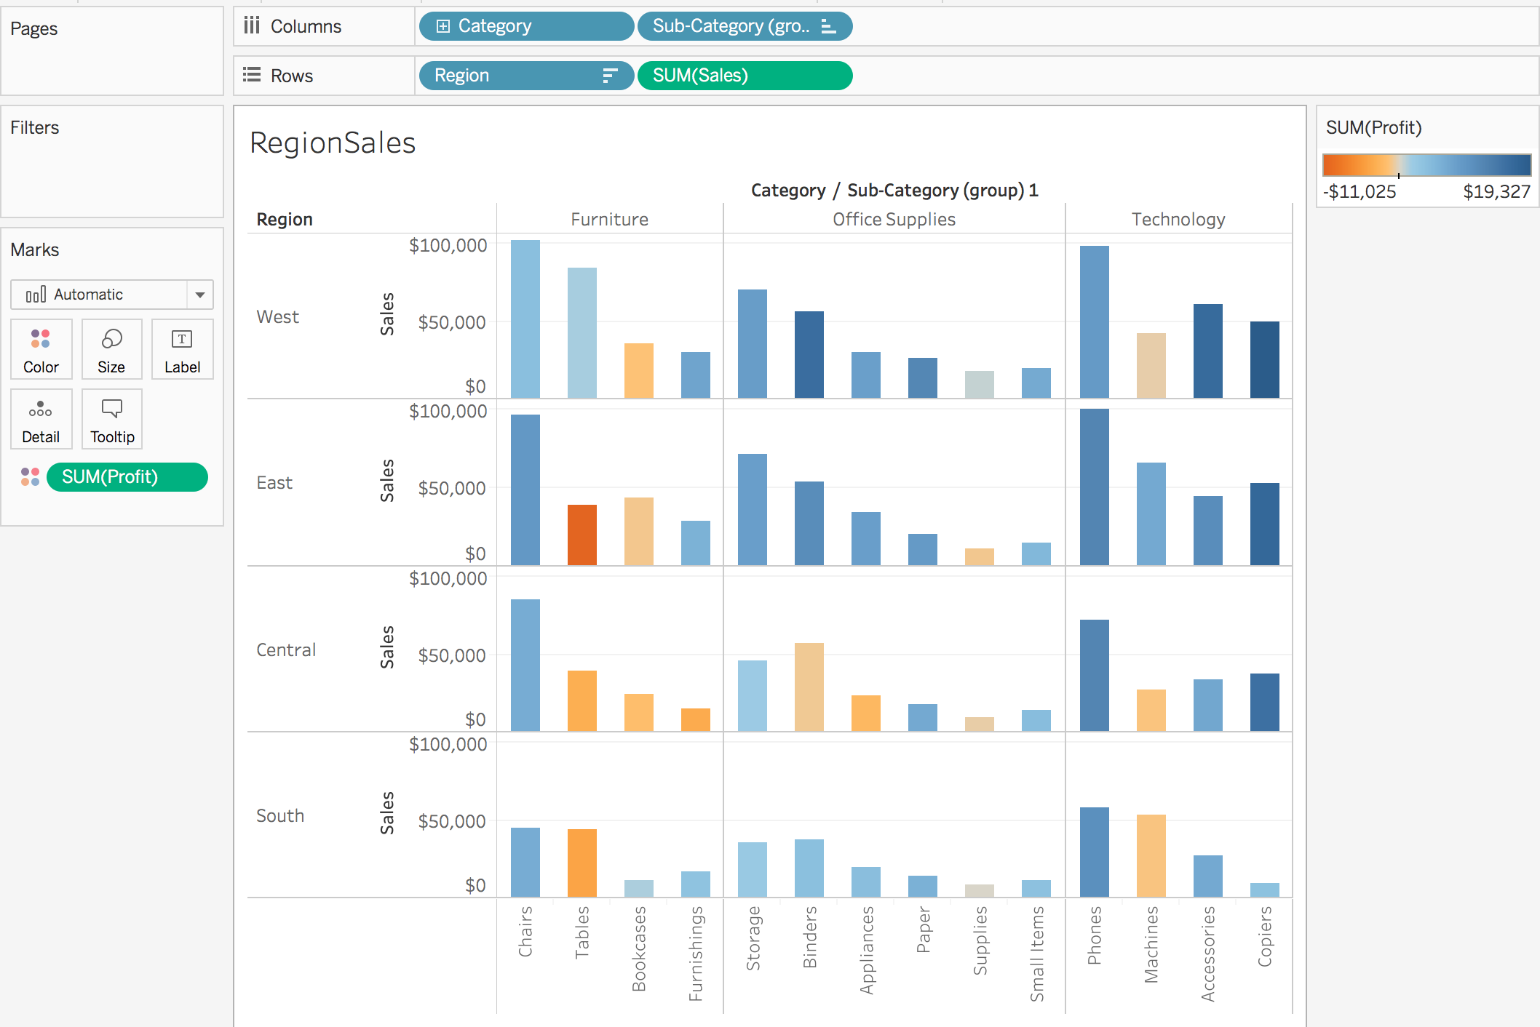
Barplot practice
We can further our insights with an additional row. Let’s color by profit.
Notes:
Column: Category, Sub-category
Rows: Region, SUM(Sales)

Slide 26
Barplot: Practice
Make a plot of the average sales of the cities, in descending order. Color by state. What is interesting about this plot?
What’s the advantage of using average sales over sum of sales?
Notes:
columns: city
rows: avg(sales)
color: state

Slide 27
Line plots
Useful for: measuring rates of change
Notes:
select sodium from nutrition;
select mfr, rating from info;

Slide 28
Lineplot practice
Find how many shipments made by each salesperson.
Bonus: How can we find the trends for each plot?

Slide 29
Treemap
Proper treemaps:
Size: Measure
Label: Dimension(s)
Notes:
demo: rows: sales, columns: sub-categories
question: What would adding region to color do?

Slide 30
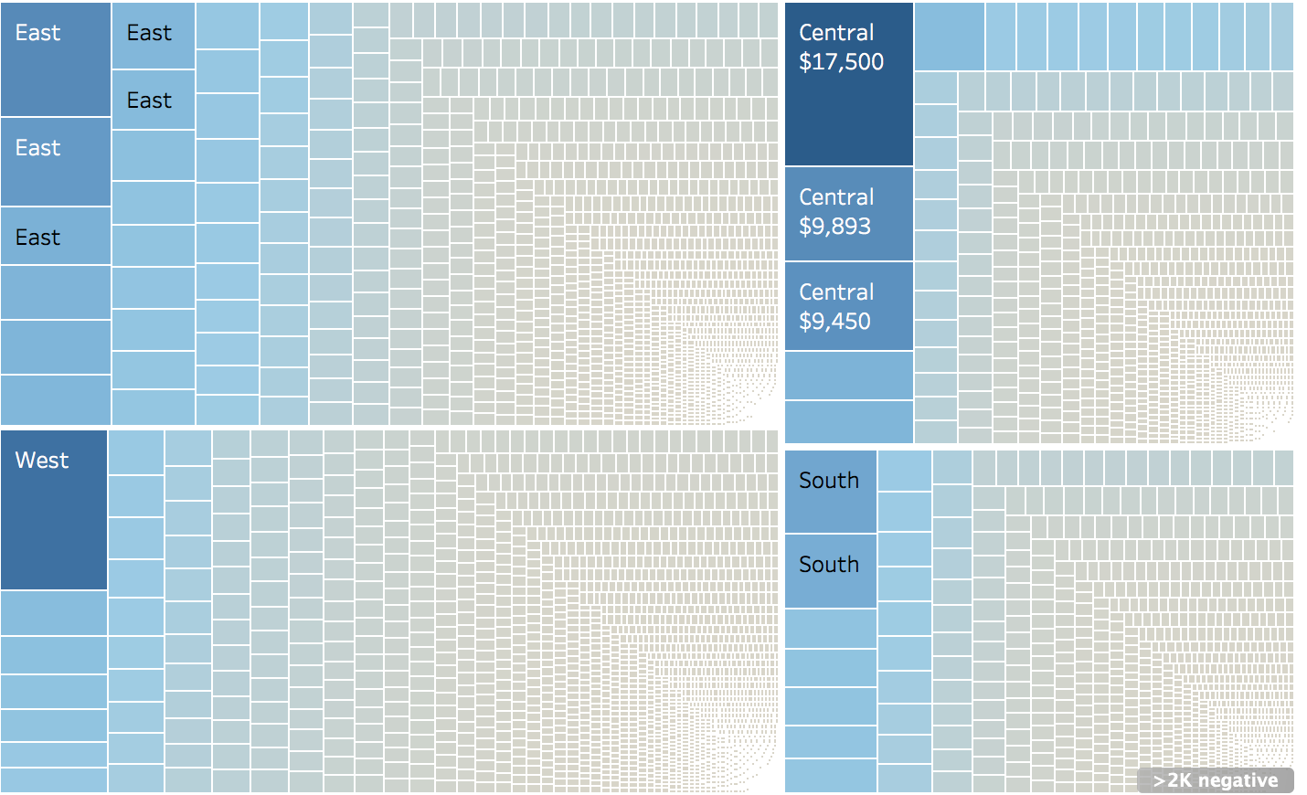
Treemap
Best used for: differences in categorical variables
Demo: What is wrong with this type of treeplot?
Notes:
Column: Category, Sub-category
Rows: Region, SUM(Sales)

Slide 31
Scatterplot
Good for first glances at data, checking for possible patterns in distribution.
Demo: display sales and profit relationship through scatterplot
Notes:
column: sales, row: profit (- both sums)
color: category
detail: sub-category
shape: region

Slide 32
Scatterplot Practice
How can I display the relationship between discount and profit ratio? What ways can I change the color and shape to gain better insight as to how this relationship appears for different locations in the United States?
Notes:
column: discount row: sales (- both sums)
color: category
detail: sub-category
shape: region
Note: show why using states as a shape is bad

Slide 33
Maps
Requires geographic data, typically in form of latitude and longitude
Good for quick visualization of where certain regions do better - allows for clustering
Demo

Slide 34
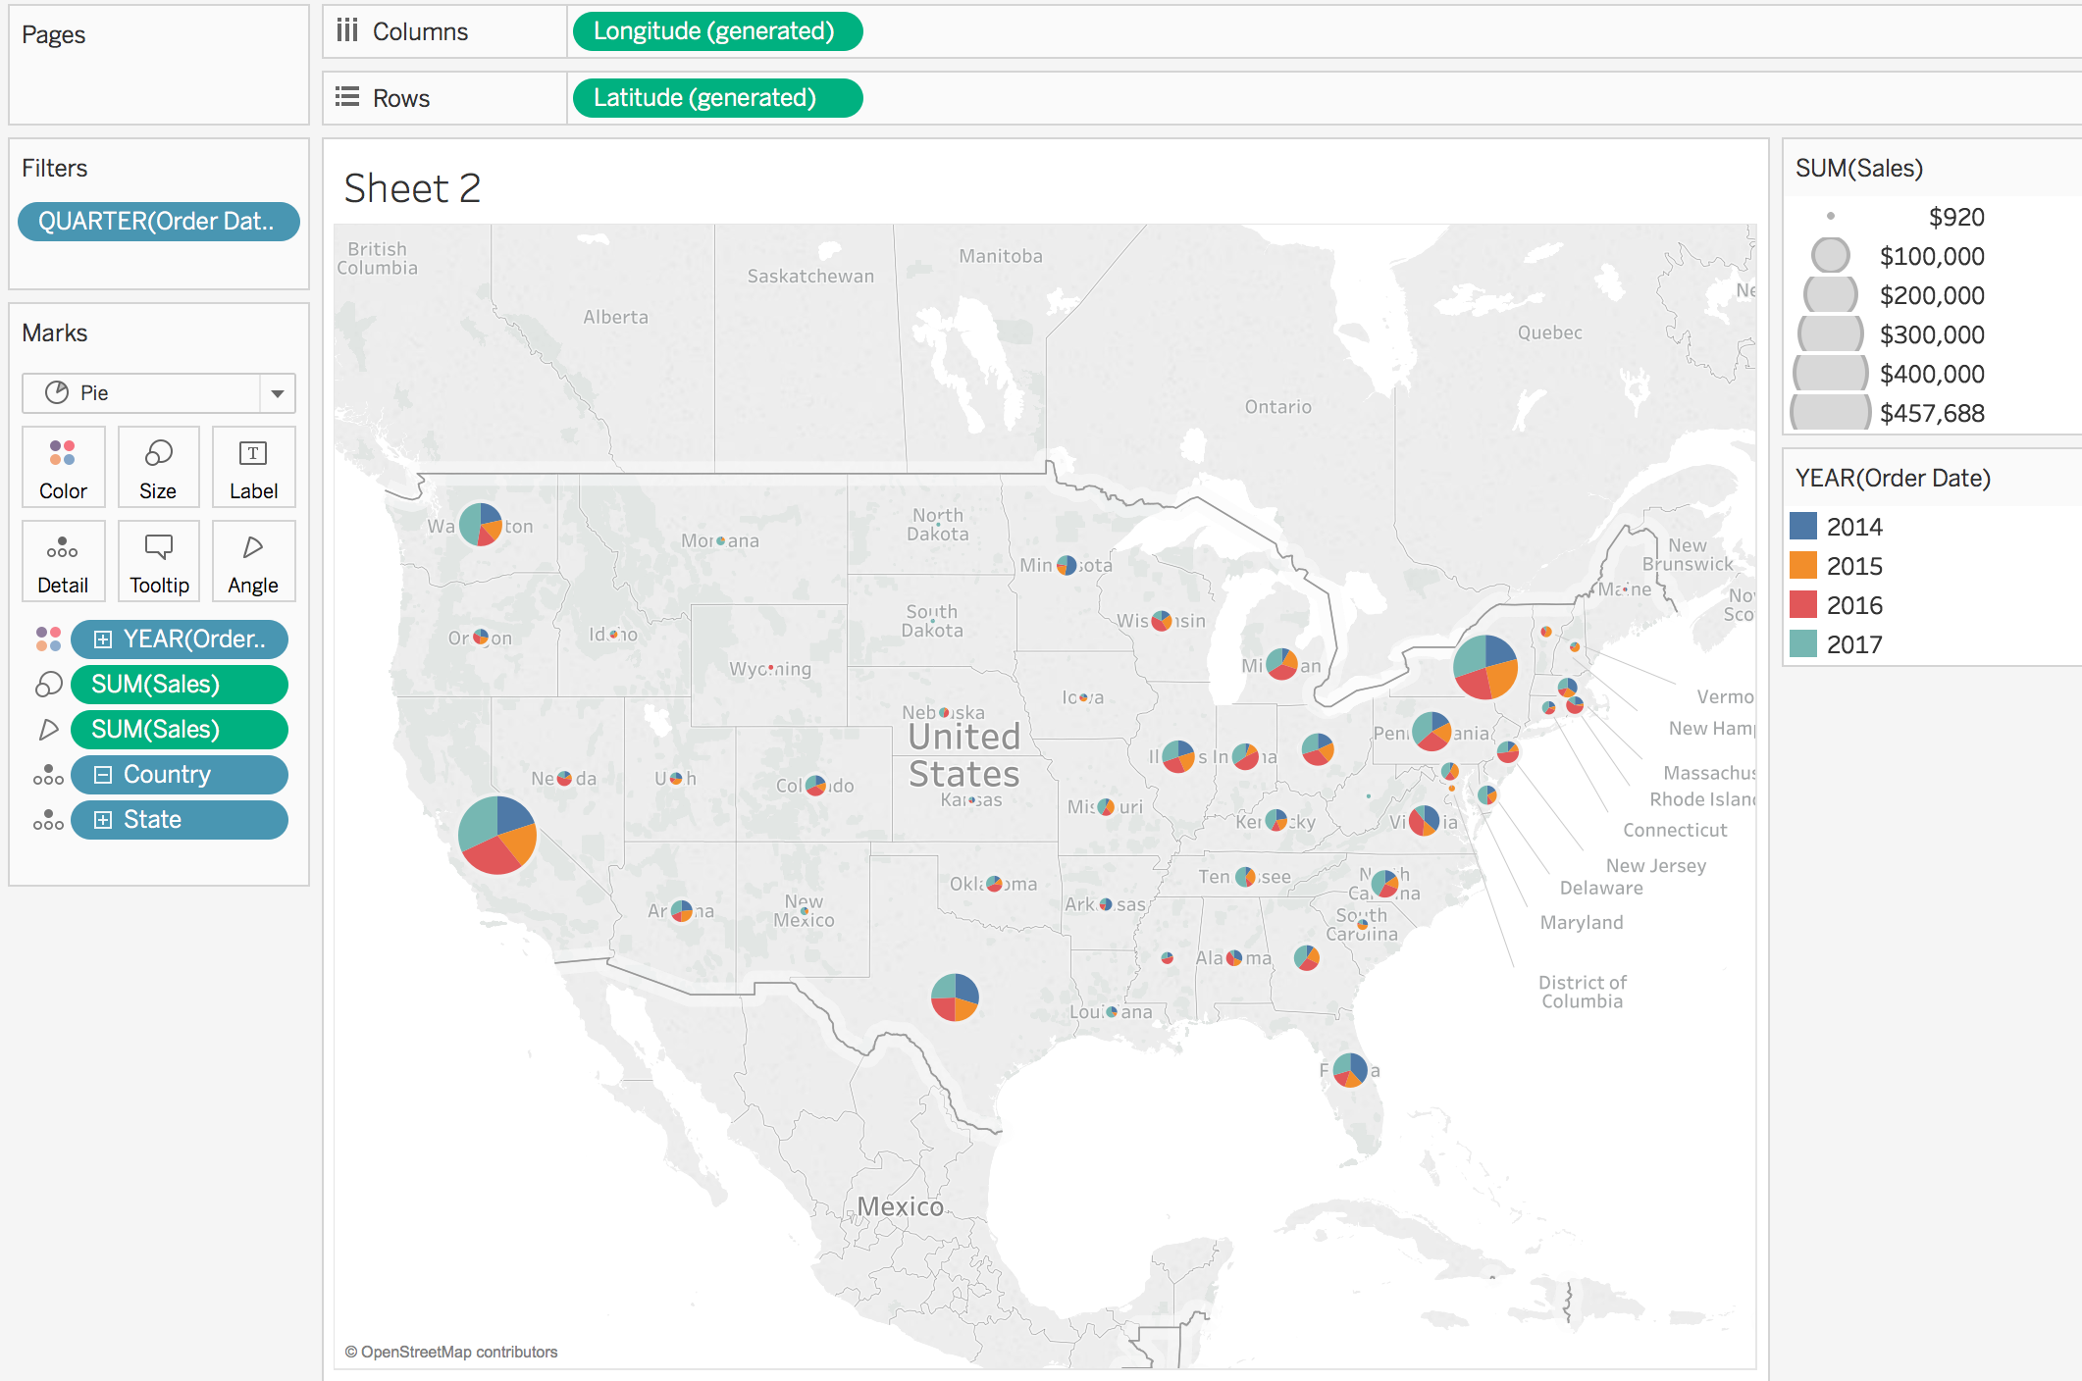
Example

Slide 35
Map Practice
Using our longitude and latitude data, find the average quarter profit for each state and plot them with sizes relative to their average profit ratio. How is this graph useful in comparison to a bar plot with the same data?
What can we do to gain better control over our visualization?

Slide 36
Dashboard Basics
Navigate to top: click new dashboard
Or: click new dashboard from bottom
Notes:
nicole: quick review, do distinct
select distinct(shelf)
from info
order by shelf;

Slide 37
Dashboards Cont.
Add views (worksheets) to dashboard
We’re going to use the example worksheets from before.
Use floating for greater flexibility, non-floating if you need something to stick
Objects
Website linking
Notes:
nicole

Slide 38
Dashboard Project
Hands-on Project
Build a dashboard from scratch.
Try: Create interactive dashboard that lets a user examine quantity of products produced per ship mode, its profitability over time, and variance of sales over each state.
Notes:
nicole
select count(*)
from info;
select count(distinct(shelf))
from info;

Slide 39
Thanks!
Feedback Form
https://goo.gl/forms/ySMEiNf7FEcLFWOi2

