Slide 1

Machine Learning in Practice
Rayid Ghani

Slide 2
What do you want/expect to learn from this class?

Slide 3
Why does this class exist?
Exposure and experience solving end-to-end real-world problems with ML
Beyond methods and models
Beyond simplifying assumptions
Beyond general-purpose, one-size-fits-all setups
Our goal is to train you to expand the scope of what you do in your future careers

Slide 4
What we want you to learn from this class
How to responsibly and effectively solve real-world problems using ML
Understand the *entire* Machine Learning process (and get hands-on experience doing a lot of it)
Build (and use) reusable ML pipelines
Learn how to formulate ML problems, use, understand, evaluate, and communicate ML methods (that you have covered in earlier classes) in the context of a real problem

Slide 5
How is this course different than typical ML classes you’ve taken before?
We’ll assume everyone knows
Methods/algorithms/models
Assumptions behind them
How to implement them
And focus on everything else that comes before the matrix and after the models are built (99% of the work done in a real-world project)

Slide 6
Grading
Pass/Fail
We want the focus to be on learning and not on the grade but...
Levels of learning
Exposed to information covered in this course
Applying the information (correctly) covered to the class project
Generalizing to the next ML problem you tackle

Slide 7
Pre-requisites
Machine Learning (methods and overall process)
Python (pandas, sklearn, tensorflow, matplotlib)
Ideally: experience with SQL, command line (bash), git(hub), working on remote servers

Slide 8
Skills needed to solve real-world problems (with ML)
CS & ML
Statistics
Classes
Social Sciences

Slide 9
Skills needed to solve real-world problems (with ML)
CS & ML
Problem
Formulation
Statistics
Communication
REAL
WORLD
Social Sciences
Ethics &
Legal Issues
Experimental
Design
Notes:
For ML students, previous iterations of this class probably involved some readings and assignments in each of these areas. This semester, we’re taking a more hands-on project-focused approach.

Slide 10
Scope
Data
Exploration
Modeling
Get Data
Store Data
Link Data
Rows
Features
Labels
Model Selection
Train-Test Splits
Performance Metrics
Model Interpretation
Entities
temporal
Spatial
…
Models
Dealing with Bias and Fairness
Field Trial Design
Deployment
Monitoring
Goals, Actions, Data, Analysis, Ethics

Slide 11
Structure of the class
Module 1: End-to-end ML Pipeline
Formulation, Modeling Setup, Features, Models, Model Selection
Module 2: Model Interpretability
Module 3: Fairness

Slide 12
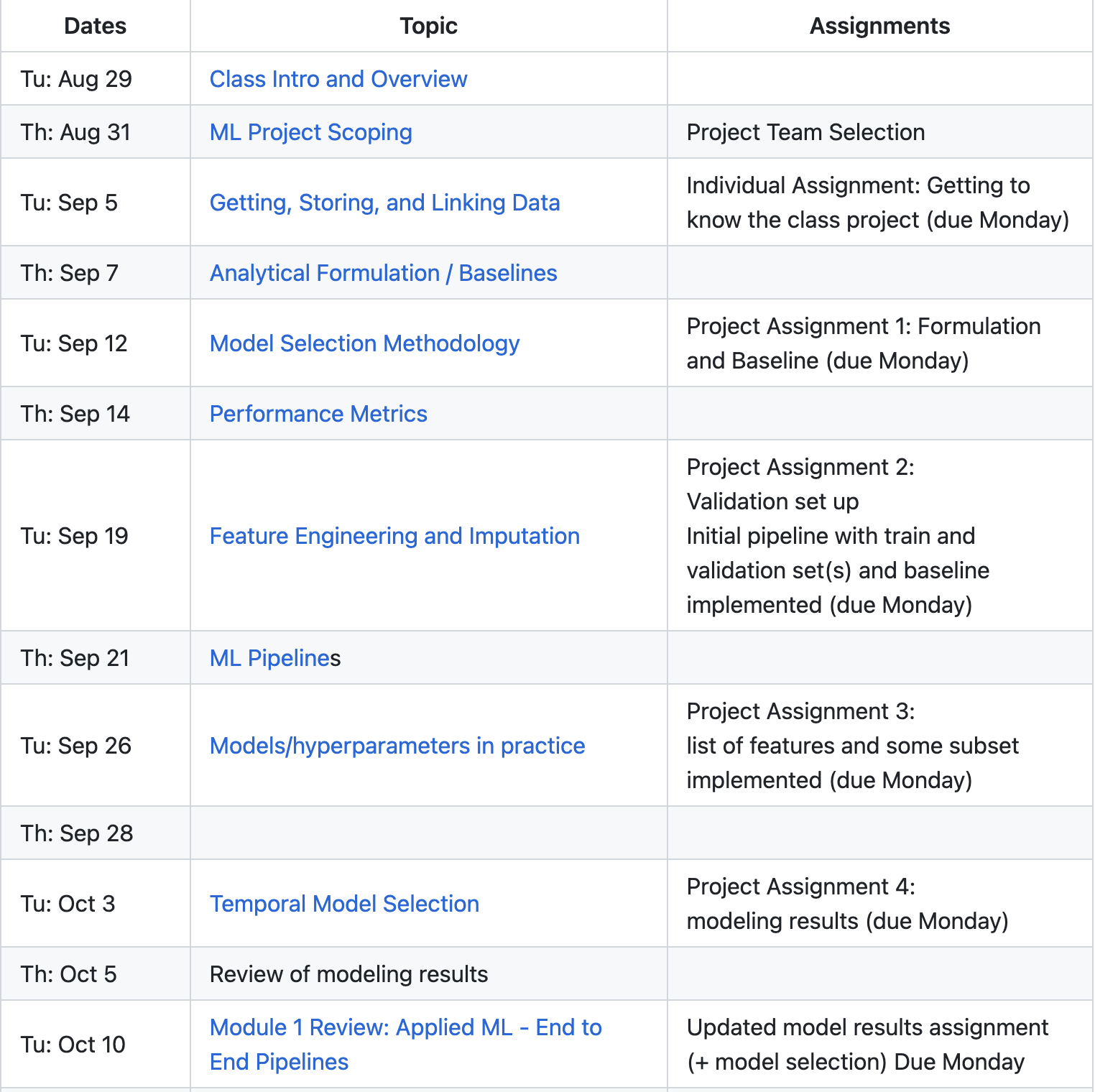
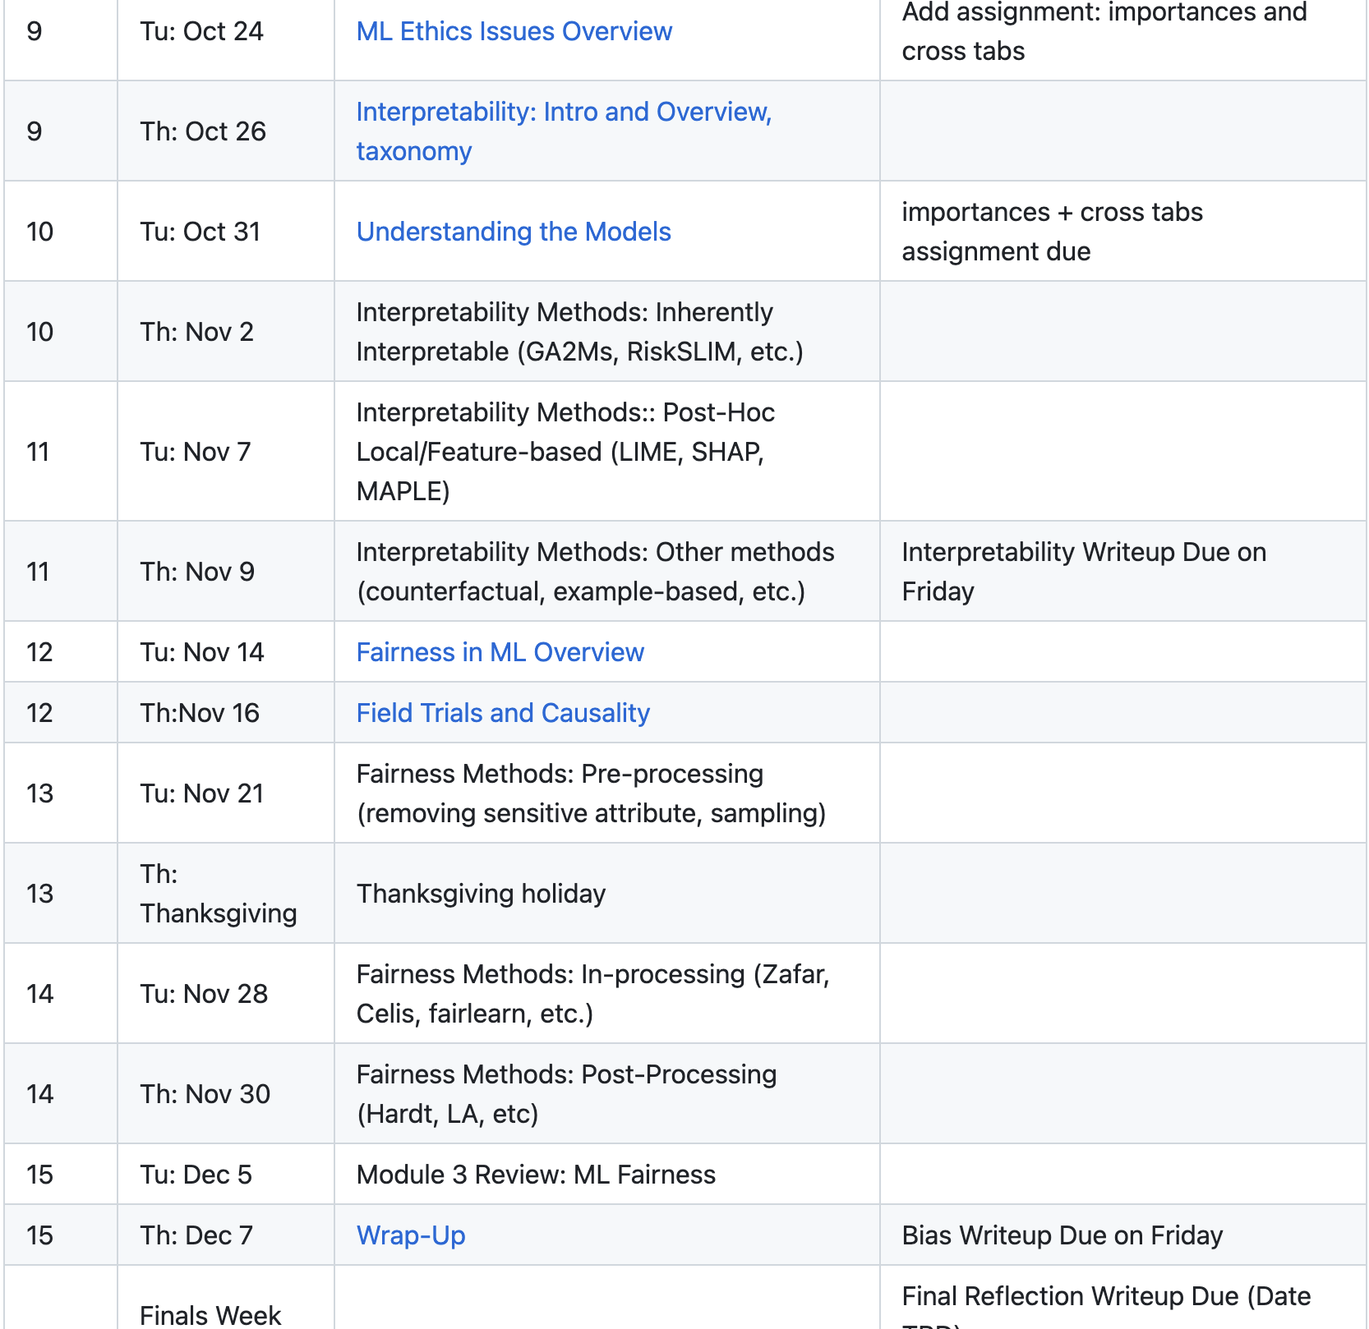
Class Schedule

Slide 13

Logistics
Attendance (is not optional)
Platforms:
Latest content will be on github
Canvas (for assignments)
Slack (and email) for communications and project and teamwork
Office hours
TA – Catalina Vajiac

Slide 14
Project Teams
You should create 5-person teams by the end of this week (and fill out the spreadsheet to let us know)
If you think you might drop this course, do it soon and keep that in mind when making teams
Notes:
If you think you’re likely to drop, please let us know sooner rather than later so we can balance teams

Slide 15


Project

Slide 16
Tech Setup Options
Get set up on github for your project
Nice to have: get familiar with
Postgresql (to analyze and query data)
*nix command line

Slide 17
Prep for next class
Reading
Project Scoping guide
Assignment
Project Team Creation (by the end of this week): link in canvas
Individual project: First pass on the ML project (due next Monday)
Notes:
We’ll be creating accounts on Wednesday and send around instructions about connecting to the course infrastructure once they’re ready for you to log on

