Slide 1

Evaluating ML Systems through Randomized Controlled Trials (RCTs)
Rayid Ghani

Slide 2
Reminders
Coming up next week:
Understanding your models assignment (plus any fixes)
Topic Assignments

Slide 3
Scope
Data
Exploration
Modeling
Get Data
Store Data
Link Data
Rows
Features
Labels
Model Selection
Train-Test Splits
Performance Metrics
Model Interpretation
Entities
temporal
Spatial
…
Models
Dealing with Bias and Fairness
Field Trial Design
Deployment
Monitoring
Goals, Actions, Data, Analysis, Ethics

Slide 4
Motivation
ML metrics (AUC, precision, recall ,etc.) on offline data are insufficient for real world evaluation
We need to carefully design evaluations to test whether our system will have real world impact

Slide 5
How would we evaluate the system we’re building?

Slide 6



Do not edit How to change the design
What question(s) would you want a field evaluation (A/B test or trial) to answer?
The Slido app must be installed on every computer you’re presenting from

Slide 7
Field Validation: Beyond A/B Testing
How well does the model perform in the real world?
Validation on truly unseen future data; only way to ensure against leakage and confounders
What key assumptions in our formulation need to be tested?
Are we intervening with the “right” people?
Are we intervening in the best way possible?
Impact of historical decision making / selective labels?
Most importantly: how well does the ML system we’re building help the organization realize its goals?

Slide 8
CASE STUDY: Mental Health and Incarceration
Cycle of Incarceration
UNMET
NEEDS
MISDEMEANOR
ARREST
JAIL
worsening or failing to improve

Slide 9
CASE STUDY: Mental Health and Incarceration
Breaking the Cycle
UNMET
NEEDS
X
MISDEMEANOR
ARREST
JAIL
MENTAL HEALTH OUTREACH

Slide 10
CASE STUDY: Mental Health and Incarceration
Return to Jail Risk
Released From Jail
In Past 3 Years
ID | SCORE
27 | 0.95
13 | 0.93
1 | 0.89
93 | 0.89
53 | 0.82
23 | 0.75
59 | 0.72
64 | 0.65
20 | 0.61
18 | 0.59
46 | 0.52
82 | 0.48
49 | 0.37
56 | 0.22
17 | 0.12
Mental
Health
Outreach
Model
X
…With History of
Mental Health
Needs
Return to
Jail

Slide 11
CASE STUDY: Mental Health and Incarceration
Return to Jail Risk
Released From Jail
In Past 3 Years
ID | SCORE
27 | 0.95
13 | 0.93
1 | 0.89
93 | 0.89
53 | 0.82
23 | 0.75
59 | 0.72
64 | 0.65
20 | 0.61
18 | 0.59
46 | 0.52
82 | 0.48
49 | 0.37
56 | 0.22
17 | 0.12
Mental
Health
Outreach
Model
X
…With History of
Mental Health
Needs
Return to
Jail
What would you want to learn
through a field trial?

Slide 12
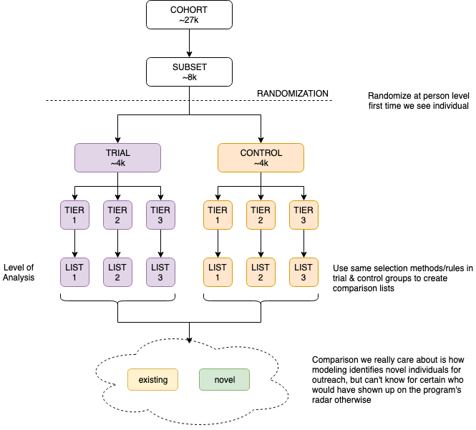

Slide 13
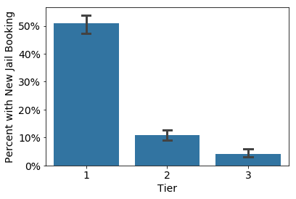
Q1: Is the Model Predictive?

Slide 14
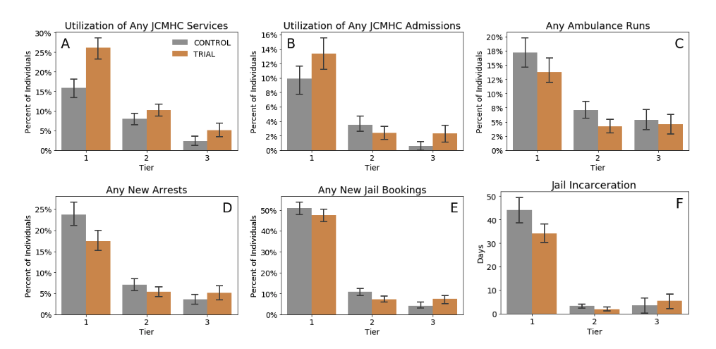
Q2: Does Model+Intervention improve Outcomes? Q3: For Whom?

Slide 15
Do not edit How to change the design
An online retailer found that shoppers using MacBooks spent more money on their website. They got very excited and ran an A/B test where they recommended a uniformly random sample of 1M subscribers using macbooks (out of 2M) higher priced products (where the store made more money). They found that the 1M who got those higher priced recommendations did in fact spend more money ($1.2M vs $800k), leading them to conclude that macbook users can be upsold to high profit products.. They implemented this new program by by targeting all shoppers using macbooks them with higher priced products. Were they right or wrong?
The Slido app must be installed on every computer you’re presenting from

Slide 16
Causal inference with experiments
Standard “Randomized Controlled Trials”
Trial Design
Outcome
Sample size (and duration)
Power
Randomization
Ethical Concerns

Slide 17
Running the numbers
Sample Size
Power Effect Size Significance Level
Effect size > what is practically useful and significant
Significance Level ~ cost of implementing the new system/model
Useful resource: https://www.povertyactionlab.org/resource/power-calculations

Slide 18
Designing Trials to Validate ML Systems
What can we do with historical data?
Model Selection
Performance Estimation
How do we select the model to deploy?
Compare shortlisted models against baseline
How do we validate whether our ML system will work when deployed?

Slide 19
Designing an experiment
What are we trying to test?
How do we create different arms of the experiment?
How we do we run the experiment?
What do we measure?
How do we evaluate?

Slide 20
What are we testing in an experiment?
Lift?
Classification?
Probability estimates?
Ranking?
How does the experiment design change?

Slide 21
How many [students, inspections, projects] should we include in our trial?
Doing a trial over [y] years with [n] projects every week will give us a [p%] chance to detect an [e%] increase in [outcome] with a statistical significance of [s%]

Slide 22
Issues to keep in mind
Randomization – how do we do it? How do we know we did it well?
Compliance (overrides by downstream action-takers)
Single blind, double blind, triple blind…?
What “model” are we testing?
The latest “best-performing” model built during model development
The last “best-performing” model built during model development retrained on new data
The model retraining and selection methodology

Slide 23
Recap
Model Selection => best candidate model to evaluate
Evaluation = Does using this “model” (and downstream actions) improve what we wanted to improve?
“model” is likely the modeling pipeline that includes retraining, updating, and possibly redoing model selection
Next class: what happens when we cannot run randomized experiments?

