Slide 1

Causal Inference (using observational data)
Rayid Ghani

Slide 2
Reminders
The project focus of the next three weeks is to apply your selected topic to your class project model(s).
Check in with me or TAs during this time with plans or intermediate results

Slide 3
Grading
 | Approach is correct and enough features and models are tested | Approach is correct and good enough but still lacking features and models | set up incorrect
Project Assignments and Presentation(s) | 3 | `2 | 1
 | ~85+ | 75-85 | < 75
Mid-Term | 3 | 2 | 1
 | Setup is correct and well done | Setup is correct but missing important things | approach is incorrect
Module 2 Assignment and Presentation | 3 | 2 | 1
35%
20%
20%
 | Coming to Class and Participating | Coming to Class and Not Participating | Not Coming to Class
Attendance and Participation | 3 | 2 | 1
 | Thoughtful and Reflective | Good enough | Missing important points
Final Reflection Writeup | 3 | 2 | 1
20%
5%

Slide 4
Things to cover today
Causal Inference with observational data
The need
The intuition
The methods
The caveats
Some examples

Slide 5
Need for Causal Inference
Many real-world questions are what-if and why questions
What happens if I change X
We often want to answer counterfactual questions
Which projects would have gotten funded without any extra support?

Slide 6
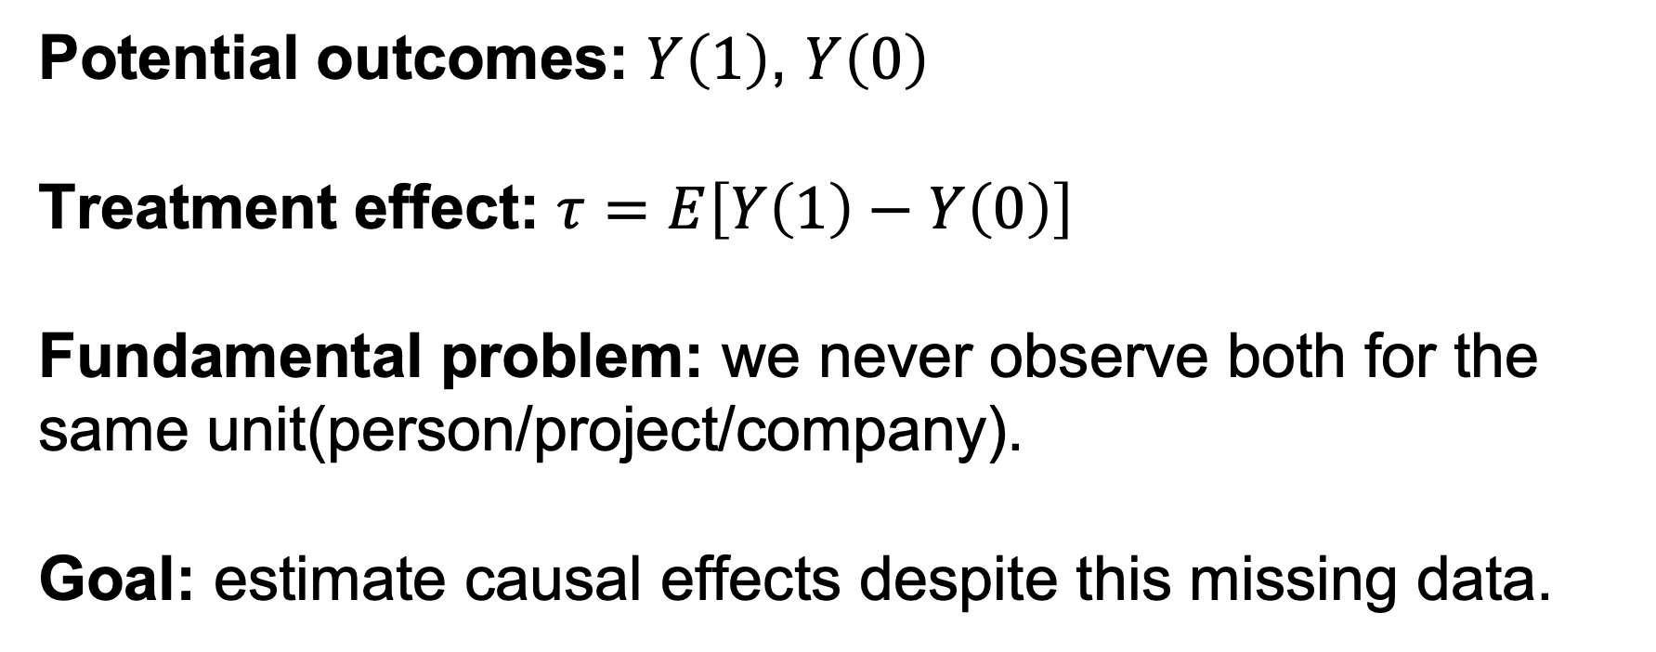
Counterfactual Framework
Potential outcomes: $Y\left(1\right)$, $Y\left(0\right)$
Treatment effect: $τ=E\left[Y\left(1\right)−Y\left(0\right)\right]$
Fundamental problem: we never observe both for the same unit(person/project/company).
Goal: estimate causal effects despite this missing data.
Last week we talked about doing this with experiments. Today we’ll talk about how we can do this (with lots of caveats) with observational data.

Slide 7
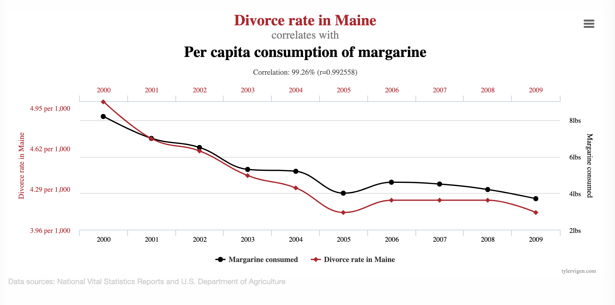
https://www.tylervigen.com/spurious-correlations

Slide 8
Does free food improve student research output?
Free food
?
Student research output

Slide 9
Does free food improve student research output?
Free food
Confounders
?
Student research output

Slide 10
Does free food improve student research output?
Free food
Confounders
?
Student research output
Examples?

Slide 11
Causal Research Design
Experiments
Quasi-experiments
Observational studies

Slide 12
Experiment
Free food
Confounders
?
Student research outputs
Researcher randomly assigns who get free food

Slide 13
Quasi-Experimental
Free food
Confounders
?
graduation
Nature/World randomly assigns who get free food

Slide 14
Causal inference with observational data
Matching
Difference-in-Difference (DID)
Regression Discontinuity Design (RDD)
Instrumental Variables
Limitations?

Slide 15
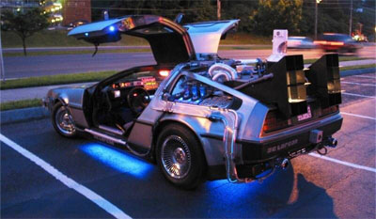
The Fundamental Problem

Slide 16
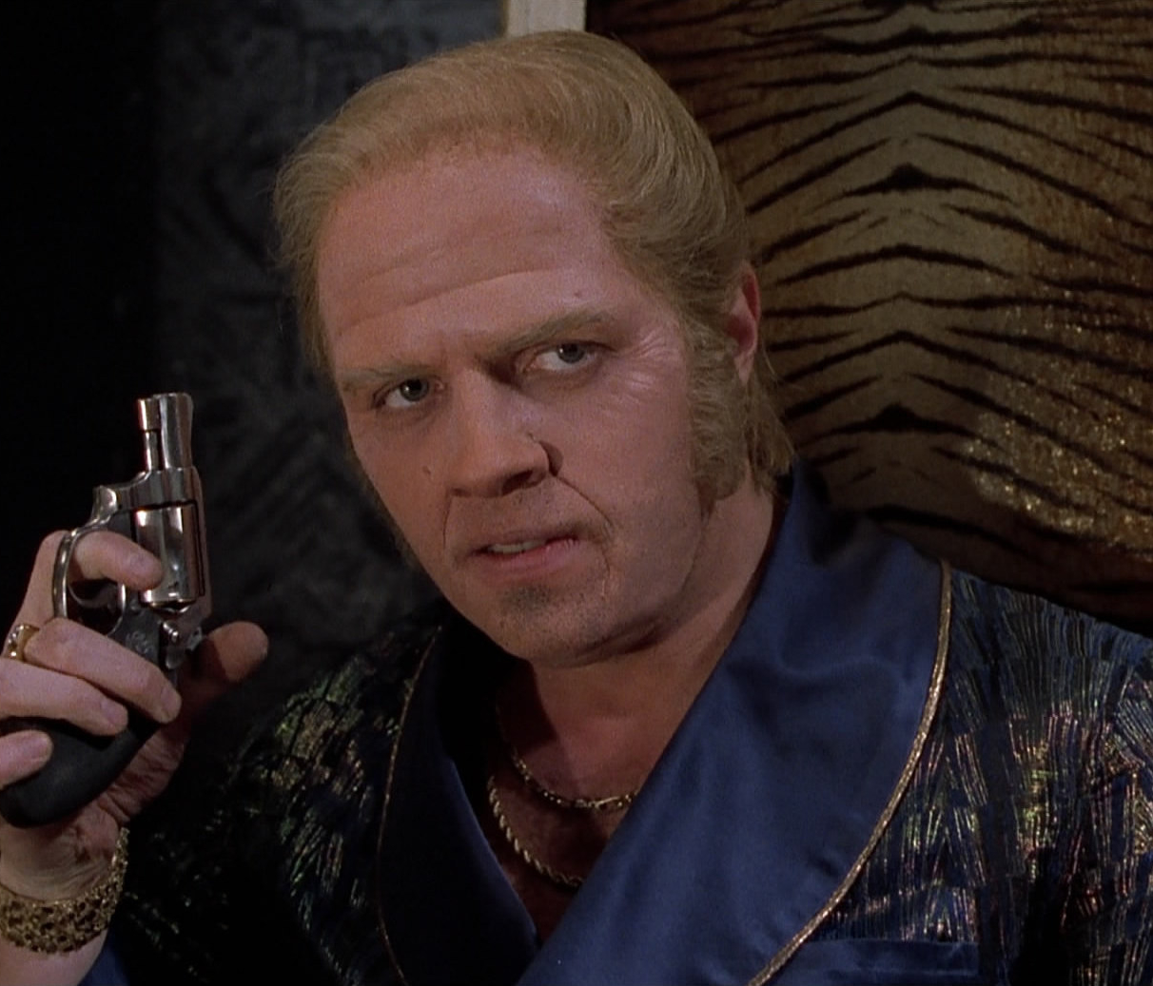
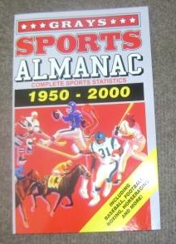
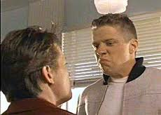


Slide 17
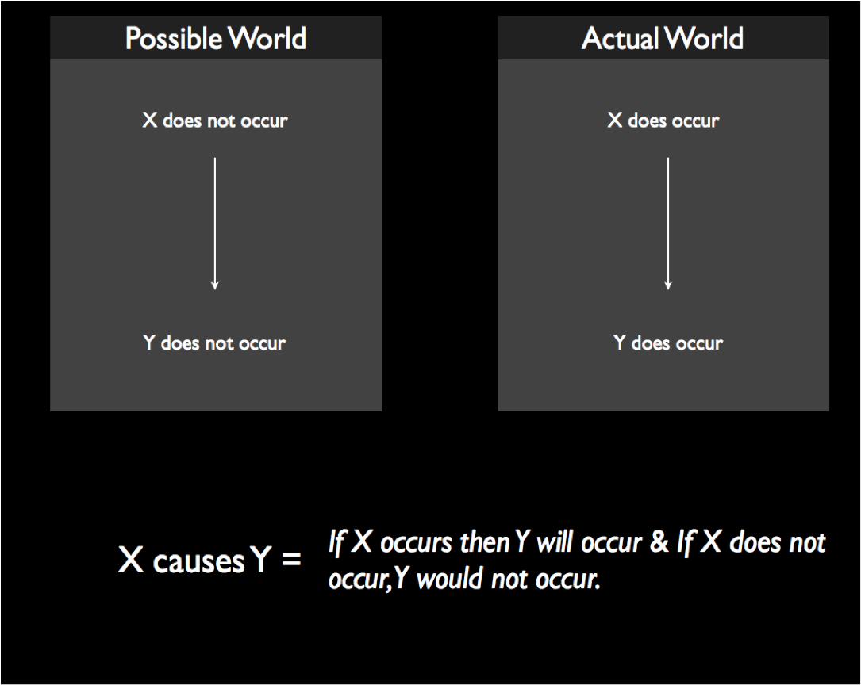

Slide 19

Group Exercise
https://bit.ly/3XppqtW

Slide 20
So Many Ways to be Wrong
We observe A is correlated with B
It could be that A causes B
Or it could be that…
B causes A (Reverse Causation)
C causes A & B (Common cause or External causation)
A causes B and C causes B (Multiple causation)
A causes C causes B (Indirect causation)
C causes A causes B (Reverse indirect causation)
A and B are unrelated (Chance)
Notes:
Focus on intuition rather than theory. I’ll do a little bit of it for kicks

Slide 21

REVERSE CAUSATION CHILDREN’S BMI AND PARENTAL RESTRICTIONS ON DIET

Slide 22
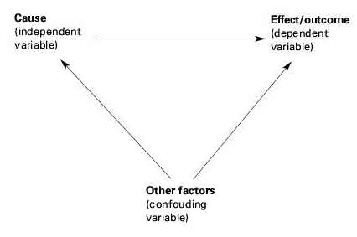
Confounding

Slide 23
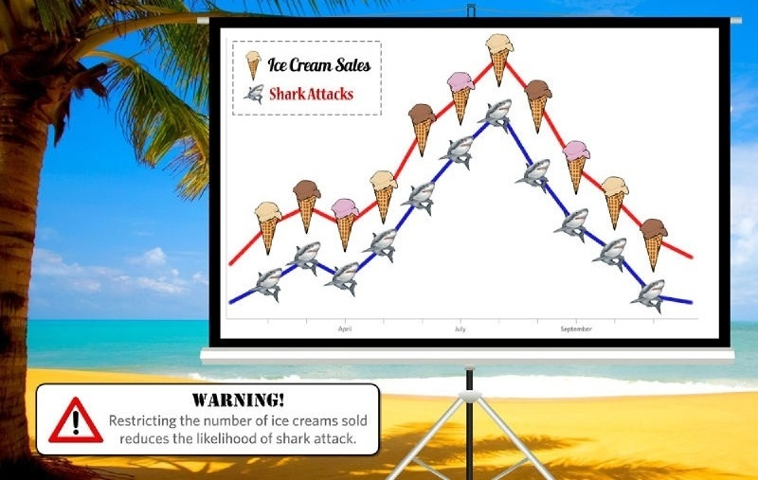
Common Cause

Slide 24
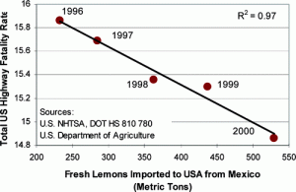
Common Trend IT’S JUST A MATTER OF TIME

Slide 25
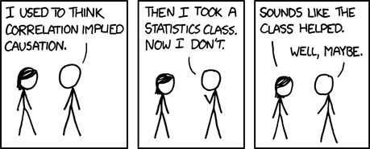
Our Goal
Source: XKCD

Slide 26
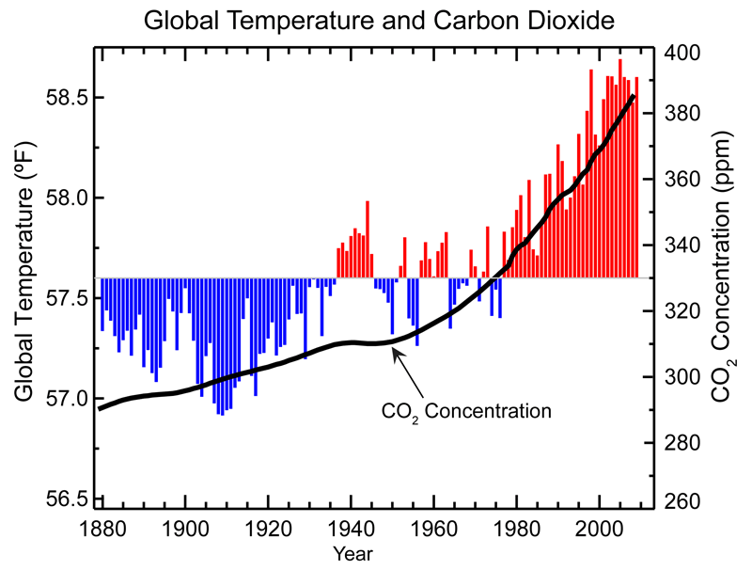
MULTIPLE CAUSATION?

Slide 27
INDIRECT CAUSATION
Chicago Summer of Learning

Slide 28
OMITTED VARIABLE BIAS
SELECTION BIAS
MEASUREMENT ERROR/BIAS
SINGULAR VARIABLE BIAS
INDIRECT CAUSATION

Slide 29

CHANCE

Slide 30
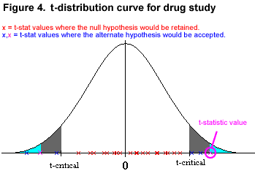
DEALING WITH CHANCE: STATISTICAL INFERENCE
Source: cvsg.k12.va.us

Slide 31
“Tricks” developed by different scientific disciplines over the years
Unexpected Shocks (Natural Experiments)
Instrumental Variables
Cutoffs (Regression discontinuity)
Matching (comparing to similar units/people)
Differences in differences
Controlling for other sources of variability

Slide 32
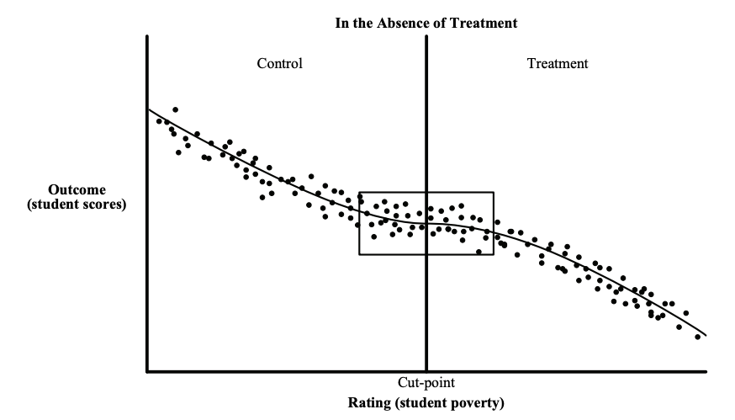
Regression Discontinuity
https://www.mdrc.org/sites/default/files/RDD%20Guide_Full%20rev%202016_0.pdf

Slide 33
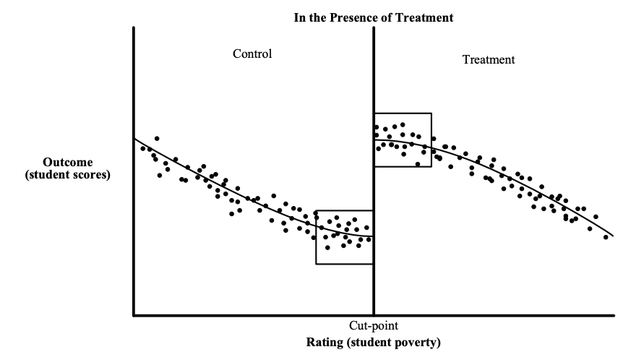
Regression Discontinuity
https://www.mdrc.org/sites/default/files/RDD%20Guide_Full%20rev%202016_0.pdf

Slide 34
RDD: Examples

Slide 35
Instrumental Variables: Examples
Education & Returns to Schooling (Angrist & Krueger, 1991)
Question: Does more compulsory schooling cause higher earnings?
Design: Uses quarter-of-birth as IV for educational attainment (compulsory schooling laws).
Ref: Summarized in Angrist (1996) Identification of Causal Effects Using Instrumental Variables. JASA.

Slide 36
Natural Experiments: Examples
Seat Belt Laws
Question: Do mandatory seat belt laws reduce fatalities?
Design: Exploit staggered adoption and enforcement intensity as policy shocks.
Ref: Cohen, A., & Einav, L. (2003). The Effects of Mandatory Seat Belt Laws on Driving Behavior and Traffic Fatalities. RESTAT.

Slide 37
Some Readings
Tutorial
Short textbook: Mostly Harmless Econometrics
References on causal inference
The seven tools of causal inference, with reflections on machine learning by Pearl, J. Comm ACM. 2019
Elements of Causal Inference by Peters et al. MIT Press. (Open Access Text)
Counterfactuals and Causal Inference: Methods and Principles for Social Research by Morgan and Winship. Cambridge University Press.
Data Analysis Using Regression and Multilevel/Hierarchical Models by Gelman and Hill. Cambridge University Press.

