Slide 1



Do not edit How to change the design
One of your group members asks you to review the random forests they're planning to run. Which lines (if any) would you give feedback on?
The Slido app must be installed on every computer you’re presenting from

Slide 2

Model Selection (and Validation)
Part II
Rayid Ghani

Slide 3
Plan for today
Team Presentations and feedback
Penguins, 👁👄👁 , Random Deforestation, Drop Table…
Topics for the rest of the semester survey
https://bit.ly/10718topics
Temporal Model Selection
Prep for Thursday session (GHC 4405) – required reading and attendance

Slide 4
Things to remember
Coming Up Next Week:
Monday: Modeling Results Update Assignment (posted on canvas)
Tuesday: Weekly Feedback Form
Midterm:
Take Home
No class on Thursday
Due Friday (Canvas)

Slide 5

Do not edit How to change the design
DN and Friends List one positive thing they’re doing that you did not do in your project so far and why you think that’s a good idea to do? List one thing that they could do to improve their project?
The Slido app must be installed on every computer you’re presenting from

Slide 6
Do not edit How to change the design
Taylor's best friend List one positive thing they’re doing that you did not do in your project so far and why you think that’s a good idea to do? List one thing that they could do to improve their project?
The Slido app must be installed on every computer you’re presenting from

Slide 7
Do not edit How to change the design
Burlington List one positive thing they’re doing that you did not do in your project so far and why you think that’s a good idea to do? List one thing that they could do to improve their project?
The Slido app must be installed on every computer you’re presenting from

Slide 8
Do not edit How to change the design
Runtime Terror List one positive thing they’re doing that you did not do in your project so far and why you think that’s a good idea to do? List one thing that they could do to improve their project?
The Slido app must be installed on every computer you’re presenting from

Slide 9
Do not edit How to change the design
Penguins List one positive thing they’re doing that you did not do in your project so far and why you think that’s a good idea to do? List one thing that they could do to improve their project?
The Slido app must be installed on every computer you’re presenting from

Slide 10
Do not edit How to change the design
👁👄👁 List one positive thing they’re doing that you did not do in your project so far and why you think that’s a good idea to do? List one thing that they could do to improve their project?
The Slido app must be installed on every computer you’re presenting from

Slide 11
Do not edit How to change the design
Random Deforestation List one positive thing they’re doing that you did not do in your project so far and why you think that’s a good idea to do? List one thing that they could do to improve their project?
The Slido app must be installed on every computer you’re presenting from

Slide 12
Do not edit How to change the design
Drop Table Students List one positive thing they’re doing that you did not do in your project so far and why you think that’s a good idea to do? List one thing that they could do to improve their project?
The Slido app must be installed on every computer you’re presenting from

Slide 13
Scope
Data
Exploration
Modeling
Get Data
Store Data
Link Data
Rows
Features
Labels
Model Selection
Train-Test Splits
Performance Metrics
Model Interpretation
Entities
temporal
Spatial
…
Models
Dealing with Bias and Fairness
Field Trial Design
Deployment
Monitoring
Goals, Actions, Data, Analysis, Ethics

Slide 14
Reminder: How to solve a prediction problem
Define and Create Rows
Define and Create Label
Define and Create Features
Create Training and Validation/ Test Sets
Train model(s) on Training Set
Validate model(s) on Validation /Test Set
Select “best” model
Unit of prediction (what/who & when?)
Outcome (What & when?)
What did we know about this entity at prediction time?
What/when do we want to generalize to?
Wide range of models, hyperparameters
Generate scores
Using custom metric(s) for the problem

Slide 15
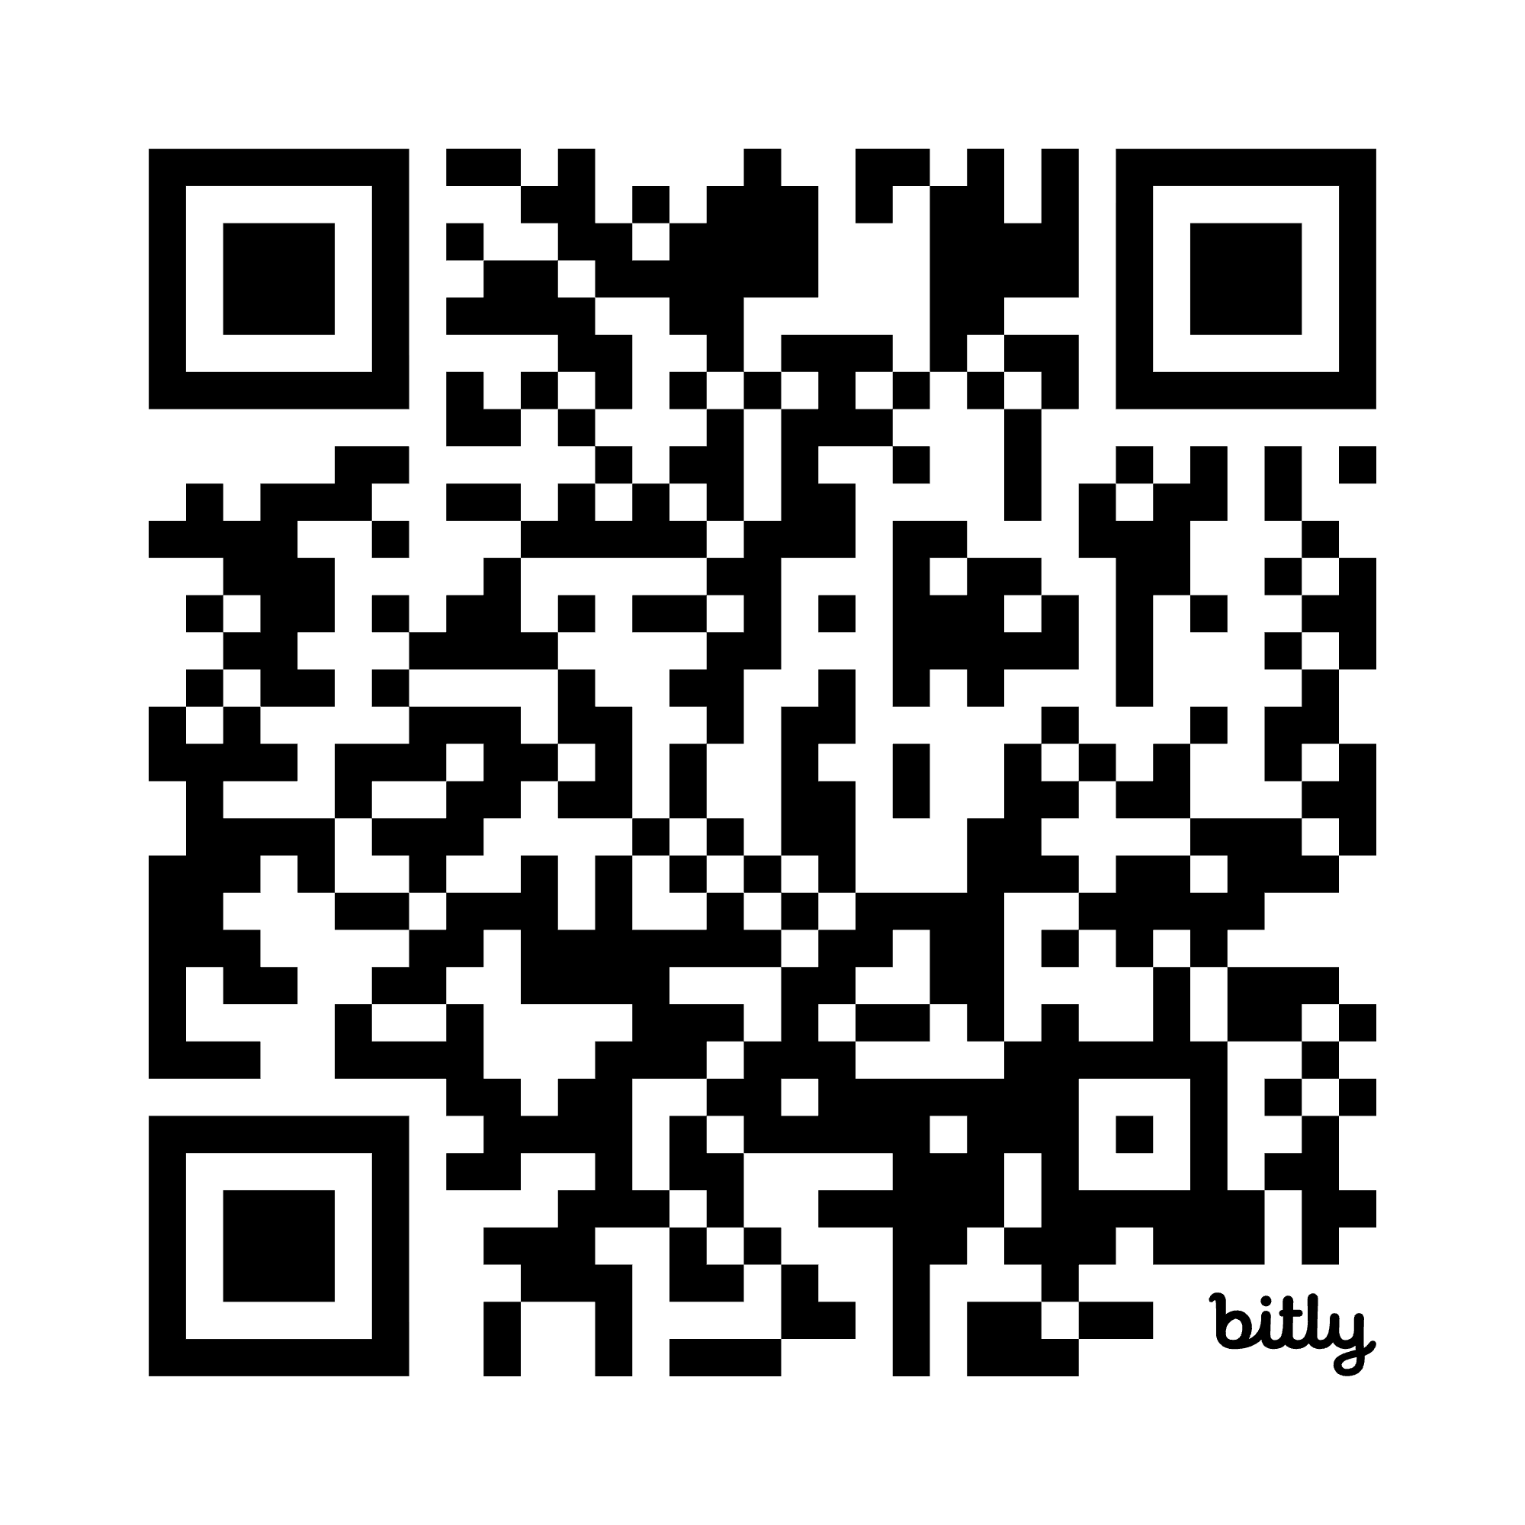
Survey on topics to cover
https://bit.ly/10718topics

Slide 16
Modeling Steps
Training
Features
Training
Learned model
Training Data
Labels/Outcomes
Testing/Validation
Apply Model
Test Data
Features
Predictions
Evaluate
Labels
Metrics

Slide 17
Why do we need to do model selection?
You’ve run a large number of different types of models varying …
You need to understand what types of models are effective under what circumstances, and
You need to decide which one(s) to use in the future

Slide 18
What do we to perform model selection
Deployment scenario
Model selection Methodology
Metric(s) (need to match your policy goals)
Comparison with baselines (to know if you’re effective)

Slide 19
What do we need our selected model to do?
Perform well
What metric?
Compared to what?
Generalize
Over what dimension?

Slide 20
The wonderful for loop
For train-test splits (CV or temporal)
For subsets of Feature Sets (Demographic only, Behavior only, Temporal only, etc.)
For Classifiers (RFC, SVM, DT, NN, Logit, GB, Boosting)
For parameters (cross products of different parameters)
Fit
Predict (predict_proba for the sklearners and no argmax for the NNers)
Evaluate (remember the thresholds)

Slide 21
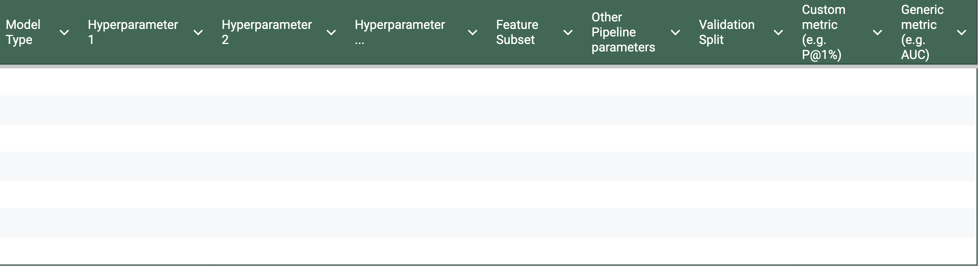
Results
Any decision or choice you made in the pipeline (cohort, label, data source, features, training window size, model used, etc. is a parameter

Slide 22
Analyzing the results
K Fold CV
?
Temporal
?

Slide 23
Analyzing the results
K Fold CV
Average metric value?
Equal weight to all validation examples
Maybe look at variance?
Temporal
Average metric value?
Robustness to distribution shifts?
Care about recency more? How much more?
May not weigh every validation example equally

Slide 24
Analyzing the results
Which approaches work best?
Which classifiers?
Which parameters?
Over which metrics?
Value of different features/feature sets?
Variance in performance over time?
Highest average?
Lowest variance?
Getting better over time?

Slide 25
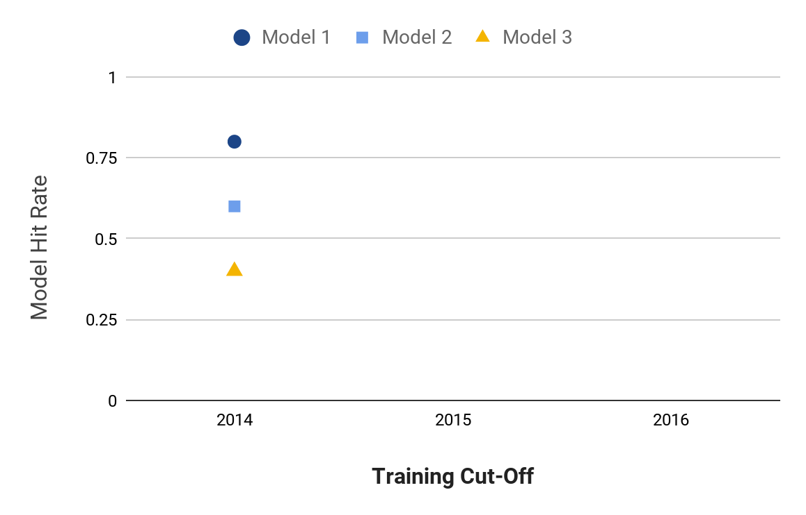
Model Selection
Precision@k
Notes:
Jane

Slide 26
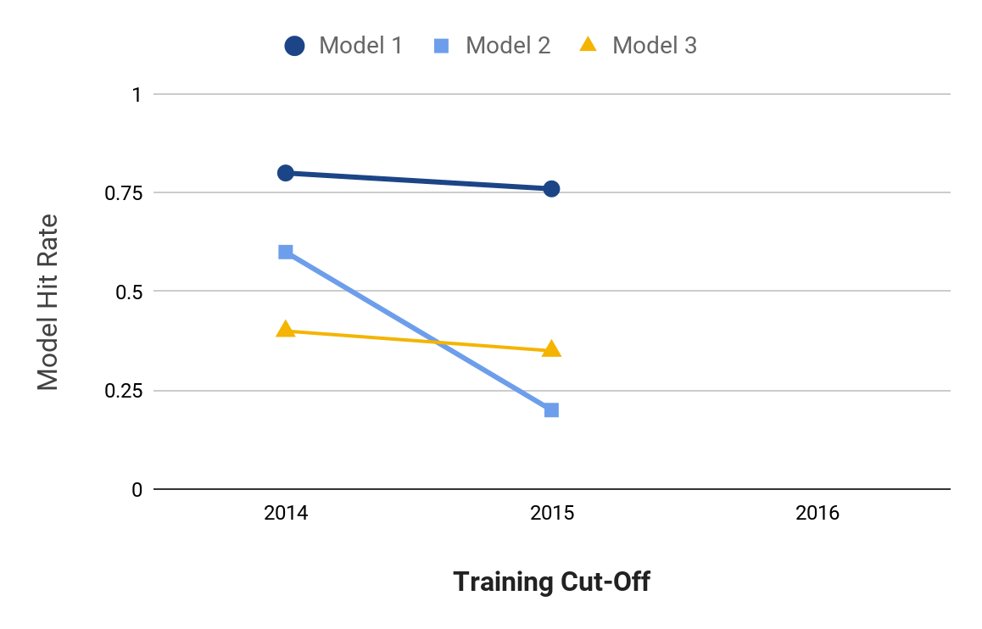
Model Selection
Precision@k
Notes:
Jane

Slide 27
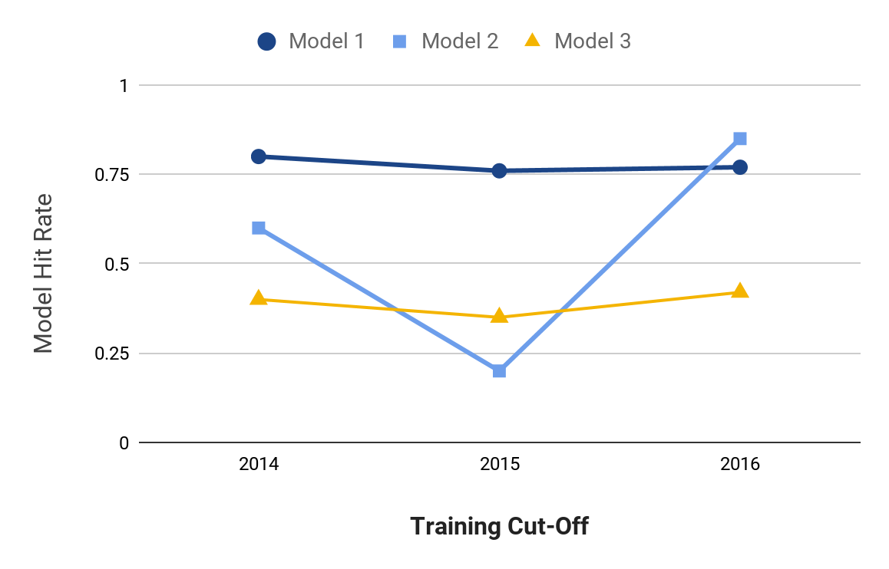
Model Selection
Precision@k
Notes:
Jane

Slide 28
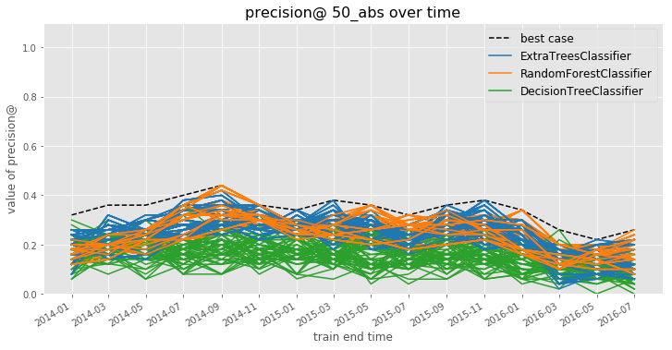
Model Selection
Notes:
Jane

Slide 29
Model Selection
How can you narrow hundreds or thousands of model specifications down to a handful of the best-performing ones?
How do you balance performance and stability?
mean performance?
balancing mean and variance?
recency-weighted mean?
What is the “regret” in subsequent time periods from using different strategies for choosing a model to deploy?
Notes:
Jane

Slide 30
Model Selection
Comparing Model Selection Strategies:
Use test set performances up to a given point in time to do model selection using each strategy
On the subsequent validation set, calculate a regret for the model selection strategy as the difference between the performance of the model specification that strategy chooses and the best-performing model specification on this new validation set
Notes:
Jane

Slide 31
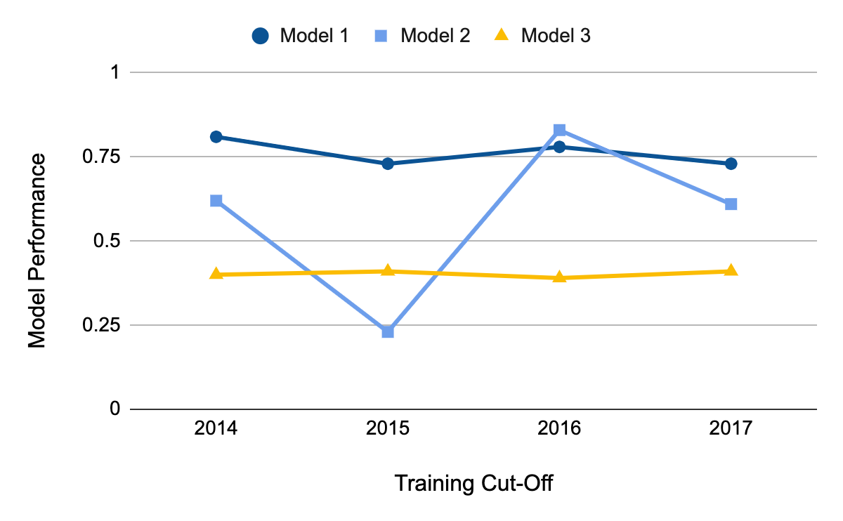
Model Selection
Apply model selection strategies to validation set performance through 2016
Notes:
Jane

Slide 32
Model Selection
Apply model selection strategies to test set performance through 2016
Calculate regret based on 2017 validation set performance
Notes:
Jane

Slide 33
Model Selection
Best Recent Perf:
Model 2
Best Average Perf:
Model 1
Lowest Variance: Model 3
Notes:
Jane

Slide 34
Model Selection
Best Model in 2017:
Model 1
Perf = 0.73
Notes:
Jane

Slide 35
Model Selection
Best Recent Perf:
Model 2
Regret:
0.73 – 0.61 = 0.12
}
Notes:
Jane

Slide 36
Model Selection
Best Average Perf:
Model 1
Regret:
0.73 – 0.73 = 0.00
}
Notes:
Jane

Slide 37
Model Selection
Lowest Variance: Model 3
Regret:
0.73 – 0.41 = 0.32
}
Notes:
Jane

Slide 38
Model Selection
Strategy | Best Model Through 2016 | Regret in 2017
Best Recent Perf. | Model 2 | 0.12
Best Average Perf. | Model 1 | 0.00
Lowest Variance | Model 3 | 0.32
Notes:
Jane

Slide 39
Model Selection
Strategy | Best Model Through 2016 | Regret in 2017
Best Recent Perf. | Model 2 | 0.12
Best Average Perf. | Model 1 | 0.00
Lowest Variance | Model 3 | 0.32
Notes:
Jane

Slide 40
Model Selection
Notes:
Jane

Slide 41
Model Selection
Notes:
Jane

Slide 42
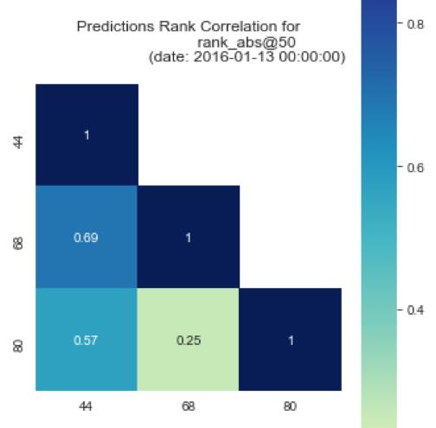
Model Selection
May not be obvious which strategy / model specification is “best”
Among good candidates, may be instructive to ask how similar or different the lists each strategy would produce are
May ultimately want to deploy (or at least test) a strategy that combines across several specifications
Notes:
Jane

Slide 43
Some Open Research Questions
What are the conditions under which temporal validation out-performs traditional cross-validation? By how much?
Likewise, what can we learn about how well certain strategies perform in terms of regret under different real-world conditions?
Many problems in policy settings involve resource constraints that require optimization at the top of the list, but few methods optimize for this directly.
e.g., Transductive Top k

