Slide 1
ML Formulation and Baselines
Rayid Ghani

Slide 2
Things to remember
Check and make sure you can access your team github repo
Due Next Week:
End of Monday – project update assignment (Formulation and Baselines)
Tuesday – weekly feedback form
Readings for Tuesday – Model Selection/”Validation” strategies

Slide 3
Scope
Data
Exploration
Modeling
Get Data
Store Data
Link Data
Rows
Features
Labels
Model Selection
Train-Test Splits
Performance Metrics
Model Interpretation
Entities
temporal
Spatial
…
Models
Dealing with Bias and Fairness
Field Trial Design
Deployment
Monitoring
Goals, Actions, Data, Analysis, Ethics

Slide 4
Plan for today
Learn how to go from scope to an ML Formulation: what decisions needs to be made and how?
Discuss the case study reading related to Formulation
Learn about effective baselines and how to develop them before building a complex ML model

Slide 5
Moving from Scope to Analytical Formulation

Slide 6
Turning the project goals/scope into an ML problem
Scoping defines the goals and approach at a high level, the analytical formulation maps this scope to an ML problem and analytical approach
Should be as detailed and specific as possible, making it possible to code it without ambiguity
One scope can result in numerous formulations – we need to develop one that is feasible and best informs our goals

Slide 7
What failure are we trying to avoid?
ML systems sometimes fail because the model design, development, and validation does not match the deployment and use case setting
The analytical formulation should be guided by –– and map back to –– how the system you’re building will be deployed and used

Slide 8
Use cases
Increase retention of users of a genai tool by offering them targeted offers
Reduce # of students who will not graduate college on time by offering extra support
Prevent people from getting late-stage Chronic Kidney Disease by doing early screening
Reduce fraudulent credit card transactions

Slide 9
Decisions we need to make
What type of analysis are we doing?

Slide 10
Decisions we need to make: analytical approach
Description
Classification
Detection
Prediction
Optimization
Causal Inference

Slide 11
Decisions we need to make
What type of analysis are you doing?
What are the relevant entities? How do you identify the cohort?

Slide 12
Decisions we need to make: cohort definition
Every entity that exists?
“Active” entities?
Event-based?
Making predictions when the events occur?
All entities that have had an event in a certain time window?

Slide 13
Decisions we need to make
What type of analysis are you doing?
What are the relevant entities? How do you identify the cohort?
How do you define the outcome/label that you care about?
How far into the future are you trying to predict?

Slide 14
Impact of formulation choices
-

Slide 15
Analytical Formulation
How often is the recommendation/decision being made?
Who/what is included in the cohort?
What is the output?
What outcome are you predicting/estimating/changing?
For what purpose?
On the first day of every semester, for all the students who are currently enrolled in an undergraduate degree program, can we identify the 100 highest risk students who are likely to not graduate college within 5 years of their college start to prioritize for proactive academic or other interventions?

Slide 16
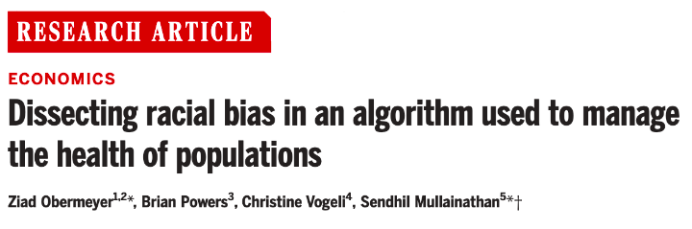
CASE STUDY

Slide 17
Formulation Decisions
In the Obermeyer et al. reading, what formulation decision is the focus of the paper?
Sli.do #10718
sli.do/10718

Slide 18



Do not edit How to change the design
In the Obermeyer et al. reading, what formulation decision is the focus of the paper?
The Slido app must be installed on every computer you’re presenting from

Slide 19
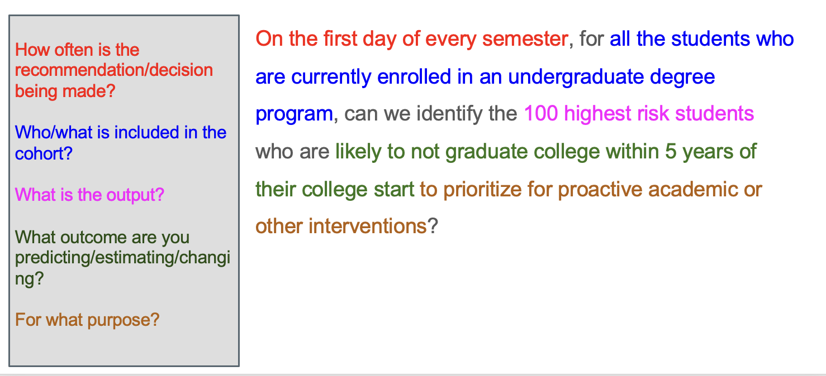
Why is this type of formulation necessary? How does it help us with ML design decision? What are the implications of each of these decisions?

Slide 20
Who/what is included in the cohort?
The rows in our “test” matrix – which people/entites are selected in each test set
And possibly also in the training set

Slide 21
How often and when is the recommendation/decision being made?
The timestamp of each row in our test matrix – the cohort defines the who/what, and this choice defines the when
The timestamp boundary for the features that can be included in that row
How the train-validation-test sets are constructed

Slide 22
What outcome are you predicting/estimating/changing?
Defines the what and when of the label for the ML models

Slide 23
What is the output?
What the model needs to produce for the end-users
Also informs evaluation/model selection metrics at the model level

Slide 24
Additional examples from real projects (will not cover in class but may be helpful)

Slide 25
Analytical Formulation
When and How often is the recommendation / decision being made?
On the 1st of every month, for all individuals who have interacted with the program in the last 3 years, can we identify the 100 individuals who are at highest risk to die by suicide or overdose in the next 6 months to recommend for proactive behavioral health outreach?
Who/what is included in the cohort?
What is the output?
What outcome are you predicting/estimating?
For what purpose?

Slide 26
Analytical Formulation
When and How often is the recommendation / decision being made?
Every year, when new aerial data arrives, for all blocklots in Baltimore City, can we identify 1,000 blocklots with a “high” level of roof damage to prioritize for demo or stabilization inspection in the next year?
Who/what is included in the cohort?
What is the output?
What outcome are you predicting/estimating?
For what purpose?

Slide 27
Analytical Formulation
When and How often is the recommendation / decision being made?
Every time ACDHS gets eviction filing data (weekly), for all individuals who have interacted with ACDHS in the 12 months who are not currently homeless and have had an eviction filing in the last 4 months, can we identify the 50 individuals at highest risk of entering into homelessness in the next 12 months to prioritize for distribution of rental assistance?
Who/what is included in the cohort?
What is the output?
What outcome are you predicting/estimating?
For what purpose?

Slide 28
Analytical Formulation - Top level
When and How often is the recommendation / decision being made?
For every time the doctor finishes taking notes during a patient visit, for all adult patients who come through the ED, can we identify up to 10 possible ICD-10 categories* that correspond to the patient’s condition to provide appropriate and timely interventions
*Categories are the first three characters of the ICD-10 code.
Who/what is included in the cohort?
What is the output?
What outcome are you predicting/estimating?
For what purpose?

Slide 29
Baselines
What is the appropriate comparison to evaluate effectiveness of your ML model?

Slide 30
Baseline Options
Common Sense
What they do today
What they could do today easily (without any or very simple ML involved)
Prior/Base Rate
What expected value would you get if you just choose at random (based on the data distribution)?

Slide 31
For a social media post recommender baseline method that doesn't require using any ML?
sli.do #10718
sli.do/10718

Slide 32
Do not edit How to change the design
What are some good baseline approaches that don’t require using any ML for a social media post recommender?
The Slido app must be installed on every computer you’re presenting from

Slide 33
Baseline Considerations
How much better than baselines does our system need to be in order to deploy?
Important to compare performance against the base rate/prior, but this prior rarely represents a “common sense” baseline
Good baselines should provide an ordering to sort the entities
Heuristic rules (or shallow decision trees) might reflect current practice, but can yield a small number of unique scores with lots of ties
In many real-world problems, a good baseline can be difficult to beat

Slide 34
Baseline Examples
Non-ML based
Existing approaches
Simple ML

Slide 35
Things to remember
Should be able to access: github and data (see canvas assignment for us to confirm)
Due Next Week:
Monday – project update assignment (Formulation and Baselines)
Tuesday – weekly feedback form
Readings for Thursday

