Slide 1

Evaluation/Performance Metrics
Rayid Ghani and Kit Rodolfa

Slide 2
Reminders
Coming up next week:
Monday: Project Update 3
Tuesday: Weekly Feedback Form
Note: all readings for next week are optional

Slide 3
Temporal Validation Review -- Example
When and How often is the recommendation / decision being made?
On the first day of every month, for all individuals residing in PA, can we identify 500 people with a high risk of contracting monkeypox in the next year to prioritize for vaccine program outreach by the PA Public Health Department?
Who/what is included in the cohort?
What is the output?
What outcome are you predicting/estimating?
For what purpose?

Slide 4
Temporal Validation Parameters
Timespan to collect labels
Gap between training/validation pairs
Time window for each training set
Time window for each validation set
Sampling frequency for examples/rows
History for features (for each example/row)

Slide 5
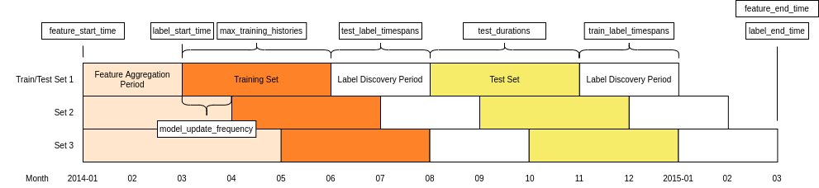
Temporal Validation Parameters

Slide 6
Temporal Validation Review -- Example
When and How often is the recommendation / decision being made?
At the time of hospital admission, for all every patient admitted, can we identify if they will be among the 50 highest-risk individuals the hospital will see that month for contracting monkeypox in the next year to prioritize for vaccine administration?
Who/what is included in the cohort?
What is the output?
What outcome are you predicting/estimating?
For what purpose?

Slide 7
Project Update 1 Review
Formulation – first of every month?
Base rate – definition and keeping parallel with label
Commonsense Baselines – what makes sense here?

Slide 8
Scope
Data
Exploration
Modeling
Get Data
Store Data
Link Data
Rows
Features
Labels
Model Selection
Train-Test Splits
Performance Metrics
Model Interpretation
Entities
temporal
Spatial
…
Models
Dealing with Bias and Fairness
Field Trial Design
Deployment
Monitoring
Goals, Actions, Data, Analysis, Ethics

Slide 9
How to solve a prediction problem
Define and Create Rows (unit of prediction)
Define and Create Label (outcome/target variable – what event and when?)
Define and Create Features (features/predictors)
Create Training and Validation/Test Sets
Train model(s) on Training Set(s)
Validate model(s) on Validation/Test Set(s)
Select “best” model

Slide 10
What is the goal of model selection?

Slide 11
What is the goal of model selection?
You’ve run a large number of different types of models varying …
You need to understand what types of models are effective under what circumstances, and
You need to decide which one(s) to use in the future

Slide 12
What do we need our selected model to do?

Slide 13
What do we need our selected model to do?
Perform well
What metric?
Compared to what?
Generalize
To what?

Slide 14
Evaluation Metrics -- Example
When and How often is the recommendation / decision being made?
Every year, when new aerial data arrives, for all blocklots in Baltimore City, can we identify 1,000 residential buildings with a “high” level of roof damage to prioritize for demolition or stabilization inspection in the next year?
Who/what is included in the cohort?
What is the output?
What outcome are you predicting/estimating?
For what purpose?

Slide 15
Discussion Question
For the roof damage example, what type of ML approach would you use? What metric would you focus on to evaluate model performance?
sli.do #10718
sli.do/10718

Slide 16
Performance Metrics

Slide 17
Score Distribution on the Test Set
# of people
Score

Slide 18
Evaluation - Metrics
Predictions are often scores between 0 and 1
We need to first turn them into 0 or 1 by selecting a threshold
Predicted Class
 | Yes | No
Yes | True Positives (TP) | False Negatives (FN)
No | False Positives (FP) | True Negatives (TN)
Actual Class
Notes:
Not comparable, not probabilities

Slide 19
Evaluation – Metrics (at a threshold k)
Accuracy = (TP + TN) / (TP + TN + FP + FN)
Precision (aka PPV: Positive Predictive Value) = TP / (TP + FP)
Recall (aka Sensitivity, TPR) = TP / (TP + FN)
Specificity = TNR
Predicted
 | Yes | No
Yes | True Positives (TP) | False Negatives (FN)
No | False Positives (FP) | True Negatives (TN)
Actual

Slide 20
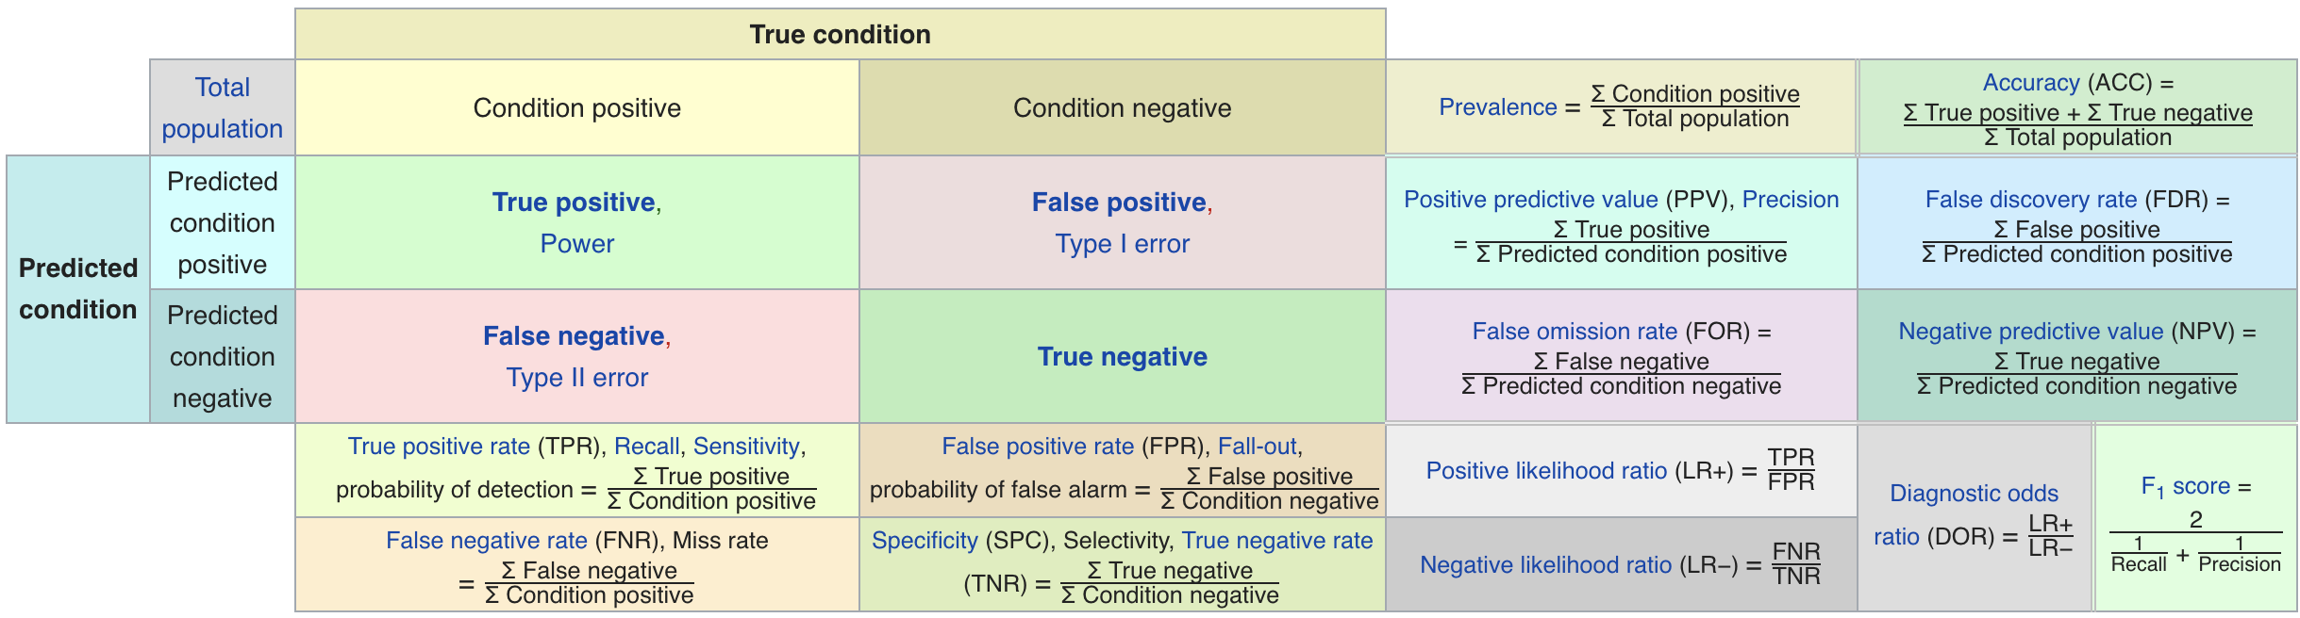
Confusion Matrix-based Metrics Cheatsheet
Source: https://en.wikipedia.org/wiki/Sensitivity_and_specificity

Slide 21
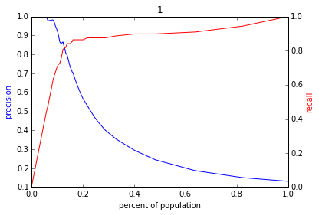
Varying the Threshold
Score
1 .9 .8 .7 .6 .5 .4 .3. .2 .1
| | | | | | | | | |
Baseline

Slide 22
ROC Curve
Receiver Operator Characteristic Curve

Slide 23
AUC (Area Under Curve)
Overall measure of performance
1 if all 1s are ranked above all 0s
0 if all 0s are above all 1s

Slide 25
AUC – Area Under Curve
If you care about the entire space

Slide 26
Evaluation - Baselines
Random according to the base rate/class prior
What they do today
What they could easily do today (without much if any ML)

Slide 27
Discussion Question
What would be some potential strategies for integrating considerations around fairness in the process of model evaluation and selection?

Slide 28
Reminders
Coming up next week:
Monday: Project Update 3
Tuesday: Weekly Feedback Form
Note: all readings for next week are optional

