Slide 1

Evaluation/Performance Metrics
Rayid Ghani

Slide 2
Scope
Data
Exploration
Modeling
Get Data
Store Data
Link Data
Rows
Features
Labels
Model Selection
Train-Test Splits
Performance Metrics
Model Interpretation
Entities
temporal
Spatial
…
Models
Dealing with Bias and Fairness
Field Trial Design
Deployment
Monitoring
Goals, Actions, Data, Analysis, Ethics

Slide 3
Reminders
Coming up next week:
Monday: Project Update 2
Tuesday: Weekly Feedback Form

Slide 4
Temporal Validation : Recap
Go to your formulation and use that to figure out:
What and when your validation set needs to be.
(literally) back into the training set which can be anything and everything before that.
That gives you your latest possible train-validation split
Then you can decide how often to "shift” that setup to create additional train-validation splits

Slide 5
Temporal Validation Review -- Example
When and How often is the recommendation / decision being made?
On the first day of every month, for all individuals residing in PA, can we identify 500 people with a high risk of contracting monkeypox in the next year to prioritize for vaccine program outreach by the PA Public Health Department?
Who/what is included in the cohort?
What is the output?
What outcome are you predicting/estimating?
For what purpose?

Slide 6
Temporal Validation
On the first day of every month, for all individuals residing in PA, can we identify 500 people with a high risk of contracting monkeypox in the next year
We will take all the individuals residing in PA as of 9/1/23 as rows in our validation set
9/1/22
9/1/23
9/1/24
All the data we have before 9/1/23 is now available for us to use as the training set.
We can choose to use all of it or as subset but that’s a design choice we’re making
And the labels for them will come over the next 12 months

Slide 7
Temporal Validation
On the first day of every month, for all individuals residing in PA, can we identify 500 people with a high risk of contracting monkeypox in the next year
Training Set 1
Validation Set 1
9/1/23
9/1/24
Training Set 2
Validation Set 2
8/1/23
8/1/24
Training Set 2
Validation Set 2
7/1/23
7/1/24

Slide 8
Temporal Validation
On the first day of every month, for all individuals residing in PA, can we identify 500 people with a high risk of contracting monkeypox in the next year
Training Set 1
Validation Set 1
9/1/23
9/1/24
Training Set 2
Validation Set 2
8/1/23
8/1/24
Training Set 2
Validation Set 2
7/1/23
7/1/24

Slide 9
Temporal Validation Parameters
Timespan to collect labels
Gap between training/validation pairs
Time window for each training set
Time window for each validation set
Sampling frequency for examples/rows
History for features (for each example/row)

Slide 10
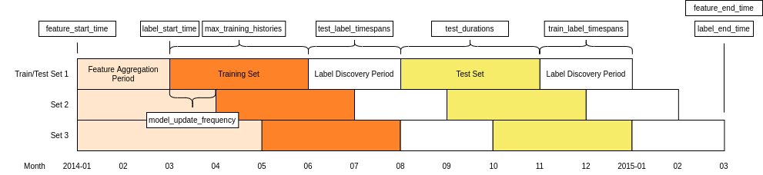
Temporal Validation Parameters

Slide 11
Temporal Validation Review -- Example
When and How often is the recommendation / decision being made?
At the time of hospital admission, for all every patient admitted, can we identify if they will be among the 50 highest-risk individuals the hospital will see that month for contracting monkeypox in the next year to prioritize for vaccine administration?
Who/what is included in the cohort?
What is the output?
What outcome are you predicting/estimating?
For what purpose?

Slide 12
Project Update 1 Review
Formulation – first of every month?
Base rate – definition and keeping parallel with label
Commonsense Baselines – what makes sense here?

Slide 13
How to solve a prediction problem
Define and Create Rows (unit of prediction)
Define and Create Label (outcome/target variable – what event and when?)
Define and Create Features (features/predictors)
Create Training and Validation/Test Sets
Train model(s) on Training Set(s)
Validate model(s) on Validation/Test Set(s)
Select “best” model

Slide 14
What do we need our selected model to do?
Perform well
What metric?
Compared to what?
Generalize
To what?

Slide 15
Evaluation Metrics -- Example
When and How often is the recommendation / decision being made?
Every year, when new aerial data arrives, for all blocklots in Baltimore City, can we identify 1,000 residential buildings with a “high” level of roof damage to prioritize for demolition or stabilization inspection in the next year?
Who/what is included in the cohort?
What is the output?
What outcome are you predicting/estimating?
For what purpose?

Slide 16
Discussion Question
For the roof damage example, what type of ML approach would you use? What metric would you focus on to evaluate model performance?
sli.do #10718
sli.do/10718

Slide 17
Performance Metrics?
Or more often, model selection metrics

Slide 18
Score Distribution on the Validation or Test Set
# of people
Score

Slide 19
Evaluation - Metrics
Predictions are often scores between 0 and 1
We need to first turn them into 0 or 1 by selecting a threshold
Predicted Class
 | Yes | No
Yes | True Positives (TP) | False Negatives (FN)
No | False Positives (FP) | True Negatives (TN)
Actual Class
Notes:
Not comparable, not probabilities

Slide 20
Evaluation – Metrics (at a threshold k)
Accuracy = (TP + TN) / (TP + TN + FP + FN)
Precision (aka PPV: Positive Predictive Value) = TP / (TP + FP)
Recall (aka Sensitivity, TPR) = TP / (TP + FN)
Specificity = TNR
Predicted
 | Yes | No
Yes | True Positives (TP) | False Negatives (FN)
No | False Positives (FP) | True Negatives (TN)
Actual

Slide 21
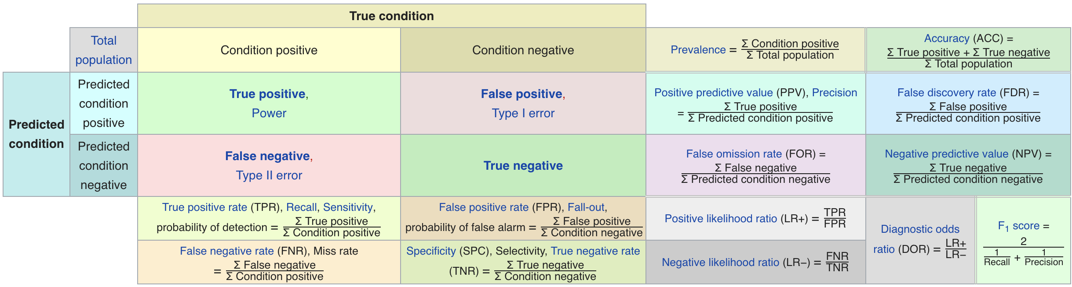
Confusion Matrix-based Metrics Cheatsheet
Source: https://en.wikipedia.org/wiki/Sensitivity_and_specificity

Slide 22
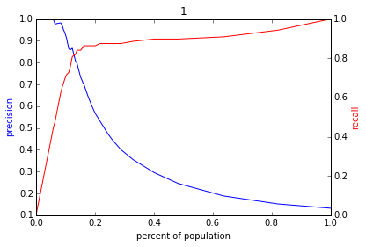
Varying the Threshold
Score
1 .9 .8 .7 .6 .5 .4 .3. .2 .1
| | | | | | | | | |
Baseline

Slide 23
ROC Curve
Receiver Operator Characteristic Curve

Slide 24
AUC (Area Under Curve)
Overall measure of performance
1 if all 1s are ranked above all 0s
0 if all 0s are above all 1s

Slide 26
AUC – Area Under Curve
If you care about the entire space

Slide 27
Evaluation - Baselines
Random according to the base rate/class prior
What they do today
What they could easily do today (without much if any ML)

Slide 28
Discussion Question
What would be some potential strategies for integrating considerations around fairness in the process of model evaluation and selection?

Slide 29
Reminders
Coming up next week:
Monday: Project Update 2
Tuesday: Weekly Feedback Form

