Slide 1

Model Selection (and Validation)
Rayid Ghani

Slide 2
Reminders
Coming up next week:
Monday: Project Update 2
Also see feedback in update 1 slides (in the next couple of days)
Tuesday: Weekly Feedback Form

Slide 3
Teamwork Question
How’s teamwork going?
sli.do #10718
sli.do/10718

Slide 4
Discussion Question
What model selection strategy is your group considering for the Donors Choose project?
sli.do #10718
sli.do/10718

Slide 5
Plan for the week
What you should be discussing this week within your team
Finalizing your analytical formulation and baselines to compare against
Validation strategy
What you should be building this week
V0 of your ML pipeline
Training/validation logic
Implemented Baselines

Slide 6
Scope
Data
Exploration
Modeling
Get Data
Store Data
Link Data
Rows
Features
Labels
Model Selection
Train-Test Splits
Performance Metrics
Model Interpretation
Entities
temporal
Spatial
…
Models
Dealing with Bias and Fairness
Field Trial Design
Deployment
Monitoring
Goals, Actions, Data, Analysis, Ethics

Slide 7
Non-ML Baselines
Ideally they give fine-grained ranks rather than large categories/groups to make it easier to rank and calculate top k metrics

Slide 8
Here’s how we typically solve a prediction problem
Define and Create Rows (unit of prediction)
Define and Create Label (outcome/target variable – what event and when?)
Define and Create Features (features/predictors)
Create Training and Validation/Test Sets
Train model(s) on Training Set(s)
Validate model(s) on Validation/Test Set(s)
Select “best” model to use

Slide 9
What is the goal of model selection?

Slide 10
What is the goal of model selection?
You’ve run a large number of different types of models varying model types, hyperparameters, features, … (other decisions in the pipeline)
Now we need to
Understand what types of models are effective under what circumstances
Decide which one(s) to use in the future

Slide 11
What do we need our selected model to do?

Slide 12
What do we need our selected model to do?
Perform well
What metric?
Compared to what?
Generalize
To what?

Slide 13
What should the model we select generalize to?

Slide 14
What do need to know to perform model selection
Deployment scenario
Model Selection Methodology
Metric(s) (need to match your initial goals)
Comparison with baselines (to know if you’re effective)

Slide 15
How do we select a model that does that?

Slide 16
Model Selection - Methodology
In-sample
Out of sample
Multiple Out-of-sample (Hold-out) Splits
Cross Validation
Leave one out (LOO)
K fold
Temporal Holdouts
Spatial Holdouts
Other Holdouts?

Slide 17
Scenarios
1: We want to track news coverage of epidemic related topics. We have tagged a small corpus (n=1000) of news articles from Jan 2019 to September 2020 and now have a stream of new incoming articles every day. We want to deploy a system that tracks the volume of coverage by media outlet going forward.
What should our model generalize to?
What is a training set?
What is the corresponding validation set?

Slide 18
Scenarios
2: We want to track news coverage of epidemic related topics. We have tagged a small corpus (n=1000) of news articles from Jan 2019 to September 2020 and now have a stream of new incoming articles every day. We want to deploy a system that tracks volume of coverage by media outlet over the last 2 years as well as going forward.
What should our model generalize to?
What is a training set?
What is the corresponding validation set?

Slide 19
Scenarios
3: We want to predict whether there will be an increase in epidemic related articles in the media during the next week.
What should our model generalize to?
What is a training set?
What is the corresponding validation set?

Slide 20
Scenarios
4: We want to predict whether there will be an increase in epidemic related articles in the media during the next month.
What should our model generalize to?
What is a training set?
What is the corresponding validation set?

Slide 21
Temporal Validation Review -- Example
When and How often is the recommendation / decision being made?
On the first day of every month, for all individuals residing in PA, can we identify 500 people with a high risk of contracting monkeypox in the next year to prioritize for vaccine program outreach by the PA Public Health Department?
Who/what is included in the cohort?
What is the output?
What outcome are you predicting/estimating?
For what purpose?

Slide 22
Temporal Validation Parameters
Timespan to collect labels
“Gap” between training/validation pairs
Time window for each training set
Time window for each validation set
Sampling frequency for examples/rows
History for features (for each example/row)

Slide 23
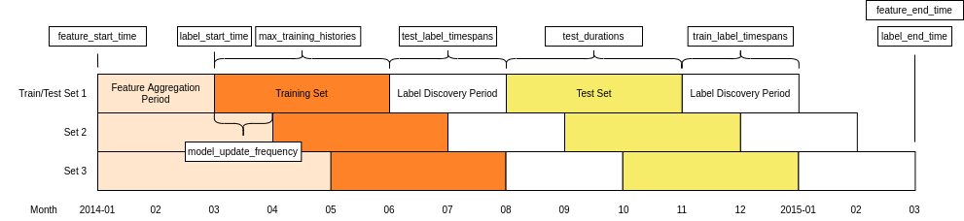
Temporal Validation Parameters

Slide 24
Temporal Validation Review -- Example
When and How often is the recommendation / decision being made?
At the time of hospital admission, for all every patient admitted, can we identify if they will be among the 50 highest-risk individuals the hospital will see that month for contracting monkeypox in the next year to prioritize for vaccine administration?
Who/what is included in the cohort?
What is the output?
What outcome are you predicting/estimating?
For what purpose?

Slide 25
Parameters
How far back to go when training models? (max training history)
To the beginning of time (expanding training window)?
Fixed history (rolling training window)?
Something else?
How far back do you get your features from?
How much to move forward from train-validation pair 1 to train-validation pair 2?
A day?
A month?
Something else?

Slide 26
Other considerations
If making repeated predictions about the same entity at different times, how often should an entity be repeated in the training data?
In an event-based deployment setup?
In a “take action at regular-ish intervals” deployment?
What about in the validation set?

Slide 27
Some tips
Set up validation set(s) to match deployment scenarios (and constraints)
Set up training set(s) any way we want but match data (both features and labels) available at training time
Making sure labels are not censored based on label period
Sampling (if helpful)
Data collection and update lag

Slide 28
Train Validation Pairs
 | Train Set |  |  |  | Validation Set
Train-Validation Pair ID | Earliest project submission date | Latest project submission date | Start date for labels | End date for labels | Start date for rows | End date for rows | Start date for labels | End date for labels
1
2
3 (most recent)
Train-Validation Pair 1
Training Examples
Label Buffer
Validation Examples
Label Buffer
Train-Validation Pair 2
Training Examples
Label Buffer
Validation Examples
Label Buffer

Slide 29
In-sample
Data
Train
Validate

Slide 30
Out-of-Sample
Data
Train
Validate

Slide 31
N-fold Cross-Validation
Data
1
2
3
4
5
Train
Validate

Slide 32
N-fold Cross-Validation
Data
1
2
3
4
5
Train
Validate

Slide 33
N-fold Cross-Validation
Data
1
2
3
4
5
Train
Validate

Slide 34
N-fold Cross-Validation
Data
1
2
3
4
5
Train
Validate

Slide 35
N-fold Cross-Validation
Data
1
2
3
4
5
Train
Validate

Slide 36
Temporal Holdouts
Data
2002 2017
Train
Validate
2002 2007 2008
Train
Validate
2002 2008 2009
Train
Validate
2002 2009 2010

Slide 37
Training - Time splits
Train
Validate
2002 2009 2010
Train
We only use this time
to get outcomes
2002 2009

Slide 38
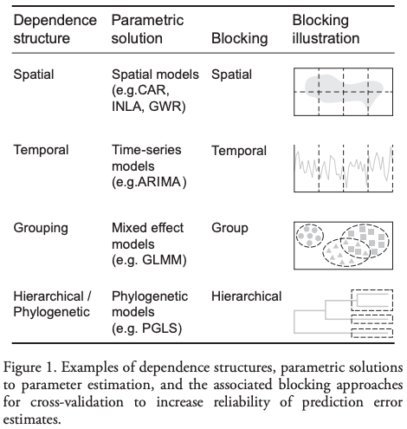
Evaluation - Methodology
In-sample
Out of sample
Multiple Out-of-sample (Hold-out) Splits
Cross Validation
Leave one out (LOO)
K fold
Holdouts Using Structure of Data
Temporal
Spatial, Hierarchical, etc.

