Slide 1

Model Selection (and “Validation”)
Rayid Ghani

Slide 2
Reminders
Coming up next week:
Monday: Project Update 2
Also see feedback in update 1 slides (in the next couple of days)
Tuesday: Weekly Feedback Form

Slide 3
Discussion Question
What model selection strategy is your group considering for the Donors Choose project?
sli.do #10718
sli.do/10718

Slide 4



Do not edit How to change the design
What model selection strategy is your group considering for the Donors Choose project?
The Slido app must be installed on every computer you’re presenting from

Slide 5
Plan for the week
What you should be discussing this week within your team
Finalizing your analytical formulation and baselines to compare against
Validation strategy
What you should be building this week
V0 of your ML pipeline
Training/validation logic
Implemented Baselines

Slide 6
Scope
Data
Exploration
Modeling
Get Data
Store Data
Link Data
Rows
Features
Labels
Model Selection
Train-Test Splits
Performance Metrics
Model Interpretation
Entities
temporal
Spatial
…
Models
Dealing with Bias and Fairness
Field Trial Design
Deployment
Monitoring
Goals, Actions, Data, Analysis, Ethics

Slide 7
Here’s how we typically solve a prediction problem
Define and Create Rows (unit of prediction – what units and when?)
Define and Create Label (outcome/target variable – what event and when?)
Define and Create Features (features/predictors)
Create Training and Validation/Test Sets
Train model(s) on Training Set(s)
Validate model(s) on Validation/Test Set(s)
Select “best” model to use

Slide 8
What is the goal of model selection?

Slide 9
What is the goal of model selection?
You’ve run a large number of different types of models varying model types, hyperparameters, features, … (other decisions in the pipeline)
Now we need to
Understand what types of models are effective under what circumstances
Decide which one(s) to use in the future

Slide 10
What do we need our selected model to do?

Slide 11
What do we need our selected model to do?
Perform well
What metric?
Compared to what?
Generalize
To what?
Next Class

Slide 12
What should the model we select generalize to?

Slide 13
What do need to know to perform model selection
Deployment scenario
Model Selection Methodology
Metric(s) (need to match your initial goals)
Comparison with baselines (to know if you’re effective)

Slide 14
How do we select a model that does that?

Slide 15
Underlying principle: match methodology to match test/inference-time
How does the potential test-time distribution differ from training?
No shift: training data is IID, test data will be IID from same distribution
Time series setting: data is not IID, future will not look like resampled present
Cluster structure, e.g. students within classrooms within schools. Test-time might be better modeled at a higher cluster level (generalizing to new schools) than within clusters (generalizing to new students within a school we’ve seen)

Slide 16
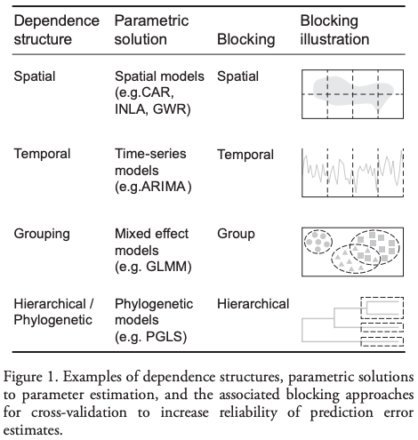
Model Selection - Methodology
In-sample
Out of sample
Multiple Out-of-sample (Hold-out) Splits
Cross Validation
Leave one out (LOO)
K fold
Temporal Holdouts
Spatial Holdouts
Other Holdouts?

Slide 17
Scenarios
1: We want to track news coverage of epidemic related topics. We have tagged a small corpus (n=1000) of news articles from Jan 2023 to September 2025 and now have a stream of new incoming articles every day. We want to deploy a system that tracks the volume of coverage by media outlet going forward.
What should our model generalize to?
What is a training set?
What is the corresponding validation set?

Slide 18
Scenarios
2: We want to track news coverage of epidemic related topics. We have tagged a small corpus (n=1000) of news from Jan 2023 to September 2025 and now have a stream of new incoming articles every day. We want to deploy a system that tracks volume of coverage by media outlet over the last 2 years as well as going forward.
What should our model generalize to?
What is a training set?
What is the corresponding validation set?

Slide 19
Scenarios
3: We want to predict whether there will be an increase in epidemic related articles in the media during the next week.
What should our model generalize to?
What is a training set?
What is the corresponding validation set?

Slide 20
Scenarios
4: We want to predict whether there will be an increase in epidemic related articles in the media during the next month.
What should our model generalize to?
What is a training set?
What is the corresponding validation set?

Slide 21
Temporal Validation Review -- Example
When and How often is the recommendation / decision being made?
On the first day of every month, for all individuals residing in PA, can we identify 500 people with a high risk of contracting monkeypox in the next year to prioritize for vaccine program outreach by the PA Public Health Department?
Who/what is included in the cohort?
What is the output?
What outcome are you predicting/estimating?
For what purpose?

Slide 22

Temporal validation
Start feature availability
End label availability
Used for features (only)
Training set
Validation
Test
1
Used for features (only)
Training set
Validation
Test
2
3
Used for features (only)
Training set
Validation
Test
$$t$$

Slide 23
Temporal validation
Length of training window
Start feature availability
End label availability
Used for features (only)
Training set
Validation
Test
1
Used for features (only)
Training set
Validation
Test
2
3
Used for features (only)
Training set
Validation
Test
$$t$$

Slide 24
Temporal validation
Amount of validation/testing
Start feature availability
End label availability
Used for features (only)
Training set
Validation
Test
1
Used for features (only)
Training set
Validation
Test
2
3
Used for features (only)
Training set
Validation
Test
$$t$$

Slide 25
Temporal validation
Frequency of retraining model
Start feature availability
End label availability
Used for features (only)
Training set
Validation
Test
1
Used for features (only)
Training set
Validation
Test
2
3
Used for features (only)
Training set
Validation
Test
$$t$$

Slide 26
Temporal validation
Minimum time for feature collection
Start feature availability
End label availability
Used for features (only)
Training set
Validation
Test
1
Used for features (only)
Training set
Validation
Test
2
3
Used for features (only)
Training set
Validation
Test
$$t$$

Slide 27
Temporal validation
Start feature availability
Minimum time for label collection
End label availability
Used for features (only)
Training set
Validation
Test
1
Used for features (only)
Training set
Validation
Test
2
3
Used for features (only)
Training set
Validation
Test
$$t$$

Slide 28
Temporal Validation Parameters
Timespan to collect labels
“Gap” between training/validation pairs
Time window for each training set
Time window for each validation set
Sampling frequency for examples/rows
History for features (for each example/row)

Slide 29
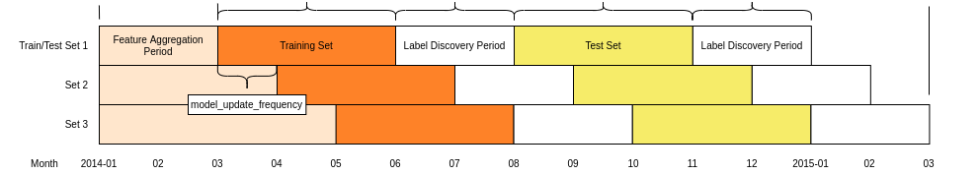
Temporal Validation Parameters
feature_end_time
label_end_time
feature_start_time
label_start_time
Max training history
label timespan
test duration
label timespan

Slide 30
Temporal Validation Review -- Example
When and How often is the recommendation / decision being made?
At the time of hospital admission, for all every patient admitted, can we identify if they will be among the 50 highest-risk individuals the hospital will see that month for contracting monkeypox in the next year to prioritize for vaccine administration?
Who/what is included in the cohort?
What is the output?
What outcome are you predicting/estimating?
For what purpose?

Slide 31
Parameters
How far back to go when training models? (max training history)
To the beginning of time (expanding training window)?
Fixed history (rolling training window)?
Something else?
How far back do you get your features from?
How much to move forward from train-validation pair 1 to train-validation pair 2?
A day?
A month?
Something else?

Slide 32
Other considerations
If making repeated predictions about the same entity at different times, how often should an entity be repeated in the training data?
In an event-based deployment setup?
In a “take action at regular-ish intervals” deployment?
What about in the validation set?

Slide 33
Some tips
Set up validation set(s) to match deployment scenarios (and constraints)
Set up training set(s) any way we want but match data (both features and labels) available at training time
Making sure labels are not censored based on label period
Sampling (if helpful)
Data collection and update lag

Slide 34

Do not edit How to change the design
what’s your experience with using git and GitHub?
The Slido app must be installed on every computer you’re presenting from

Slide 35
Extra Slides (not covered in class)

Slide 36
Train Validation Pairs
 | Train Set |  |  |  | Validation Set
Train-Validation Pair ID | Earliest project submission date | Latest project submission date | Start date for labels | End date for labels | Start date for rows | End date for rows | Start date for labels | End date for labels
1
2
3 (most recent)
Train-Validation Pair 1
Training Examples
Label Buffer
Validation Examples
Label Buffer
Train-Validation Pair 2
Training Examples
Label Buffer
Validation Examples
Label Buffer

Slide 37
In-sample
Data
Train
Validate

Slide 38
Out-of-Sample
Data
Train
Validate

Slide 39
k-fold Cross-Validation
Data
1
2
3
4
5
Train
Validate

Slide 40
k-fold Cross-Validation
Data
1
2
3
4
5
Train
Validate

Slide 41
k-fold Cross-Validation
Data
1
2
3
4
5
Train
Validate

Slide 42
k-fold Cross-Validation
Data
1
2
3
4
5
Train
Validate

Slide 43
k-fold Cross-Validation
Data
1
2
3
4
5
Train
Validate

Slide 44
Temporal Holdouts
Data
2002 2017
Train
Validate
2002 2007 2008
Train
Validate
2002 2008 2009
Train
Validate
2002 2009 2010

Slide 45
Training - Time splits
Train
Validate
2002 2009 2010
Train
We only use this time
to get outcomes
2002 2009

Slide 46
Question
On the first day of every semester, for all the students who are currently enrolled in an undergraduate degree program, can we identify the 100 highest risk students who are likely to not graduate college within 5 years of their college start to prioritize for proactive academic or other interventions?
Suppose that our training set is all students from the last five years, and we randomly split students into the train and test sets. Is this most likely to over/under/correctly estimate our model’s accuracy for next year?

Slide 47
Pros and cons
Single train/validation/test set: simple to implement and interpret
K-fold CV: more work/computation time, but reduces noise, especially when dataset is somewhat smaller. Can get away with a smaller test set, leaving more for training

Slide 48
Temporal validation
Making predictions about entities that arrive over time
Time series forecasting
Typically, your model will be periodically retrained using more recent data
Idea: mimic this process by creating train/validation/test sets that roll forward in time

Slide 49
Temporal Validation Review -- Example
When and How often is the recommendation / decision being made?
At the time of hospital admission, for all every patient admitted, can we identify if they will be among the 50 highest-risk individuals the hospital will see that month for contracting monkeypox in the next year to prioritize for vaccine administration?
Who/what is included in the cohort?
What is the output?
What outcome are you predicting/estimating?
For what purpose?

Slide 50
Spatial structure
Related to clustering and temporal structure
We often believe that nearby places are correlated
What do we care about in deployment?
Generalization to new locations? → Allocate large spatial blocks to train/test set
Filling in between places seen during training → Allocate smaller patches

