Slide 1

Causal Inference and ML Experiments
Rayid Ghani and Kit Rodolfa

Slide 2
Reminders
Coming up next week:
Module 3 Presentations – Preprocessing
Coming up the following week:
Module 3 Presentation Recordings (no class meetings)

Slide 3
Recap:
Bias and Fairness

Slide 4
Scope
Data
Exploration
Modeling
Get Data
Store Data
Link Data
Rows
Features
Labels
Model Selection
Train-Test Splits
Performance Metrics
Model Interpretation
Entities
temporal
Spatial
…
Models
Dealing with Bias and Fairness
Field Trial Design
Deployment
Monitoring
Goals, Actions, Data, Analysis, Ethics

Slide 5
Things to cover today
Causal Inference 001
With Observational Data
Methods
Examples
Experiments
Standard Randomized Controlled Trials
Trial Design
Examples
Validating ML models/systems
Trial Design
Examples

Slide 6
What is the purpose of doing field validation?

Slide 7
Field Validation: Beyond A/B Testing
How well does the model perform in the real world?
Validation on truly unseen future data; only way to ensure against leakage
What key assumptions in our formulation need to be tested?
Are we intervening with the “right” people?
Are we intervening in the best way possible?
Impact of historical decision making / selective labels?
Most importantly: how well does the ML system we’re building help the organization realize its goals?

Slide 8
CASE STUDY: Mental Health and Incarceration
Cycle of Incarceration
UNMET
NEEDS
MISDEMEANOR
ARREST
JAIL
worsening or failing to improve

Slide 9
CASE STUDY: Mental Health and Incarceration
Breaking the Cycle
UNMET
NEEDS
X
MISDEMEANOR
ARREST
JAIL
MENTAL HEALTH OUTREACH

Slide 10
CASE STUDY: Mental Health and Incarceration
Return to Jail Risk
Released From Jail
In Past 3 Years
ID | SCORE
27 | 0.95
13 | 0.93
1 | 0.89
93 | 0.89
53 | 0.82
23 | 0.75
59 | 0.72
64 | 0.65
20 | 0.61
18 | 0.59
46 | 0.52
82 | 0.48
49 | 0.37
56 | 0.22
17 | 0.12
Mental
Health
Outreach
Model
X
…With History of
Mental Health
Needs
Return to
Jail

Slide 11
CASE STUDY: Mental Health and Incarceration
Return to Jail Risk
Released From Jail
In Past 3 Years
ID | SCORE
27 | 0.95
13 | 0.93
1 | 0.89
93 | 0.89
53 | 0.82
23 | 0.75
59 | 0.72
64 | 0.65
20 | 0.61
18 | 0.59
46 | 0.52
82 | 0.48
49 | 0.37
56 | 0.22
17 | 0.12
Mental
Health
Outreach
Model
X
…With History of
Mental Health
Needs
Return to
Jail
What would you want to learn
through a field trial?

Slide 12
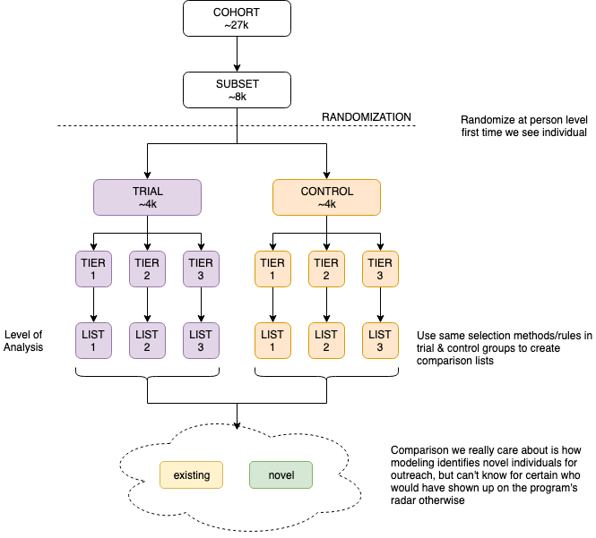

Slide 13
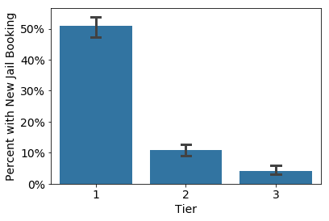
Q1: Is the Model Predictive?

Slide 14
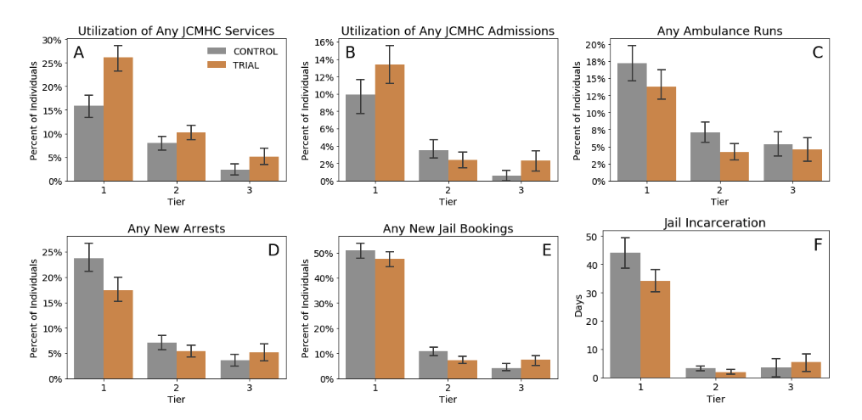
Q2: Does Model+Intervention Affect Outcomes? For Whom?

Slide 15
Causal inference with experiments
Standard “Randomized Controlled Trials”
Trial Design
Outcome
Sample size
Power
Randomization
Ethical Concerns

Slide 16
Some things to keep in mind
Sample Size
Power Effect Size Significance Level
Effect size > what is practically useful and significant
Significance Level ~ cost of implementing the new system/model

Slide 17
Designing Trials to Validate ML Systems
What can we do with historical data?
Model Selection
Performance Estimation
How do we select the model to deploy?
Compare shortlisted models against baseline
How do we validate whether our ML system will work when deployed?

Slide 18
Designing an experiment
What are we trying to test?
How do we create different arms of the experiment?
How we do we run the experiment?
What do we measure?
How do we evaluate?

Slide 19
What are we testing in an experiment?
Lift?
Classification?
Probability estimates?
Ranking?
How does the experiment design change?

Slide 20
How many [students, inspections, projects] should we include in our trial?
Doing a trial over [y] years with [n] students every year will give us a [p%] chance to detect an [e%] increase in [outcome] with a statistical significance of [s%]

