Slide 1

ML Interpretability: Overview and Use Cases
Rayid Ghani

Slide 2
Scope
Data
Exploration
Modeling
Get Data
Store Data
Link Data
Rows
Features
Labels
Model Selection
Train-Test Splits
Performance Metrics
Model Interpretation
Entities
temporal
Spatial
…
Models
Dealing with Bias and Fairness
Field Trial Design
Deployment
Monitoring
Goals, Actions, Data, Analysis, Ethics

Slide 3
What we’ll cover today
Understand different goals for interpretability
Types of Interpretability Methods
Compare classical post-hoc interpretability tools (e.g., SHAP, LIME, PDPs) and model-intrinsic approaches (e.g., GAMs, monotonic models).
Recognize interpretability challenges in complex deep models and LLMs.
Apply interpretability tools to real-world use cases and understand their limitations.

Slide 4



Do not edit How to change the design
Why do we want interpretablity of models in ML?
The Slido app must be installed on every computer you’re presenting from

Slide 5
Why do we want Interpretability?

Slide 6
Why do we want Interpretability?
Debugging the Model
Improving the performance of the system
Creating and increasing trust and adoption
Selecting appropriate actions/interventions
Legal or Contractual Recourse

Slide 7
Case Study: Pneumonia and Asthma
Risk of Death
from Pneumonia
Patient Record
Healthy
0.21

Slide 8
Case Study: Pneumonia and Asthma
Risk of Death
from Pneumonia
Patient Record
Healthy
0.21
Has Asthma
0.13

Slide 9
Deeper Dive into Use Cases
Use Case | User | Task | What type of method?
Debugging
Improving performance
Trust
Interventions
Recourse

Slide 10
Deeper Dive into Use Cases
Use Case | User | Task | Global or Local
Debugging | ML Developer | Sanity check and improve “correctness” | Both
Improving performance | Action- taker | Decide to agree or override | Local
Trust | Policymaker/Action-Taker | Model use => better outcomes | Both
Interventions | Action-Taker | Improve outcomes | Local
Recourse | Individual(s) affected | Provide information that the individual can understand and ideally change | Local

Slide 11
Do not edit How to change the design
What properties do we want from an explanation?
The Slido app must be installed on every computer you’re presenting from

Slide 12
What do we want from an explanation?
Fidelity: how accurately they reflect the model.
“Liking” an explanation versus it being correct and useful
Comprehensibility: how well humans grasp them.
Correct vs understandable
Usefulness: how well they support a goal (debugging, intervention, regulation).
Correct and understandable vs usable

Slide 13
How to interpret specific models
Decision Trees
RFs
NNs
Are there other methods that are easier to interpret/understand out of the box?

Slide 14
How would we validate if an interpretability method is effective?
Use Case | Evaluation Methodology
Debugging
Improving performance
Trust
Interventions
Recourse

Slide 15
Evaluating Explainable ML Methods
How easy is the method to apply to a new setting (either with an existing implementation or from the description in the paper)?
Are there parameters you need to choose? If so, how do you find good values and how sensitive are the results to these choices?
Do the explanations “make sense”? Are they internally consistent? Do they seem consistent with what you know about the context and the data?
Are the explanations useful? Would they actually improve outcomes for the given use case?
Do you have to make any trade-offs to improve interpretability (e.g., computational time, model accuracy?)

Slide 16
Explainability vs Accuracy?
Accuracy
Explainability

Slide 17
Explainability vs “Accuracy”?
“Accuracy” (P@10% for example)
2-Deep Decision Tree
Explainability

Slide 18
Explainability vs Accuracy?
Deep Neural Net
Accuracy
2-Deep Decision Tree
Explainability

Slide 19
Explainability vs Accuracy?
Deep Neural Net
Accuracy
Pareto Frontier
2-Deep Decision Tree
Explainability

Slide 20
Explainability vs Accuracy?
Deep Neural Net
Explainable ML Goal
Accuracy
Pareto Frontier
2-Deep Decision Tree
Explainability

Slide 21

Case Study: Evaluating an Explainable ML System

Slide 22
Case Study: Evaluating an Explainable ML System
Application: Preventing Hypoxaemia During Surgery
Low arterial blood oxygen tension
Good predictions would allow anesthesiologists to take preventative measures during surgery
User study comparing predictive performance of humans and models

Slide 23
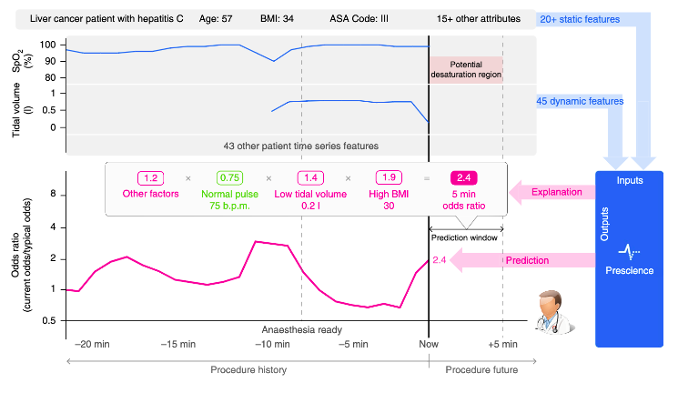
Case Study: Evaluating an Explainable ML System

Slide 24
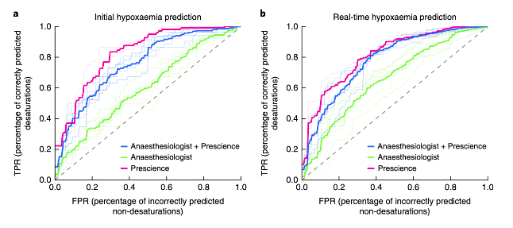
Case Study: Evaluating an Explainable ML System

Slide 25
Case Study: Evaluating an Explainable ML System
What can we conclude from
these results?
Human Alone
Human + ML System
ML System Alone

Slide 26
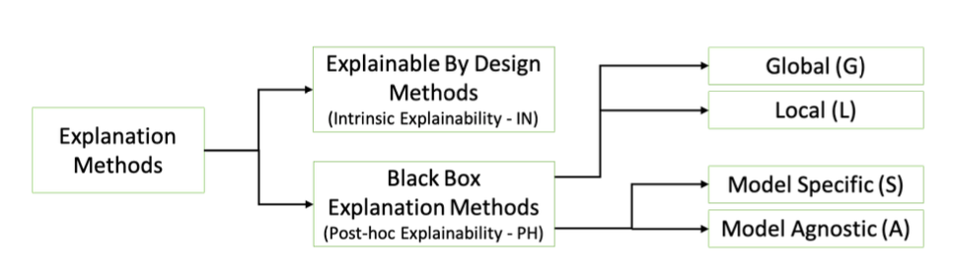
Many Approaches to Model Explanations
Bodria et al, arxiv:2102.13076v1

Slide 27
Types of Interpretablity Methods
Global vs Local
Inherently Interpretable models vs Post-hoc model agnostic

Slide 28
Global vs. Local
Global: how the entire model behaves on average.
e.g. feature importance, coefficients, partial-dependence plots.
Local: why one prediction was made.
e.g. SHAP or LIME explanation for a single case.

Slide 29
Intrinsic vs. Post-hoc
Intrinsic — Model itself is understandable (e.g., linear regression, decision trees, generalized additive models).
Post-hoc — Use secondary methods to explain black boxes (e.g., SHAP, LIME, Grad-CAM).
Tradeoffs?

Slide 30
Some of the teams will explore the following…
Inherently-Interpretable Models
Post-Hoc Individual Feature Importances
Prototypes
Counterfactuals

Slide 31
Interpretability in Deep Learning
Representation Interpretability vs Important features
Inputs are high-dimensional (pixels, tokens, embeddings).
Learned features are distributed and hierarchical.
Internal activations don’t correspond directly to human-interpretable concepts.

Slide 32
Common types of methods for Deep Learning
Saliency and Gradient-Based Methods
Attribute importance to input features by measuring how small changes in input affect model output.
Example- and Influence-Based Methods
explain training examples that most influenced a prediction.
Concept-Based Explanations

Slide 33
Explainability in Large Language Models
Proxy interpretability via attention, probing, and mechanistic inspection.
Attention-Based Explanations
Examine attention weights to see which input tokens influence output.
Probing and Representation Analysis
Identify what information is encoded in intermediate representations. Train simple probe classifiers on frozen embeddings (e.g., POS, gender, factuality).
Mechanistic Interpretability
Reverse-engineer neurons, circuits, and attention heads. Study individual components’ behavior to reveal structure or causal role.

Slide 34
Reminders

