Slide 1

ML Interpretability: Overview and Use Cases
Rayid Ghani and Kit Rodolfa

Slide 2
Why do we want Interpretability?
Take a few minutes to answer
the poll as you get settled:
slido.com
#10718

Slide 3
Reminder: Modules 2 and 3
Module 2 & 3 classes focus on 2-3 methods/approaches each day
Each group responsible for applying one approach from each class (may implement from scratch or use existing packages)
“Extended Abstract” (3-4 pages) at end of the module comparing results from the three methods you applied to the class project
Presentations and “discussants” (15 minutes)
We will assign one of each, other methods up to you
Method overview and preliminary results

Slide 4
Reminders
Next week:
Tuesday: Understanding your models
Thursday: Module 2 Presentations
Coming up the following week:
Monday: Update 6 (feature importances + crosstabs)
Tuesday/Thursday: Module 2 Presentations
Friday: Extended Abstract on Interpretability

Slide 5
Scope
Data
Exploration
Modeling
Get Data
Store Data
Link Data
Rows
Features
Labels
Model Selection
Train-Test Splits
Performance Metrics
Model Interpretation
Entities
temporal
Spatial
…
Models
Dealing with Bias and Fairness
Field Trial Design
Deployment
Monitoring
Goals, Actions, Data, Analysis, Ethics

Slide 6
What we’ll cover today
Why we want ML models to be interpretable?
Real-world use cases
Types of Interpretability

Slide 7
Why do we want Interpretability?

Slide 8
Why do we want Interpretability?
Debugging the Model
Improving the performance of the system
Creating and increasing trust and adoption
Selecting appropriate actions/interventions
Legal Recourse

Slide 9
Case Study: Pneumonia and Asthma
Risk of Death
from Pneumonia
Patient Record
Healthy
0.21

Slide 10
Case Study: Pneumonia and Asthma
Risk of Death
from Pneumonia
Patient Record
Healthy
0.21
Has Asthma
0.13

Slide 11
Deeper Dive into Use Cases
Use Case | User | Task | What type of method?
Debugging
Improving performance
Trust
Interventions
Recourse

Slide 12
Deeper Dive into Use Cases
Use Case | User | Task | Global or Local
Debugging | ML Developer | Sanity check and improve “correctness” | Both
Improving performance | Action- taker | Decide to agree or override | Local
Trust | Policymaker/Action-Taker | Model use => better outcomes | Both
Interventions | Action-Taker | Improve outcomes | Local
Recourse | Individual(s) affected | Provide information that the individual can understand and ideally change | Local

Slide 13
What do we want from a global explanation?

Slide 14
How to interpret specific models
Decision Trees
KNN
SVMs
RFs
NNs
Are there other methods that are easier to interpret/understand out of the box?

Slide 15
What do we want from a local explanation?

Slide 16
How would we validate if an interpretability method is effective?
Use Case | Evaluation Methodology
Debugging
Improving performance
Trust
Interventions
Recourse

Slide 17
Evaluating Explainable ML Methods
How easy is the method to apply to a new setting (either with an existing implementation or from the description in the paper)?
Are there parameters you need to choose? If so, how do you find good values and how sensitive are the results to these choices?
Do the explanations “make sense”? Are they internally consistent? Do they seem consistent with what you know about the context and the data?
Are the explanations useful? Would they actually improve outcomes for the given use case?
Do you have to make any trade-offs to improve interpretability (e.g., computational time, model accuracy?)

Slide 18
Explainability vs Accuracy?
Accuracy
Explainability

Slide 19
Explainability vs Accuracy?
Accuracy
2-Deep Decision Tree
Explainability

Slide 20
Explainability vs Accuracy?
Deep Neural Net
Accuracy
2-Deep Decision Tree
Explainability

Slide 21
Explainability vs Accuracy?
Deep Neural Net
Accuracy
Pareto Frontier
2-Deep Decision Tree
Explainability

Slide 22
Explainability vs Accuracy?
Deep Neural Net
Explainable ML Goal
Accuracy
Pareto Frontier
2-Deep Decision Tree
Explainability

Slide 23

Case Study: Evaluating an Explainable ML System

Slide 24
Case Study: Evaluating an Explainable ML System
Application: Preventing Hypoxaemia During Surgery
Low arterial blood oxygen tension
Good predictions would allow anesthesiologists to take preventative measures during surgery
User study comparing predictive performance of humans and models

Slide 25
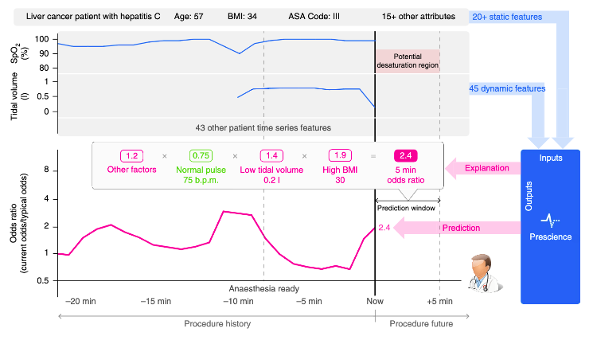
Case Study: Evaluating an Explainable ML System

Slide 26
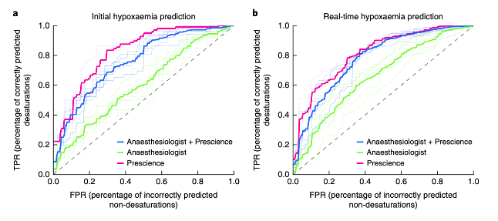
Case Study: Evaluating an Explainable ML System

Slide 27

Case Study: Evaluating an Explainable ML System
What can we conclude from
these results?
Human Alone
Human + ML System
ML System Alone
slido.com
#10718

Slide 28
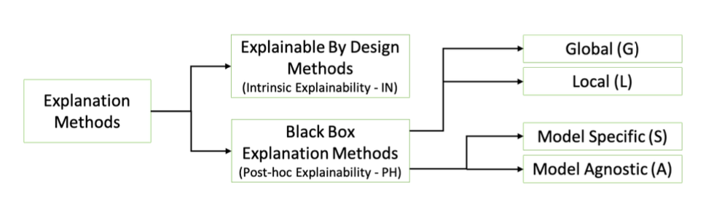
Many Approaches to Model Explanations
Bodria et al, arxiv:2102.13076v1

Slide 29
In Module 2, We’ll Explore a Few of Them…
Inherently-Interpretable Models
Post-Hoc Individual Feature Importances
Prototypes
Counterfactuals

Slide 30
Reminders
Next week:
Tuesday: Understanding your models
Thursday: Module 2 Presentations
Coming up the following week:
Monday: Update 6 (feature importances + crosstabs)
Tuesday/Thursday: Module 2 Presentations
Friday: Extended Abstract on Interpretability

