Slide 1

ML and Fairness (Overview)
Rayid Ghani

Slide 2
Scope
Data
Exploration
Modeling
Get Data
Store Data
Link Data
Rows
Features
Labels
Model Selection
Train-Test Splits
Performance Metrics
Model Interpretation
Entities
temporal
Spatial
…
Models
Dealing with Bias and Fairness
Field Trial Design
Deployment
Monitoring
Goals, Actions, Data, Analysis, Ethics

Slide 3
If you take one thing away from this session
The goal is not to make the ML model fair but to
make the overall system and outcomes fair

Slide 4
The goal is not to make the ML model fair but to
make the overall system and outcomes fair
AI/ML Model
Actions
Outcomes

Slide 5
Compared to what?
Current (Human) Decisions
Actions
Outcomes
Does the new system need to be perfect or can it be better than the status quo and still worth implementing?

Slide 6
Workflow
Define (desired fairness or equity goals)
Understand (root causes of bias)
Improve (fairness of AI systems)
Measure and Detect (bias)
Mitigate (the impact through adjusting interventions)
Monitor & Evaluate

Slide 7
The focus should not just be on making the ML model fair but rather on making the overall system and outcomes fair
Define (desired fairness or equity goals)
Understand (root causes of bias)
Improve (fairness of AI systems)
Measure and Detect (bias)
Mitigate (the impact through adjusting interventions)
Monitor & Evaluate

Slide 8



Do not edit How to change the design
What type of bias would we care about in our class project? how would you define that mathematically?
The Slido app must be installed on every computer you’re presenting from

Slide 9
Many Bias Measures: How do we select what we design for?
Do we allocate equal resources to every group?
Do we allocate resources proportional to need?
Do we make sure we don’t miss people with of a certain group disproportionately?
Do we make sure we don’t have disproportionate false positives from a particular group?
...

Slide 10
Many Bias Measures: How do we select what we design for?
Do we allocate equal resources to every group?
Do we allocate resources proportional to need?
Do we make sure we don’t miss people with of a certain group disproportionately?
Do we make sure we don’t have disproportionate false positives from a particular group?
...

Slide 11
Many Bias Measures: How do we select what we care about?
Statistical/Demographic Parity
Impact Parity
False Discovery Rate Parity
False Omission Rate Parity
False Positive Rate Parity
False Negative Rate Parity
...

Slide 12
Why do we have to choose?

Slide 13
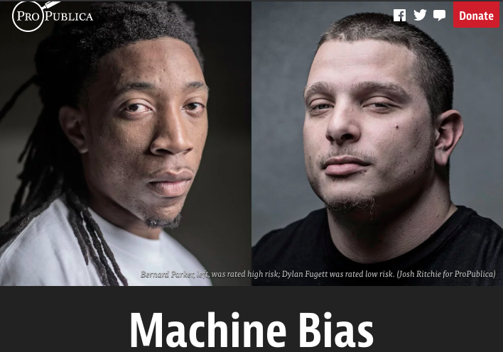
Incompatibility Between Fairness Metrics

Slide 14
Consider Three Metrics…
False Positive Rate
False Negative Rate
False Discovery Rate

Slide 15
Consider Three Metrics…
False Positive Rate: Among people who do not recidivate, the proportion the model incorrectly predicts will recidivate
False Negative Rate: Among people who do recidivate, the proportion the model incorrectly predicts will not recidivate
False Discovery Rate: Among the people who the model predicts will recidivate, how many actually do not

Slide 16
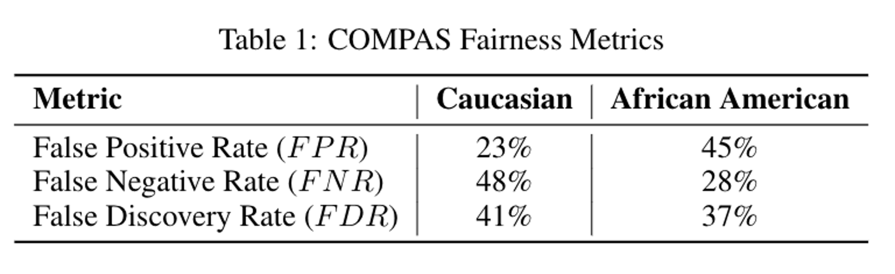

Slide 17
ProPublica identified considerable disparities:
The algorithm was twice as likely to incorrectly predict black individuals were at high risk of recidivating (FPR)
It was also nearly twice as likely to incorrectly predict white individuals were at low risk of recidivating (FNR)

Slide 18
However, the creator of the algorithm pointed out that the algorithm is well-balanced across races on precision (equivalently, FDR), claiming this is the correct measure of fairness in this context.

Slide 19
Who is right?
Is the COMPAS algorithm biased?
Can’t the algorithm achieve both measures of fairness at the same time?

Slide 20
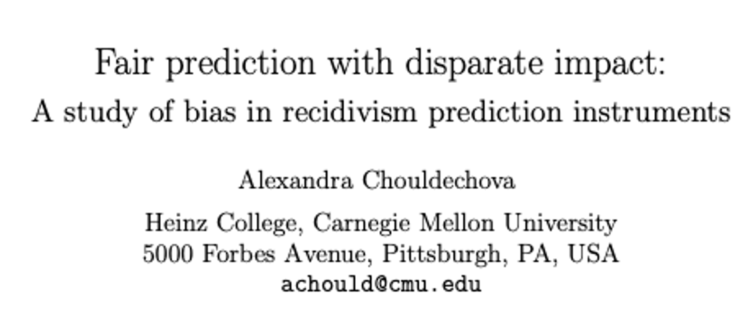

Slide 21
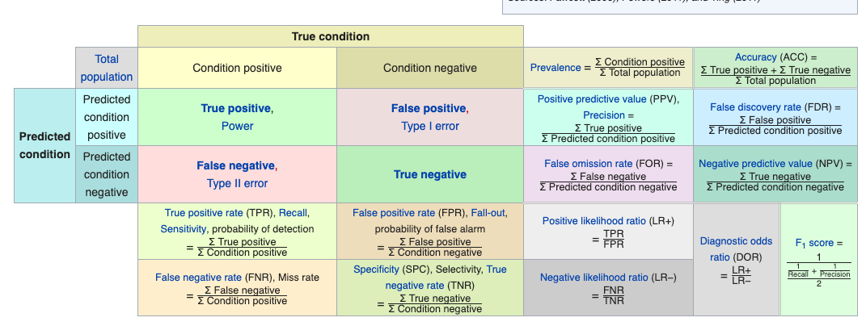

Incompatibility Between Fairness Metrics

Slide 22
Incompatibility Between Fairness Metrics
False Positive Rate
Among all actual 0’s,
fraction predicted to be 1
False Negative Rate
Among all actual 1’s,
fraction predicted to be 0
Prevalence
Fraction of
actual 1’s in
population
False Discovery Rate
Among all predicted 1’s,
fraction that are actual 0’s
=(1 – precision)
Chouldechova, A. (2017). Fair prediction with disparate impact: A study of bias in recidivism prediction instruments. Big data, 5(2), 153-163.

Slide 23
Incompatibility Between Fairness Metrics
If prevalence is unequal across groups...

Slide 24
Incompatibility Between Fairness Metrics
If prevalence is unequal across groups...
…and FDR (or precision)
is equal across groups...

Slide 25
Incompatibility Between Fairness Metrics
If prevalence is unequal across groups...
…and FDR (or precision)
is equal across groups...
…then either FPR or FNR can be equal across groups, but not both

Slide 26
Does that mean we cannot achieve fairness in ML? models?
Sadly, no… we can’t have it all!
But this also doesn’t mean fairness is unachievable or we shouldn’t bother.
Instead, it means we have to carefully consider and choose the appropriate fairness metrics for our context

Slide 27
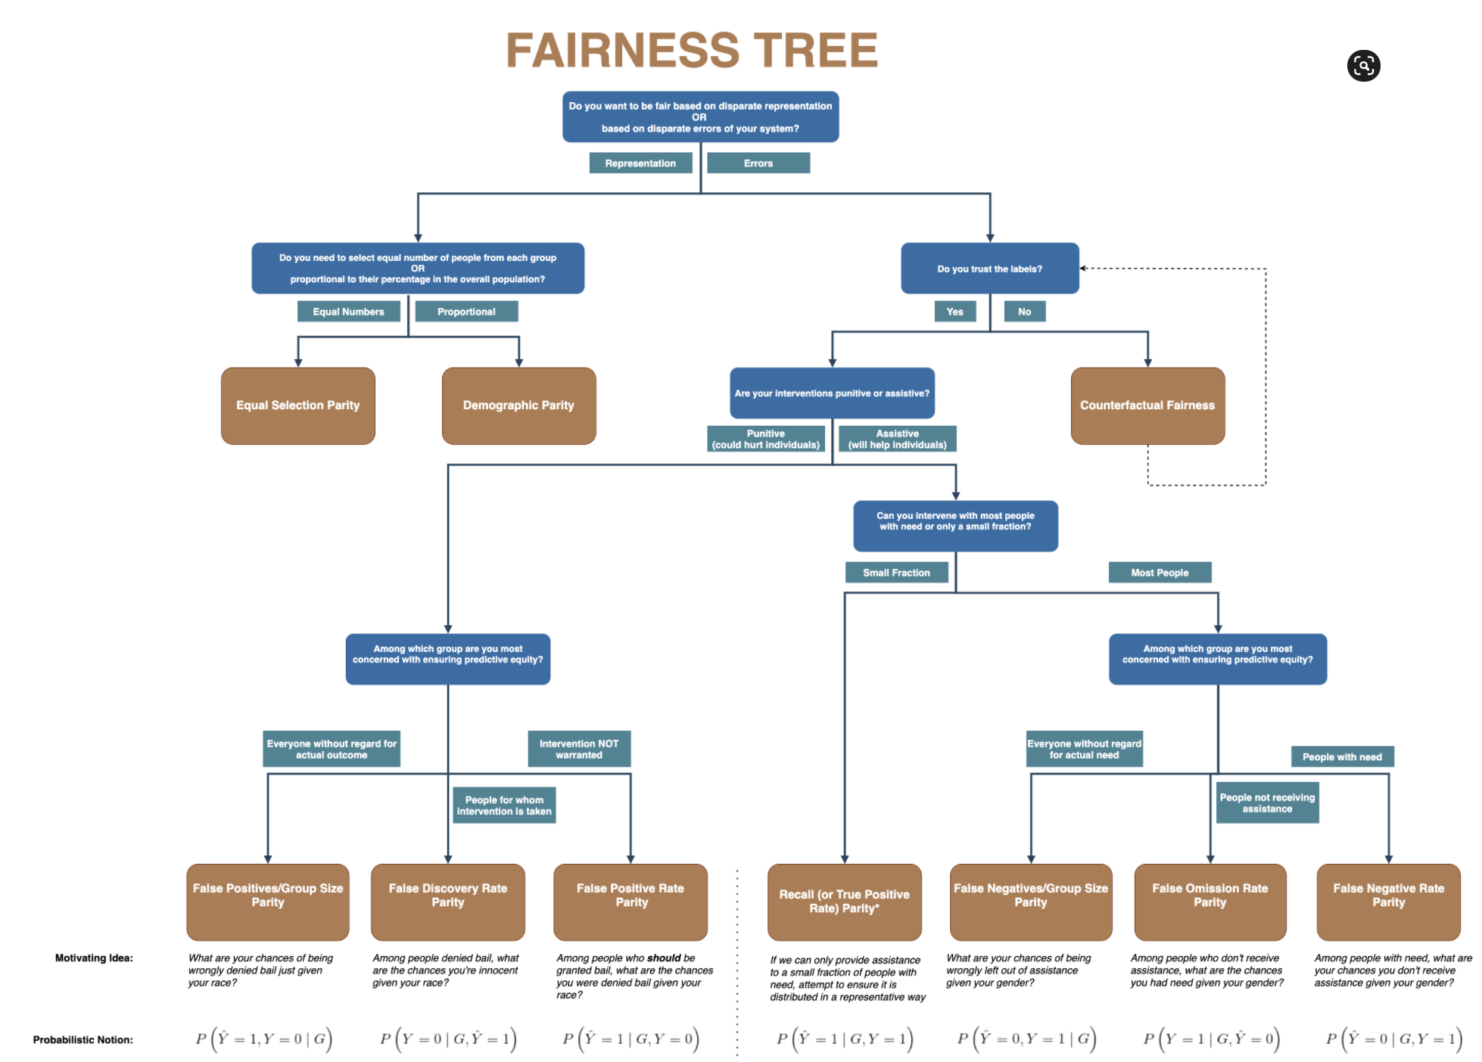
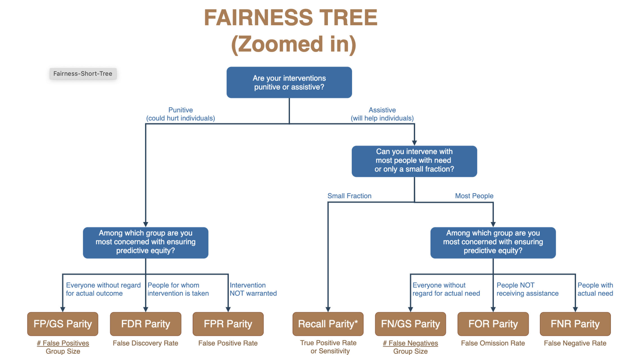

Slide 28
The focus should not just on making the ML model fair but rather on making the overall system and outcomes fair
Define (desired fairness or equity goals)
Understand (root causes of bias)
Improve (fairness of AI systems)
Measure and Detect (bias)
Mitigate (the impact through adjusting interventions)
Monitor & Evaluate

Slide 29
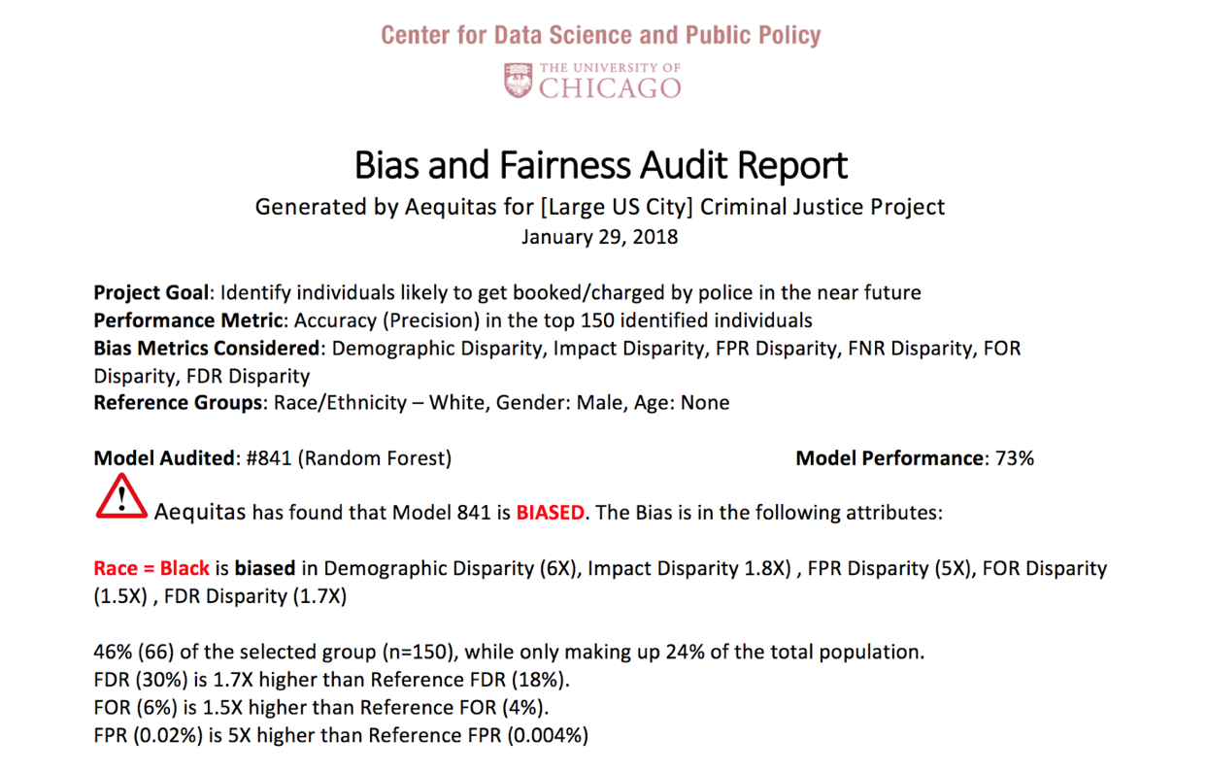
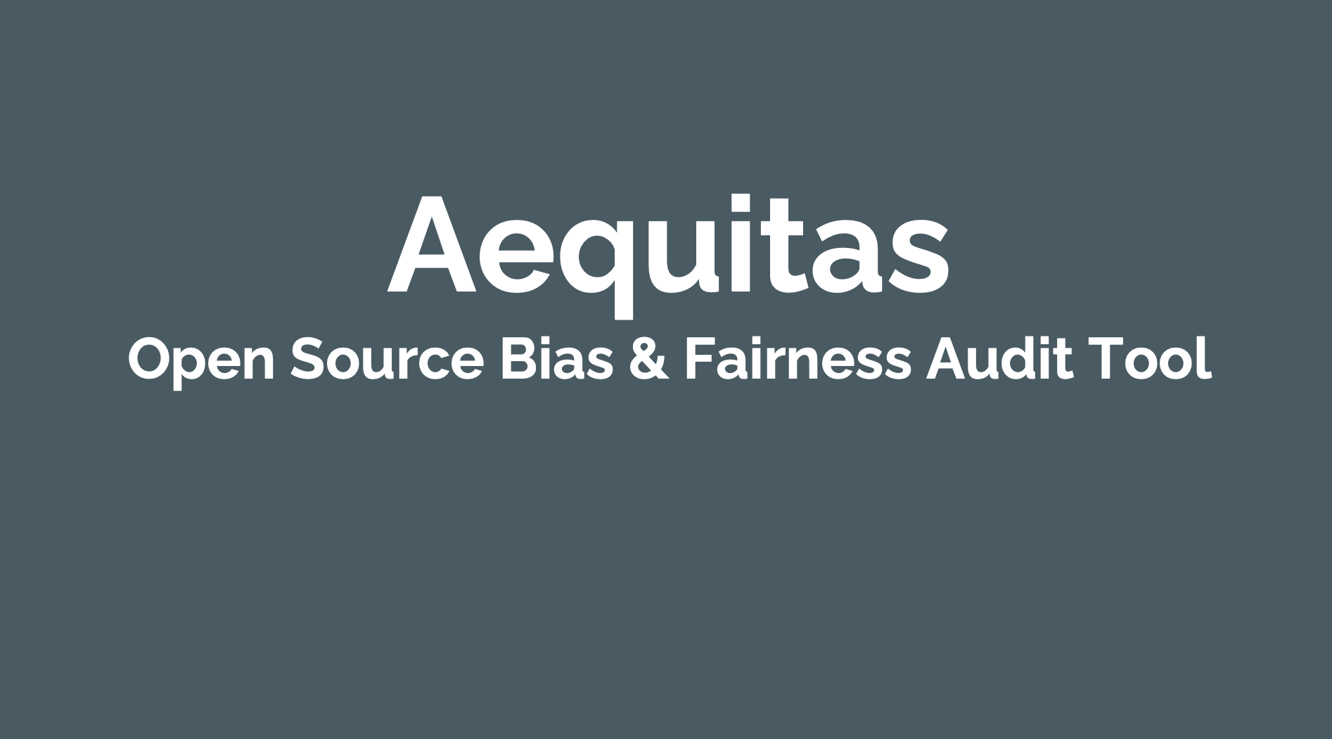
Aequitas: Bias Audit Tool
http://datasciencepublicpolicy.org/aequitas
http://www.datasciencepublicpolicy.org/aequitas/

Slide 30
What do you need to audit predictions of a model?
Predictions (either binary predicted labels or scores along with a desired “top-k” list size)
Attributes that define protected groups (e.g. race, sex, age)
Labels* (if interested in disparate errors)
Notes:
Label - counterfactual caveat

Slide 31

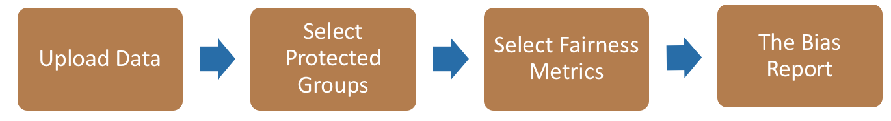
Bias Audit flow
Race
Sex
Age
Predicted Scores and Labels
Equal True Positive Rate

Slide 32
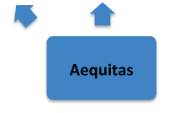
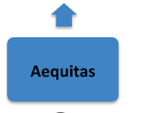
Get Data
Store and Link Data
Process Data
Explore Data
Modeling
Communicate
Maintain
Deploy
Evaluate & Select
Test

Slide 33
Audit COMPAS using Aequitas
You can acquainted with the tool by running the COMPAS demo notebook.
https://github.com/dssg/aequitas

Slide 34
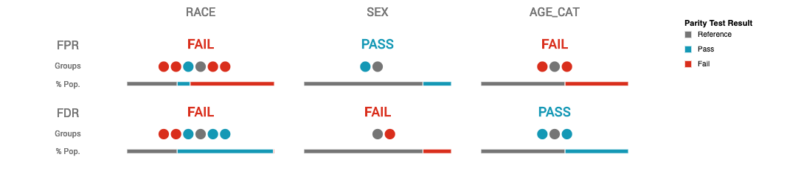
Aequitas Summary for COMPAS

Slide 35
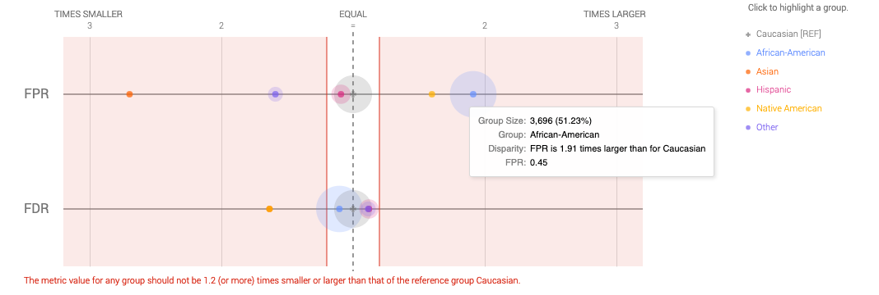
Disparity Chart

Slide 36
Auditing a Model for Bias
(click on link to load
notebook and run setup)
https://bit.ly/kddfairness

Slide 37
The focus should not just on making the ML model fair but rather on making the overall system and outcomes fair
Define (desired fairness or equity goals)
Understand (root causes of bias)
Improve (fairness of AI systems)
Measure and Detect (bias)
Mitigate (the impact through adjusting interventions)
Monitor & Evaluate

Slide 38
Diagnosing the root causes of bias in AI/ML Systems
World
AI Pipeline
Actions
Data
Disparity in Outcomes
Bias and disparity (in outcomes) can come from any of these four components
Sample Bias
Measurement Bias
Label Bias
System Developers
Complexity or flaws
Design Choices

Slide 39
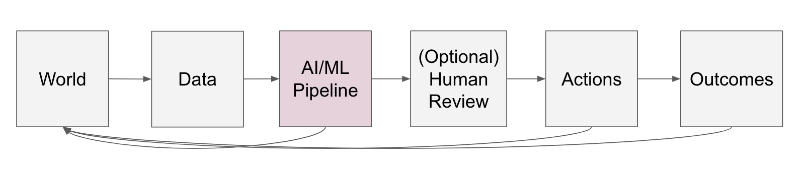
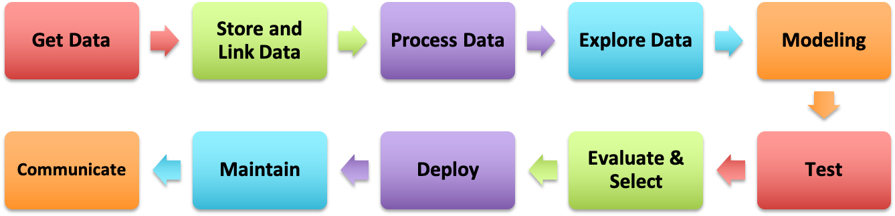
Even within the ML Pipeline, bias can be introduced in every step

Slide 40
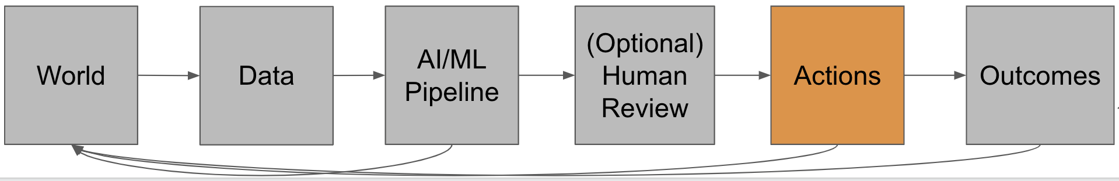
Action/Intervention Bias
Heterogeneity in the effectiveness of an intervention across groups.
Discriminatory ‘overrides’ by the actors conducting the interventions.

Slide 41
The focus should not just on making the ML model fair but rather on making the overall system and outcomes fair
Define (desired fairness or equity goals)
Understand (root causes of bias)
Improve (fairness of AI systems)
Measure and Detect (bias)
Mitigate (the impact through adjusting interventions)
Monitor & Evaluate

Slide 42
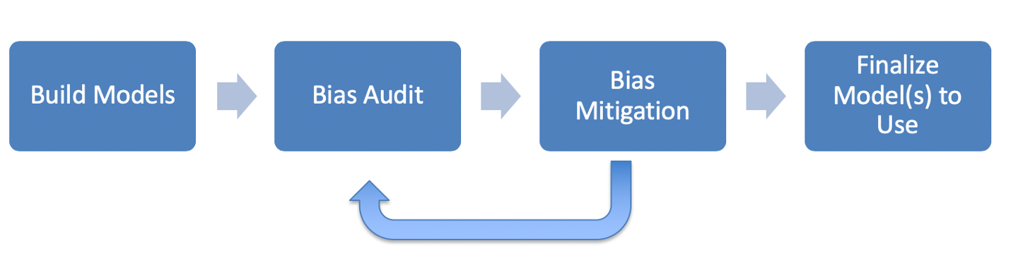
ML Fairness Workflow

Slide 43
How can we reduce bias in ML models?
Fix the world
Pre-Processing: Fix the input data
Remove sensitive attributes (and correlated ones)
Resample and/or reweight protected groups
In-Processing: Optimize for fairness in model training
Post-Processing
Choose fair models during model selection
Post-hoc adjustments to ‘de-bias’ model scores

Slide 44
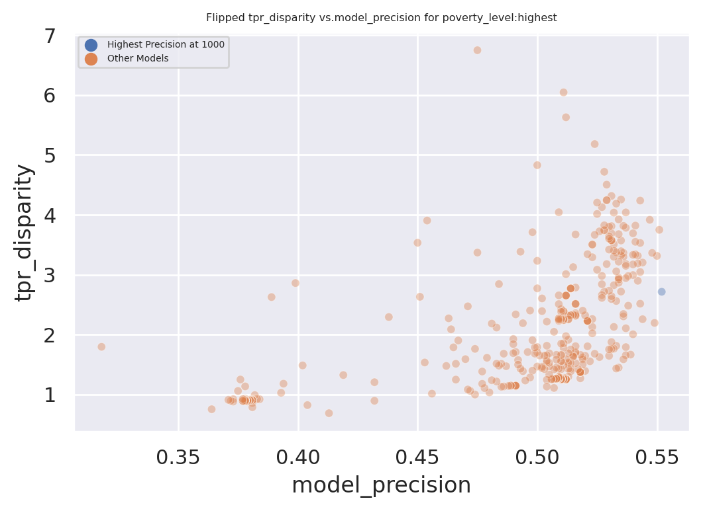
Exploring Trade-Offs
Each point is a different
model specification
Disparity
Precision@k

Slide 45
Exploring Trade-Offs
Each point is a different
model specification
Points further to the right
are more accurate
Disparity
Precision@k

Slide 46
Exploring Trade-Offs
Each point is a different
model specification
Points further to the right
are more accurate
Points closer to 1 on the
y-axis are more fair
Disparity
Precision@k

Slide 47
Exploring Trade-Offs
Disparity
“Best” model just based
on top k precision
Precision@k

Slide 48
Exploring Trade-Offs
Disparity
Pareto Frontier
Precision@k

Slide 49
Exploring Trade-Offs
Disparity
Our hope:
Fairness-improving
methods can expand this
frontier by adding new
points
Precision@k

Slide 50

Case Study: Reducing Misdemeanor Recidivism through Diversion and Social Service Programs
Predictive Fairness to Reduce Misdemeanor Recidivism Through Social Service Interventions. Rodolfa et al. ACM FAT* 2020
UNMET
NEEDS
MISDEMEANOR
ARREST
JAIL
worsening or failing to improve
Notes:
Unmet needs might include homelessness, unemployment, substance abuse/addiction, mental health issues, etc.
Not suggesting these are only factors in crime/arrests, but believe they are important contributors

Slide 51
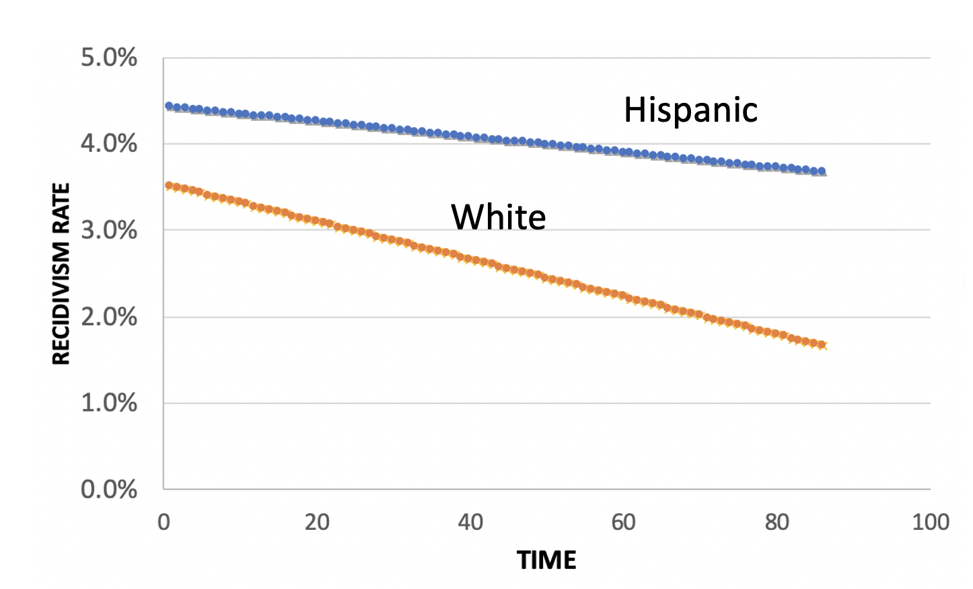
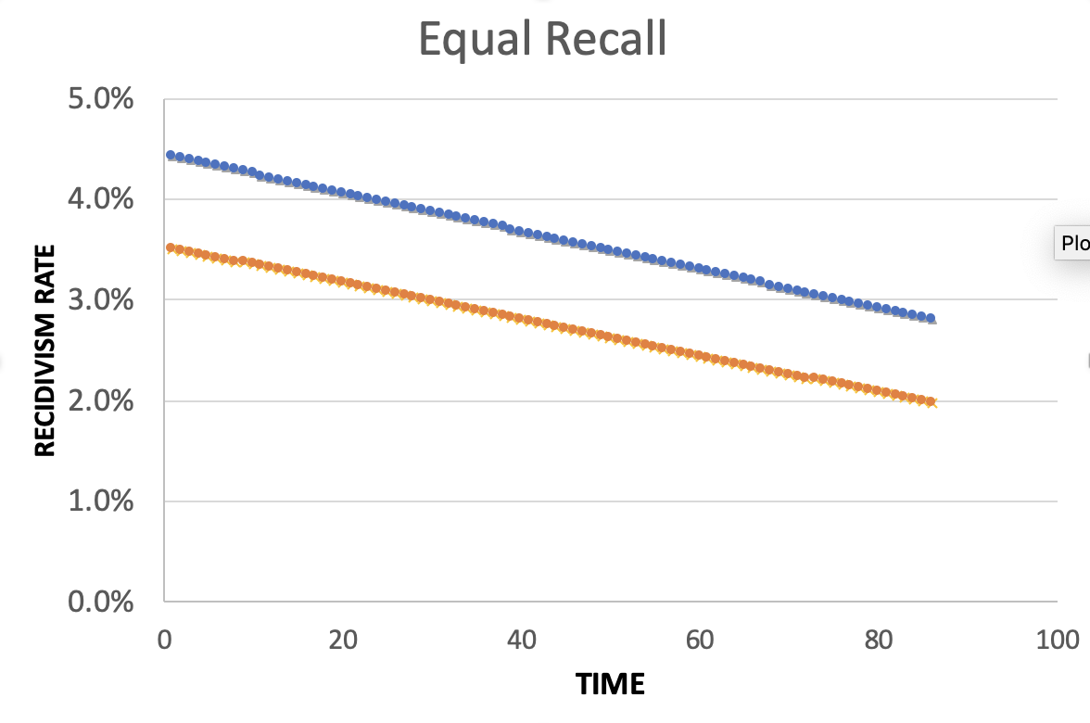
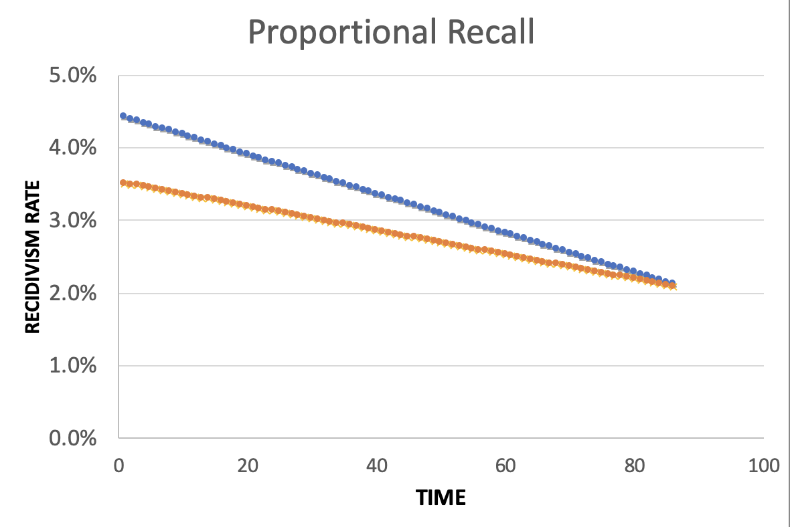
Policy Menu
Designing for Efficiency
72.7% Efficient
Equality
Additional Cost: 2%
Equity
Additional Cost: 2%

Slide 52
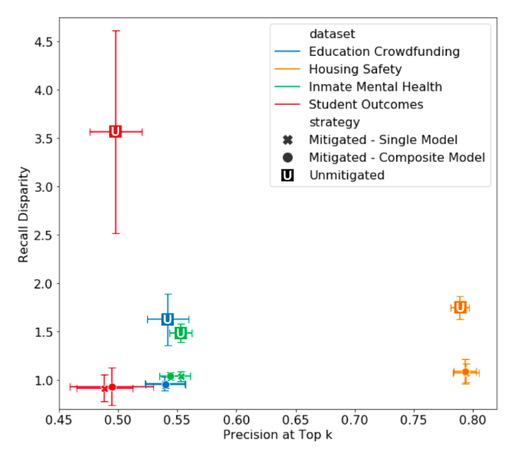
Bias
No Disparity
“Accuracy”

Slide 53
We may not have to sacrifice accuracy in order to get fairness but we do have to deliberately and explicitly design our AI systems for equity and fairness

Slide 54
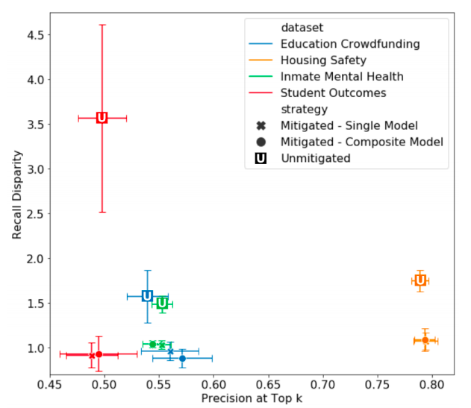

Slide 55
Some common practitioner (mis)perceptions
Not using race in my models makes my models not racist
Using race in my models makes my models racist
Bias comes from and can be fixed by “fixing” the data
I have to eliminate all bias in order to use/deploy an ML system
I have to satisfy all measures of bias in order to be fair
There is always a tradeoff between fairness and accuracy
A fair ML model = Fair and equitable outcomes
Bias reduction methods actually reduce bias

Slide 56
Useful Resources
Hands-on Fairness and Bias Tutorial with interactive Jupyter Notebooks
Aequitas: Bias Audit Tool
For more details,
link to tutorial: https://dssg.github.io/fairness_tutorial
Github Repo: http://github.com/dssg/fairness_tutorial
Interactive Colab (Python) Notebooks: https://dssg.github.io/fairness_tutorial/notebooks/
Fairness Tree

Slide 57
Appendix

Slide 58
Legal and Social Principles
Choices about fairness and equity are implicit in any decision process but being made explicit by the growing use of algorithmic decision support.

Slide 59
Legal and Social Principles
Choices about fairness and equity are implicit in any decision process but being made explicit by the growing use of algorithmic decision support. What implicit choices about fairness are encoded when we say…
Beyond a reasonable doubt? (e.g., criminal court)
The preponderance of evidence? (e.g., civil court)
Probable cause? (e.g., indictment by grand jury)
Innocent until proven guilty?

Slide 60
Legal Perspectives and Challenges
Title VII of US Civil Rights Act – Job Discrimination
Disparate Treatment (intentional discrimination)
Disparate Impact (regardless of intention)
14th Amendment
Equal Protection (under laws and government actions)
“Strict Scrutiny” Standard: compelling state interest, narrowly tailored, and least restrictive means
Notes:
14th Amendment often interpreted to prohibit racial classification in most cases (that is, taking race into account in state decision-making) as well as racial intentions/discriminatory purpose

Slide 61
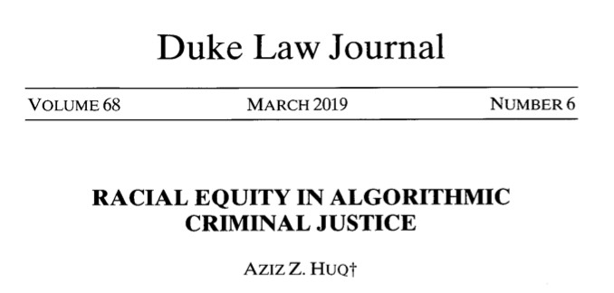
Legal Perspectives and Challenges

Slide 62
Legal Perspectives and Challenges
What Challenges Does Huq Identify Applying Current Legal Standards to Algorithmic Decision Making?

Slide 63
Legal Perspectives and Challenges
What Challenges Does Huq Identify Applying Current Legal Standards to Algorithmic Decision Making?
Expanded scale and reach of state power
Durability of errors – need for special skills to update/fix problems
What does “discriminatory intent” mean in this context?
Unclear how to apply “anticlassification” standard of equal protection

Slide 64
Legal Perspectives and Challenges
Difficulties with Equal Protection’s “Anticlassification” Standard:
Simply omitting race as a feature doesn’t ensure an algorithm is “colorblind” – too much correlated information in other features
Accounting for race may in fact be needed to decrease disparities

Slide 65
Legal Perspectives and Challenges
Drug Possession Rates
 | Black | White
Baseball Cap | 0% | 100%
No Cap | 2% | 2%

Slide 66
Legal Perspectives and Challenges
Drug Possession Rates
 | Black (25% of Pop.) | White (75% of Pop.)
Baseball Cap | 0% | 100%
No Cap | 2% | 2%
Race-Blind Policy:
75% Precision
Many Needless Searches of Minorities

Slide 67
Legal Perspectives and Challenges
Drug Possession Rates
 | Black (25% of Pop.) | White (75% of Pop.)
Baseball Cap | 0% | 100%
No Cap | 2% | 2%
Race-Aware Policy:
100% Precision
No Needless Searches of Minorities

Slide 68
Legal Perspectives and Challenges
How does Huq suggest modifying our criteria for assessing discrimination in this new context?

Slide 69
Legal Perspectives and Challenges
“Rather than asking about abstract definitions of fairness, a criminal justice algorithm should be evaluated in terms of its long-term, dynamic effects on racial stratification… [and] focus on the net burden thereby placed on the racial minority.”

Slide 70
Three Concepts of Fairness in ML
We’ve focused here on the concept of group fairness – balancing aggregate metrics across groups
Some also study the concept of individual fairness – that similar individuals should be treated similarly
An important related line of work concerns counterfactual fairness – how would your prediction if you were a member of a different group?

Slide 71
Practical Challenges with Individual Fairness
How do you measure “similarity”? Over what distance metric and what features?
Individual fairness doesn’t guarantee group fairness (but also vice-versa)
In the light of existing or historical discrimination, the protected attribute / group membership might be an important measure of dissimilarity in itself

Slide 72
Where does this leave us?
What can we do to understand bias and improve fairness of our systems?
Bias and equity audits
Try to fix the input data
Optimize for fairness in model training
Choose fair models during model selection
Post-hoc adjustments to de-bias model scores
Measure relative effectiveness of interventions across groups and develop better-tailored interventions

Slide 73
Post-Processing
Case Study

Slide 74
Case Study: Post-hoc Adjustments and Policy Goals
Cycle of Incarceration
UNMET
NEEDS
MISDEMEANOR
ARREST
JAIL
worsening or failing to improve

Slide 75
Case Study: Post-hoc Adjustments and Policy Goals
Breaking the Cycle
UNMET
NEEDS
X
MISDEMEANOR
ARREST
JAIL
TAILORED
INTERVENTION

Slide 76
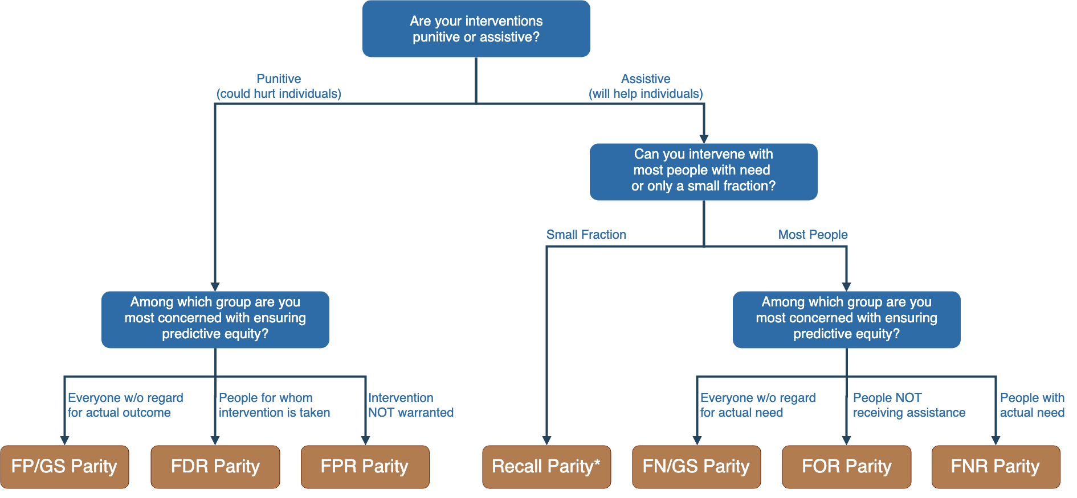
Notes:
Context-dependence of fairness definition
Idea of fairness tree is starting point for conversations with stakeholders, help guide discussion
In assistive program with resource constraints, focus on recall parity (equivalent to equality of opportunity discussed by Hardt and others --- also “sensitivity” and TPR and 1-FNR)

Slide 77
Notes:
Context-dependence of fairness definition
Idea of fairness tree is starting point for conversations with stakeholders, help guide discussion
In assistive program with resource constraints, focus on recall parity (equivalent to equality of opportunity discussed by Hardt and others --- also “sensitivity” and TPR and 1-FNR)

Slide 78
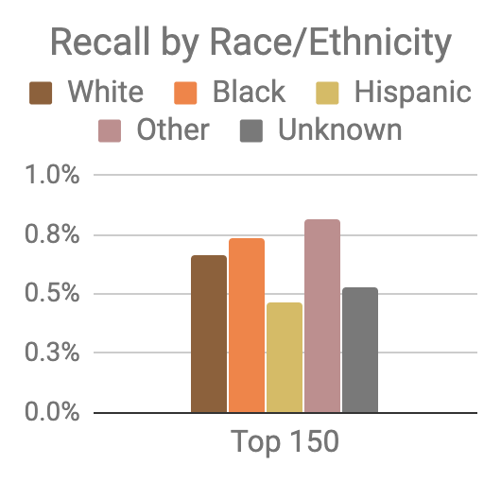
Model was optimized for efficiency, not equity
Top 150 highest risk reasonably balanced between black and white individuals
However, hispanic and unknown race/ethnicity groups very underrepresented

Slide 79
Mitigating Disparities
Single Threshold
White
Black
Hispanic
Recall
Lower Scores / Higher Recall
Group Thresholds
Recall

Slide 80
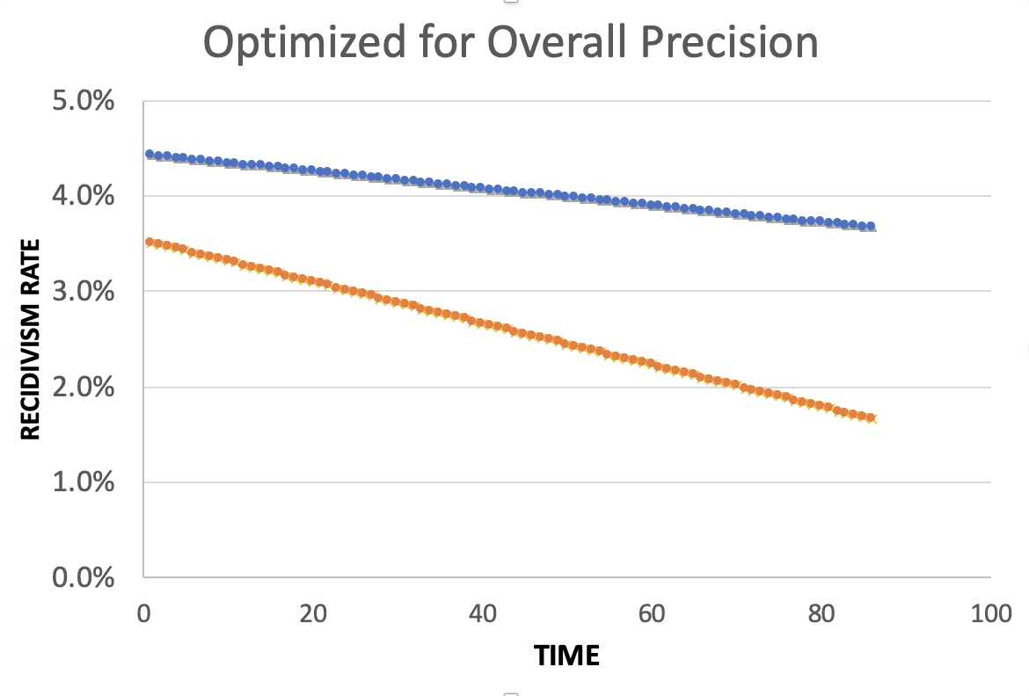
Equality of Predictions vs Underlying Disparities
Widening Gap:
Disparities Getting
Larger Over Time

Slide 81
Equality of Predictions vs Underlying Disparities
Parallel Lines:
Disparities Remain
Constant Over Time

Slide 82
Equality of Predictions vs Underlying Disparities
Converging Lines:
Disparities Decrease
Over Time

Slide 84
Menu of Options
Current Scale
Expanded Scale
No
Constraint
Equalize
Recall
Reduce
Disparities

Slide 85
Menu of Options
Current Scale
Expanded Scale
No
Constraint
INITIAL
MODEL
Equalize
Recall
Reduce
Disparities

Slide 86
Menu of Options
Current Scale
Expanded Scale
No
Constraint
Equalize
Recall
EXPLICIT
EQUITY / EFFICIENCY
TRADE-OFF
“COST OF
EQUITY”
Reduce
Disparities

Slide 87
Menu of Options
Current Scale
Expanded Scale
No
Constraint
Equalize
Recall
IMPROVE OUTCOMES AT SAME
RATE ACROSS GROUPS
Reduce
Disparities
IMPROVE OUTCOMES FASTER FOR GROUPS
WITH HIGHER INCARCERATION RATES
Notes:
For the “Reduce Disparities” options, we targeted recall levels in proportion to underlying prevalence in the population. Could make other choices, but this has the nice property of readjusting as these prevalences change while also still distributing resources across all groups, but one could reasonably take many possible approaches.

Slide 88
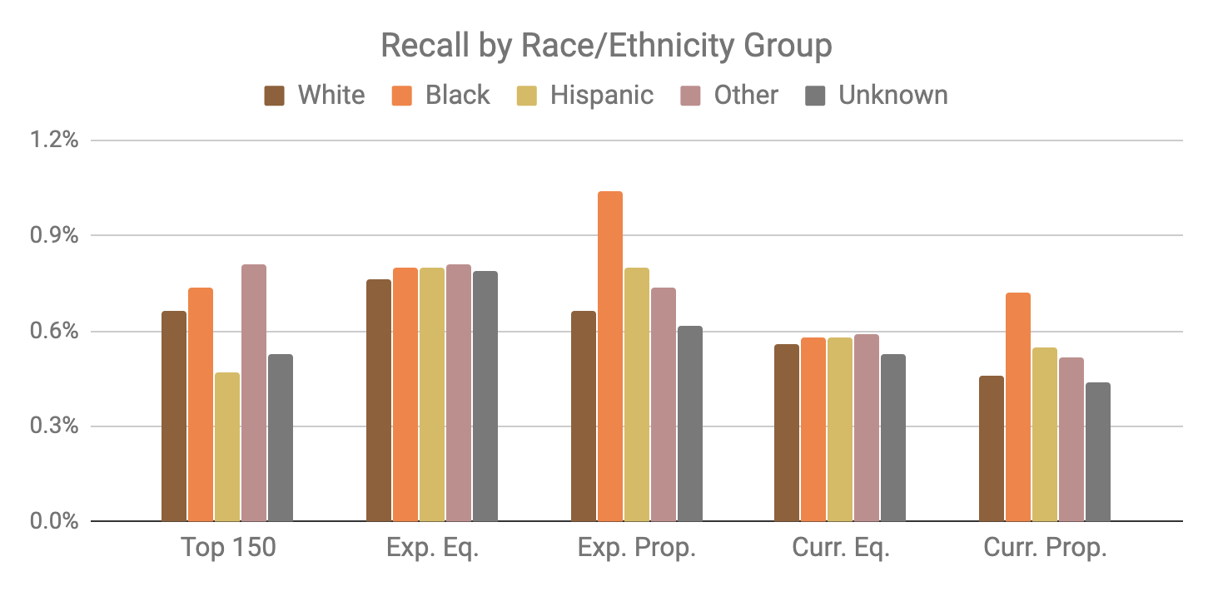
Base Model
Expanded Scale
Current Scale

Slide 89
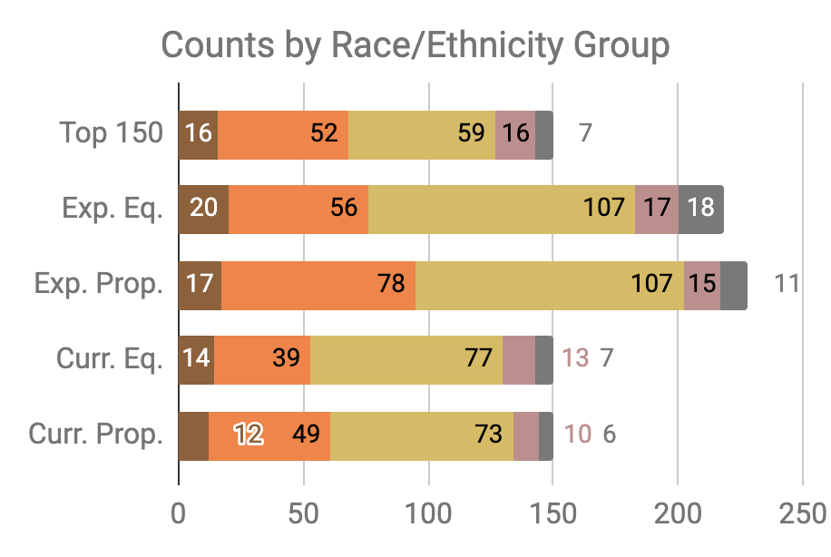

Slide 90
Little Equity/Efficiency Trade-Off at Current Scale
Top 150
72.7%
Precision
150
Total Count
Equal
Recall
70.7%
Precision
150
Total Count
Proportional
Recall
70.7%
Precision
150
Total Count

