Slide 1

Interpretability: Simple ways of Understanding ML Models and their Predictions
Rayid Ghani and Kit Rodolfa

Slide 2
Reminders
This week:
Thursday: Module 2 Presentations
Coming up next week:
Tuesday: Feedback Form
Tuesday/Thursday: Module 2 Presentations
Friday: Extended Abstract on Interpretability

Slide 3
Scope
Data
Exploration
Modeling
Get Data
Store Data
Link Data
Rows
Features
Labels
Model Selection
Train-Test Splits
Performance Metrics
Model Interpretation
Entities
temporal
Spatial
…
Models
Dealing with Bias and Fairness
Field Trial Design
Deployment
Monitoring
Goals, Actions, Data, Analysis, Ethics

Slide 4
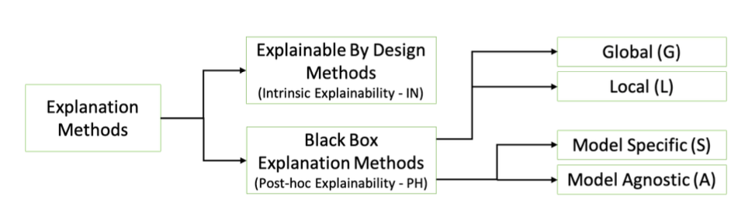
Last Time: Approaches to Model Explanations
Bodria et al, arxiv:2102.13076v1

Slide 5
Last Time: Use Cases
Use Case | User | Task | Global or Local
Debugging | ML Developer | Sanity check and improve “correctness” | Both
Improving performance | Action- taker | Decide to agree or override | Local
Trust | Policymaker/Action-Taker | Model use => better outcomes | Both
Interventions | Action-Taker | Improve outcomes | Local
Recourse | Individual(s) affected | Provide information that the individual can understand and ideally change | Local

Slide 6
Today: Understanding what the model is doing
Look at the model
Look at score distributions and calibration
Look at Feature Importances
Look at contributions of “feature groups“
Cross-Tabs on the “predictions”
Error Analysis

Slide 7
Case Study
Childhood Vaccination in Mexico

Slide 8
How to interpret specific models
Decision Trees
KNN
SVMs
RFs
NNs

Slide 9
Feature Importances

Slide 10
Leave one out feature groups
(Incremental) Predictive Utility of a Feature (Group):
Run models with all feature groups
Run models with only 1 feature group
Run models with all except 1 feature group
And if it’s feasible, run all possible feature subsets

Slide 11
Understanding Predictions
Score Distributions
Stack-Ranking and Calibration
Cross-Tabs
Clustering

Slide 12
Characterizing the top k predicted entities
Optional (only available for historical data)
entity_id | score | true_label
582 | 0.99 | 1
882 | 0.91 | 1
471 | 0.85 | 0
094 | 0.84 | 1
... | ... | ...

Slide 13
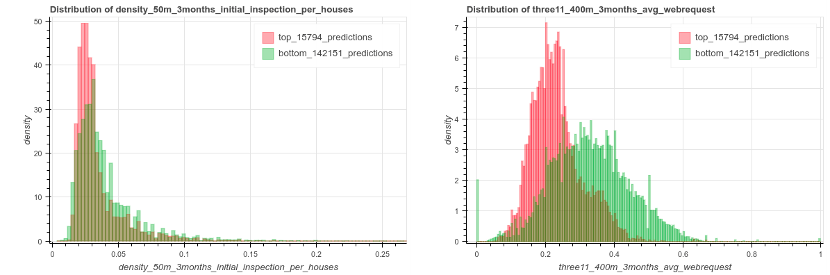

Slide 14
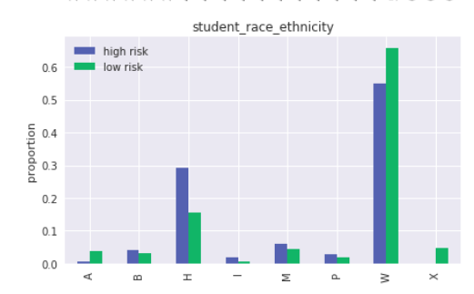
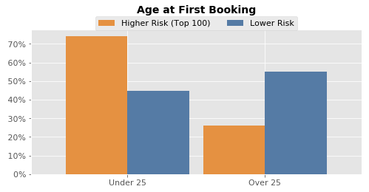
Cross-Tabs

Slide 15
Cross-Tabs
Continuous Variables
T-Test
Null-Hypothesis: The feature mean in the high-risk group is the same as in the low-risk group
KS-Test
Null-Hypothesis: The feature distribution in the high-risk group is the same as in the low-risk group.
Categorical Variables
Chi-Square Test / Fisher’s Exact Test
Null Hypothesis: The high-risk and low-risk groups have the same feature distribution.

Slide 16
Example
Compared to the overall population, the top 5% predicted to be at highest risk are
2x | less likely to report an illness in the past three years (4.3% versus 9.1%)
177 days | above average age in their grade last year, compared to 98 days younger than average in negative group
1.8x | more likely to missing data for their commute method in the last year (94% vs 51%)
10x | more grades repeated on average in the last year (.15 vs .015)
3x | more likely to have missing gender data for the previous year (48% vs 19%)
3x | more likely to have missing data for father entry (48% imputed vs 19%)
10% | fewer years spent in rural areas in past 3 years (.85 vs .95)

Slide 17
Error Analysis
Error Trees
Clustering
Individual Feature Importances

Slide 18
Module 2 Presentation Reminders
High-level introduction and how the method works ~2 minutes
What you had to do to apply it to your project ~4 minutes
Results from your analysis ~5 minutes
General strengths/weaknesses, suggestions for improvements ~4 minutes

Slide 19
Evaluating Explainable ML Methods
How easy is the method to apply to a new setting (either with an existing implementation or from the description in the paper)?
Are there parameters you need to choose? If so, how do you find good values and how sensitive are the results to these choices?
Do the explanations “make sense”? Are they internally consistent? Do they seem consistent with what you know about the context and the data?
Are the explanations useful? Would they actually improve outcomes for the given use case?
Do you have to make any trade-offs to improve interpretability (e.g., computational time, model accuracy?)

Slide 20
Explainability vs Accuracy?
Deep Neural Net
Explainable ML Goal
Accuracy
Pareto Frontier
2-Deep Decision Tree
Explainability

Slide 21
Module 2 Presentation Questions
Any questions on presentations for module 2? How are things going so far?

Slide 22
Reminders
This week:
Thursday: Module 2 Presentations
Coming up next week:
Tuesday: Feedback Form
Tuesday/Thursday: Module 2 Presentations
Friday: Extended Abstract on Interpretability

