Slide 1

Causal Inference and ML Experiments
Rayid Ghani and Kit Rodolfa

Slide 2
Reminders
Coming up next week:
Module 3 Presentations – Preprocessing
Coming up the following week:
Module 3 Presentation Recordings (no class meetings)

Slide 3
Recap:
Bias and Fairness

Slide 4
Scope
Data
Exploration
Modeling
Get Data
Store Data
Link Data
Rows
Features
Labels
Model Selection
Train-Test Splits
Performance Metrics
Model Interpretation
Entities
temporal
Spatial
…
Models
Dealing with Bias and Fairness
Field Trial Design
Deployment
Monitoring
Goals, Actions, Data, Analysis, Ethics

Slide 5
Many Bias Measures: How do we select what we care about?

Slide 6
So… what does this mean?
Sadly, no… we can’t have it all!
But this also doesn’t mean fairness is unachievable or we shouldn’t bother.
Instead, it means we have to carefully consider and choose the appropriate fairness metrics for our context

Slide 7
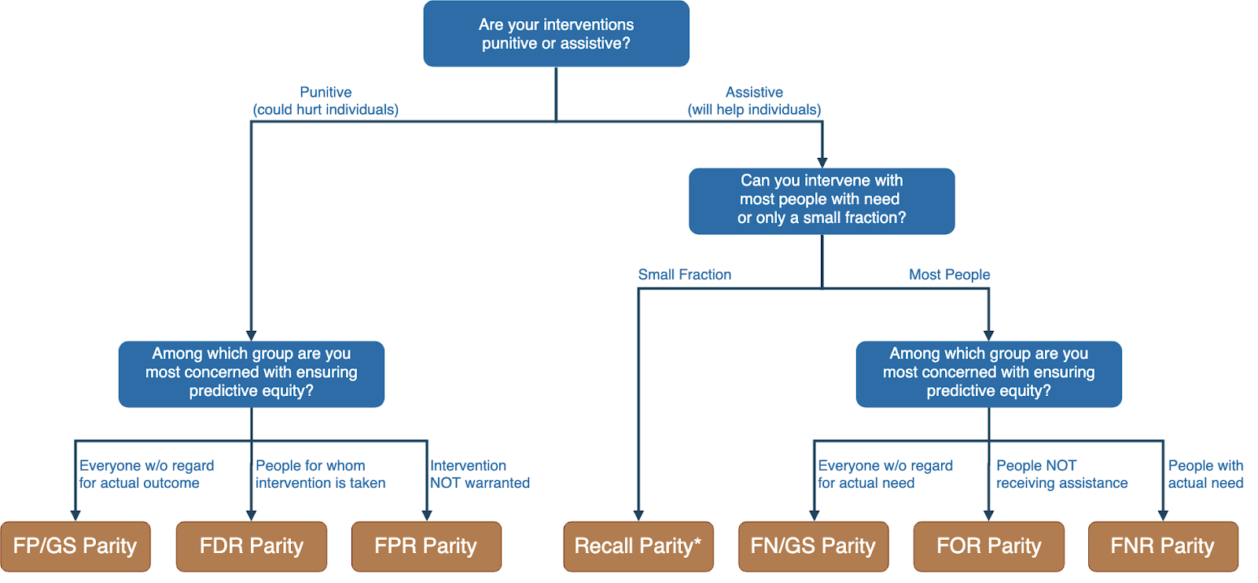
Translating project goals to fairness metrics

Slide 8
How should we think about fairness for the class project?
What metric(s) might make sense?

Slide 9
How can we reduce bias in ML models?
Fix the world
Pre-Processing: Fix the input data
Remove sensitive attributes (and correlated ones)
Resample and/or reweight protected groups
In-Processing: Optimize for fairness in model training
Post-Processing
Choose fair models during model selection
Post-hoc adjustments to ‘de-bias’ model scores

Slide 10
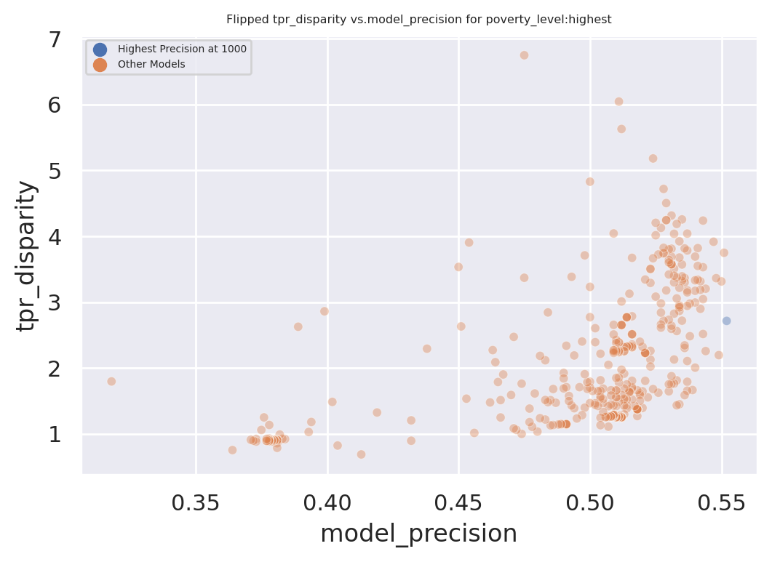
Exploring Trade-Offs
Disparity
Our hope:
Fairness-improving
methods can expand this
frontier by adding new
points
Precision@k

Slide 11
Module 3 Presentation Reminders
High-level introduction and how the method works ~2 minutes
What you had to do to apply it to your project ~4 minutes
Results from your analysis ~5 minutes
General strengths/weaknesses, suggestions for improvements ~4 minutes

Slide 12
Module 3 Presentation Reminders
Focus on appropriate bias metrics
Are there trade-offs between fairness and precision?
Choice of group attributes for analyses

Slide 13
Fairness / Module 3 Questions?

Slide 14
Causality and
Field Validation

Slide 15
Scope
Data
Exploration
Modeling
Get Data
Store Data
Link Data
Rows
Features
Labels
Model Selection
Train-Test Splits
Performance Metrics
Model Interpretation
Entities
temporal
Spatial
…
Models
Dealing with Bias and Fairness
Field Trial Design
Deployment
Monitoring
Goals, Actions, Data, Analysis, Ethics

Slide 16
Things to cover today
Causal Inference 001
With Observational Data
Methods
Examples
Experiments
Standard Randomized Controlled Trials
Trial Design
Examples
Validating ML models/systems
Trial Design
Examples

Slide 17
What is the purpose of doing field validation?

Slide 18
Field Validation: Beyond A/B Testing
How well does the model perform in the real world?
Validation on truly unseen future data; only way to ensure against leakage
What key assumptions in our formulation need to be tested?
Are we intervening with the “right” people?
Are we intervening in the best way possible?
Impact of historical decision making / selective labels?
Most importantly: how well does the ML system we’re building help the organization realize its goals?

Slide 19
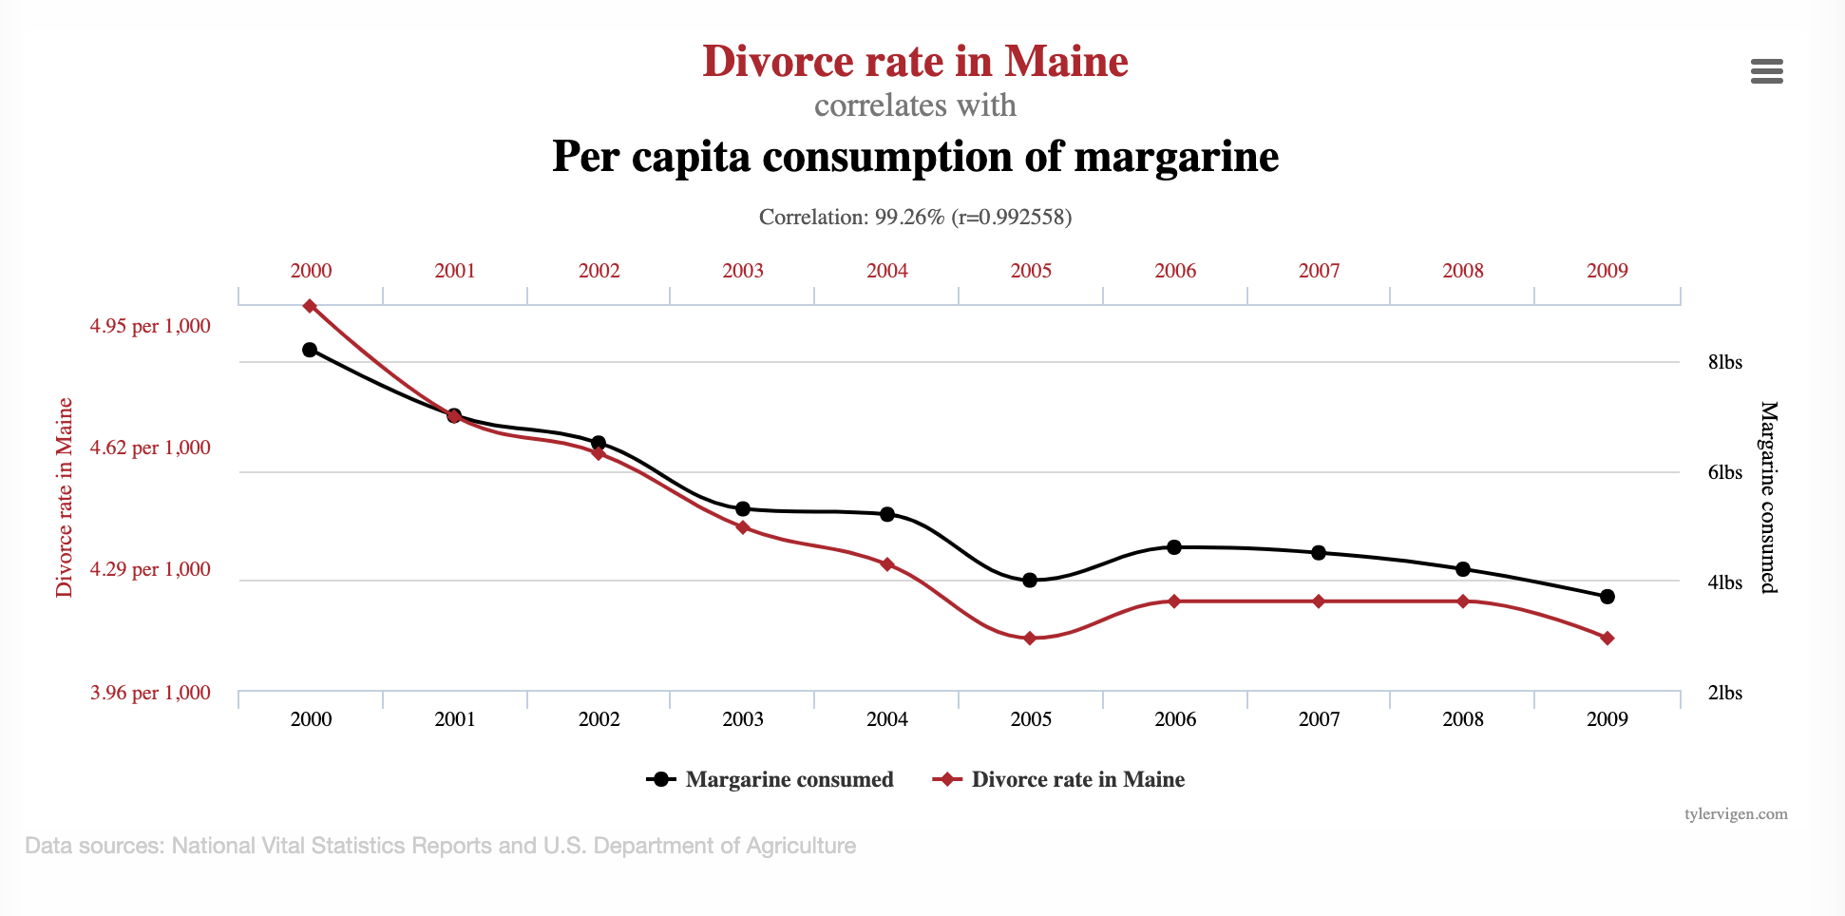
Goals of Causal Inference

Slide 20
Do sports programs affect school graduation rates?
sports programs
?
graduation

Slide 21
Do sports programs affect school graduation rates?
sports programs
Confounders
?
graduation

Slide 22
Do sports programs affect school graduation rates?
sports programs
Confounders
?
graduation
Examples?

Slide 23
Causal Research Design
Experiments
Quasi-experiments
Observational studies

Slide 24
Experiment
sports programs
Confounders
?
graduation
Researcher randomly assigns sports programs

Slide 25
Quasi-Experimental
sports programs
Confounders
?
graduation
Nature/World randomly assigns sports programs

Slide 26
Observational Study
sports programs
Confounders
graduation
Include confounders in regression

Slide 27
CASE STUDY: Mental Health and Incarceration
Cycle of Incarceration
UNMET
NEEDS
MISDEMEANOR
ARREST
JAIL
worsening or failing to improve

Slide 28
CASE STUDY: Mental Health and Incarceration
Breaking the Cycle
UNMET
NEEDS
X
MISDEMEANOR
ARREST
JAIL
MENTAL HEALTH OUTREACH

Slide 29
CASE STUDY: Mental Health and Incarceration
Return to Jail Risk
Released From Jail
In Past 3 Years
ID | SCORE
27 | 0.95
13 | 0.93
1 | 0.89
93 | 0.89
53 | 0.82
23 | 0.75
59 | 0.72
64 | 0.65
20 | 0.61
18 | 0.59
46 | 0.52
82 | 0.48
49 | 0.37
56 | 0.22
17 | 0.12
Mental
Health
Outreach
Model
X
…With History of
Mental Health
Needs
Return to
Jail

Slide 30
CASE STUDY: Mental Health and Incarceration
Return to Jail Risk
Released From Jail
In Past 3 Years
ID | SCORE
27 | 0.95
13 | 0.93
1 | 0.89
93 | 0.89
53 | 0.82
23 | 0.75
59 | 0.72
64 | 0.65
20 | 0.61
18 | 0.59
46 | 0.52
82 | 0.48
49 | 0.37
56 | 0.22
17 | 0.12
Mental
Health
Outreach
Model
X
…With History of
Mental Health
Needs
Return to
Jail
What would you want to learn
through a field trial?

Slide 31
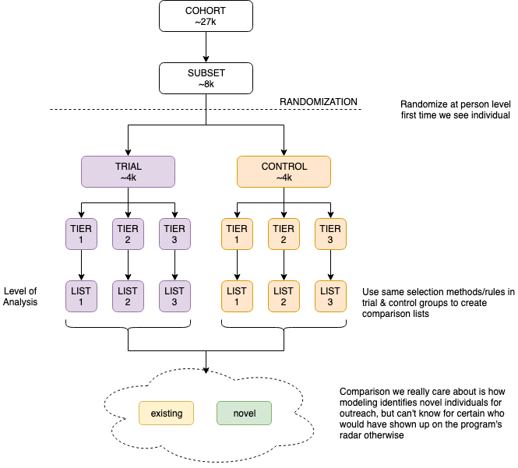

Slide 32
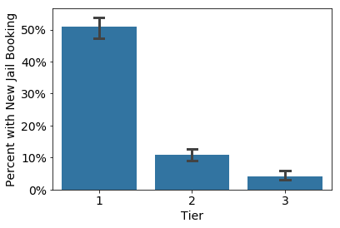
Q1: Is the Model Predictive?

Slide 33
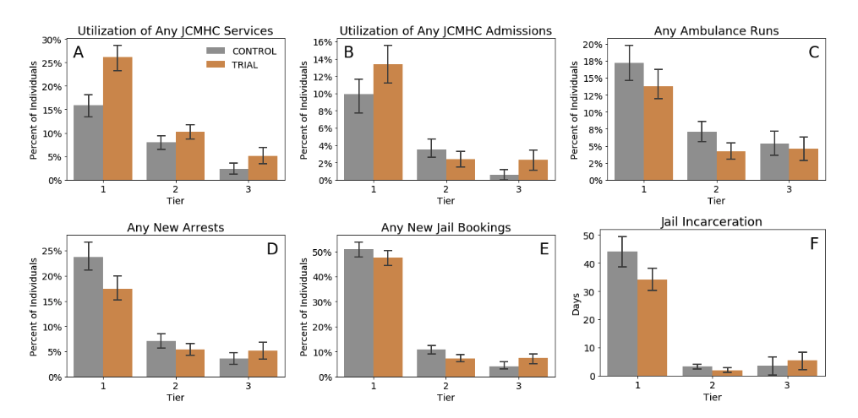
Q2: Does Model+Intervention Affect Outcomes? For Whom?

Slide 34
Methods for causal inference
Using Observational Data
Using Experiments

Slide 35
Causal inference with observational data
Matching
Difference-in-Difference (DID)
Regression Discontinuity Design (RDD)
Instrumental Variables
Limitations?

Slide 36
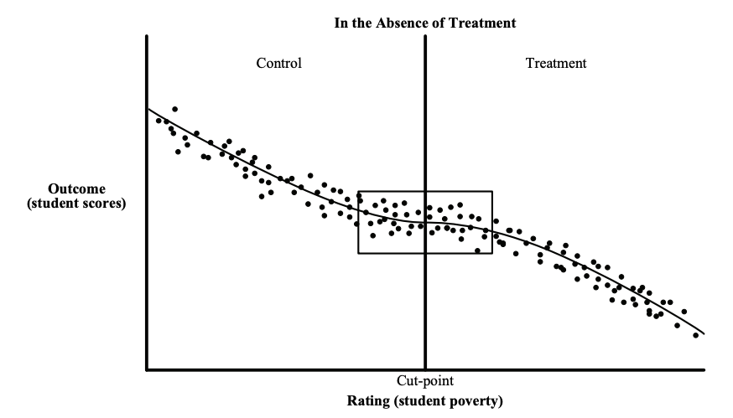
Causal inference with observational data
https://www.mdrc.org/sites/default/files/RDD%20Guide_Full%20rev%202016_0.pdf

Slide 37
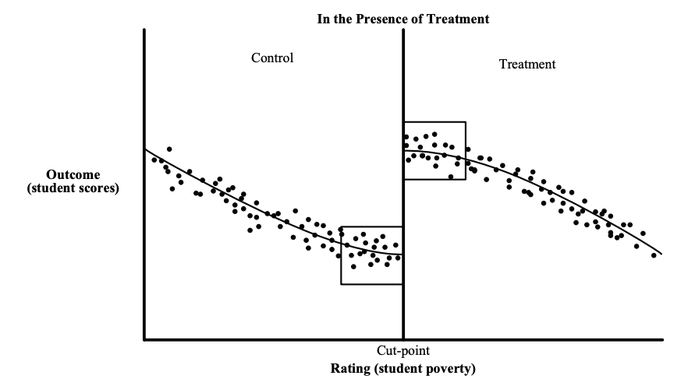
Causal inference with observational data
https://www.mdrc.org/sites/default/files/RDD%20Guide_Full%20rev%202016_0.pdf

Slide 38
Causal inference with experiments
Standard “Randomized Controlled Trials”
Trial Design
Outcome
Sample size
Power
Randomization
Ethical Concerns

Slide 39
Some things to keep in mind
Sample Size
Power Effect Size Significance Level
Effect size > what is practically useful and significant
Significance Level ~ cost of implementing the new system/model

Slide 40
Designing Trials to Validate ML Systems
What can we do with historical data?
Model Selection
Performance Estimation
How do we select the model to deploy?
Compare shortlisted models against baseline
How do we validate whether our ML system will work when deployed?

Slide 41
Designing an experiment
What are we trying to test?
How do we create different arms of the experiment?
How we do we run the experiment?
What do we measure?
How do we evaluate?

Slide 42
What are we testing in an experiment?
Lift?
Classification?
Probability estimates?
Ranking?
How does the experiment design change?

Slide 43
How many [students, inspections, projects] should we include in our trial?
Doing a trial over [y] years with [n] students every year will give us a [p%] chance to detect an [e%] increase in [outcome] with a statistical significance of [s%]

Slide 44
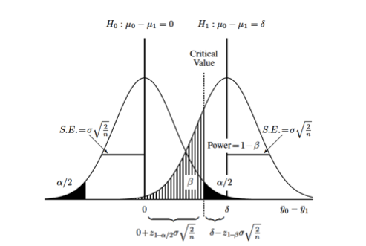
How many [students, inspections, projects] should we include in our trial?
https://clincalc.com/stats/samplesize.aspx

Slide 45
Some Readings
References on causal inference
The seven tools of causal inference, with reflections on machine learning by Pearl, J. Comm ACM. 2019
Elements of Causal Inference by Peters et al. MIT Press. (Open Access Text)
Counterfactuals and Causal Inference: Methods and Principles for Social Research by Morgan and Winship. Cambridge University Press.
Data Analysis Using Regression and Multilevel/Hierarchical Models by Gelman and Hill. Cambridge University Press.

Slide 46
Reminders
Coming up next week:
Module 3 Presentations – Preprocessing
Coming up the following week:
Module 3 Presentation Recordings (no class meetings)

